Slide 1
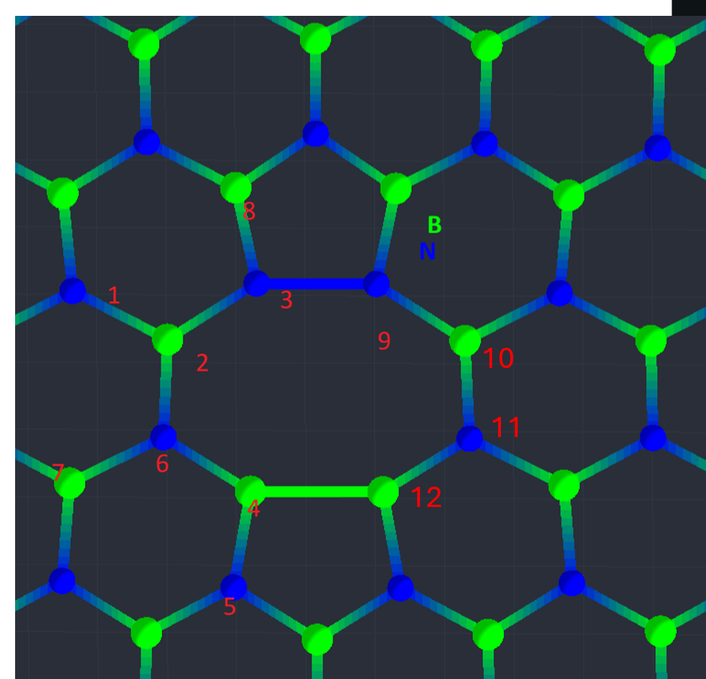
Carbon-decorated divacancies in hBN
First-principles screening toward UV–VIS quantum emitters
Status report and project roadmap for FTMC discussion
Franciszek Zabierowski
Warsaw University of Technology
FTMC discussion: Lukas Razinkovas group

Slide 2
What this presentation is about
Scientific question
What is done
What remains
Can carbon-decorated divacancies form optically active centers in hBN?
Do they create localized in-gap states suitable for UV–VIS emission?
Which geometries are worth full optical-property calculations?
Defect-nomenclature scheme and structural models
PBE → HSE relaxation workflow
Neutral-state calculated in HSE
Excited-state geometries
ZPL, Huang–Rhys factor, Debye–Waller factor, PL lineshape
Optical matrix elements and final candidate ranking
Charge-transition levels to justify q = 0 optical calculations
Complete ΔSCF / excited-state convergence
Franciszek Zabierowski | FTMC project discussion

Slide 3

Motivation: hBN emitters are promising, but their microscopic origin is often unclear
Why hBN?
The bottleneck
Project position
Wide-bandgap van der Waals material
Room-temperature single-photon emission has been observed
Emitter classes span UV, blue, visible and NIR ranges
2D geometry makes integration with nanophotonics attractive
Many emitters remain chemically unidentified
Carbon is repeatedly implicated in UV/VIS emission
Different local geometries may yield very different spectra
DFT is needed to connect structure, levels and optical fingerprints
This project focuses on carbon-decorated divacancy complexes as a bridge between two known motifs:
  carbon dimer $C_{B}C_{N}$
  divacancy $V_{B}V_{N}$
The target is not only “does it emit?”, but also “which local bonding topology controls the emission?”
Context: Aharonovich et al., Nano Lett. 2022; Çakan et al., Adv. Optical Mater. 2025
Franciszek Zabierowski | FTMC project discussion

Slide 4
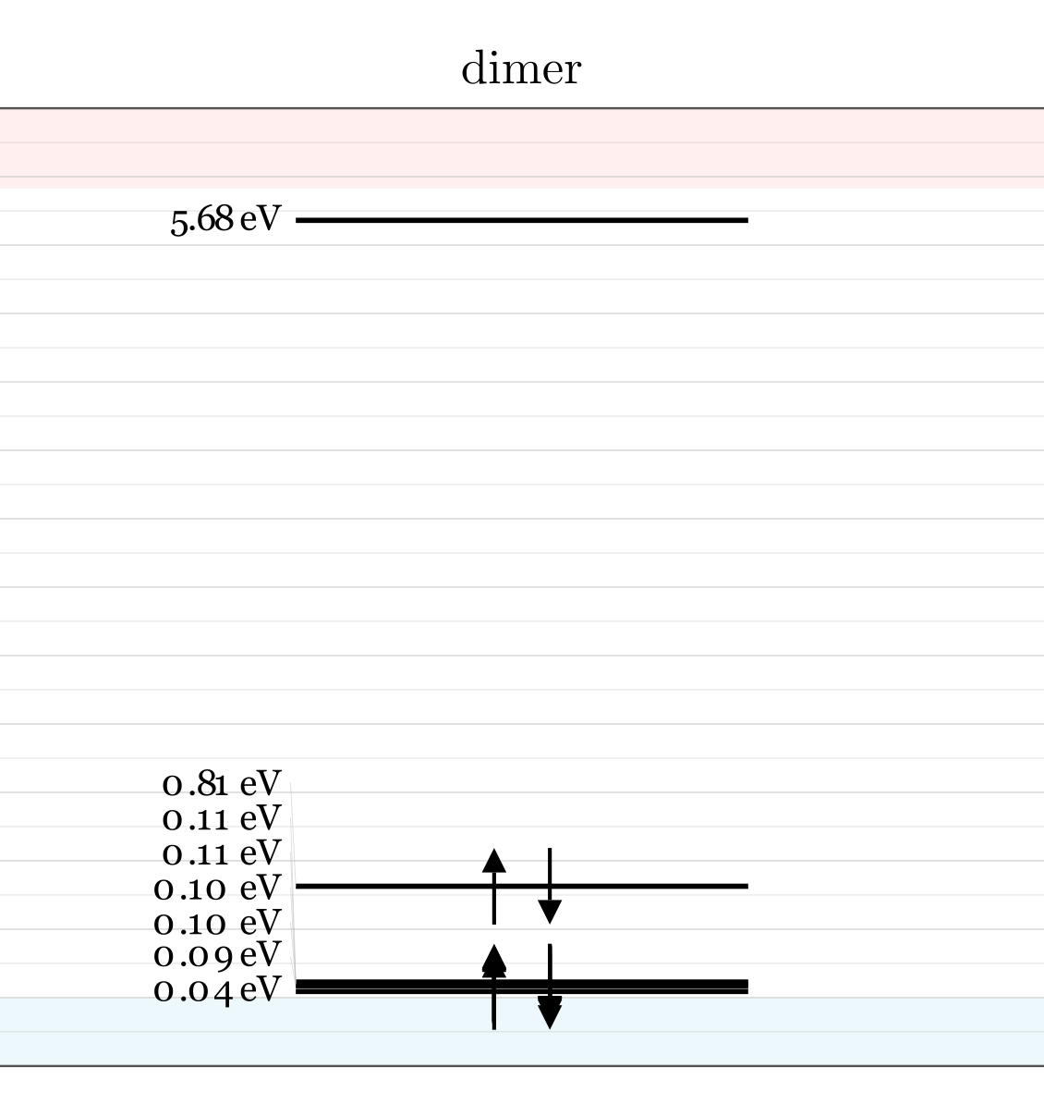
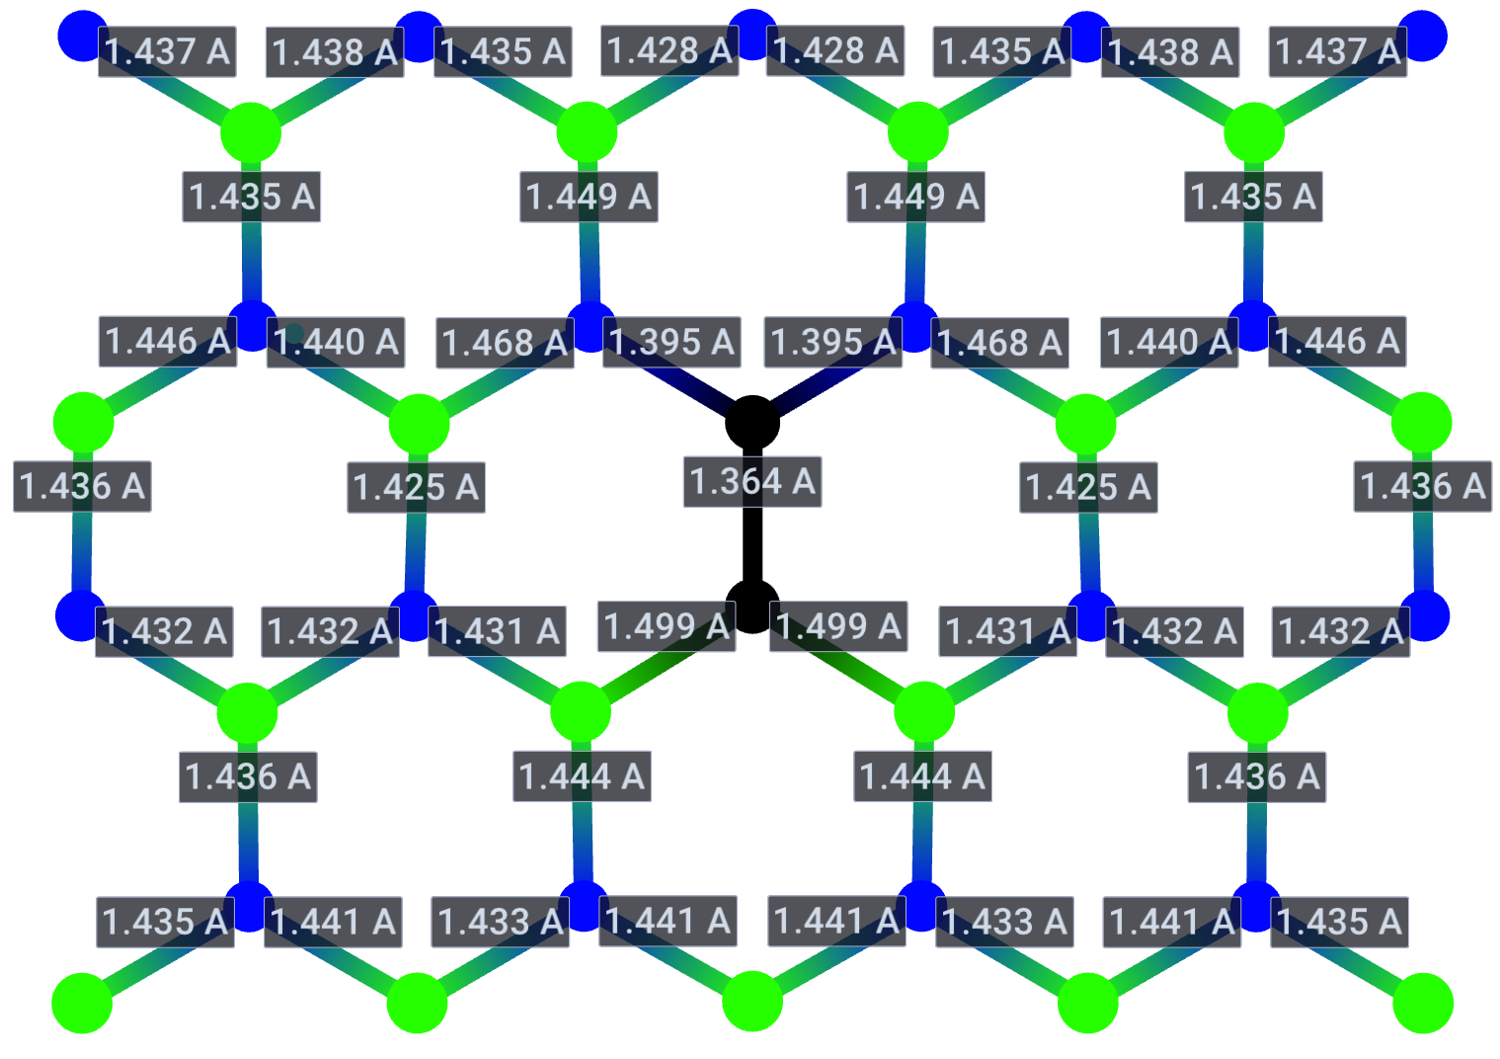
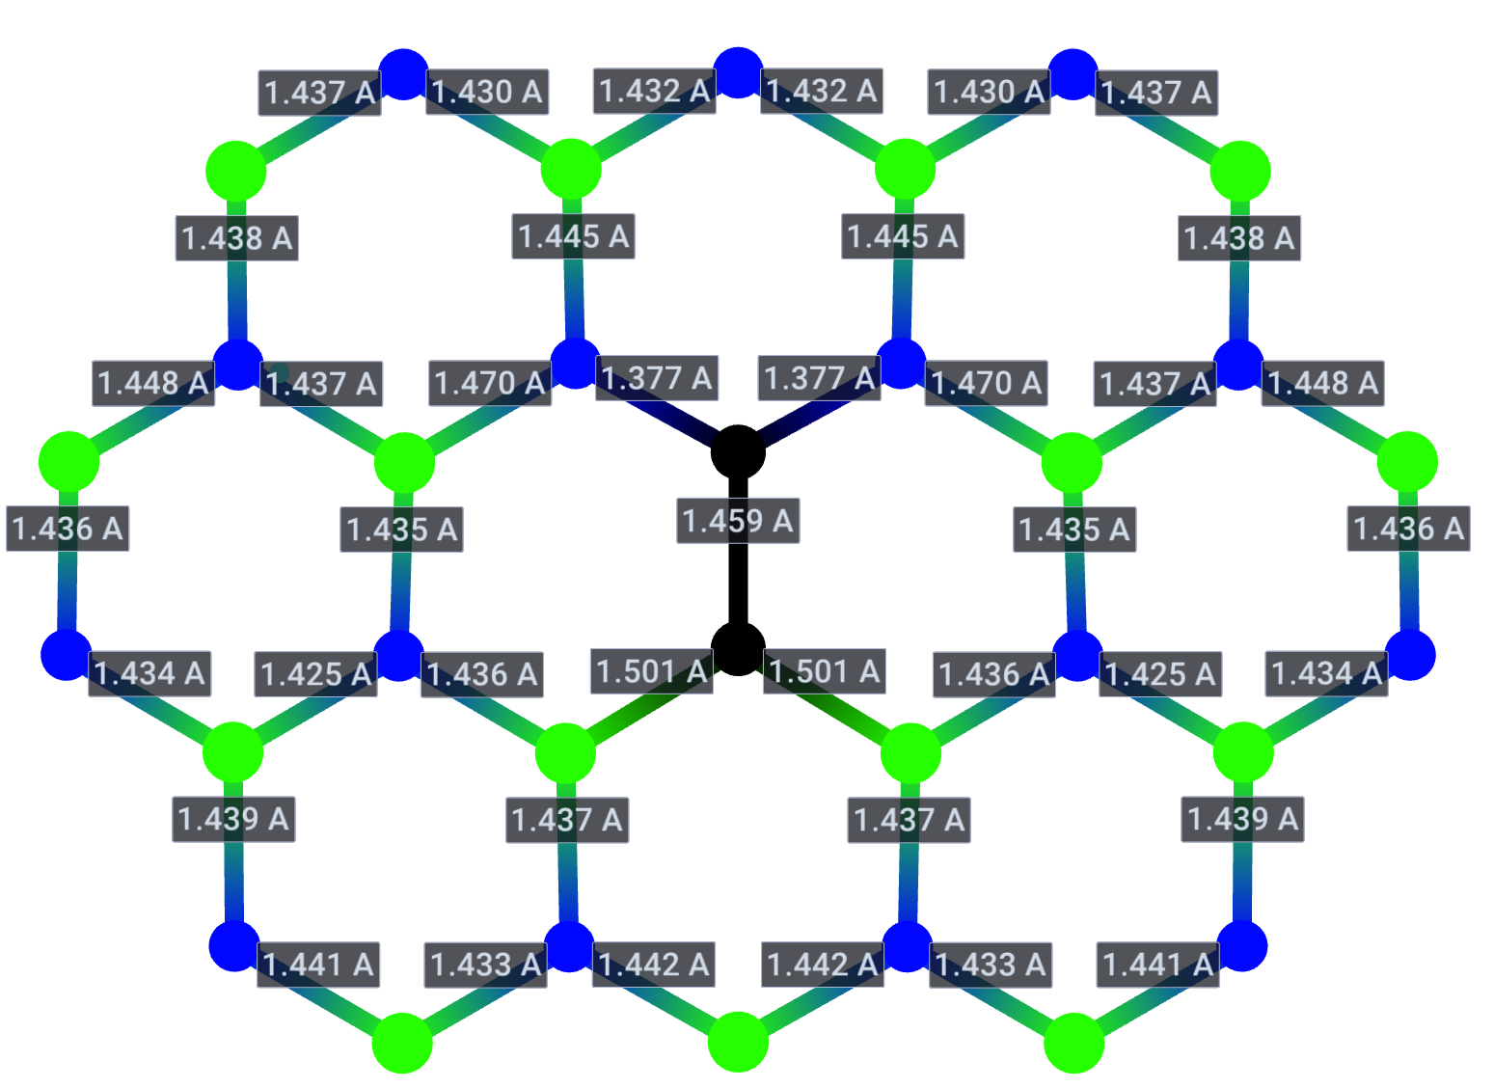
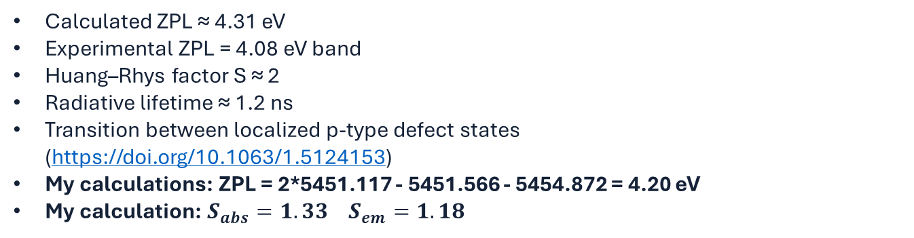
Two reference motifs: carbon dimer and BN divacancy
$C_{B}C_{N}$ carbon dimer
$$Ground state$$
$$Excited state$$
Calculated ZPL ≈ 4.31 eV
Experimental ZPL = 4.08 eV band
Huang–Rhys factor S ≈ 2
Radiative lifetime ≈ 1.2 ns
Transition between localized p-type defect states
(https://doi.org/10.1063/1.5124153)
My calculations: ZPL = 2*5451.117 - 5451.566 - 5454.872 = 4.20 eV
My calculation: $S_{abs}=1.33 S_{em}=1.18$
Franciszek Zabierowski | FTMC project discussion

Slide 5
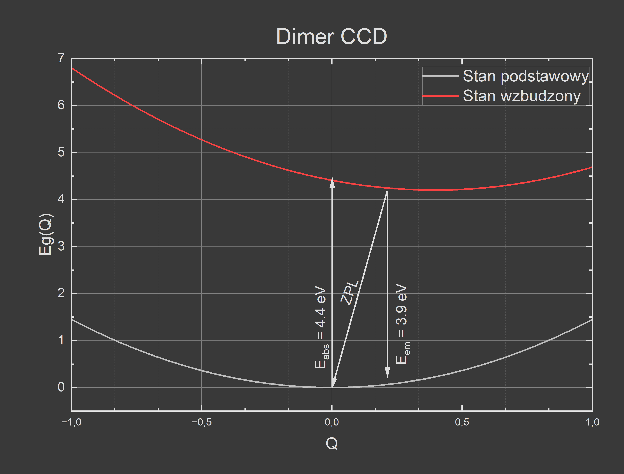
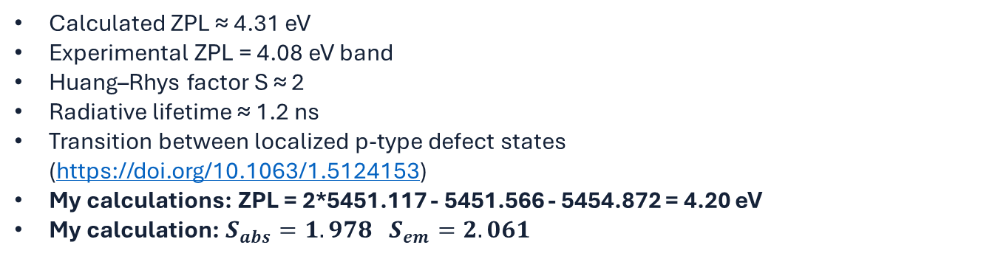
Two reference motifs: carbon dimer and BN divacancy
Calculated ZPL ≈ 4.31 eV
Experimental ZPL = 4.08 eV band
Huang–Rhys factor S ≈ 2
Radiative lifetime ≈ 1.2 ns
Transition between localized p-type defect states
(https://doi.org/10.1063/1.5124153)
My calculations: ZPL = 2*5451.117 - 5451.566 - 5454.872 = 4.20 eV
My calculation: $S_{abs}=1.978 S_{em}=2.061$
Franciszek Zabierowski | FTMC project discussion

Slide 6
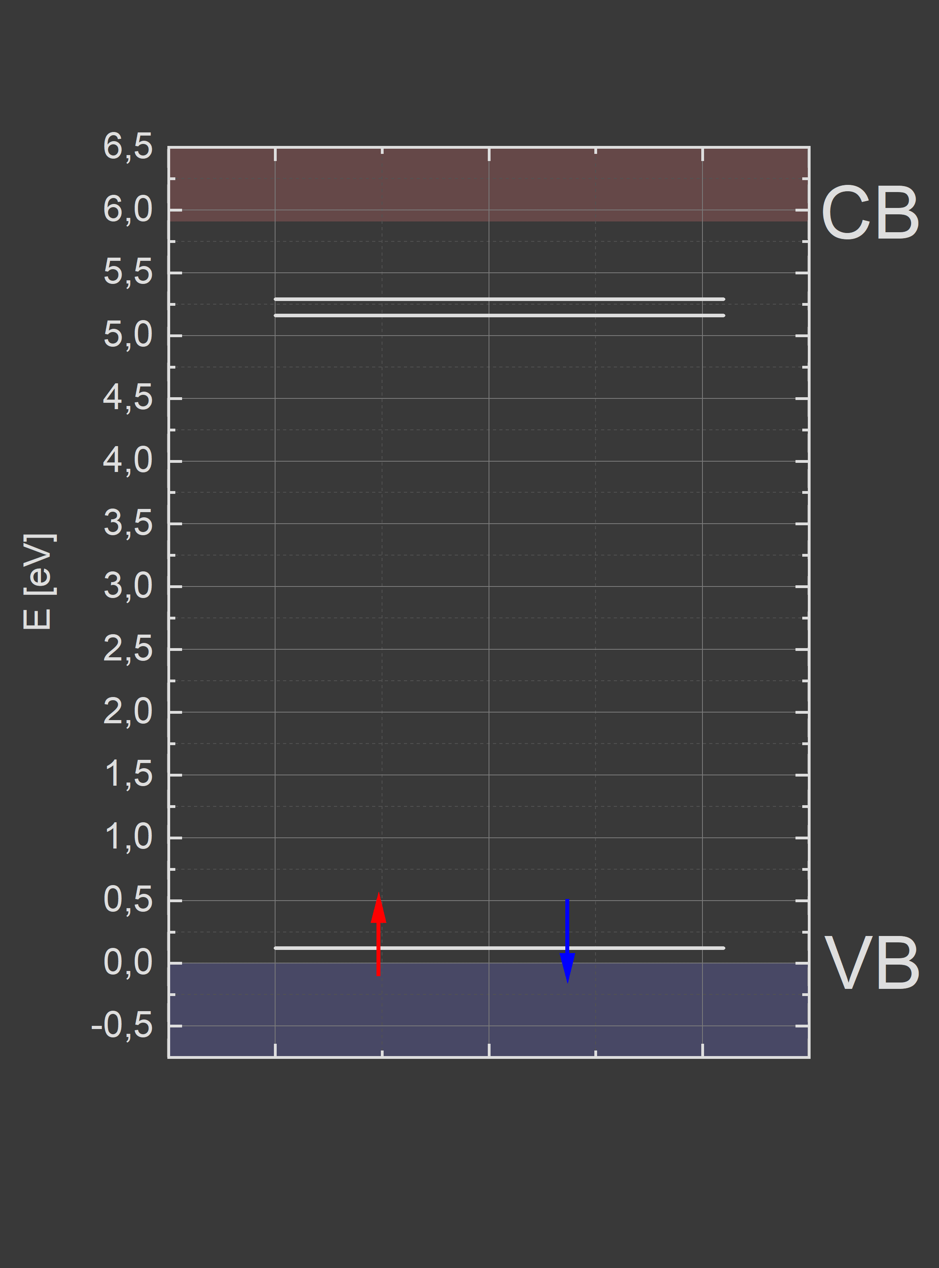
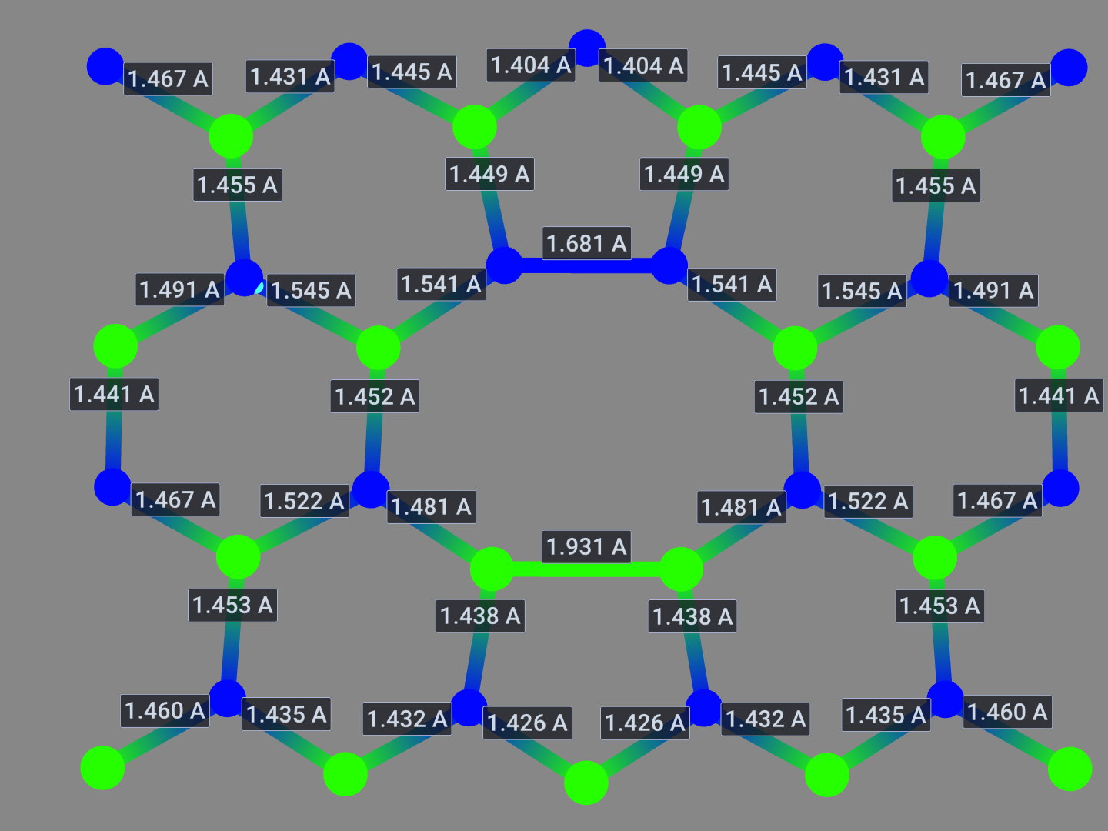
Two reference motifs: carbon dimer and BN divacancy
V₂ = $V_{B}V_{N}$ divacancy
Divacancies are probable in irradiated hBN
Reconstruction yields 5–8–5 topology
Characteristic strong B–B and N–N bonds
Migration barriers: single-step divacancy motion in Zobelli et al.
Bond B-B: 1.931 vs 1.93 (Zobelli)
Bond N-N: 1.681 vs 1.74 (Zobelli)
Activation energy for vacancy migration: 1.4eV – 1.8eV (Zobelli)
Can be created by electron irradiation (Zobelli)
Zobelli et al., Phys. Rev. B 2007, DOI: 10.1103/PhysRevB.75.094104
Franciszek Zabierowski | FTMC project discussion

Slide 7
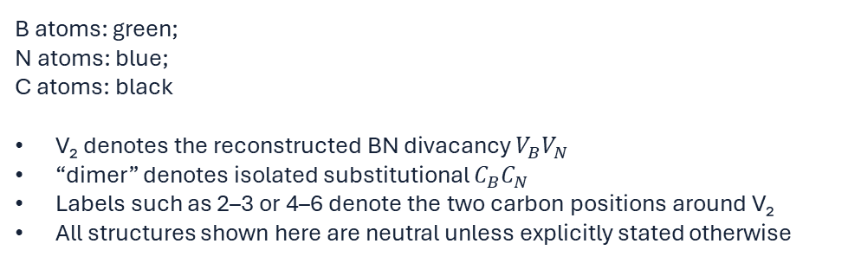
Defect construction and nomenclature
Notation used here
B atoms: green;
N atoms: blue;
C atoms: black
V₂ denotes the reconstructed BN divacancy $V_{B}V_{N}$
“dimer” denotes isolated substitutional $C_{B}C_{N}$
Labels such as 2–3 or 4–6 denote the two carbon positions around V₂
All structures shown here are neutral unless explicitly stated otherwise
Franciszek Zabierowski | FTMC project discussion

Slide 8
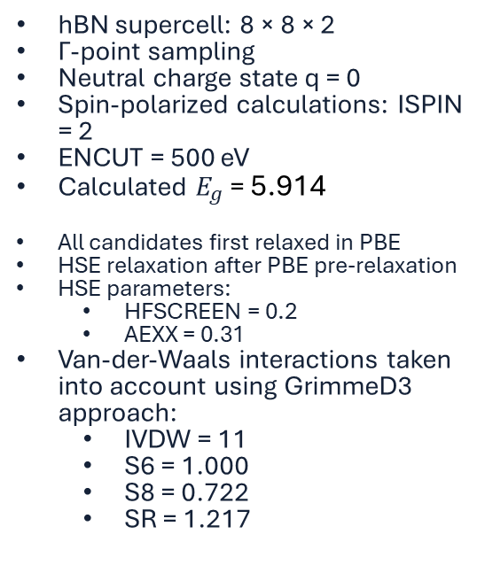

Computational setup
Model
Functional strategy
Excited states
hBN supercell: 8 × 8 × 2
Γ-point sampling
Neutral charge state q = 0
Spin-polarized calculations: ISPIN = 2
ENCUT = 500 eV
Calculated $E_{g}$ = 5.914
All candidates first relaxed in PBE
HSE relaxation after PBE pre-relaxation
HSE parameters:
  HFSCREEN = 0.2
  AEXX = 0.31
Van-der-Waals interactions taken into account using GrimmeD3 approach:
  IVDW = 11
  S6 = 1.000
  S8 = 0.722
  SR = 1.217
First relacation in PBE
Final geometry in HSE for ground state
Excited state geometry in PBE for $d_{fc}$ approximation
Excited state in HSE
Tryplet energy for excited state geometry
Ground state energy for excited state geometry
ΔSCF-like constrained occupations using FERWE / FERDO
Excitation defined as electron transfer between selected defect levels
Excited-state geometries partially converged; several remain problematic
Triplet single-point energies via NUPDOWN = 2 where needed
Franciszek Zabierowski | FTMC project discussion

Slide 9
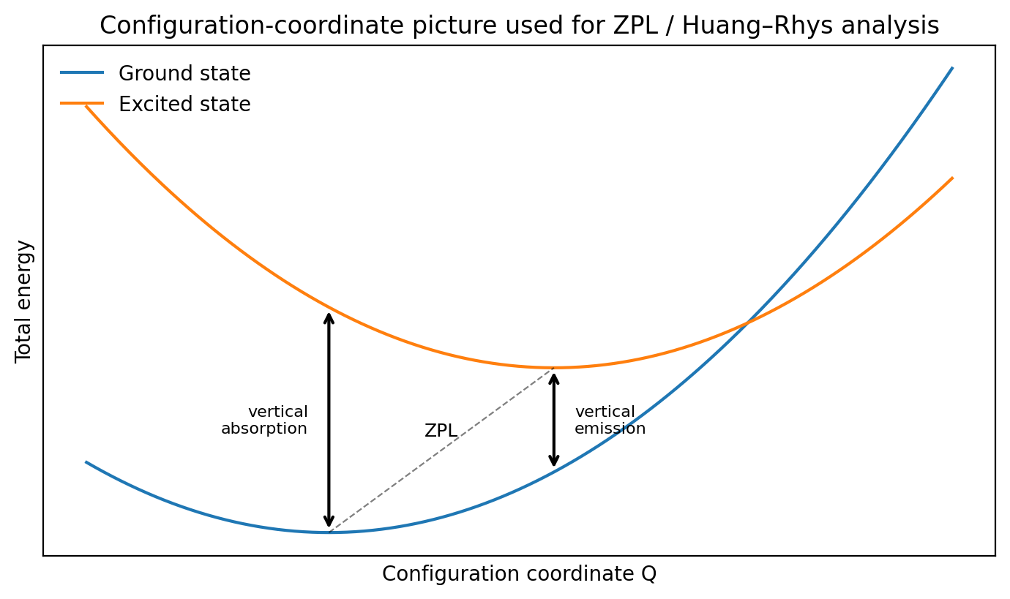
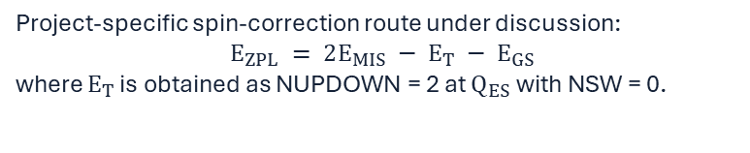

Optical-property model: what the next calculations will deliver
Energy quantities
Ground-state minimum: $E_{GS}(Q_{GS})$
Excited-state minimum: $E_{ES}(Q_{ES})$
Vertical absorption: $E_{ES}(Q_{GS}) − E_{GS}(Q_{GS})$
Vertical emission: $E_{ES}(Q_{ES}) − E_{GS}(Q_{ES})$
ZPL: $E_{ES} \left(Q_{ES}\right)−E_{GS}(Q_{GS})$
Project-specific spin-correction route under discussion:
$$E_{ZPL} = 2E_{MIS} − E_{T} − E_{GS}$$
where $E_{T}$ is obtained as NUPDOWN = 2 at $Q_{ES}$ with NSW = 0.
Franciszek Zabierowski | FTMC project discussion

Slide 10
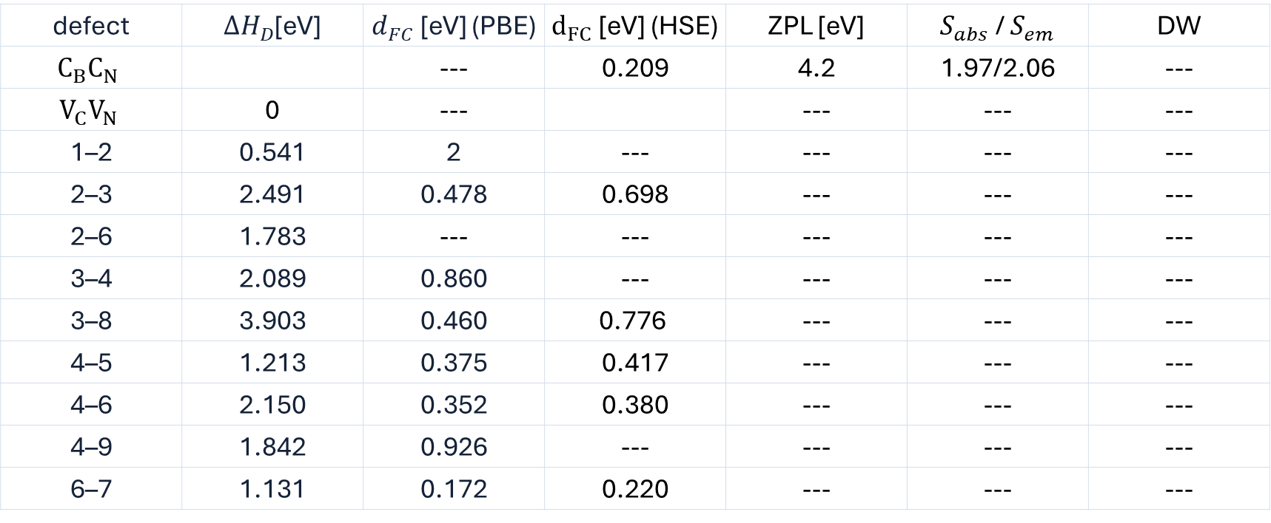
Current numerical summary: relative energy and structural reorganization
defect | $ΔH_{D}$[eV] | $d_{FC}$ [eV] (PBE) | $d_{FC}$[eV] (HSE) | ZPL [eV] | $S_{abs}$ / $S_{em}$ | DW
$$C_{B}C_{N}$$ |  | --- | 0.209 | 4.2 | 1.97/2.06 | ---
$$V_{C}V_{N}$$ | 0 | --- |  | --- | --- | ---
1–2 | 0.541 | 2 | --- | --- | --- | ---
2–3 | 2.491 | 0.478 | 0.698 | --- | --- | ---
2–6 | 1.783 | --- | --- | --- | --- | ---
3–4 | 2.089 | 0.860 | --- | --- | --- | ---
3–8 | 3.903 | 0.460 | $$\text{0.776}$$ | --- | --- | ---
4–5 | 1.213 | 0.375 | 0.417 | --- | --- | ---
4–6 | 2.150 | 0.352 | 0.380 | --- | --- | ---
4–9 | 1.842 | 0.926 | --- | --- | --- | ---
6–7 | 1.131 | 0.172 | 0.220 | --- | --- | ---
Interpretation used here: the V₂-referenced formation/binding-energy formalism cancels chemical-potential dependence. Δ_FC is treated as a proxy for structural relaxation/electron–phonon coupling strength.
Franciszek Zabierowski | FTMC project discussion

Slide 11
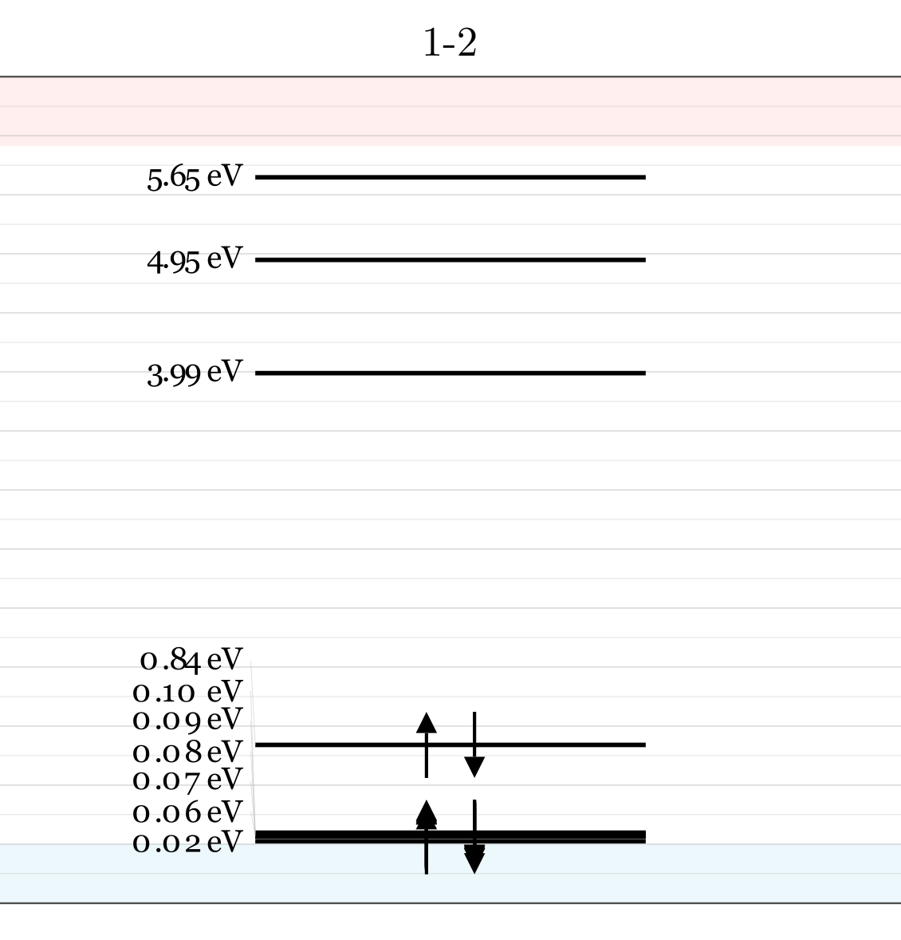
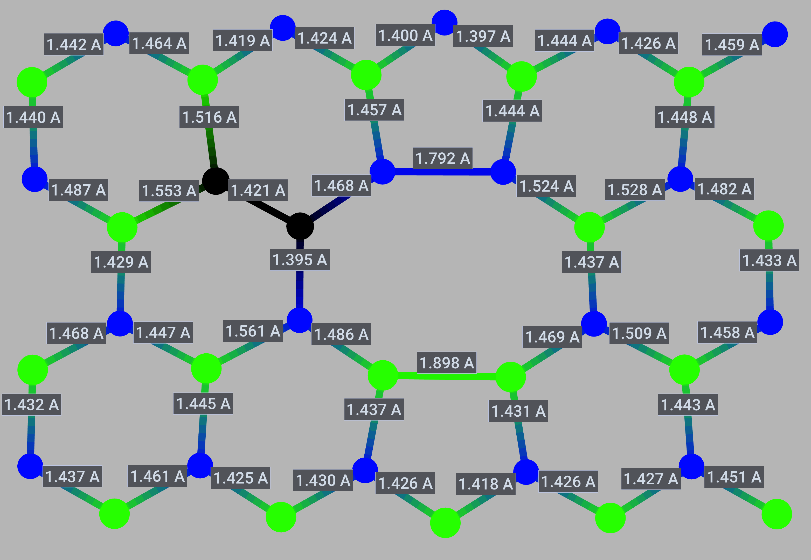
Geometry 1-2
Lack of convergance in PBE and HSE in excited state
Franck-Condon shift already large (>2eV) (PBE).
Further calculations are abandoned
Franciszek Zabierowski | FTMC project discussion

Slide 12
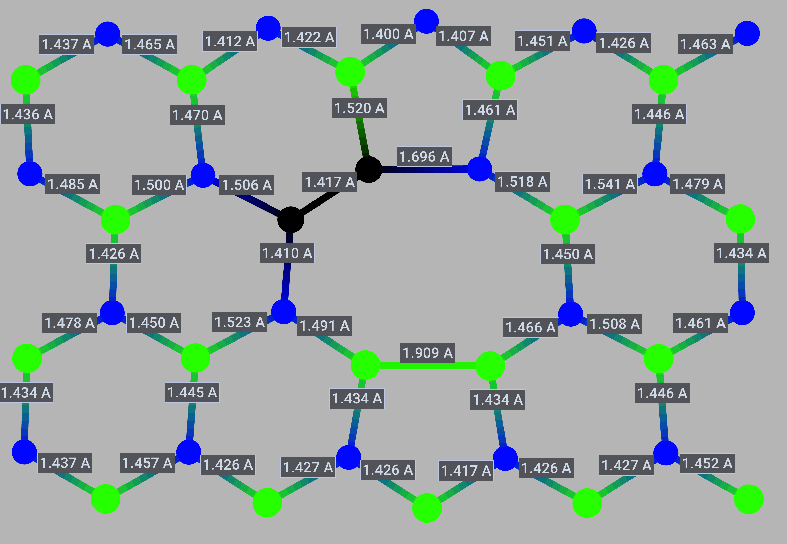
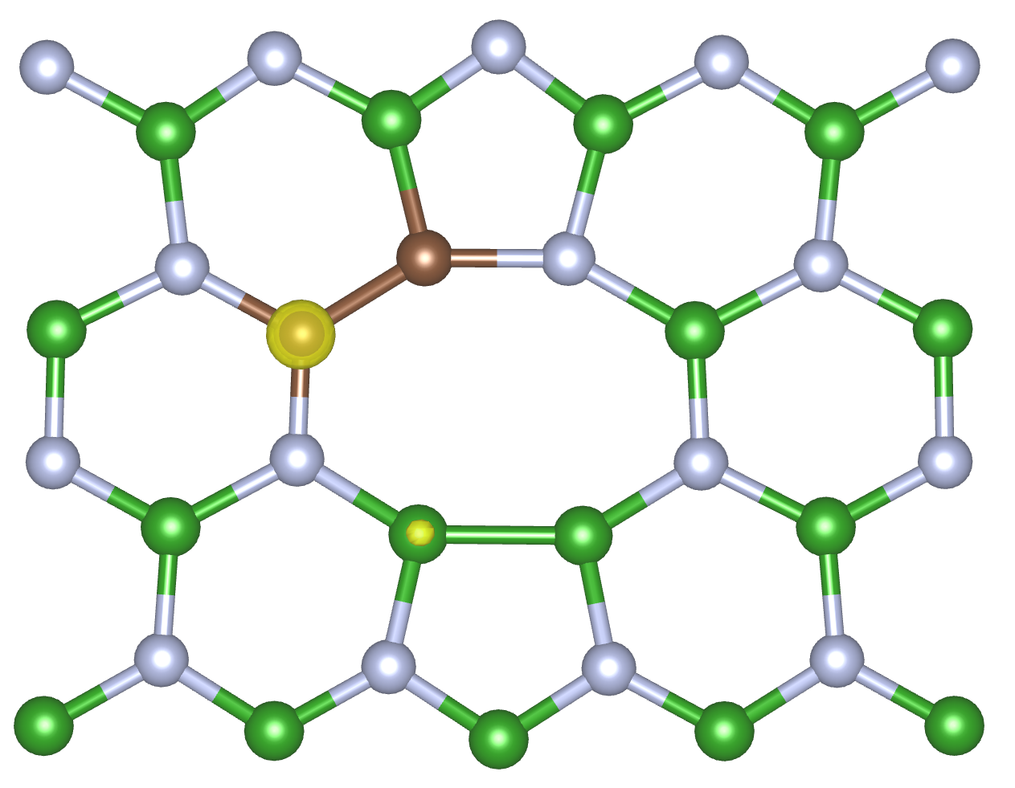
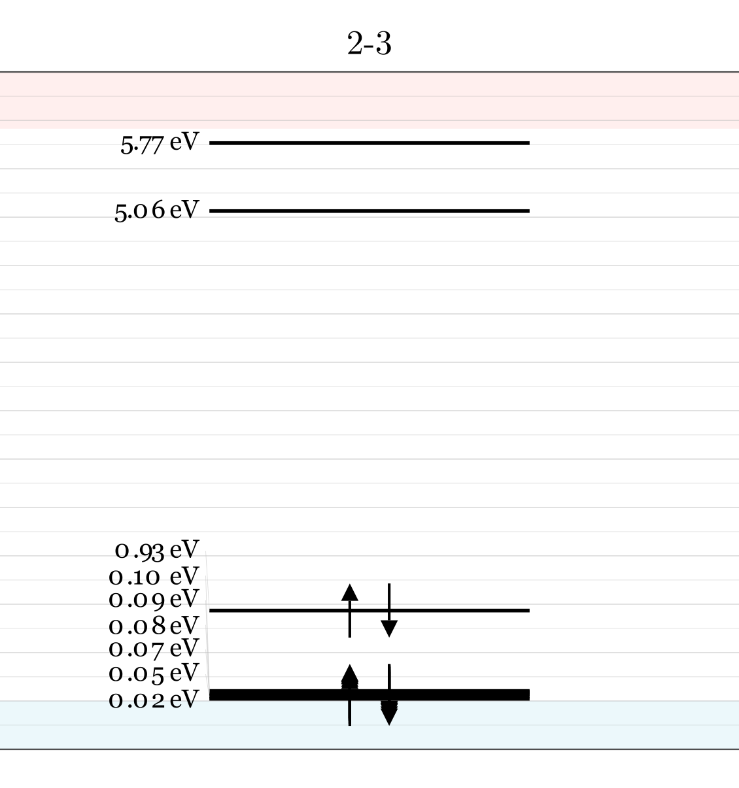
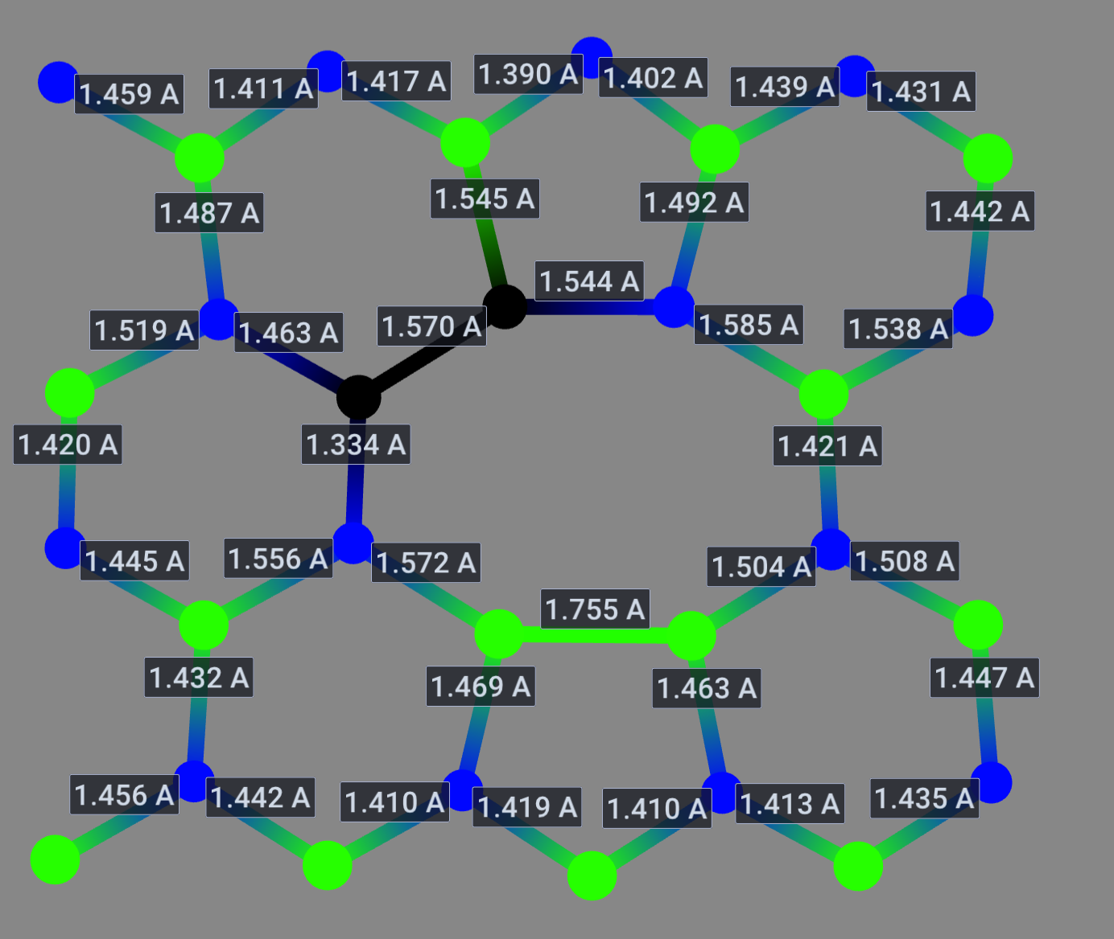
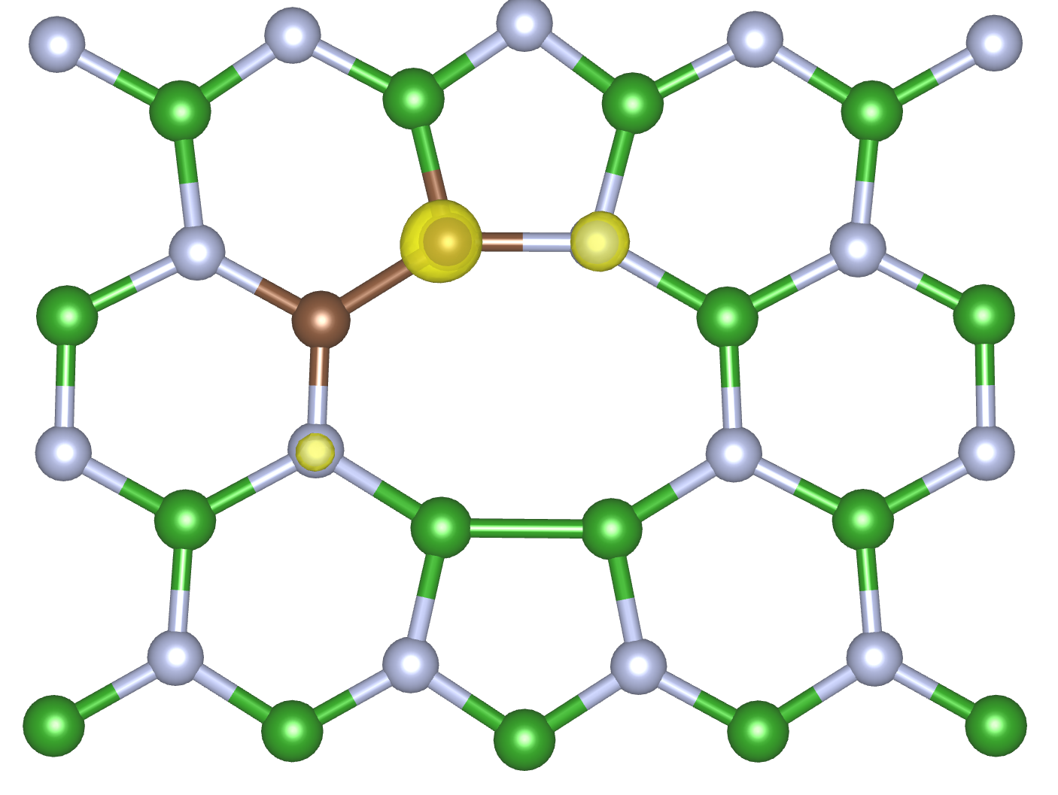
defect | $ΔH_{D}$[eV] | $d_{FC}$ [eV] (PBE) | $d_{FC}$[eV] (HSE) | ZPL [eV] | S | DW
2–3 | 2.491 | 0.478 | 0.698 | --- | --- | ---
Geometry 2-3
Franciszek Zabierowski | FTMC project discussion

Slide 13
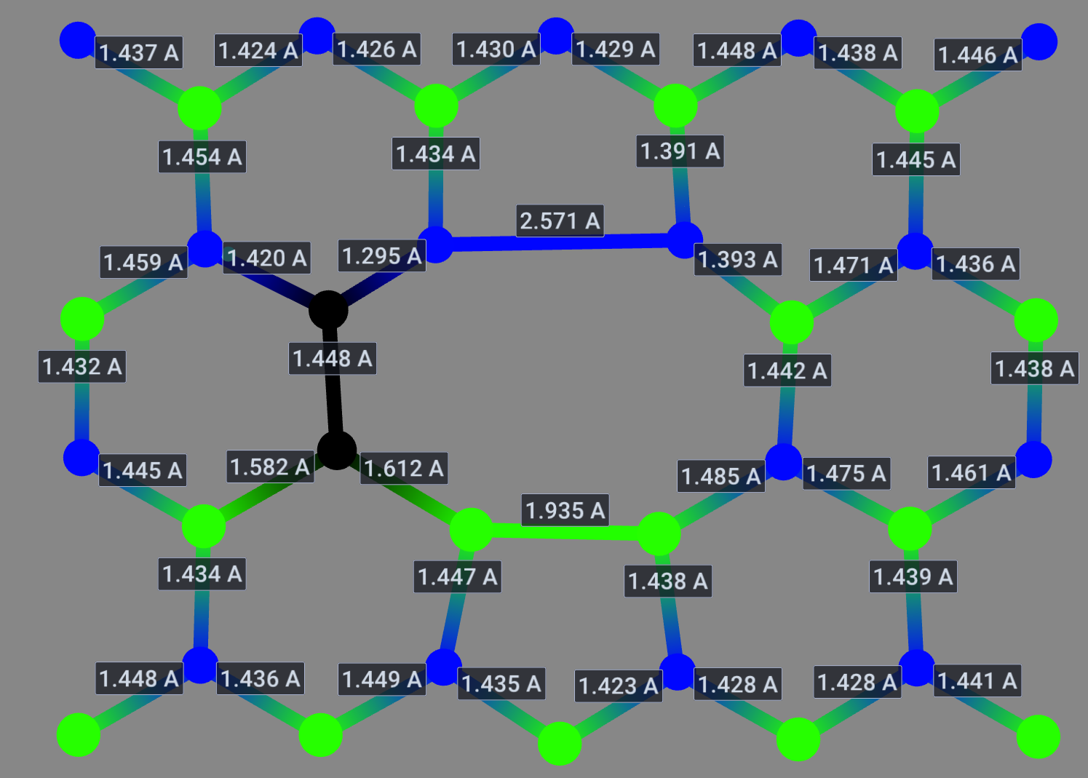
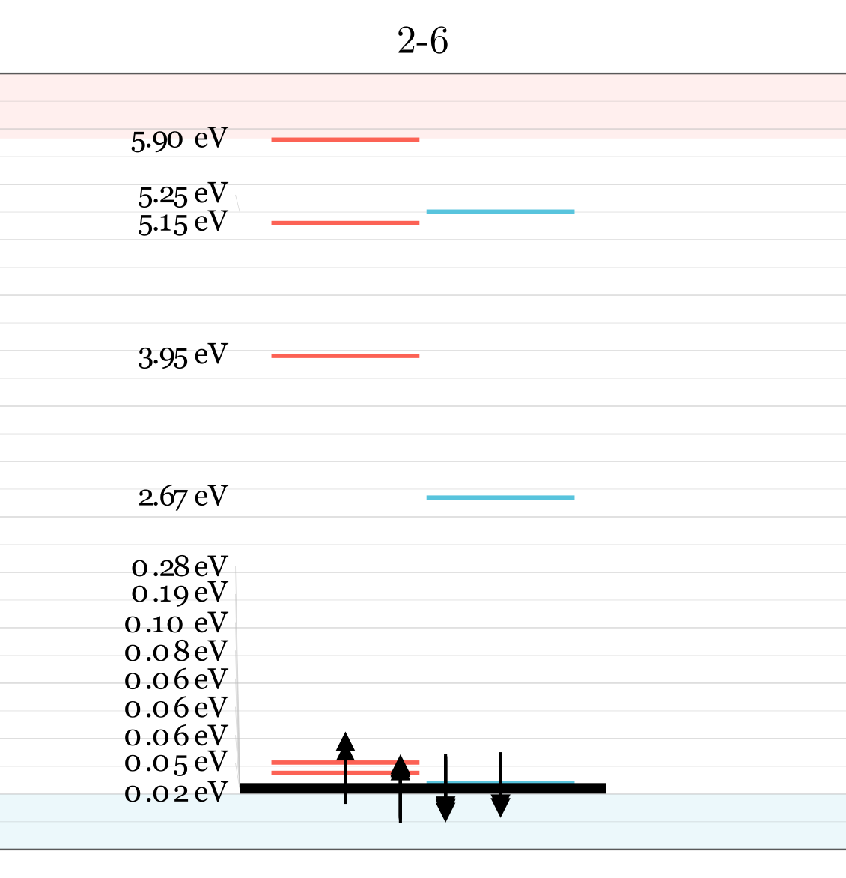
defect | $ΔH_{D}$[eV] | $d_{FC}$ [eV] (PBE) | $d_{FC}$[eV] (HSE) | ZPL [eV] | S | DW
2–6 | 1.783 | --- | --- | --- | --- | ---
Geometry 2-6
Lack of convergance in HSE and PBE for excited state
VASP is changing the order of orbitals
Franciszek Zabierowski | FTMC project discussion

Slide 14
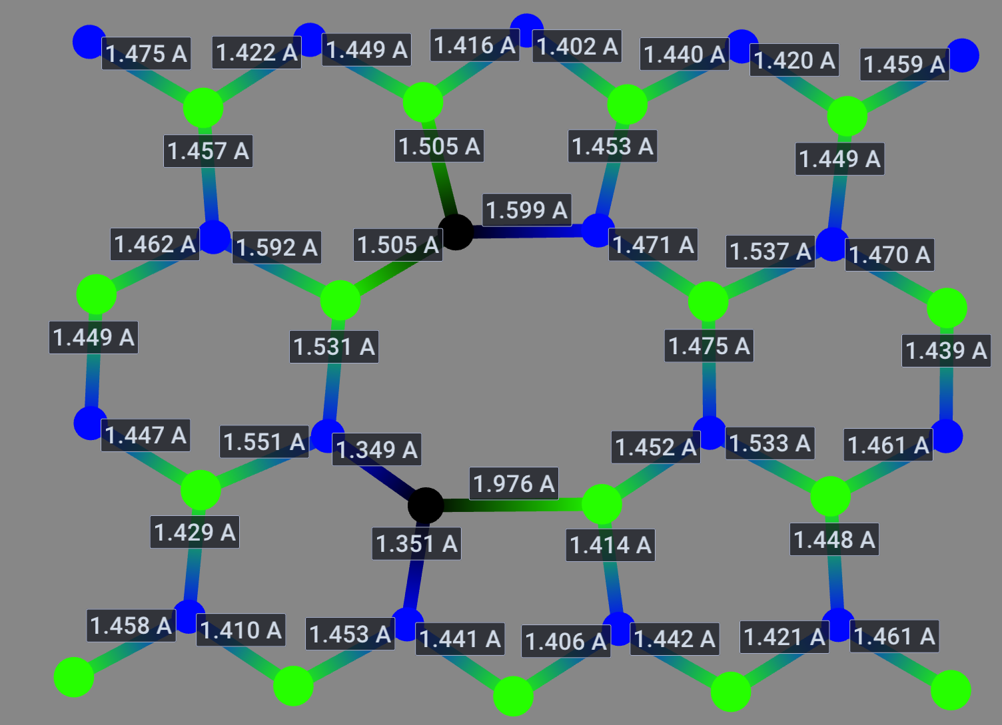
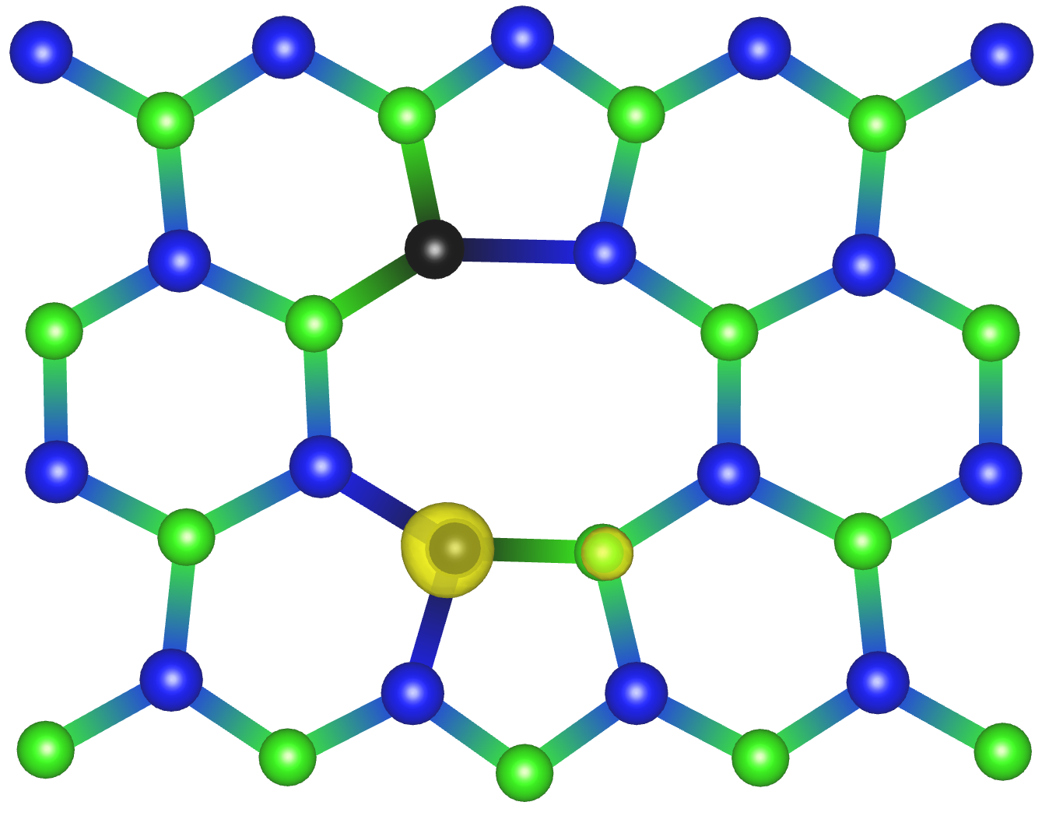
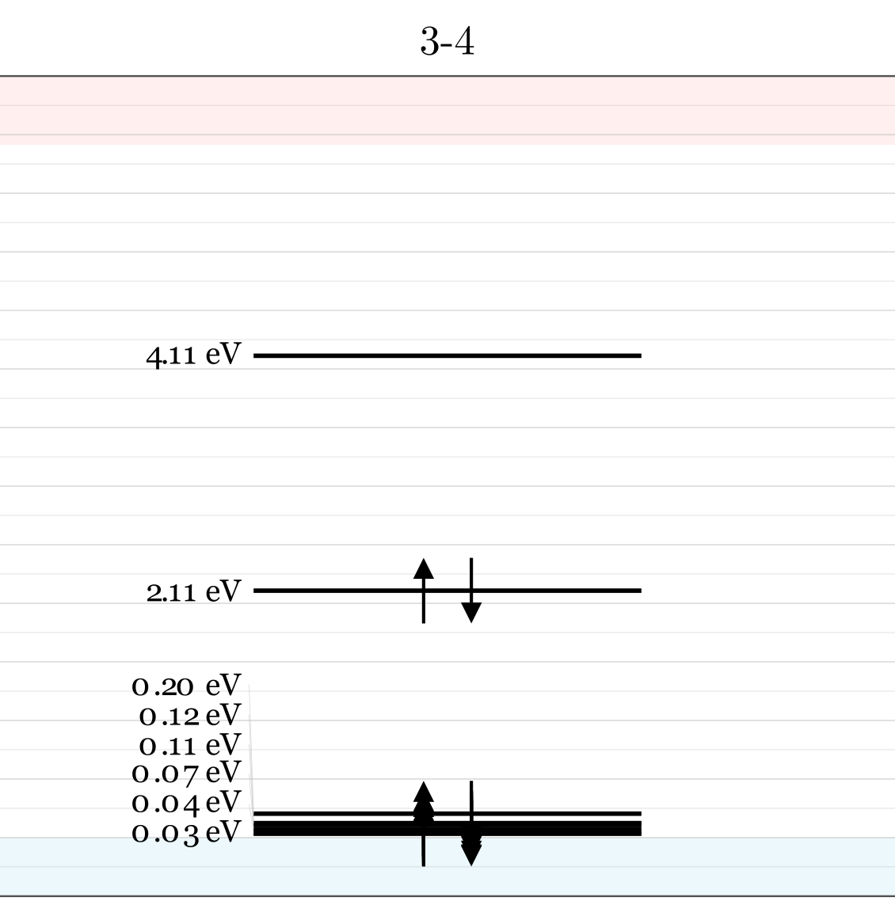
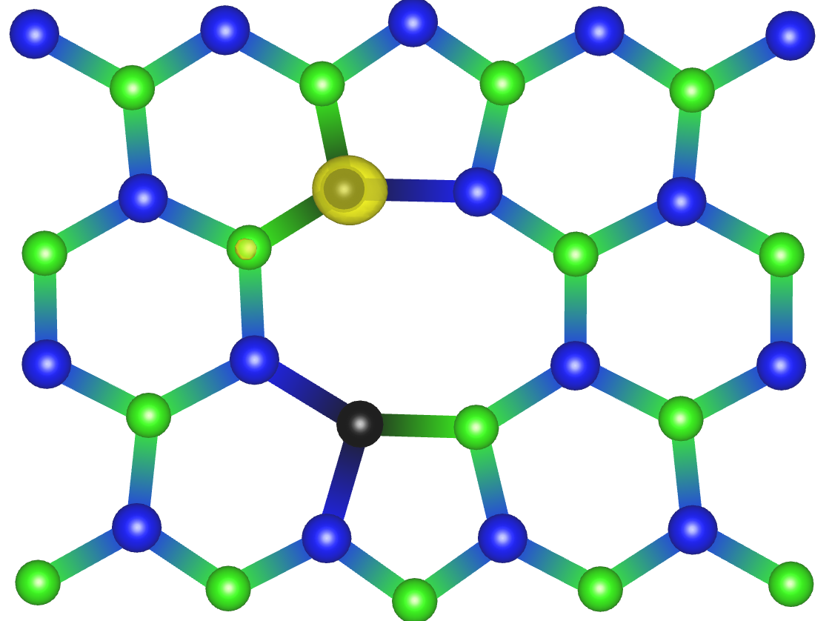
defect | $ΔH_{D}$[eV] | $d_{FC}$ [eV] (PBE) | $d_{FC}$[eV] (HSE) | ZPL [eV] | S | DW
3-4 | 2.089 | 0.860 | --- | --- | --- | ---
Geometry 3-4
-5423.67339549 eV
-5424.33944231 eV
-5424.59162756 eV
-5423.67339549 eV
-5423.88315488 eV
Franciszek Zabierowski | FTMC project discussion

Slide 15
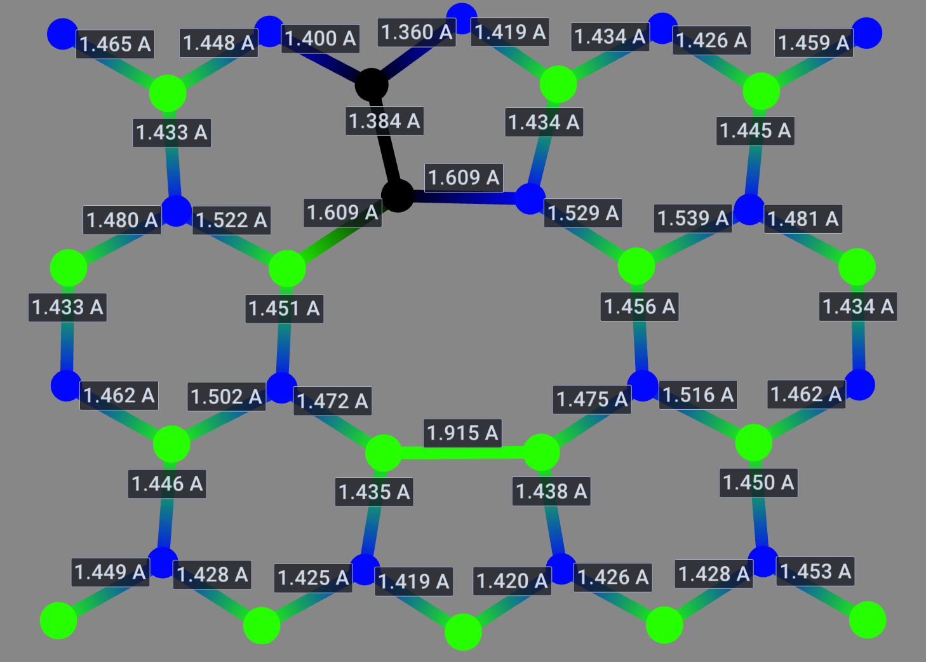
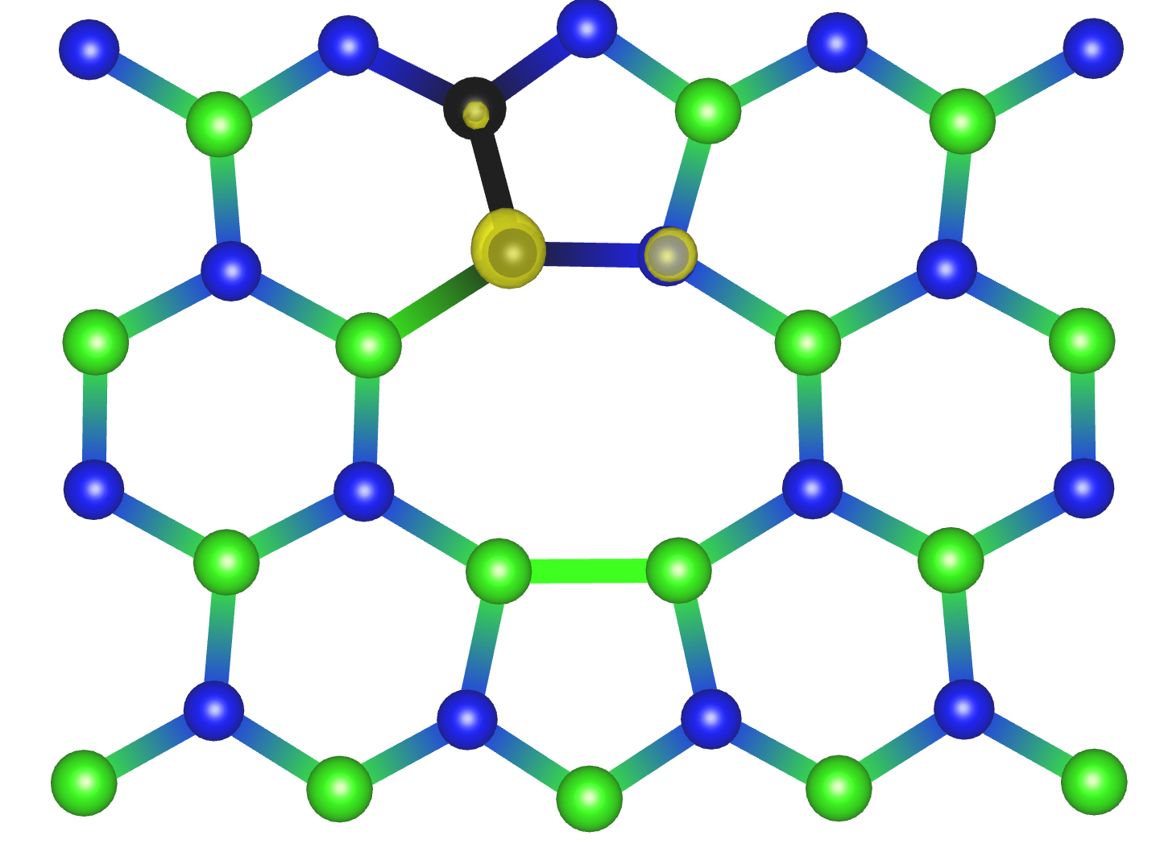

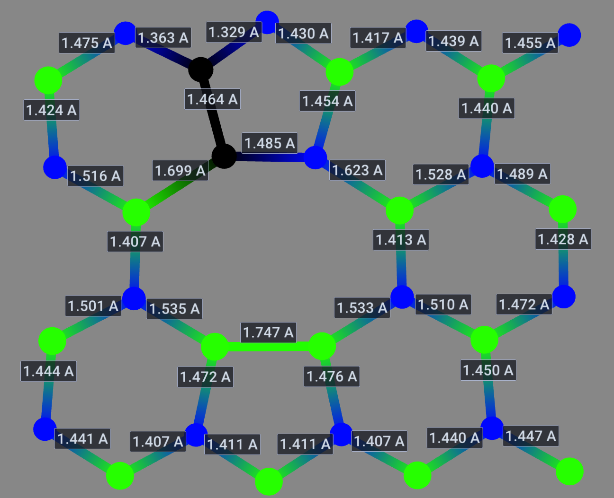
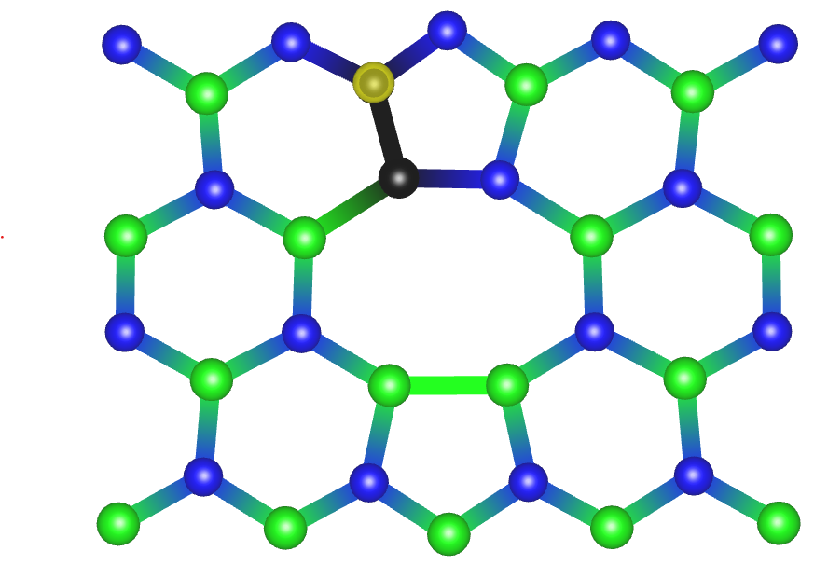
defect | $ΔH_{D}$[eV] | $d_{FC}$ [eV] (PBE) | $d_{FC}$[eV] (HSE) | ZPL [eV] | S | DW
3–8 | 3.903 | 0.460 | $$\text{0.776}$$ | --- | --- | ---
Geometry 3-8
Franciszek Zabierowski | FTMC project discussion

Slide 16
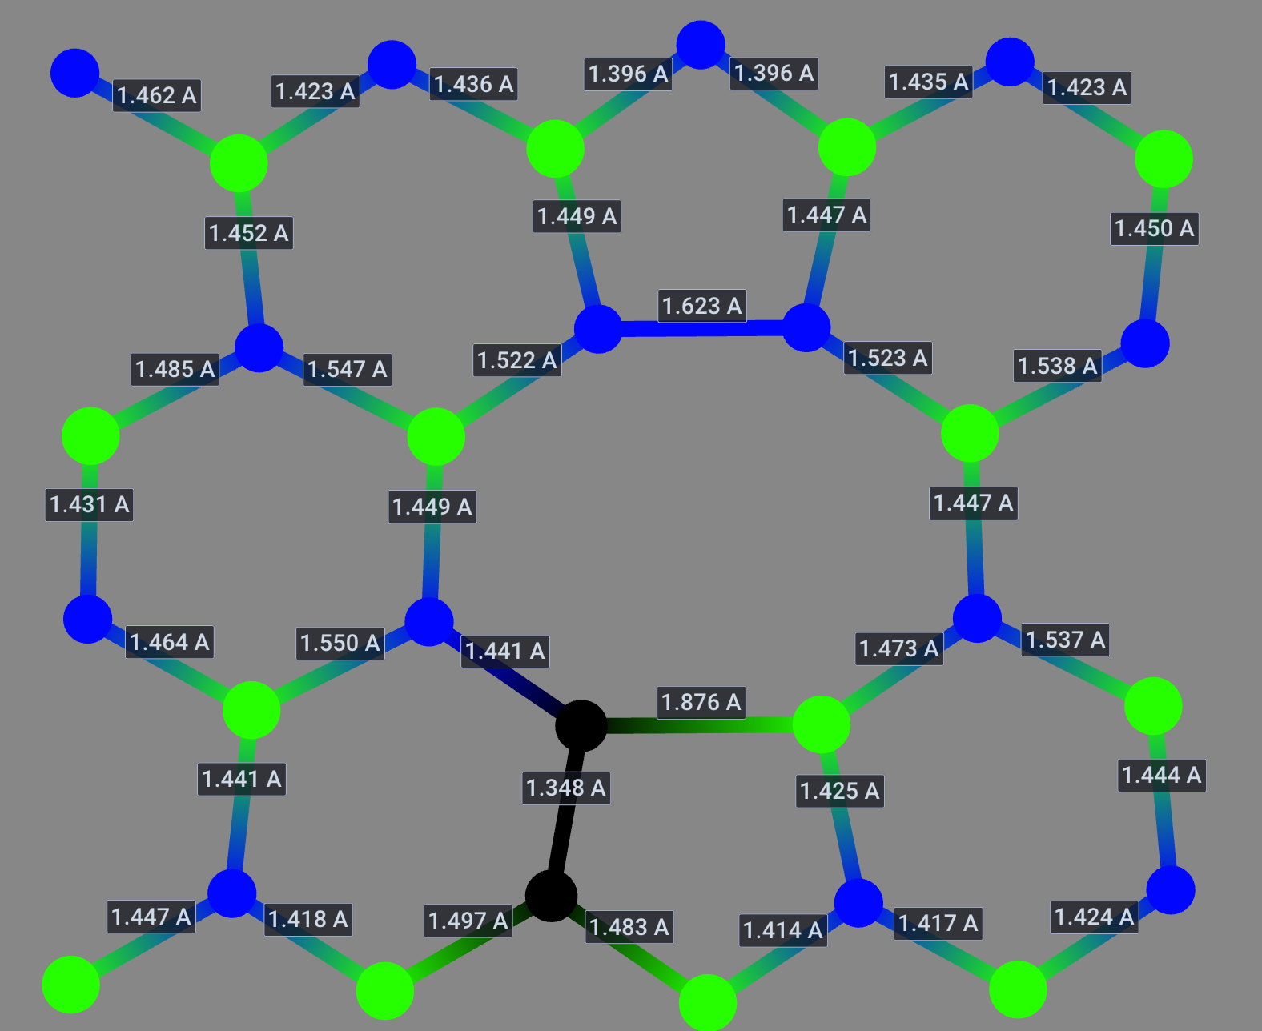
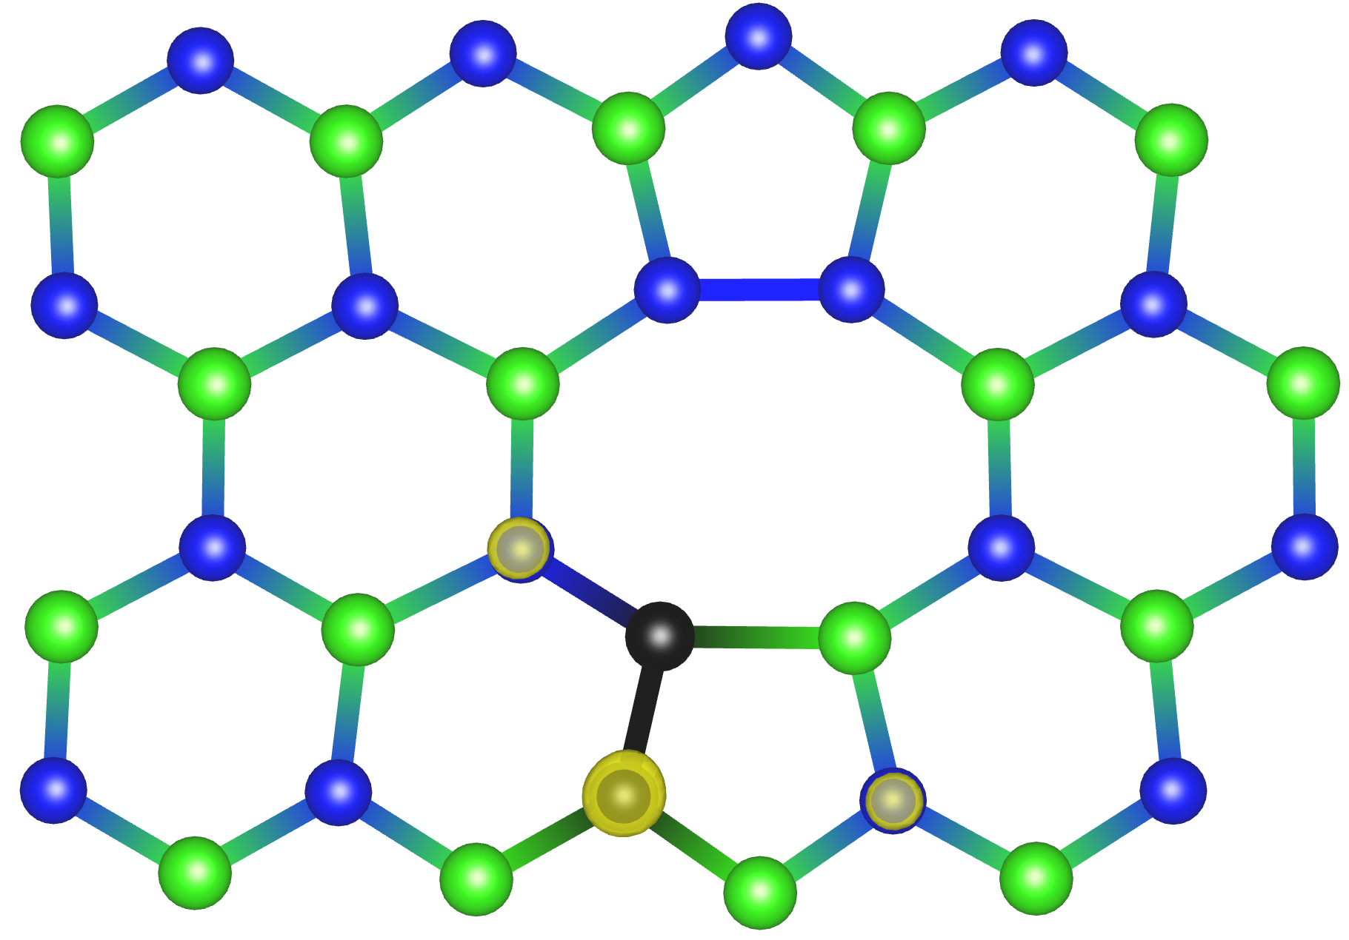
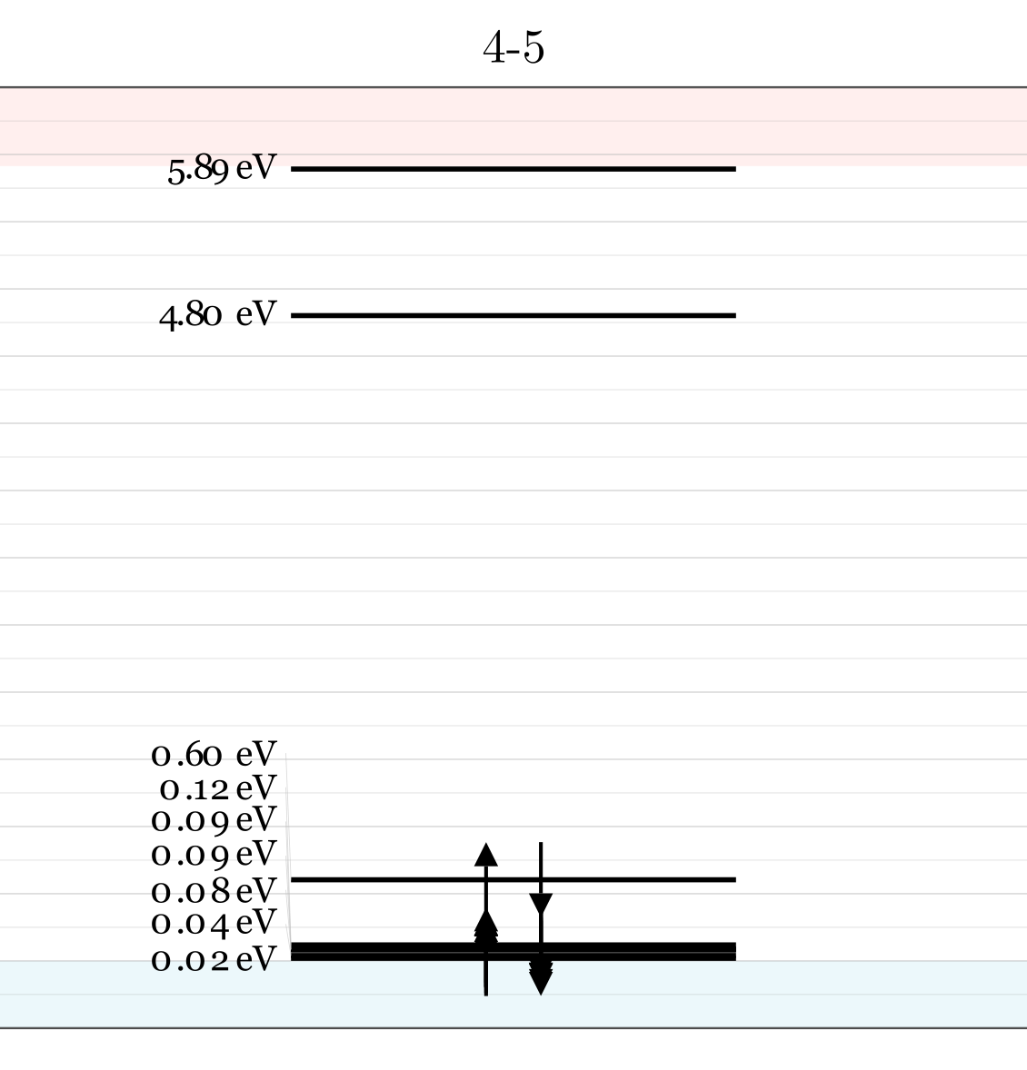
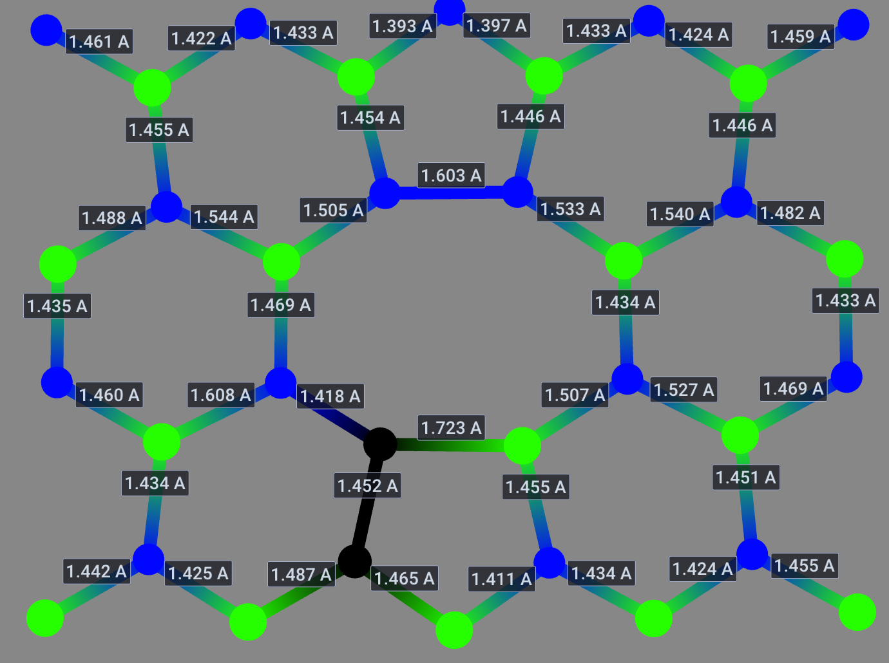
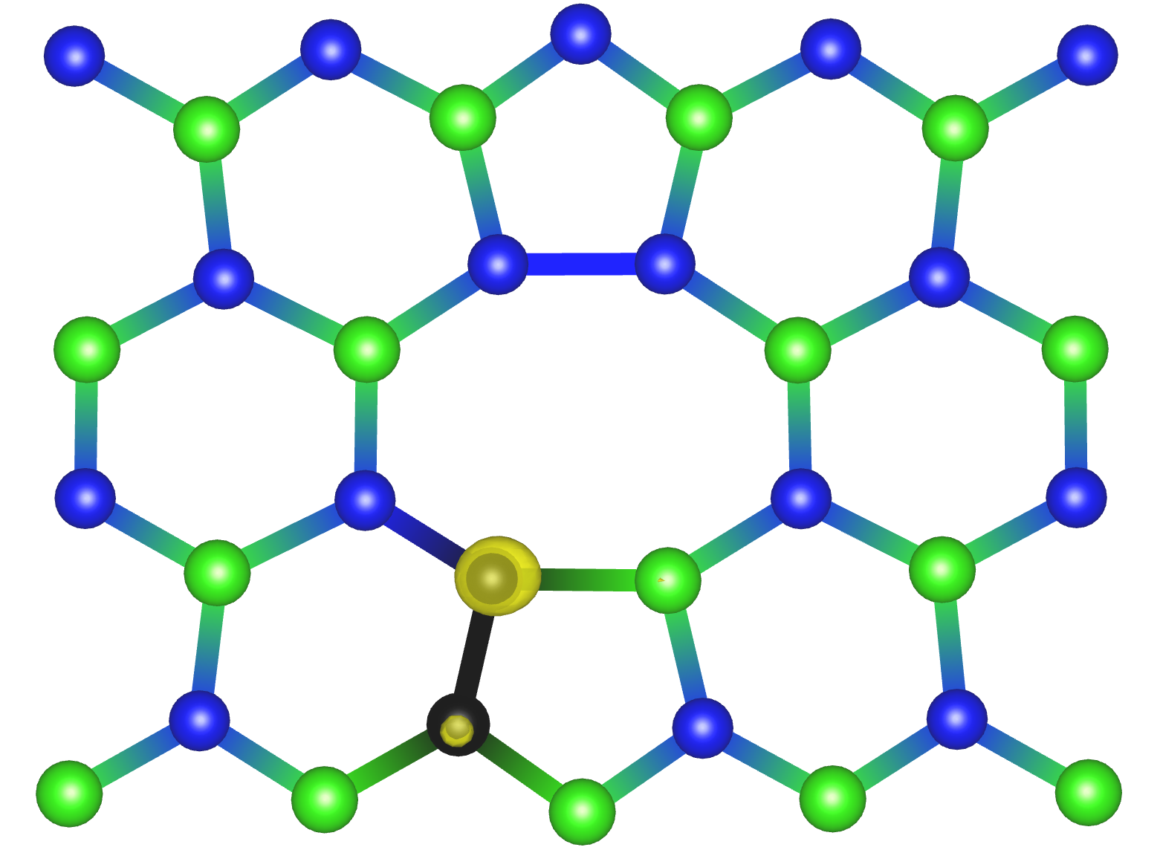
defect | $ΔH_{D}$[eV] | $d_{FC}$ [eV] (PBE) | $d_{FC}$[eV] (HSE) | ZPL [eV] | S | DW
4–5 | 1.213 | 0.375 | 0.417 | --- | --- | ---
Geometry 4-5
Franciszek Zabierowski | FTMC project discussion

Slide 17
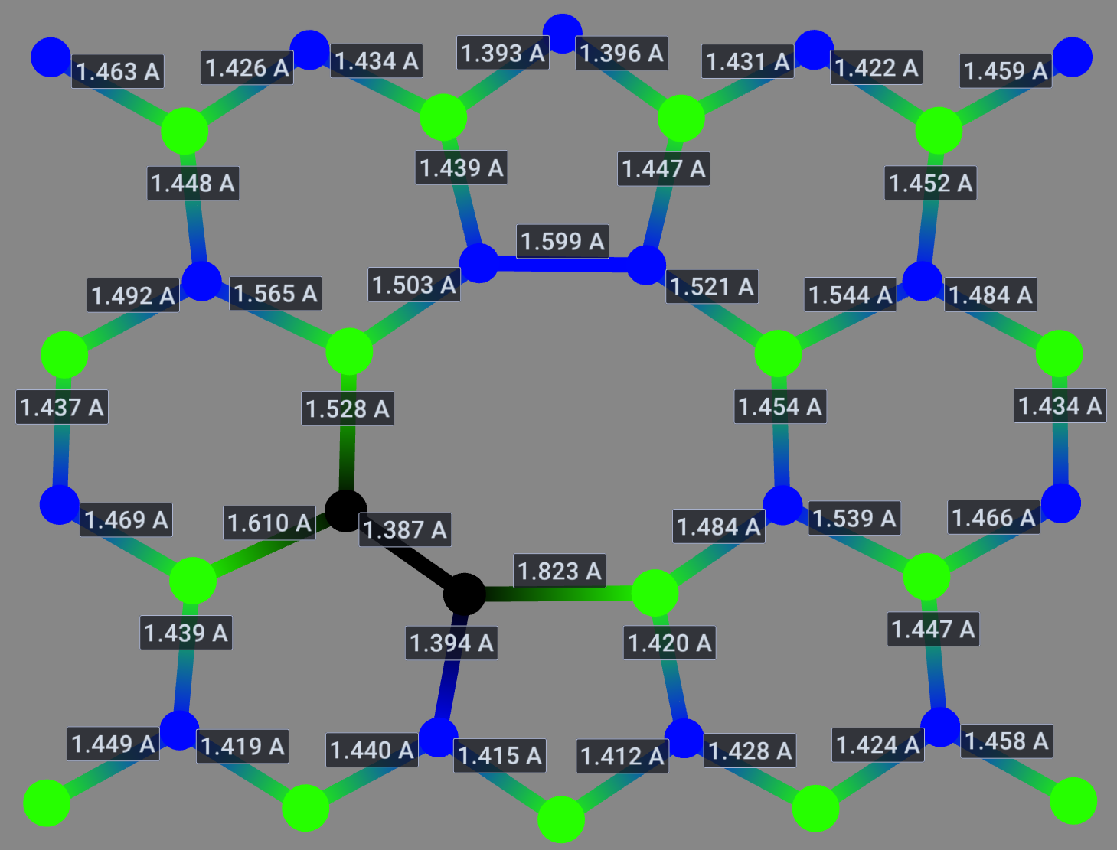
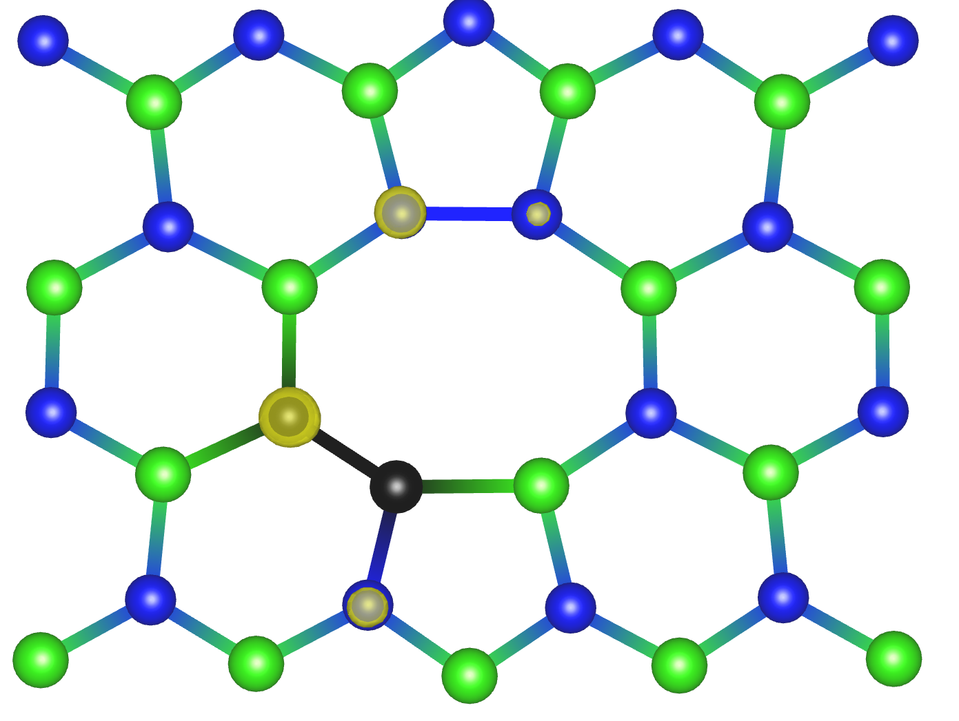

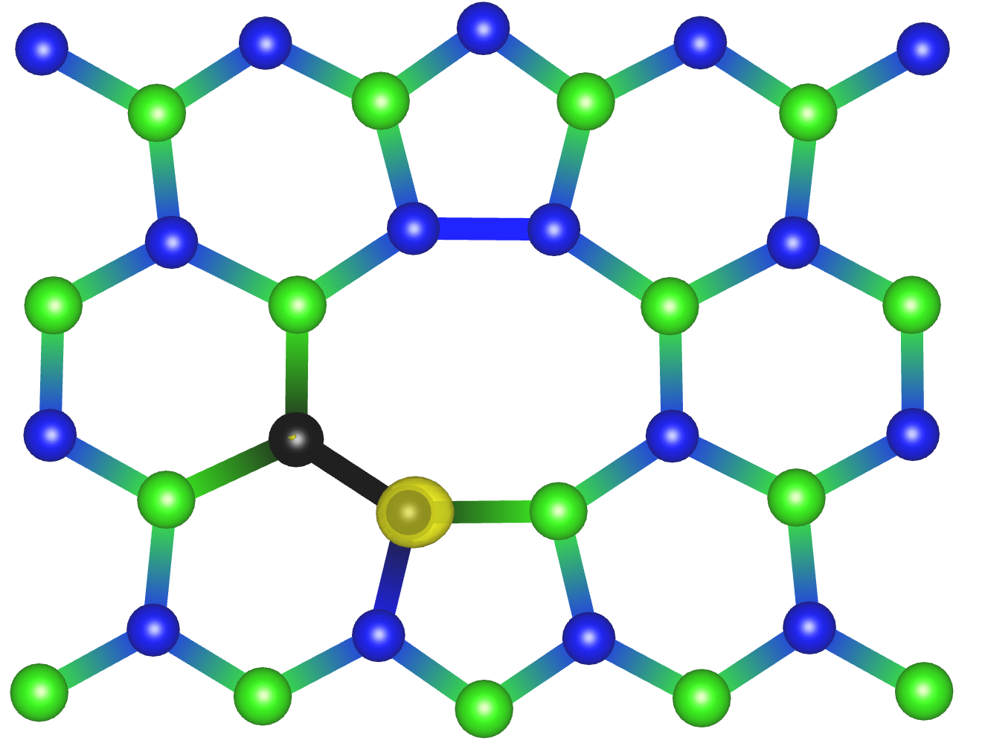
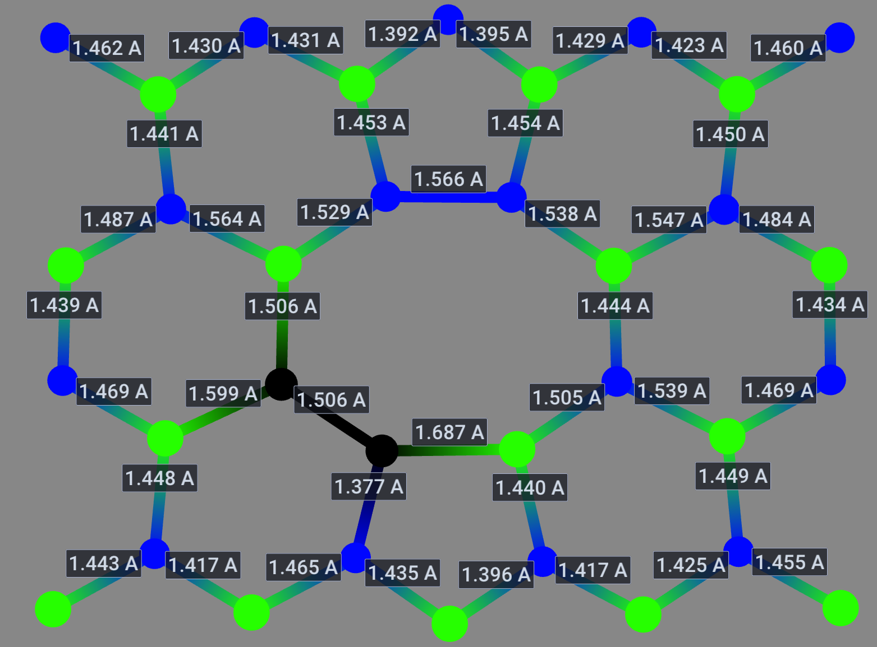
defect | $ΔH_{D}$[eV] | $d_{FC}$ [eV] (PBE) | $d_{FC}$[eV] (HSE) | ZPL [eV] | S | DW
4–6 | 2.150 | 0.352 | 0.380 | --- | --- | ---
Geometry 4-6
Franciszek Zabierowski | FTMC project discussion

Slide 18
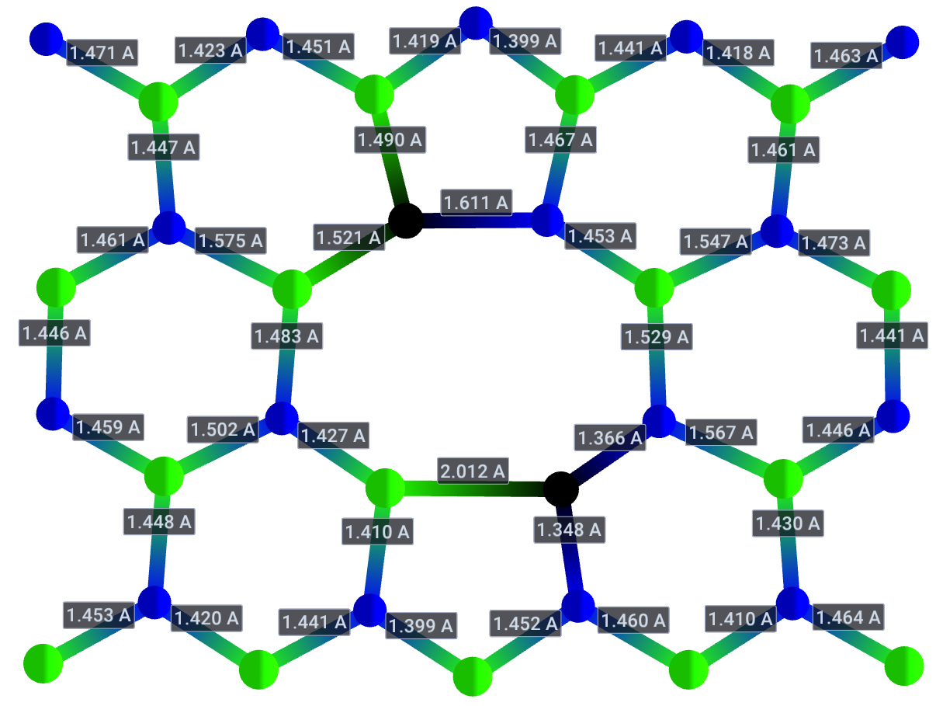
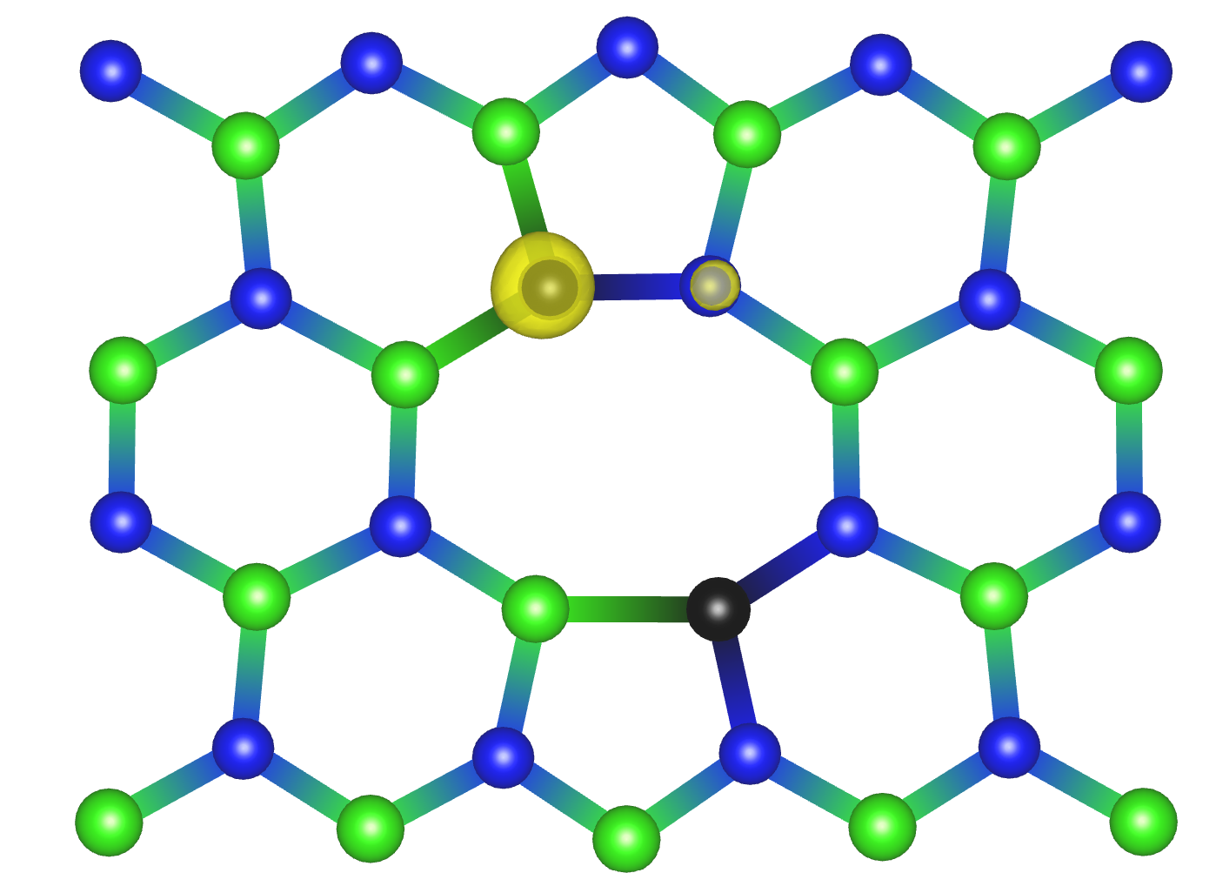
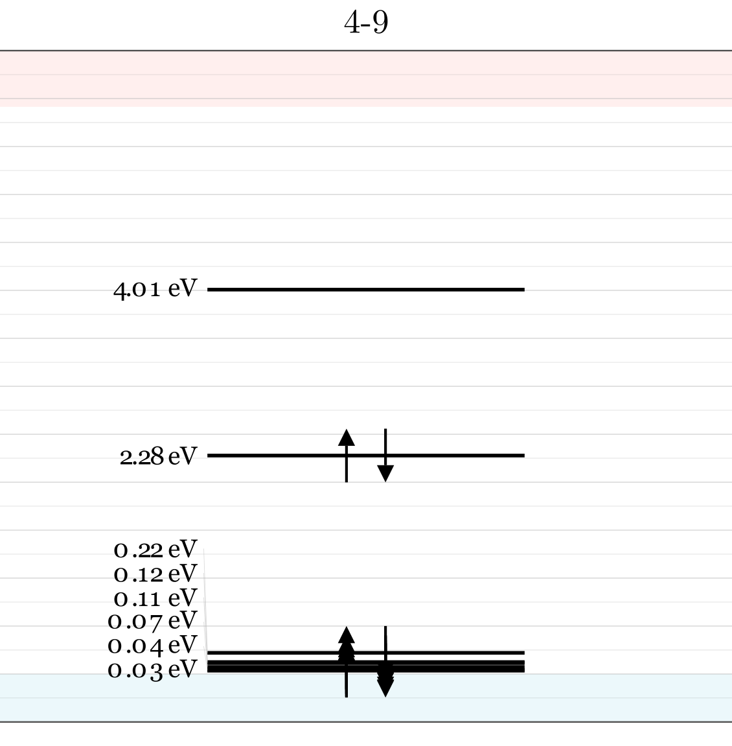
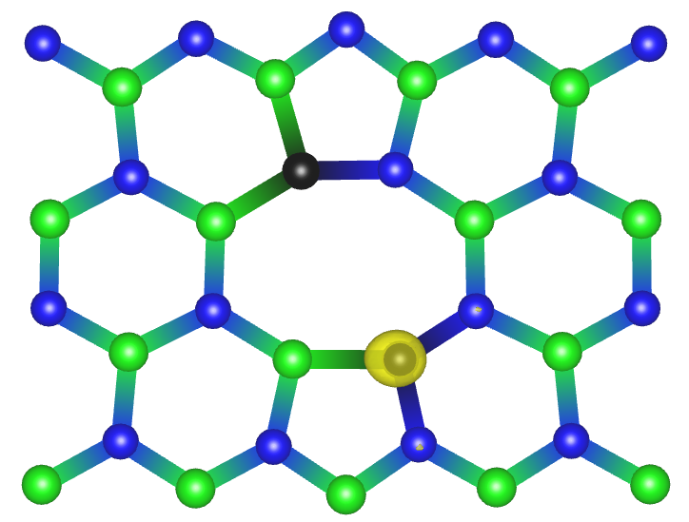
defect | $ΔH_{D}$[eV] | $d_{FC}$ [eV] (PBE) | $d_{FC}$[eV] (HSE) | ZPL [eV] | S | DW
4–9 | 1.842 | 0.926 | --- | --- | --- | ---
Geometry 4-9
-5423.60167078 eV
-5424.31766788 eV
-5424.41533639 eV
-5421.18710134 eV
Franciszek Zabierowski | FTMC project discussion

Slide 19
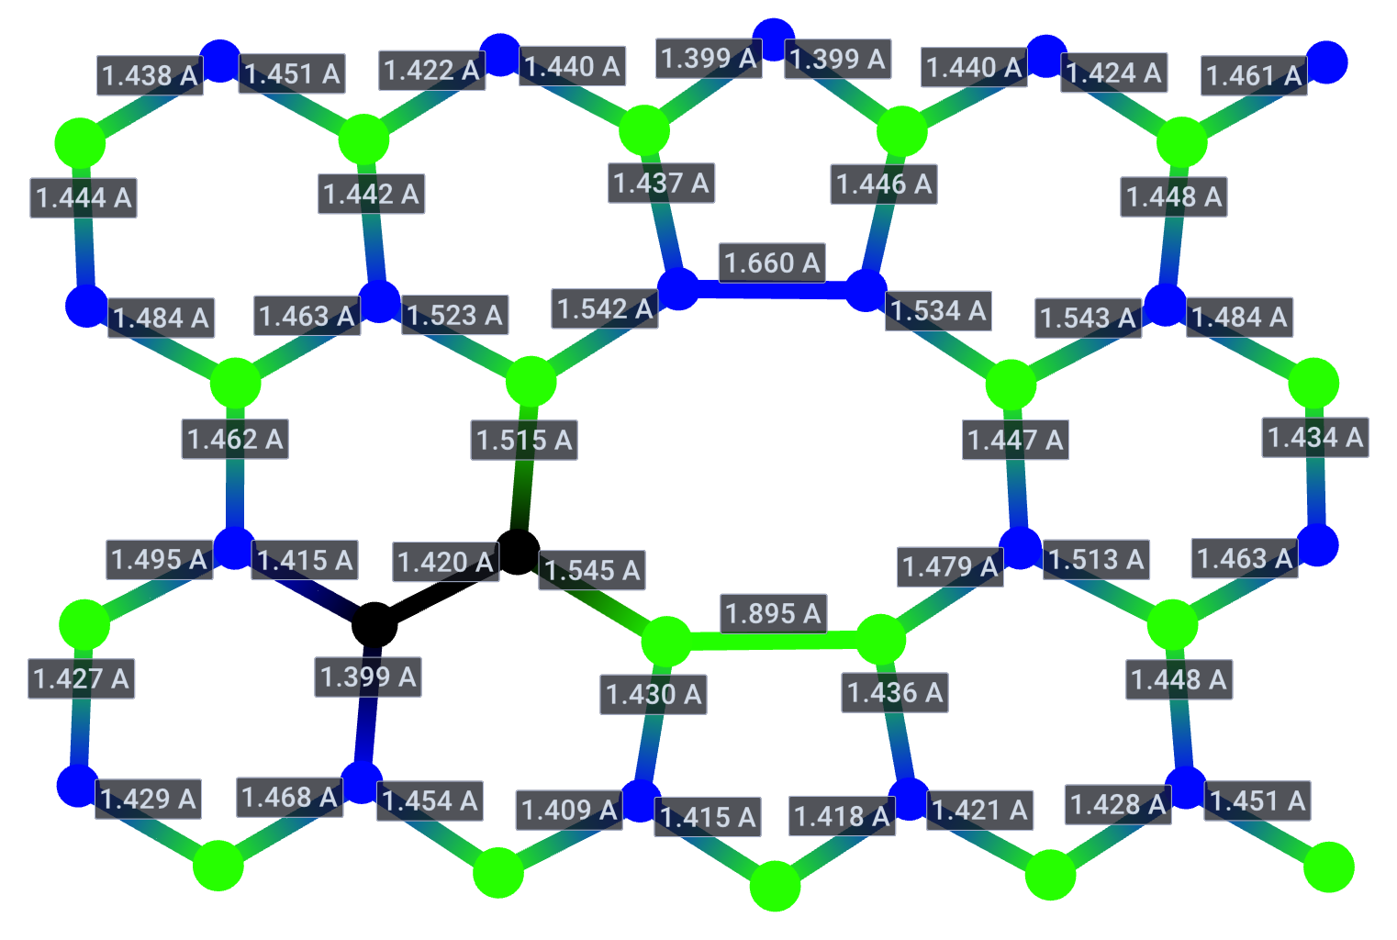
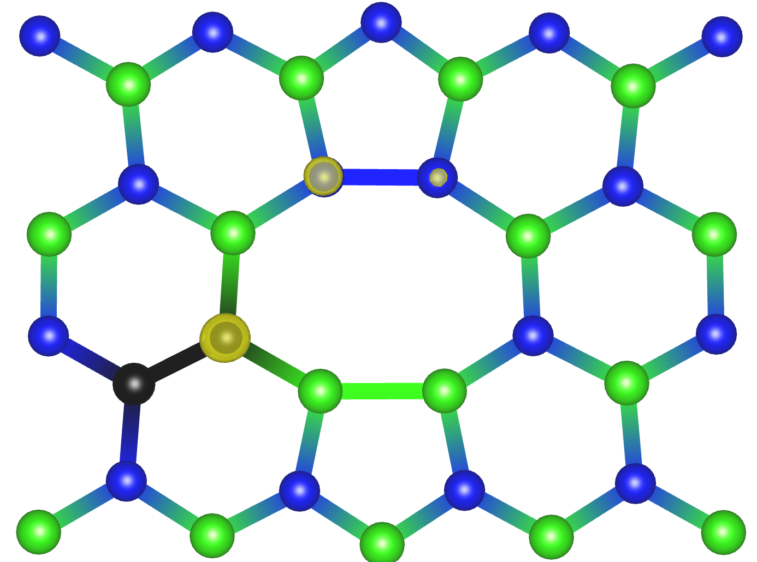
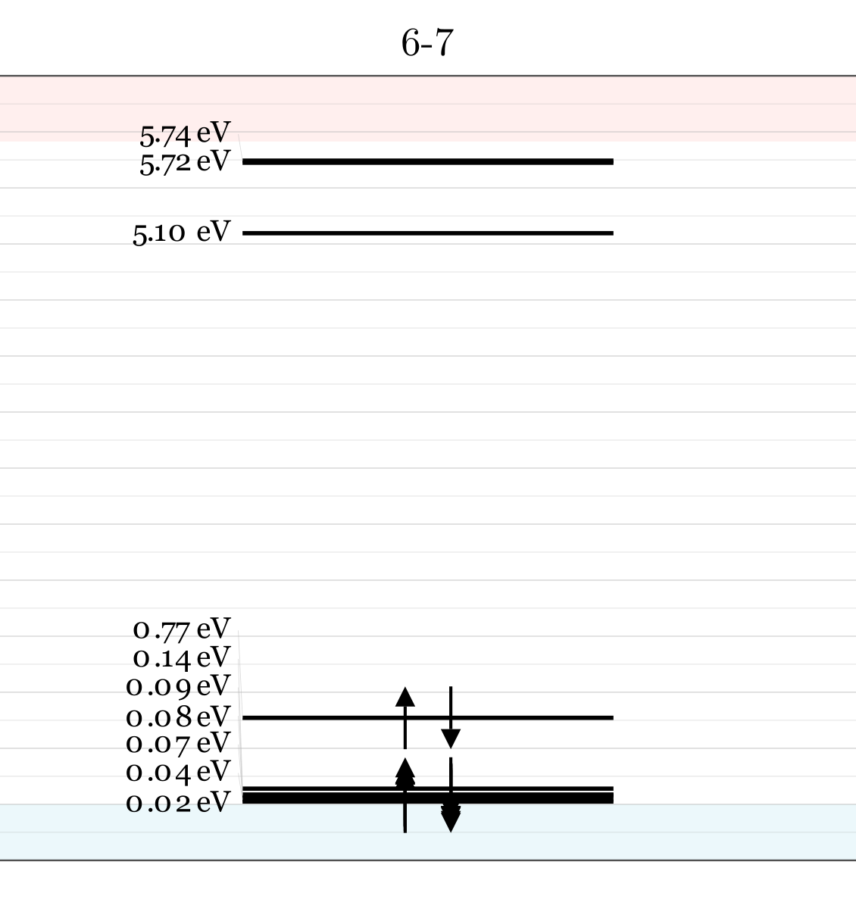


defect | $ΔH_{D}$[eV] | $d_{FC}$ [eV] (PBE) | $d_{FC}$[eV] (HSE) | ZPL [eV] | S | DW
6–7 | 1.131 | 0.172 | 0.220 | --- | --- | ---
Geometry 6-7
Franciszek Zabierowski | FTMC project discussion

Slide 20

Current numerical summary: relative energy and structural reorganization
defect | $ΔH_{D}$[eV] | $d_{FC}$ [eV] (PBE) | $d_{FC}$[eV] (HSE) | ZPL [eV] | S | DW
$$C_{B}C_{N}$$ |  | --- | 0.209 | 4.2 | --- | ---
$$V_{C}V_{N}$$ | 0 | --- |  | --- | --- | ---
1–2 | 0.541 | 2 | --- | --- | --- | ---
2–3 | 2.491 | 0.478 | 0.698 | --- | --- | ---
2–6 | 1.783 | --- | --- | --- | --- | ---
3–4 | 2.089 | 0.860 | --- | --- | --- | ---
3–8 | 3.903 | 0.460 | $$\text{0.776}$$ | --- | --- | ---
4–5 | 1.213 | 0.375 | 0.417 | --- | --- | ---
4–6 | 2.150 | 0.352 | 0.380 | --- | --- | ---
4–9 | 1.842 | 0.926 | --- | --- | --- | ---
6–7 | 1.131 | 0.172 | 0.220 | --- | --- | ---
Interpretation used here: the V₂-referenced formation/binding-energy formalism cancels chemical-potential dependence. Δ_FC is treated as a proxy for structural relaxation/electron–phonon coupling strength.
Franciszek Zabierowski | FTMC project discussion

Slide 21

What remains to be done in Vilnius / next thesis stage
Optical fingerprints
Extended model space
Charge physics
Compute ZPL consistently
Calculate Huang–Rhys factor and Debye–Waller factor
Generate CCD and PL lineshapes
Finish $E_{GS}(Q_{ES})$
Selected tetramers around V₂
Additional dimer positions: e.g. 3–9, 4–12
Same calculations for selected tetramers and other defects which carbon
Calculate charge-transition levels ε(q/q′)
Use them to justify focusing on q = 0 for optical calculations
Franciszek Zabierowski | FTMC project discussion

