Slide 1
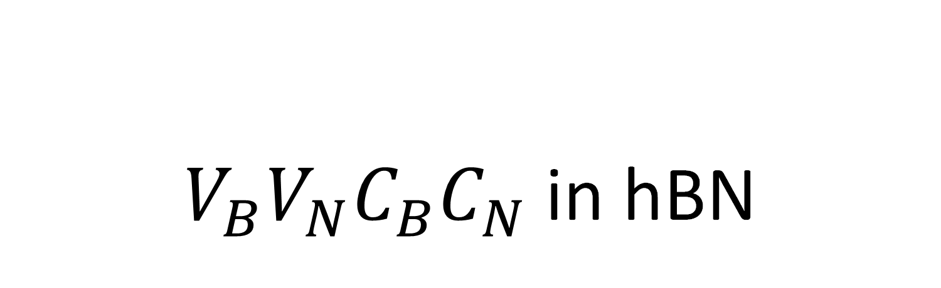
$V_{B}V_{N}C_{B}C_{N}$ in hBN
Franciszek Zabierowski

Slide 2
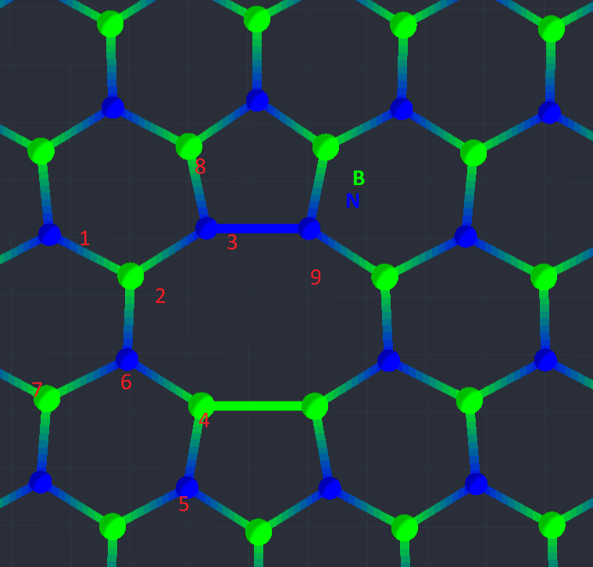
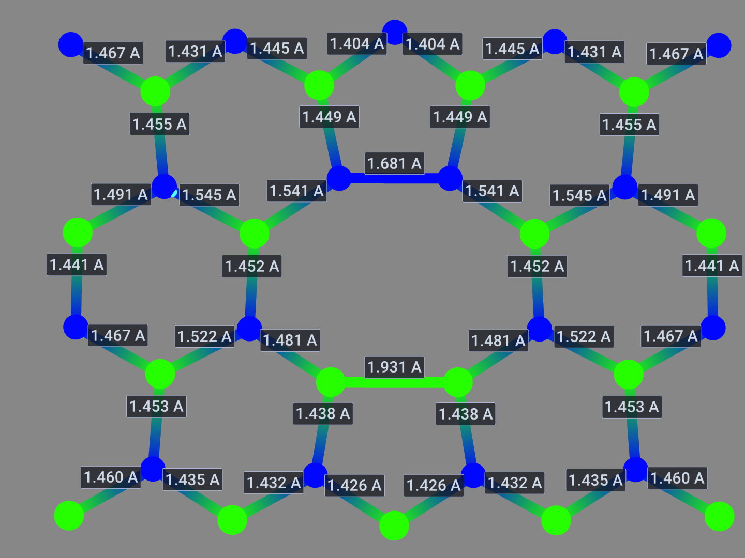
Di-Vacancy geometry and nomenclature

Slide 3
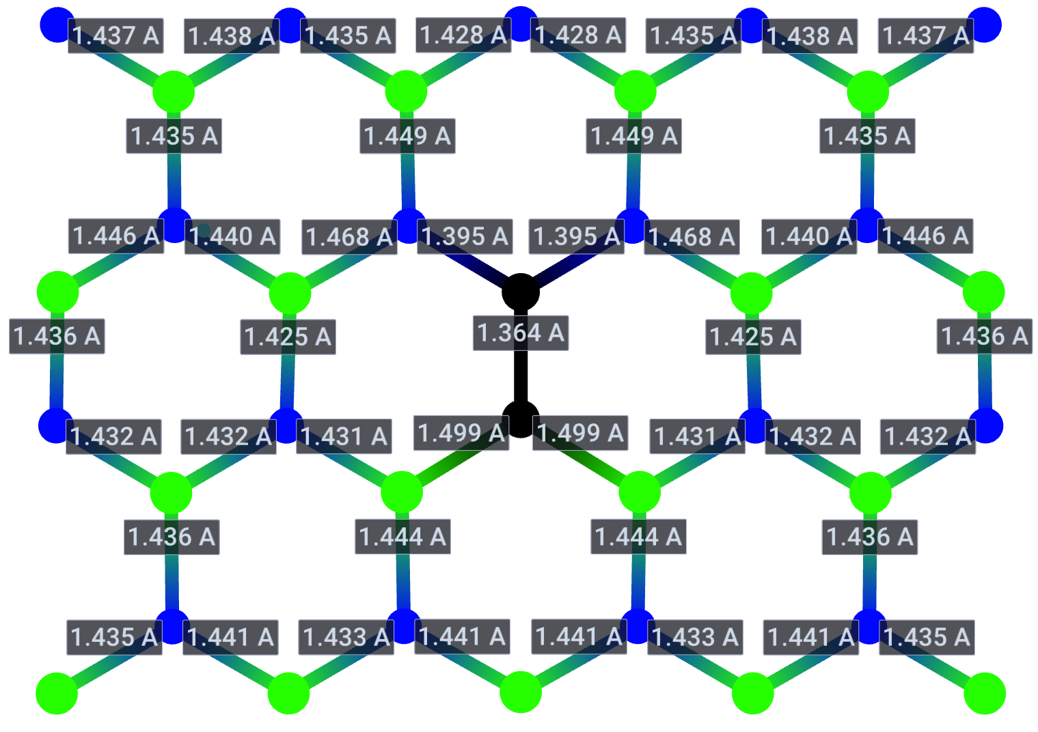
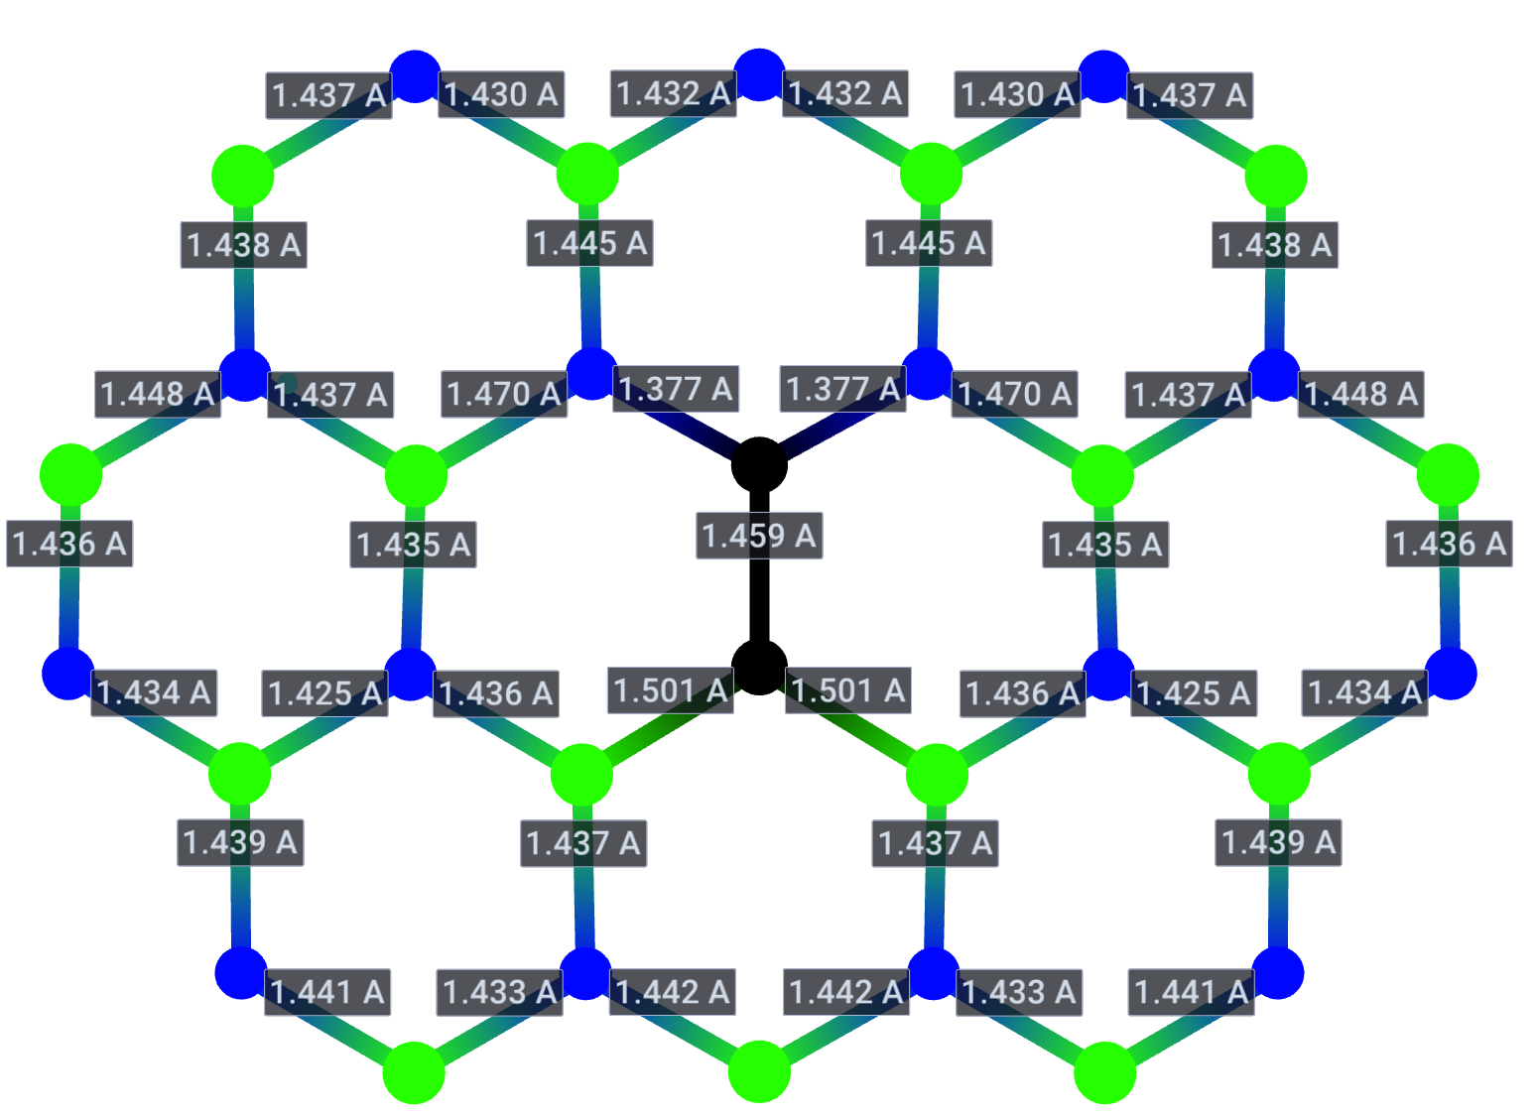
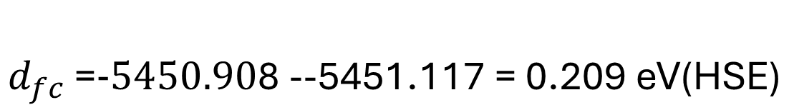
Carbon dimer
$$d_{fc}\text{ =}-5450.90\text{8 -}\text{-5451.117}\text{ = 0.209 }\text{eV}\text{(}\text{HSE}\text{)}$$
Ground State (HSE)
Excited State (HSE)

Slide 4
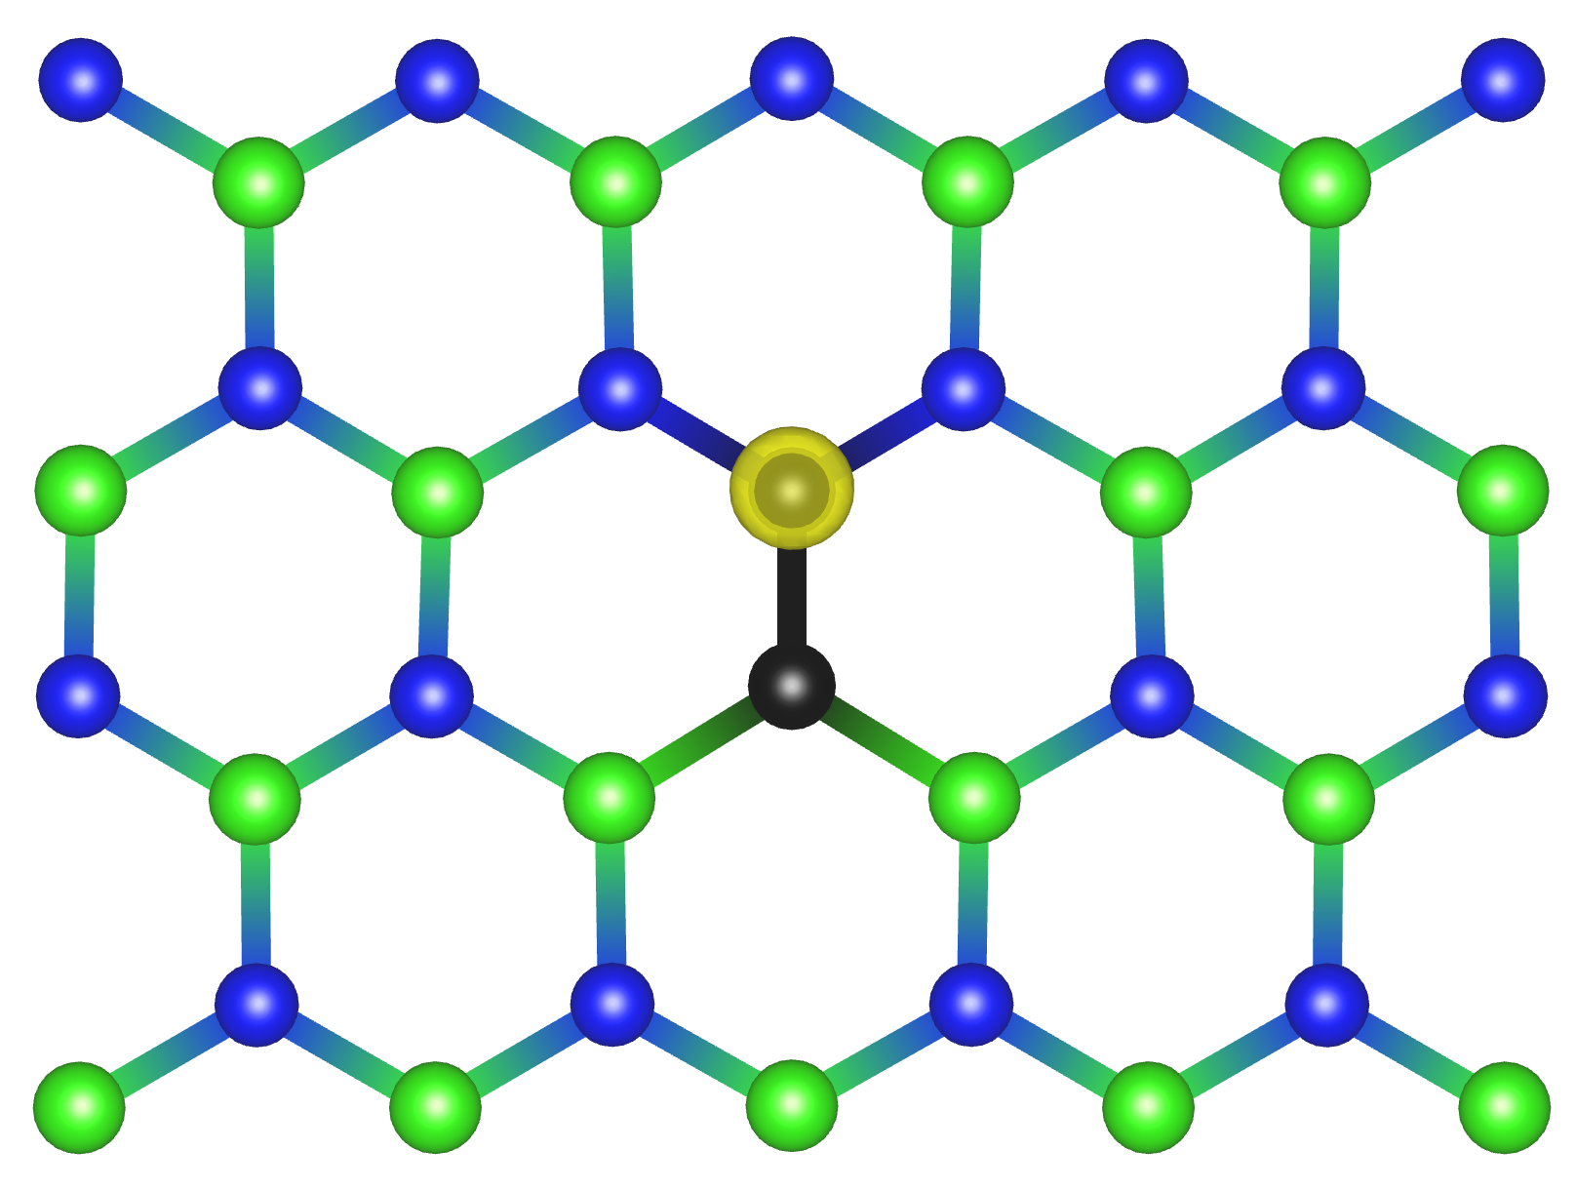
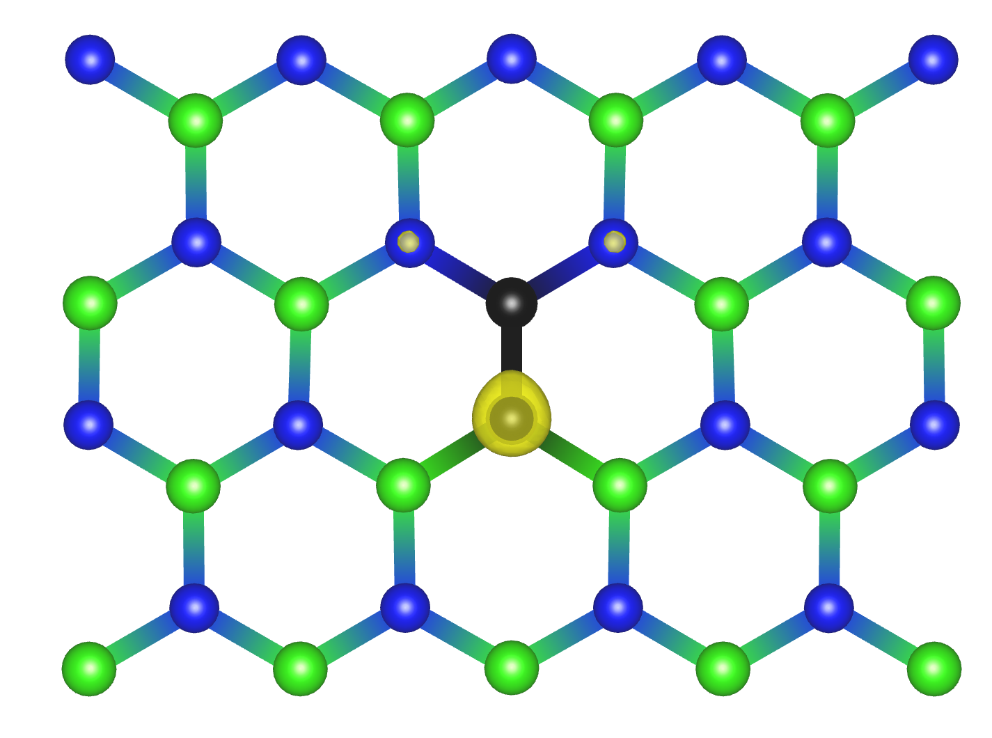
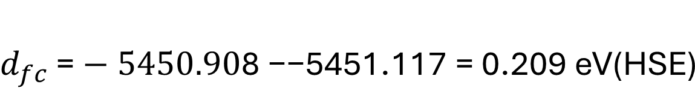
Carbon dimer
$$d_{fc}\text{ =}−5450.90\text{8 −}\text{−5451.117}\text{ = 0.209 }\text{eV}\text{(}\text{HSE}\text{)}$$
Ground State (HSE)
Excited State (HSE)

Slide 5
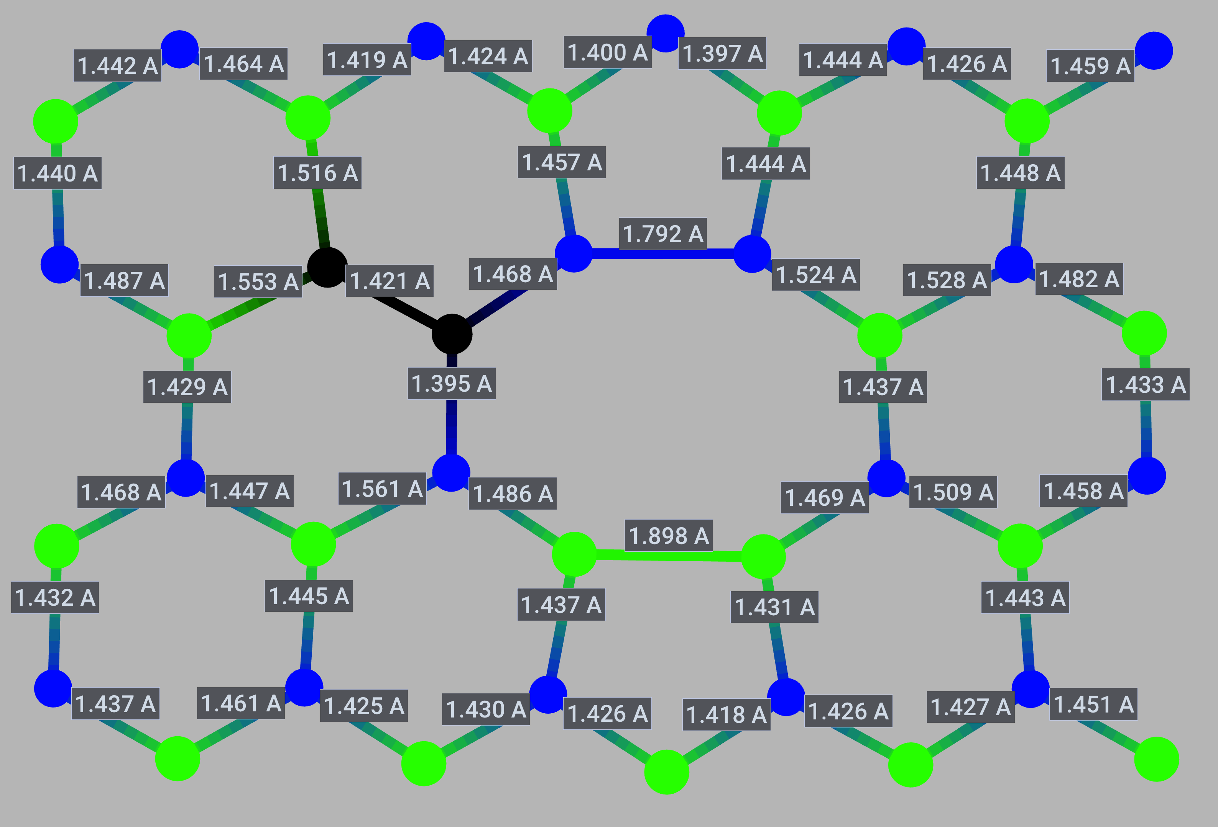
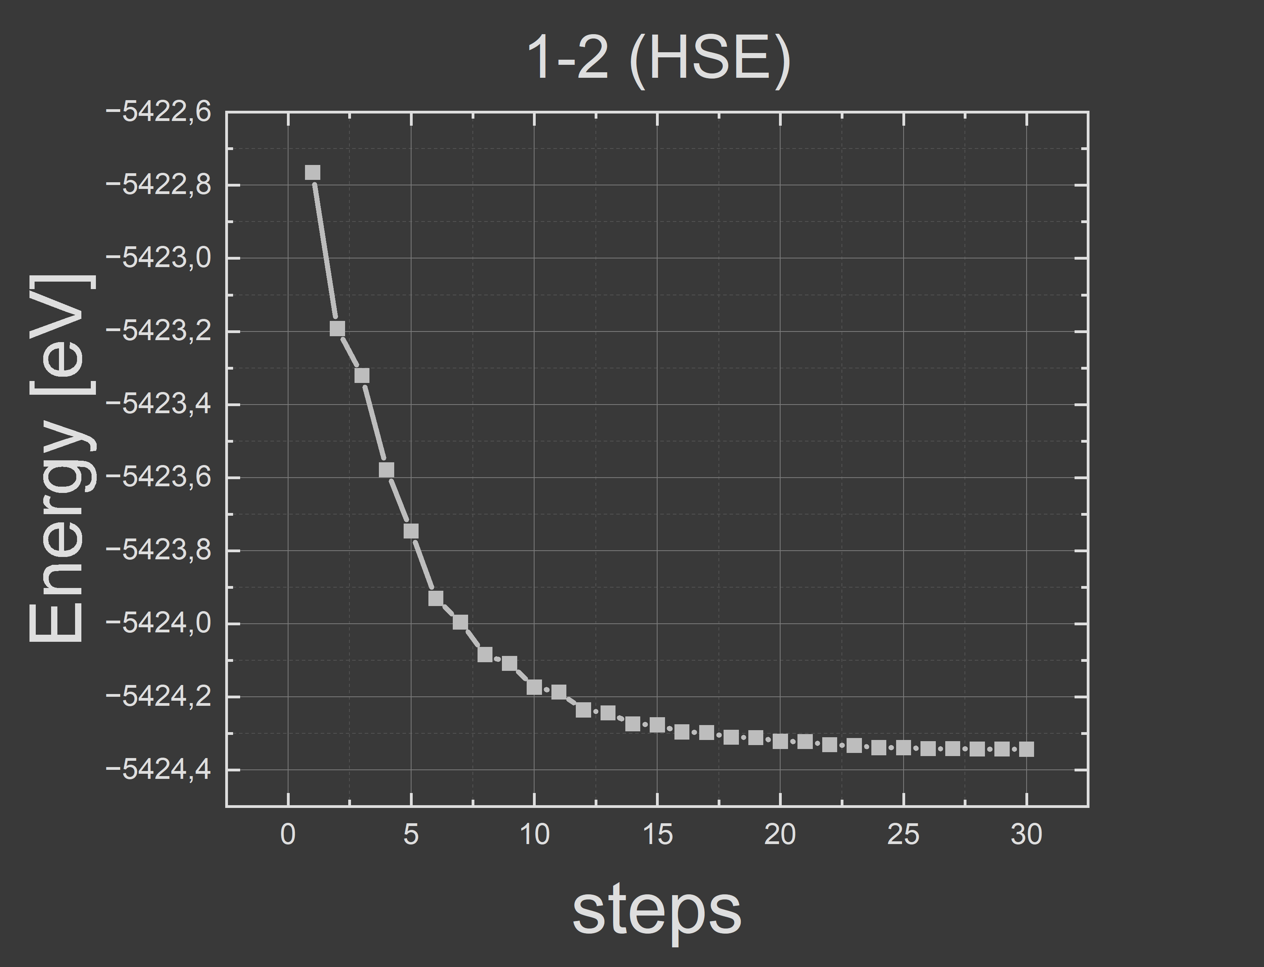

1-2 geometry
$$d_{fc}\text{ = }\text{−4517.6 − −4519.60 = 2 }\text{eV}\text{ (}\text{PBE}\text{)} \\ d_{fc}\text{ =}\text{−5422.765 − −5424.342 = 1.577 }\text{eV} \text{(}\text{HSE}\text{)}$$
$\text{Lack} \text{of} \text{convergence} \text{in} \text{excited} \text{state}$ in excited state
Ground State

Slide 6
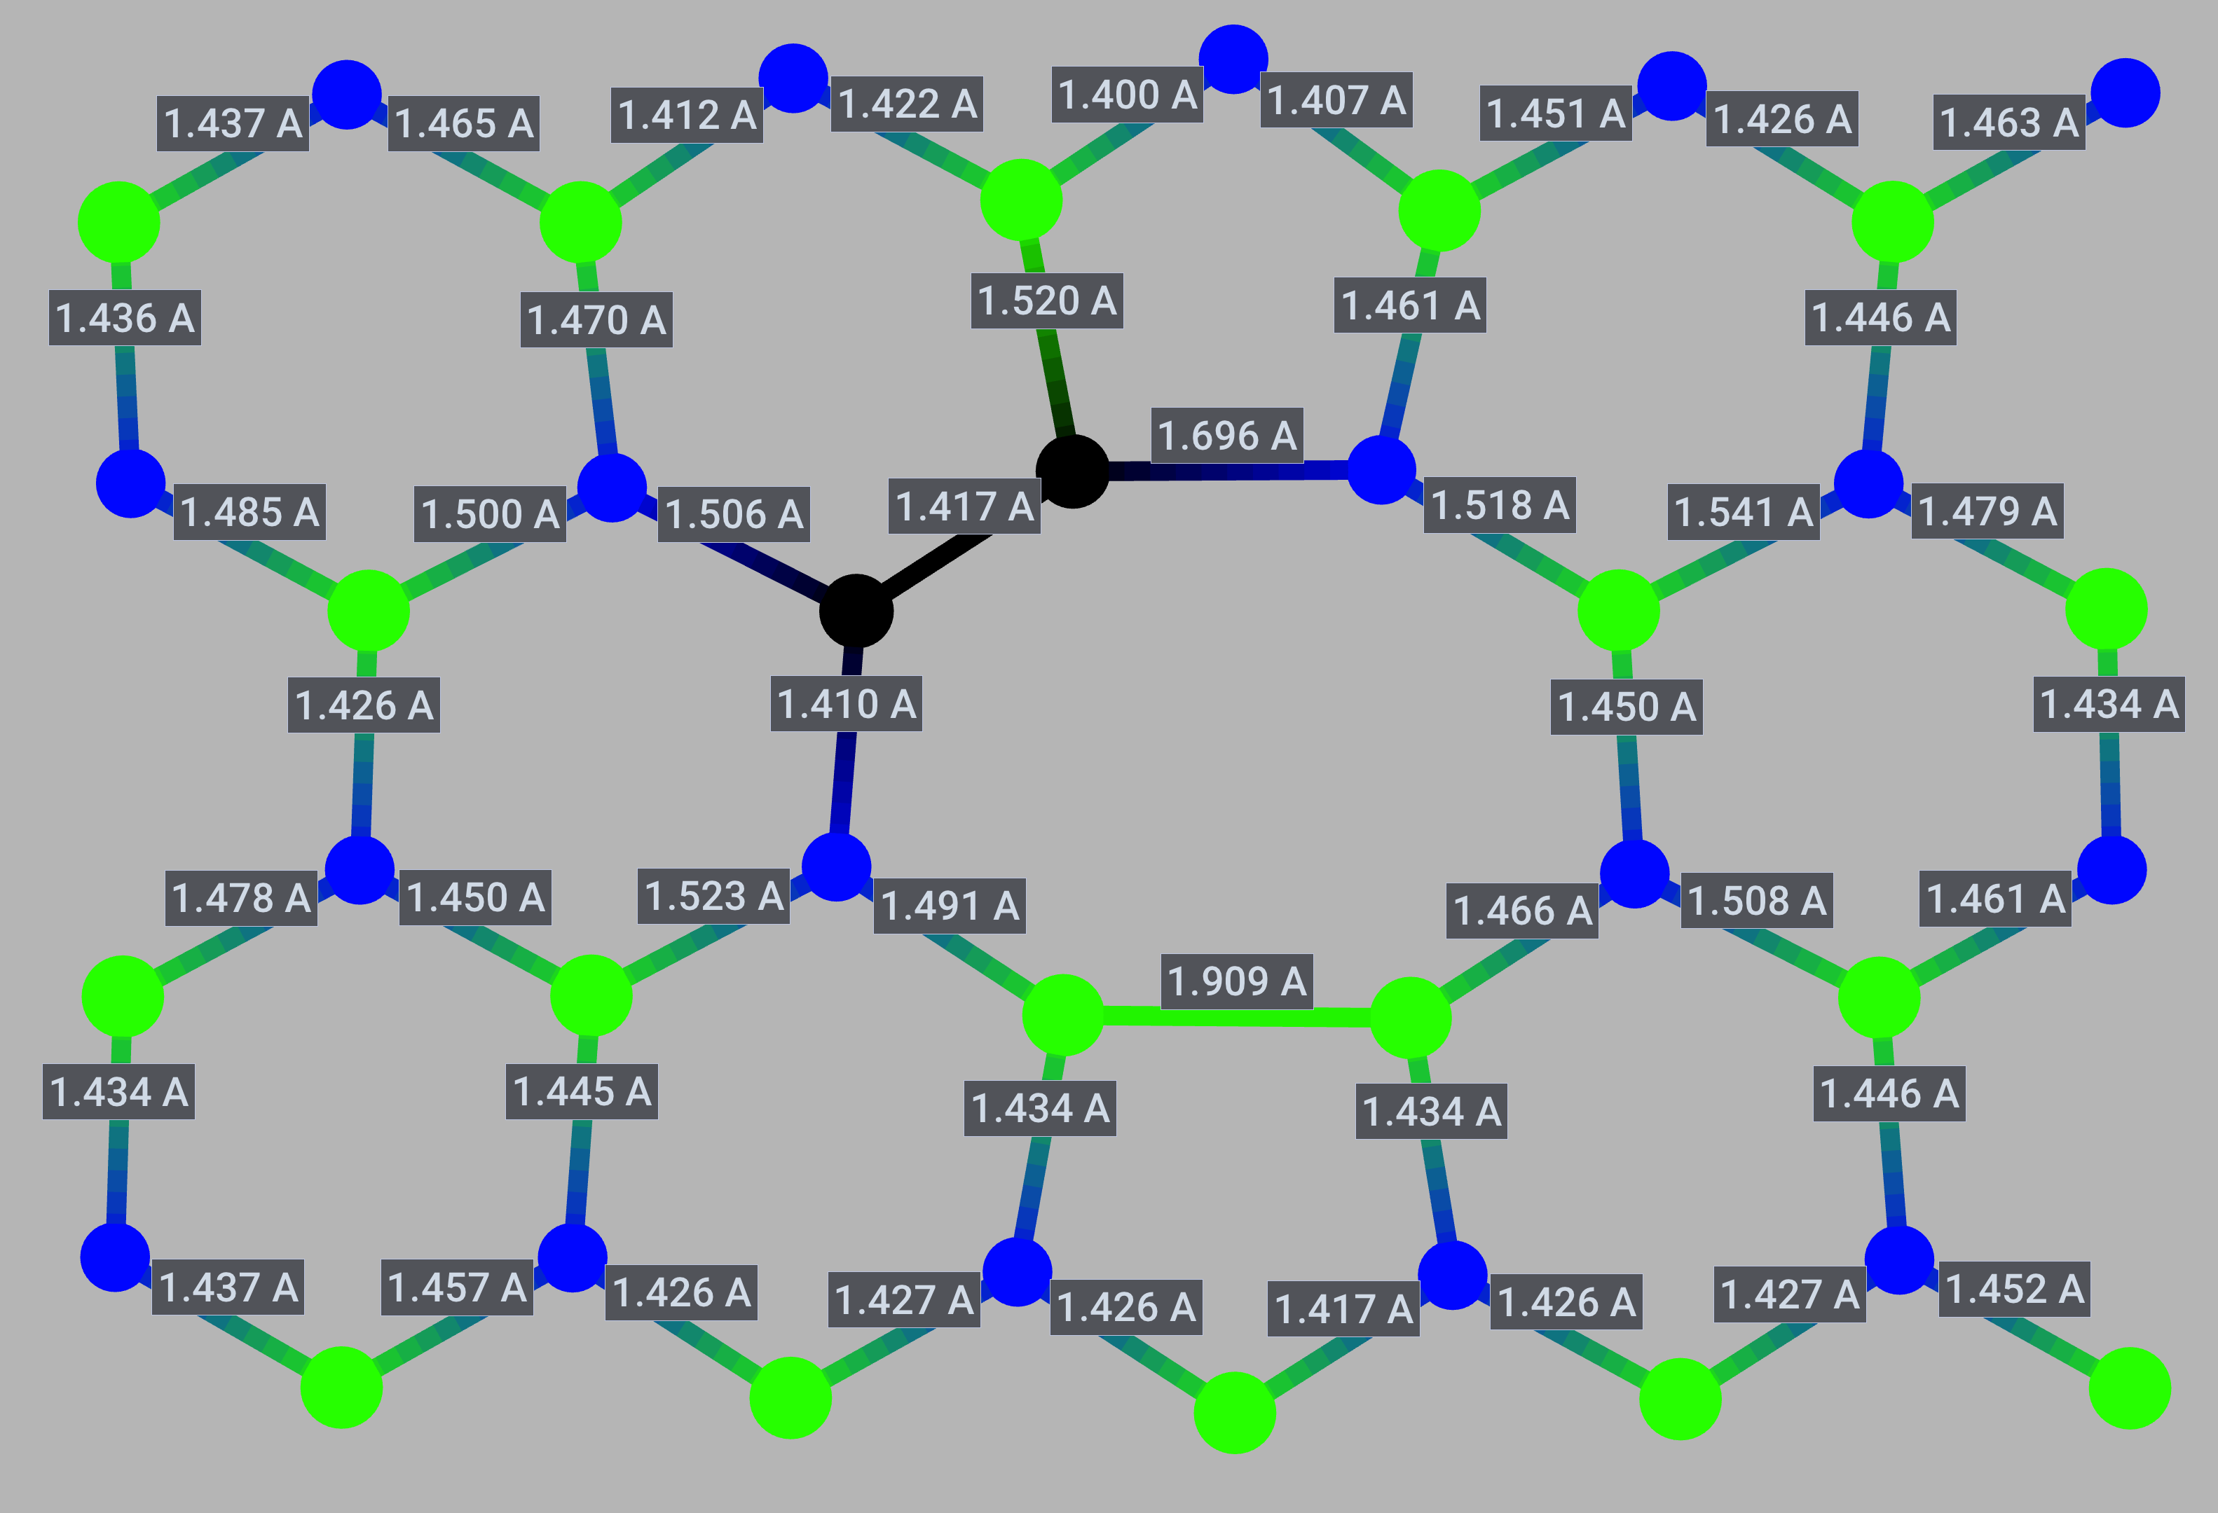
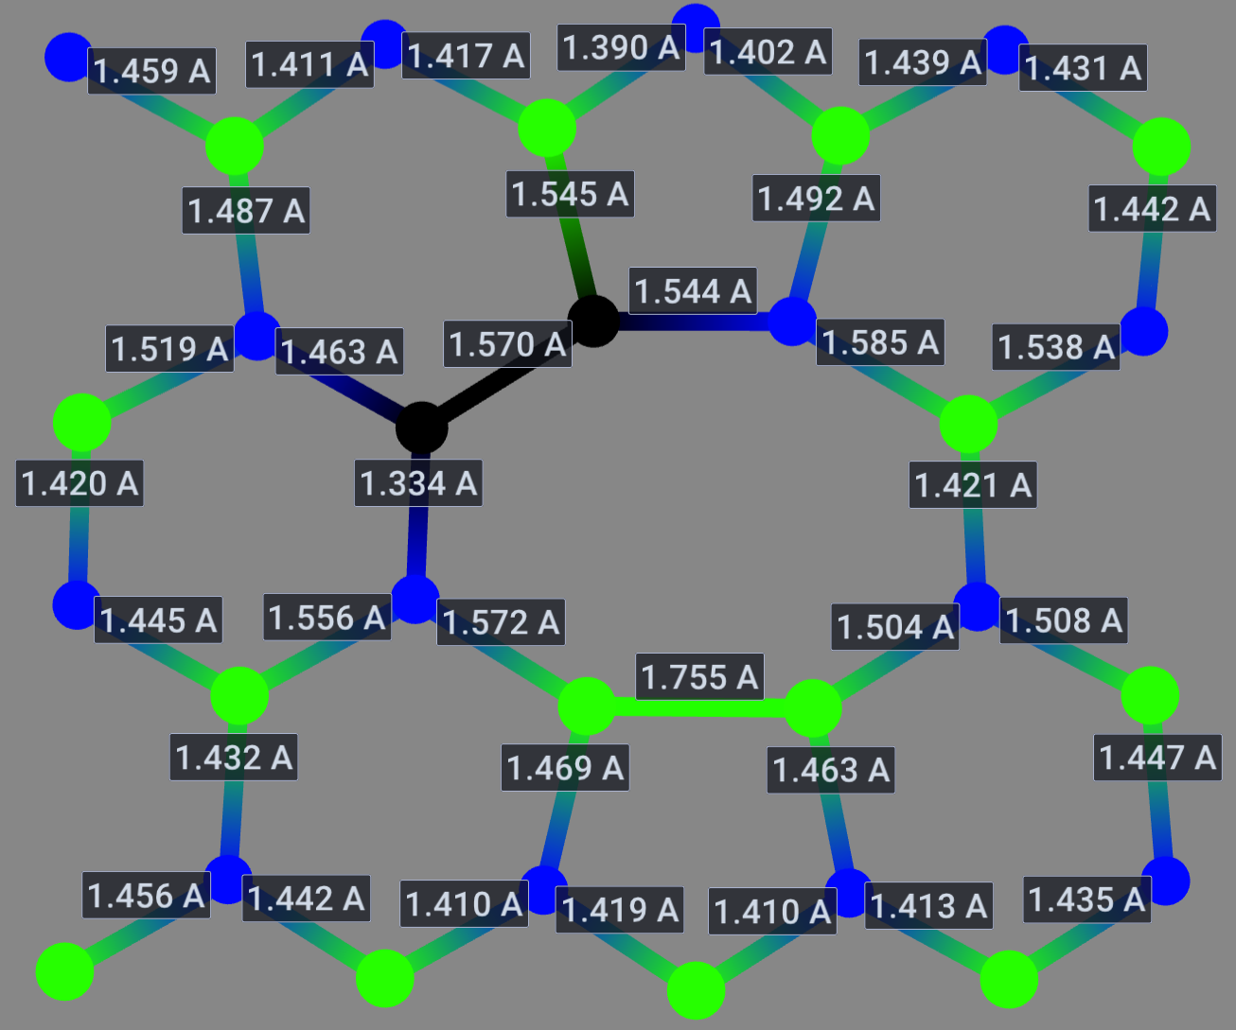
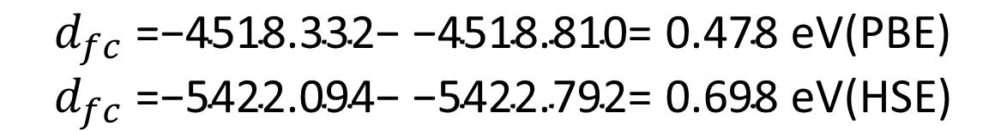
2-3 geometry
$$d_{fc}\text{ =}\text{−4518.332− −4518.810= 0.478 }\text{eV}\text{(}\text{PBE}\text{)} \\ d_{fc}\text{ =}\text{−5422.094− −5422.792= 0.698 }\text{eV}\text{(}\text{HSE}\text{)}$$
Ground State
Excited State

Slide 7
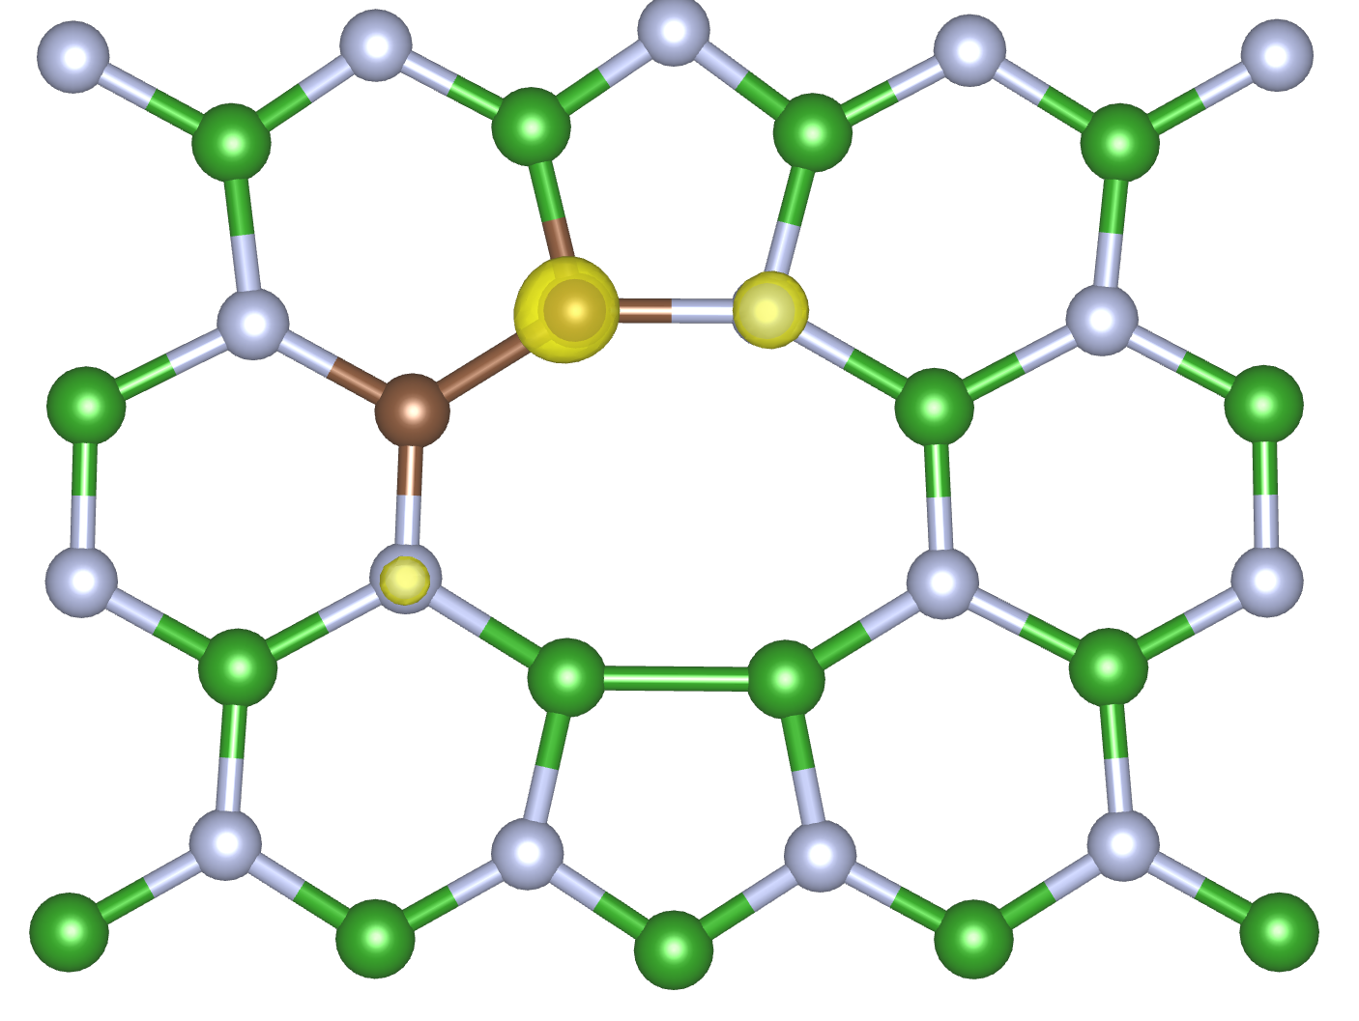
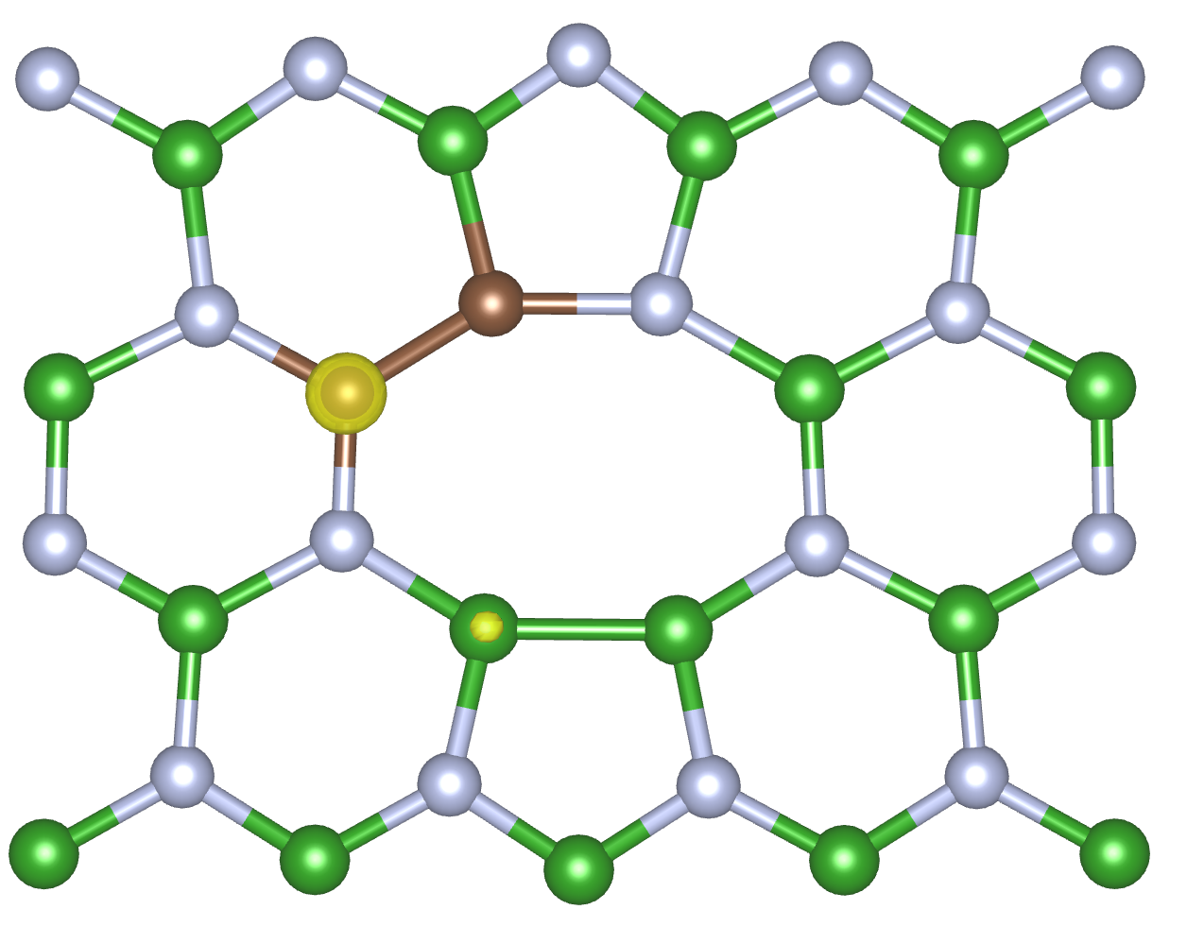
2-3 geometry
$$d_{fc}\text{ =}\text{−4518.332− −4518.810= 0.478 }\text{eV}\text{(}\text{PBE}\text{)} \\ d_{fc}\text{ =}\text{−5422.094− −5422.792= 0.698 }\text{eV}\text{(}\text{HSE}\text{)}$$
Ground State (PBE)
Excited State (PBE)

Slide 8
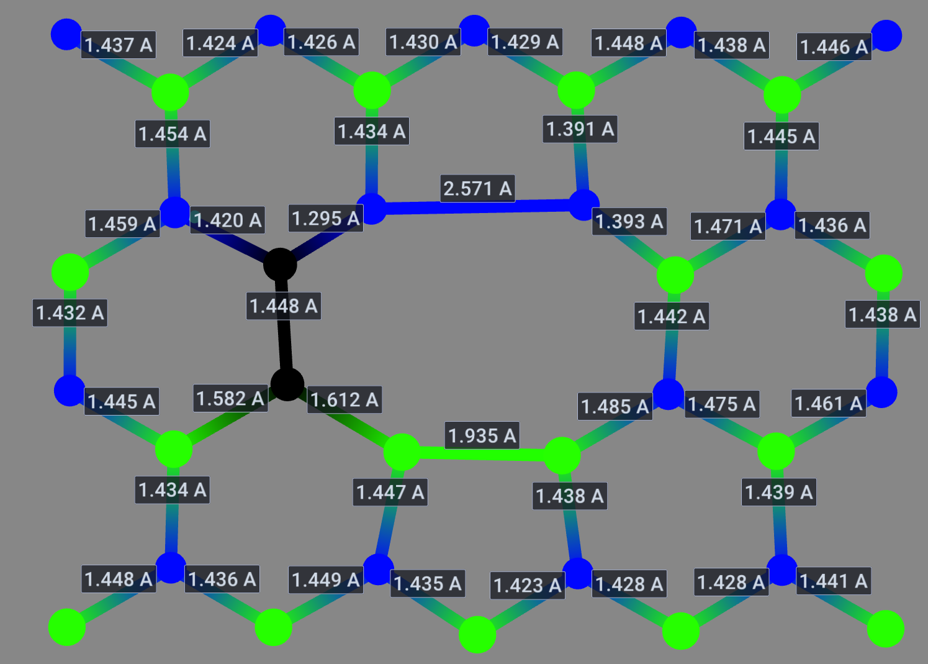

2-6 geometry
$$d_{fc}\text{ =} \text{(}\text{PBE}\text{)} \\ d_{fc}\text{ =} \text{(}\text{HSE}\text{)}$$
Ground State
Excited State
lack of convergance

Slide 9
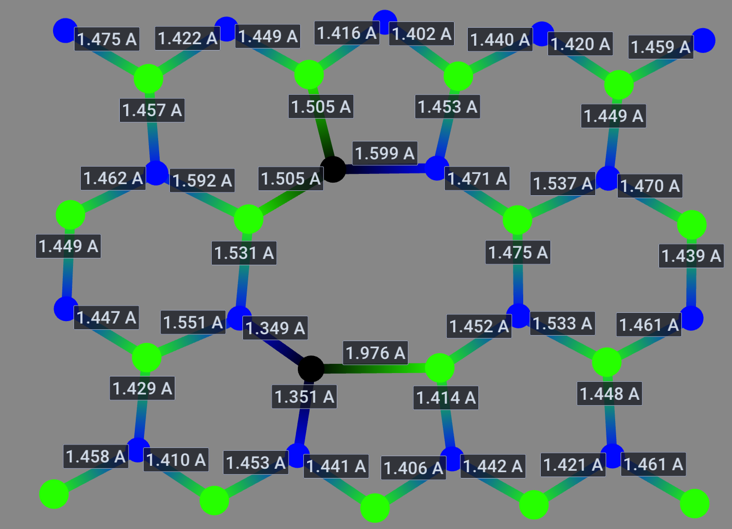
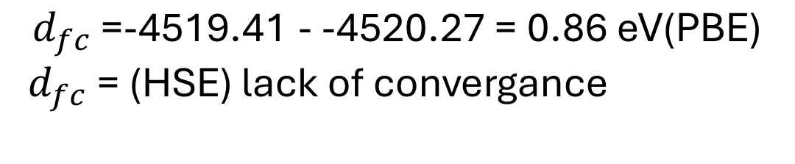
3-4 geometry
$$d_{fc}\text{ =}\text{-4519.41 - -4520.27 = 0.86 }\text{eV}\text{(}\text{PBE}\text{)}$$
$d_{fc}\text{ =} \text{(}\text{HSE}\text{)}$ lack of convergance
Ground State (HSE)
Excited State (HSE)

Slide 10
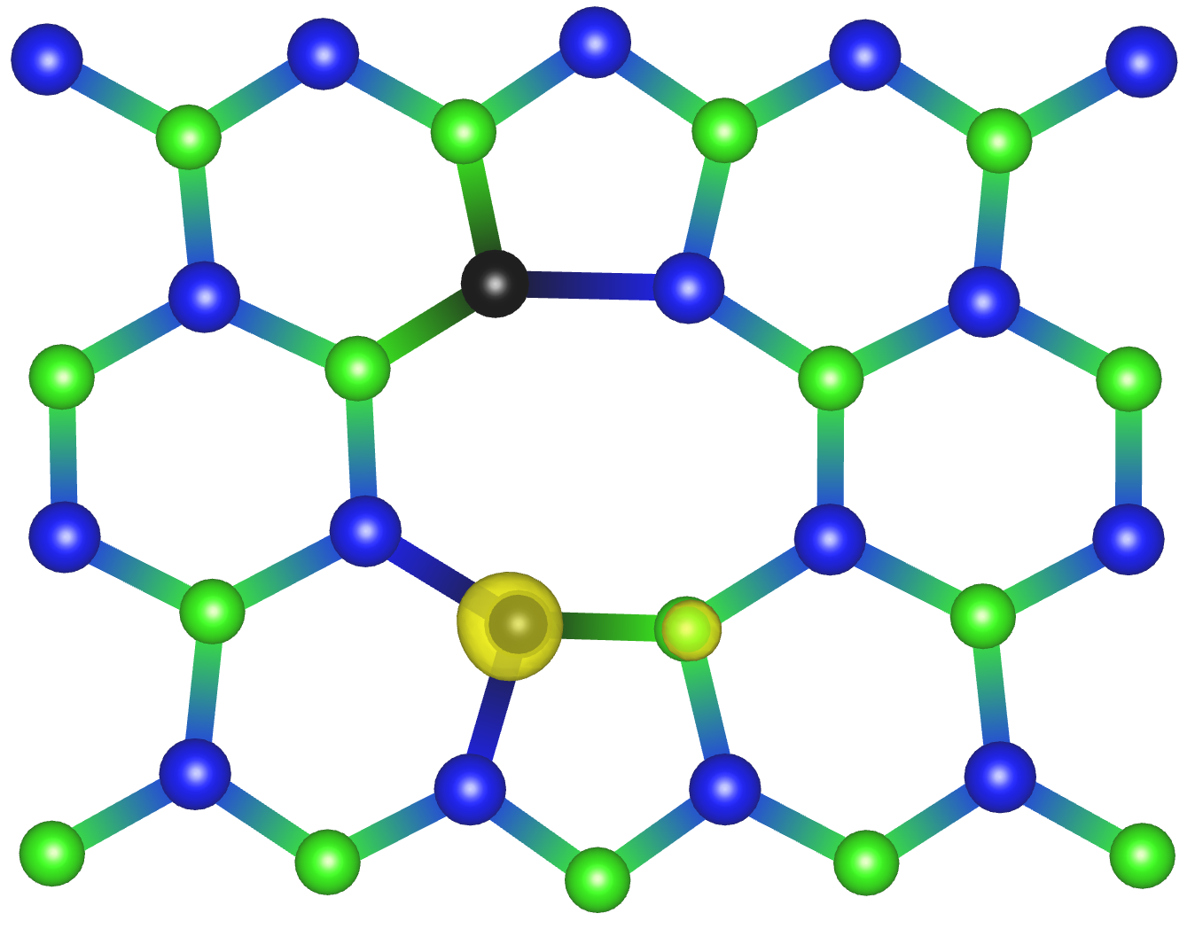
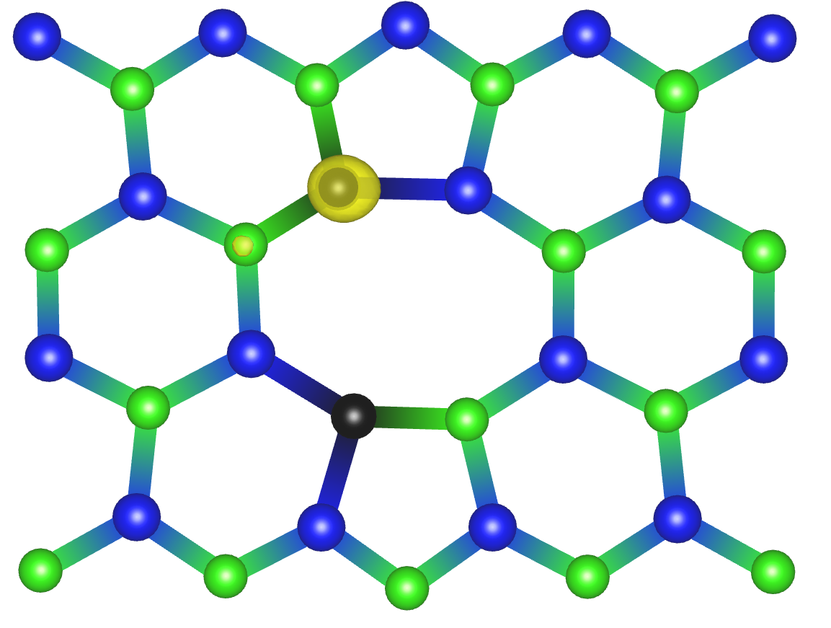
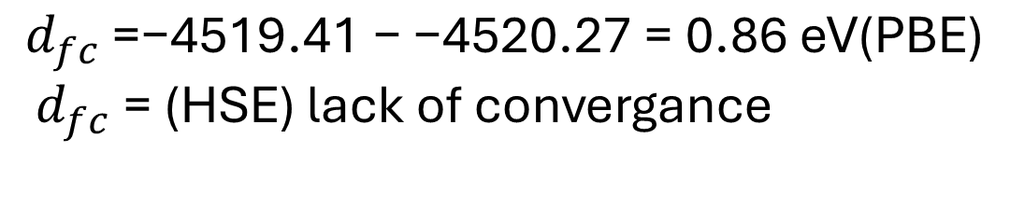
3-4 geometry
$$d_{fc}\text{ =}\text{−4519.41 − −4520.27 = 0.86 }\text{eV}\text{(}\text{PBE}\text{)}$$
$d_{fc}\text{ =} \text{(}\text{HSE}\text{)}$ lack of convergance
Ground State (PBE)
Excited State (PBE)

Slide 11
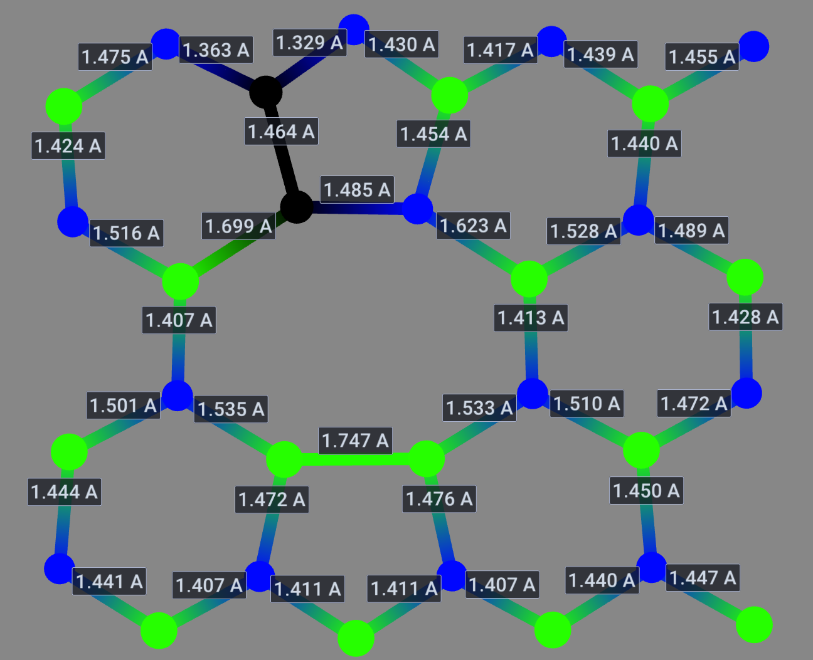
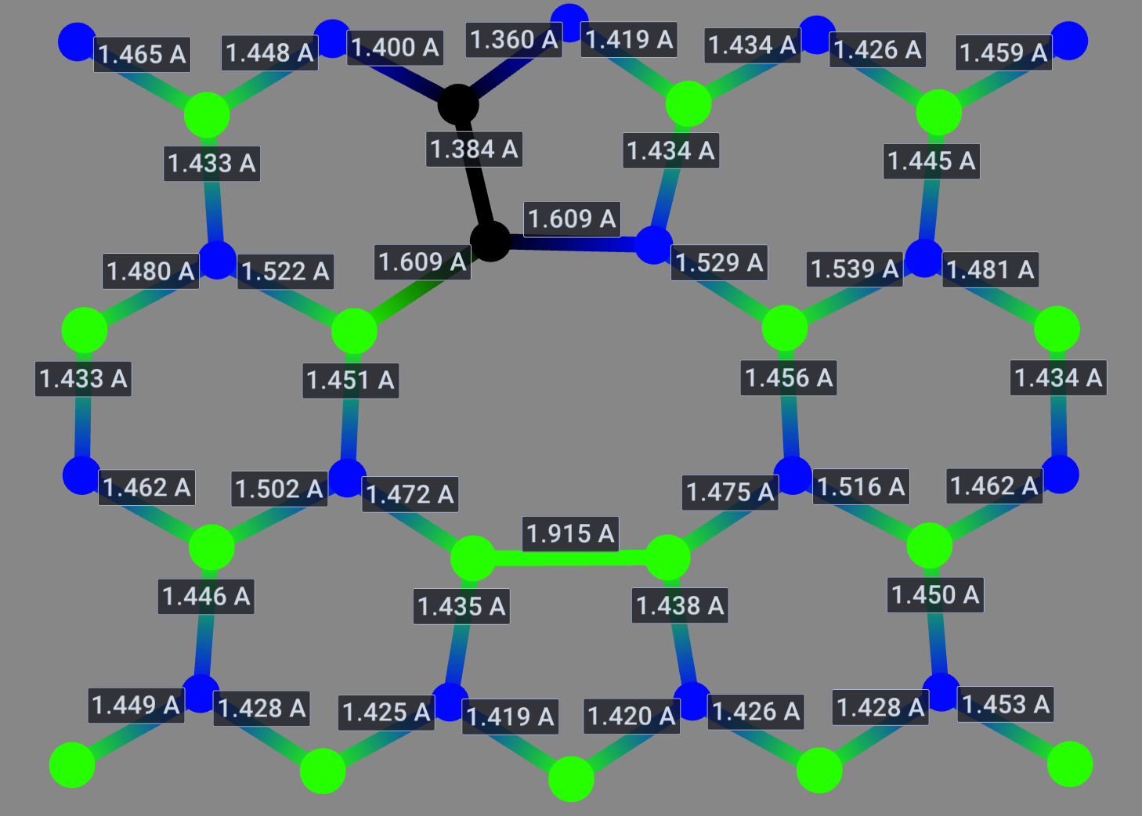
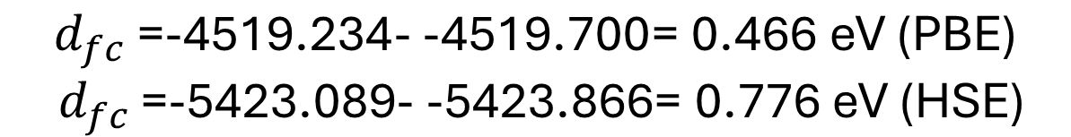
3-8 geometry
$$d_{fc}\text{ =}\text{-4519.234- -4519.700= 0.466 }\text{eV} \text{(}\text{PBE}\text{)}$$
$d_{fc}\text{ =}\text{-5423.089- -5423.866= 0.776 }\text{eV} \text{(}\text{HSE}\text{)}$
Ground State (HSE)
Excited State (HSE)

Slide 12
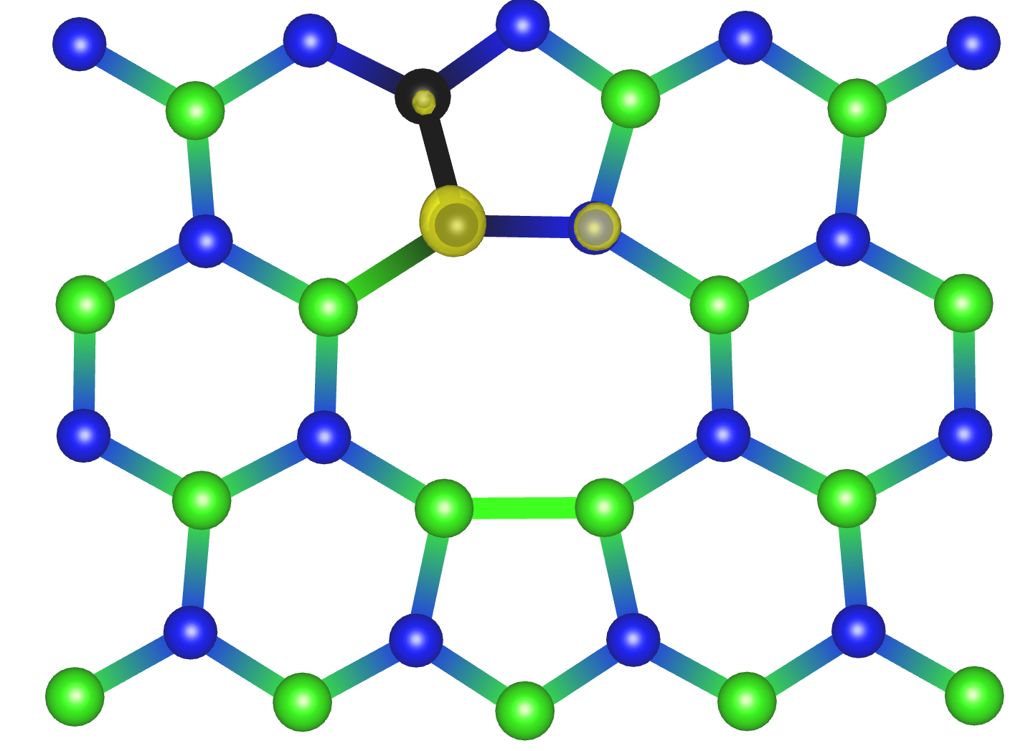
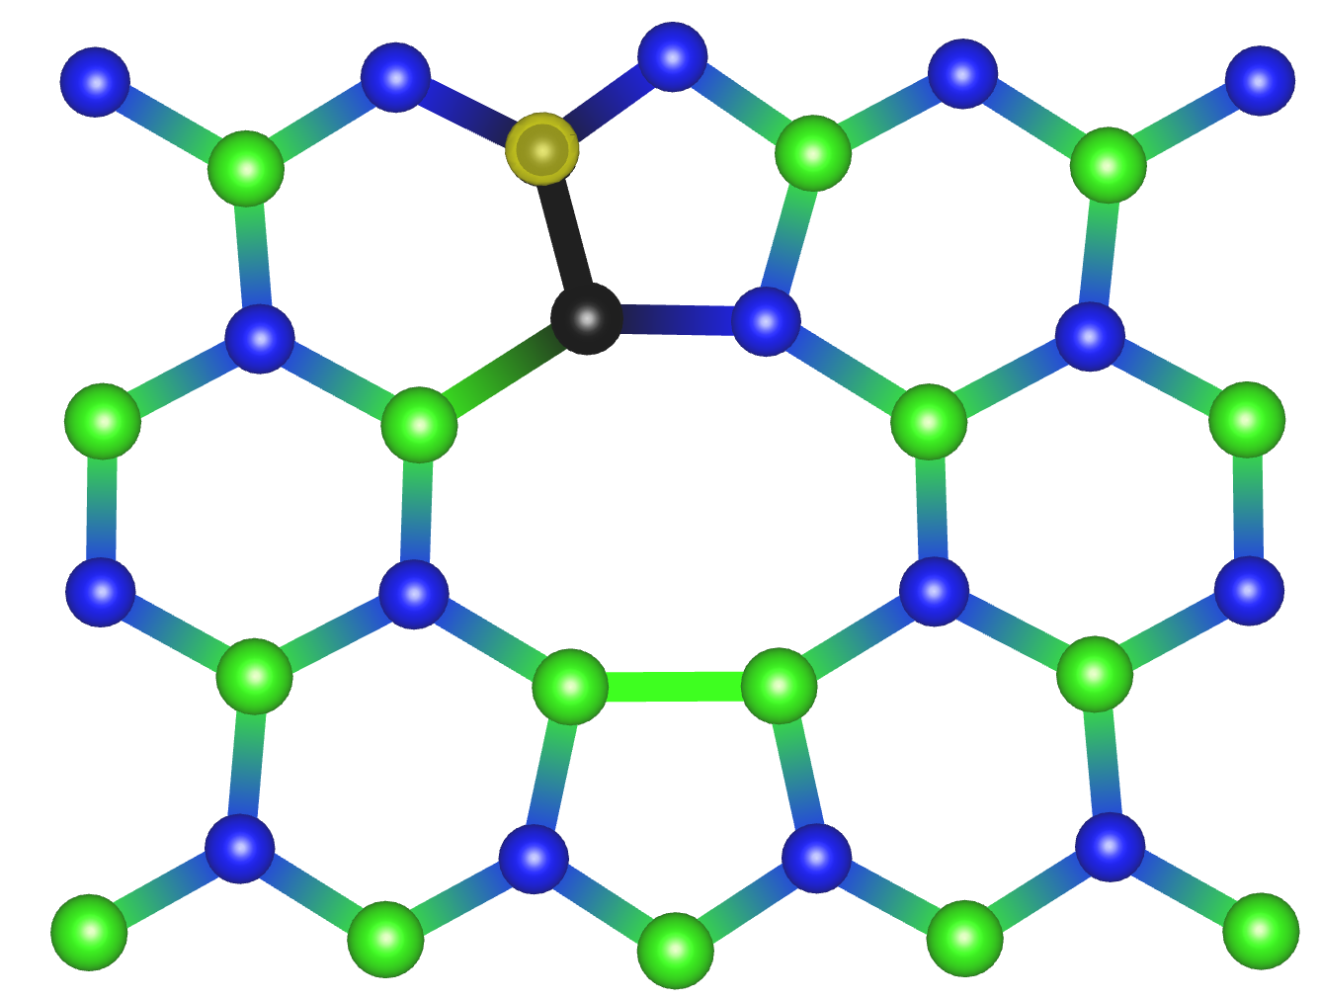
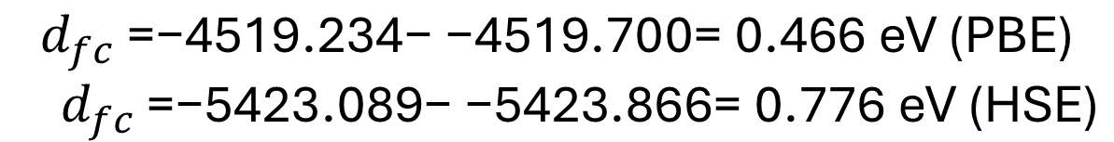
3-8 geometry
$$d_{fc}\text{ =}\text{−4519.234− −4519.700= 0.466 }\text{eV} \text{(}\text{PBE}\text{)}$$
$d_{fc}\text{ =}\text{−5423.089− −5423.866= 0.776 }\text{eV} \text{(}\text{HSE}\text{)}$
Ground State (PBE)
Excited State (PBE)

Slide 13
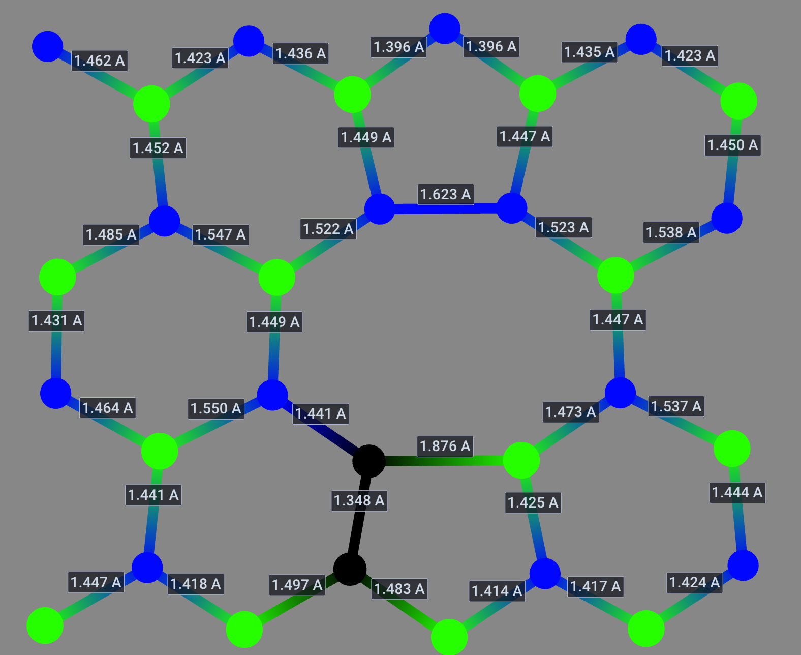
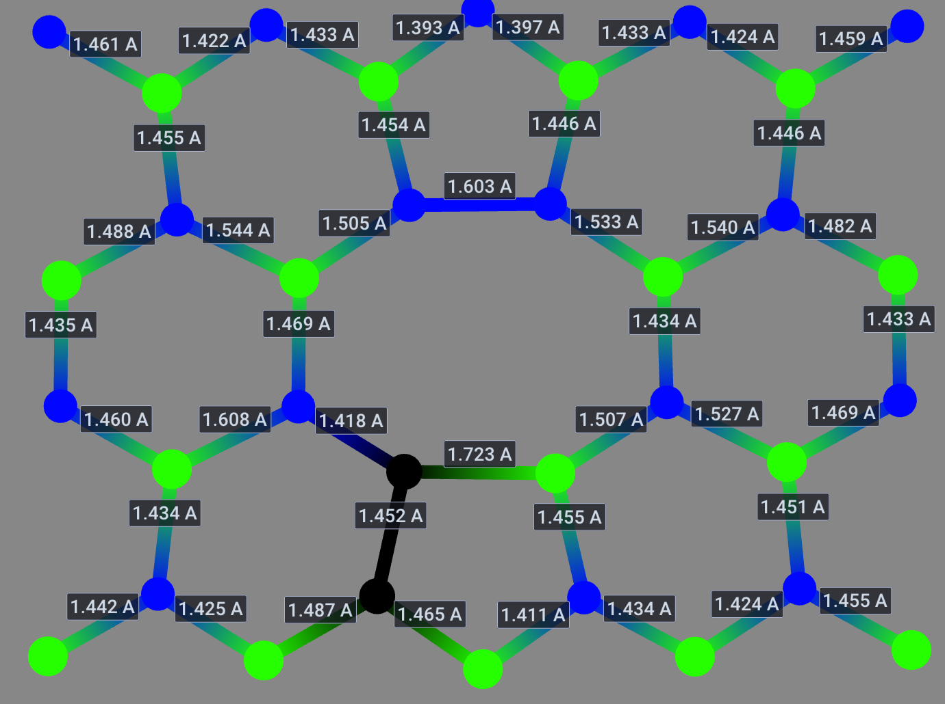
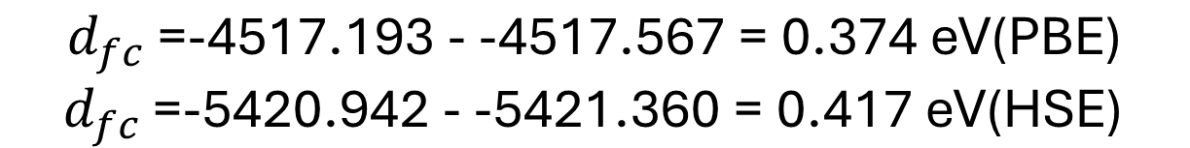
4-5 geometry
$$d_{fc}\text{ =}\text{-4517.193 - -4517.567 = 0.374 }\text{eV}\text{(}\text{PBE}\text{)}$$
$d_{fc}\text{ =}\text{-5420.942} \text{- -5421.360 = 0.417 }\text{eV}\text{(}\text{HSE}\text{)}$
Ground State (HSE)
Excited State (HSE)

Slide 14
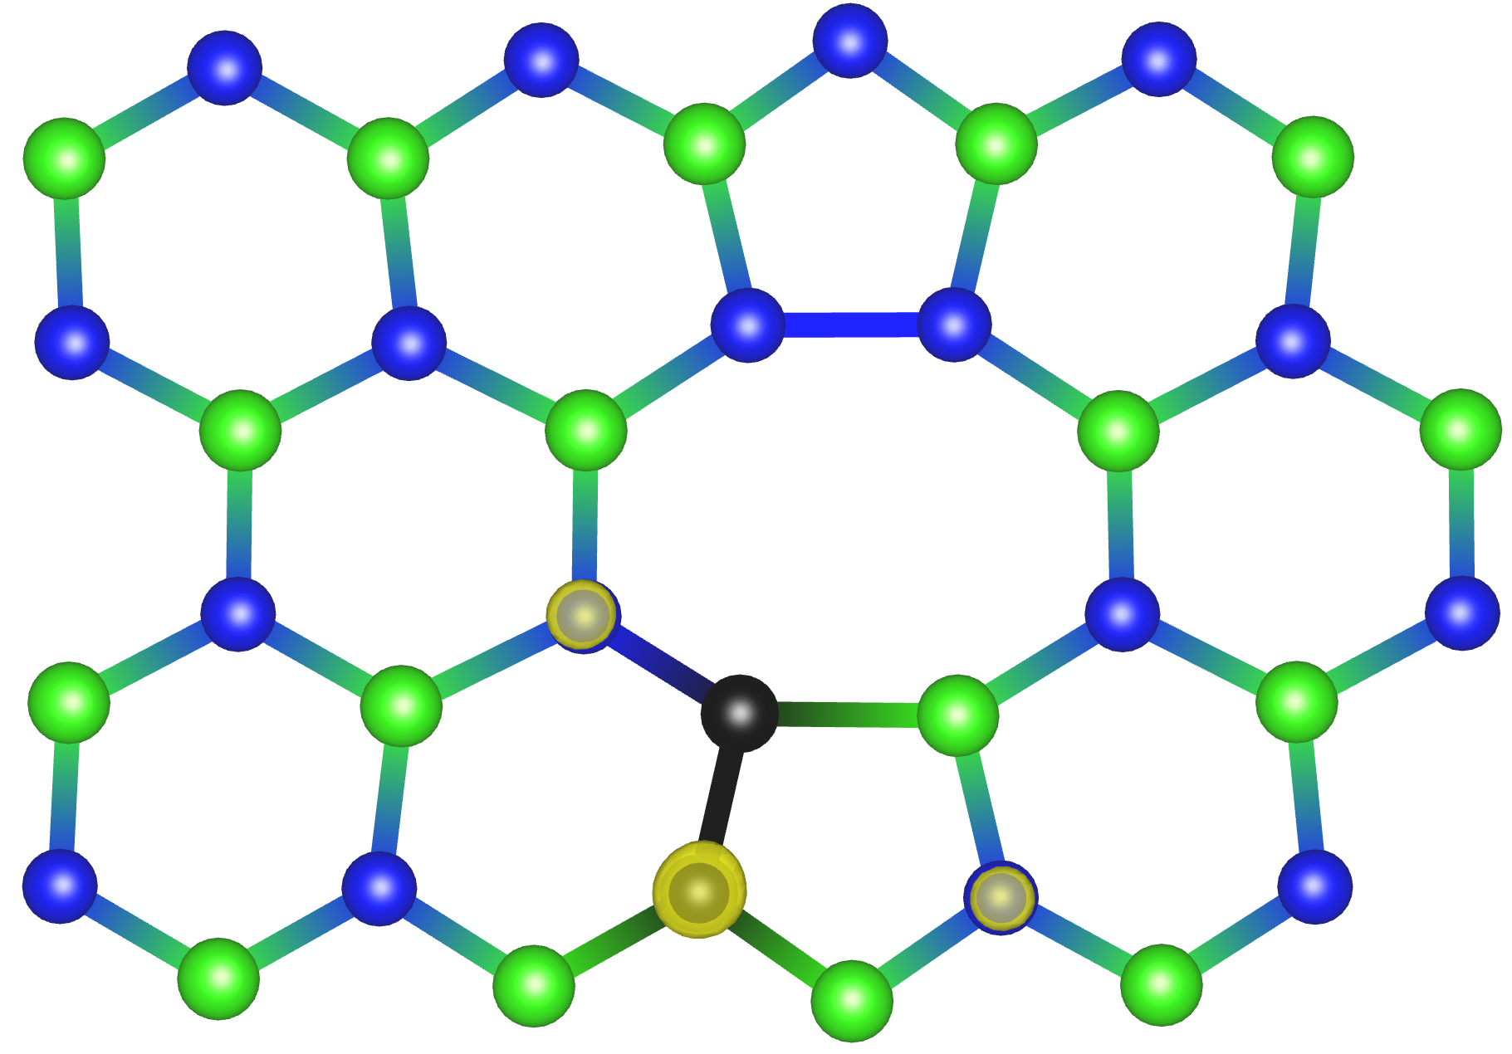
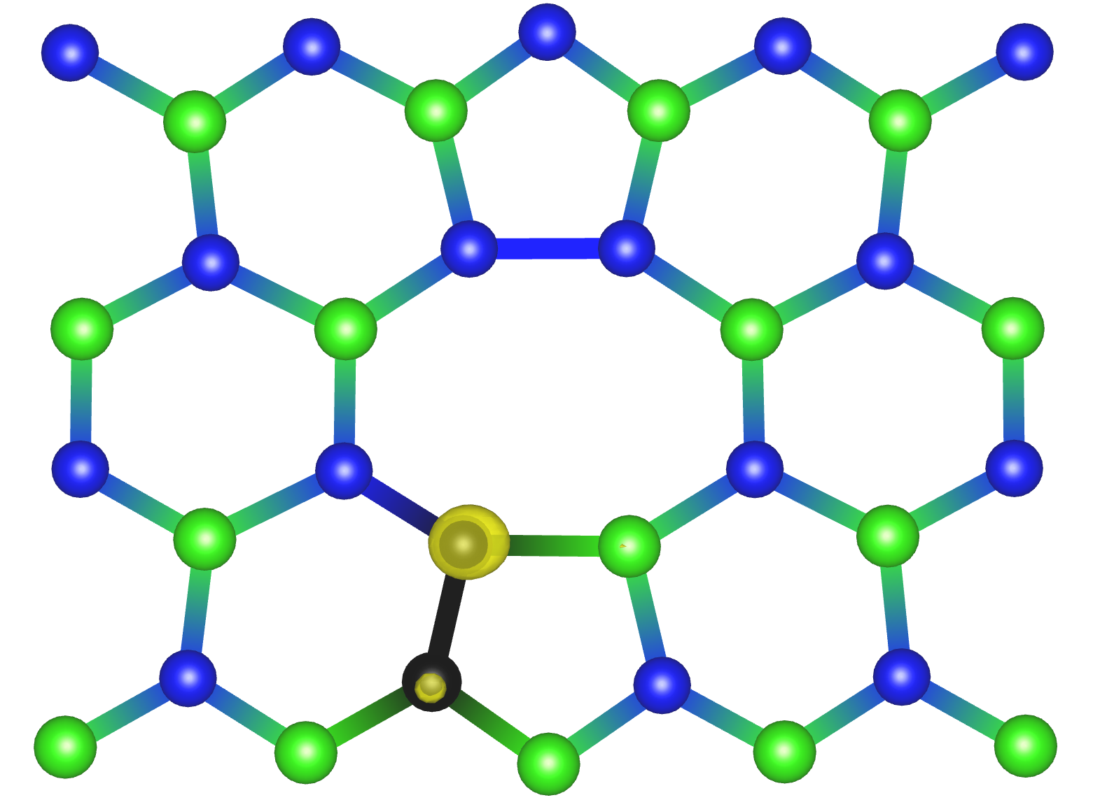
4-5 geometry
$$d_{fc}\text{ =}\text{-4517.193 - -4517.567 = 0.374 }\text{eV}\text{(}\text{PBE}\text{)}$$
$d_{fc}\text{ =}\text{-5420.942} \text{- -5421.360 = 0.417 }\text{eV}\text{(}\text{HSE}\text{)}$
Ground State (PBE)
Excited State (PBE)

Slide 15
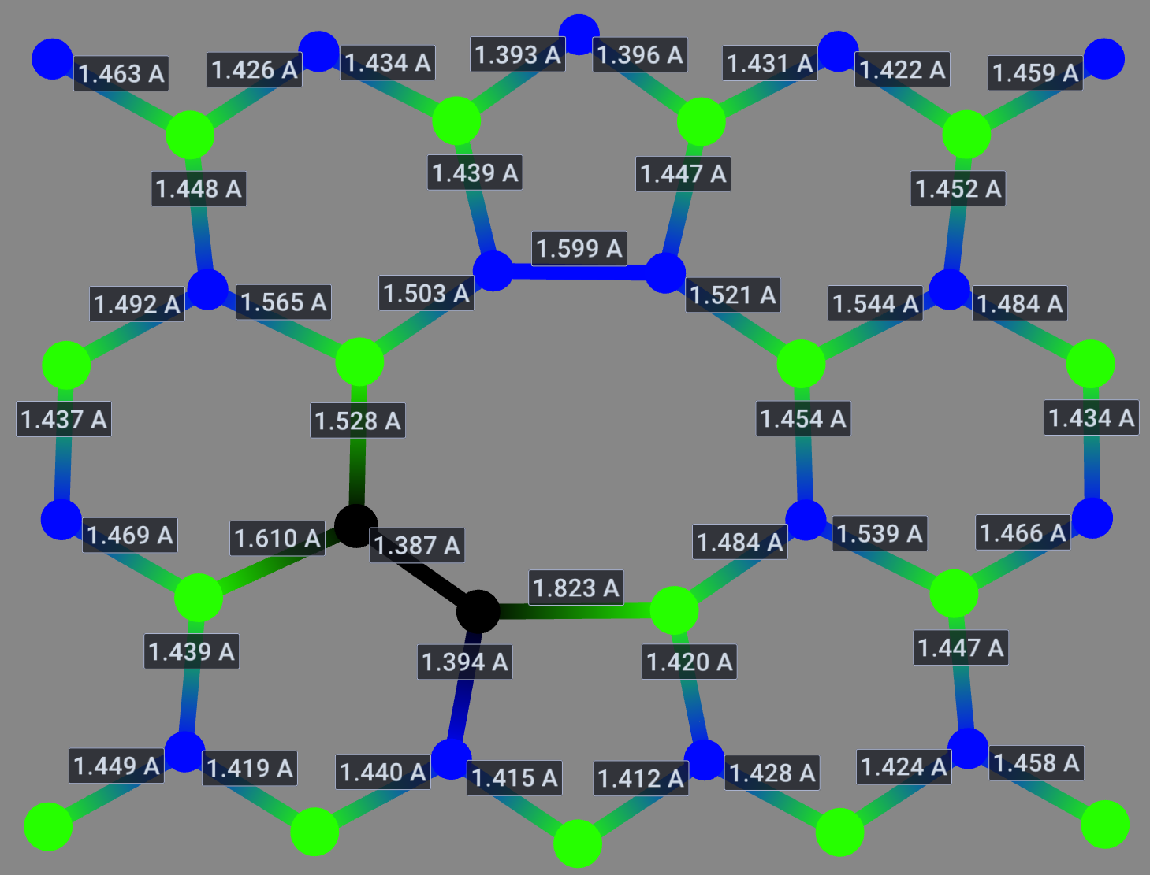
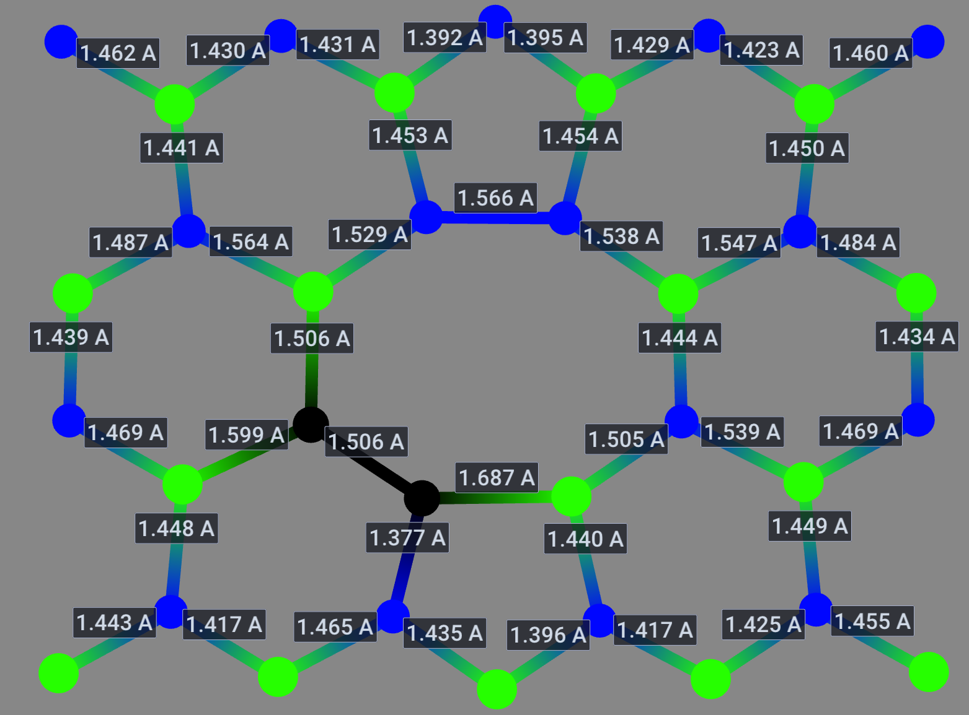
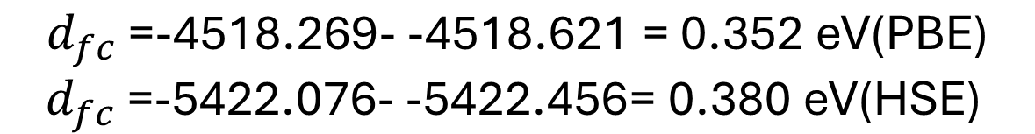
4-6 geometry
$$d_{fc}\text{ =}\text{-4518.269- -4518.621 = 0.352 }\text{eV}\text{(}\text{PBE}\text{)}$$
$d_{fc}\text{ =}\text{-5422.076- -5422.456= 0.380 }\text{eV}\text{(}\text{HSE}\text{)}$
Ground State (HSE)
Excited State (HSE)

Slide 16
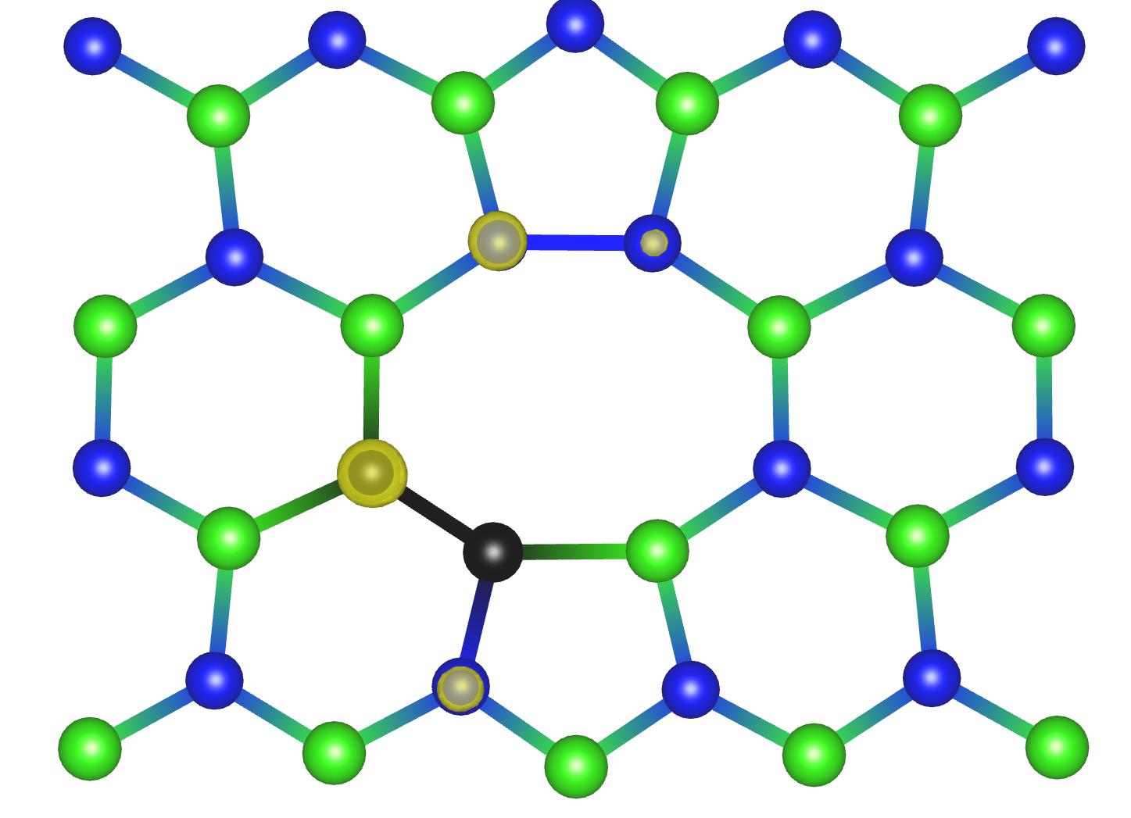
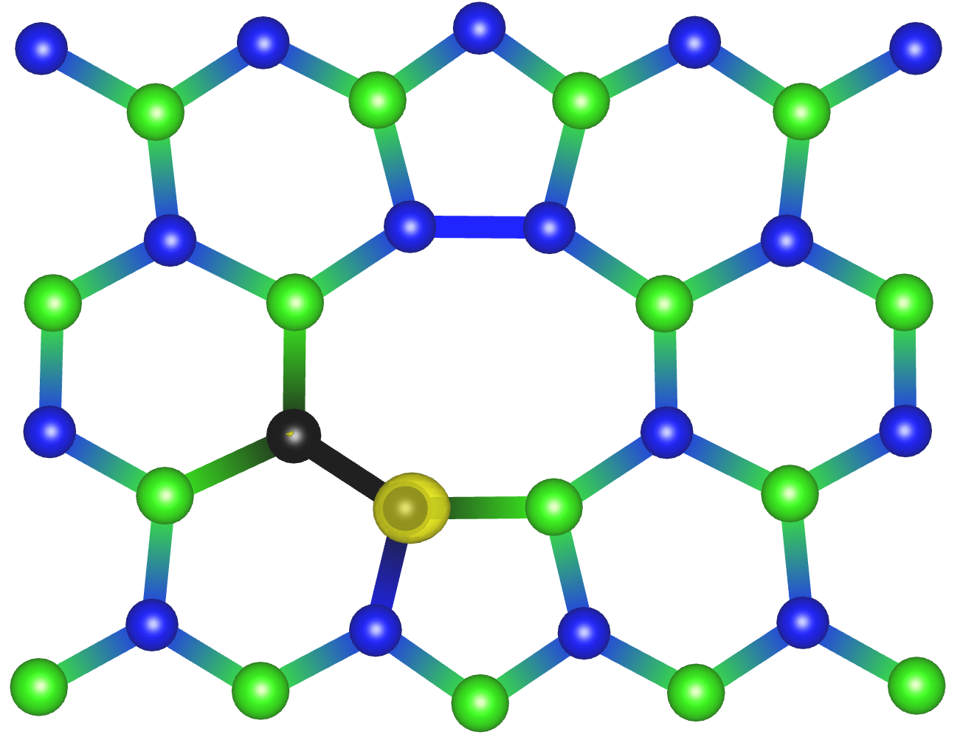
4-6 geometry
$$d_{fc}\text{ =}\text{-4518.269- -4518.621 = 0.352 }\text{eV}\text{(}\text{PBE}\text{)}$$
$d_{fc}\text{ =}\text{-5422.076- -5422.456= 0.380 }\text{eV}\text{(}\text{HSE}\text{)}$
Ground State (PBE)
Excited State (PBE)

Slide 17
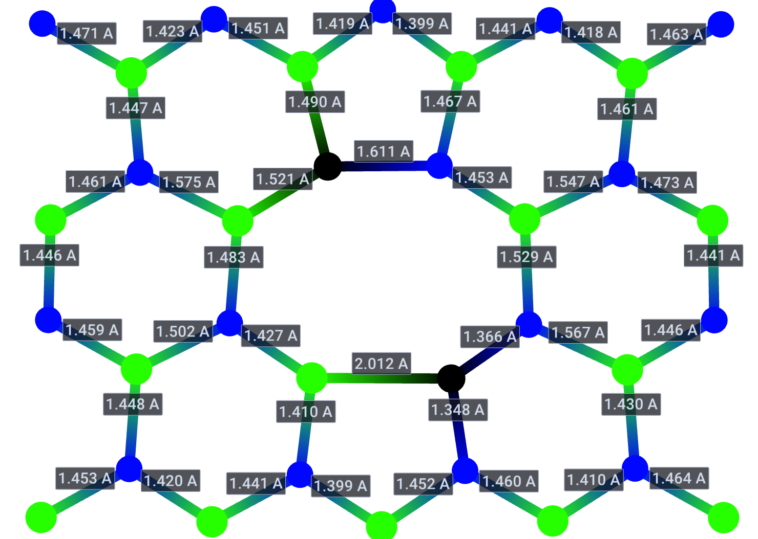
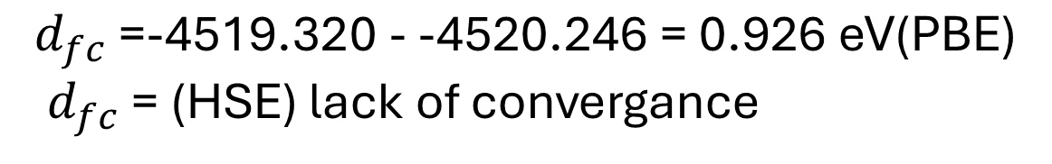
4-9 geometry
$$d_{fc}\text{ =}\text{-4519.320 - -4520.246 = 0.926 }\text{eV}\text{(}\text{PBE}\text{)}$$
$d_{fc}\text{ =} \text{(}\text{HSE}\text{)}$ lack of convergance
Ground State (HSE)
Excited State (HSE)
lack of convergance

Slide 18
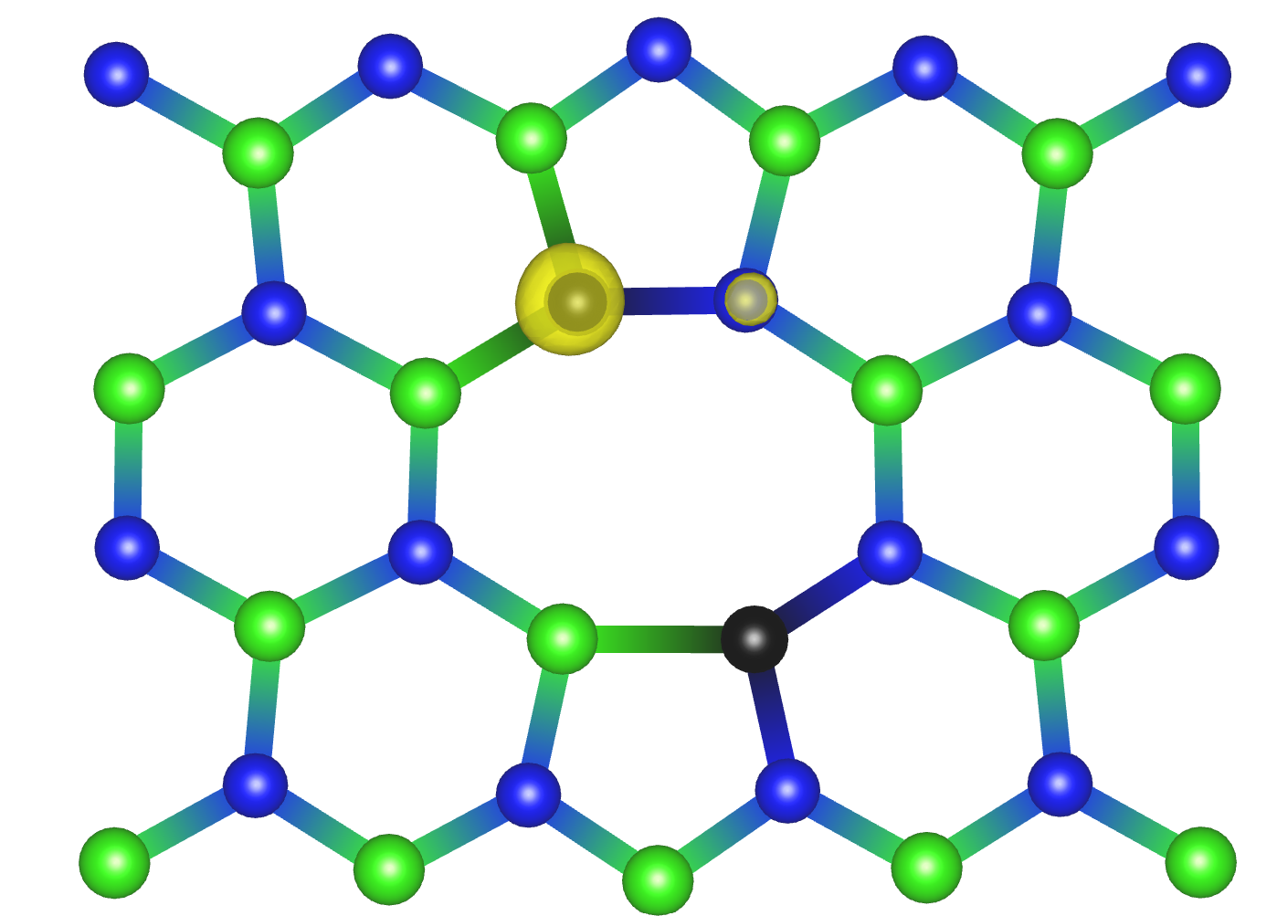
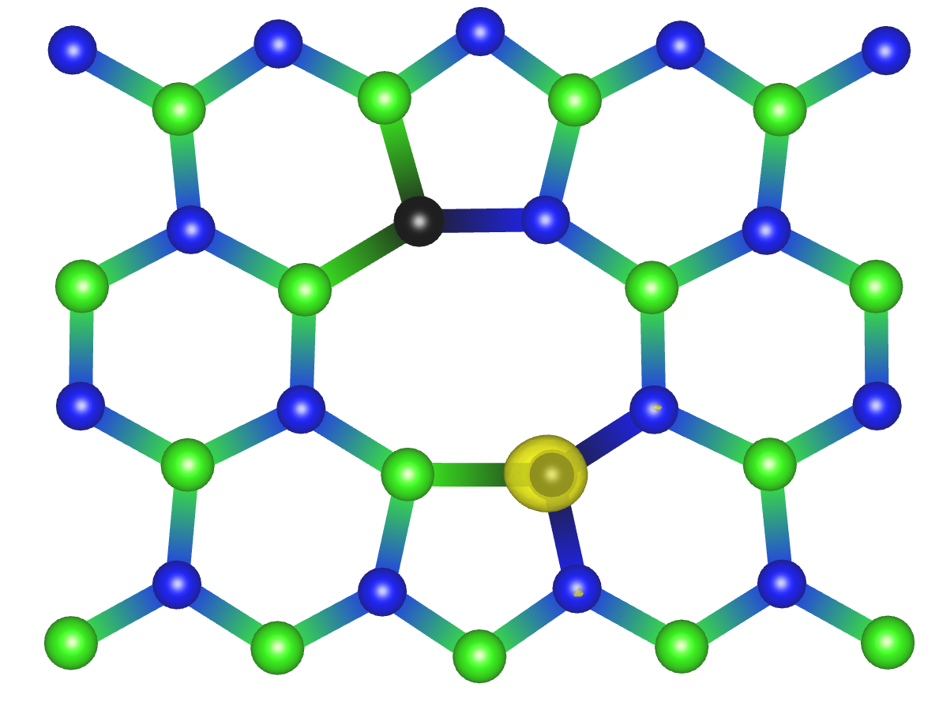
4-9 geometry
$$d_{fc}\text{ =}\text{-4519.320 - -4520.246 = 0.926 }\text{eV}\text{(}\text{PBE}\text{)}$$
$d_{fc}\text{ =} \text{(}\text{HSE}\text{)}$ lack of convergance
Ground State (PBE)
Excited State (PBE)

Slide 19
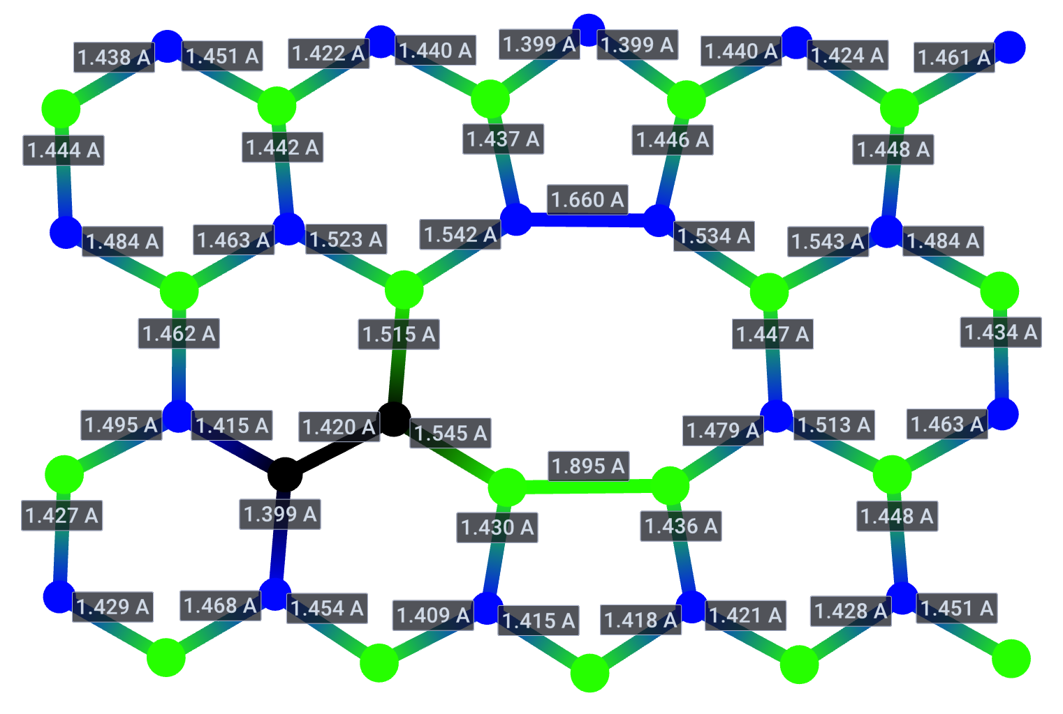
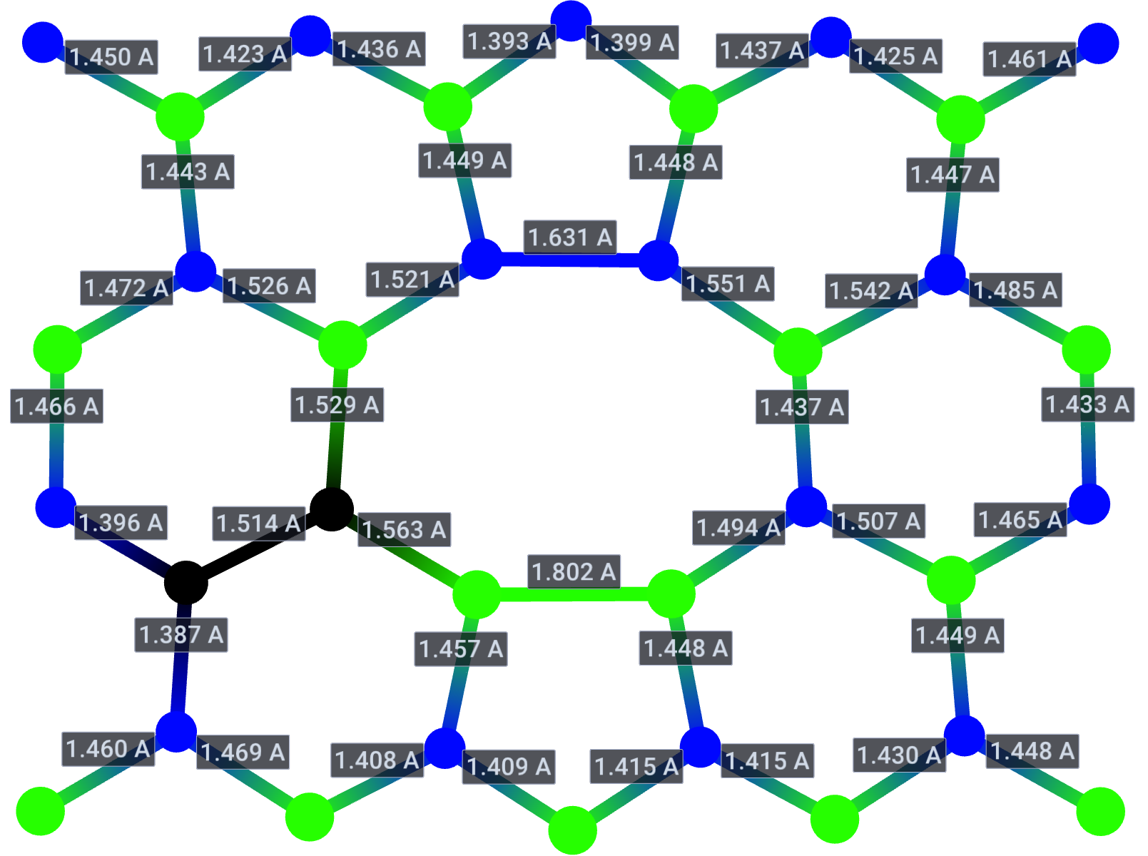
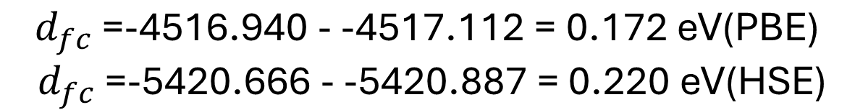
6-7 geometry
$$d_{fc}\text{ =}\text{-4516.940 - -4517.112 = 0.172 }\text{eV}\text{(}\text{PBE}\text{)}$$
$d_{fc}\text{ =}\text{-5420.666 - -5420.887 = 0.220 }\text{eV}\text{(}\text{HSE}\text{)}$
Ground State (HSE)
Excited State (HSE)

Slide 20
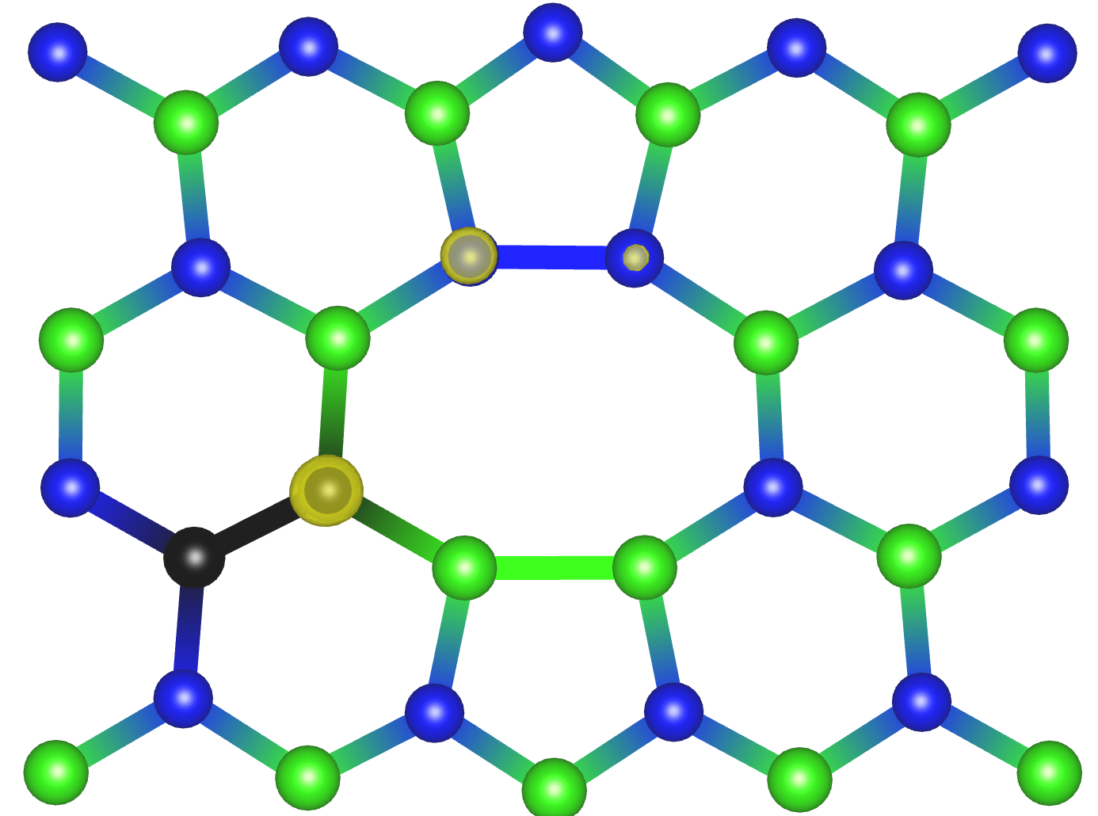
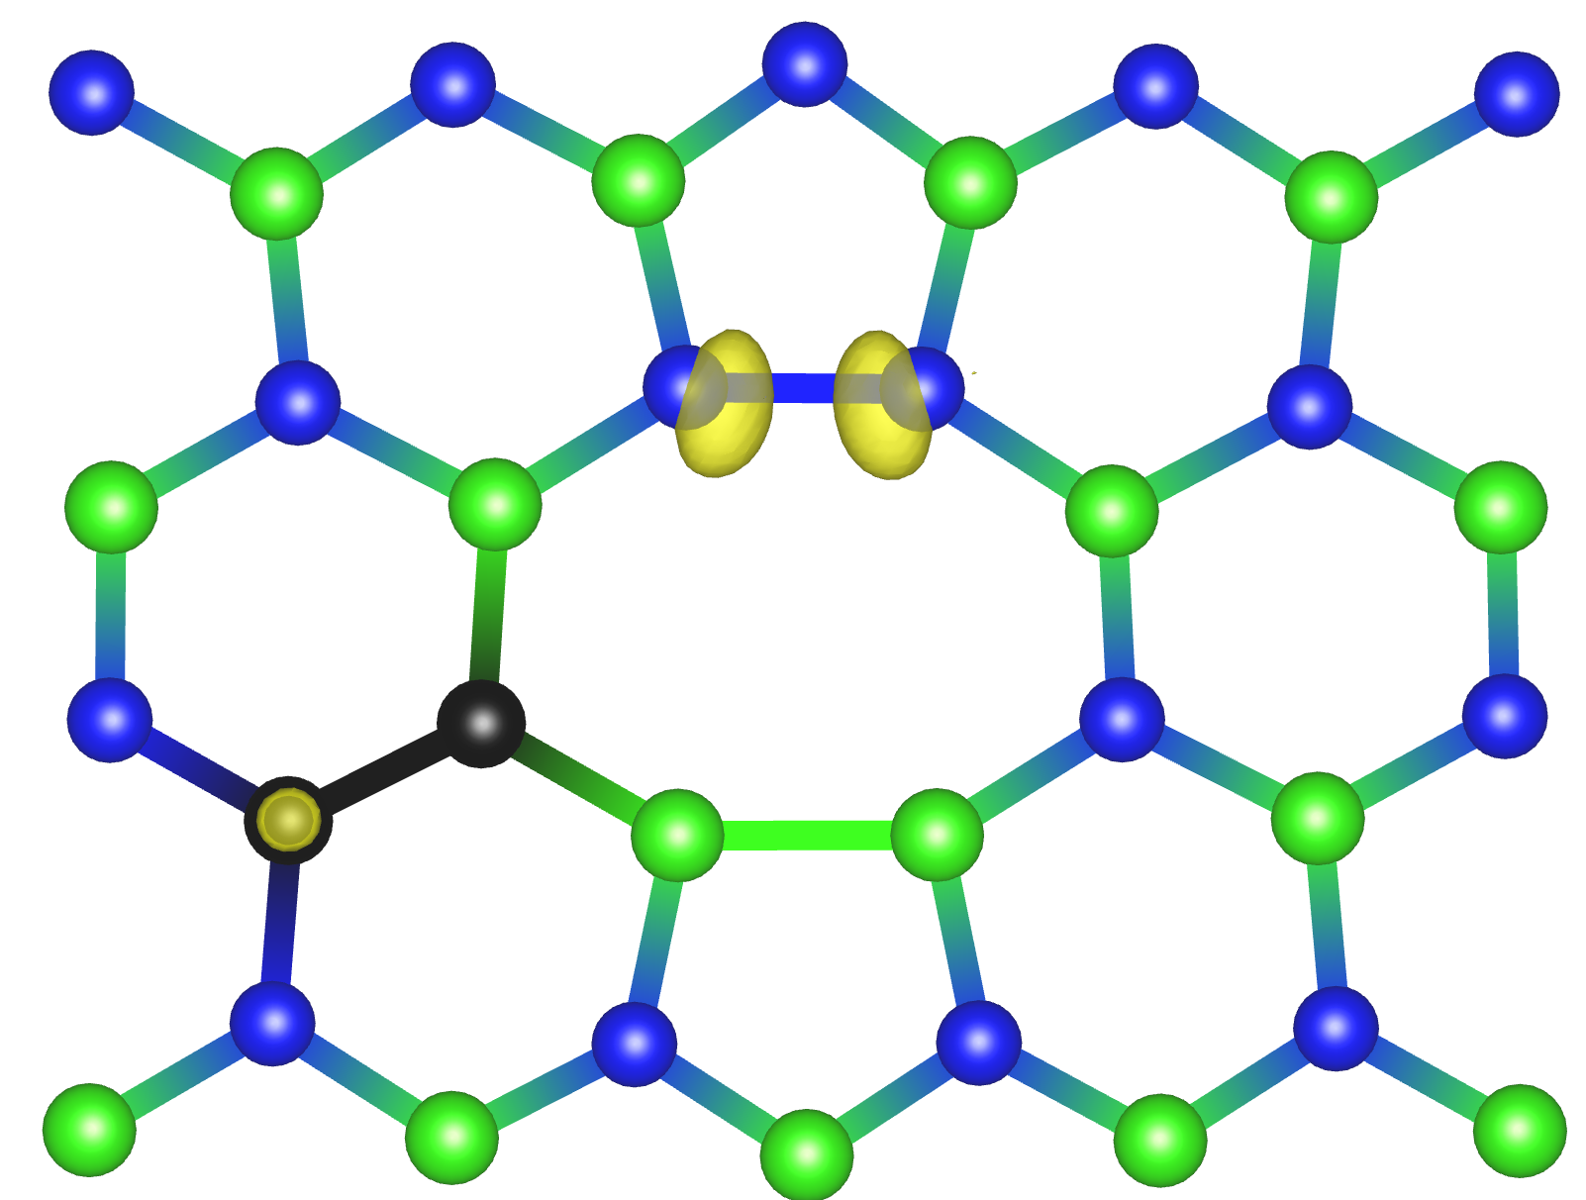
6-7 geometry
$$d_{fc}\text{ =}\text{-4516.940 - -4517.112 = 0.172 }\text{eV}\text{(}\text{PBE}\text{)}$$
$d_{fc}\text{ =}\text{-5420.666 - -5420.887 = 0.220 }\text{eV}\text{(}\text{HSE}\text{)}$
Ground State (PBE)
Excited State (PBE)

Slide 21

To be done
Excited state for $V_{2 }$and orbitals
$$V_{2}$$
Ground state excited geometry
Huang-Rhys factor
optical matrix element
CCD
ZPL
$$C_{B}C_{N}$$
2-3
3-8
4-5
4-6
6-7

Slide 22
To be done
Ground and excited state for 3-9
Ground and excited state for dimer 4-12
Ground and excited state for tetramer 4-6-2-3
Ground and excited state for tetramer 2-3-9-10
Ground and excited state for tetramer 6-4-12-11
Ground and excited state for tetramer 2-3-9-10-11-12-4-9
10
11
12

