Slide 1
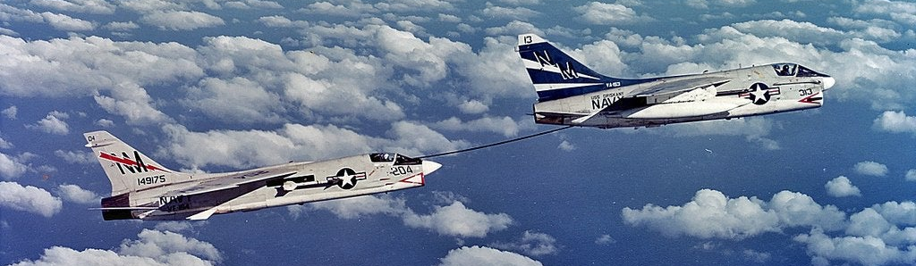







Why Dimensionless? (again)
Dimensional derivatives change with
Trim condition
Size
Dimensionless derivatives stay the same for an aircraft (with fixed CG)!

