Slide 1
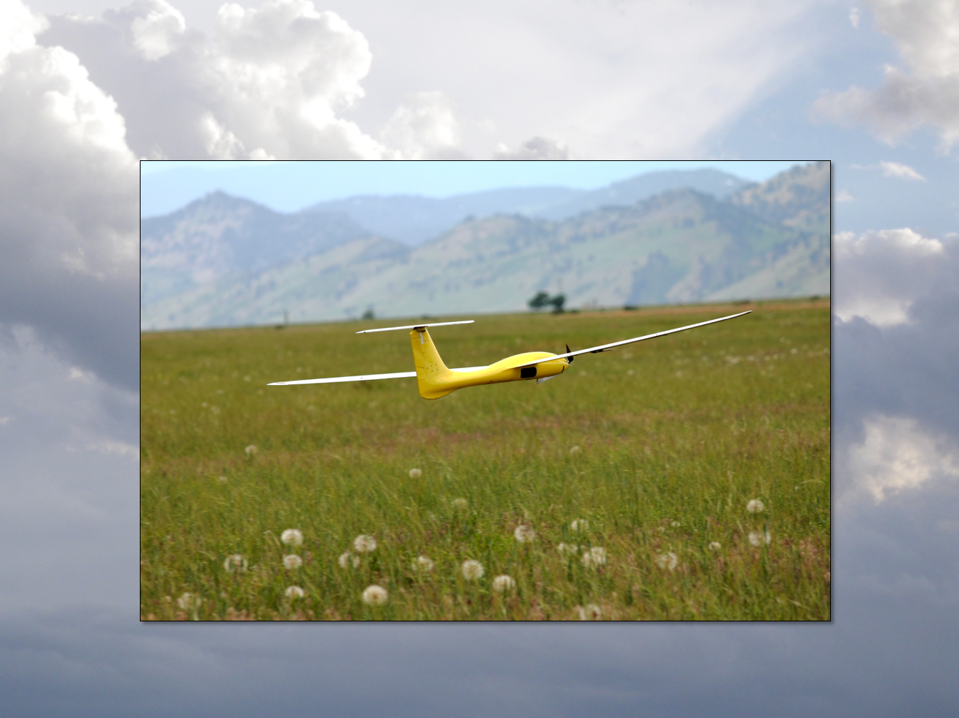
Quadrotor Control
Aircraft Dynamics
UNIVERSITY OF COLORADO BOULDER

Slide 2
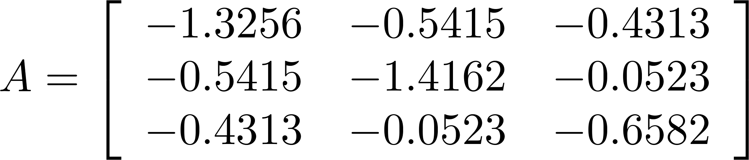
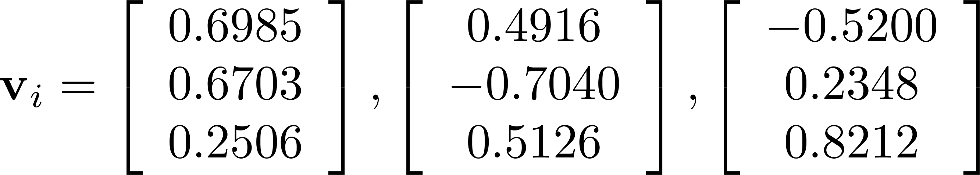
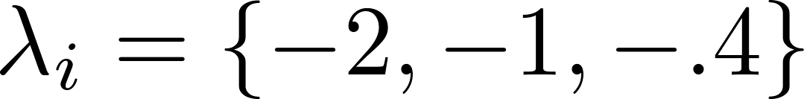
Example
For a state space model the eigenvalues λ_{i} of the matrix A are the poles of the system.

Slide 3
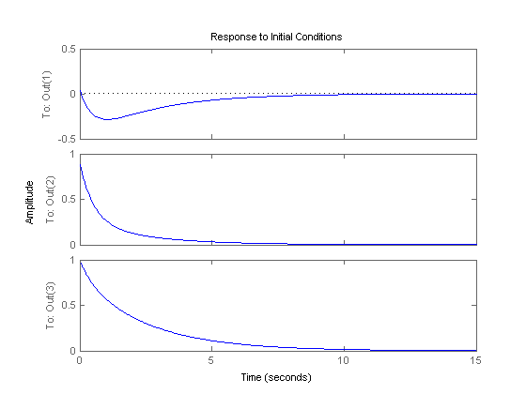
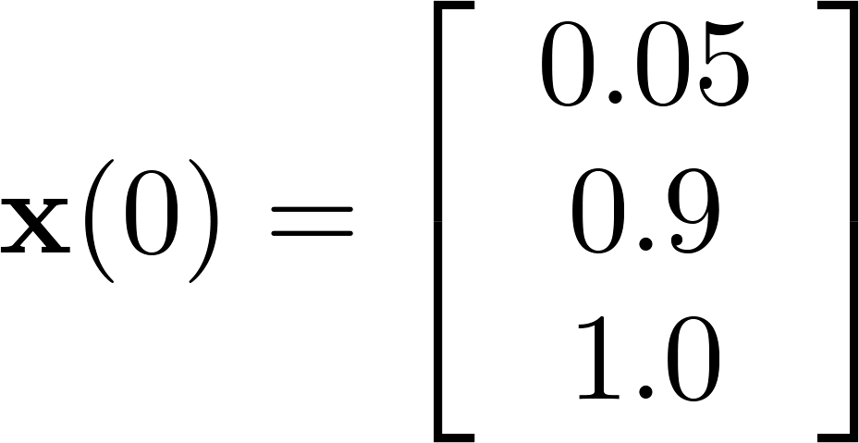
Example
Matlab:
sys = ss(A,eye(3),eye(3),0)
initial(sys,[0.05; 0.9; 1.0],10)

Slide 4
Example
What is happening here if all poles are negative and real (exponential decay)

Slide 5
Example
What is happening here if all poles are negative and real (exponential decay)
+ =

Slide 6
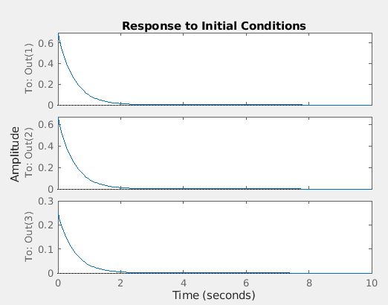
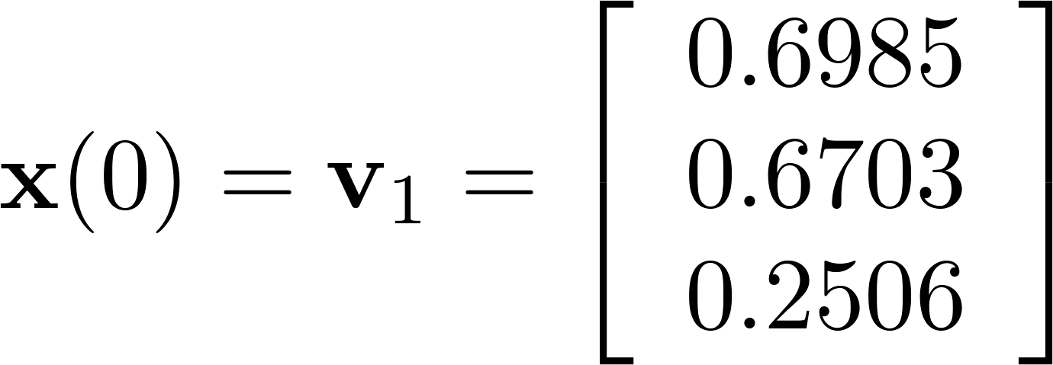
Example

Slide 7
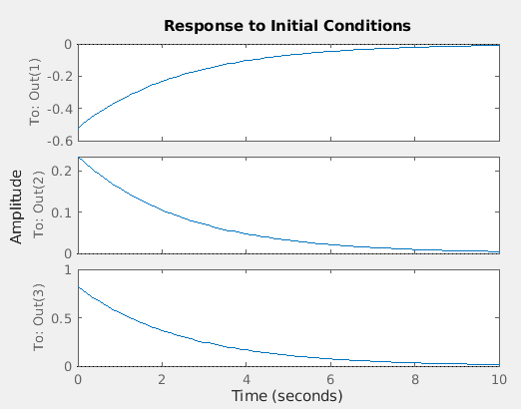
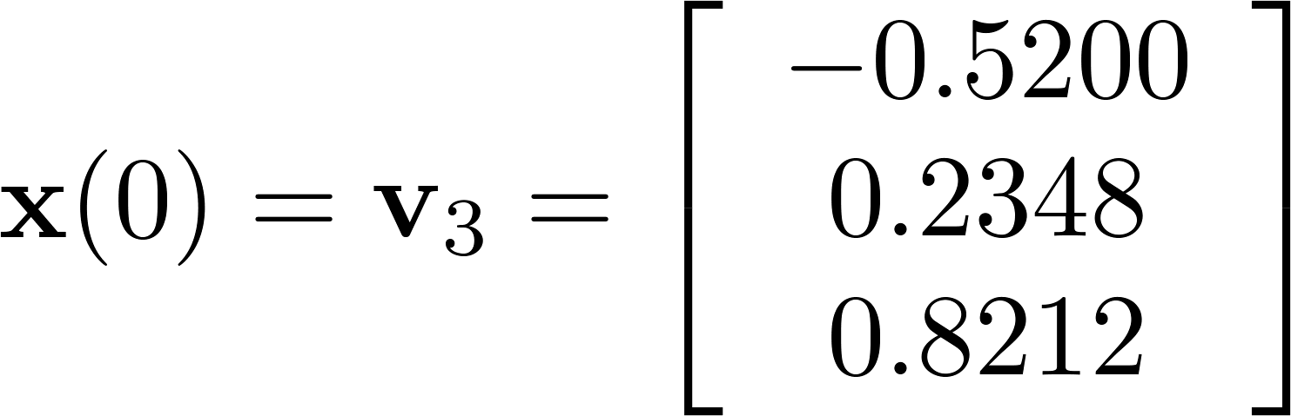
Example

Slide 8
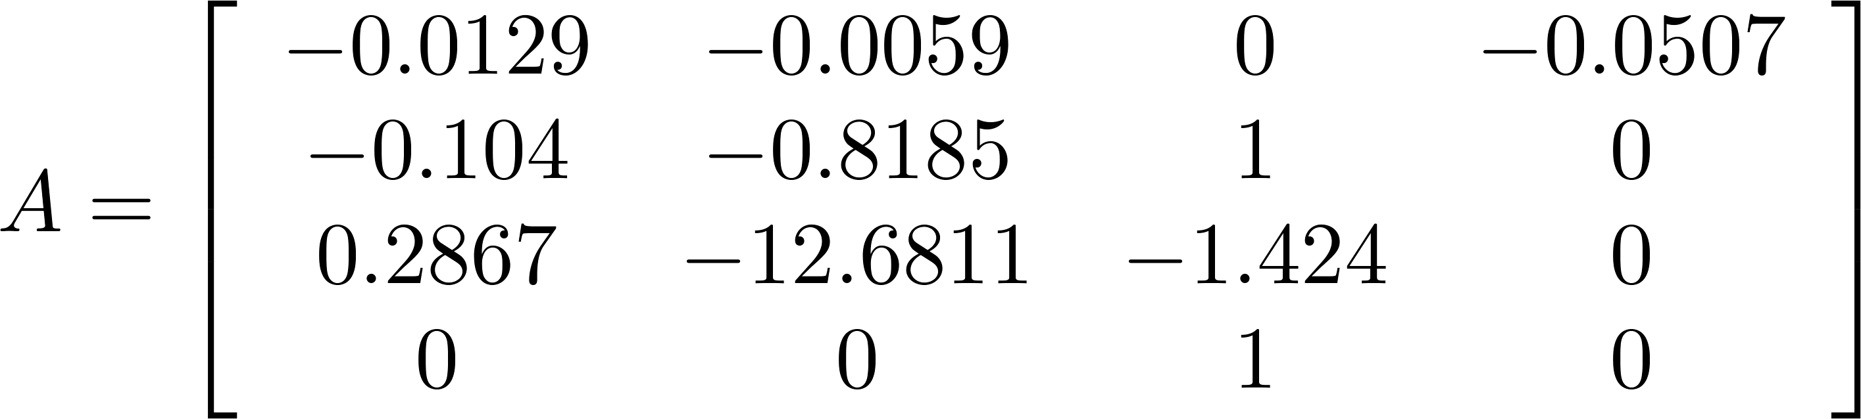
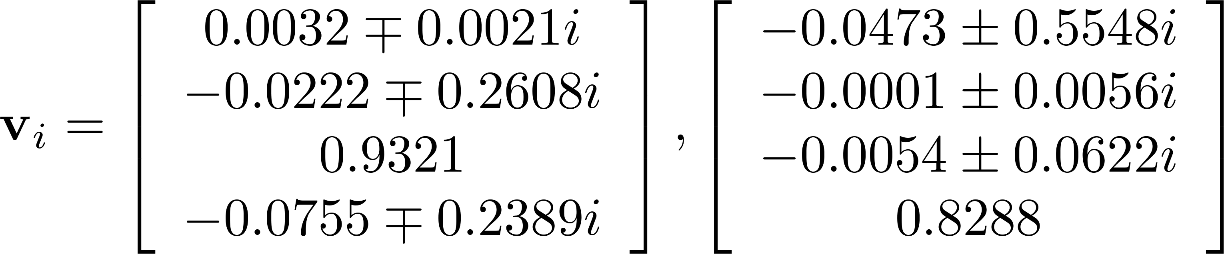
Another Example

Slide 9
Another Example
For a state space model the eigenvalues λ_{i} of the matrix A are the poles of the system, and

Slide 10
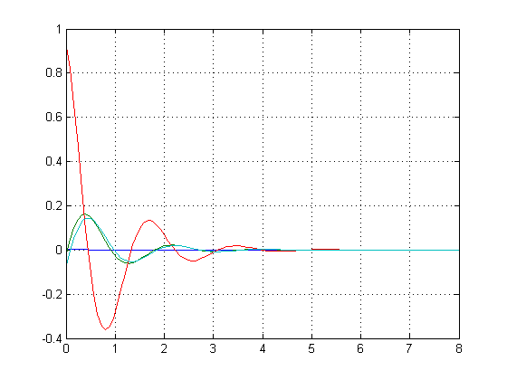
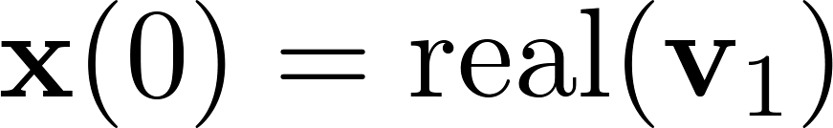
Another Example

Slide 11
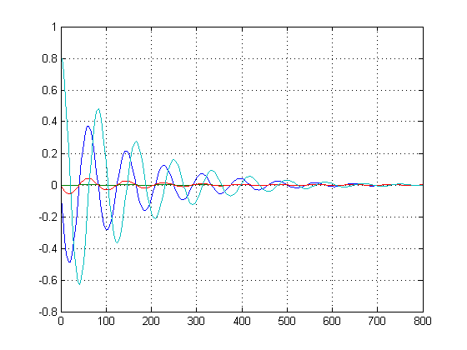
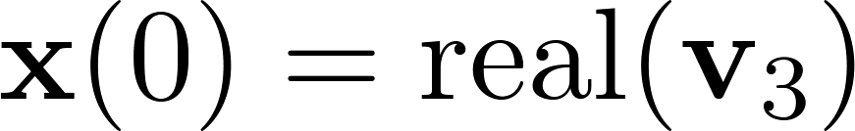
Another Example
Oscillations with (very) different natural frequency and damping ratio, different relative magnitude and phases

Slide 12
Linear Control Design Process
Derive Equations of Motion
Linearize and Separate Equations
Design Control Architecture
Choose Gain Values
Test in Linear Simulation
Test in Nonlinear Simulation
P(I)D Tuning
Pole Assignment
Root Locus
Optimal Control (LQR)

Slide 13
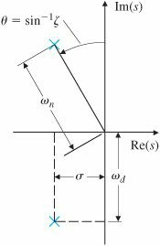
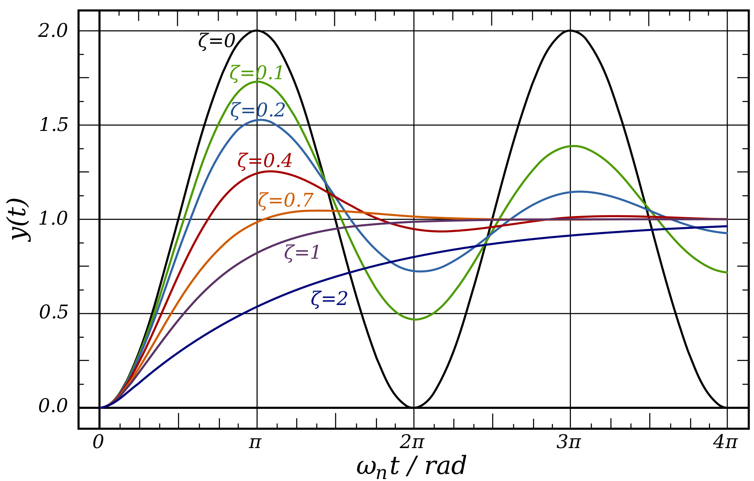
Pole Locations

Slide 14
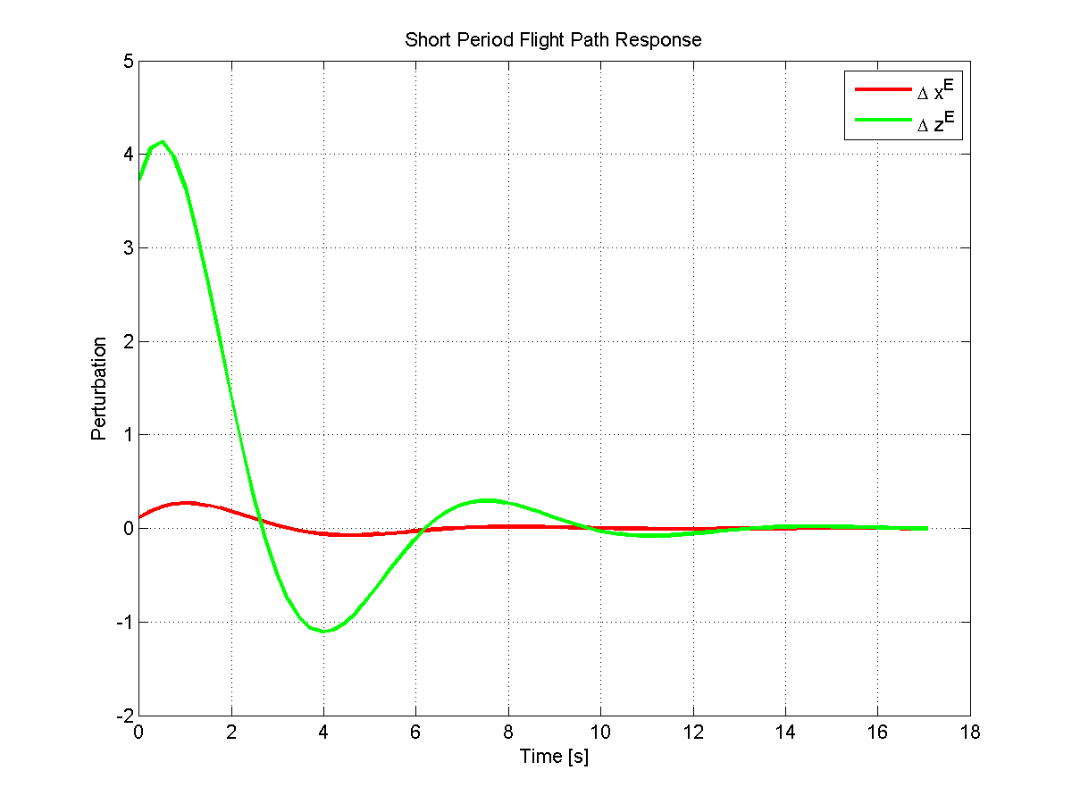
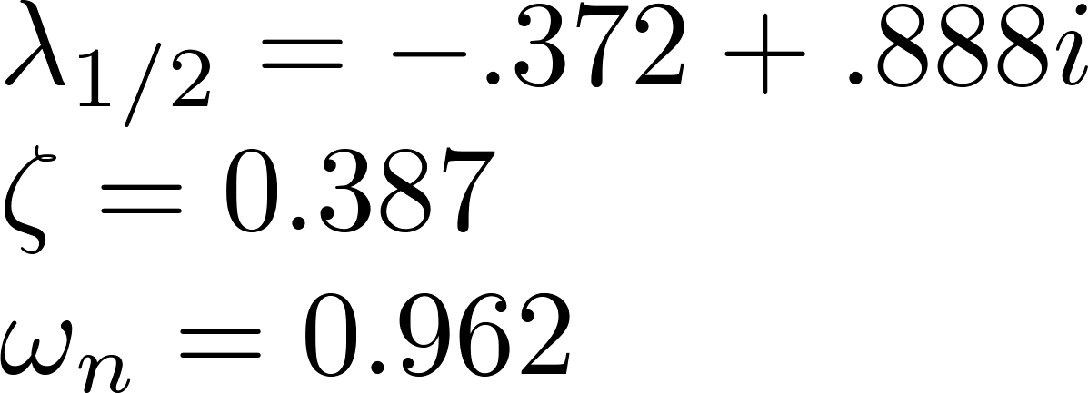
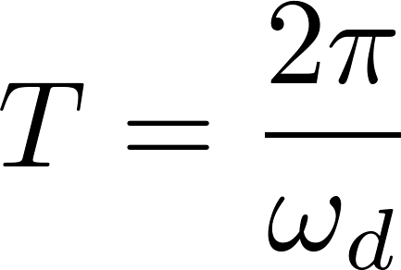
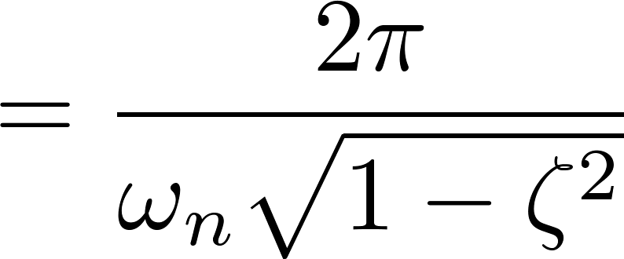
Oscillatory Response

Slide 15
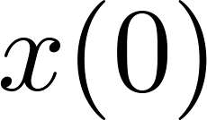
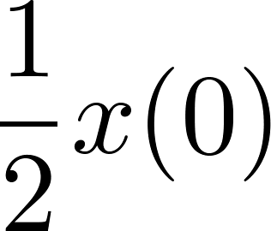
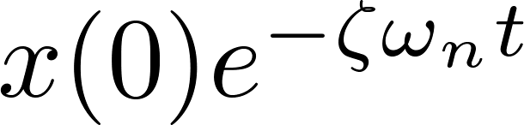
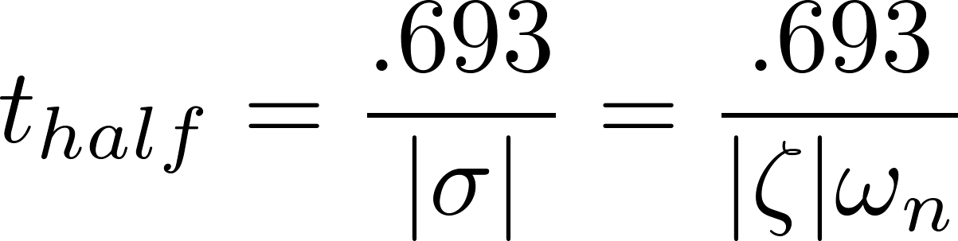
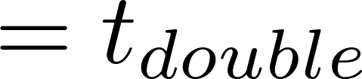
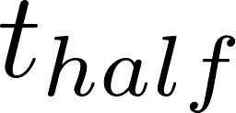
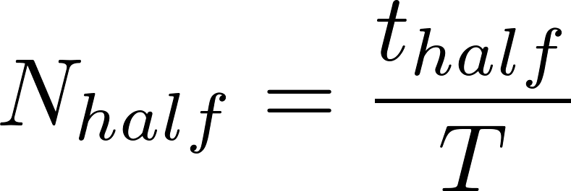
Oscillatory Response

Slide 16
Linear Systems Review
There is a set of supplementary notes on the course Canvas page titled “ASEN3128_Fall22_supplement_LinearSystemResponseReview”

