Slide 1
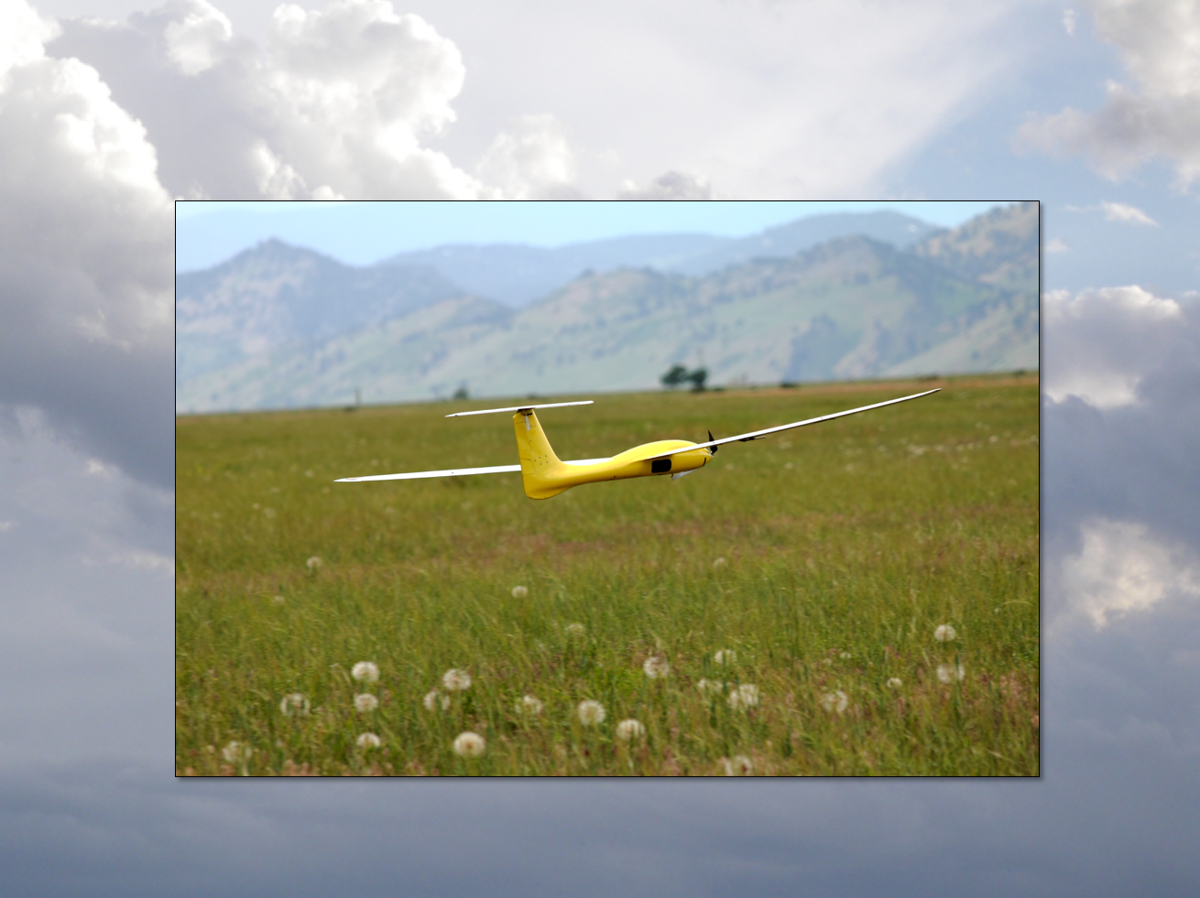
Longitudinal Forces and Moments
Aircraft Dynamics
UNIVERSITY OF COLORADO BOULDER

Slide 2
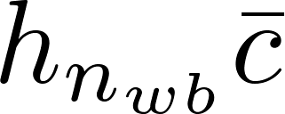


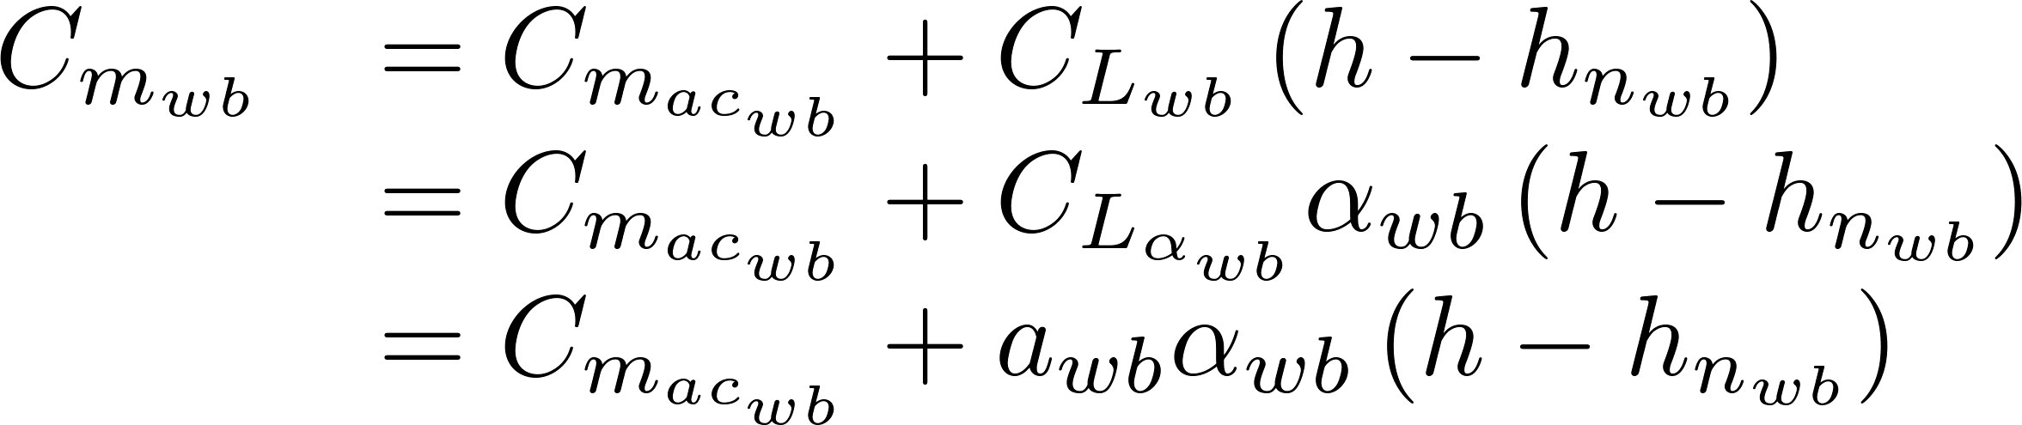
Wing / Body / Nacelle
L_{wb}
M_{acwb}
D_{wb}
C.G.
z
α_{wb}
relative wind
Non-dimensionalize and ignore several terms

Slide 3


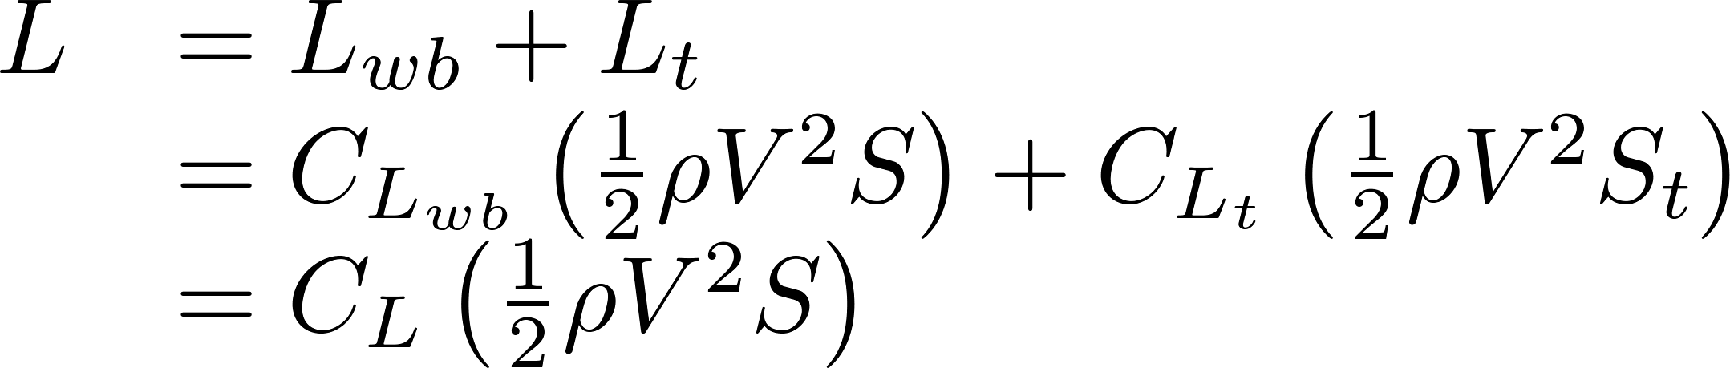
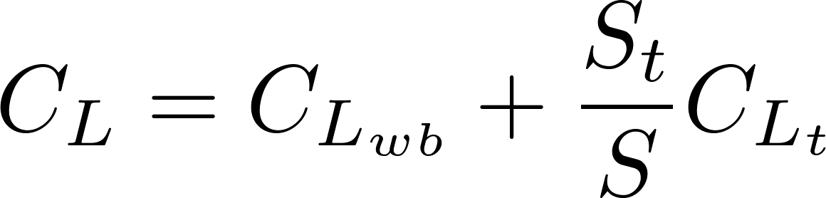
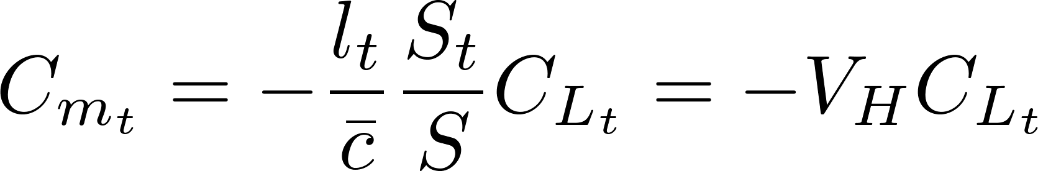
Tail
D_{t}
(See Etkin Fig. 2.11)
L_{t}
C.G.
M_{act}
α_{wb}
relative wind

Slide 4
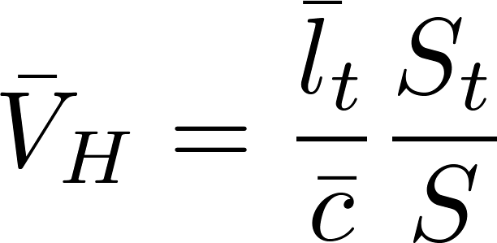
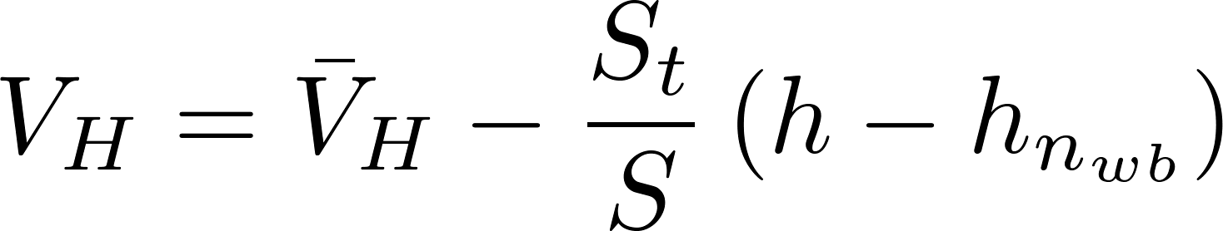
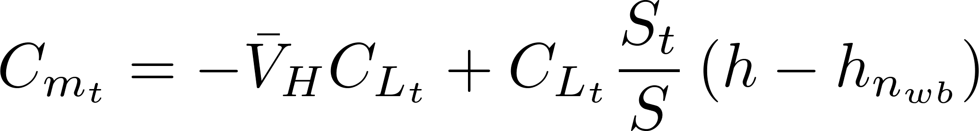
Tail
D_{t}
(See Etkin Fig. 2.11)
L_{t}
C.G.
M_{act}
α_{wb}
relative wind
CG can change during flight so more convenient to label relative to wing-body mean aerodynamic center

Slide 5
Total Pitch Moment
wing-body
tail
engine

Slide 6
Neutral Point
For stability we need an increase in angle of attack to cause a negative moment
Need negative C_{mα}
Center of gravity location that gives C_{mα} = 0 is called the “neutral point” h_{n}

Slide 7
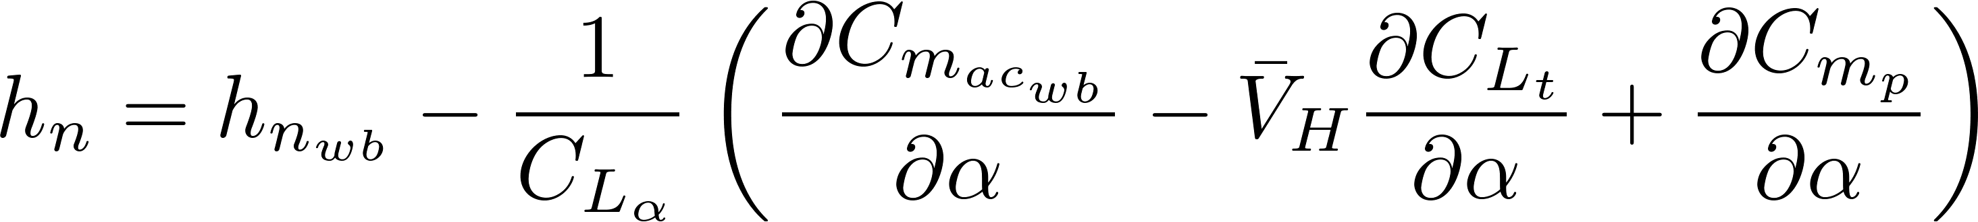
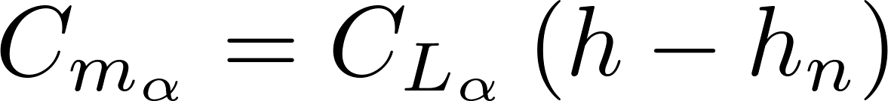
Neutral Point
For stability we need an increase in angle of attack to cause a negative moment
Need negative C_{mα}
Center of gravity location that gives C_{mα} = 0 is called the “neutral point” h_{n}

Slide 8

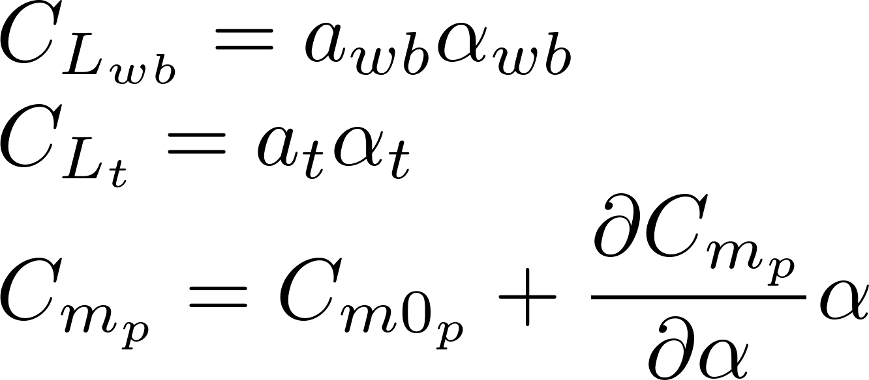
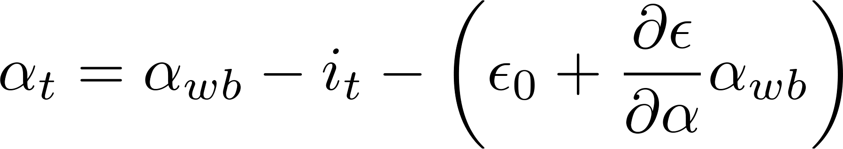
Linear Lift
D_{t}
(See Etkin Fig. 2.11)
L_{t}
C.G.
M_{act}
α_{wb}
α_{t}
relative wind
relative wind

Slide 9
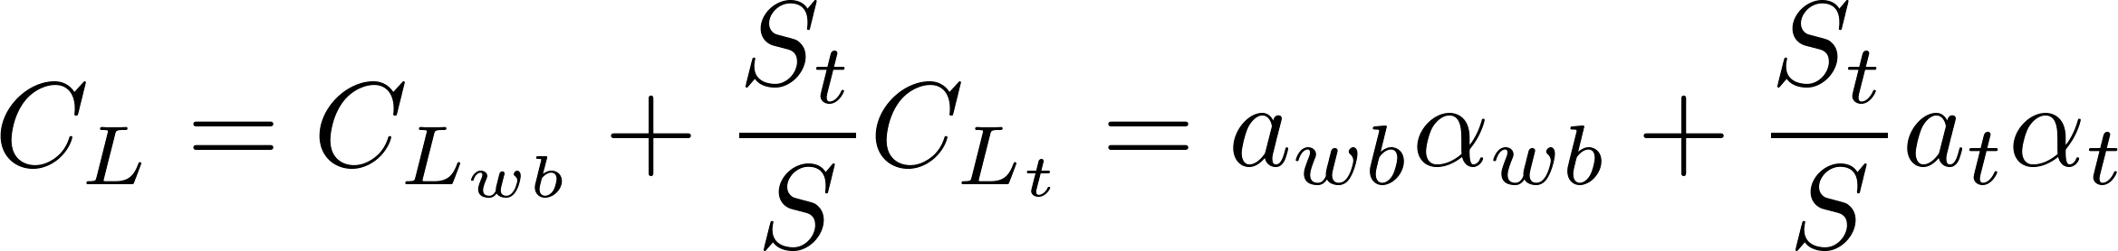
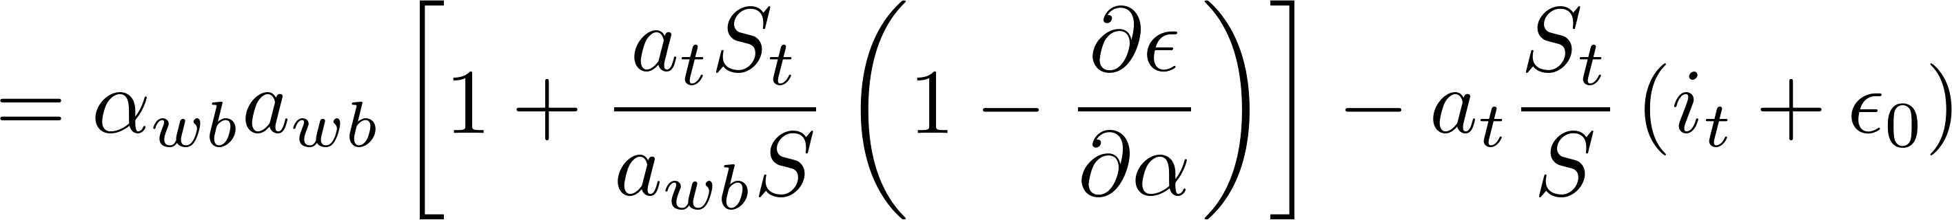
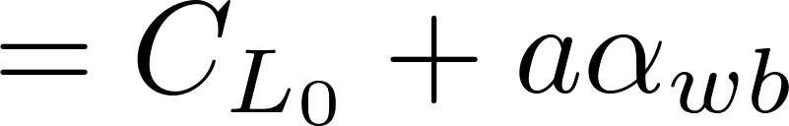
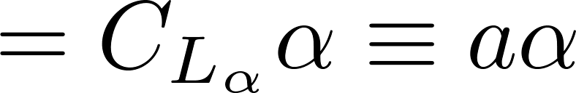
Linear Lift
Defines body coordinate system so zero angle of attack creates no lift
Angle of attack α_{wb} of wing and angle of attack α_{t} of tail differ from angle of attack α by constant offsets

Slide 10
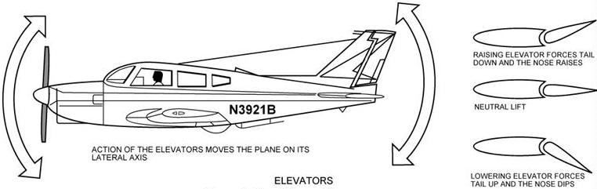
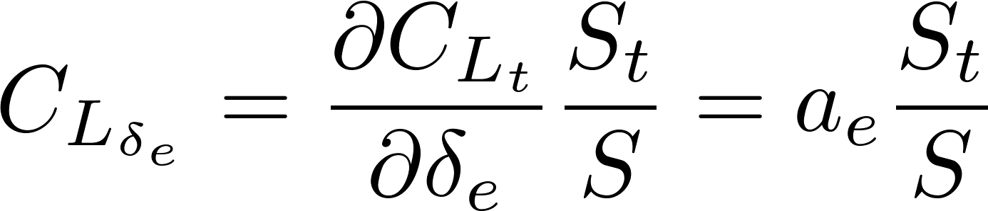
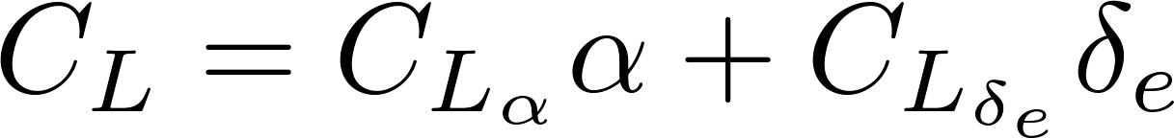
Longitudinal Control (Elevator)
http://avstop.com/ac/1-14.html
ΔL_{t}
ΔD_{t}
ΔΜ_{t}

Slide 11
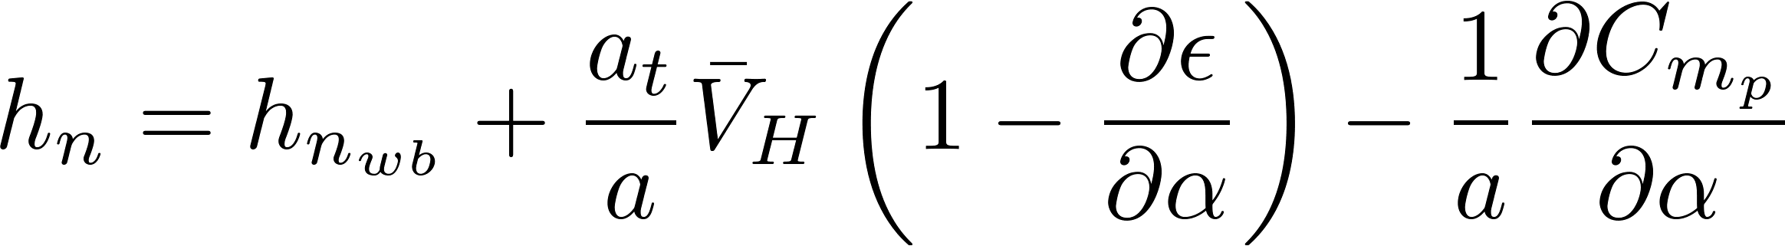
Summary
Direct dependence on CG location h

