Slide 1
CSE 219 Computer science III
Software Development lifecycle

Slide 2
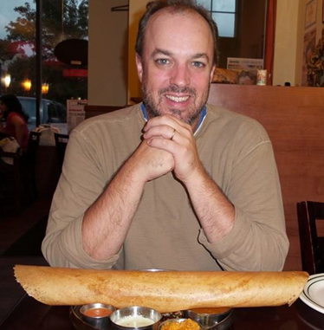
Who am i?
Richard McKenna
richard@cs.stonybrook.edu
CS Room 1436
M 11:30am – 12:30pm
Tu 1pm – 2pm
Th 1pm – 2pm
11:30am – 12:30pm
http://www.cs.stonybrook.edu/~richard

Slide 3
Course homepages
http://www.cs.stonybrook.edu/~cse219
Syllabus
schedule (lecture slides, hw, etc …)
etc.
http://blackboard.stonybrook.edu
grades

Slide 4
Course description
Development of the basic concepts and techniques from Computer Science I and II into practical programming skills that include a systematic approach to program design, coding, testing, and debugging. Application of these skills to the construction of robust programs of 1000-2000 lines of source code. Use of programming environments and tools to aid in the software development process.
NOTE: You must have taken CSE 214 and received a grade of "C" or better in order to take this course

Slide 5
Course topics
Project Technologies Basics
GUIs & Event Programming
2D Graphics
Software Design (UML)
Design Patterns
Programming style
Algorithms and data structure selection
Code maintenance & documentation

Slide 6
Course topics (continued)
Effectively using an IDE & associated tools for:
Designing
Code editing
Testing
Debugging
Revision control
Profiling
Documentation
Deployment

Slide 7

Textbook #1
Head First Object Oriented Design and Analysis (on-line version)
by Brett McLaughlin, Gary Pollice, David West
Published by O'Reilly Media, Inc. 2006
Print ISBN-10: 0-596-00867-8
Print ISBN-13: 978-0-596-00867-3

Slide 8
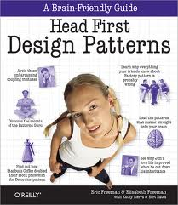
Textbook #2
Head First Design Patterns (on-line version)
by Eric T Freeman, Elisabeth Robson, Bert Bates, Kathy Sierra
Published by O'Reilly Media, Inc. 2004
Print ISBN-10: 0-596-00712-4
Print ISBN-13: 978-0-596-00712-6

Slide 9

On-Line texbooks
Via our Library
http://sbufind.library.stonybrook.edu/vufind/

Slide 10

Course ide
Download
http://netbeans.org/downloads/index.html
HW 1:
NetBeans Tutorials
Build Process/Version Control
Contract

Slide 11
Lab facilities
CS Windows Lab
http://www.cs.stonybrook.edu/facilities/windowslab
CS 2114, CS 2120, CS 2126, & CS 2129
all registered students have accounts
Room combo: 2-7-6-8-4

Slide 12
How are grades computed?
Final Exam 25 %
Midterm Exam 25%
6 Homework Assignments 30 % (5 % each)
Final Project 20 %
100 %
Note CEAS Policy: The Pass/No Credit (P/NC) option is not available for this course.

Slide 13
Academic dishonesty
All work you submit for homework, projects, or exams MUST be your own work.
If you cheat or aid someone in cheating, you will automatically fail this course and be brought up on charges of academic dishonesty without warning.
PLEASE UNDERSTAND THESE RULES

Slide 14
THE MYSTERY OF THE DISAPPEARING STUDENT
Why would a student not take an exam, but remain registered for a course?
Why would a student not do any programming assignments, but remain registered for a course?

Slide 15
ADVICE FOR THE SEMESTER
3 ½ months is not a long time
Points are more difficult to makeup later in the semester
Have the same sense of urgency for the 1st assignment as you would for the last
NO EXTRA CREDIT

Slide 16
SO WHAT IS THIS COURSE REALLY ABOUT?
Short Answer:
OOP mastery
No more toys
Plan, then do (design, then code)
Student to Pro

Slide 17
The long answer
Learn methodologies for building high quality software systems
What properties make a software system high quality?
correctness
efficiency
ease of use
reliability/robustness
maintainability
modifiability
extensibility
scalability

Slide 18
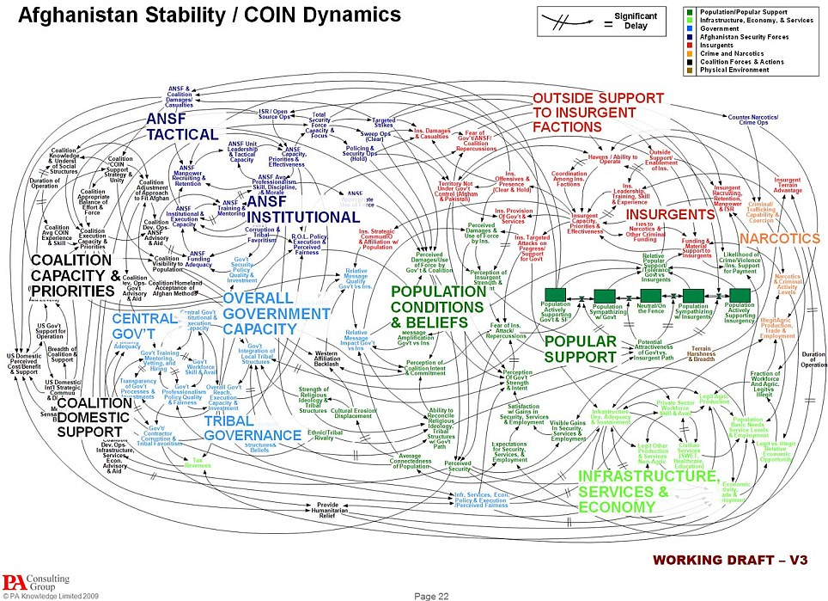
klocs
As programs get larger, these goals become much more difficult to achieve. Why?
program complexity
team complexity
Notes:
Ref: http://i.dailymail.co.uk/i/pix/2010/04/28/article-0-09562375000005DC-283_964x699.jpg

Slide 19
How can these properties be achieved?
By using well proven, established processes preferably while taking advantage of good tools
Bottom Line:
don’t be a flying by the seat of your pants software engineer
Requirements Analysis
Design & Document
Evaluate Design
Code
Test
Deploy
Profile
Debug

Slide 20
Other steps to consider
Integration
Maintenance

Slide 21
integration
Done in large projects
Combine developed software into a cohesive unit
A
B
C
D
E
ABCDE

Slide 22

Software maintenance
Follows Deployment
Monitoring and Updating deployed software
Notes:
Ref: http://img.timeinc.net/time/daily/2009/0903/3mile_island_0326.jpg

Slide 23
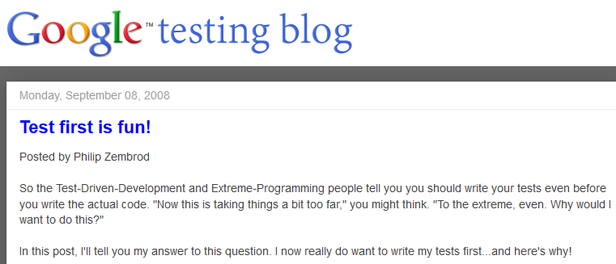


Updated software development lifecycle
Waterfall Model
many variations
Requirements Analysis
Design
Evaluate Design
Code
Test, Debug, & Profile Components
Integrate
Test, Debug, & Profile Whole
Deploy
Maintain

Slide 24
Software jobs
Not all of you are going to be programmers
but you should know how to design, program, test, debug software
Other types of jobs:
Designer
Tester
Database, Network, Security Administrator
Project Leader
Manager
Founder/CEO
Professor
etc …
NOTE: designers & programmers on a project may not be the same people

Slide 25
Design, then code
We will design all classes before coding
not easy to do
UML is used for software design
You cannot design a system unless you really understand the necessary technology
designs cannot be created without a little testing
trying out different small-scale examples (HWs 2 & 3)

Slide 26
The HW Plan
HW 1 – Build Process
HW 2 – Technology Ramp-Up – GUIs, Events & XML
HW 3 – Technology Ramp-Up – 2D Graphics & Threads
HW 4 - UML Design
HW 5 – Implementation Stage #1
HW 6 – Implementation Stage #2
Final Project – Completed Work

Slide 27

What is a framework?
Groups of classes that form the basis for customization cooperating classes for a particular technology
ex: games, the Web, databases, etc.
used to build new applications & other frameworks
What framework will we use for GUI development?

Slide 28
Applications using frameworks
How can this happen?
Framework
App calls methods in Framework
App calls methods in Framework
Framework calls methods in Apps?
Application #1
Application #2

Slide 29





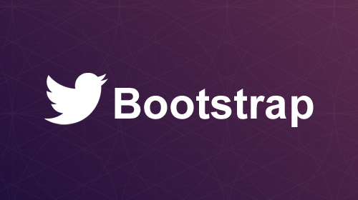
Lots and lots and lots of frameworks

Slide 30
Framework documentation
Frameworks are many classes working together
Framework developers must explain how to use them
API
Commenting
Tutorials
Frameworks can be open source, free, proprietary

Slide 31
Who cares?
We are constantly using Java frameworks
Think about how you might create a framework
Learning how and why to make frameworks will make you a powerful developer

Slide 32

Your project?

