Slide 1
CSE 219 Computer science III
Designing with exceptions

Slide 2
Testing vs. Debugging
Testing
Does the code work properly
YES
Coding
NO
Debugging

Slide 3
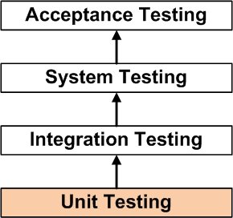
Testing
Tells us when something is wrong
not how to fix it
Notes:
http://softwaretestingfundamentals.com/wp-content/uploads/2010/12/unittesting.jpg

Slide 4
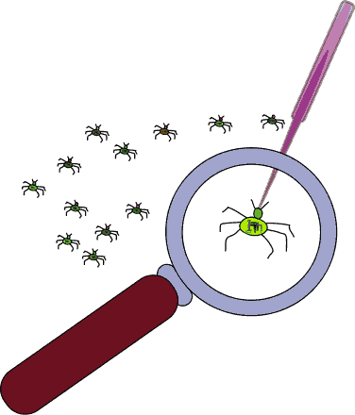
Debugging
Process of understanding and correcting errors
First locate the problem
find line of your code that produces initial problem
Then address the algorithm
correct implementation of algorithm
OR
change algorithm
Notes:
http://www.wpclipart.com/computer/humour/debugging.png.html

Slide 5
Debugging is an important skill
Become proficient ASAP
Why?
Reveal bugs that are not otherwise evident
like infinite loops
Don’t design to debug
Don’t rely on debugging to write your code
Try to define and implement correct algorithms
fast debugging << correct algorithm implementation

Slide 6
Debugging Strategy
When you know a bug exists for a particular case
Determine in which class the error originates
Determine in which method the error originates
Determine on which line of code the error originates
Knowing where the problem originates is half the battle
Reproducing an error helps

Slide 7
Common Bugs Revealed by Debugging
Un-constructed
Objects
Improper
Iteration
Un-initialized
Variables
Missing
Implementations
Failing to reinitialize a variable in loop
Incomplete
Changes

Slide 8
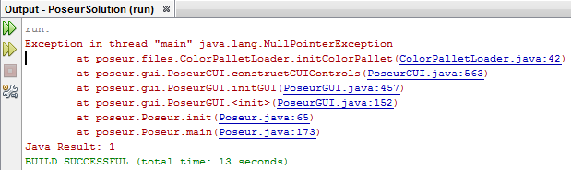
Not all errors are created equal
On difficulty scale:
syntax errors << runtime errors << logical errors
Note:
runtime errors may be due to logical errors

Slide 9
Plan to Debugging
Assumption:
every program will contain faults
no programmer gets it right the first time
So?
Design, write, & document your programs in ways that will make them easier to test & debug
How?
write well-documented modular code
avoid “I'll fix this later” approach

Slide 10
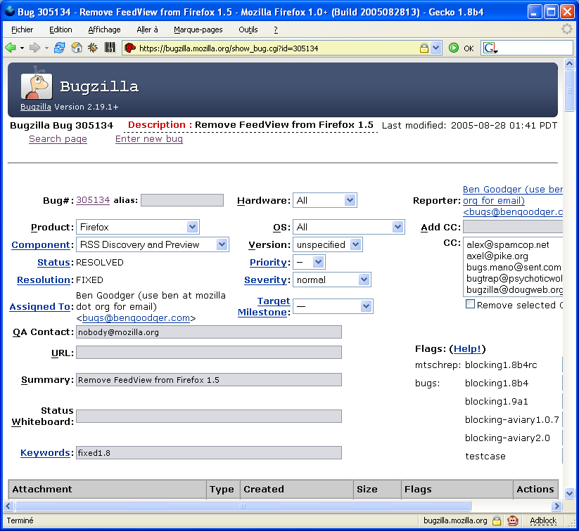
Professionals use tools
Even for tracking bugs
Notes:
http://www.download.ba/program-image/bugzilla.jpg

Slide 11
Debugging by Brute Force
i.e. the print statement
display contents of select variables
display benchmarks of program progress
i.e. Is this line of code reached?
System.out.println(“Before Foo”);
foo();
System.out.println(“After Foo”);
Advantage:
easy to implement

Slide 12
Disadvantages of print Approach
Makes a mess of code
Hit-or-miss
Can't identify certain types of problems
Not easy to use for:
Large-scale programs
Graphical programs
Web apps
Mobile apps

Slide 13
Debugging by Brute Force Example
private static boolean debug = true;
...
public int calculate (int y, int z)
{
int x;
x = mystery(y);
if (debug)
{
System.out.println
(“DEBUG: x = ” + x + “ y = ” + y);
}
x += mystery(z);
return x;
}

Slide 14
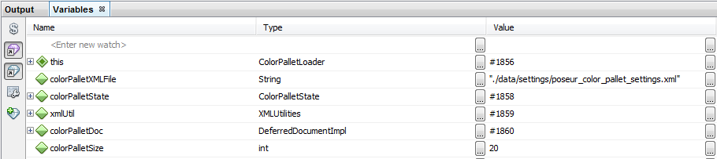
Debugging by IDE
All modern IDEs provide:
examination of the contents of variables
setting and removing of breakpoints
query and search commands
single-step execution through a program
examination of different threads of execution

Slide 15
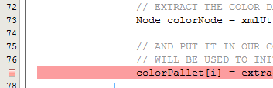
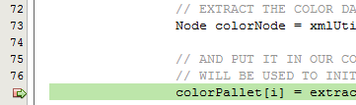
NetBeans Debugger
Similar to other IDE debuggers
eclipse, Visual Studio, etc.
Set Breakpoints
placese where debugger will stop
Walk through code via:
Stop
Pause
Continue
Step Over
Step Over Expression
Step Into
Step Out

Slide 16
Robust Programs
Methods have domain (arguments) & range (results)
Total methods – behavior is defined for all inputs in the method domain
By definition these are robust methods
Partial methods can lead to programs that are not robust
Robust program continues to behave reasonably even in the presence of errors
If an error occurs, robust programs behave in a well-defined way. Either:
Providing some approximation of its behavior in the absence of an error – graceful degradation
OR
Halt with a meaningful error message without crashing or damage to permanent data or software systems

Slide 17
Exceptions
Allow the flow of control to move from the location of an error to an error handler
Better than returning -1?
Treats errors differently from normal results
Forces the programmer to deal with these errors
Types of errors:
User input errors
Device errors
Physical limitations
Code errors
An exception is an abstraction
allows us to handle errors in a more general way

Slide 18
Exceptions/Errors in Java
An exception may be thrown because:
A method is called that throws a checked exception.
FileNotFoundException, IOException
A method is called that detects an error and explicitly throws a checked exception.
Create your own class that extends Exception.
A method throws an unchecked exception due to a programming error (i.e. a run-time logical error).
ArithmeticException, NullPointerException
An internal error occurs in the Java Virtual Machine (JVM) or runtime library.
e.g. VirtualMachineError, OutOfMemoryError

Slide 19
Method Design w/ Exceptions
Throw an exception when a method’s preconditions are not met
As well as any other error condition found in the method
Throw different types of exceptions for different types of problems
Specify detailed information about the reason for the exception in the Exception message
Provide a specification of all exceptions possibly thrown inside a method

Slide 20
Exceptions in Java
Throwable
Error
Exception
RuntimeException
Checked Exceptions
Unchecked Exceptions
A method throwing a checked exception must declare the exception in the header via throws
A method throwing an unchecked exception does not have to declare the exception in its header
but it is advisable to do so – for this course you should!
also, make sure your specification explains the conditions that generate each exception

Slide 21
Handling Exceptions
An exception is handled in two ways:
Enclose the method call that can cause an exception in a try block.
Use a catch block to handle the possible exception.
Pass the exception back to the current method’s caller.
Java automatically passes the exception to the method’s caller if:
the exception type of one of its supertypes is listed in the method’s header (in a throws clause)
the exception type is unchecked
Again! Make sure that any exception your code raises is listed in the header and is described in the method’s specification.

Slide 22
Tips on Using Exceptions
Too much exception handling will slow your code down dramatically
Exception handling is not supposed to replace a simple test by an application
Robust GUIs should check input from users before processing information
Exceptions serve to protect the methods & classes that throw them
Defensive programming: writing each procedure to defend itself against errors

Slide 23
Tips on Using Exceptions
Do not micromanage exceptions
Example: Read a string and convert it to an int.
try
{ line = inFile.readLine();
}
catch (IOException e)
{ System.out.println(e);
}
try
{ num = Integer.parseInt(line);
}
catch (NumberFormatException e)
{ System.out.println(e);
}

Slide 24
Tips on Using Exceptions
Example (cont’d):
try
{ line = inFile.readLine();
num = Integer.parseInt(line);
}
catch (IOException e)
{ System.out.println(e);
}
catch (NumberFormatException e)
{ System.out.println(e);
}
Separate normal processing from error handling.

Slide 25
Tips on Using Exceptions
Do not squelch exceptions.
Example: Popping off a stack with 100 elements.
sum = 0;
for (i=1; i <= 100; i++)
{
try
{ sum += s.pop();
}
catch(EmptyStackException e)
{
} // squelched!
}
Logical errors can be completely missed if exceptions are ignored.

Slide 26
Reflecting
Method A calls method B, which throws an exception, rather than passing the exception:
The caller A explicitly catches the exception from B and throws a different type of exception.
Example: Find the min of an array.
Method begins by trying to get the element in position 0.
If the array is empty, IndexOutOfBoundsException is thrown.
The min method may catch this and return EmptyException.
Why would we want to do this?
Turn vague exceptions into more relevant ones
Turn unchecked exceptions into checked ones

Slide 27
Masking
Method A calls method B, which throws an exception.
The caller A explicitly catches and handles the exception and continues with the normal flow
Any method calling A is none the wiser
Example: Sorting an array.
Method tries to get element in position 0.
If the array is empty, the array is already sorted (by definition).
Method catches IndexOutOfBoundsException and masks it.

Slide 28
Design Issues with Exceptions
When should one use them?
Checked or unchecked?
Use existing Exception classes or make your own?

Slide 29
When Do We Use Exceptions?
Exceptions should be used to prevent data (static or instance variables) from reaching an illegal state
Make a partial method more like a total method
Exceptions may be avoided (by returning an int error code) if a method is used only locally
Ex: private helper methods
Use exceptions for exceptional situations - duh
Special Java rule for overriding:
If you override a method, the subclass method cannot throw more checked exceptions than the superclass that you replace.

Slide 30
Use checked or unchecked?
Always use checked exceptions!
Why?
let other programmers (and yourself) be aware of potential errors
make them anticipate these errors
make them handle these errors as they see fit
Many exceptions in the JDK are unchecked. Why?

Slide 31
Programmer vs. User
Unchecked exceptions occurring are generally the fault of the programmer
Checked exceptions occurring may be the fault of the user/system/Internet access

