Slide 1
CSE 219 Computer science III
Test-driven development
(a.k.a. Design to test)

Slide 2
Reading Assignment
Why Software Fails:
http://www.spectrum.ieee.org/sep05/1685

Slide 3
Man-hours
Labor is sometimes measured in man-hours, man-months, or man-years.
Example: Doom3 took 5 years and more than 100 man-years of labor to develop
Company Spokesman: "It will be ready when it's done"
Why not double the size of the team and halve the lead time (concept date to release date)?

Slide 4
Man-hours: The Mythical Man-Month
Assume that a software program might take one expert programmer a year to develop = 12 man-months
Market pressures might be such that we want to get the program finished in a month, rather than a year
1 programmer * 12 months = 12 programmers * 1 month?
When you throw additional programmers at a project that is late, you are likely to make it more late!
Remove promised-but-not-yet-completed features, rather than multiplying workers bees.
Also, at least one team member must have detailed knowledge of the entire system (all the modules).

Slide 5
Design to Implementation
Assume a modular design has been completed
Can all the modules be developed in parallel?
most likely not - due to dependencies
division of work within a module may also be necessary
can classes within a module be developed in parallel?
most likely not - due to dependencies
division of work within a class may also be necessary
can methods within a class be developed in parallel?
Again most likely not - due to dependencies

Slide 6
Bottom-Up Development
Traditional approach:
All modules used by module M are implemented and tested before M is implemented.
Requires the use of drivers (i.e., testers).
Example of Module dependencies:
Bottom-up development can place less of a
load on system resources.
Bottom-up development can lead to earlier
completion of useful subsystems.
A
B
C
D
E

Slide 7
Top-Down Development
All modules that use module M are implemented and tested before M is implemented.
Modules themselves will probably use bottom-up development
Requires the use of stubs.
Testing procedures are important
Example of module dependencies:
If the design contains a type hierarchy, top-
down development is required.
A
B
C
D
E

Slide 8
The Development Strategy
Should be defined explicitly before implementation begins
Should be primarily top-down, with bottom-up used mainly for modules that are easier to implement than to simulate
Advantages of top-down outweigh bottom-up
simplifies system integration & test
makes it possible to produce useful partial versions of the system
allows critical high-level design errors to be caught early
Bottom-up development may be used for each module
we’ll see this with module testing as well

Slide 9
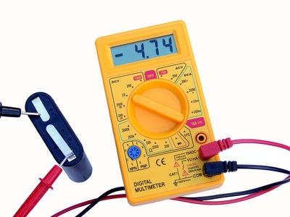
What is design to test?
Approach to implementation
design modular classes and methods
before coding:
determine what needs to be tested
design test cases for those important methods
test incrementally, as you implement your solution

Slide 10
Don't Design to Fail
1
Design to Test = --------------------
Design to Fail
Things to avoid:
coding without a design
not planning on how a design will be tested
creating large amounts of untested code
coding very large methods
lack of modularity can doom an implementation

Slide 11
Testing vs. Debugging
Testing
Does the code work properly
YES
Coding
NO
Debugging

Slide 12
Important Definitions
Testing
a process of running a program on a set of test cases and comparing the actual results with expected results
Verification
a formal or informal argument that a program works as intended for all possible inputs
Validation
a process designed to increase confidence that a program works as intended
performed through verification or testing
Defensive Programming
writing programs in a way designed to ease the process of validation and debugging

Slide 13
Kinds of Testing
Unit Testing
Test each module in a program separately.
Integration Testing
Test interfaces between modules.
Much more difficult than unit testing
Regression Testing
Test programs after modifications to ensure correct behavior of the original program is preserved.
System Testing
Test overall system behavior.

Slide 14
Aspects of Testing
How do we generate test cases?
Exhaustive
Consider all possible combinations of inputs.
Often infeasible – why?
Is it feasible with your Journey Through Europe program?
Sampled
A small but representative subset of all input combinations.
Black-box testing - Test cases generated from program specifications and not dependent on the implementation
Glass-box testing - Test cases generated from program’s code

Slide 15
Black-box testing
It is the best place to start when attempting to test a program thoroughly
Test cases based on program’s specification, not on its implementation (see the homework grading sheets)
Test cases are not affected by:
Invalid assumptions made by the programmer
Implementation changes
Use same test cases even after program structures has changed
Test cases can be generated by an “independent” agent, unfamiliar with the implementation.
Test cases should cover all paths (not all cases) through the specification, including exceptions.

Slide 16
Boundary Conditions
A boundary condition is an input that is “one away” from producing a different behavior in the program code
Such checks catch 2 common types of errors:
Logical errors, in which a path to handle a special case presented by a boundary condition is omitted
Failure to check for conditionals that may cause the underlying language or hardware system to raise an exception (ex: arithmetic overflow)

Slide 17
Glass-box testing
Black-box testing is generally not enough.
For Glass-box testing, the code of a program being tested is taken into account
Path-completeness:
Test cases are generated to exercise each path through a program.
May be insufficient to catch all errors.
Can be used effectively only for a program fragment that contains a reasonable number of paths to test.

Slide 18
Testing paths through specification
Examine the method specifications (preconditions) & all paths through method to generate unique test cases for testing.
/* REQUIRES: x >= 0 && y >= 10 */
public static int calc(int x, int y) { ... }
Translate paths to test cases:
x = 0, y = 10 (x == 0 && y == 10)
x = 5, y = 10 (x > 0 && y == 10)
x = 0, y = 15 (x == 0 && y > 10)
x = 5, y = 15 (x > 0 && y > 10)
x = -1, y = 10 (x < 0 && y == 10)
x = -1, y = 15 (x < 0 && y > 10)
x = -1, y = 9 (x < 9 && y < 10)
x = 0, y = 9 (x == 0 && y < 10)
x = 1, y = 9 (x > 0 && y < 10)

Slide 19
JUnit
Unit-test framework for Java programs.
open source software
hosted on SourceForge: http://junit.sourceforge.net/javadoc
Moved to http://junit.org (for JUnit 4 and later)
not in the standard JDK:
import junit.framework.*;
//for JUnit 3.8 and earlier
import org.junit.*; //for JUnit 4 and later
Associate a Test class with each unit
one or more classes

Slide 20
JUnit
The test class has a set of test methods
public void testX()
where X is the method to be tested
The test methods use “assertions” to perform the tests, ex:
Assert.assertEquals(x,y)
Assert.assertTrue(c)
Assert.assertSame(obj1, obj2)

Slide 21
Building unit tests with JUnit
Initialize any instance variables necessary for testing in the test object
Define tests for emptiness, equality, boundary conditions, ...
Define test suites, if necessary, to group tests.
Use Assert methods to perform tests

Slide 22
JUnit 3.8 vs. 4
JUnit 4: all test methods are annotated with @Test.
Unlike JUnit3 tests, you do not need to prefix the method name with "test“.
JUnit 4 does not have the test classes extend junit.framework.TestCase (directly or indirectly).
Usually, tests with JUnit4 do not need to extend anything (which is good, since Java does not support multiple inheritance).

Slide 23
JUnit Example – StatCompiler.java
public class StatCompiler {
/**
* a, b, & c must all be positive
**/
public static int averageOfPosInts(int a, int b, int c)
throws IllegalArgumentException{
if ((a < 0) || (b <0) || (c < 0))
throw new IllegalArgumentException("No neg values");
int sum = a + b + c;
return sum/3;
}
public static int median(int a, int b, int c){
if ( (a >=b) && (a <=c)) return a;
else if ((a >= b) && (a >=c)) return b;
else return c;
}
}

Slide 24
StatCompilerTest_3_8.java
import junit.framework.*;
// JUnit 3.8
public class StatCompilerTest extends TestCase {
public StatCompilerTest(java.lang.String testName) {
super(testName);
}
public void testAverageOfPosInts() {
System.out.println("testAverageOfPosInts");
Assert.assertEquals(StatCompiler.averageOfPosInts
(1, 2, 3), 2);
try{
StatCompiler.averageOfPosInts(-1, 2, 3);
fail("Exception should have been thrown");
} catch (IllegalArgumentException iae) {}
}
public void testMedian() {
System.out.println("testMedian");
Assert.assertEquals(2, StatCompiler.median(1, 2, 3));
Assert.assertEquals(2, StatCompiler.median(3, 2, 1));
}
}

Slide 25
Run JUnit version 3.8
Junit version 3.8
testAverageOfPosInts
testMedian
===================================================
Errors logged for the StatCompilerTest test:
No errors.
===================================================
Failures logged for the StatCompilerTest test:
Total failures: 1
Test case testMedian(StatCompilerTest) failed with "expected:<2> but was:<3>“ at StatCompilerTest.testMedian(StatCompilerTest.java:42)
===================================================
Summary of StatCompilerTest test:
Result: Failed
Run: 2
Failures: 1
Errors: 0
Elapsed time: 0.01

Slide 26
StatCompilerTest_4.java
import org.junit.Test;
import static org.junit.Assert.*;
public class StatCompilerTest {
@Test
public void testAverageOfPosInts() {
System.out.println("averageOfPosInts");
int a = 1;
int b = 2;
int c = 3;
int expResult = 2;
int result = StatCompiler.averageOfPosInts(a, b, c);
assertEquals(expResult, result);
}
@Test
public void testMedian() {
System.out.println("median");
int a = 3;
int b = 2;
int c = 1;
int expResult = 2;
int result = StatCompiler.median(a, b, c);
assertEquals(expResult, result);
}
}

Slide 27
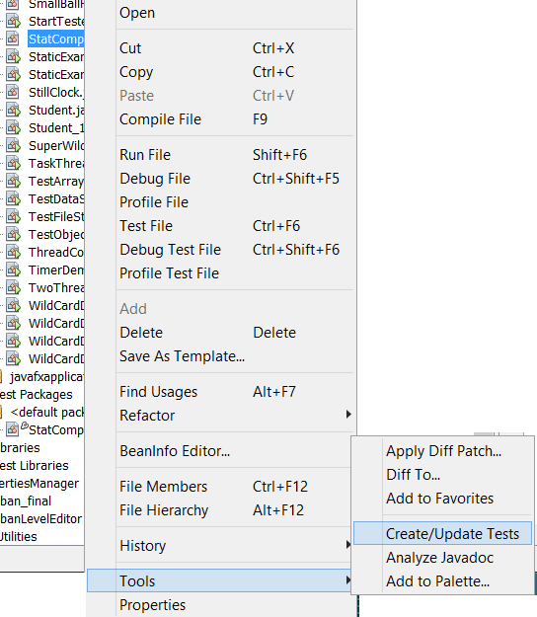
NetBeans and Junit: Download the Junit library and add it in the path. The Junit plugin is installed.

Slide 28
Run JUnit version 4
Run: java org.junit.runner.JUnitCore [test class name]
JUnit version 4.11
.testAverageOfPosInts
.testMedian
Time: 0.005
There was 1 failure:
1) testMedian(JUnit_test_01)
java.lang.AssertionError: expected:<2> but was:<3>
FAILURES!!!
Tests run: 2, Failures: 1

Slide 29
Notes on Static import
Static import is a feature introduced in the Java programming language that allows members (fields and methods) defined in a class as public static to be used in Java code without specifying the class in which the field is defined.
The mechanism can be used to reference individual members of a class:
import static java.lang.Math.PI;
import static java.lang.Math.pow;
or all the static members of a class:
import static java.lang.Math.*;

Slide 30
Static import example
import static java.lang.Math.*;
// OR
// import static java.lang.Math.PI;
// import static java.lang.Math.pow;
import static java.lang.System.out;
public class HelloWorld {
public static void main(String[] args) {
out.println("Hello World!");
out.println("A circle with a diameter of 5 cm has:");
out.println("A circumference of " + (PI * 5) + " cm");
out.println("And an area of " + (PI * pow(2.5,2))
+ " sq. cm");
}
}

Slide 31
Notes on Assertions
An assertion is a Java statement that enables you to assert an assumption about your program.
An assertion contains a Boolean expression that should be true during program execution.
Assertions can be used to assure program correctness and avoid logic errors.

Slide 32
Declaring Assertions
An assertion is declared using the new Java keyword assert in JDK 1.4 as follows:
assert assertion; OR
assert assertion : detailMessage;
where assertion is a Boolean expression and detailMessage is a primitive-type or an Object value.

Slide 33
Executing Assertions
When an assertion statement is executed, Java evaluates the assertion.
If it is false, an AssertionError will be thrown.
The AssertionError class has a no-arg constructor and seven overloaded single-argument constructors of type int, long, float, double, boolean, char, and Object.
For the first assert statement with no detail message, the no-arg constructor of AssertionError is used.
For the second assert statement with a detail message, an appropriate AssertionError constructor is used to match the data type of the message.
Since AssertionError is a subclass of Error, when an assertion becomes false, the program displays a message on the console and exits.

Slide 34
Executing Assertions Example
public class AssertionDemo {
public static void main(String[] args) {
int i; int sum = 0;
for (i = 0; i < 10; i++) {
sum += i;
}
assert i == 10;
assert sum > 10 && sum < 5 * 10 : "sum is " + sum;
}
}

Slide 35
Running Programs with Assertions
By default, the assertions are disabled at runtime. To enable it, use the switch –enableassertions, or –ea for short, as follows:
java –ea AssertionDemo
public class AssertionDemo {
public static void main(String[] args) {
int i; int sum = 0;
for (i = 0; i < 10; i++) {
sum += i;
}
assert i != 10;
}
}
Exception in thread "main" java.lang.AssertionError
at AssertionDemo.main(AssertionDemo.java:7)

Slide 36
Running Programs with Assertions
Assertions can be selectively enabled or disabled at class level or package level.
The disable switch is –disableassertions or –da for short.
For example, the following command enables assertions in package package1 and disables assertions in class Class1.
java –ea:package1 –da:Class1 AssertionDemo

Slide 37
Using Exception Handling or Assertions
Assertion should not be used to replace exception handling.
Exception handling deals with unusual circumstances during program execution.
Assertions are to assure the correctness of the program.
Exception handling addresses robustness and assertion addresses correctness.
Assertions are used for internal consistency and validity checks.
Assertions are checked at runtime and can be turned on or off at startup time.

Slide 38
Using Exception Handling or Assertions
Do not use assertions for argument checking in public methods:
Valid arguments that may be passed to a public method are considered to be part of the method’s contract.
The contract must always be obeyed whether assertions are enabled or disabled.
For example, the following code in the Circle class should be rewritten using exception handling:
public void setRadius(double newRadius) {
assert newRadius >= 0;
radius = newRadius;
}

Slide 39
Using Exception Handling or Assertions
Use assertions to reaffirm assumptions.
This gives you more confidence to assure correctness of the program.
A common use of assertions is to replace assumptions with assertions in the code.
A good use of assertions is place assertions in a switch statement without a default case. For example:
switch (month) {
case 1: ... ; break;
case 2: ... ; break;
...
case 12: ... ; break;
default: assert false : "Invalid month: " + month
}

