Slide 1
CSE 219 Computer science III
Creational design patterns

Slide 2
Design Patterns
Design Pattern
A description of a problem and its solution that you can apply to many similar programming situations
Patterns:
facilitate reuse of good, tried-and-tested solutions
capture the structure and interaction between components

Slide 3
Why is this important?
Using proven, effective design patterns can make you a better software designer & coder
You will recognize commonly used patterns in others’ code
Java API
Project team members
Bitter ex-employees
And you'll learn when to apply them to your own code
experience reuse (as opposed to code reuse)
we want you thinking at the pattern level
In addition, different technologies have their own patterns:
Servlet patterns, GUI patterns, etc …

Slide 4
Common Design Patterns
Creational
Structural
Behavioral
Factory
Singleton
Builder
Prototype
Decorator
Adapter
Facade
Flyweight
Bridge
Strategy
Template
Observer
Command
Iterator
State
Textbook: Head First Design Patterns

Slide 5
Common Design Patterns
Creational
Structural
Behavioral
Factory
Singleton
Builder
Prototype
Decorator
Adapter
Facade
Flyweight
Bridge
Strategy
Template
Observer
Command
Iterator
State
Textbook: Head First Design Patterns

Slide 6
The Factory Pattern
Factories make stuff
Factory classes make objects
Shouldn't constructors do that?
factory classes employ constructors
What's the point?
prevent misuse/improper construction
hides construction
provide API convenience
one stop shop for getting an object of a family type

Slide 7
What objects do factories make?
Typically objects of the same family
common ancestor
same apparent type
different actual type
Factory Pattern in the Java API:
BorderFactory.createXXXBorder methods
return apparent type of Border
return actual types of BevelBorder, EtchedBorder, etc …
lots of factory classes in security packages

Slide 8
Border Example
…
JPanel panel = new JPanel();
Border border = BorderFactory.createEtchedBorder();
panel.setBorder(border);
JPanel panel2 = new JPanel();
Border border2 = BorderFactory.createTitledBorder("Title");
panel2.setBorder(border2);
…

Slide 9
How could we implement a Factory Pattern?
public class BorderFactory
{ public static Border createEtchedBorder()
{ return new EtchedBorder();
}
public static Border createTitledBorder(String title)
{ return new TitledBorder(title);
}
…
}
public class EtchedBorder implements Border
{ // Border Methods }
public class TitledBorder implements Border
{ // Border Methods }

Slide 10
Factory Pattern Bonus
The programmer using the Factory class never needs to know about the actual class/type
simplifies use for programmer
fewer classes to learn
Ex: Using BorderFactory, one only needs to know Border & BorderFactory
not TitledBorder, BeveledBorder, EtchedBorder, etc.

Slide 11
Common Design Patterns
Creational
Structural
Behavioral
Factory
Singleton
Builder
Prototype
Decorator
Adapter
Facade
Flyweight
Bridge
Strategy
Template
Observer
Command
Iterator
State
Textbook: Head First Design Patterns

Slide 12
The Singleton Pattern
Define a type where only one object of that type may be constructed:
make the constructor private.
singleton object favorable to fully static class, why?
can be used as a method argument
class can be extended
What makes a good singleton candidate?
central app organizer class
something everybody needs

Slide 13
Example: The PropertiesManager Singleton
public class PropertiesManager
{
private static PropertiesManager singleton
= null;
private PropertiesManager() {}
public static PropertiesManager
getPropertiesManager()
{
if (singleton == null)
{ singleton = new PropertiesManager();
}
return singleton;
}
…
}

Slide 14
What's so great about a singleton?
Other classes may now easily USE the PropertiesManager
PropertiesManager singleton =
PropertiesManager.getPropertiesManager();
Singleton.dowhaterver()
Don’t have to worry about passing objects around
Don’t have to worry about object consistency
Note: the singleton is of course only good for classes that will never need more than one instance in an application

Slide 15
Common Design Patterns
Creational
Structural
Behavioral
Factory
Singleton
Builder
Prototype
Decorator
Adapter
Facade
Flyweight
Bridge
Strategy
Template
Observer
Command
Iterator
State
Textbook: Head First Design Patterns

Slide 16
The Builder Pattern
Use the Builder Pattern to:
encapsulate the construction of a product
allow it to be constructed in steps
Good for complex object construction
objects that require lots of custom initialized pieces
Scenario:
build a vacation planner for a theme park
guests can choose a hotel, tickets, events, etc.
guests may want zero to many of each
create a planner to encapsulate all this info

Slide 17
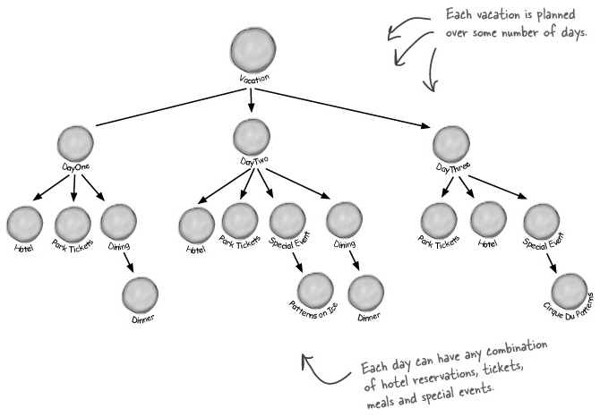
A Builder Pattern Example

Slide 18
So what’s the problem?
A flexible construction design is needed
Lots of customization
some customers might not want a hotel
some might want multiple rooms in multiple hotels
some might want restaurant reservations
some might want stuff no one else does
We need:
a flexible data structure that can represent guest planners and all their variations
a sequence of potentially complex steps to create the planner

Slide 19
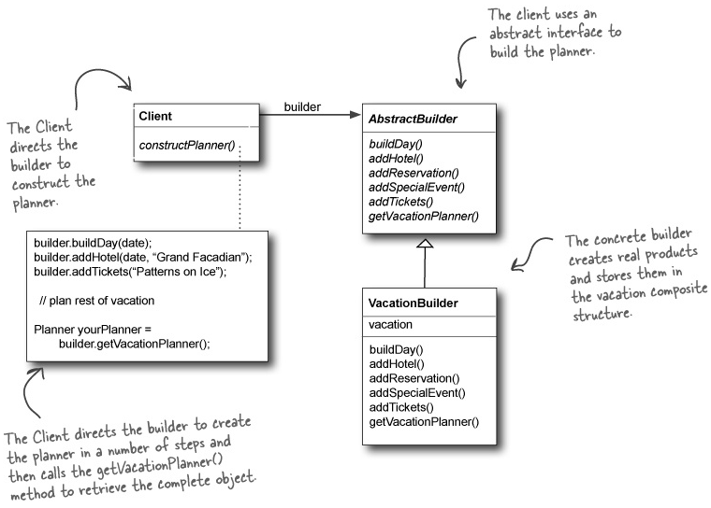
A Builder Pattern Example

Slide 20
Builder Benefits
Encapsulates the way a complex object is constructed.
Allows objects to be constructed in a multistep and varying process (as opposed to one step factories).
Hides the internal representation of the product from the client.
Product implementations can be swapped in and out because the client only sees an abstract interface.

Slide 21
Common Design Patterns
Creational
Structural
Behavioral
Factory
Singleton
Builder
Prototype
Decorator
Adapter
Facade
Flyweight
Bridge
Strategy
Template
Observer
Command
Iterator
State
Textbook: Head First Design Patterns

Slide 22
The Prototype Pattern
Use the Prototype Pattern when creating an instance of a given class is either expensive or complicated
Scenario:
Your interactive role playing game has an insatiable appetite for monsters. As your heroes make their journey through a dynamically created landscape, they encounter an endless chain of foes that must be subdued. You’d like the monster’s characteristics to evolve with the changing landscape. It doesn’t make a lot of sense for bird-like monsters to follow your characters into undersea realms. Finally, you’d like to allow advanced players to create their own custom monsters.

Slide 23
So what’s the problem?
It’s best to decouple the code that handles the details of creating the monsters from the code that actually needs to create them on the fly
Putting complicated combinations of state variables into constructors can be tricky
Prototype:
have a single place where all the instantiation details would be encapsulated

Slide 24
So what does the Prototype Pattern do?
Allows you to make new instances by copying existing instances
in Java this typically means using the clone() method, or de-serialization when you need deep copies
A key aspect of this pattern is that the client code can make new instances without knowing which specific class is being instantiated

Slide 25
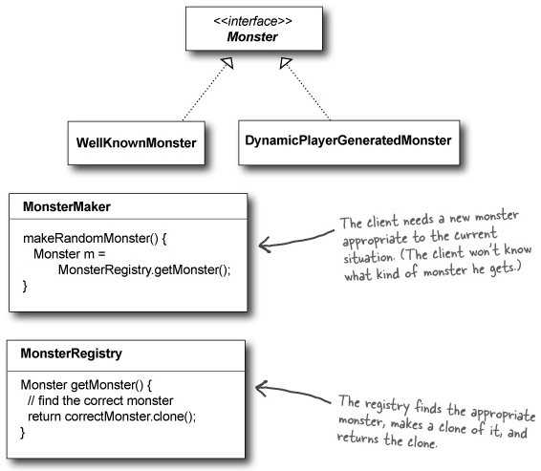
A Prototype Pattern Example

Slide 26
Prototype Benefits
Hides the complexities of making new instances from the client.
Provides the option for the client to generate objects whose type is not known.
In some circumstances, copying an object can be more efficient than creating a new object.

Slide 27
Prototype Uses and Drawbacks
Prototype should be considered when a system must create new objects of many types in a complex class hierarchy.
A drawback to using the Prototype is that making a copy of an object can sometimes be complicated.

