Slide 1
CSE 219 Computer science III
STRUCTURAL design patterns

Slide 2
Common Design Patterns
Creational
Structural
Behavioral
Factory
Singleton
Builder
Prototype
Decorator
Adapter
Facade
Flyweight
Bridge
Strategy
Template
Observer
Command
Iterator
State
Textbook: Head First Design Patterns

Slide 3
The Decorator Pattern
Attaches additional responsibilities to an object dynamically.
i.e. decorating an object
Decorators provide a flexible alternative to sub-classing for extending functionality
How?
By wrapping an object
Works on the principle that classes should be open to extension but closed to modification

Slide 4
Decorator Goal
Allow classes to be easily extended to incorporate new behavior without modifying existing code
What do we get if we accomplish this?
Designs that are resilient to change and flexible enough to take on new functionality to meet changing requirements.

Slide 5
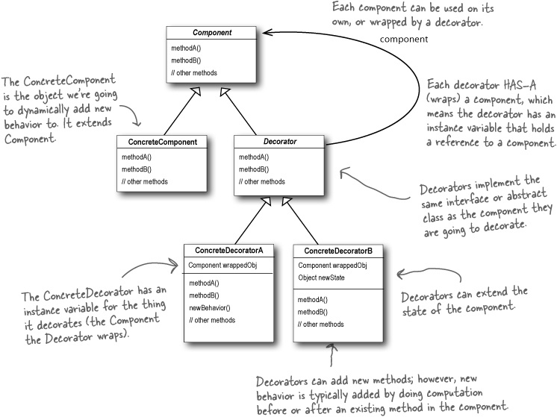
Decorators Override Functionality

Slide 6
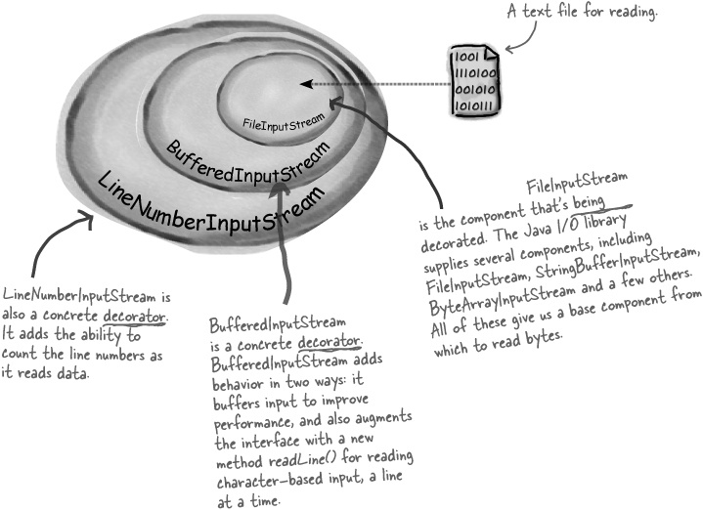
Java’s IO Library

Slide 7
Common Design Patterns
Creational
Structural
Behavioral
Factory
Singleton
Builder
Prototype
Decorator
Adapter
Facade
Flyweight
Bridge
Strategy
Template
Observer
Command
Iterator
State
Textbook: Head First Design Patterns

Slide 8
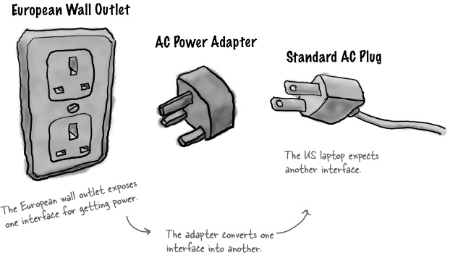
Ever been to Europe?
This is an abstraction of the Adapter Pattern

Slide 9

The Adapter Pattern
Converts the interface of a class into another interface a client expects
Adapter lets classes work together that couldn’t otherwise because of incompatible interfaces
Interfaces?
Do you know what a driver is?

Slide 10
Adapter Scenario
You have an existing system
You need to work a vendor library into the system
The new vendor interface is different from the last vendor
You really don’t want to change your existing system
Solution?
Make a class that adapts the new vendor interface into what the system uses

Slide 11
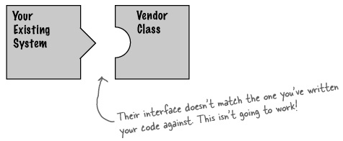
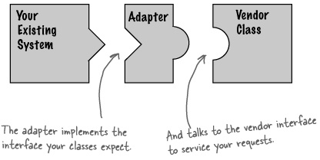
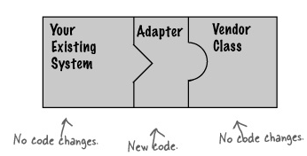
Adapter Visualized

Slide 12
How do we do it?
Ex: Driver
Existing system uses a driver via an interface
New hardware uses a different interface
Adapter can adapt differences
Existing system HAS-A OldInterface
Adapter implements OldInterface and HAS-A NewInterface
Existing system calls OldInterface methods on adapter, adapter forwards them to NewInterface implementations

Slide 13
What’s good about this?
Decouple the client from the implemented interface
If we expect the interface to change over time, the adapter encapsulates that change so that the client doesn’t have to be modified each time it needs to operate against a different interface.

Slide 14
Common Design Patterns
Creational
Structural
Behavioral
Factory
Singleton
Builder
Prototype
Decorator
Adapter
Facade
Flyweight
Bridge
Strategy
Template
Observer
Command
Iterator
State
Textbook: Head First Design Patterns

Slide 15
The Facade Pattern
Provides a unified interface to a set of interfaces in a subsystem.
The facade defines a higher-level interface that makes the subsystem easier to use
Employs the principle of least knowledge

Slide 16
Scenario: Watching a movie
Steps:
Turn on the popcorn popper
Start the popper popping
Dim the lights
Put the screen down
Turn the projector on
Set the projector input to DVD
Put the projector on wide-screen mode
Turn the sound amplifier on
Set the amplifier to DVD input
Set the amplifier to surround sound
Set the amplifier volume to medium (5)
Turn the DVD Player on
Start the DVD Player playing

Slide 17
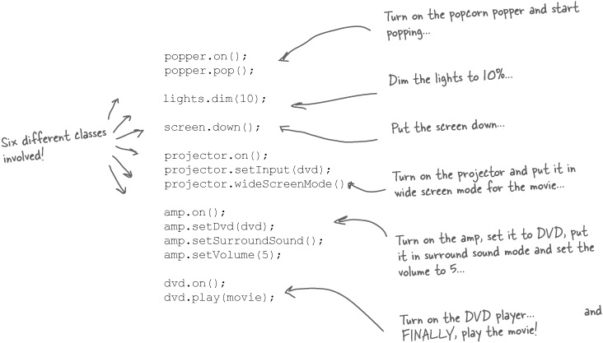
Scenario: Watching a movie
Let’s do it programically:

Slide 18
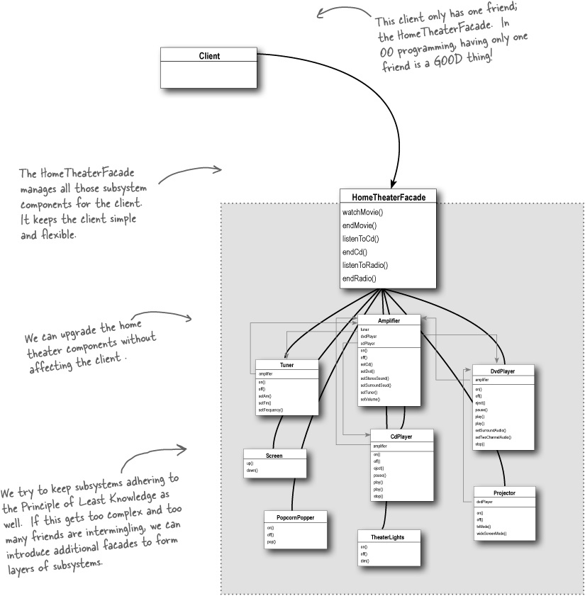
The Façade
Pattern

Slide 19
Which is which?
Converts one interface to another
Makes an interface simpler
Doesn’t alter the interface, but adds responsibility
Decorator
Adapter
Facade

Slide 20
Common Design Patterns
Creational
Structural
Behavioral
Factory
Singleton
Builder
Prototype
Decorator
Adapter
Facade
Flyweight
Bridge
Strategy
Template
Observer
Command
Iterator
State
Textbook: Head First Design Patterns

Slide 21
The Flyweight Pattern
A “neat hack”
Allows one object to be used to represent many identical instances
Flyweights must be immutable.
Flyweights depend on an associated table
maps identical instances to the single object that represents all of them
Used in processing many large documents
search engines
a document as an array of immutable Strings
repeated Words would share objects
just one object for “the” referenced all over the place
use static Hashtable to store mappings
use javax.naming.Context to provide String to Object binding

Slide 22
String Example
What’s the output?
String s1 = "Hello";
String s2 = "Hello";
if (s1 == s2) System.out.println(1);
String s3 = new String("Hello");
if (s1 == s3) System.out.println(2);
String s4 = "Hell";
s4 += "o";
if (s1 == s4) System.out.println(3);

Slide 23
Common Design Patterns
Creational
Structural
Behavioral
Factory
Singleton
Builder
Prototype
Decorator
Adapter
Facade
Flyweight
Bridge
Strategy
Template
Observer
Command
Iterator
State
Textbook: Head First Design Patterns

Slide 24
The Bridge Pattern
Used to vary not only your implementations, but also your abstractions
Scenario:
you’re writing the code for a new ergonomic and user-friendly remote control for TVs
there will be lots of implementations – one for each model of TV – use an abstraction (interface)
you know there will be many changes over time to the specification – needs to accommodate changes
Solution? Abstract the abstraction

Slide 25
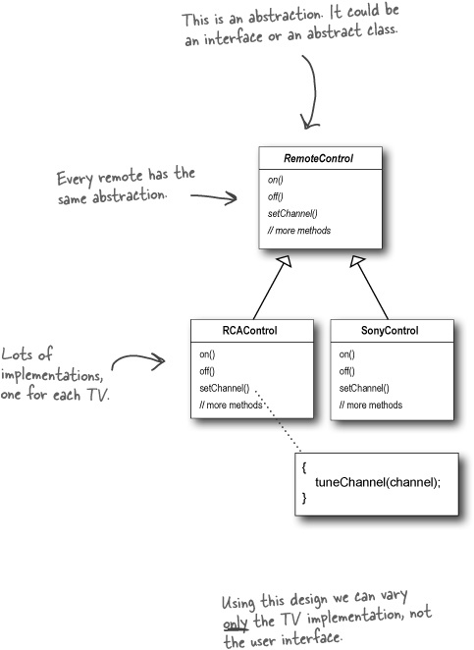
Our Scenario
A bridge-less design
Won’t easily accommodate change

Slide 26
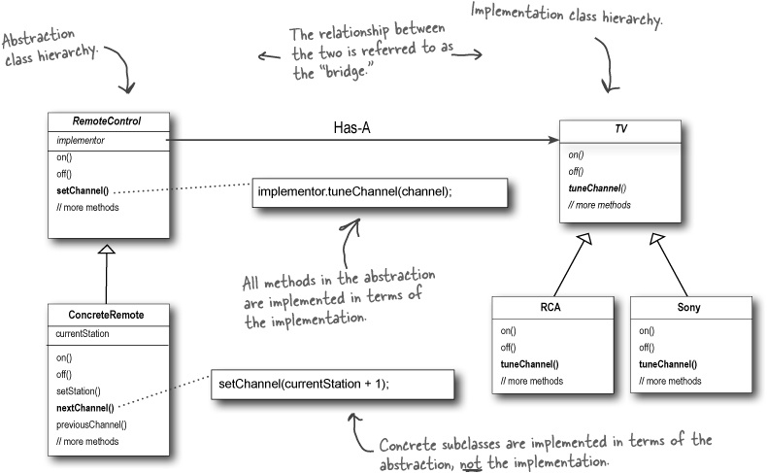
This is better

