Slide 1
CSE 219 Computer science III
behavioral design patterns

Slide 2
Common Design Patterns
Creational
Structural
Behavioral
Factory
Singleton
Builder
Prototype
Decorator
Adapter
Facade
Flyweight
Bridge
Strategy
Template
Observer
Command
Iterator
State
Textbook: Head First Design Patterns

Slide 3
The Strategy Pattern
How does it work?
defines a family of algorithms, encapsulates each one, and makes them interchangeable
lets the algorithm vary independently from the clients that use them
An algorithm in a box
place essential steps for an algorithm in a strategy interface
different methods represent different parts of the algorithm
classes implementing this interface customize methods
Classes can be composed (HAS-A) of the interface type
the interface type is the apparent type
the actual type can be determined at run-time

Slide 4
Strategy Pattern in the Java API
LayoutManagers interface
describes how to arrange components:
resizing
components added to or removed from the container.
size and position the components it manages.
public interface LayoutManager
{
void addLayoutComponent(String name, Component comp);
void removeLayoutComponent(Component comp);
Dimension preferredLayoutSize(Container parent);
Dimension minimumLayoutSize(Container parent);
void layoutContainer(Container parent);
}

Slide 5
Think of how Containers use LayoutManagers
What makes this so great?
public class Container extends Component
{
private List<Component> component;
private LayoutManager layoutMgr;
…
public LayoutManager getLayout() {
return layoutMgr;
}
public void setLayout(LayoutManager mgr) {
layoutMgr = mgr;
}
}

Slide 6
This is why it's great
Interchangeable layout algorithms in a box
public void initGUI()
{
northPanel = new JPanel();
northPanel.setLayout(new BorderLayout());
northOfNorthPanel = new Jpanel();
northPanel.add(northOfNorthPanel, "NORTH");
northPanelOfNorthPanel.add(cutButton);
northPanelOfNorthPanel.add(pasteButton);
...
}

Slide 7
Common Design Patterns
Creational
Structural
Behavioral
Factory
Singleton
Builder
Prototype
Decorator
Adapter
Facade
Flyweight
Bridge
Strategy
Template
Observer
Command
Iterator
State
Textbook: Head First Design Patterns

Slide 8
Template Method Pattern
Defines the skeleton of an algorithm in a method, deferring some steps to subclasses.
Lets subclasses redefine certain steps of an algorithm without changing the algorithm’s structure.
A template for an algorithm

Slide 9
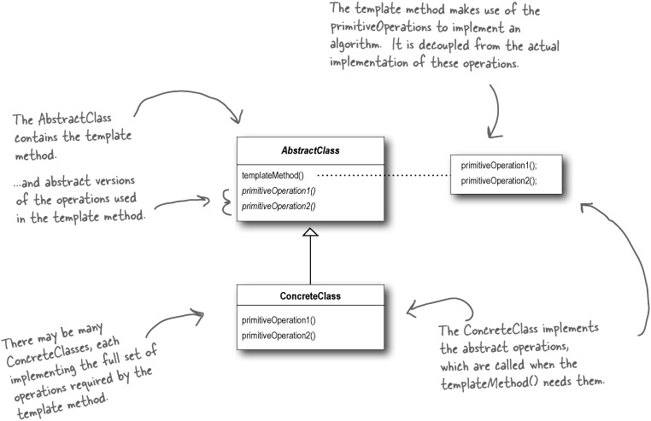
Template Method Pattern

Slide 10
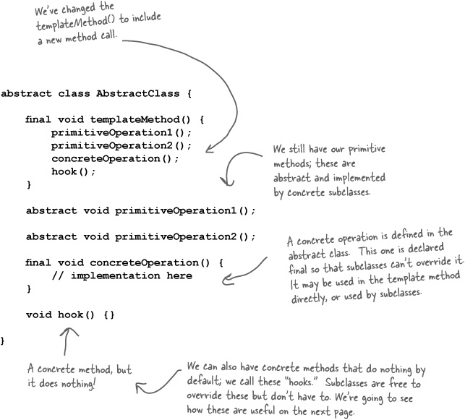
Template Method Pattern

Slide 11
What’s a hook?
A type of method
Declared in the abstract class
only given an empty or default implementation
Gives subclasses the ability to “hook into” the algorithm at various points, if they wish
a subclass is also free to ignore the hook.

Slide 12
Strategy vs. Template Method
What’s the difference?
Strategy
subclasses decide how to implement steps in an algorithm
Template Method
encapsulate interchangeable behaviors and use delegation to decide which behavior to use

Slide 13
Common Design Patterns
Creational
Structural
Behavioral
Factory
Singleton
Builder
Prototype
Decorator
Adapter
Facade
Flyweight
Bridge
Strategy
Template
Observer
Command
Iterator
State
Textbook: Head First Design Patterns

Slide 14
The Observer Pattern
Defines a one-to-many dependency between objects so that when one object changes state, all of its dependents are notified and updated automatically.
Hmm, where have we seen this?
in our GUI
State Manager class maintains application's state
call methods to change app's state
app's state change forces update of GUI

Slide 15
JTrees
Used to display a hierarchical structure
File structure, browsing history, etc…

Slide 16
Editing
To edit the tree, you must go through the model:
JTree tree = new JTree(…
TreeModel model = tree.getModel();
// Insert Node
model.insertNodeInto(…
// Remove Node
model.removeNodeFromParent(…
// Change Node
model.nodeChanged(…
// UPDATING THE MODEL WILL NOW AUTOMATICALLY UPDATE THE
// VIEW (JTree) THANKS TO MVC!

Slide 17
Complex Controls have their own States
Tables, trees, lists, combo boxes, etc.
data is managed separately from the view
when state changes, view is updated
This is called MVC
Model
View
Controller
MVC employs the Observer Pattern

Slide 18
MVC employs the Observer Pattern
Model
data structure, no visual representation
notifies views when something interesting happens
View
visual representation
views attach themselves to model in order to be notified
Controller
event handler
listeners that are attached to view in order to be notified of user interaction (or otherwise)
MVC Interaction
controller updates model
model tells view that data has changed
view redrawn

Slide 19
Controller
Model
View
updateData
notify
repaint
return
return

Slide 20
MVC Architecture
The model passes its data to the view for rendering
Model
View
The view determines which events are passed to the controller
The controller updates the model based on events received
Controller

Slide 21
UI Frameworks loves MVC
ComboBoxModel – JComboBox - ItemListener
ListModel – JList - ListSelectionListener
TableModel - JTable - CellEditorListener
TreeModel - JTree - TreeSelectionListener
…
Note:
all Swing components have loads of different listeners

Slide 22
Common Design Patterns
Creational
Structural
Behavioral
Factory
Singleton
Builder
Prototype
Decorator
Adapter
Facade
Flyweight
Bridge
Strategy
Template
Observer
Command
Iterator
State
Textbook: Head First Design Patterns

Slide 23
Command Abstraction
For many GUIs, a single function may be triggered by many means (e.g., keystroke, menu, button, etc…)
we want to link all similar events to the same listener
The information concerning the command can be abstracted to a separate command object
Common Approach:
specify a String for each command
have listener respond to each command differently
ensure commands are handled in a uniform way
commands can be specified inside a text file
The Command Pattern

Slide 24
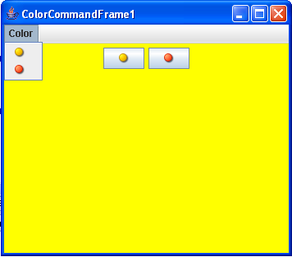
Suppose I wanted to create a simple GUI:
1 colored panel
2 buttons, yellow & red
2 menu items, yellow & red
clicking on the buttons or menu items changes the color of the panel
Since the buttons & the menu items both perform the same function, they should be tied to the same commands
I could even add popup menu items
Example

Slide 25
Using Command Strings
public class ColorCommandFrame1 extends JFrame
implements ActionListener {
private Toolkit tk = Toolkit.getDefaultToolkit();
private ImageIcon yellowIcon
= new ImageIcon(tk.getImage("yellow_bullet.bmp"));
private ImageIcon redIcon
= new ImageIcon(tk.getImage("red_bullet.bmp"));
private JPanel coloredPanel = new JPanel();
private JButton yellowButton = new JButton(yellowIcon);
private JButton redButton = new JButton(redIcon);
private JMenuBar menuBar = new JMenuBar();
private JMenu colorMenu = new JMenu("Color");
private JMenuItem yellowMenuItem = new JMenuItem(yellowIcon);
private JMenuItem redMenuItem = new JMenuItem(redIcon);
private JPopupMenu popupMenu = new JPopupMenu();
private JMenuItem yellowPopupItem = new JMenuItem(yellowIcon);
private JMenuItem redPopupItem = new JMenuItem(redIcon);
private static final String YELLOW_COMMAND = "YELLOW_COMMAND";
private static final String RED_COMMAND = "RED_COMMAND";

Slide 26
public ColorCommandFrame1() {
super("ColorCommandFrame1");
setDefaultCloseOperation(JFrame.EXIT_ON_CLOSE);
setExtendedState(JFrame.MAXIMIZED_BOTH);
initButtons();
initPopupMenu();
initMenu();
}
public void initButtons() {
yellowButton.setActionCommand(YELLOW_COMMAND);
redButton.setActionCommand(RED_COMMAND);
yellowButton.addActionListener(this);
redButton.addActionListener(this);
coloredPanel.add(yellowButton);
coloredPanel.add(redButton);
Container contentPane = getContentPane();
contentPane.add(coloredPanel);
}

Slide 27
public void initPopupMenu() {
yellowPopupItem.setActionCommand(YELLOW_COMMAND);
redPopupItem.setActionCommand(RED_COMMAND);
yellowPopupItem.addActionListener(this);
redPopupItem.addActionListener(this);
popupMenu.add(yellowPopupItem);
popupMenu.add(redPopupItem);
coloredPanel.addMouseListener(new MouseAdapter() {
public void mousePressed(MouseEvent e) {
maybeShowPopup(e);
}
public void mouseReleased(MouseEvent e) {
maybeShowPopup(e);
}
private void maybeShowPopup(MouseEvent e) {
if (e.isPopupTrigger()) {
popupMenu.show(e.getComponent(), e.getX(), e.getY());
}
}
});
}

Slide 28
public void initMenu() {
yellowMenuItem.setActionCommand(YELLOW_COMMAND);
redMenuItem.setActionCommand(RED_COMMAND);
yellowMenuItem.addActionListener(this);
redMenuItem.addActionListener(this);
colorMenu.add(yellowMenuItem);
colorMenu.add(redMenuItem);
menuBar.add(colorMenu);
setJMenuBar(menuBar);
}
public void actionPerformed(ActionEvent ae) {
String command = ae.getActionCommand();
if (command.equals(YELLOW_COMMAND))
coloredPanel.setBackground(Color.YELLOW);
else if (command.equals(RED_COMMAND))
coloredPanel.setBackground(Color.RED);
}
}

Slide 29
Note: we did not use The Command Pattern
We used separate event handler objects for each type of interaction (IMO this is better)
Some would call the command pattern an anti-pattern
What’s an anti-pattern?
a pattern to avoid
What’s wrong with it?
makes for a long link of if statements
can make for a long method/easy to make a mistake

Slide 30
Common Design Patterns
Creational
Structural
Behavioral
Factory
Singleton
Builder
Prototype
Decorator
Adapter
Facade
Flyweight
Bridge
Strategy
Template
Observer
Command
Iterator
State
Textbook: Head First Design Patterns

Slide 31
Iteration
What’s the problem?
you have to perform some operation on a sequence of elements in a given data structure
Solution:
Iterator Pattern a.k.a. Iteration Abstraction
iterate over a group of objects without revealing details of how the items are obtained
Think of someone else using a class you define

Slide 32
Iterator
An Iterator produces proper elements for processing
Defining an Iterator may be complex
Using an Iterator must be simple
they’re all used in the same way
E.g. update() all elements of List list:
Iterator it;
for (it=list.listIterator(); it.hasNext(); )
it.next().update();
Makes iteration through elements of a set “higher level”
Separates the production of elements for iteration from the operation at each step in the iteration.

Slide 33
Iterator (cont’d)
Iterator is a design pattern that is encountered very often.
Problem: Mechanism to operate on every element of a set.
Context: The set is represented in some data structure (list, array, hashtable, etc.)
Solution: Provide a way to iterate through every element.
Common Classes using Iterators in Java API
StringTokenizer
Vector, ArrayList, etc …
Even I/O streams work like Iterators

Slide 34
Iterator (in Java)
public interface Iterator {
// Returns true if there are more
// elements to iterate over; false
// otherwise
public boolean hasNext();
// If there are more elements to
// iterate over, returns the next one.
// Modifies the state “this” to record
// that it has returned the element.
// If no elements remain, throw
// NoSuchElementException.
public Object next()
throws NoSuchElementException;
public void remove();
}

Slide 35
Iterator vs. Enumeration
Java provides another interface Enumeration for iterating over a collection.
Iterator is
newer (since JDK 1.2)
has shorter method names
has a remove() method to remove elements from a collection during iteration
Iterator Enumeration
hasNext() hasMoreElements()
next() nextElement()
remove() -
Iterator is recommended for new implementations.

Slide 36
Example Loop controlled by next()
private Payroll payroll = new Payroll();
...
public void decreasePayroll() {
Iterator it = payroll.getIterator();
while (it.hasNext()) {
Employee e = (Employee)it.next();
double salary = e.getSalary();
e.setSalary(salary*.9);
}
}

Slide 37
Implementing an Iterator
public class Payroll {
private Employee[] employees;
private int num_employees;
...
// An iterator to loop through all Employees
public Iterator getIterator() {
return new EmplGen();
}
...
private class EmplGen implements Iterator {
// see next slide
...
}
}

Slide 38
Implementing an Iterator
private class EmplGen implements Iterator {
private int n = 0;
public boolean hasNext() {
return n < num_employees;
}
public Object next() throws NoSuchElementException {
Object obj;
if (n < num_employees) {
obj = employees[n];
n++;
return obj;
}
else throw new NoSuchElementException
("No More Employees");
}
}
state of iteration
captured by index n
returns true if there
is an element left
to iterate over
returns the next
element in the
iteration sequence

Slide 39
Common Design Patterns
Creational
Structural
Behavioral
Factory
Singleton
Builder
Prototype
Decorator
Adapter
Facade
Flyweight
Bridge
Strategy
Template
Observer
Command
Iterator
State
Textbook: Head First Design Patterns

Slide 40
State Pattern
Dynamically change the representation of an object.
also called Data Abstraction
Users of the object are unaware of the change.
Example:
Implement a set as a Vector if the number of elements is small
Implement a set as a Hashtable if the number of elements is large
State pattern is used only on mutable objects.

Slide 41
Example: Set
public class Set {
private Object elements;
public boolean isIn(Object member){
if (elements instanceof Vector)
// search using Vector methods
else
// search using Hashtable methods
}
public void add(Object member){
if (elements instanceof Vector)
// add using Vector methods
else
// add using Hashtable methods
}
}

Slide 42
Using the state pattern: SetRep
public interface SetRep {
public void add(object member);
public boolean isIn(Object member);
public int size();
public void remove();
}
public class SmallSet implements SetRep {
private Vector set;
public void add(Object element) { ... }
public void remove() { ... }
...
}
public class LargeSet implements SetRep {
private Hashtable set;
public void add(Object element) { ... }
public void remove() { ... }
...
}

Slide 43
Using the state pattern: a new Set
public class Set {
private SetRep rep;
private int threshold;
public void add(Object element) {
if (rep.size() == threshold)
rep = new LargeSet(rep.elements());
rep.add(element);
}
public void remove(Object element) {
rep.remove(elem);
if (rep.size == threshold)
rep = new SmallSet(rep.elements());
}
}

Slide 44
There are others too
Chain of Responsibility
Composite
Interpreter
Mediator
Memento
Proxy
Visitor

