Slide 1
CSE 219
Computer science III
Assertions, annotations,
And Reflection

Slide 2
Notes on Assertions
An assertion is a Java statement that enables you to assert an assumption about your program.
An assertion contains a Boolean expression that should be true during program execution.
Assertions can be used to assure program correctness and avoid logic errors.

Slide 3
Declaring Assertions
An assertion is declared using the new Java keyword assert in JDK 1.4 as follows:
      assert assertion; OR
      assert assertion : detailMessage;
where assertion is a Boolean expression and detailMessage is a primitive-type or an Object value.

Slide 4
Executing Assertions
When an assertion statement is executed, Java evaluates the assertion.
  If it is false, an AssertionError will be thrown.
  The AssertionError class has a no-arg constructor and seven overloaded single-argument constructors of type int, long, float, double, boolean, char, and Object.
  For the first assert statement with no detail message, the no-arg constructor of AssertionError is used.
  For the second assert statement with a detail message, an appropriate AssertionError constructor is used to match the data type of the message.
  Since AssertionError is a subclass of Error, when an assertion becomes false, the program displays a message on the console and exits.

Slide 5
Executing Assertions Example
public class AssertionDemo {
public static void main(String[] args) {
int i; int sum = 0;
for (i = 0; i < 10; i++) {
sum += i;
}
assert i == 10;
assert sum > 10 && sum < 5 * 10 : "sum is " + sum;
}
}

Slide 6
Running Programs with Assertions
By default, the assertions are disabled at runtime. To enable it, use the switch –enableassertions, or –ea for short, as follows:
java –ea AssertionDemo
public class AssertionDemo {
public static void main(String[] args) {
int i; int sum = 0;
for (i = 0; i < 10; i++) {
sum += i;
}
assert i != 10;
}
}
Exception in thread "main" java.lang.AssertionError
at AssertionDemo.main(AssertionDemo.java:7)

Slide 7
Running Programs with Assertions
Assertions can be selectively enabled or disabled at class level or package level.
  The disable switch is –disableassertions or –da for short.
  For example, the following command enables assertions in package package1 and disables assertions in class Class1.
  java –ea:package1 –da:Class1 AssertionDemo

Slide 8
Using Exception Handling or Assertions
Assertion should not be used to replace exception handling.
  Exception handling deals with unusual circumstances during program execution.
  Assertions are to assure the correctness of the program.
  Exception handling addresses robustness and assertion addresses correctness.
  Assertions are used for internal consistency and validity checks.
  Assertions are checked at runtime and can be turned on or off at startup time.

Slide 9
Using Exception Handling or Assertions
Do not use assertions for argument checking in public methods:
  Valid arguments that may be passed to a public method are considered to be part of the method’s contract.
  The contract must always be obeyed whether assertions are enabled or disabled.
  For example, the following code in the Circle class should be rewritten using exception handling:
    public void setRadius(double newRadius) {
    assert newRadius >= 0;
    radius = newRadius;
    }

Slide 10
Using Exception Handling or Assertions
Use assertions to reaffirm assumptions.
  This gives you more confidence to assure correctness of the program.
  A common use of assertions is to replace assumptions with assertions in the code.
  A good use of assertions is place assertions in a switch statement without a default case. For example:
    switch (month) {
    case 1: ... ; break;
    case 2: ... ; break;
    ...
    case 12: ... ; break;
    default: assert false : "Invalid month: " + month
    }

Slide 11
Annotations and Reflection?
What is this stuff?
Features of some languages
Programmer conveniences
Alternate development modes
Notes:
http://gwb.blob.core.windows.net/tompepe/Windows-Live-Writer/b42edb1d2197_5E6/i-dont-always-follow-coding-standards-but-when-i-do-i-follow-my-own_2.jpg

Slide 12
Annotations
Remember JUnit?
Have you seen these?
  @Before, @After, @Test
@ is Java’s notation for the start of an annotation
  like @author for javadoc
What are they?
  metadata
  provide data about a program
Notes:
http://blogs.microsoft.co.il/blogs/gilf/archive/2009/05/02/why-you-have-to-use-coding-conventions.aspx

Slide 13
What are annotations used for?
Information for the compiler
  detect errors
  suppress warnings.
Compile-time and deployment-time processing
  for IDEs and other tools
  generate code, XML files, etc.
Runtime processing
  some are used at runtime.
Notes:
http://blogs.microsoft.co.il/blogs/gilf/archive/2009/05/02/why-you-have-to-use-coding-conventions.aspx

Slide 14
Annotations can have names and data
  @Author(
  name = "Benjamin Franklin",
  date = "3/27/2003"
  )
  class MyClass()
  OR
  @SuppressWarnings(value = "unchecked")
  void myMethod() { ... }
Notes:
http://blogs.microsoft.co.il/blogs/gilf/archive/2009/05/02/why-you-have-to-use-coding-conventions.aspx

Slide 15
Where can annotations be used?
Declarations of classes, fields, methods, etc.
Java SE 8 also has type annotations:
  Class instance creation expresson:
  new @Interned MyObject();
  Type cast:
myString = (@NonNull String) str;
  implements clause:
class UnmodifiableList<T> implements
@Readonly List<@Readonly T> { ... }
  Thrown exception declaration:
void monitorTemperature() throws
@Critical TemperatureException { ... }
Notes:
http://blogs.microsoft.co.il/blogs/gilf/archive/2009/05/02/why-you-have-to-use-coding-conventions.aspx

Slide 16
Why do we care about annotations?
Tools love to use them
What tools?
  JUnit
  Javadoc
  Web-related Tools. Like what?
    JPA
    App Servers
    Etc.
Notes:
http://blogs.microsoft.co.il/blogs/gilf/archive/2009/05/02/why-you-have-to-use-coding-conventions.aspx

Slide 17
Annotations Look-Up
Scattered in the Java EE 6 API. Ex:
  http://docs.oracle.com/javaee/6/api/javax/annotation/package-summary.html
  http://docs.oracle.com/javaee/6/api/javax/faces/bean/package-summary.html
Via cheat sheet:
  http://www.physics.usyd.edu.au/~rennie/javaEE6ReferenceSheet.pdf

Slide 18
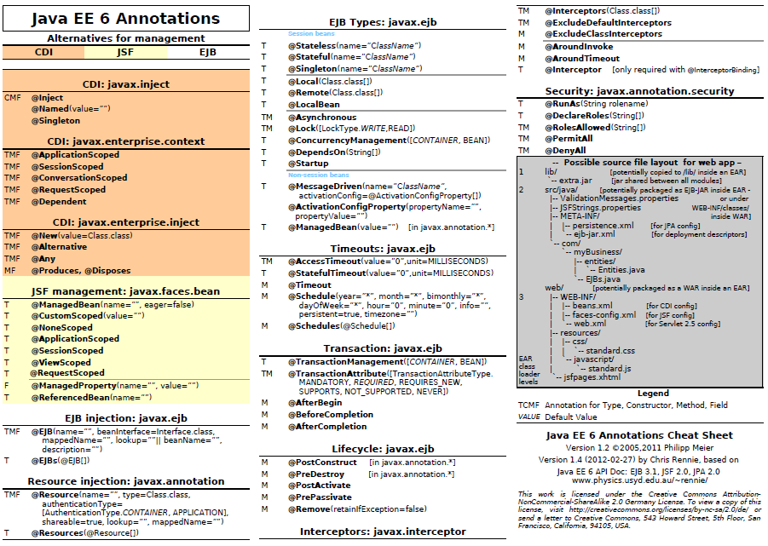

Slide 19
So what’s Reflection?
A powerful programming feature
  requires the ability to examine or modify the runtime behavior of applications running in the Java virtual machine.
i.e. dynamically examine classes and objects
Should be used only by developers who have a strong grasp of the fundamentals of the language.
Can enable applications to perform operations which would otherwise be impossible.

Slide 20
So what does it really mean?
Call methods at runtime that you didn’t know existed at compile time
  Huh?
Isn’t that polymorphism
  No, polymorphism uses inheritance and knows the overridden method signatures
At runtime:
  ask a Class what methods it has
  call one of those methods

Slide 21
What is it used for?
Extensibility Features
  dynamically use Classes not known at compile time
  plug-ins, add-ons, etc.
  complete flexibility
Class Browsers and Visual Development Environments
  i.e. display class properties
  think the visual debugger
Debuggers and Test Tools
  Watch class values change
How?
  it all starts with the Class class

Slide 22
The Class class
Every object in Java is a member of a Class
How do we get an object’s Class?
  getClass method inherited from Object. Ex:
    Class c = "Hello".getClass();
  Using Class.forName and a string. Ex:
  Class c =
  Class.forName("java.lang.String");
  Other methods:
    getSuperclass
    getDeclaredClasses
    getEnclosingClass

Slide 23
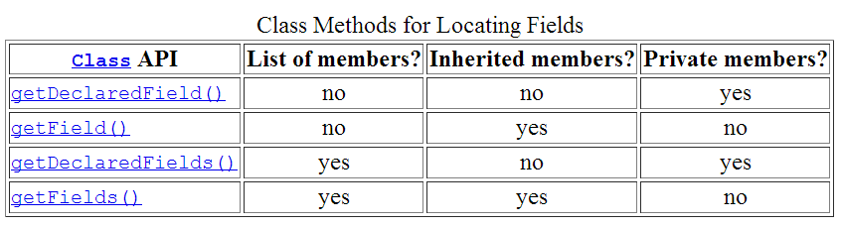
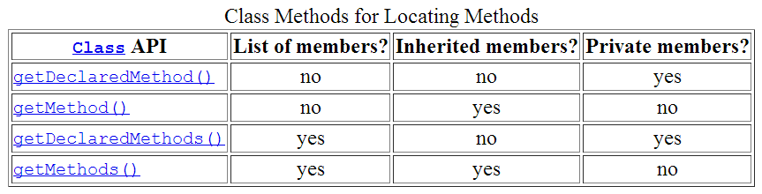
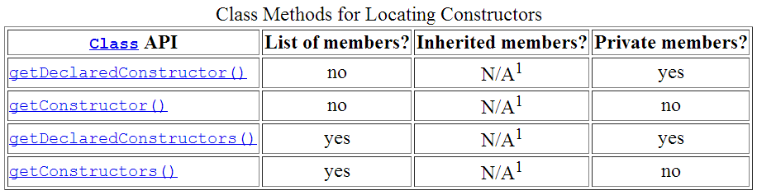
The Class class has useful methods

Slide 24
Fields
Has a type and value
Type is a Class
Get/Set data via get/set methods
For public variables, for private ones, use methods
Other useful classes
  Method
  Constructor

Slide 25
Drawbacks of Reflection
Performance Overhead
  dynamic type resolution is expensive
  certain Java virtual machine optimizations skipped
  should be avoided in hot spots
Security Restrictions
  requires a runtime permission which may not be present when running under a security manager.
    can’t be used with Applets
Exposure of Internals
  allows code to perform operations that would be illegal in non-reflective code
    accessing private fields and methods
  can result in unexpected side-effects

