Slide 1
CSE 219 Computer science III
Threads and timers

Slide 2
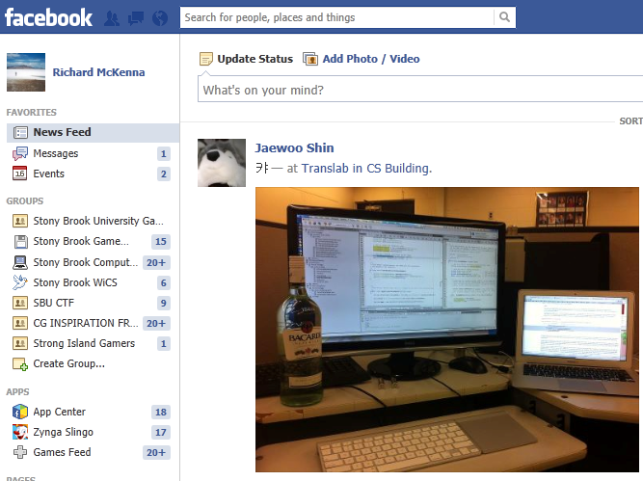

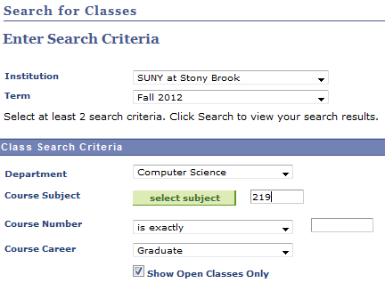
Multi-tasking
When you’re working, how many different applications do you have open at one time?

Slide 3


Multithreaded?
When you request a Web page. Should IE:
wait for the page before doing anything else
OR
do other work while waiting
like responding to user input/rendering

Slide 4
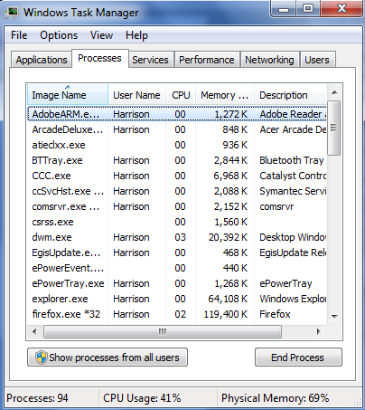
OS Multi-tasking
How many tasks is the OS performing?
3-fingered salute
How many CPUs does your PC have?

Slide 5

Tools for OS Multi-tasking
Threads
Thread scheduling
Time-sharing
Virtual Memory
CSE 306

Slide 6
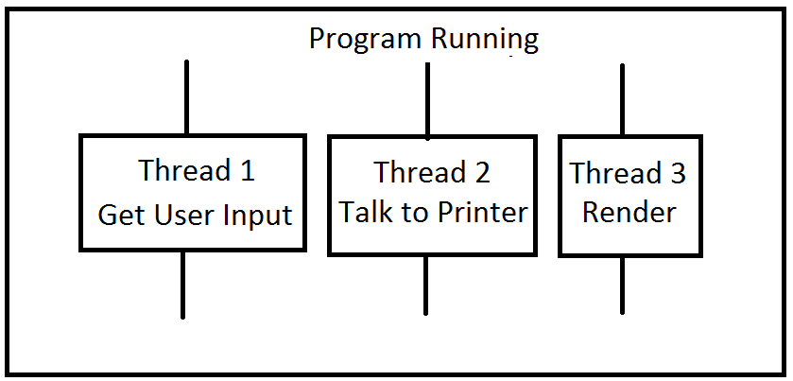
Program Multi-Tasking
Most apps need to do multiple tasks “simultaneously”
For example:
getting user input
printing
Internet
How would you do this?
using threads (that you define)
AND
using a thread scheduler (that the JVM provides)

Slide 7


Multi-Core Complicates Everything
Intel Xeon E7
10 Cores
20 Threads
We'll ignore multicore
let the OS work it out
We'll assume a single core

Slide 8

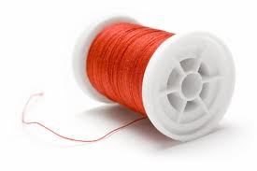
Threads and the Thread Scheduler
You define your own threads
i.e. tasks
Note: main is its own thread
You make your threads runnable
i.e. start them
Java's thread scheduler decides order
What order should it use?

Slide 9
State transitions of a thread
new
start
unblock thread
blocked
runnable
run method ends
block thread
dead

Slide 10
new state
A constructed Thread object
Not yet started
Not yet known to thread scheduler
Not runnable
new

Slide 11
New – to – Runnable Transition
Constructed thread is started
call start method on it
Can be scheduled
There may be many threads in this state
new
start
runnable

Slide 12
Runnable – to – Blocked Transition
Runnable thread made unrunnable
call sleep method on it (for X milliseconds)
directly or via lock method
Can not be scheduled
There may be many threads in this state
blocked
runnable
block thread

Slide 13
Blocked – to – Runnable Transition
Unrunnable thread made runnable
sleep time expires
and is not renewed
unlock method ensures this
Can be scheduled
unblock thread
blocked
runnable

Slide 14
Runnable – to – Dead Transition
Run method completes
Cannot be rescheduled
Dead is Dead
Call isAlive to take a pulse
runnable
run method ends
dead

Slide 15
Defining your own threads
public class MyThread extends Thread {
...
public void run() {
// task to do when
// the thread is started
}
}
Create a new thread:
MyThread mT = new MyThread();
Run the thread:
mT.start();

Slide 16
The 2 key Thread methods
start()
makes thread runnable
calls the run method
Thread class’ start method already does all of this
if your class that extends Thread you don’t have to define start
run()
executed when a thread is start()ed
where thread work is done (the point of it all)
Thread class’ run method does nothing
if your class extends Thread you must define run
to specify what work your thread will do

Slide 17
For you, run >> start
Method Summary
void | run() When an object implementing interface Runnable is used to create a thread, starting the thread causes the object's run method to be called in that separately executing thread.
run does all the work
run may do one thing or many
via iteration
it may even exist for the duration of the program

Slide 18
start vs. run
All code executes within a thread of execution
even the main method has a thread
public static void main(String[] args) {
MyThread t = new MyThread();
t.start();
…
Now we have 2 threads. What about:
public static void main(String[] args) {
MyThread t = new MyThread();
t.run();
…
Still just 1 thread. Why?

Slide 19
Run vs. Start Example
public class RandomThread extends Thread
{
public void run()
{
while (true)
{
int num = (int) (Math.random() * 10);
System.out.println("\t\t\t\t" + num);
try { Thread.sleep(10); }
catch(InterruptedException ie) {}
}
}
}

Slide 20
What will StartTester do?
public class StartTester
{
public static void main(String[] args)
{
RandomThread thread = new RandomThread();
thread.start();
while (true)
{
Calendar today = new GregorianCalendar();
long hour = today.get(Calendar.HOUR);
long minute = today.get(Calendar.MINUTE);
long second = today.get(Calendar.SECOND);
System.out.println(hour + ":"
+ minute + ":" + second);
try { Thread.sleep(10); }
catch(InterruptedException ie) {}
}
}
}
THIS IS A MULTITHREADED APPLICATION!

Slide 21
What will RunTester do?
public class RunTester
{
public static void main(String[] args)
{
RandomThread thread = new RandomThread();
thread.run();
while (true)
{
Calendar today = new GregorianCalendar();
long hour = today.get(Calendar.HOUR);
long minute = today.get(Calendar.MINUTE);
long second = today.get(Calendar.SECOND);
System.out.println(hour + ":"
+ minute + ":" + second);
try { Thread.sleep(10); }
catch(InterruptedException ie) {}
}
}
}
THIS IS NOT A MULTITHREADED APPLICATION!

Slide 22
Runnable interface
What if we want to make our frame multi-threaded?
it already extends JFrame
Alternative appraoch:
use implements Runnable
AND
define start AND run
Runnable interface has 1 method: run
What class do you think implements Runnable?

Slide 23
public class RandomFrame extends JFrame implements Runnable
{
private Thread proxyThread = null;
public void run()
{
JLabel numLabel = new JLabel("");
add(numLabel);
int counter = 0;
while (counter < 1000)
{
counter++;
numLabel.setText("" + counter);
try { Thread.sleep(10); }
catch(InterruptedException ie) {}
}
}
public void start()
{
if (proxyThread == null)
{
proxyThread = new Thread(this);
proxyThread.start();
}
}
public Thread(Runnable target)
Specifies whose run method should be called when the thread executes

Slide 24
RunnableFrame (continued)
public static void main(String[] args)
{
RandomFrame frame = new RandomFrame();
frame.start();
frame.setVisible(true);
}
}
Starts JFrame's thread

Slide 25
The Static yield() Method
You can use the yield() method to temporarily release time for other threads.
public void run() {
for (int i = 1; i <= lastNum; i++){
System.out.print(" " + i);
Thread.yield();
}
}
Every time a number is printed, the print100 thread is yielded. So, the numbers are printed after the characters.

Slide 26
Killing a thread
Threads usually perform actions repeatedly
What if you want to tell a thread to stop doing what it’s doing?
This takes cooperation between threads

Slide 27
Do not use the stop method
Why?
it's deprecated
Why?
It kills threads immediately
a thread’s run method may be mid-algorithm when killed
Preferred option: ask thread to kill itself. How?
via your own instance variable
make it a loop control for run
lets the thread set its affairs in order before dying

Slide 28
Typical run structure
public class NiceThread extends Thread
{
private boolean die = false;
public void askToDie() { die = true; }
public void run() {
while (!die) {
// do work here
try {sleep(someAmountOfTime); }
catch (InterruptedException ie) { }
}
// set affairs in order}
}
// DEAD IS DEAD
}

Slide 29
Timer Threads
Common Problem:
Need program to do something X times/second
Like what?
count time
display time
update and render scene
2 Java Options:
have your thread do the counting
have a Java Timer do the counting

Slide 30
Java Timers
Execute TimerTasks on schedule
via its own hidden thread
What do we do?
define our own TimerTask
put work in run method
construct our task
construct a timer
schedule task on timer
cancel unschedules our task (i.e. kills it)

Slide 31
Using a Timer
We could have our own Timer
private Timer animationTimer;
We could define our own task:
public class AnimateAndRenderTask extends TimerTask
We could have our own task
private AnimateAndRenderTask animator;
get the timer up and running:
animator = new AnimateAndRenderTask(sprites, this);
animator.pauseScene();
animationTimer.scheduleAtFixedRate(animator, 0L,
FRAME_RATE);

Slide 32
What does our task do?
public class AnimateAndRenderTask extends TimerTask
{ ArrayList<Sprite> spritesToAnimate;
…
public void run()
{
if (!scenePaused)
{
for (Sprite spriteToAnimate : spritesToAnimate)
{
float timeScaler = renderer.getTimeScaler();
spriteToAnimate.update(timeScaler);
}
renderer.repaint();
}
}
}
Update all sprites
Force repaint of scene

