Slide 1
CSE 219 Computer science III
Object oriented design

Slide 2
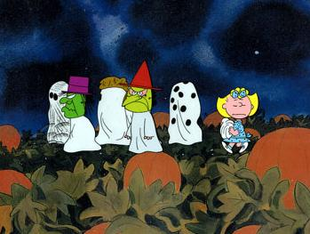
Halloween is coming!

Slide 3
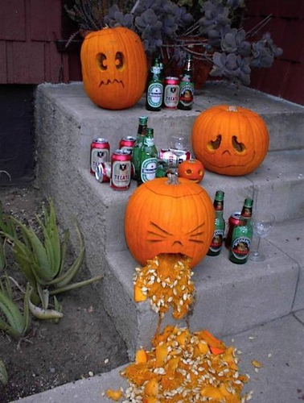
Time to Make a Jack O'Lantern

Slide 4
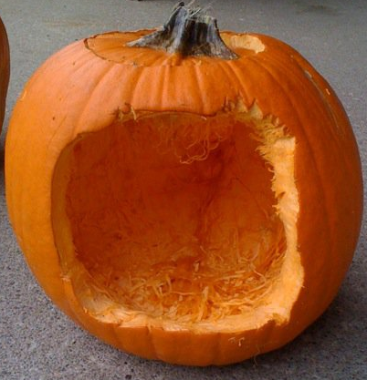
Without a plan, your Jack is doomed

Slide 5
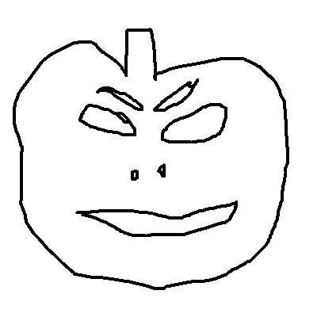


Design, prototype, then implement

Slide 6
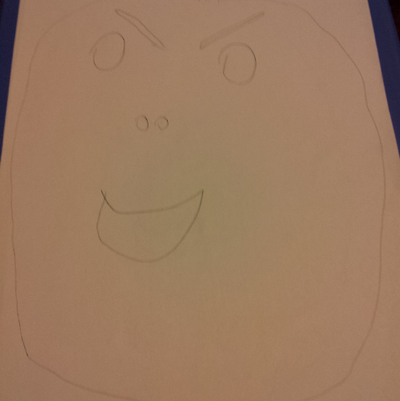
Design

Slide 7
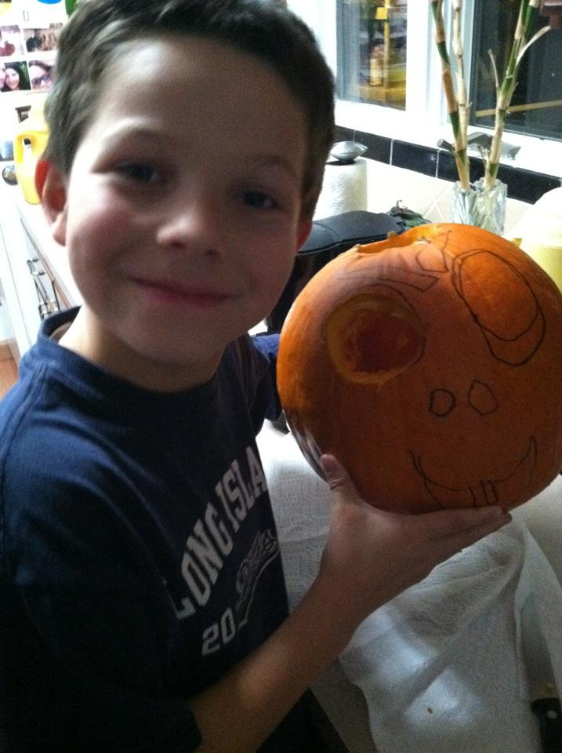
Prototype

Slide 8
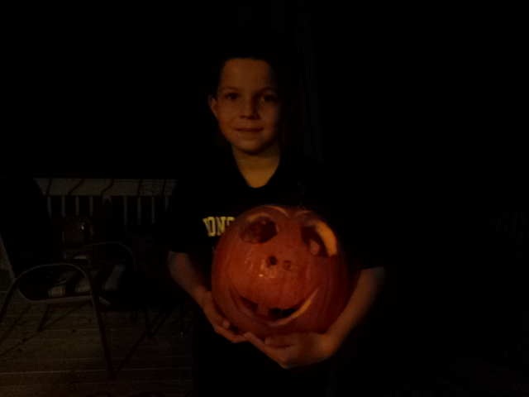
Implement

Slide 9

Enjoy

Slide 10

And of course smash

Slide 11
High Quality Software Properties
Correctness, Efficiency, Ease of use, Reliability/robustness, Reusability, Maintainability, Modifiability, Testability, Extensibility, Scalability
When should we consider these properties?
the requirements analysis & design stages
How about the implementation stages?
too late to make a big impact

Slide 12
UML Diagrams
UML - Unified Modeling Language
UML diagrams are used to design object-oriented software systems
represent systems visually
provides a system architecture
makes coding more efficient and system more reliable
diagrams show relationships among classes and objects
Can software engineering be automated?
Visual programming
Patterns & frameworks
CASE tools

Slide 13
Types of UML Diagrams
Types we'll make:
Use Case Diagram
Class Diagram
Sequence Diagram
Others:
State, Activity, Collaboration, Communication, Component, & Deployment Diagrams

Slide 14
What will we use UML Diagrams for?
Use Case Diagrams
describe all the ways users will interact with the program
Class Diagrams
describe all of our classes for our app
class names, relationships, instance variables, method signatures
Sequence Diagrams
describe all event handling
method invocation chains

Slide 15

What tools should we use?
UML modeling software
Violet UML Editor (nice simple option)
http://alexdp.free.fr/violetumleditor/page.php

Slide 16
How can these properties be achieved?
By using well proven, established processes
preferably while taking advantage of good tools
Software Development Life Cycle
Requirements Analysis
Design & Document
Evaluate Design
Code
Test
Deploy
Profile
Debug

Slide 17
Where to begin?
Understand and Define the problem
the point of a requirements analysis
What are system input & output?
How will users interact with the system?
What data must the system maintain?
Generate a problem specification document
defines the problem
defines what needs to be done to solve the problem
I'll do this for you this semester

Slide 18
Requirements Analysis
i.e. Software Specification (spec.)
Also called Software Requirements Specification (SRS)
This document serves two roles. It:
defines the problem to be solved
explains how to solve it
This is the input into the software design stage

Slide 19
What goes in an SRS/RA document?
The why, where, when, what, how, and who
Why are we making this software?
Where and when will it be created?
What, exactly, are we going to make?
How are we going to make it?
Who will be performing each role?

Slide 20
What really goes in an SRS/RA?
Detailed descriptions of all:
necessary data
program input and output
GUI screens & controls
user actions and program reactions
For a database:
necessary forms & views

Slide 21
Where do you start?
Interviews (really)
Who do you interview?
end users
What do they need?
What do they want?

Slide 22
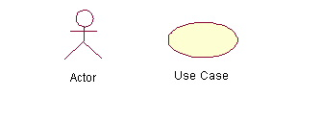
UML Use Case Diagrams
A set of scenarios that describe an interaction between a user and a system
Done first in a project design
helps you to better understand the system requirements
To draw a Use Case Diagram:
List a sequence of steps a user might take in order to complete an action.
Example actor: a user placing an order with a sales company

Slide 23
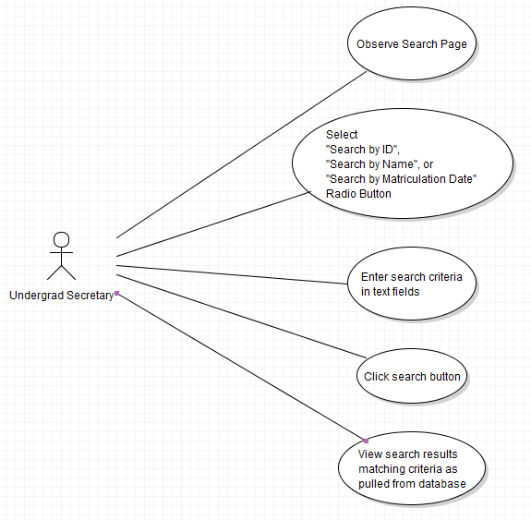
Informal UML Use Case Diagram

Slide 24
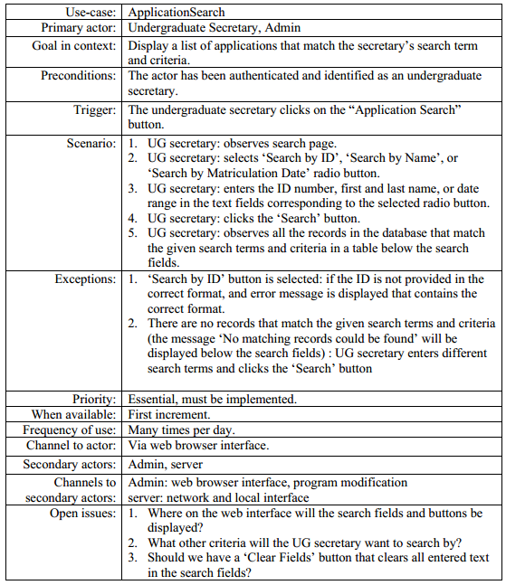
Formal UML
Use Case Diagram

Slide 25
UML Use Case Diagrams
Fed as input to the next step
What's that?
class, data, and function design
UML Class Diagrams
UML Sequence Diagrams

Slide 26
How can these properties be achieved?
By using well proven, established processes
preferably while taking advantage of good tools
Software Development Life Cycle
Requirements Analysis
Design & Document
Evaluate Design
Code
Test
Deploy
Profile
Debug

Slide 27
First things first
Have other “similar” problems been solved?
Do design patterns exist to help?
Does a framework exist to help us
Will other “similar” problems need to be solved?
Should we make a framework?

Slide 28
Class Design Approaches
Important Approaches:
Data-Driven design
Top-Down design (employing software decomposition)
What are the “easy” and “hard” parts?
Why is this important?
work measurement

Slide 29
Data-driven Design
From the problem specification, extract
nouns (objects, attributes of objects)
verbs (methods)
Divide data into separate logical, manageable groupings
these will form your objects
Note needs for data structures or algorithms
design your data management classes early on

Slide 30
Class relationships
Think data flow:
What HAS what?
What IS what?
What USES what?
Where should data go?
How will event handler X change data in class Y?
Static or non-static?
Design patterns will help us make these decisions
Bottom line: think modular
no 1000 line classes or 100 line methods

Slide 31
Modularity
How reusable are your classes?
can they be used in a future project?
Think of programmers, not just users
Can individual classes be easily separated and re-used
Data vs. Mechanics
Functionality vs. Presentation

Slide 32
Functionality vs. Presentation
What is a game state manager (GSM)?
classes that do the work of managing data & enforcing rules on that data
Why separate the GSM and the UI?
so we can change the GSM without changing the UI
so we can change the UI without changing the GSM
so we can design several different UIs for an GSM
reuse code that is proven to work
This is a common principle throughout GUI design
even for Web sites (separate content)
different programmers for each task

Slide 33
Choosing Data Structures
Internal data structures
What is the natural representation of the given data?
Setup vs. access speeds
Keep data ordered?
Which access algorithms?
Ordered by what?

Slide 34
UML Class Diagrams
A UML class diagram consists of one or more classes, each with sections for:
class name
instance variables
methods
Lines between classes represent associations
Uses
Aggregation (HAS-A), also known as containment
Inheritance (IS-A)

Slide 35
UML Class Responsibilities Diagrams
Class Name
Die
State Info: number of faces
value facing up
State info to be translated into instance variables
Responsibilities:
access instance variables
roll die
PairOfDice
State Info: die1: Die
die2: Die
Responsibilities:
access instance variables
roll dice
calculate total
Responsibilities to be translated into methods

Slide 36
UML Class Diagrams
Derived from class responsibilities diagrams
Show relationships between classes
Class associations denoted by lines connecting classes
A feathered arrow denotes a one-directional association
Connecting line means ClassA and ClassB have a relationship
ClassA
ClassB
Instance variable info
Instance variable info
Method header info
Method header info
Feathered arrow means ClassA knows of and uses ClassC, but ClassC has no knowledge of ClassA
ClassC
Instance variable info
Method header info

Slide 37
Method and Instance Variable Descriptions
Instance Variables Format
variableName : variableType
For example,
upValue : int
Method Header Format
methodName(argumentName :
argumentType): returnType
For example,
setDie1(newDie1 : Die) : void
$ denotes a static method or variable, for example:
$ myStaticMethod(x : int) : void

Slide 38
UML Class Diagrams & Aggregation
UML class diagram for PairOfDice & Die:
Diamond denotes aggregation
PairOfDice HAS-A Die
PairOfDice
Die
die1: Die
die2: Die
numFaces: int
upValue : int
1
2
getDie1() : Die
getDie2() : Die
getTotal() : int
rollDice() : void
setDie1(newDie1: Die) : void
setDie2(newDie2: Die) : void
getUpValue() : int
getNumFaces() : int
roll() : void
Denote multiplicity, 2 Die object for each PairOfDice object

Slide 39
UML Class Diagrams & Inheritance
public class Student extends Person
Person
name: String
age : int
getAge() : int
getName() : String
setAge(newAge: int) : void
Triangle denotes inheritance
Student IS-A Person
Student
gpa: double
getGPA() : double
setGPA(newGPA: double) : void

Slide 40
Encapsulation
We can take one of two views of an object:
internal - the variables the object holds and the methods that make the object useful
external - the services that an object provides and how the object interacts
From the external view, an object is an encapsulated entity, providing a set of specific services
These services define the interface to the object
abstraction hides details from the rest of the system
40

Slide 41
Class Diagrams and Encapsulation
In a UML class diagram
public members can be preceded by +
private members are preceded by -
protected members are preceded by #
PairOfDice
Die
die1: Die
die2: Die
- numFaces: int
- upValue : int
+ getDie1() : Die
+ getDie2() : Die
+ getTotal() : int
+ rollDice() : void
+ setDie1(newDie1: Die) : void
+ setDie2(newDie2: Die) : void
+ getUpValue() : int
+ getNumFaces() : int
+ roll() : void

Slide 42
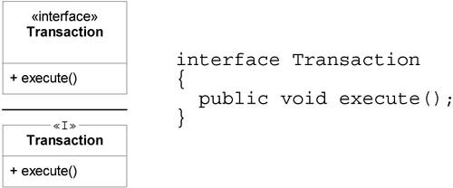
Interfaces in UML (http://www.informit.com/articles/article.asp?p=336264&seqNum=3)
2 ways to denote an interface
<<interface>>, OR
<<I>>

Slide 43
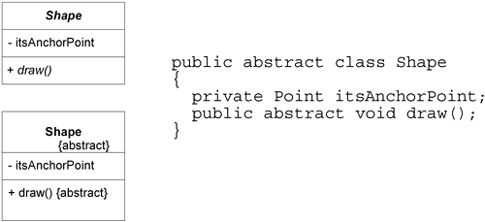
Abstract Classes in UML (http://www.informit.com/articles/article.asp?p=336264&seqNum=3)
2 ways to denote a class or method is abstract:
class or method name in italics, OR
{abstract} notation

Slide 44
UML Sequence Diagrams
Demonstrate the behavior of objects in program
describe the objects and the messages they pass
diagrams are read left to right and descending

Slide 45
Top-down class design
Top-down class design strategy:
Decompose the problem into sub-problems (large chunks)
software decomposition
Write skeletal classes for sub-problems.
Write skeletal methods for sub-problems.
Repeat for each sub-problem.
If necessary, go back and redesign higher-level classes to improve:
modularity
information hiding
information flow
etc.

Slide 46
Designing Methods
Decide method signatures
numbers and types of parameters and return values
Write down what a method should do
use top-down design
decompose methods into helper methods
Use javadoc comments to describe methods
Use method specs for implementation

Slide 47
Results of Top-down class design
UML Class Diagrams
Skeletal Classes
instance variables
static variables
class diagrams
method headers
DOCUMENTATION

Slide 48
Software Longevity
The FORTRAN & COBOL programming languages are almost 50 years old
many mainframes still use code written in the 1960s
software maintenance is more than ½ a project
Moral of the story:
the code you write may outlive you, so make it:
Easy to understand
Easy to modify & maintain
software must be ready to accommodate change

Slide 49
Software Maintenance
What is software maintenance?
Improving or extending existing software
incorporate new functionality
incorporate new data to be managed
incorporate new technologies
incorporate new algorithms
incorporate use with new tools
incorporate things we cannot think of now

Slide 50
Summary
Always use data driven & top-down design:
identify and group system data
identify classes, their methods and method signatures
determine what methods should do
identify helper methods
Write down step by step algorithms inside methods to help you!!!
document each class, method and field
specify all conditions that need to be enforced or checked
decide where to generate exceptions
add to documentation
evaluate design, and repeat above process
until implementation instructions are well-defined

