Slide 1
— course overview — 18.06: Linear Algebra
Prof. Steven Johnson,
MIT Applied Math, Physics
Fall 2018
http://web.mit.edu/18.06
https://github.com/stevengj/1806
Textbook: Strang, Introduction to Linear Algebra, 5th edition
+ supplementary notes

Slide 2
Help wanted: arrive 10 minutes early and get paid $10 to erase the boards Apply at MIT math office (2-110).

Slide 3
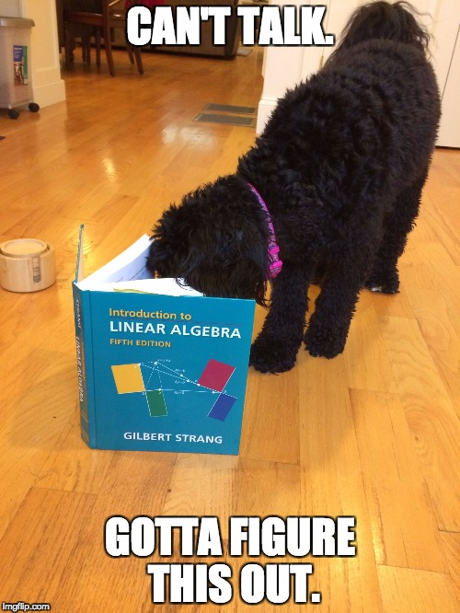
The textbook
Gil Strang, Introduction to Linear Algebra, 5th edition
For a discounted, autographed copy of the textbook, see Professor Strang in 2-245. (Cash or check only.)

Slide 4
Administrative Details
Lectures MWF11, 54-100
Tuesday recitations — use Stellar to switch sections
Weekly psets, due Wednesday 10:55am. Electronic submission through Stellar
— no extensions or makeup, but lowest pset score will be dropped
— pset 1 to be posted shortly
Grading: homework 15%, 3 exams 45% (9/28, 10/26, & 11/30), & final exam 40%
Collaboration policy: talk to anyone you want, read anything you want, but:
• Make an effort on a problem before collaborating.
• Write up your solutions independently (from “blank sheet of paper”).
• List your collaborators and external sources (not course materials).
18.06 piazza.com forum: bit.ly/2Neh71U

Slide 5
Syllabus and Calendar
Significant overlap with Strang’s OCW video lectures: these are a useful supplement but not a replacement for attending lecture. Likely topics:
Exam 1: Friday 9/28. Elimination, LU factorization, nullspaces and other subspaces, bases and dimensions, vector spaces, complexity. (Book: 1–3.5, 11.1)
Exam 2: Friday 10/26. Orthogonality, projections, least-squares, QR, Gram–Schmidt, orthogonal functions, determinants, infinite dimensional vector spaces (Book: 1–5, 10.5). Concentrating on material since exam 1, but linear algebra is cumulative!
Exam 3: Friday 11/30. Eigenvectors, determinants, similar matrices, Markov matrices, ODEs, symmetric matrices, definite matrices, matrices from graphs and engineering. (Book: 1–7, 10.1–3.)
Other topics: defective matrices, SVD and principal-components analysis, sparse matrices and iterative methods, complex matrices, symmetric linear operators on functions.
Final exam: all of the above.
Before each exam, a definitive list of topics will be announced, along with a review session.

Slide 6
What is 18.06 about?
High school:
3 “linear” equations
(only ± and × constants)
in 3 unknowns
Method: eliminate unknowns one at a time.
take “dot products” of rows × columns
Equivalent matrix problem
Ax = b
Ax is a “linear operation:”
A(x+y) = Ax + Ay
A(3x) = 3Ax
A
x
b
matrix of
coefficients
vector of
unknowns
vector of
right-hand sides

Slide 7
What is 18.06 about?
Linear system of equations,
in matrix form
Ax = b
A
x
b
Will we learn faster methods to solve this? No. (Except if A is special.) The standard “Gaussian elimination” (and “LU factorization”) matrix methods are just a slightly more organized version of the high-school algebra elimination technique.
Will we get better at doing these calculations by hand? Maybe, but who cares? Nowadays, all important matrix calculations are done by computers.
Will we learn more about the computer algorithms? A little. But mostly the techniques for “serious” numerical linear-algebra are topics for another course (e.g. 18.335).

Slide 8
How do we think about linear systems? (imagine someone gives you a 10⁶×10⁶ matrix)
All the formulas for 2×2 and 3×3 matrices would fit on one piece of paper. They aren’t the reason why linear algebra is important (as a class or a field of study).
Large problems are solved by computers, but must be understood by human beings. (And we need to give computers the right tasks!)
Understand non-square problems: #equations > #unknowns or vice versa
Break up matrices into simpler pieces
Factorize matrices into products of simpler matrices: A=LU (triangular: Gauss), A=QR (orthogonal/triangular), A=XΛX^{–1} (diagonal: eigenvecs/vals), A=UΣV* (orthogonal/diagonal: SVD)
Submatrices (matrices of matrices).
Break up vectors into simpler pieces: subspaces and basis choices.
Algebraic manipulations to turn harder/unfamiliar problems (e.g. minimization or differential equations) into simpler/familiar ones: algebra on whole matrices at once

Slide 9
Don’t expect a lot of “turn the crank” problems
on psets or exams of the form
“solve this system of equations.”
… we will turn it upside-down, give you the answer and ask the question, ask about properties of the solution from partial information, … the general goal is to require you to understand the crank rather than just turn it.

Slide 10
Where do big matrices come from? Lots of examples in many fields, but here are a couple that are relatively easy to understand…

Slide 11
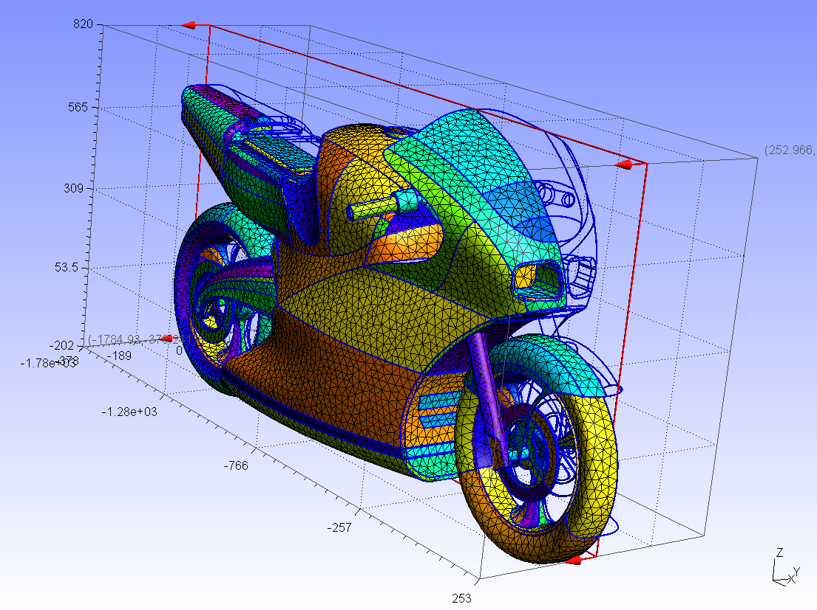
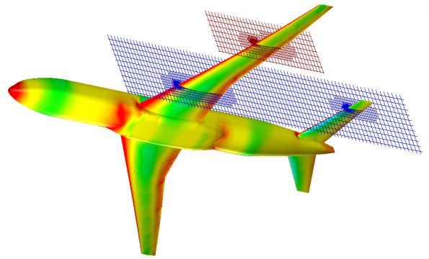
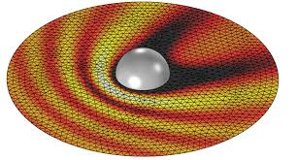
Engineering & Scientific Modeling [ 18.303, 18.330, 6.336, 6.339, … ]
http://gmsh.info/
Unknown functions
(fluid flow, mechanical stress,
electromagnetic fields, …) approximated by values on a discrete mesh/grid
e.g. 100x100x100 grid
= 10⁶ unknowns!
http://www.electronics-eetimes.com/
comsol.com

Slide 12
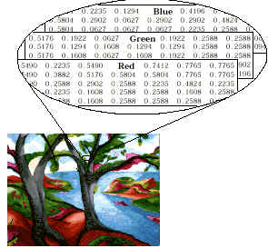
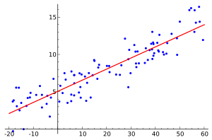
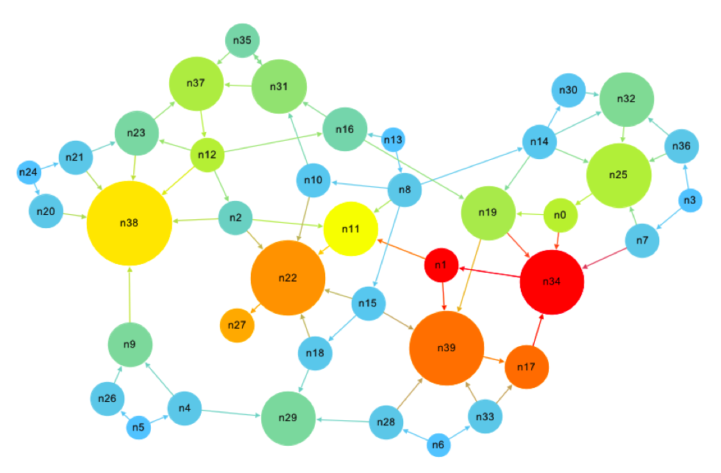
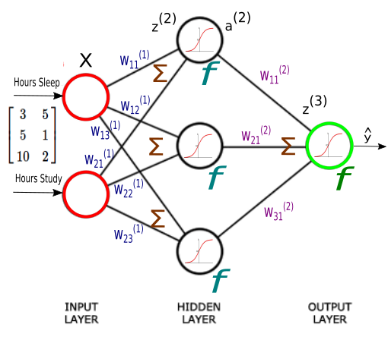
Data analysis and Machine Learning
Regression:
(curve fitting)
[ Mathworks ]
[ wikipedia ]
Image processing:
images are just matrices of numbers
(red/green/blue intensity)
Google “page rank” problem
(also for gene networks etc.)
Determine the “most important”
web pages just from how they link.
matrix = (# web pages) × (# web pages)
(entry = 1 if they link, 0 otherwise)
[ computationalculture.net ]
Machine Learning

Slide 13
Not just matrices of numbers
There are lots of surprising and important generalizations of the ideas in linear algebra.
Instead of vectors with a finite number of unknowns, similar ideas apply to functions with an infinite number of unknowns.
Instead of matrices multiplying vectors, we can think about linear operators on functions
Poisson’s equation
(e.g. 18.303)
“A”
“x”
“b”
linear
operator
∇²
unknown
function
u(x,y,z)
right-hand side
f(x,y,z)

Slide 14
18.06 vs. 18.700
“applied” vs. “pure” math
few proofs vs. formal proofs expected
(deduce patterns (definitions to
from examples, lemmas to theorems
informal arguments) … training in proof writing)
more applications vs. more theorems
more concrete vs. more abstract
some computers vs. only pencil-and-paper

Slide 15
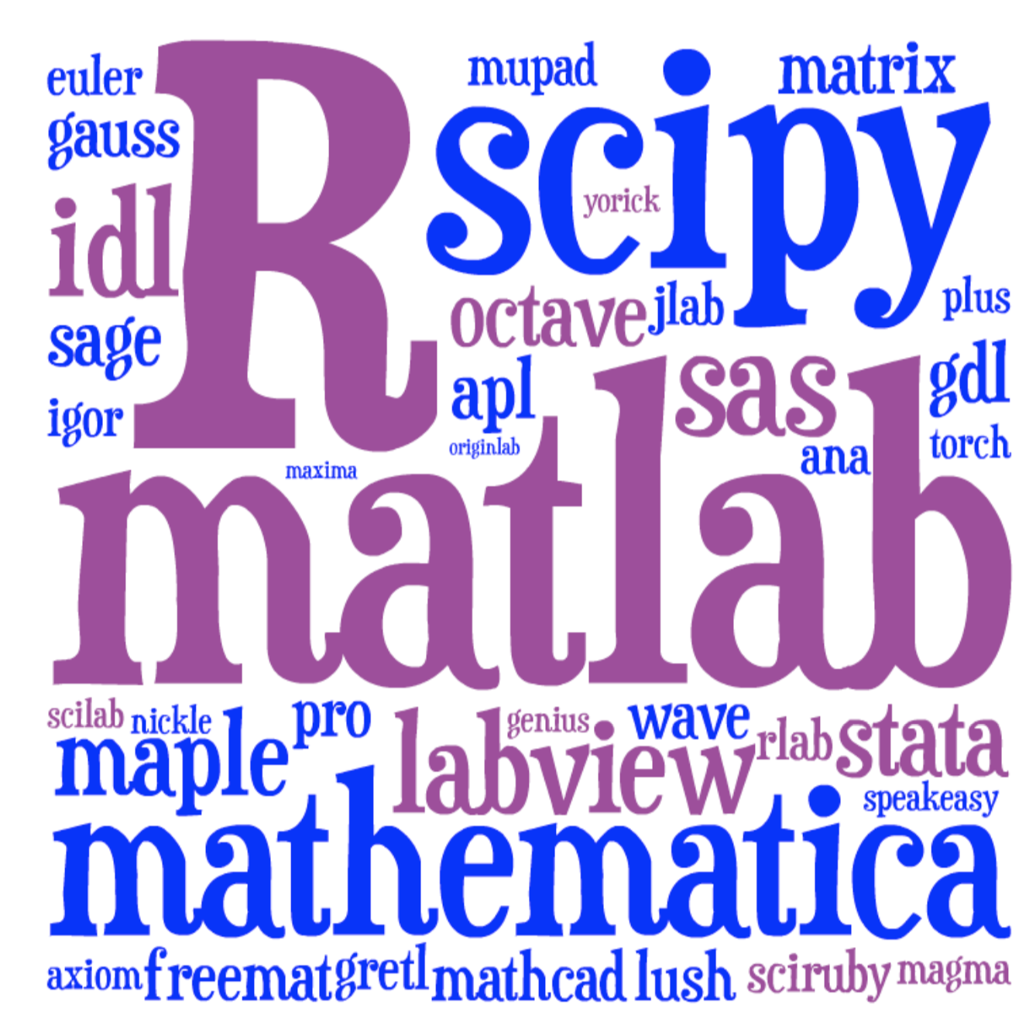

Computer software
This semester: a relatively new language
that scales better to real problems.
Lots of choices:
julialang.org
No programming required for 18.06,
just a “glorified calculator” to turn the crank.
Use it online: log in at juliabox.com
see “Julia” link on Stellar
Optional tutorial: Friday 5pm 32-141
[ image: Viral Shah ]

Slide 16

18.06 vs. 18.700
puppies vs. no puppies
“Cookie”
2-year old mini labradoodle

