Slide 1
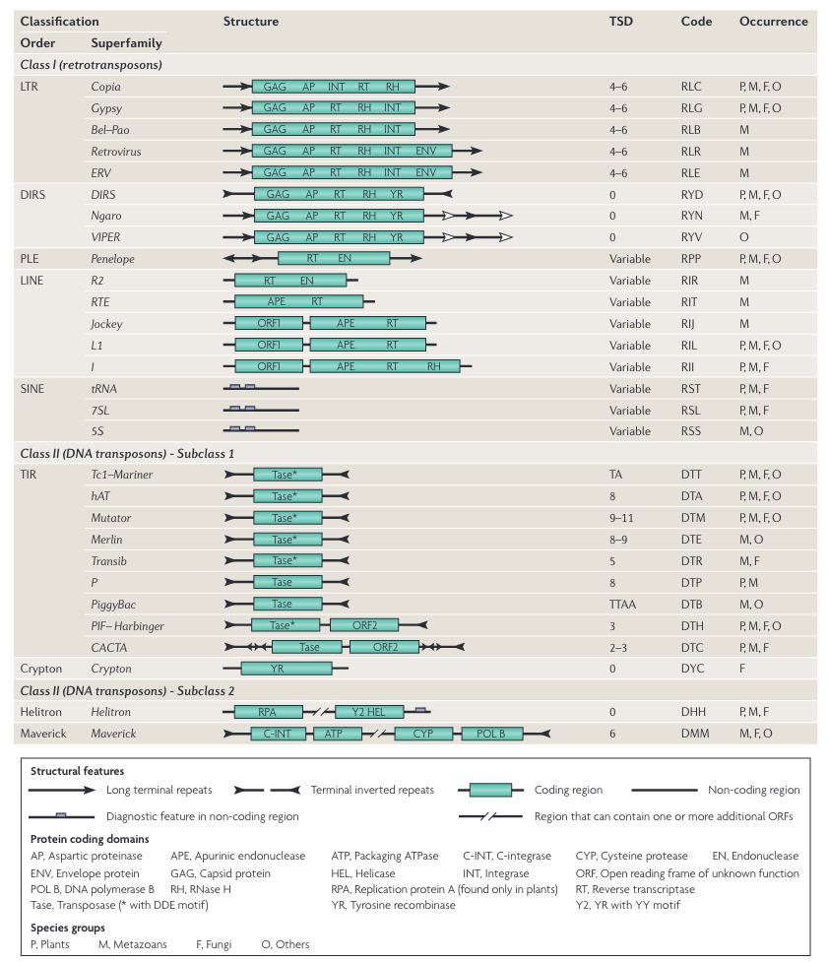
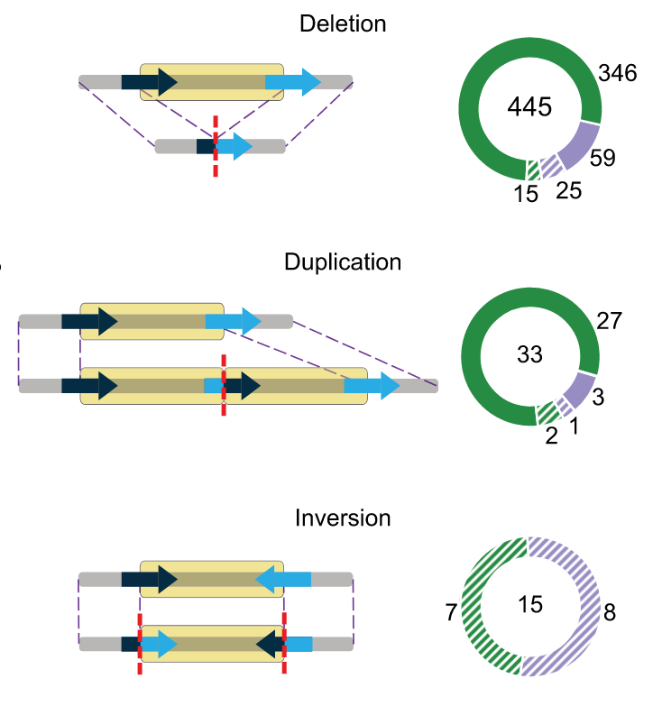
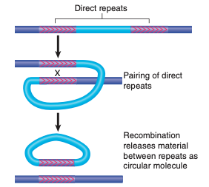
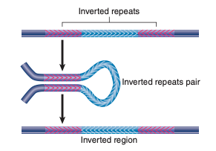
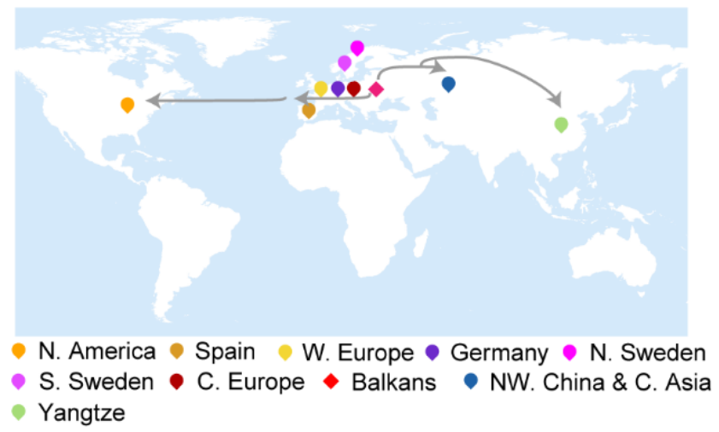
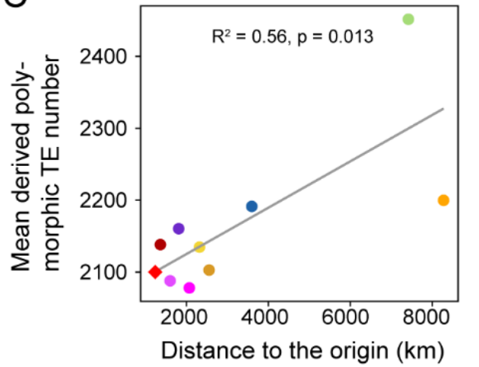
Background
1. Classification
2. TE mutation
3. Relationship between TE load and range expansion
Wicker et al., 2007
Jiang et al. 2023

Slide 2
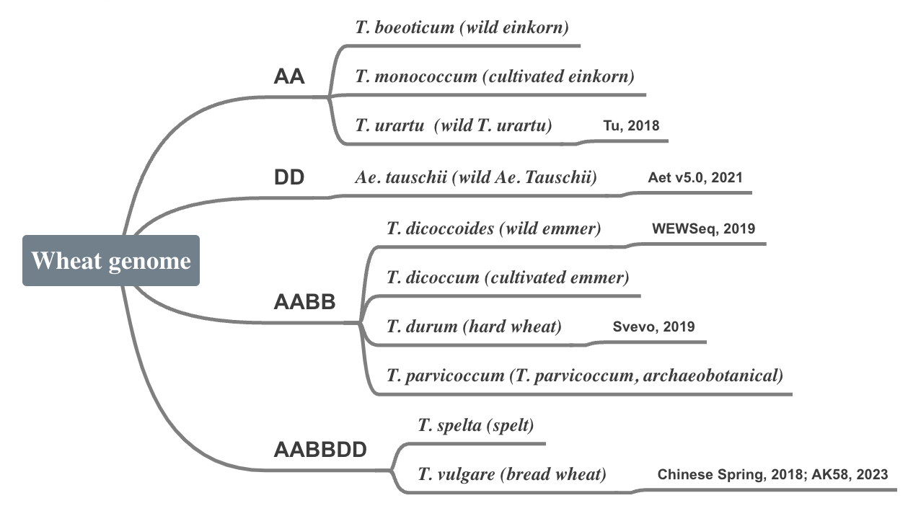
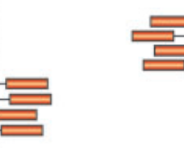
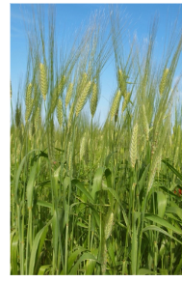


Pipeline
TE detectiing Tools:
Censor
LTR Finder
PILER
Repeat Masker
INSurVeyor
RepeatModeler2
TIR-Learner
Detection
Sample
Resequencing data of wheats:
Vmap2
Pareek et al. 2011

Slide 3
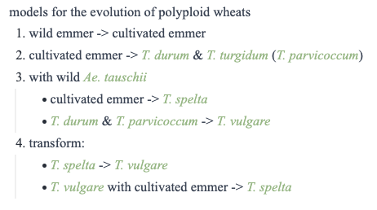
Propose
TE\Wheat |  |  |  | AABBDD | a2 | a3 | ...
class | subclass | transposon | family | Sample 1 | Sample 2 | Sample 3
class II (DNA TE) | subclass 1 | TIR | hHAT (DTA)
 |  |  | CACTA (DTC)
 |  |  | PIF/Harbinger (DTH)
 |  |  | Mutator (DTM)
 |  |  | Tcl/Mariner (DTT)
 |  | Crypton | Crypton
 | subclass 2 | Helitron | Helitron
 |  | Maverick | Maverick
 | Polinton
class I (retroTE) | LTR retroTE | LTR | Copia
 |  |  | Gypsy
 |  |  | Bel–Pao
 |  |  | Retrovirus
 |  |  | ERV
 |  | DIR | DIRS
 |  |  | Ngaro
 |  |  | VIPER
 |  | PLE | Penelope
 | non-LTR retroTE | LINE | R2
 |  |  | RTE
 |  |  | Jockey
 |  |  | L1
 |  |  | l
 | SINE |  | tRNA
 |  |  | 7SL
 |  |  | 5S
Detecting TEs in genome
Quantifying TEs in population
Quantifying TE load
Proportion of different TEs in samples

Slide 4
CS TEs library
TE annotation: iwgsc_refseqv1.0_TransposableElements_2017Mar13.gff3
Tool: RepeatMasker (DB: Dfam) Arabidopsis thaliana

Slide 5
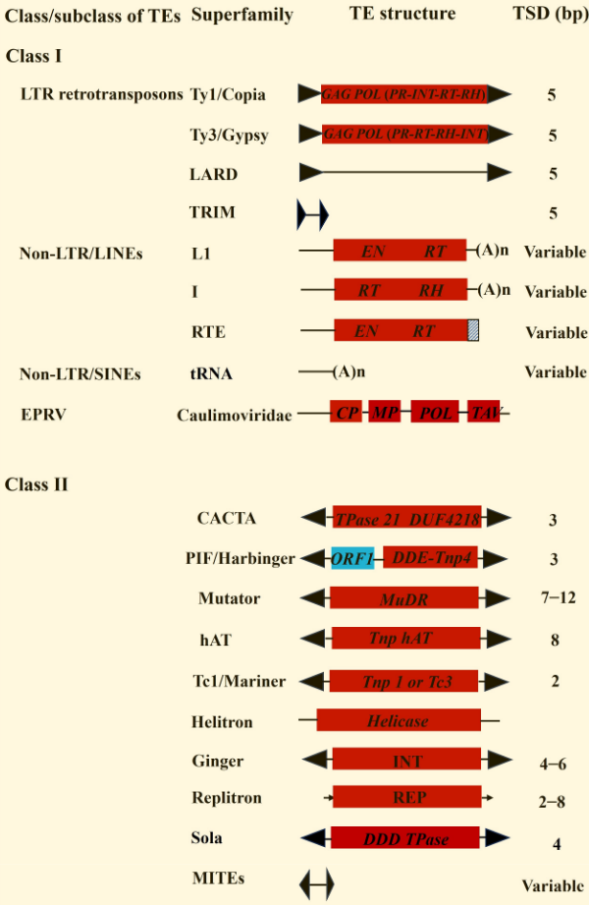
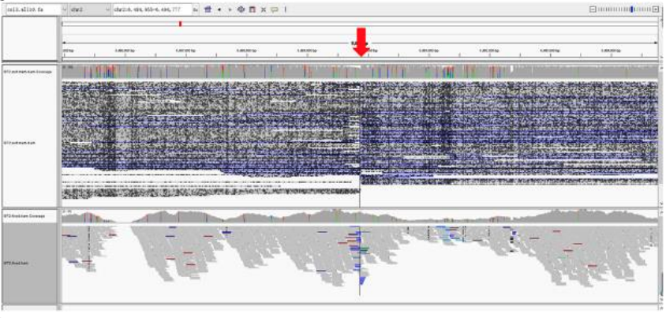
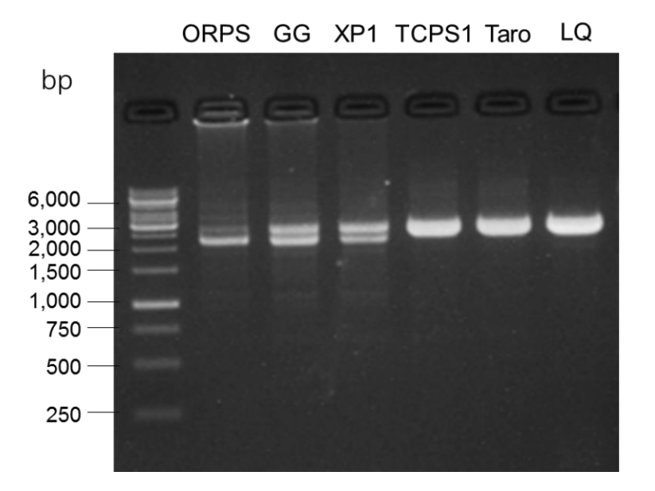
TE annotation
Activity annotation
Structural integrity:
total number of transposition-related domains for each TE
Method: gene prediction
Transcription potential: transcriptome data
DNA methylation level: extent of DNA methylation-induced TE repression
TE validation
(Gao et al., 2023)
xTea (x-Transposable element analyzer) (Chu et al., 2021, p. 2)
Short reads: MELT14, TraFiC-mem
Long reads: PALMER

Slide 6
TE age annotation
Non-LTR age estimation
Based on: extended sequence alignment of their reverse transcriptase (RT) domain.
LTR age estimation:
Based on: diversification of 2 LTR TEs on either end of each intact LTR TE
Gene distance (K)
Substitution rate (μ)
Insertion time = K/2μ
(Malik et al., 1999)
(Ma et al., 2004)
Subsequent work:
Age annotation
Other reference genome TE annotations and analysis
Main TEs

Slide 7
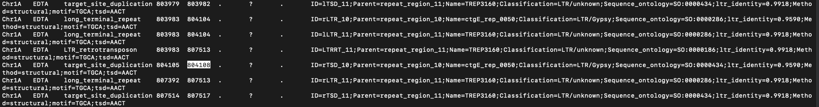
一个LTR转座子的不同组成部分
序列相同，但注释的信息有差别，看起来像是不同软件做的结果放在了一起，没有合并

Slide 8
