Slide 1
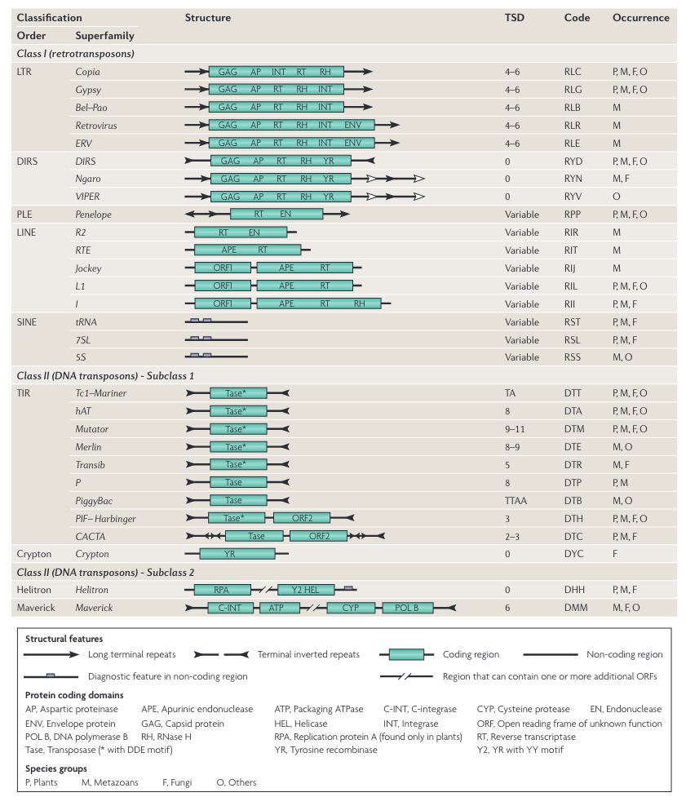
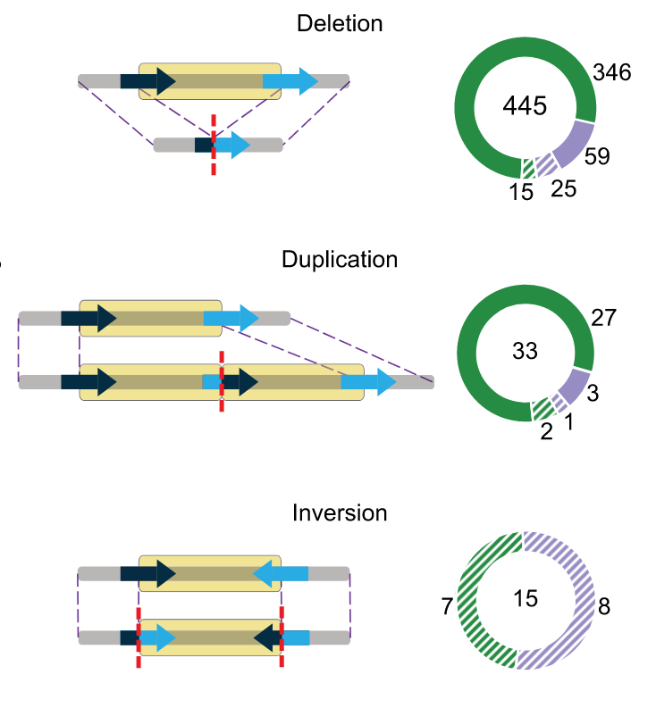
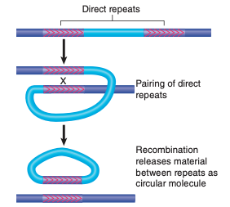
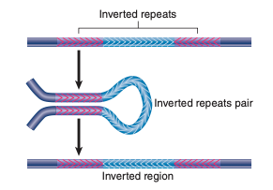
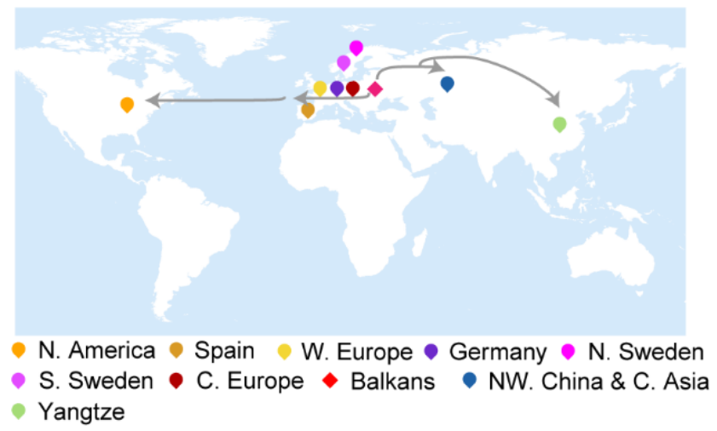
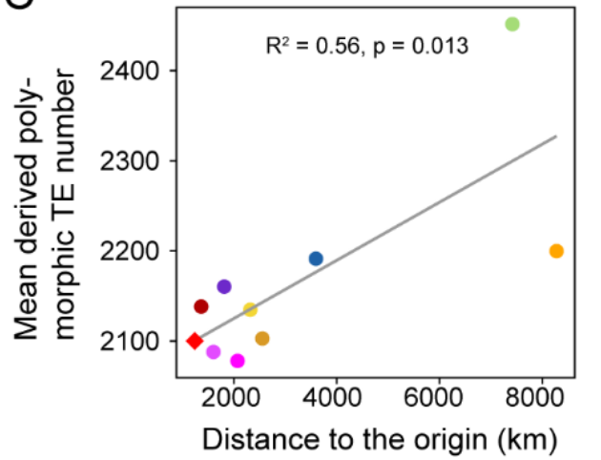
Background
1. Classification
2. TE mutation
3. Relationship between TE load and range expansion
Wicker et al., 2007
Jiang et al. 2023

Slide 2
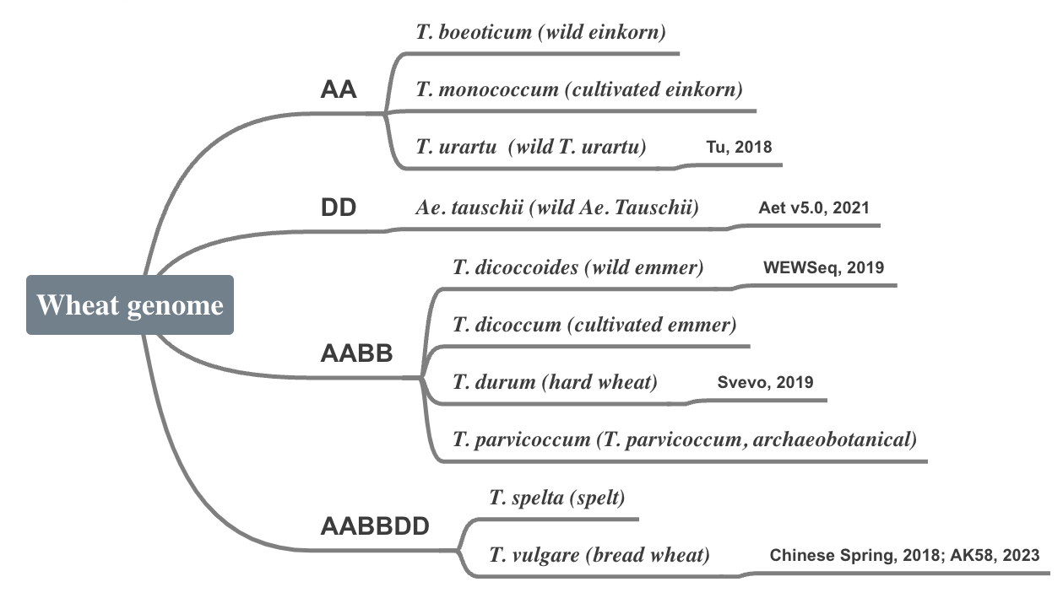
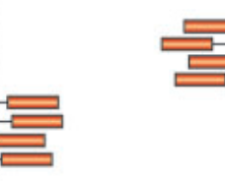
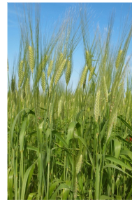


Pipeline
TE detectiing Tools:
LTR_Harvest
LTR_Finder
RepeatMasker
TIR-Learner
HelitronScanner
RECON
PILER
MITE-Hunter
Detection
Sample
Resequencing data of wheats:
Vmap2
Pareek et al. 2011

Slide 3
TE library
1. Curated TE library
Source | Species | number
TREP v.19 | Triticum monococcum | 169
 | Triticum urartu | 22
 | Aegilops tauschii | 22
 | Triticum durum | 100
 | Triticum aestivum | 801
 | Triticum unknown | 70
2. Putative TE library
Source | Species | number
Dfam | Hordeum vulgare | 1101
 | Aegilops tauschii | 1308

Slide 4
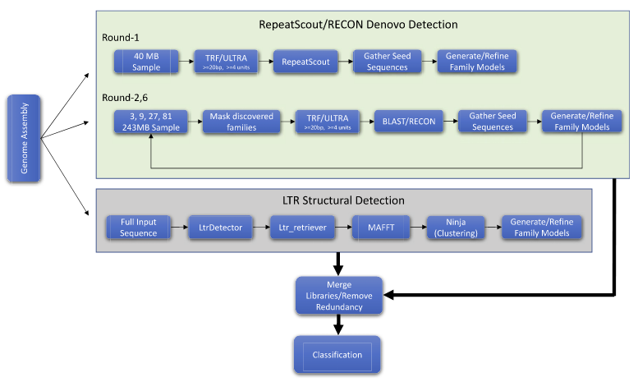
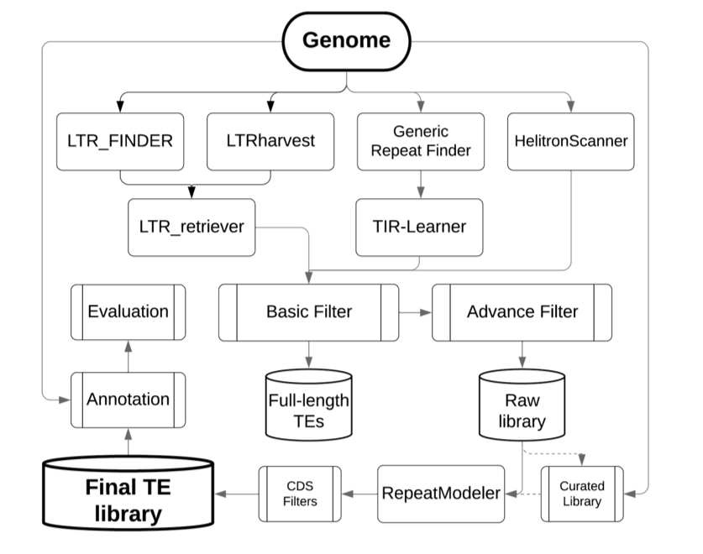
TE detection
1. RepeatModeler2

Slide 5
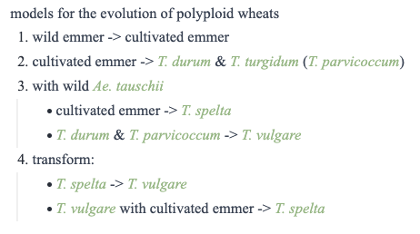
Population analysis
TE\Wheat |  |  |  | AABBDD | a2 | a3 | ...
class | subclass | transposon | family | Sample 1 | Sample 2 | Sample 3
class II (DNA TE) | subclass 1 | TIR | hHAT (DTA)
 |  |  | CACTA (DTC)
 |  |  | PIF/Harbinger (DTH)
 |  |  | Mutator (DTM)
 |  |  | Tcl/Mariner (DTT)
 |  | Crypton | Crypton
 | subclass 2 | Helitron | Helitron
 |  | Maverick | Maverick
 | Polinton
class I (retroTE) | LTR retroTE | LTR | Copia
 |  |  | Gypsy
 |  |  | Bel–Pao
 |  |  | Retrovirus
 |  |  | ERV
 |  | DIR | DIRS
 |  |  | Ngaro
 |  |  | VIPER
 |  | PLE | Penelope
 | non-LTR retroTE | LINE | R2
 |  |  | RTE
 |  |  | Jockey
 |  |  | L1
 |  |  | l
 | SINE |  | tRNA
 |  |  | 7SL
 |  |  | 5S
Detecting TEs in genome
Quantifying TEs in population
Quantifying TE load
Proportion of different TEs in samples

Slide 6
CS TEs library
TE annotation: iwgsc_refseqv1.0_TransposableElements_2017Mar13.gff3
Tool: RepeatMasker (DB: Dfam) Arabidopsis thaliana

Slide 7
TE age annotation
Non-LTR age estimation
Based on: extended sequence alignment of their reverse transcriptase (RT) domain.
LTR age estimation:
Based on: diversification of 2 LTR TEs on either end of each intact LTR TE
Gene distance (K)
Substitution rate (μ)
Insertion time = K/2μ
(Malik et al., 1999)
(Ma et al., 2004)
Subsequent work:
Age annotation
Other reference genome TE annotations and analysis
Main TEs

Slide 8
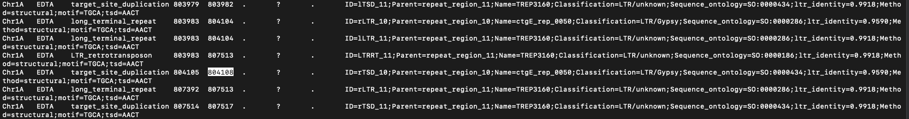
一个LTR转座子的不同组成部分
序列相同，但注释的信息有差别，看起来像是不同软件做的结果放在了一起，没有合并

Slide 9
