Slide 1
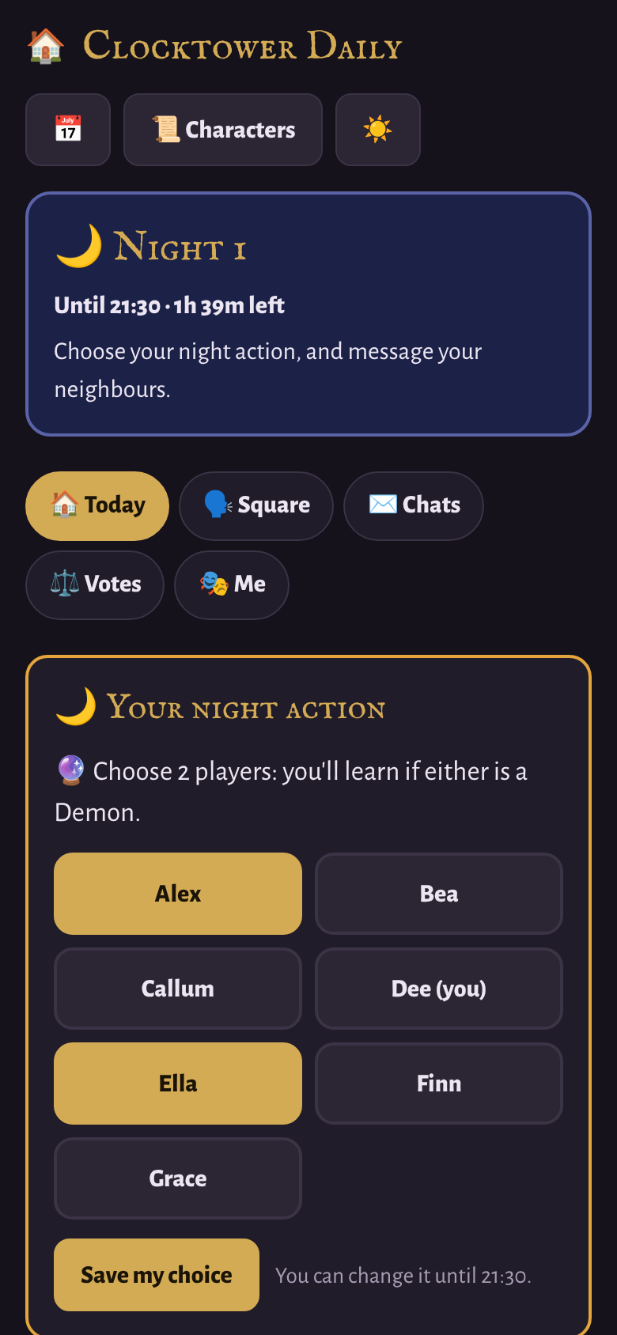

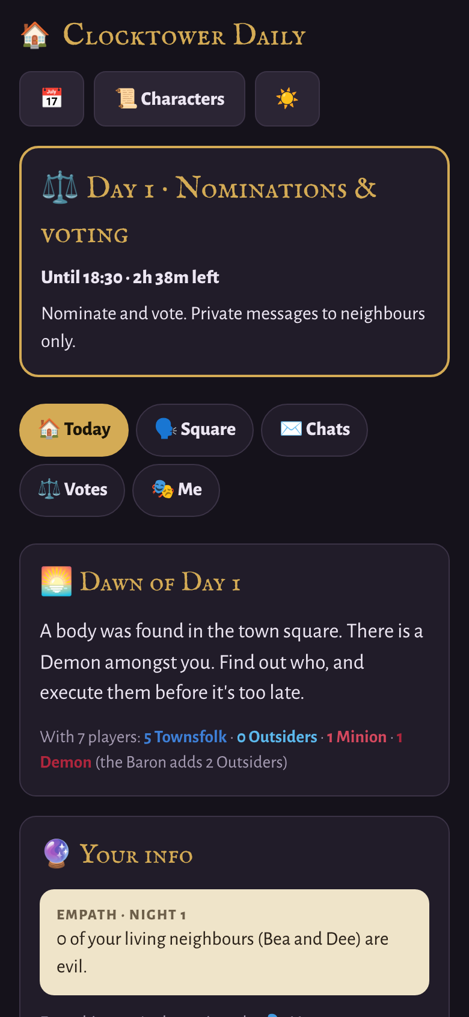
Clocktower Daily
How to play: a guide for players
Blood on the Clocktower, one day at a time
Notes:
Welcome, everyone. Over the next few days we're going to play Blood on the Clocktower in a new way. Instead of all sitting round a table for one evening, the game runs for several days on your phones, and you play whenever it suits you.
This short guide walks you through how it works, from joining the game to casting your vote. It takes about ten minutes, and there's time for questions at the end.

Slide 2



A game that fits around your day
On your phone
Runs on the clock
Secrets stay secret
Your character, your night actions, your chats and your votes: all in one app.
The day moves on by a timetable. Nobody needs to be online at the same time.
Only you can see your character, your info and your private messages.
A game usually lasts 4 to 7 days. Check in a few times a day and you won't miss a thing.
Notes:
Here's the big idea. Clocktower Daily is the same game you know, good against evil with a Demon hiding in the town, but stretched over several days.
Everything happens on your phone: your character, your night actions, your conversations and your votes. The day moves on by the clock, so you don't need to be online at the same time as anyone else. You just need to check in a few times a day.
And your secrets are safe. Nobody else can see your character, your information or your private messages. A game usually lasts somewhere between four and seven days.

Slide 3
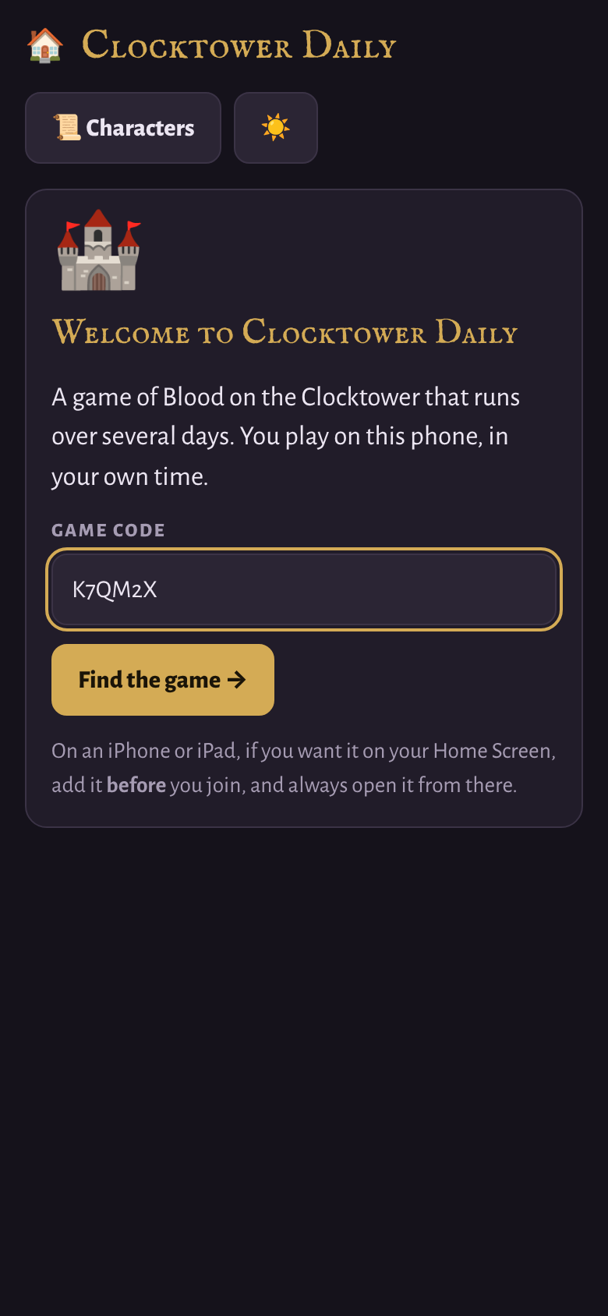

Joining the game
1
Open the link
Use the link from your Storyteller, or scan the QR code at the end of this guide.
2
Enter the code and your name
The game code has 6 letters and numbers.
3
Wait to be seated
Your Storyteller seats you in the circle. Your character appears when they deal.
Use the same phone and browser all game.
On an iPhone or iPad, add the app to your Home Screen before you join, then always open it from there.
Notes:
Getting in takes about a minute. Open the link I'll send you, or scan the QR code at the end of this guide. Type in the six-letter game code and your name, then wait. I'll give you a seat in the circle, and when I deal the characters, yours appears on your screen.
Two important tips. First, use the same phone and the same browser all game, because that's how the app knows it's you. Second, if you're on an iPhone or iPad and you want the app on your Home Screen, add it before you join and always open it from there.
If you do have to switch phones, just join again with the same name, and I'll move your seat across.

Slide 4








Your day at a glance
07:30
07:45
13:30
18:30
19:00
19:30
21:30
Dawn
Private chats
Nominations
Voting closes
Execution revealed
Night falls
Night closes
Deaths and your night info
Message anyone
Neighbours-only chats
Votes are counted
Every vote is shown
Make your night choice
The Storyteller gets to work
Never miss a deadline. Tap the calendar button in the app to add the timetable to your phone's calendar, with reminders before voting and night actions close. Your Storyteller may change the times.
Notes:
Every day follows the same rhythm.
At half past seven in the morning, dawn breaks. You find out who died in the night, and anything your character learnt arrives on your phone. From quarter to eight, you can have private chats with anyone.
At half past one, nominations open, and from then on private chats are only with your neighbours. Voting closes at half past six, and the execution is revealed at seven.
Then night falls at half past seven, and anyone with a night ability has until half past nine to make their choice. After that, I work through the night.
I can tweak these times if we need to. The calendar button in the app adds the whole timetable to your phone's calendar, with reminders before voting and night actions close.

Slide 5




Five tabs, everything you need
Today
The news from the night, your night action, your latest info, the town and today's times.
Square
The public town square: everyone can read what you post.
Chats
Private one-to-one messages. Only the two of you can read them.
Votes
Nominations, defences and your secret votes.
Me
Your character, your ability and everything you've learnt.
A red dot on a tab means there's something new.
Notes:
The app has five tabs along the top.
Today is your home page: the news from the night, your night action, your latest info, the seating plan and today's timetable.
Square is the public town square, where everyone can read what you post. Chats is for private one-to-one messages. Votes is where nominations happen and where you cast your secret votes. And Me shows your character, what your ability does, and everything you've learnt so far.
If you see a red dot on a tab, there's something new to look at.

Slide 6



Night: make your choice
Some characters choose players at night. If yours does, a card appears on your Today tab between 19:30 and 21:30.
Poisoner
Monk
Imp
Fortune Teller
Butler
Ravenkeeper
Tap the players you choose
Tap Save my choice
Change your mind until 21:30
No night action? Sleep tight. You can still message the players sitting either side of you.
Notes:
When night falls, players whose characters act at night get a card on their Today tab. For example, the Fortune Teller picks two players, the Monk picks someone to protect, and the Imp picks who to kill.
Tap the players, then tap Save my choice. You can change your mind right up until night actions close at half past nine.
If your character doesn't do anything at night, you can just sleep, though you can still message the players sitting either side of you. Once the night closes, I work through everyone's choices by hand and decide what happens.

Slide 7
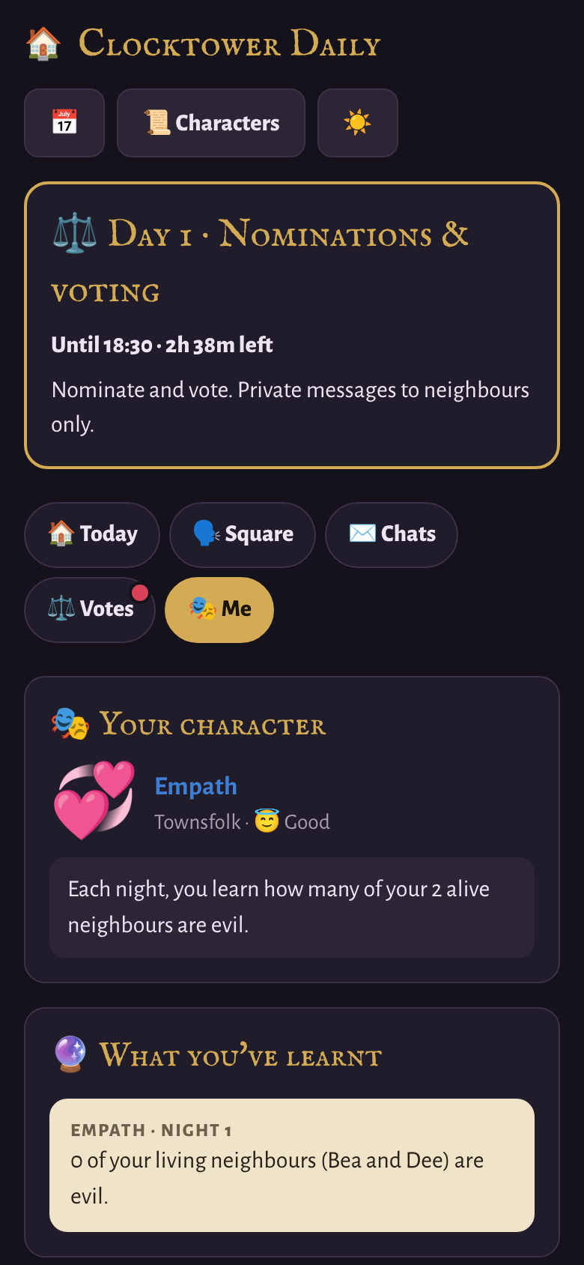



Dawn: what happened in the night
Who died
At 07:30 the Today tab shows who was found dead in the night.
Your info arrives
Anything your character learnt appears in a parchment box, marked with the night.
Look back any time
Everything you've learnt stays under the Me tab.
Day 1 is different: nobody dies on the first night. You'll see how many of each character type are in play.
Notes:
At dawn, open the app to see what happened. The Today tab tells you who was found dead in the night.
On the very first morning nobody has died yet. Instead it reminds everyone that there's a Demon amongst you, and shows how many Townsfolk, Outsiders, Minions and Demons are in play.
If your character learnt something overnight, it appears in a parchment-coloured box, marked with the night it came from. Everything you've ever learnt is kept under the Me tab, so you can always look back.

Slide 8
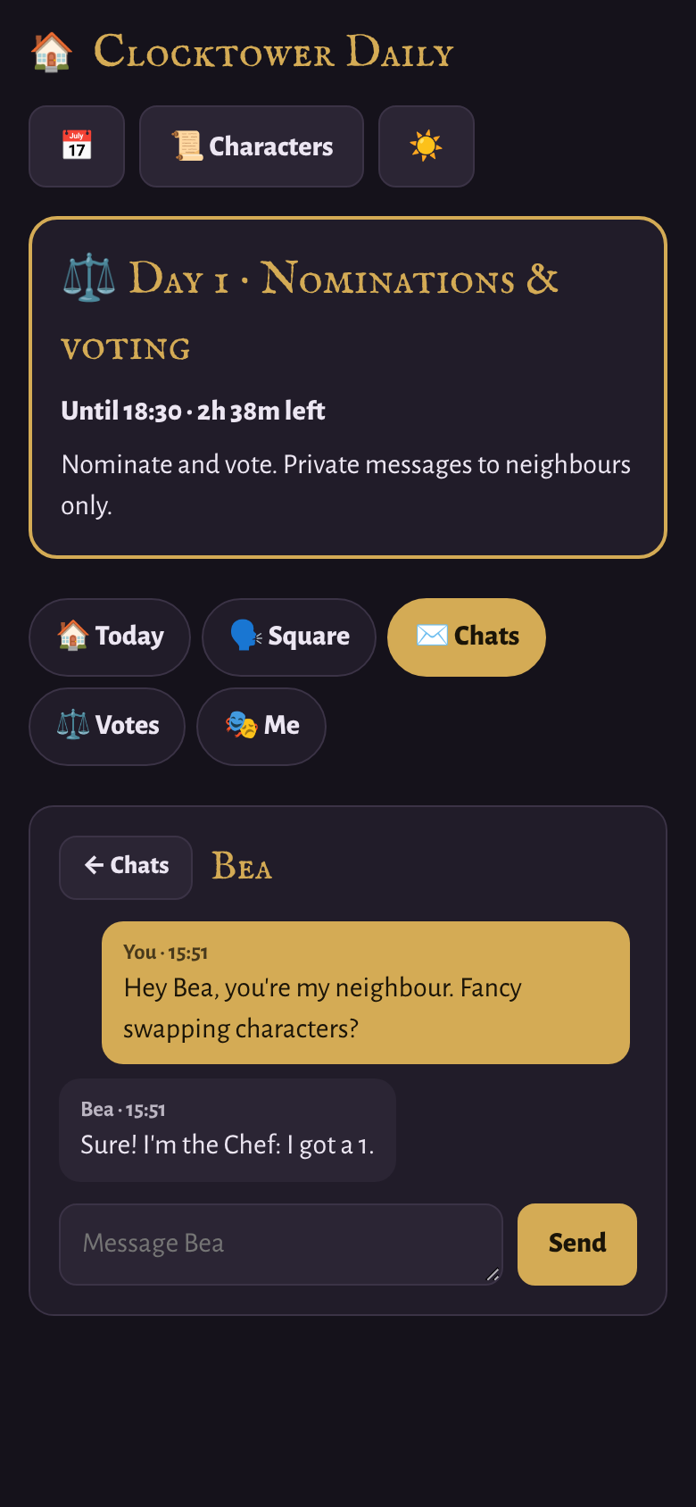
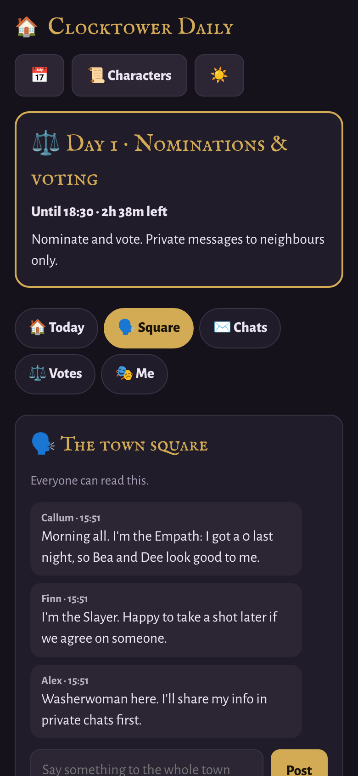
Talk, talk, talk
Private chats
Town square
Only the two of you can read a chat.
07:45 to 13:30: message anyone.
Other times: only your neighbours, the players sitting either side of you.
Everyone can read it.
Open all day, closed at night.
Slayer? Take your one shot from here. Anyone can claim it.
Notes:
Clocktower is all about talking, and there are two ways to do it.
Private chats are one to one, and only the two of you can read them. In the morning, during the private chats window, you can message anyone. The rest of the time, during nominations and at night, you can only message your neighbours: the players sitting either side of you.
The town square is the opposite: everything there is public. Use it to share claims, make accusations and get organised. And if you're the Slayer, or you want people to think you are, you can take your once-per-game Slayer shot from the square.

Slide 9
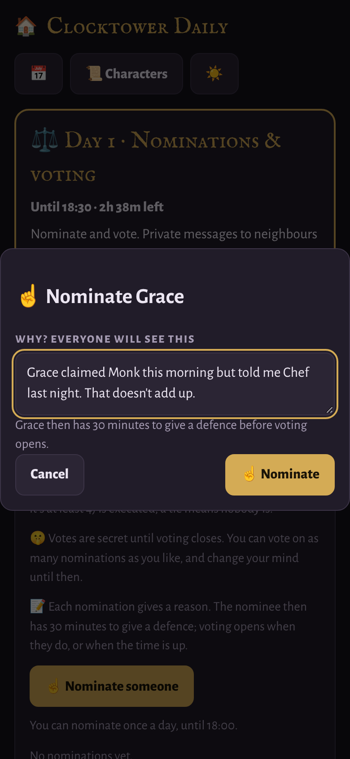
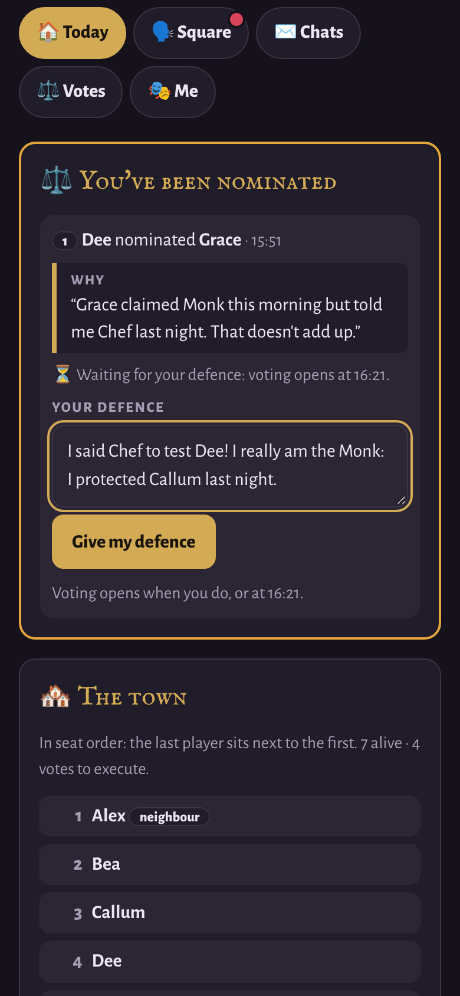



Nominations: reason, defence, vote
1. Nominate, with a reason
You can nominate once a day, and each player can be nominated once a day. Everyone sees your reason.
2. The nominee defends
They're told straight away and have 30 minutes to write a defence.
3. Voting opens
As soon as the defence is in, or when the 30 minutes are up.
Nominations stop 30 minutes before voting closes, and they're always listed in the order they were made.
Notes:
Nominations open at half past one, and they work in three steps.
First, someone nominates, and they have to give a reason, which everyone can see. You can nominate once a day, and each player can only be nominated once a day.
Second, the nominee is told straight away, and gets thirty minutes to write a defence.
Third, voting on that nomination opens as soon as the defence is in, or when the thirty minutes are up.
New nominations stop thirty minutes before voting closes, so the last person nominated still gets a fair hearing. And nominations are always listed in the order they were made, with the first at the top.

Slide 10
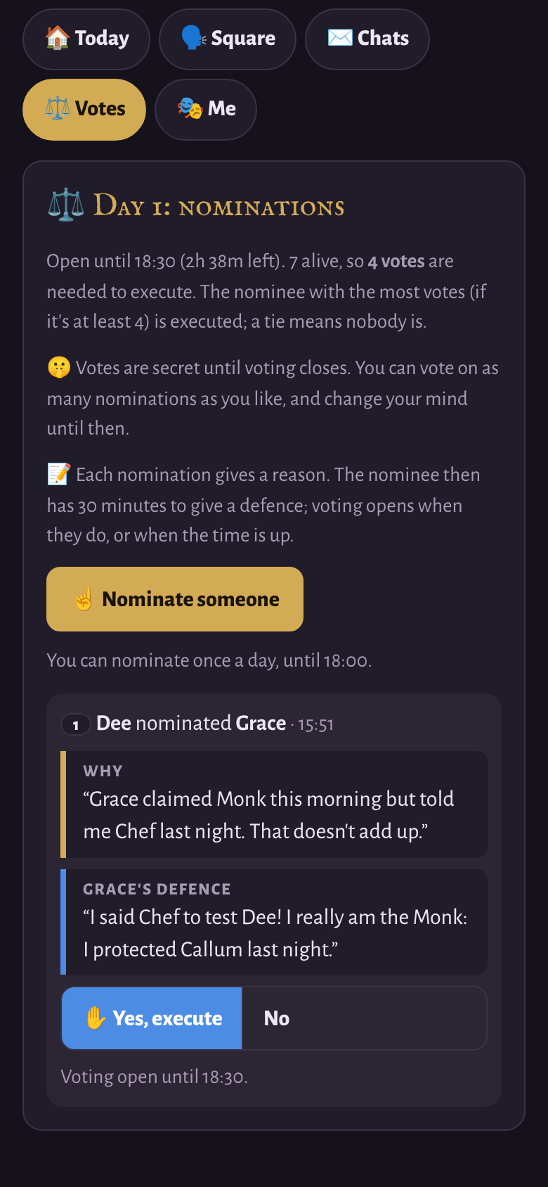
Voting
Half
Secret
To be executed, a player needs the most votes, and votes from at least half the living players.
Votes are secret until voting closes at 18:30.
Change
Ghost
Vote on as many nominations as you like, and change your mind until 18:30.
Dead? You have one ghost vote for the rest of the game.
A tie at the top means nobody is executed. The Butler's vote only counts if their Master votes too.
Notes:
Voting is secret until it closes at half past six. Tap 'Yes, execute' on any nomination you support. You can vote on as many nominations as you like, and you can change your mind until voting closes.
To be executed, a player needs the most votes, and votes from at least half the living players. If there's a tie at the top, nobody is executed.
If you're dead, you get one ghost vote for the rest of the game, so use it wisely. And a word for the Butler: your vote only counts if your Master votes for the same person.

Slide 11
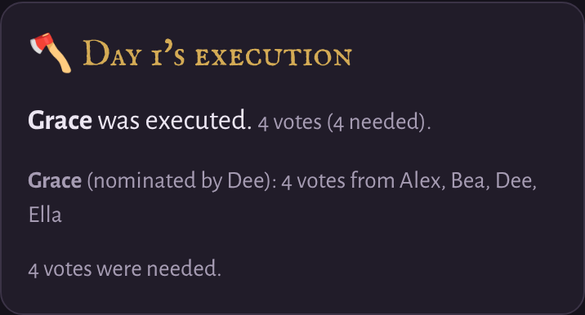


19:00: the execution
Most votes (and enough)
A tie at the top
Every vote revealed
That player is executed.
Nobody is executed.
See exactly who voted for whom. Study it!
Notes:
At seven o'clock, the result is revealed to everyone. You'll see who was executed, or that nobody was, and exactly how everyone voted on every nomination.
That's often the most useful information of the day, so study it! Then night falls at half past seven, and the cycle begins again.

Slide 12
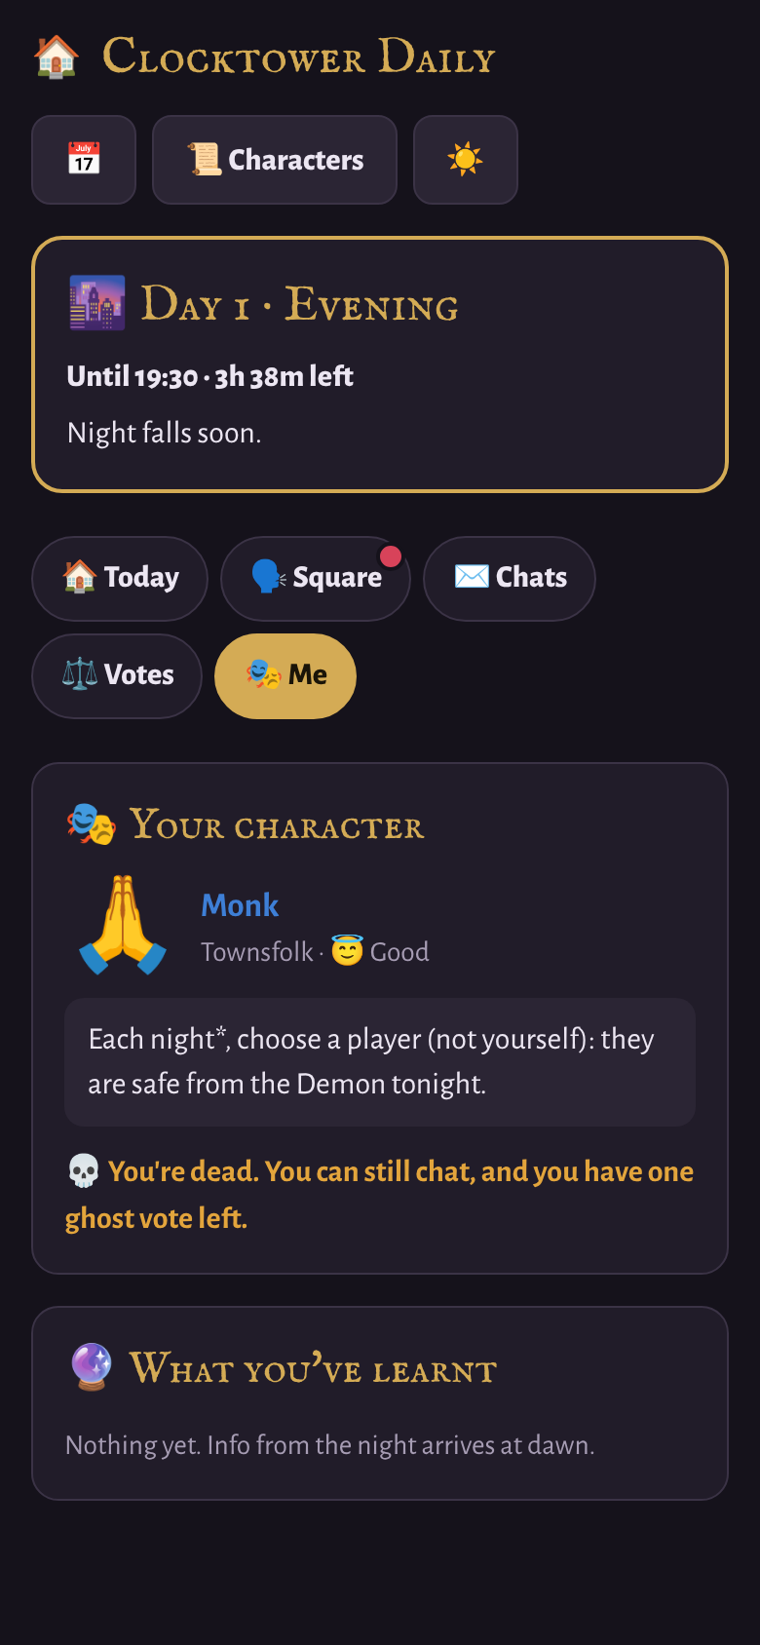


Dead, but not done
You still can
You can't
Chat privately
Post in the town square
Use your one ghost vote
Help your team win
Nominate
Take a night action
Your ghost vote
Use it on any one nomination, on any day. Games are often won or lost on the ghost votes, so stay involved!
Notes:
Dying isn't the end. If you die, you can still chat privately, and you can still read and post in the town square. You just can't nominate, and you don't get a night action.
You do keep one ghost vote, which you can use on any one nomination for the rest of the game. Lots of games are won or lost on the ghost votes, so stay involved.

Slide 13



Good habits
Check in three times a day
Add the calendar
Give real reasons
Morning for the news, after lunch for nominations, evening for the result and your night action.
Tap the calendar button once and your phone reminds you before each deadline.
A good reason for a nomination gets the town talking.
Always defend yourself
Keep your screen to yourself
Stuck? Ask your Storyteller
If you're nominated, write a defence. Silence looks suspicious!
What you share, and what you bluff, is up to you.
If something isn't working, message them outside the app.
Notes:
A few tips to get the most out of the game.
Check in at least three times a day: in the morning for the news, after lunch for nominations, and in the evening for the result and your night action. Add the timetable to your calendar, so you don't miss a deadline.
Always give a real reason when you nominate. And if you're nominated, write a defence: silence looks suspicious.
Keep your phone screen to yourself. What you share, and what you bluff, is up to you. And if anything goes wrong, just message me.

Slide 14

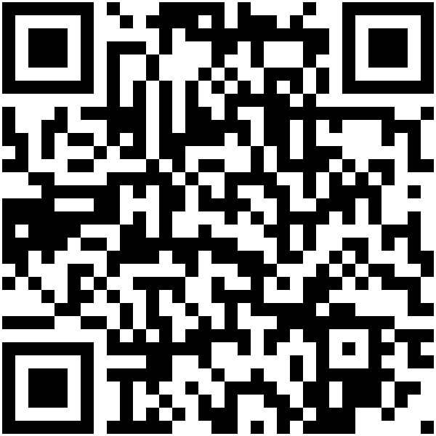
Take your seat
sirlegend123.github.io/Games/daily.html
Then enter the game code from your Storyteller.
Trust no one. Vote wisely.
Scan to open Clocktower Daily
Notes:
That's everything. Scan the code or open the link, type in the game code I'll send you, and take your seat.
Remember: the Demon is one of us. Trust no one, and vote wisely. Any questions?

