Slide 1


How to play: a guide for players
A game of murder and suspicion, played on your phone over several days
Notes:
Welcome to Hollow Hall. Over the next few days we're going to play a game of murder and suspicion called The Shadows. It all happens on your phone, in your own time, so you can play around work and everything else.
I'm the host. I'll run the game, but I'm not playing: I can't be murdered, and I won't take sides. In the next few minutes I'll show you how it works.

Slide 2


Two sides, one castle
🕯️ The Guests
🗡️ The Shadows
Most of you. You don't know who anyone else is. Find the Shadows, and banish them at the round table.
A few of you, hidden amongst the Guests. You know each other. Each night, you choose a Guest to murder.
You win when every Shadow is gone.
You win when you equal the Guests left.
Notes:
There are two sides. Most of you are Guests. A few of you are Shadows, hidden in plain sight.
If you're a Guest, you don't know who anyone is. Your job is to work out who the Shadows are, and banish them at the round table. The Guests win when every Shadow has gone.
If you're a Shadow, you'll get to know the other Shadows. Each night, together, you choose a Guest to murder. The Shadows win if they ever equal the number of Guests left.

Slide 3
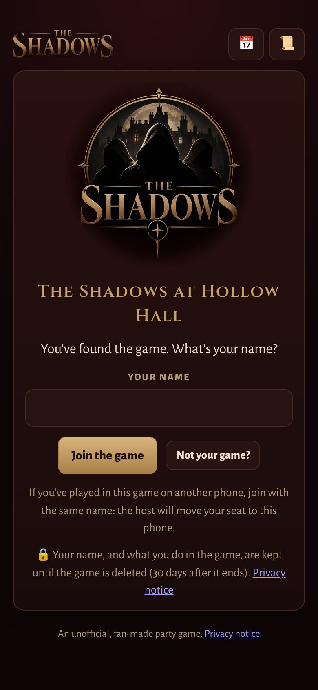




Joining the game
Scan the QR code, or open the link
I'll share it with you. It opens The Shadows on your phone.
Type your name
Then wait for me to give you a seat in the castle.
Add it to your Home Screen
On an iPhone, do this first (Share, then Add to Home Screen), then join from there.
Turn on notifications
Your phone tells you when breakfast is served, when it's time to vote, and when someone messages you.
Notes:
To join, scan the QR code I'll share, or open the link. Type your name, and wait for me to seat you.
If you have an iPhone, add it to your Home Screen first: tap Share, then Add to Home Screen, and open it from there. That way it works like an app, and notifications work.
And please do turn notifications on. They tell you when breakfast is served, when voting opens, and when someone messages you, so you never miss a thing.

Slide 4
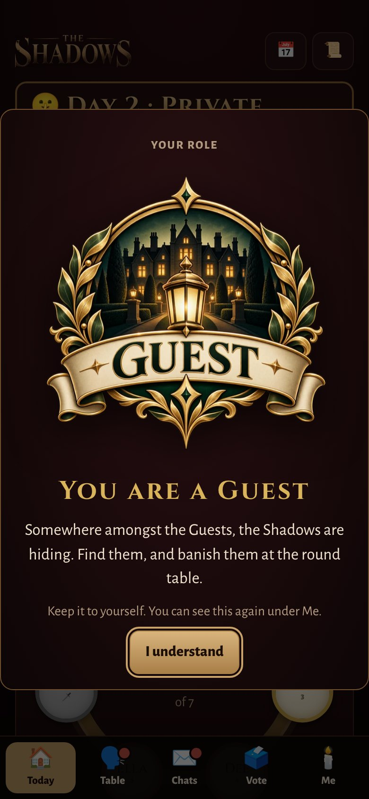
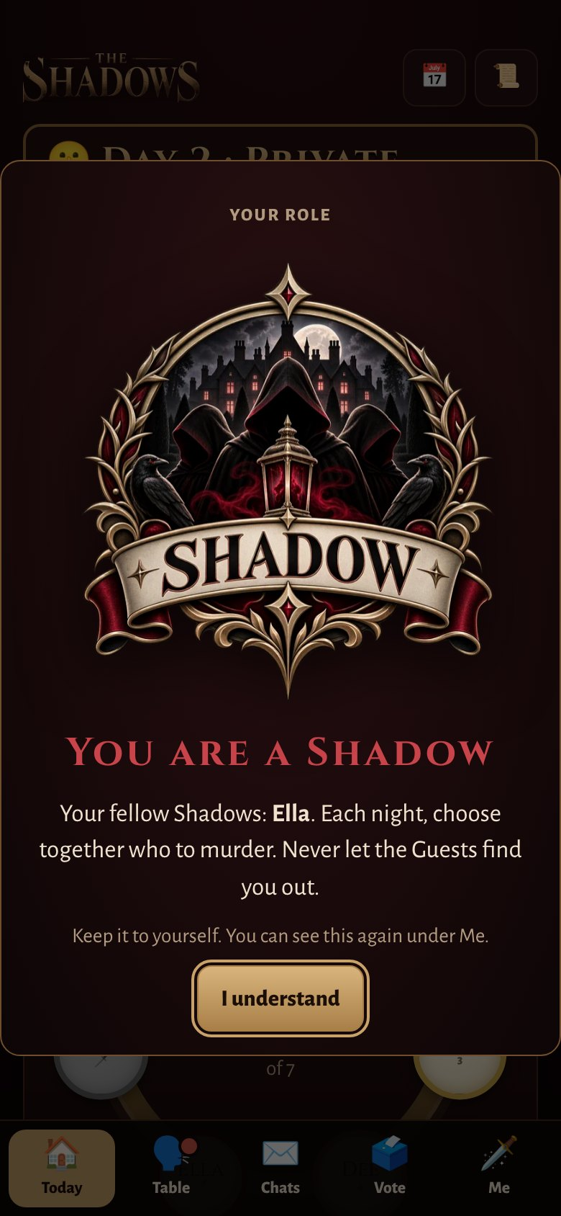
Your role
When the game begins, your phone shows your emblem: Guest or Shadow.
Keep it to yourself. Never show anyone your screen.
The Shadows don't know each other at first: they meet on the first night, when their own chat opens.
Notes:
When I start the game, your phone shows your role, with its emblem: Guest, or Shadow. Keep it to yourself, and never show anyone your screen.
If you're a Shadow, you won't know who the other Shadows are on the first day. You'll meet them on the first night, when your own secret chat opens. You can see your emblem again any time under Me.

Slide 5
Each day
07:30
🍳 Breakfast
Find out who was murdered in the night. Private chats open.
07:30 to 18:00
🤫 Private chats
Talk to anyone, one to one. This is when alliances are made.
18:00
🗣️ The round table
Open discussion, with everyone. Private chats close.
19:00 to 20:00
🗳️ Voting
Vote, in secret, to banish the player you suspect.
20:30
⚖️ The banishment
Who is banished, and which side they were on.
20:30 to 22:00
🌙 Night
The Shadows meet, and choose who to murder.
Notes:
Every day follows the same timetable.
At half past seven, breakfast is served: you find out who was murdered in the night, and private chats open.
Until six o'clock, it's private chats only: talk to anyone, one to one. That's when alliances are made, and lies are told.
At six, the round table: an open discussion with everyone. Private chats close.
From seven until eight, everyone votes in secret to banish the player they suspect. At half past eight, we find out who's banished, and which side they were on.
Then night falls. The Shadows meet, and by ten o'clock they've chosen who to murder. I may change these times for our game: the app always shows the real ones, and you can add them to your calendar.

Slide 6
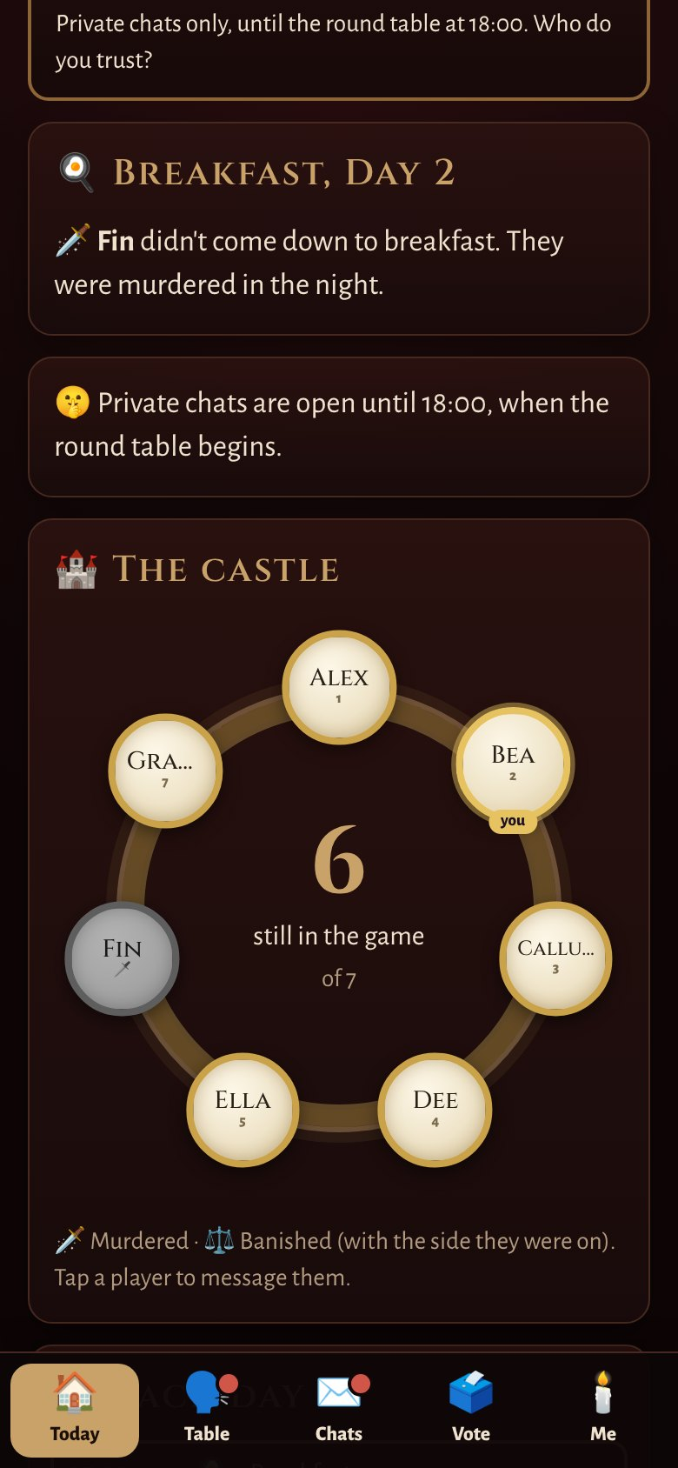
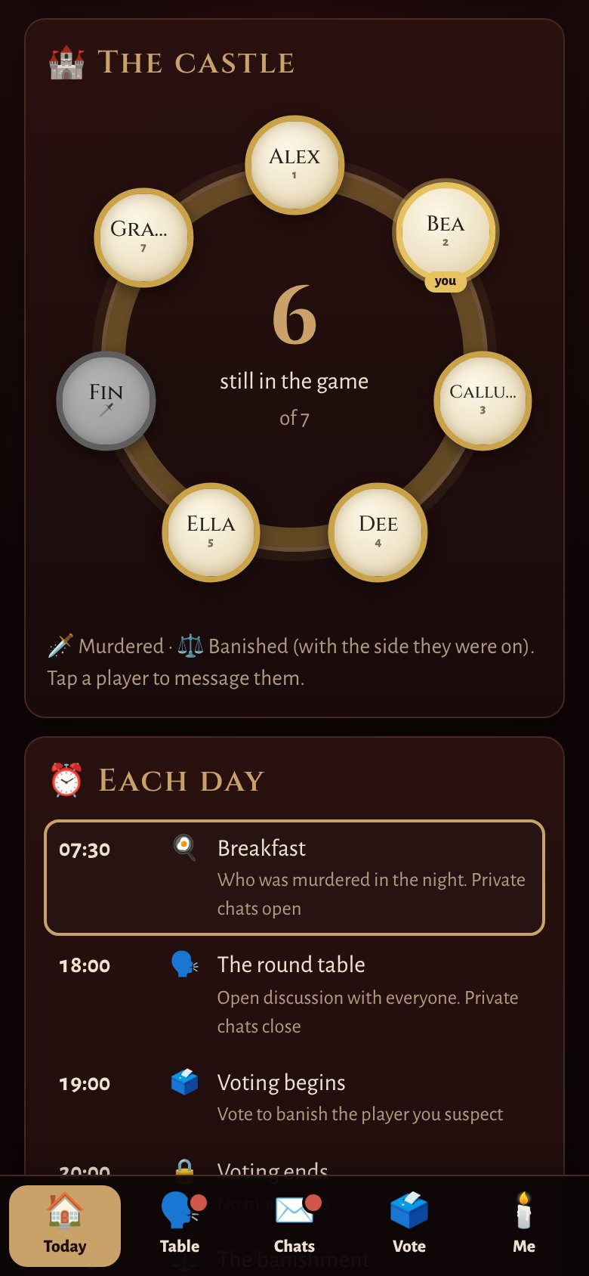



Breakfast, and the castle
Breakfast
Who was murdered in the night. Nobody, if the Shadows were stopped, or held back.
The castle
Everyone, round the table. 🗡️ marks the murdered; ⚖️ the banished, with the side they were on.
Tap anyone
to message them in private.
Notes:
Each morning, breakfast tells you who was murdered in the night. Some mornings, nobody was: perhaps someone was protected, or perhaps the Shadows were held back.
Under Today you'll also see the castle: everyone sitting round the table. A dagger marks those who were murdered. The scales mark those who were banished, and their emblem shows which side they were on. Tap anyone to message them.

Slide 7
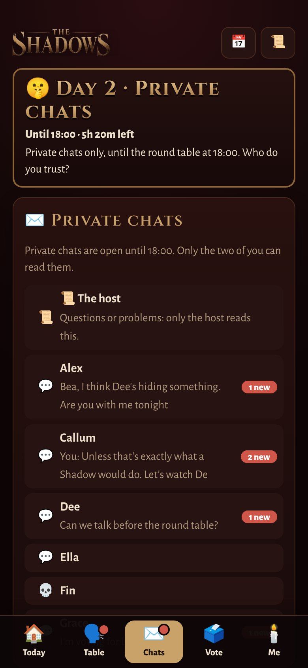
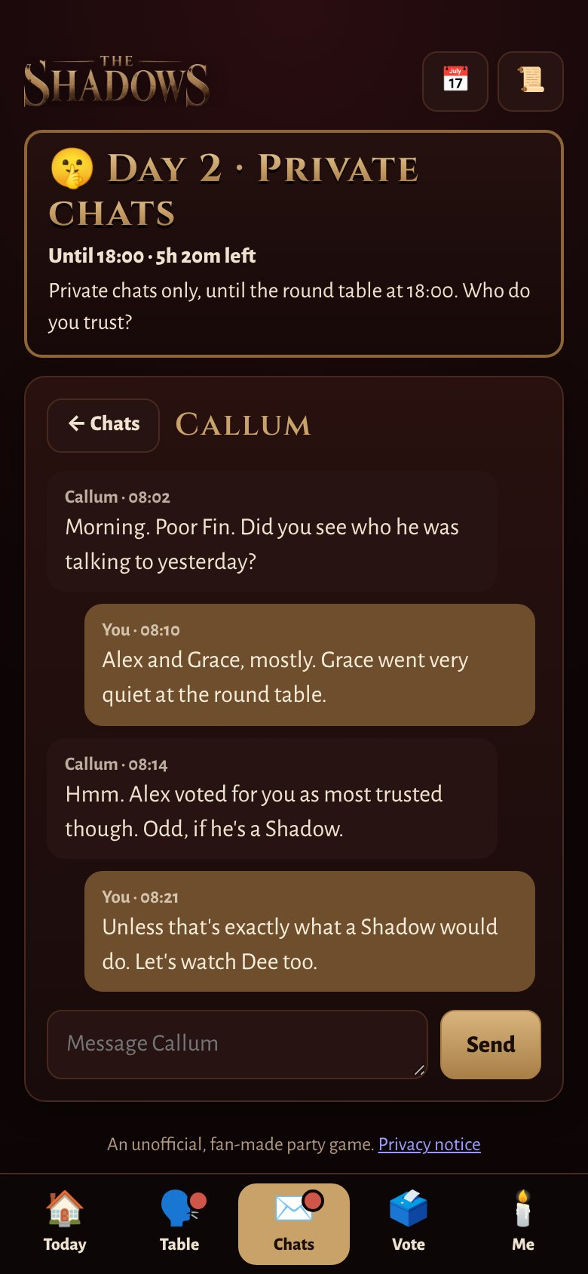




Private chats
One to one
Only the two of you can read it. Not even me.
From breakfast until 18:00
After that, the talking happens at the round table.
The host, any time
Questions or problems: message me, day or night.
Anyone could be lying
Including the people you trust most.
Notes:
Private chats are where the real game is played. You can message anyone, one to one, from breakfast until six. Only the two of you can read it: not even I can.
You can message me at any time, day or night, with questions or problems.
And remember: anyone could be lying to you. Including the people you trust most.

Slide 8
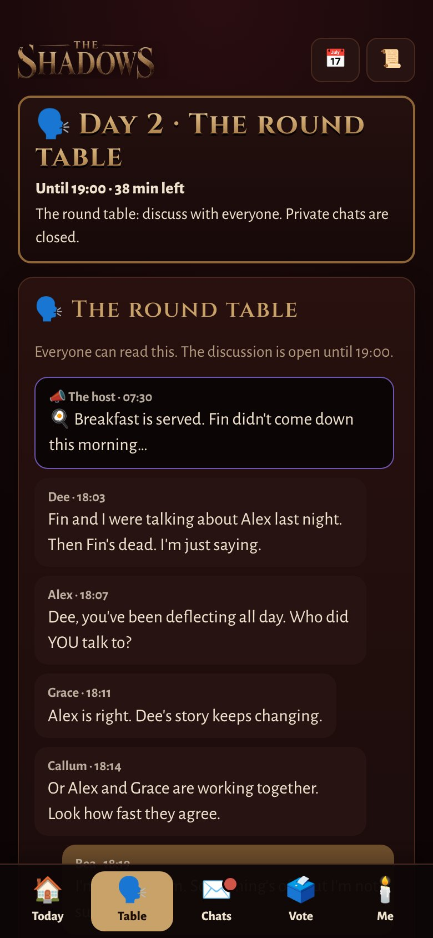
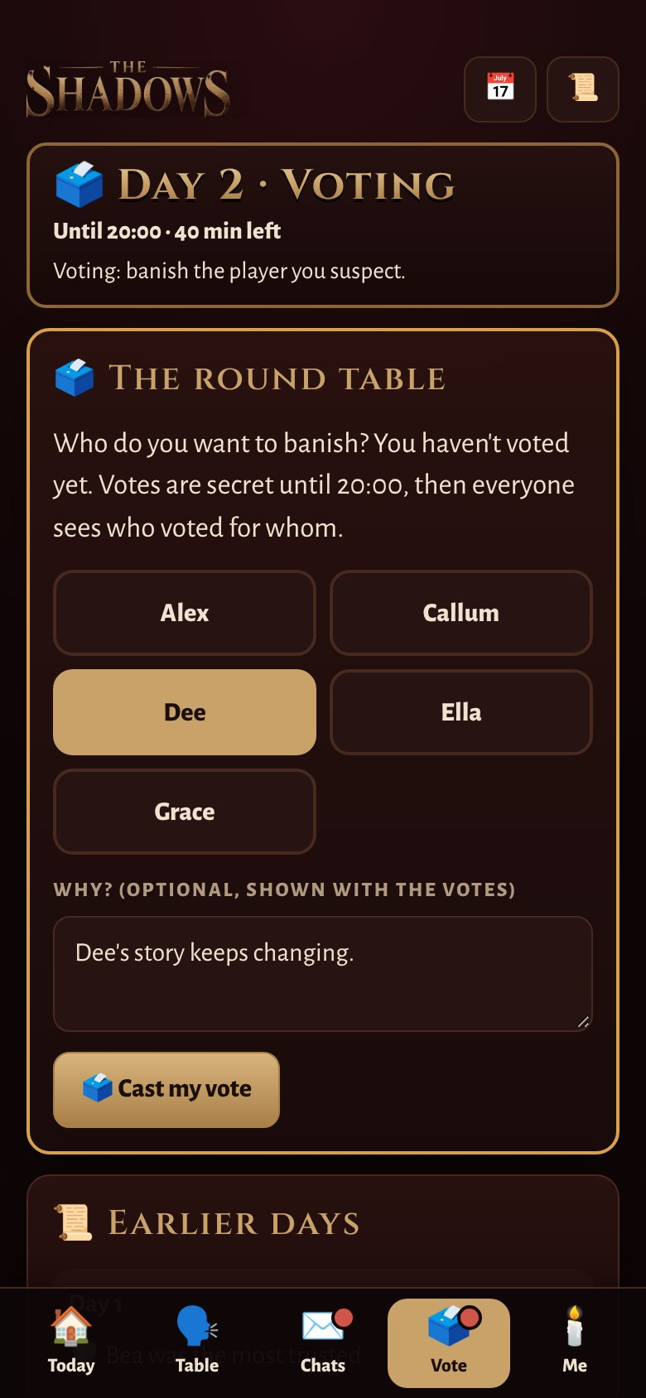



The round table, and the vote
18:00: the round table
An open discussion: everyone reads everything. Accuse, defend, persuade.
19:00 to 20:00: the vote
Choose who to banish, and say why if you like. You can change your vote until it closes.
Secret, then not
Nobody sees the votes until voting ends. Then everyone sees who voted for whom.
Notes:
At six o'clock, the round table opens: an open discussion with everyone. This is the time to accuse, defend yourself, and persuade.
At seven, voting opens. Choose who you want to banish, and add a reason if you like. You can change your mind until eight.
Votes are secret until voting closes. Then everyone sees exactly who voted for whom: so think about what your vote says about you.

Slide 9
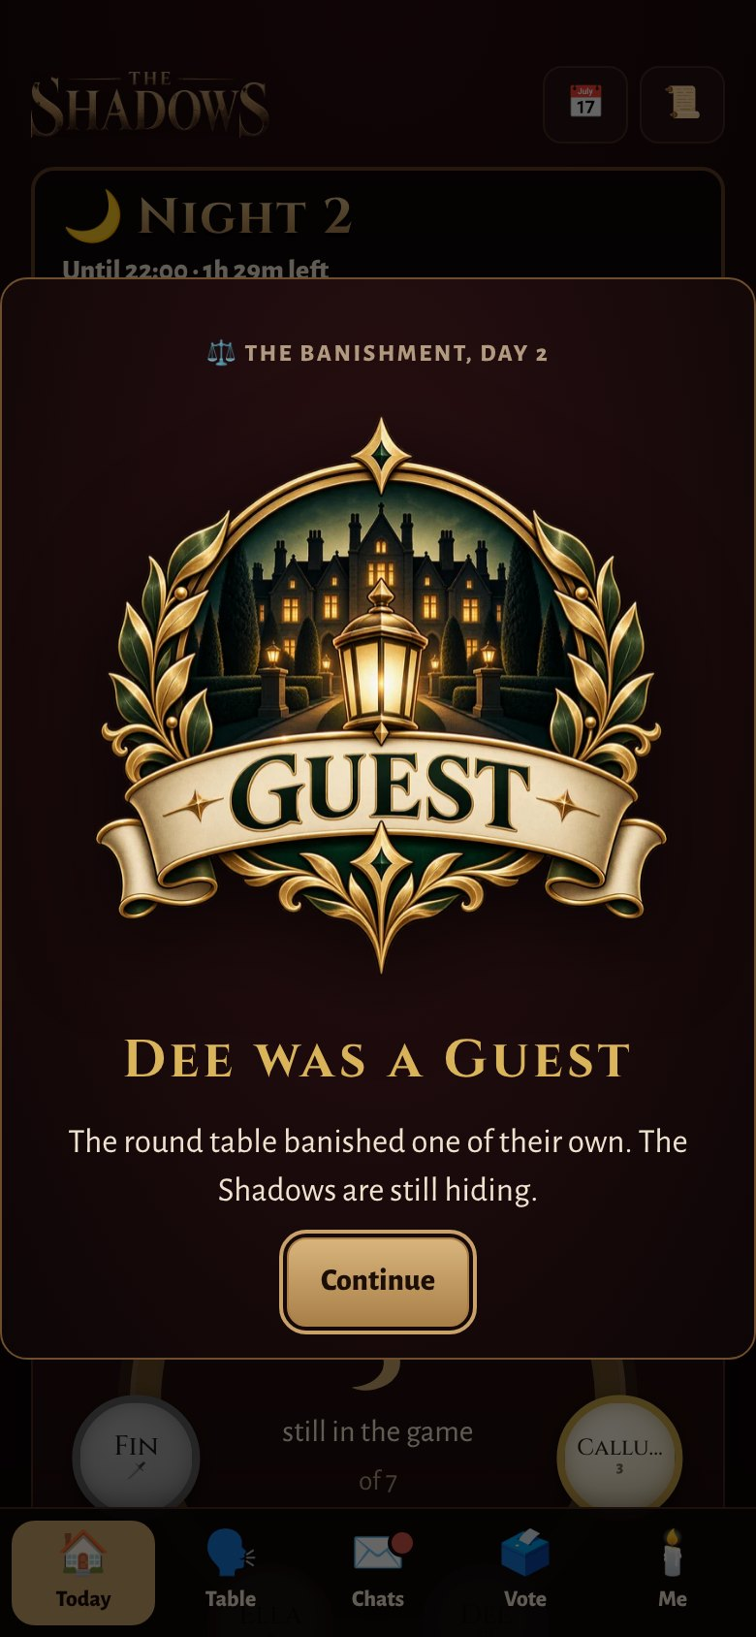




The banishment
The most votes is banished
If there's a tie, I decide.
Their side is revealed
At 20:30 everyone sees their emblem. Was it a Shadow, or one of your own?
Day 1 is different
No banishment. Instead, everyone votes for who they trust most: they get a shield for the first night.
Banished, or murdered?
You're out of the game, but you can still watch, and talk to the others who are out.
Notes:
Whoever gets the most votes is banished. If there's a tie, I decide.
At half past eight, everyone sees who's been banished, and their emblem shows which side they were on. Did you catch a Shadow? Or banish one of your own?
The first day is different. There's no banishment: instead, everyone votes for the player they trust most, and they get a shield for the first night. Nobody can murder them.
If you're banished or murdered, you're out of the game, but you can still watch everything, and chat with the others who are out.

Slide 10



Daily tasks, and shields
Some days have a task. Win it, and you get a 🛡️ shield: the Shadows can't murder you that night. Other days, there's no task at all.
🤫 The Whisper
🔐 The Combination
🕯️ The Lanterns
A phrase passes from player to player in private chats, round everyone and back to the start. Say it twice, or send it to someone who's had it, and you risk it all.
Everyone holds one digit of a secret code. Share digits, put the code together, and enter it. Careful: not every digit you're told is true.
Everyone has a secret number. Light the lanterns in order, without seeing how many are lit. As you light yours, name who deserves the shield.
Notes:
Some days, there's a task. Win it, and you get a shield: the Shadows can't murder you that night. Other days there's no task at all, and you can just enjoy a day off.
The Whisper: a phrase is passed from player to player in private chats, and it has to go round everyone and back to whoever started it. You can only say it once, and if anyone is sent it three times, it fails. The last to say it wins the shield.
The Combination: everyone holds one digit of a secret code. Share your digits, put the code together, and enter it. The first correct code wins. But be careful: not every digit you're told will be true.
The Lanterns: everyone gets a secret number, and the lanterns must be lit in order, but nobody can see how many are lit. Light out of turn and they all go out. As you light yours, you name who deserves the shield.
At the round table, everyone finds out how the task went, and who won the shield. Who lied? Who held things up? That's all evidence.

Slide 11
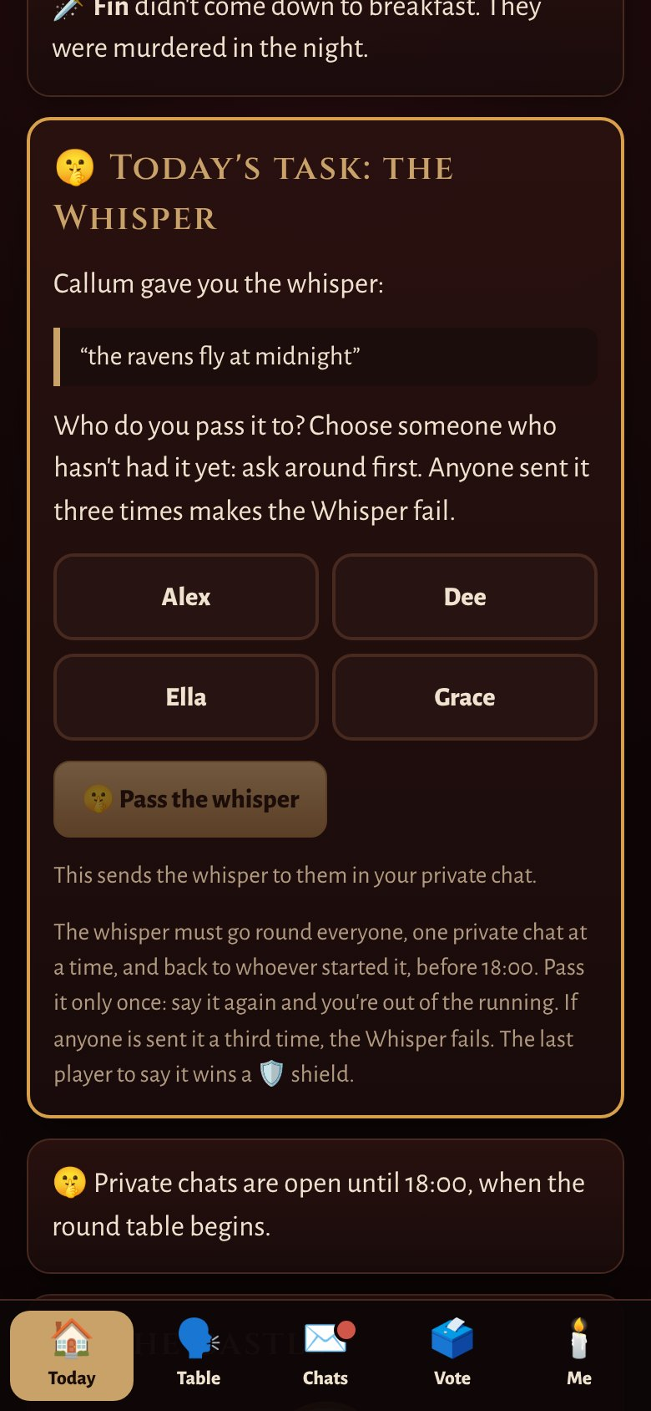
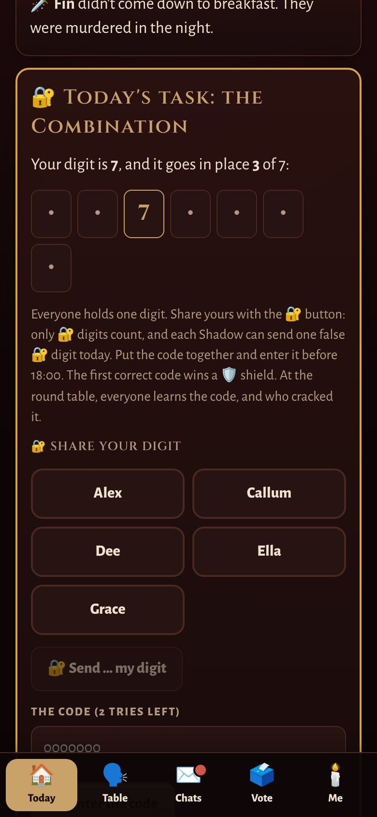
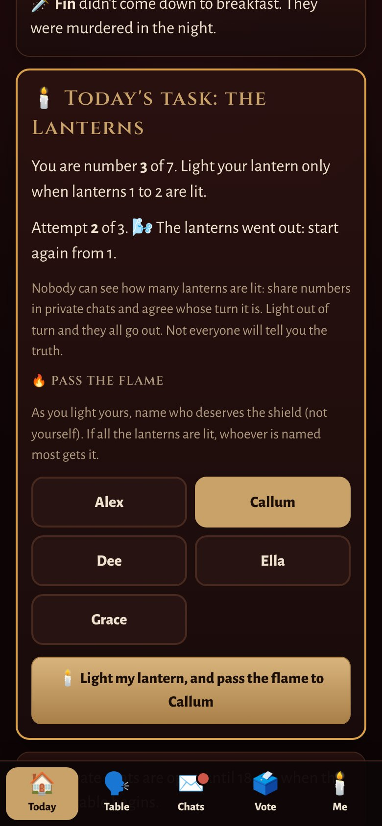
The tasks on your phone
🤫 The Whisper
🔐 The Combination
🕯️ The Lanterns
Notes:
Here's what the tasks look like. Each one appears under Today, with everything you need: what you've been given, who to pass it to, and how many tries you have left.
You'll find out on the morning of each day whether there's a task, and which one.

Slide 12
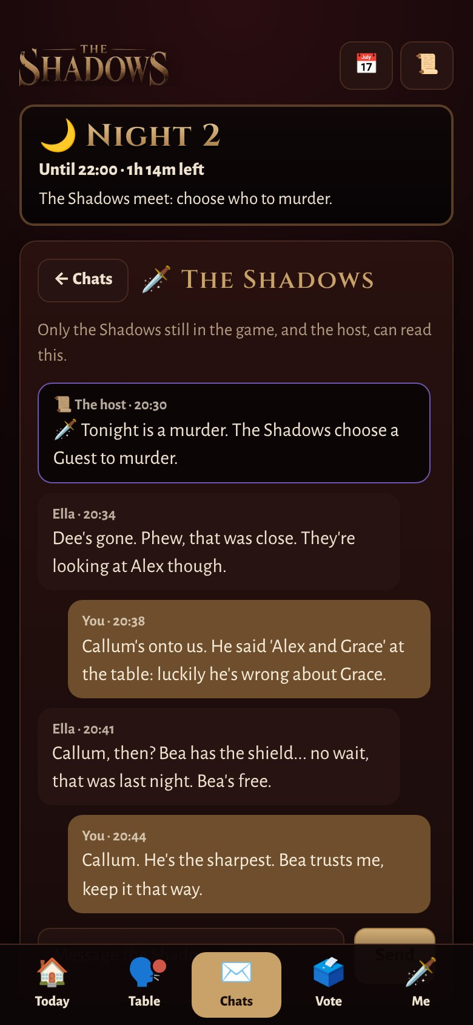
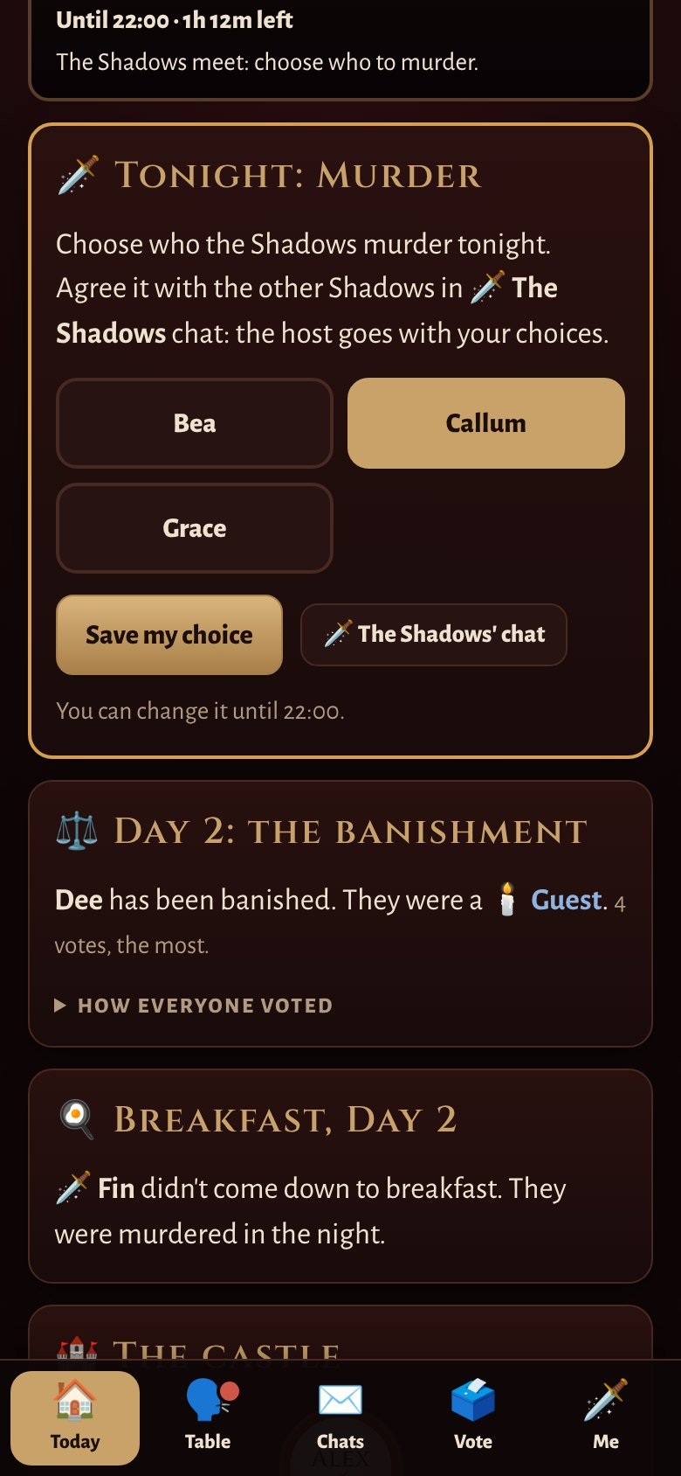



If you're a Shadow
Your own chat
It opens at the banishment (20:30). Only the Shadows, and I, can read it.
Choose a victim by 22:00
Agree it together. I go with your choice.
Sometimes, a secret mission
On some days you'll have a mission to earn tonight's murder. Everyone finds out if you succeeded, but not what it was.
Some nights, no murder
I'll tell you when. Nobody else will know.
Notes:
If you're a Shadow, here's your night. At half past eight, your own chat opens: only the Shadows, and I, can read it. Agree together who to murder, and choose them by ten o'clock.
On some days, you'll have a secret mission to complete during the day, to earn that night's murder. At the round table everyone finds out whether the Shadows succeeded, but never what the mission was.
And some nights there will be no murder at all. I'll tell you; nobody else will know.
Guests: listen carefully. Anything odd that happens during the day might be the Shadows at work.

Slide 13
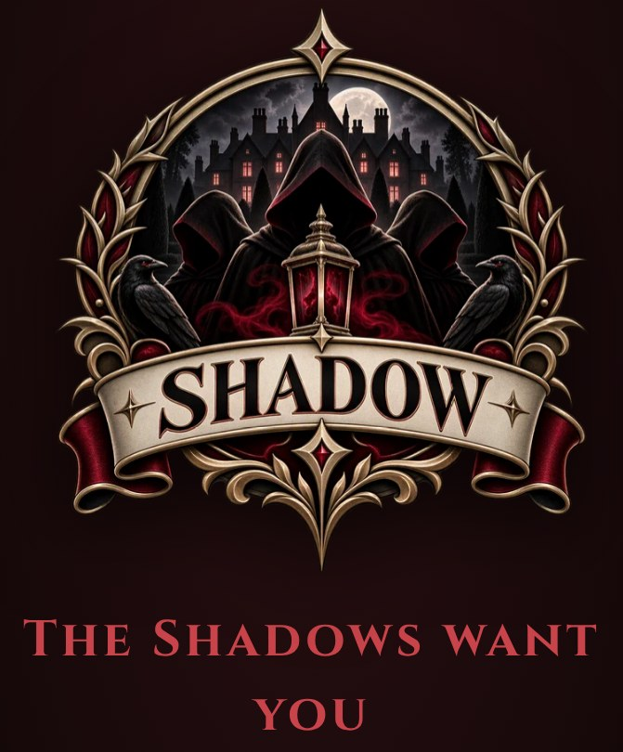



The Shadows want you
🌹 A seduction
The Shadows may invite a Guest to join them. Accept, and you become a Shadow. Refuse, and nothing happens to you.
⛓️ A blackmail
Join them, or die. There is no third way.
It's yours alone
Only you and I will know. Decide quickly: the clock is ticking.
Notes:
The Shadows may also try to grow their numbers, by making a Guest an offer.
A seduction is an invitation: accept, and you become a Shadow. Refuse, and nothing happens to you.
A blackmail is rather less polite: join the Shadows, or die.
If you're ever made an offer, it's yours alone. Only you and I will know about it. Think carefully, but don't take too long: the clock is ticking.

Slide 14
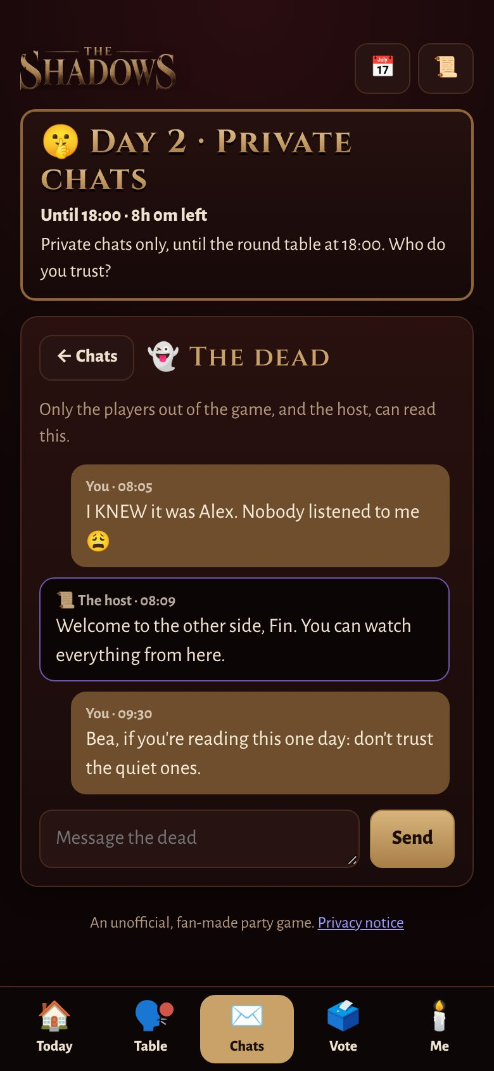

Out of the game
You can't talk to the living
No private chats, no round table, no vote.
👻 The dead have their own chat
Talk to everyone else who's out: compare notes, and enjoy the show.
You can still watch
Breakfast, the round table, the votes: you see it all.
Notes:
If you're murdered or banished, you're out of the game. You can't message the players who are still in, post at the round table, or vote.
But you're not forgotten. The dead have their own chat, so you can talk to everyone else who's out, and compare notes. And you can still watch everything: breakfast, the round table, the votes. It's often the most entertaining seat in the house.

Slide 15



Winning, and a few tips
How it ends
Turn on notifications
And check in at breakfast, the round table and the vote.
The Guests win
when every Shadow has been banished.
Watch the votes
Who votes with whom tells you a lot.
Notice the odd
A strange phrase, a lie about a digit, someone gone quiet…
The Shadows win
if they ever equal the Guests left.
Keep your screen to yourself
What you share, and what you bluff, is up to you.
At the end, everyone's side is revealed.
Notes:
To sum up: the Guests win when every Shadow has been banished. The Shadows win if they ever equal the number of Guests left. When the game ends, everyone's side is revealed.
A few tips. Turn on notifications, and check in at breakfast, the round table and the vote. Watch the votes: who votes with whom tells you a lot. Notice anything odd: a strange turn of phrase, a lie about a digit, someone who's suddenly gone quiet. And keep your screen to yourself: what you share, and what you bluff, is up to you.
Good luck. And sleep with one eye open.

