Slide 1
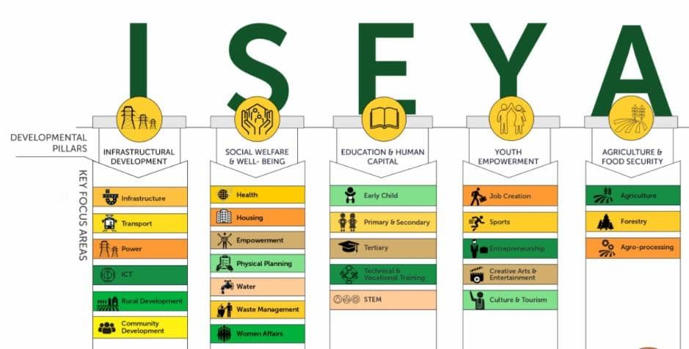
DEVELOPMENT
PILLARS
INFRASTRUCTURAL
DEVELOPMENT
SOCIAL WELFARE
& WELL-BEING
EDUCATION & HUMAN
CAPITAL
YOUTH
EMPOWERMENT
AGRICULTURAL &
FOOD SECURITY
INFRASTRUCTURE
HEALTH
EARLY CHILD
JOB CREATION
AGRICULTURE
HOUSING
PRIMARY & SECONDARY
FORESTRY
TRANSPORT
SPORTS
EMPOWERMENT
POWER
TERTIARY
ENTREPRENEURSHIP
AGRO PROCESSING
PHYSICAL PLANING
ICT
TECHNICAL &
VOCAL TRAINING
CREATIVE ARTE &
ENTERTAIMENT
WATER
RURAL DEVELOPMENT
STEM
CULTURE & TOURISM
WASTE MANAGEMENT
COMMUNITY
DEVELOPMENT
WOMEN AFFAIRS

