Slide 1

Understanding The Theoretical & Conceptual Perspectives Of Local Governance
By
Prof. Vincent Onodugo, PhD, FCAI, FIIA FNIM
Dean, Faculty of Business Administration
University of Nigeria, Enugu Campus
vincent.onodugo@unn.edu.ng 08035487972

Slide 2
Outline
Context
The concept of Local Governance
Significance of Local Governance
Theoretical frameworks of Local Governance
Key issues and Challenges Associated with Local Governance
Policy recommendations on ways forward
Concluding Remarks

Slide 3
Context
The essential kernel of participatory & constitutional democracy hinges on how much the citizenry is involved in governance and deciding on what affects them.
Over the years, especially with protracted military incursion in governance, the Nigerian federation, became so unitary and centralized, that governance in Nigeria presents an inverted pyramid with much of the power in the hand of the federal government.
The consequences are that over sixty eight(68) items of governance are in the exclusive list and 52 items in the concurrent list while only a paltry 9 are in the residual list.
Part of the effect is that some of the roads used by local residents are termed federal roads supposedly to be maintained by distant federal government that does not use the roads. The same for mineral resources which locals cannot mine because it is within the purview of FGN. Even centralized policing seems not to meet the security needs of residents in rural populace.

Slide 4
Context
Lately, there have been serial agitations by some sections of the federation that there should be a return to true federalism and proper devolution of power under the hackneyed term called ‘ restructuring’
It is against this backdrop that a discourse on conceptual and theoretical perspectives on local governance finds its relevance.
This discourse is the goal of this Paper.

Slide 5
Concept of Local Governance
The term “governance” has been put as the methods through which public choices are made”…. (Hague, 2012)
To situate this within the context of politics, governance has been defined as “the use of political authority and exercise of control over a society and the management of resources for social and economic development”. (Landell-Mills and Serageldin 1991: P 3)
To provide a matrix of relationship between the system(leaders) and the led a more serious classification is made; “The efficient execution of public concerns by means of the age group of a command (set of rules) acknowledged as lawful, for the rationale of encouraging and increasing communal standards required by persons and groups”…Charlick (1992: P3) .

Slide 6
Concept of Local Governance… Cont
The word local means “ relating or restricted to a particular area or one’s neighborhood” Local governance therefore is the extent to which authority is exercised at the level of the local community.
Broader definition of local governance is:
“analysis and understanding of problems by elected and appointed politicians and their senior staff, the making of policy, the process of deliberation and cogitation, the process of cultivating and exercising political judgment, the making of decisions, and the oversight and scrutiny that other politicians and regulators exercise.” (Perri, 2004:2)
Two broad things are involved:
Identification analysis of the problems (needs of the community).
Making choices and policies for solution to the overall improvement of the welfare of the local populace.

Slide 7
Concept of Local Governance… Cont
Governance is deemed to be local only to the degree that the local population participates in its actuation; that is, the extent that the local population determines its direction in line with their priorities, problems, local needs, and potentials for benefits (Kauzya, 2003).
Local Governance vs Local Government Administration.
There is some convergence, especially in Nigeria, that local governance is directly related to the activities and practices of local governments.
In other words, local governments are at the heart of local governance and determine to a great extent the quality of political administration that would be delivered to the people. Hence, the local governments are the closest that the government can be to the people (da Cruz & Marques, 2017)

Slide 8
Characteristics or features of Good Local Governance
Legitimacy: The acceptance of the authority by masses as of accepting those in power; the continuation of an authorized set of regulations methods, and procedures.
Accountability: This is linked to legality in which office holders act in public trust for the promotion of the welfare of the people. Consequently, they are answerable to the public for the conduct of their affairs.
Management effectiveness: The essential thrust of local governance is to effectively utilize public reserves or resources to provide needed local services. The quantum and quality of services rendered to the locales will thus become a benchmark for its assessment.
Availability of information: The nexus between the led and office holders is predicated on the free flow of information. It is access to information that will give the citizenry the power to participate in governance and allows the citizenry to observe and analyze the efficacy of those in command and their official procedures.
Good local governance
Legitimacy
Accountability
Management efficiency
Information availability

Slide 9
Significance and Import of Local Governance
It provides a veritable ground for political education and developing political culture. The local political activities give the locals first hand opportunities to be exposed to politics and governance. Debates, campaigns and lobbying all start their early roots at this level. Some complex political jargons are given local meanings and contexts at this level.
It provides a training ground for inculcating political leadership Skills: One of the major challenges in national leadership is that people who have not tried their hands at the local levels jump to national politics. Participation at the local governance levels equips prospective national leaders with the nuances and rope learning experience. In the process they acquire the needed skills for leadership at other levels.
Increases the Pace of Community Development: Development, just like security assumes significance within the context of particular environment. Local governance operates in an environment where people ‘who wear the shoes knows where it pinches’. They are able to prioritize governance to suit their needs.
Accountability & Transparency: Local governance ( and it operators) because of its proximity to the people is easier to be held accountable for their actions. The outcomes of their actions are easier for people to see.

Slide 10
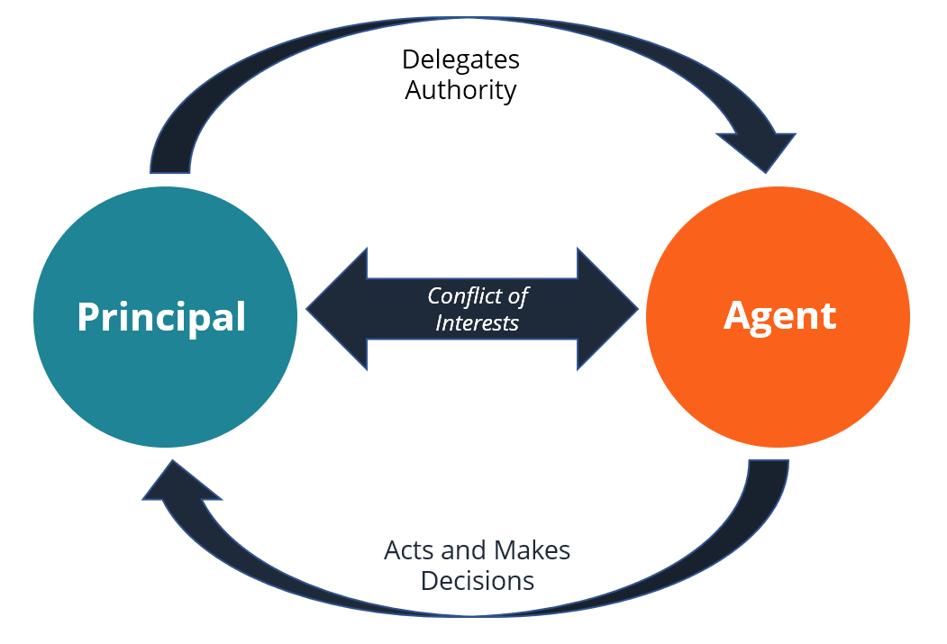
Principal-Agency Theory: Its explanation of the practice of Local Governance in Nigeria
Governance generally and local governance in particular is a social contract between the governed (Principal) and the leaders (agents).
The led (Principal) in a democratic environment confers (delegates) the authority to utilize public resources to the political actors (agents) to act in the utmost interest of the led.
In ideal situations where votes count, the principals (electorates) can sack the agents at will, if and when they think that the agents (leaders) are not working in their interest.

Slide 11
The Conundrum of Principal-Agency Theory in local governance in Nigeria
The controlling link between owners of resources/authority ( Principal-citizenry) and the agents ( political actors) lies in the ability of the former to hire and fire the latter, in this case, through elections.
In the Nigerian situation the citizenry has been robbed of the power to hire their local leaders- local government officials and/or even traditional rulers by political elites.
Consequently, the agents ( Local government officials) serve the interest of political elites represented today by the state governors mostly at the expense of the citizenry.
This is why there is a disconnect between the welfare of the local populace and the activities of the local leaders & political actors.

Slide 12
Local Governance Models and Framework by de Sardan(2011).
1.Chiefly Model/Framework: The Chiefly mode is the foremost mode of local governance, dating back to the pre-colonial and colonial eras and derives its legitimacy from various pre-colonial institutions. Their main function was to act as mediators between the colonialists and the local people.
Legal Framework: Although the 1960, 1963, and 1979 Constitutions made provisions for traditional rulers in the constitution, yet it has only been reduced to a mere tool in the hands of politicians who have continued to reduce the political rele­vance of the royal fathers for their selfish gains. The 1999 constitution made no single provision for the traditional rulers’ consti­tutional recognition
Policy Framework: Known today as local governance through traditional rulers
Institutional framework: The traditional institution is characterized by corruption, predation, patrimony, lack of accountability, aristocratic flamboyance, defense of patriarchal and aristocratic ideologies, internecine rivalries, and the confusion of powers. There is no power in the constitution to protect the traditional rulers, considering the ease with which they are removed and replaced by their respective governors.

Slide 13
Local Governance Models and Framework…contd
2. Associational Framework: The associational framework is a situation whereby the local governance architecture of communities is overseen by cooperative societies and non-governmental organizations (NGOs) that require that they be given a legitimate status like that of their Western or European Counterparts in order to make local interventions.
Policy Framework: The Associational model entails the setup of community-based organizations – clubs, development associations, village councils, regional boards, home town associations, market women associations, vigilante groups, funeral groups, youth associations, district committees, and cooperatives; the establishment of management bodies; the delineation of an executive board; written financial accounts; and annual general meetings of members.
Legal Framework: Section 40 of the Constitution of the Federal Republic of Nigeria 1999 provides that Every person shall be entitled to assemble freely and associate with other persons, and in particular he may form or belong to any political party, trade union or any association for the protection of his interests
Institutional framework: Associations wield political influence only to the extent that the local community adopts its standards and its democratic ideologies are tacitly incorporated into the local political culture. As time goes on, these norms routinely form the basis for which the behaviours of community members are judged

Slide 14
Local Governance Models and Framework…contd
3. The Municipal Framework: A municipality is described as a single administrative division that has a corporate status and exercises powers of self-jurisdiction and self-government which are derived from the regional and national laws that oversee it.
Policy Framework: Municipal councils are usually set up across a national territory with an elected leader, known as a Mayor, who administers the territorial district; exercises budget autonomy; and assumes responsibilities that are given to it by the state and federal authorities.
Legal Framework: Rather than municipal councils, the constitution of the Federal Republic of Nigeria provides for the creation of Wards within Local Government Councils. Each LGA is subdivided into a minimum of 10 and a maximum of 20 Wards with a Councilor as the politically elected leader of each Ward. He reports to the Local Government Chairman.
Institutional framework: In Nigeria, the impact of councilors on the wellbeing of local communities is hardly felt. Local elections are perceived as an opportunity for both the leaders and the voters to ‘eat’, in other words as a rent from which the maximum benefit must be obtained

Slide 15
Local Governance Models and Framework…contd
The Project-Based Framework: The project-based framework of governance entails all kinds of developmental assistance and structural advancements that are implemented on a local level, notwithstanding whoever is the promoter or sponsor of the projects. It seeks to engender governance by improving local infrastructure.
Policy Framework: The project mode depends on and sponsors the association mode of local governance. It is found in the domain of project management. A project monitoring/implementation organization or team is responsible for facilitating the project-based framework of governance in a given locality
Legal Framework: Currently, there is no provision for the project-based framework of local governance in the Nigerian constitution. But a bill in that regard titled: “Constituency Development Funds Bill 2016” is still pending in the National Assembly.
Institutional framework: The project-based mode of governance thrives on sophisticated and ultra-modern infrastructural establishments in communities, which sometimes are not in line with the administrative and social contextual needs of the people. Most of the developmental projects in Nigeria are implemented by expatriates; although nationalists and civil servants are becoming involved in project development. The direct actions require the employment of locals for the project to be completed.

Slide 16
Local Governance Models and Framework…contd
The Bureaucratic Framework: The bureaucratic framework of local governance draws from the notion that the presence or influence of state actors on the affairs of locals was seen as the presence of commanders, as was obtained during colonial regime where the state actions at the local level was seen as commandant de cercle (which meant that a colonial official was in charge of local administration). Thus, this framework suggests that the state takes responsibility for local governance.
Legal Framework: Currently, There is no specific provision in the constitution of the Federal Republic of Nigeria for the state or its intermediaries to become direct actors in local governance. Rather, the state influences local governance through the local government
Policy Framework: Two main approaches to bureaucracy exist and they are the Marxian approach and the Weberian approach. The former is regarded as a tool for exploitation, oppression and manipulation by the elite class who seek to exercise total control over the resources of the state at all levels; while the latter is viewed as a complex, large-scale, specialized and hierarchical organization which achieves society’s goals and objectives of the local government
Institutional framework: The bureaucratic framework may be expedited through the Civil Service. Attempts to impose the influence of the state or the elites are usually met with resistance from the local governments and communities

Slide 17
Local Governance Models and Framework…contd
The Sponsorship-Based Framework: The logic of local governance through sponsorships is at the centre of the political and social lives of local communities.
Policy Framework: The sponsorship-based framework entails that rich members of the public philanthropically influence governance by providing resources for the provision of infrastructure (roads, water, electricity, schools, hospitals); the payment of taxes to the government on behalf of the citizens; and the provision of food aids to indigent locals.
Legal Framework: The constitution of the Federal Republic of Nigeria does not give specific provisions on how rich members of the community should sponsor developmental projects but it is expected that they seek the permission of local authorities before implementing any project
Institutional framework: The essence of sponsoring developmental projects is usually for the sponsor to gain a high profile, acceptance, and legitimacy in the community in order to fulfill certain political or personal ambitions.

Slide 18
Local Governance Models and Framework…contd
The Religious Framework: Religious framework entails that local governance is effectuated by religious institutions.
Policy Framework: The organizations involved in this mode of governance are usually of the Catholic, Protestant, or Islamic origins; even though there are others within the Charismatic Movements, Syncretic and prophetic congregations. These institutions influence governance by providing social services in the form of health, education, and humanitarian interventions.
Legal Framework: While the constitution of the country is extensive about the freedom of religion, it gives no provision for the role that religious institutions must play in local governance within their communities
Institutional framework: Nigerians are wont to support and enforce developmental projects facilitated by their religious groups when compared to those ones implemented by the government.

Slide 19
Local Governance Models and Framework…contd
The Merchant Framework: The merchant model of local governance suggests that individuals and private providers can deliver public goods and services on behalf of multinational organizations that seek to establish their presence in local communities.
Policy Framework: The merchant model thrives in response to the proliferation of neoliberal policies in countries of the world. Merchants engage in daily commercial transactions that define them. The goods and services they provide are usually paid for by the public because they assume a mercantilist outlook in their operations – seeking profit and income generation.
Legal Framework: Federal and state laws delineate how commercial business activities should be conducted in different states and localities in the country. But these laws do not relate to the extent that they exercise governance over their localities.
Institutional framework: Private merchants can engage in local governance through state-controlled subcontracting, concessions, and public service outsourcing. Nonetheless, the merchant model of local governance should not be misconstrued with the privatization of public institutions.

Slide 20
Local Governance Models and Framework…contd
The Local Government Framework: This is the most popular model of local governance which has gained wide acceptance in many countries of the world as well as in Africa. It is the third tier of government after the Federal and State governments. Nigeria has a total of 774 local government areas that are administered by a chairman (as the chief executive).
Policy Framework: The policy guiding the formulation and existence of local governments require that they execute local governance in the following ways:
Collection of fees and taxes
Licensing of trucks, bicycles, wheel barrows, carts, canoes, etc
The naming of streets, roads; and the numbering of residents
The set-up, maintenance, and the regulation of markets, public conveniences, and motor parks
The set-up and maintenance of burial grounds, cemeteries, or homes for indigents
The provision and maintenance of refuse disposal facilities and public transportation infrastructure
The construction and maintenance of streets, roads, parks, public highways, drains, open spaces, and bridges.
The registration of marriages, deaths, and births; and other functions

Slide 21
Local Government Framework Contd…
Legal Framework: The 1999 Constitution of the Federal Republic of Nigeria made adequate provision for the establishment and functioning of local governments in Nigeria.
Section 7(1) of the Constitution states that the system of local government by democratically elected local government councils is under this Constitution guaranteed; and accordingly, the Government of every State shall, subject to section 8 of this Constitution, ensure their existence under a Law which provides for the establishment, structure, composition, finance and functions of such councils.
Regarding their role in local governance, the constitution clearly states that it shall be the duty of a local government council within the State to participate in economic planning and development of the area and to this end an economic planning board shall be established by a Law enacted by the House of Assembly of the State.

Slide 22
Local Government Framework Contd…
Institutional Framework: The local government is an institution that is controlled and overseen by the federal and state government. Abe & Omotosho (2021) delineate the institutional characteristics of the local government:
Local government is government at the grassroots or local level.
Local government does not exercise full sovereignty since it is a creation of a legislature at the central or intermediate levels.
It is a legal entity that is separate from the Federal and State Governments
It has jurisdictional powers over the inhabitants of the geographical area
It exercises and possesses the institutional structure and authority required for the achievement of its goals and objectives
The citizens of the local area are expected to participate directly or indirectly in local governance by electing, appointing, or nominating their representatives
The local governments are expected to provide various ways of improving the welfare and living standards of the community members
The Constitution also makes provision for the autonomy of the local government.

Slide 23
Issues and challenges in local Governance administration
Lack of financial resources as there is low capital funding for local governance.
Poor management of resources by local governance institutions
Corruption and nepotism; The lack of the required financial autonomy needed for local governments to effectively manage resources. Some States use LGCs as an extension of financial pipeline for personal interests.
Political interference as the state governments are beginning to take over the function of the local governments; such as the removal of traditional rulers by state governors
Overdependence of the local governments on the state and federal governments
Insecurity of the tenure of local government chairmen have led to increased political and developmental instability in local governments
Low grassroot participation in governance as the gap between the leaders and the led continue to widen

Slide 24
Policy Recommendations
There should be no interference of the federal and state governments in the management and running of the local governments, including giving them financial autonomy
The traditional institutions should be strengthened in order to improve governance at grassroot levels because traditional rulers are closer to the people.
Private participation of eminent individuals in local governance should be encouraged.
The rule of law should be allowed to prosper in the local governments and not the rule of thumb
To ensure proper accountability of local governments, there should be periodic reviews of the accounts of local governments by external auditors
The federal government should adjust the statutory allocations to improve the welfare of the local governments and increase developmental activities at grassroots.
The local governance institutions such as the local government, religious organizations, clubs, unions, associations, and traditional rulers should exhibit transparency and integrity in their activities so that the citizens would feel the impact of the government closer to them
Efforts should be made to rebuild the relationships between the local governments and the citizens which may involve going beyond state based approaches and the civil society to focus on their intersection through transparency, accountability, and responsiveness

Slide 25
Paradigm shifts Required for Revitalizing Local Governance in Nigeria
Changing the narratives through focus on circle of influence. Stephen Covey did say that it is not what happens that is of consequence but how we react to what happens to us. The pervading maladministration across the various tiers of government is of concern to all of us. However, what can change the situation is what we can do within our areas of influence to change the narrative:
Citizenry: participate actively in choosing your leaders
Leaders: Do your best to advance the welfare of the led
Etc
Allowing the Locales to choose their leaders: A major paradigm shift in revitalizing local governance in Nigeria is for the local people to be allowed to choose their leaders whether traditional rulers or elected local government councilors and chairmen. Once this is done, power will revert to the citizenry and the leaders will become real ‘agents’ and accountable.
The way it is now this liberty will not come without a fight by the citizenry.

Slide 26

WHAT IS THIS MAN FAMOUS FOR???
Theory of Relativity
E=mc²
BUT HIS BEST WORK MAY BE HIS DEFINITION OF INSANITY: “DOING THE SAME TASKS OVER AND OVER AGAIN AND EXPECTING DIFFERENT RESULTS.” ALBERT EINSTEIN

Slide 27
THANK YOU FOR LISTENING

