Slide 1
Menadżer haseł, część PYTHONowa
Kawa Patryk, Twardosz Adam

Slide 2
MongoDB
Podstawy i konsola bazy danych

Slide 3
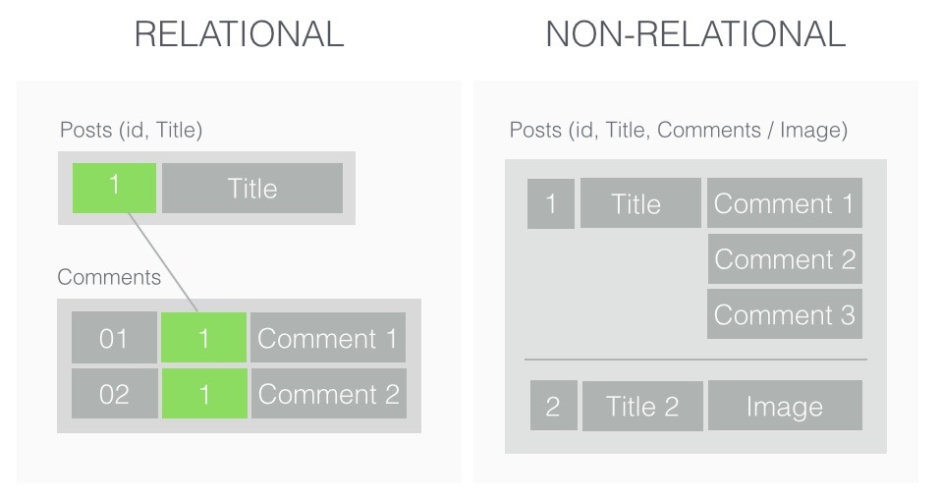
Source: http://www.michalbialecki.com/2018/03/16/relational-vs-non-relational-databases/

Slide 4
Relational vs Non-Relational Databases
Relational DBs
Non-Relational DBs
Strict schema, data is stores in tables
Structured Query Language
Vertical - you can scale by adding more power to an existing machine
Oracle, MySQL, MSSQL, IBM DB2, PostgreSQL
Schemaless, data is kept in key-value pairs, columns, documents or graphs
Unstructured, simple language that supports any kind of schema
Horizontal - you can scale be adding more machines
Mongo DB, Couch DB, Raven DB, Redis, Neo4j

Slide 5
MongoDB Introduction
Is a Non-Relational Database
Each database contains of collections, and each collection contains of documents
Each document can vary in content
The document structure is more in line with how developers construct their classes and objects in their respective programming languages
The document doesn't need to have a schema defined beforehand. Fields can be created on the fly.
The data model available within MongoDB allows you to represent hierarchical relationships, to store arrays, and other more complex structures more easily.
The whole structure is based on binary form of JSONs

Slide 6
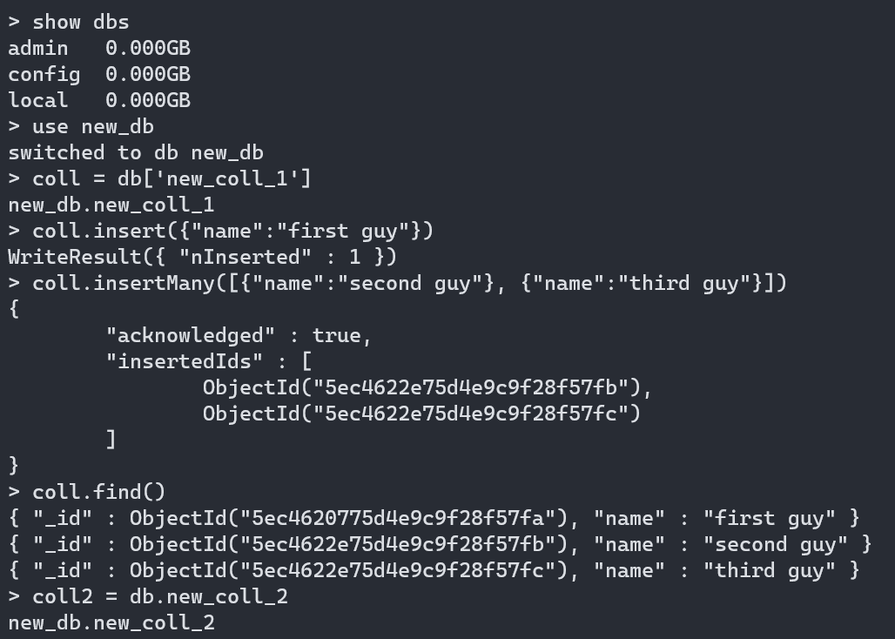
Useful Shell Commands

Slide 7
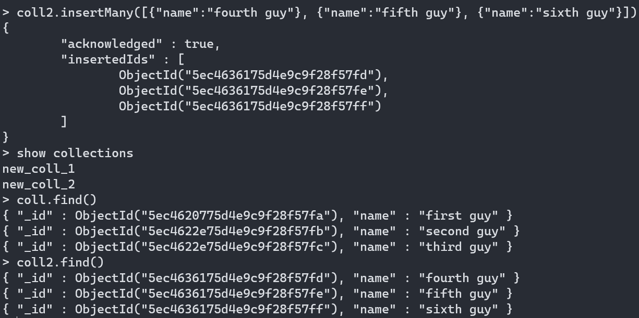
Useful Shell Commands

Slide 8
In our project we use pymongo – MongoDB Python driver
- Easy to use, because it’s Python
- All data converts to dictionary: - document -> dictionary - collection -> list of dictionaries
https://pymongo.readthedocs.io/en/stable/

Slide 9
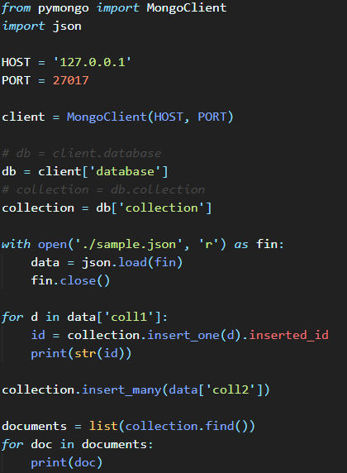
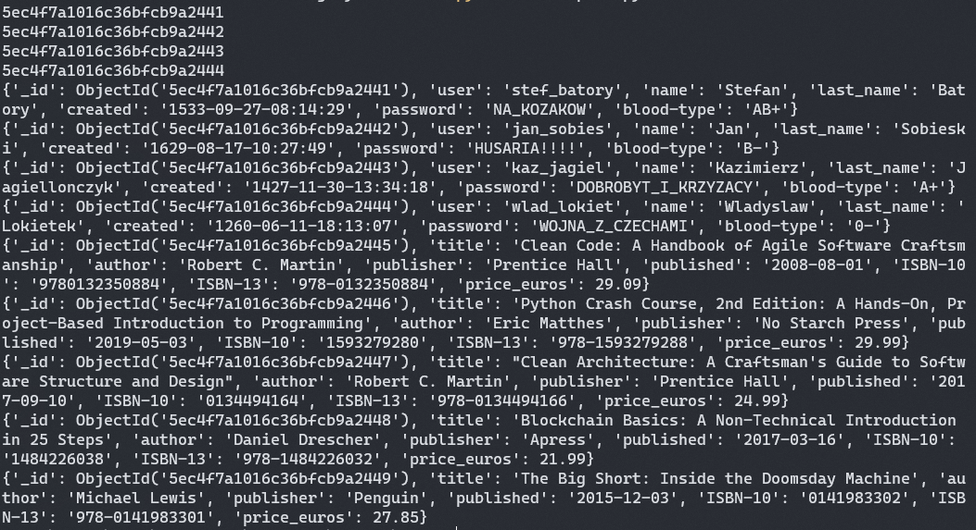
Simple pymongo queries

Slide 10
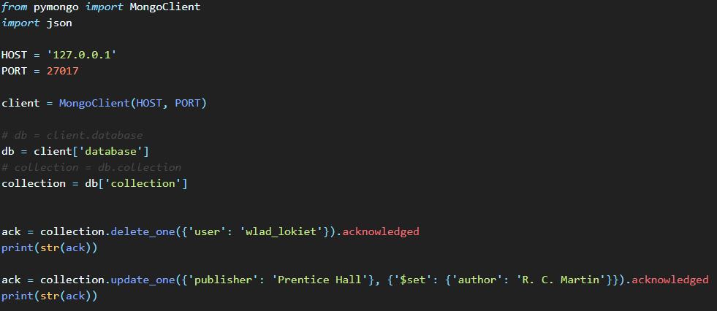

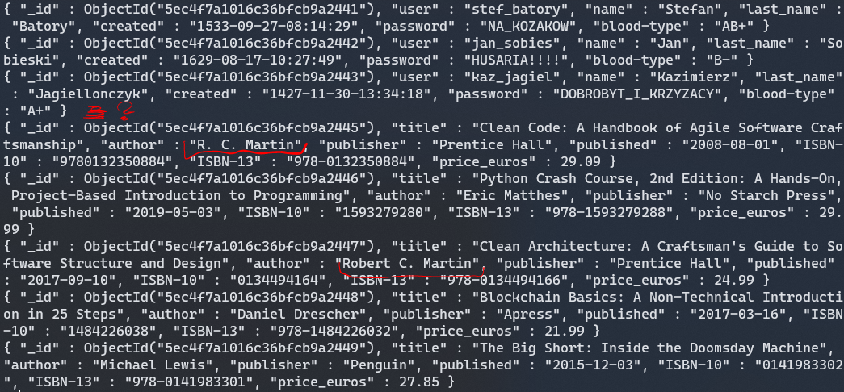
Simple pymongo queries

Slide 11
REST_API
Flask i Flask-RESTful

Slide 12
Flask
Flask is a micro web framework written in Python.
It uses two lower level frameworks: Werkzeug and Jinja
It provides a lot of functionality without additional modules
However it has a great support of extensions
It has no database abstraction layer and form validation
It’s the most popular framework in Python
In our orject we just a tiny bit of the Flask framework, which is a possibility to create RESTful endpoints
https://flask.palletsprojects.com/en/1.1.x/

Slide 13
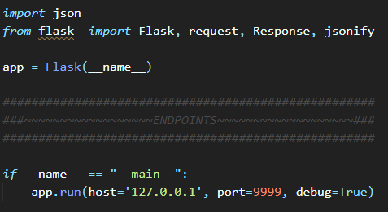

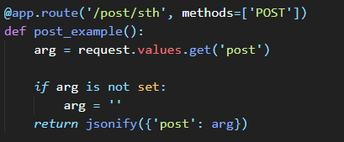
Flask - example

Slide 14
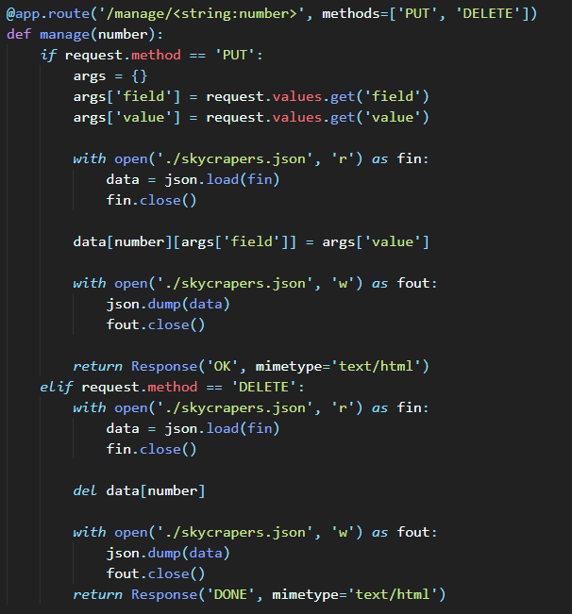
Flask - example

Slide 15
Flask RESTful
Flask-RESTful is an extension for Flask that adds support for quickly building REST APIs. It is a lightweight abstraction that works with your existing ORM/libraries. Flask-RESTful encourages best practices with minimal setup. If you are familiar with Flask, Flask-RESTful should be easy to pick up.
https://flask-restful.readthedocs.io/en/latest/

Slide 16
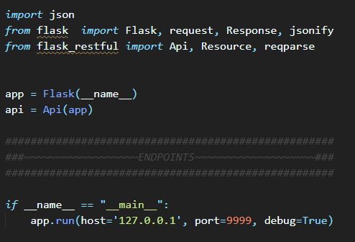

Flask RESTful - example

Slide 17
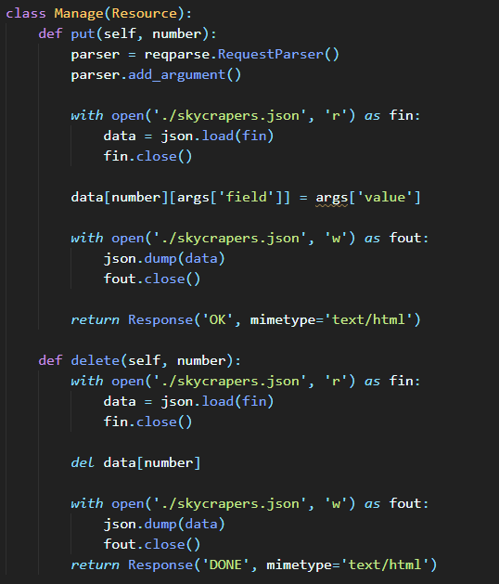
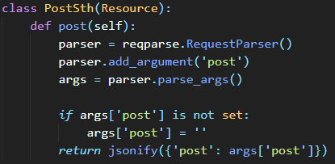
Flask RESTful - example

Slide 18
Szyfrowanie plików i dokumentów w bazie
Pycryptodome i AES

Slide 19
AES
Is a symetric block cipher user to encrypt data.
Each block consists of 16 bytes
There are a few modes of AES cipher, but in our project we use CBC mode
Every message that we want to be encrypted need to be multiplication of 16 bytes, so when it is less, we have to add padding
At first sequence CBC mode requires Initial Vector so message can be encrypted properly

Slide 20
pycryptodome
It is a module in Python used in cryptography tasks
It replaced PyCrypto module which is unmaintained since 2014
We’ll be using only a few parts of the module connected with AES and private key generation
https://www.pycryptodome.org/en/latest/

Slide 21
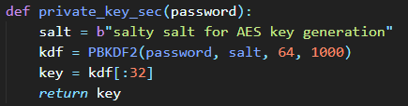

Pycryptodome AES example – private key generation two ways

Slide 22
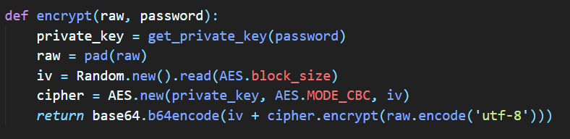
Pycryptodome AES example – encryption

Slide 23
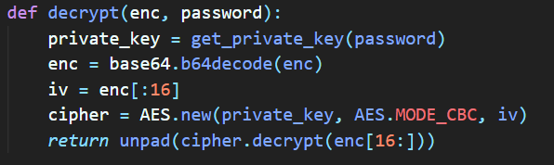
Pycryptodome AES example – decryption

Slide 24
Digression: ~lambda expressions
Lambda Expressions are used to create a inline function so it makes code more concise.
Lambda expressions look like this:
lambda arguments: expression
These are examples of using lamdas:

