Slide 1
Richard Jon Santos
Personal Portfolio

Slide 2
About me
My name is Richard Jon Santos
I am an Australian Filipino born in 1992
I am currently a student in Coder Academy striving to become a Full Stack Developer.
Things i like to do:
Eat Sleep Code Repeat
Play video games
Keeping my car clean, But my room is a mess haha.

Slide 3
Skills
I Code
HTML,CSS,JS
Ruby, Rails
Bootstrap

Slide 4
Logo and Wireframe

Slide 5
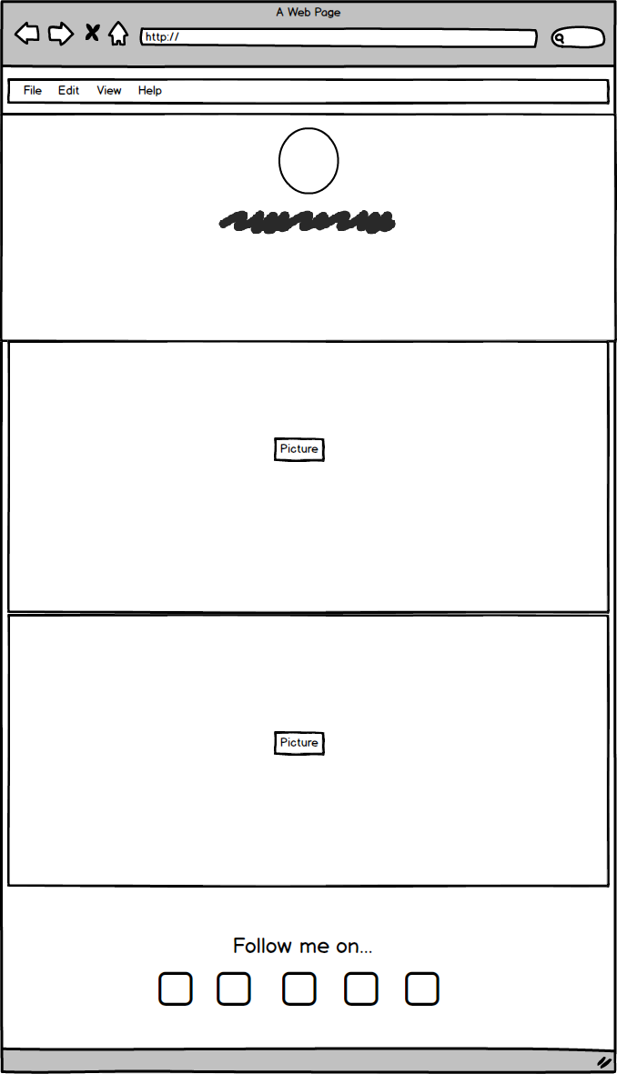
Wireframe
Menu > Pictures > About me > Portfolio > Contact

Slide 6
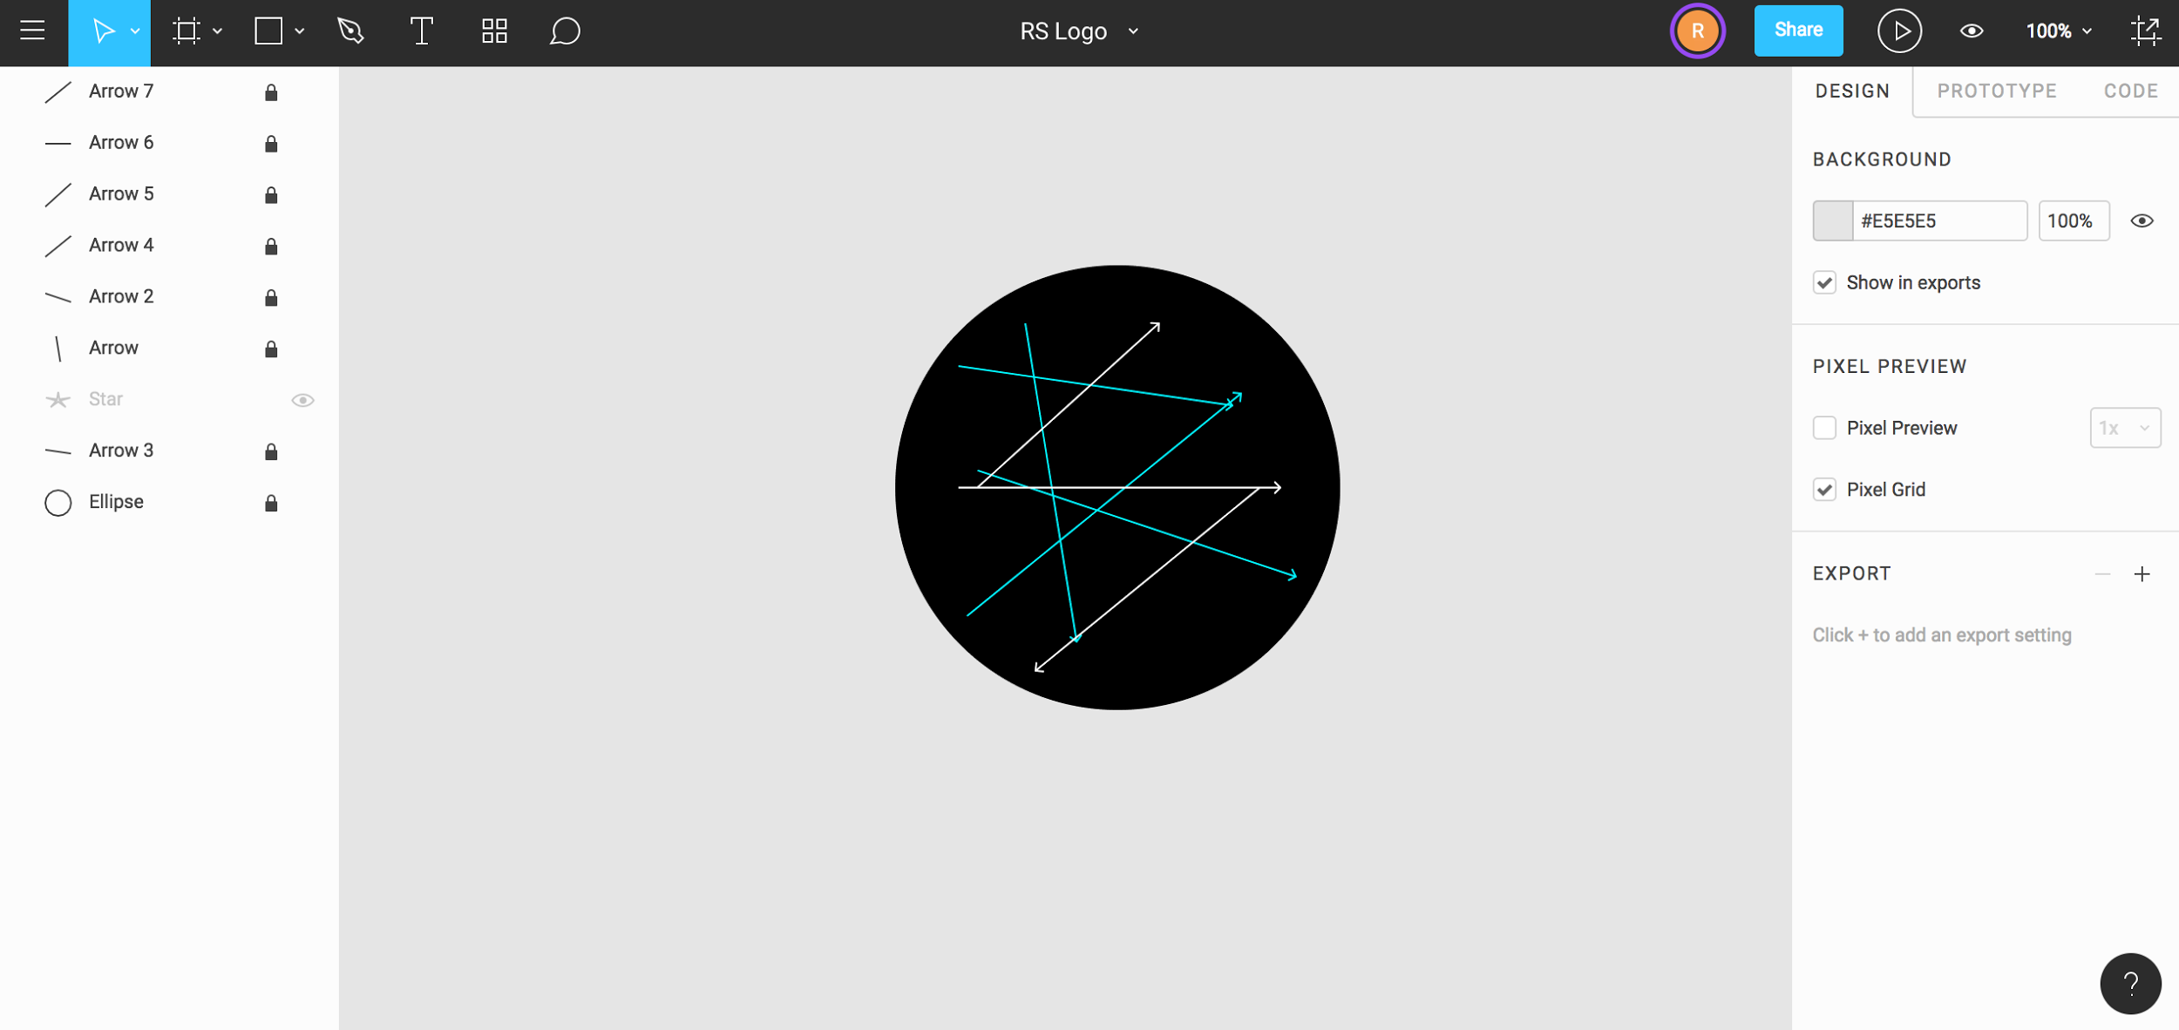

Logo - In the making
Logo - Final
This is the RS logo
Made in Figma
The colors - Black, White, Mint, Arrow lines
Minimal Logo also used also as a Favicom

Slide 7
Richard Jon Santos
Future Full Stack Developer.

