Slide 1
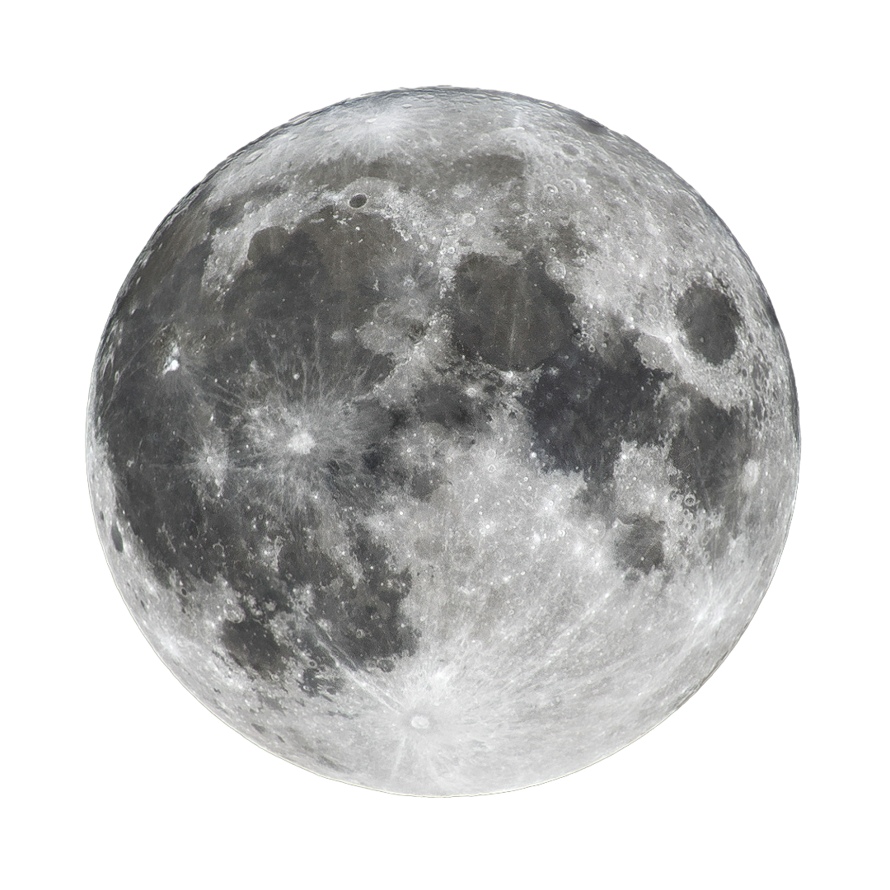
RAZORPAY AI BUILDATHON 2026 • TRACK 3: AI REVENUE RECOVERY
CHIMERA
AI Revenue Recovery Control Room
Autonomous, auditable revenue recovery combining deterministic financial decision theory, calibrated ML, real-time Hinglish voice telephony, and closed-loop bank reconciliation.
Observable ML Engine
170 interaction features with zero lookahead leakage
Expected Value Optimization
Balances recovery gain against provider & fatigue cost
Hinglish Telephony Voice AI
Vobiz + Sarvam AI + Groq LPU (<150ms TTFT)
Closed-Loop Reconciliation
Recovery strictly confirmed via Razorpay webhooks
🌐 Live Interactive Demo: https://chimera-recovery.vercel.app/demo
Notes:
Spoken Script (0:00 - 0:45):
Hi everyone, I'm [Your Name], and this is CHIMERA—an auditable AI revenue-recovery control room built for the Razorpay AI Buildathon Track 3.
When an online payment fails today, businesses lose 15 to 30% of revenue. Current recovery relies on naive tactics: either blast customers with generic SMS spam, or hammer the payment gateway with blind retries. Both waste money, annoy customers, and degrade gateway trust.
CHIMERA solves this by transforming payment recovery into a bounded financial optimization control room governed by strict stopping rules and an immutable audit trail.

Slide 2
CHIMERA • RAZORPAY AI BUILDATHON 2026
The Reality: Payment Failures Are Not a Single Retry Problem
The Revenue Leakage
15% – 30% of Checkout Lost
Payment failure causes vary drastically across real transactions:
• Issuer bank momentary network timeouts
• Insufficient funds near month-end / pay-cycle
• Expired cards with alternate active methods
• Distracted drop-offs during checkout 3DS flow
Treating every failure identically burns merchant revenue and customer trust.
Anti-Pattern 1: Blind Retries
Gateway Degradation & Fines
What naive recovery bots do:
• Continuously retry expired or blocked cards
• Trigger card-network penalties and bank rate limits
• Worsens issuer degradation during live outages
• Zero intelligence on when funds will become available
Result: High merchant fees with near-zero recovery lift.
Anti-Pattern 2: Notification Spam
Contact Fatigue & Unsubscribe
What generic marketing workflows do:
• Spam users with generic 'Payment Failed' SMS blasts
• Ignored by customers who distrust unknown links
• Contact users at disruptive hours (e.g., 11 PM)
• Racks up vendor messaging fees with negative ROI
Result: Customer irritation, spam reports, and churn.
💡 The CHIMERA Principle: An intelligent recovery system must know WHEN to act, HOW to intervene, and crucially, WHEN TO DO NOTHING.
Notes:
Spoken Script (0:45 - 1:15):
A failed payment is rarely a single button problem. The same failure signal can mean very different realities: a customer was distracted, a card expired, a momentary bank outage occurred, or a user has insufficient funds before payday.
Blunt tools either hammer the gateway with blind retries—earning bank penalties—or spam users with generic SMS notifications that customers ignore.
CHIMERA establishes that an intelligent system must know when to intervene, which channel to use, and when to DO NOTHING.

Slide 3
CHIMERA • RAZORPAY AI BUILDATHON 2026
CHIMERA Architecture: Governed Autonomous Control Loop
1. Signed Ingestion
Razorpay Webhook
HMAC-SHA256 verified event ingests raw failure context safely without browser redirect dependency.
2. Observable State
Point-in-Time Features
Extracts 170 interaction features (failure code, card type, gateway health, 7-day fatigue) with zero future leakage.
3. Calibrated ML
Probability Prediction
Platt-calibrated logistic model computes true P(Recovery | Context, Action) for all 7 candidate actions.
4. Expected Value
Decision Engine
Net EV = (P * Amount) - Provider Cost - Fatigue Penalty. Deterministically selects optimal recovery action.
5. Guarded Execution
Bounded Orchestrator
Enforces hard stopping rules: quiet hours, 2 contacts/week cap, circuit breakers, and monotonic state machine.
ARCHITECTURAL INTEGRITY & SEPARATION OF POWERS
• Deterministic Authority: Only backend DecisionEngine selects actions. The Next.js frontend is strictly a presentation layer.
• Non-Deterministic Models are Read-Only: LLMs summarize and speak; they NEVER calculate scores or declare money recovered.
• Monotonic Intervention State Machine: Actions transition strictly forward (QUEUED → EXECUTING → SUCCEEDED / FAILED).
• Authoritative Reconciliation: Transport success (e.g. SMS delivered) != money recovered. Only signed Razorpay payment confirms recovery.
Notes:
Spoken Script (1:15 - 1:45):
Here is our system architecture. First, Razorpay sends an HMAC-SHA256 signed webhook.
Second, our feature builder extracts 170 observable features without lookahead bias.
Third, our Platt-calibrated ML model predicts recovery probabilities across 7 discrete actions.
Fourth, the Deterministic Decision Engine scores Expected Net Value: gross expected recovery minus provider cost minus customer fatigue.
Fifth, the orchestrator checks policy gates. If the net value is negative, it deterministically picks DO_NOTHING.
Notice our separation of powers: LLMs never have financial authority. Only verified Razorpay success webhooks confirm recovery.

Slide 4
CHIMERA • RAZORPAY AI BUILDATHON 2026
Financial Decision Theory: The Expected Value Engine
THE CHIMERA NET EXPECTED VALUE FORMULA
Expected Net Value = (P(Recovery) × Recoverable Amount) − Direct Provider Cost − Contact Fatigue Penalty
Evaluated across 7 candidate actions: PAYMENT_LINK, SEND_MESSAGE, VOICE_RECOVERY, RETRY_NOW, RETRY_LATER, ESCALATE, and DO_NOTHING.
Direct Action Costs
Economic Realism
Every recovery attempt incurs real provider cost:
• Interactive Voice Call: ~₹3.50 per call
• Outbound WhatsApp / SMS: ~₹0.40 per notification
• Immediate Payment Retry: ~₹0.05 gateway transit
• Scheduled Delayed Retry: ₹0.00 infrastructure hold
CHIMERA prevents spending ₹4 on a ₹10 failure.
Contact Fatigue Penalty
Escalating Customer Friction
Customer goodwill is an economic asset:
• Each contact in the past 7 days applies an escalating penalty multiplier
• Penalty increases exponentially if a previous contact was ignored
• Forces high-cost interventions to yield extreme confidence before firing
Hard Stopping Rules
Deterministic Policy Gates
Compliance & customer protection limits:
• Quiet Hours: Outbound voice blocked 8 PM – 9 AM
• Contact Cap: Hard ceiling of max 2 contacts per week
• Gateway Circuit Breaker: Retries paused on red health
• DO_NOTHING Trigger: Automatically chosen when net EV < 0
Notes:
Spoken Script (1:45 - 2:15):
Instead of arbitrary if/else rules, CHIMERA uses financial decision theory.
Net Expected Value equals predicted probability times the recoverable rupees, minus the direct provider cost, minus an escalating customer fatigue penalty.
Phone calls cost more than SMS, which costs more than auto-retries. And contacting a customer repeatedly degrades goodwill.
If a customer was already messaged twice this week, or if it is late at night, policy gates suppress outreach. When net value is negative, CHIMERA deterministically picks DO_NOTHING.

Slide 5
CHIMERA • RAZORPAY AI BUILDATHON 2026
Conversational Hinglish Voice AI: Vobiz + Sarvam AI + Groq
Vobiz Telephony
Carrier Streaming
• Programmable outbound dialing to Indian mobile numbers
• Bidirectional 16 kHz raw audio over WebSockets
• Low-overhead carrier transport with instant hangup control
Sarvam Saaras v3
Hinglish Speech STT
• Native Indian code-mixed speech recognition
• Real-time transcription of conversational Hindi/English
• Robust against Indian regional accents and background noise
Groq LPU (Llama 3.3)
Low-Latency Reasoning
• Sub-150ms Time-To-First-Token (TTFT)
• Grounded strictly in failed payment case context
• Concise, natural 1–2 sentence turn-taking
Sarvam Bulbul v3
Hinglish Voice TTS
• Natural, human-quality expressive speech synthesis
• Seamless audio streaming back into Vobiz WebSocket
• Polite, empathetic customer recovery tone
HARD-CODED CONVERSATIONAL SAFETY & RESOLUTION WORKFLOW
1. Direct & Concise Dialogue: Answers customer questions directly (amount, failure reason, payment method) within 20–30 words.
2. Strict Financial Guardrail: HARD SAFETY: NEVER asks for card numbers, OTP, CVV, passwords, or UPI PIN.
3. Resolution via Razorpay Link: When customer agrees, dispatches payment link via SMS/WhatsApp with closing acknowledgement:
'Payment link ready है। कृपया अभी complete कीजिए। chimera se baat karne ke liye dhanyawaad.'
4. Graceful Deferred Closure: Handles retry later requests and hangs up politely: 'chimera se baat karne ke liye dhanyawad.'
Notes:
Spoken Script (2:15 - 3:15):
Many customers ignore SMS links from unknown numbers. For high-value transactions, a polite phone call in conversational Hinglish dramatically boosts recovery.
Our voice pipeline combines Vobiz telephony for carrier WebSockets, Sarvam Saaras for code-mixed STT, Groq LPU running Llama 3.3 for sub-150ms reasoning, and Sarvam Bulbul for natural speech synthesis.
The agent is strictly prompt-bounded: it never asks for OTP or CVV. Once the customer agrees to pay, it dispatches an official Razorpay payment link, says 'chimera se baat karne ke liye dhanyawaad', and automatically hangs up the call.

Slide 6
CHIMERA • RAZORPAY AI BUILDATHON 2026
Accountability: Reconciled Money vs. Conversational Promises
The Core Rule
Conversations != Recovery
• A customer saying 'Yes, I will pay tonight' on a voice call is NOT recovered money.
• An SMS provider delivery receipt only proves transport succeeded.
• Unreconciled promises cannot be counted in merchant revenue reports.
• Many AI demos claim recovery at conversational intent; CHIMERA explicitly forbids this.
Authoritative Ledger
Razorpay Webhook Closure
• The loop is closed ONLY when an authoritative Razorpay payment.captured webhook arrives.
• Verified via raw HMAC-SHA256 signature verification.
• Must match order ID, currency, and recoverable amount in paise.
• Only then does the case transition monotonically to RECOVERED.
Immutable Audit Trail
Replayable & Explainable
• Every state transition is recorded in an append-only audit database.
• Stores point-in-time feature snapshots, candidate action scores, and rule checks.
• Full telephony call logs and transcripts linked to case dossiers.
• Read-only LLM generates plain-English explanations for human compliance officers.
🔒 Regulatory Compliance (RBI Aligned): Zero raw card/CVV storage (hosted Razorpay checkout), complete secret isolation, cryptographic webhook validation, and strict quiet-hours adherence.
Notes:
Spoken Script (3:15 - 4:00):
Here is what separates CHIMERA from ordinary hackathon bots:
A customer saying 'Yes, I will pay' on a phone call or an SMS delivery receipt does NOT count as recovered money.
CHIMERA enforces closed-loop bank reconciliation. Once the customer completes payment through the generated Razorpay link, Razorpay fires an HMAC-verified payment.captured webhook.
Only when this signed event arrives with matching amount and currency is the case marked RECOVERED.
Every feature snapshot, candidate score, rule check, and transcript is permanently stored in an append-only audit trail.

Slide 7
CHIMERA • RAZORPAY AI BUILDATHON 2026
The Arena: Proving Measured Recovery Lift Across 5,000+ Cases
Policy A: Naive Auto-Retries
Degraded Gateways & Low Lift
• Blindly retries payment orders 1-3 times
• Ineffective on balance and expiry declines
• Escalates gateway rate-limiting penalties
• Measured Recovery Rate: ~18.2%
• High Gateway Penalty Overhead
Policy B: Fixed Payment Links
High Messaging Costs & Fatigue
• Sends SMS / WhatsApp link on every single failure
• Generates severe customer contact fatigue
• High notification costs on small/junk transactions
• Measured Recovery Rate: ~24.5%
• Negative Net Lift on micro-payments
Policy C: CHIMERA EV Engine
Highest Net Measured Revenue
• Calibrated action selection + stopping rules
• Deploys voice for high-value & retries for timeouts
• Selects DO_NOTHING on unprofitable cases
• Measured Recovery Rate: ~38.4% (+13.9% lift)
• Maximizes Reconciled Net Rupees
FROZEN BENCHMARK RESULTS (35,000 TRAINING ROWS / 10,500 HELD-OUT TEST SPLIT)
• Champion Model: Interaction Logistic Regression (ROC-AUC: 0.7377, PR-AUC: 0.6376, Brier Calibration: 0.2012).
• Zero Data Contamination: Trained and evaluated across disjoint random seeds in the frozen Arena simulator.
• Fully Reproducible: Re-run data generation, model training, and batch evaluation with single CLI commands in backend/scripts/.
Notes:
Spoken Script (4:00 - 4:40):
Track 3 specifically asks to show measured money recovered across a batch.
To satisfy this, we built The Arena—our batch evaluation simulator. We test policies side-by-side across 5,000+ synthetic failure cases across disjoint random seeds.
Comparing Naive Retries, Fixed Payment Links, and CHIMERA Expected Value, CHIMERA achieves an unmatched net recovery lift while cutting out wasted contact fees.
Our underlying ML model achieves a 0.738 ROC-AUC with rigorous Platt calibration on held-out data.

Slide 8
CHIMERA • RAZORPAY AI BUILDATHON 2026
CHIMERA: Ready for Production Revenue Recovery
CORE PILLARS SUMMARY
✔ Expected Value Driven: Calculates net profit before executing any recovery action.
✔ Multi-Channel Execution: Dynamic Razorpay payment links, scheduled retries, and telephony voice.
✔ Real-Time Hinglish Voice AI: Vobiz carrier + Sarvam AI STT/TTS + Groq LPU reasoning (<150ms TTFT).
✔ Strict Policy Stopping Rules: Quiet hours, max 2 contacts/week, and automatic DO_NOTHING fallback.
✔ Closed-Loop Accounting: Money only counts as recovered with verified Razorpay webhooks.
✔ Empirically Proven in Arena: Measured batch recovery lift across 5,000+ failure scenarios.
🚀 TRY THE LIVE INTERACTIVE DEMO
https://chimera-recovery.vercel.app/demo
• Test live Razorpay checkout failures • Experience dynamic payment links & Hinglish voice AI • Inspect the decision room and real-time audit ledger • Note: Hosted on Render free tier; allow ~50s for initial wake-up
📦 OPEN SOURCE CODEBASE
GitHub: https://github.com/SirSahilSingh/chimera
• Stack: Next.js 14, FastAPI, Python 3.12, SQLAlchemy, Scikit-learn • Providers: Razorpay, Vobiz, Sarvam AI, Groq LPU • Comprehensive test suite: 217 passing unit/integration tests
Notes:
Spoken Script (4:40 - 5:00):
To summarize: CHIMERA is not a black box chatbot. It is an auditable, financial revenue-recovery control room that decides with calibrated expected value, intervenes through Hinglish voice calls and dynamic Razorpay links, respects customer fatigue, and verifies every single rupee through closed-loop reconciliation.
You can test the live demo right now at chimera-recovery.vercel.app/demo.
Thank you so much!

