Slide 1
GIP
Rares Tudor

Slide 2
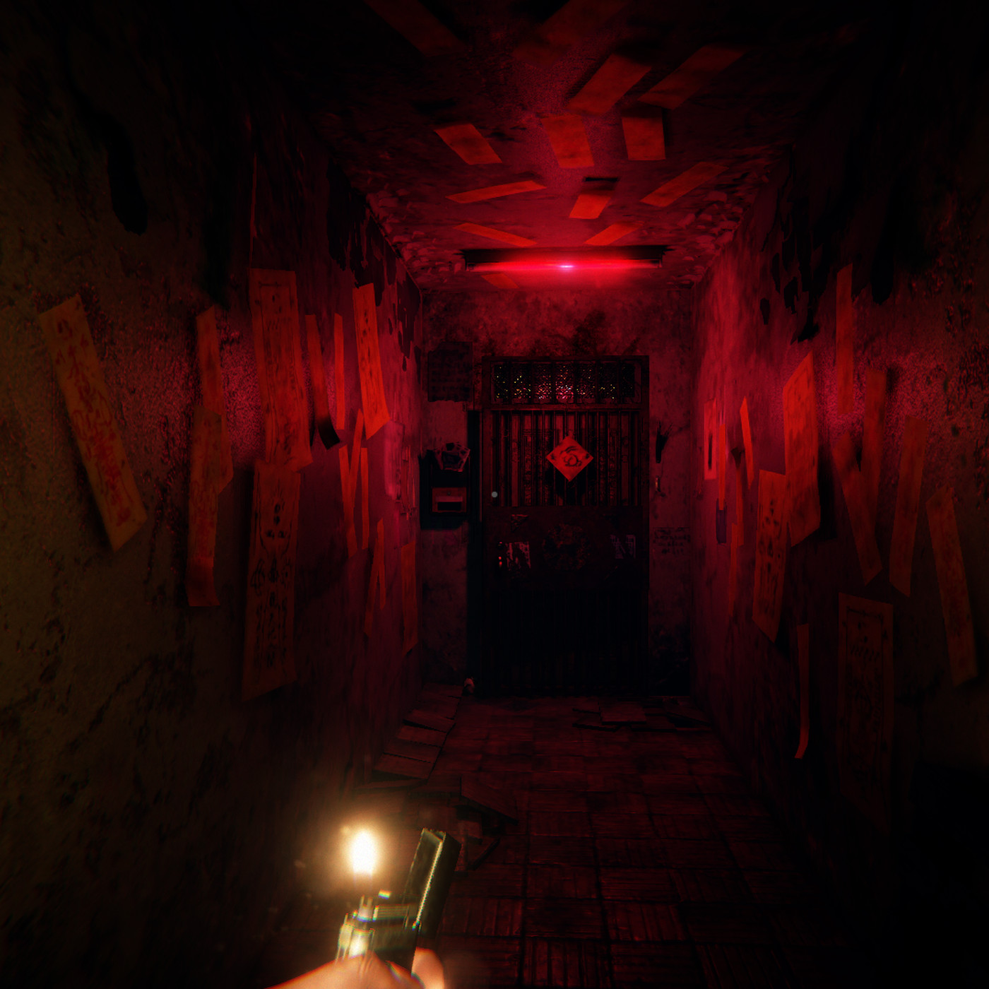
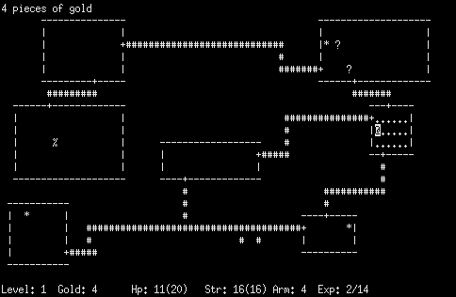

My 3 Ideas
3D Game | 2.5D Game | Language Courses App
Typical horror Game in a forest
Roguelike-Dungeon Game
Language Courses App where you can learn different languages

Slide 3
3D Game
Typical Horror game in a forest
Made in Unity or UnrealEngine
Requirements:
Storyline
Characters
Code
3D Graphics
Real Context:
Always wanted to make a game and play it.

Slide 4
2.5D Game
Roguelike Dungeon hack & slash game
Requirements:
Made in Unity or UnrealEngine
Small storyline/Quest
Enemies
Shops
2D Graphics
3D Sprites
Code
Real Context:
Always wanted to make a game and play it.

Slide 5
Language App
Language Courses App with multiple languages
Requirements:
Made with Java or Kotlin
Code
Database
Multiple Languages
Multiple Courses/Lessons
Real Context:
I always want to learn more languages and thought this might help me too.

Slide 6
End
Thank you for listening

