Slide 1
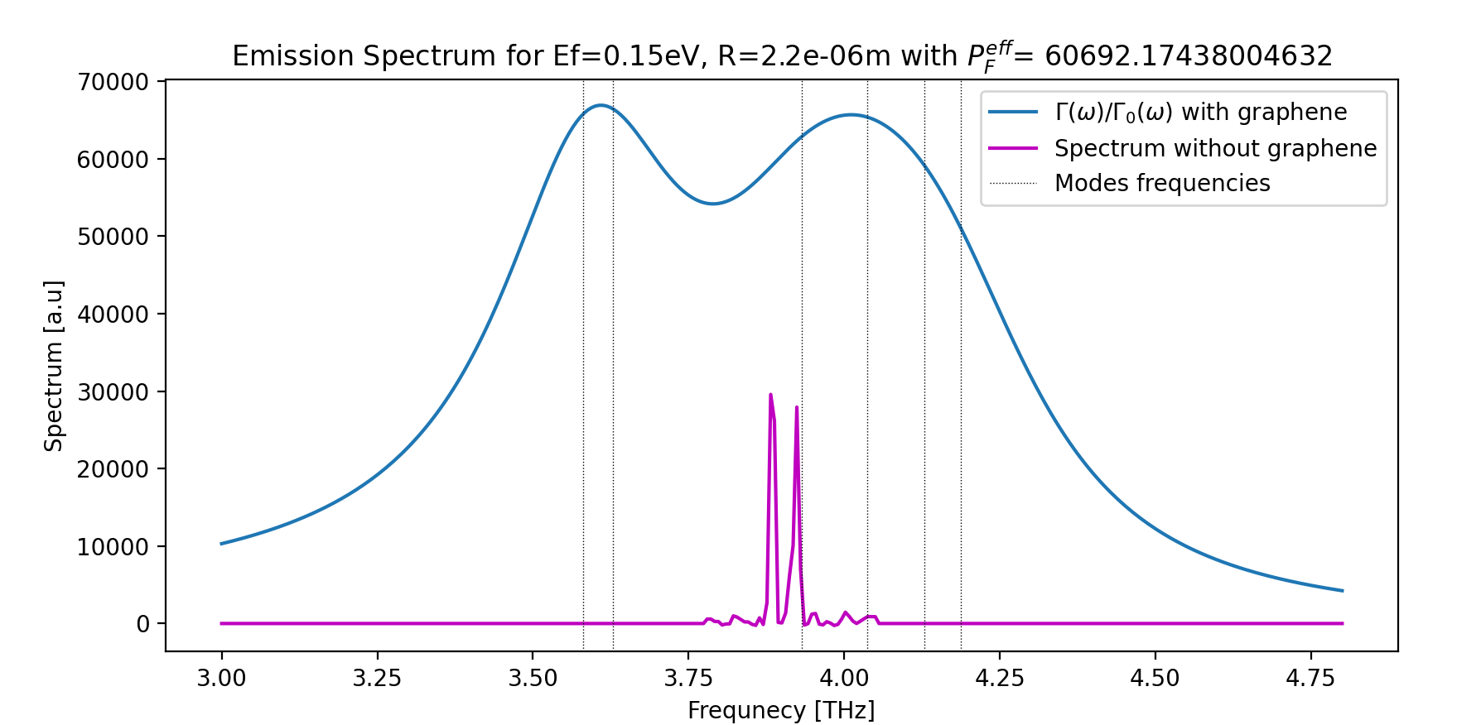
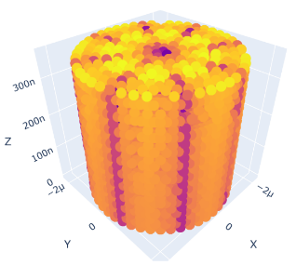
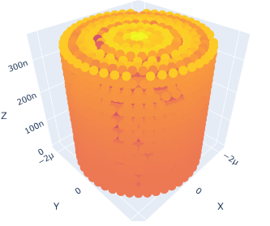
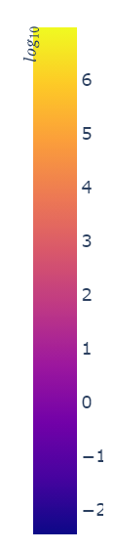
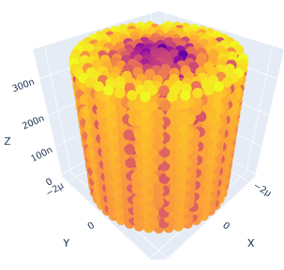
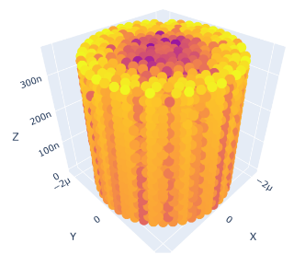
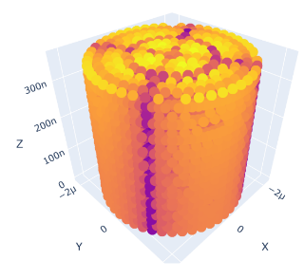
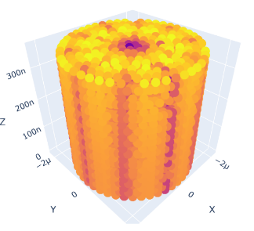
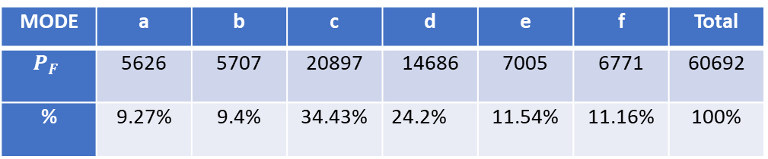
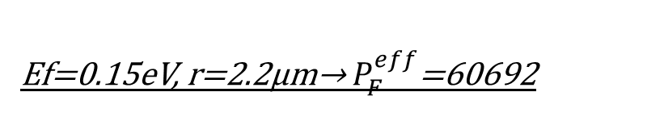
Ef=0.15eV, r=2.2μm→ $P_{F}^{eff}$=60692
Electric Field in the Device [Logarithmic Scale]
(a)
(b)
(c)
(e)
(d)
(f)
(a) f=3.58THz
(d) f=4.04THz
(b) f=3.63THz
(e) f=4.13THz
MODE | a | b | c | d | e | f | Total
$$P_{F}$$ | 5626 | 5707 | 20897 | 14686 | 7005 | 6771 | 60692
% | 9.27% | 9.4% | 34.43% | 24.2% | 11.54% | 11.16% | 100%
(c) f=3.93THz
(f) f=4.19THz

Slide 2
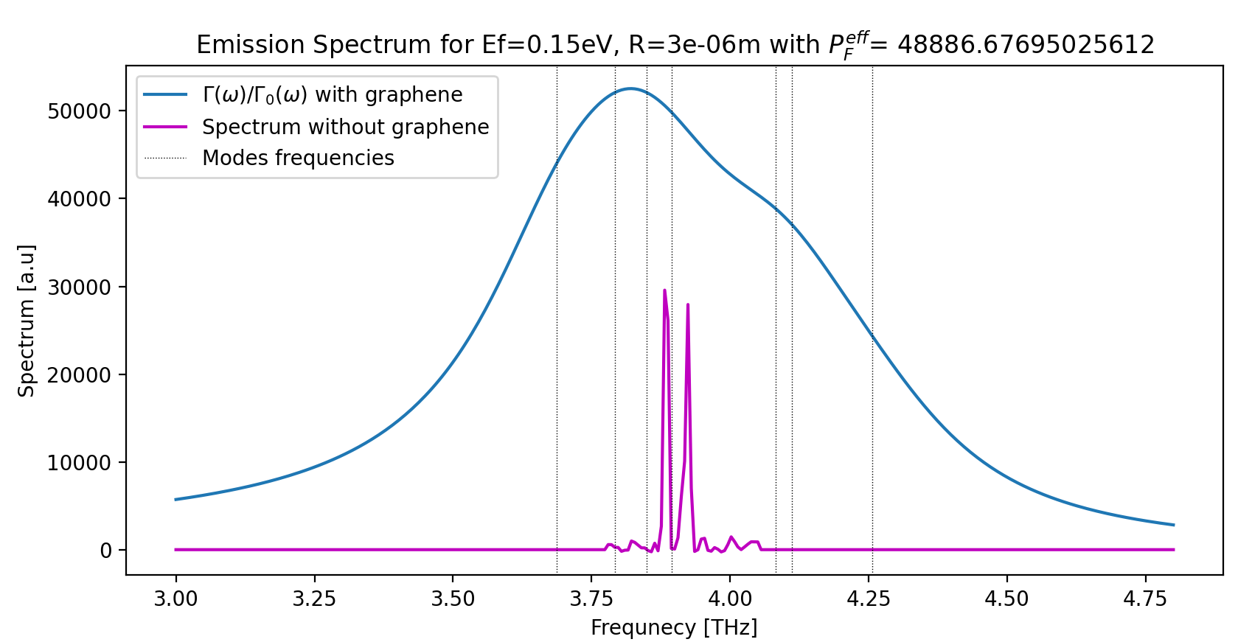
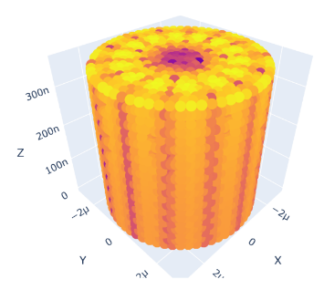
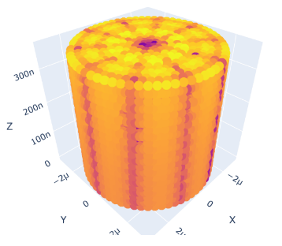
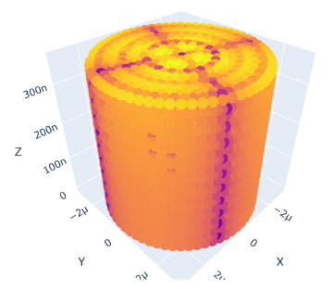
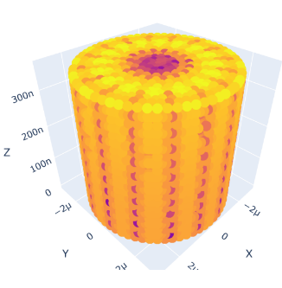
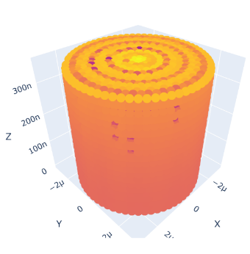
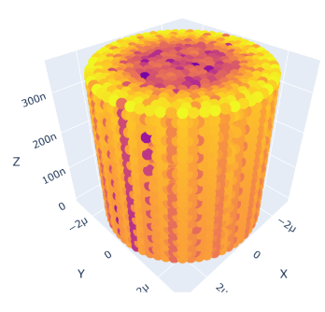
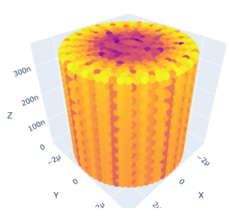
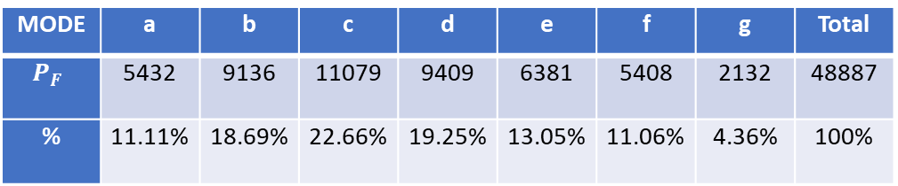
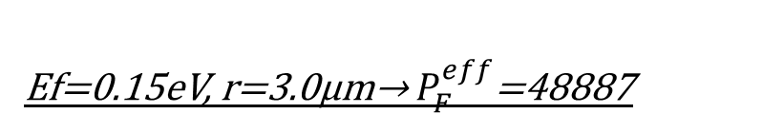
Ef=0.15eV, r=3.0μm→ $P_{F}^{eff}$=48887
Electric Field in the Device [Logarithmic Scale]
(a)
(c)
(b)
(d)
(e)
(a) f=3.69THz
(e) f=4.08THz
(f)
(g)
(b) f=3.79THz
(f) f=4.11THz
MODE | a | b | c | d | e | f | g | Total
$$P_{F}$$ | 5432 | 9136 | 11079 | 9409 | 6381 | 5408 | 2132 | 48887
% | 11.11% | 18.69% | 22.66% | 19.25% | 13.05% | 11.06% | 4.36% | 100%
(c) f=3.85THz
(g) f=4,26THz
(d) f=3.90THz

Slide 3
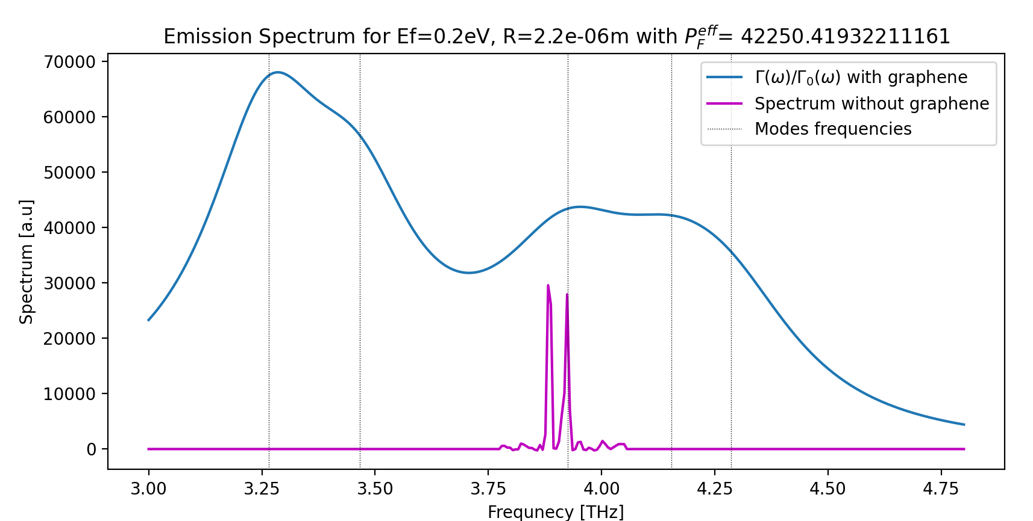
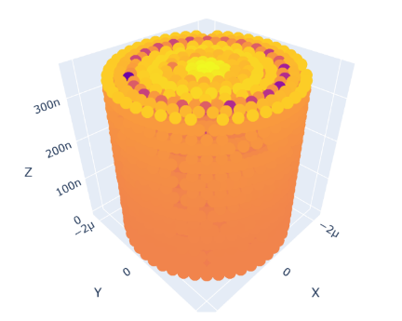
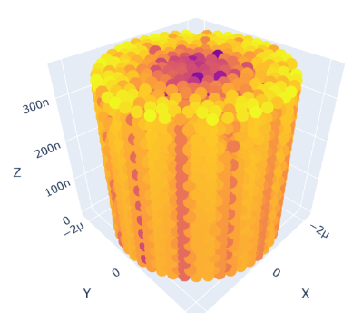
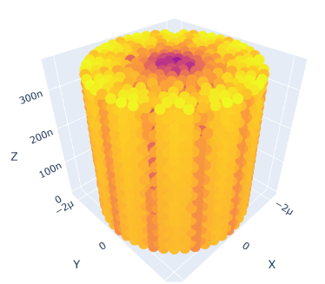
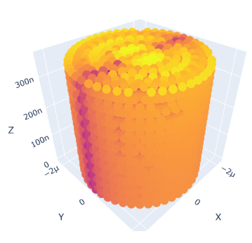
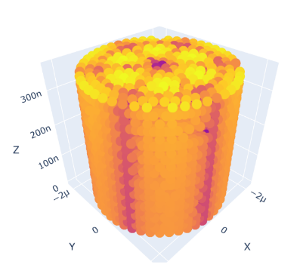
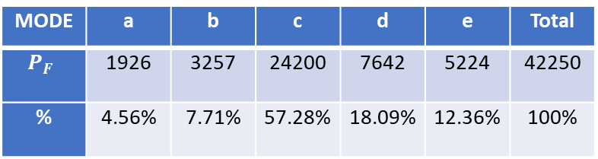
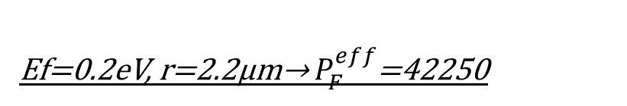
Ef=0.2eV, r=2.2μm→ $P_{F}^{eff}$=42250
Electric Field in the Device [Logarithmic Scale]
(a)
(b)
(c)
(a) f=3.27THz
(d) f=4.15THz
(d)
(e)
(b) f=3.47THz
(e) f=4.29THz
MODE | a | b | c | d | e | Total
$$P_{F}$$ | 1926 | 3257 | 24200 | 7642 | 5224 | 42250
% | 4.56% | 7.71% | 57.28% | 18.09% | 12.36% | 100%
(c) f=3.93THz

Slide 4
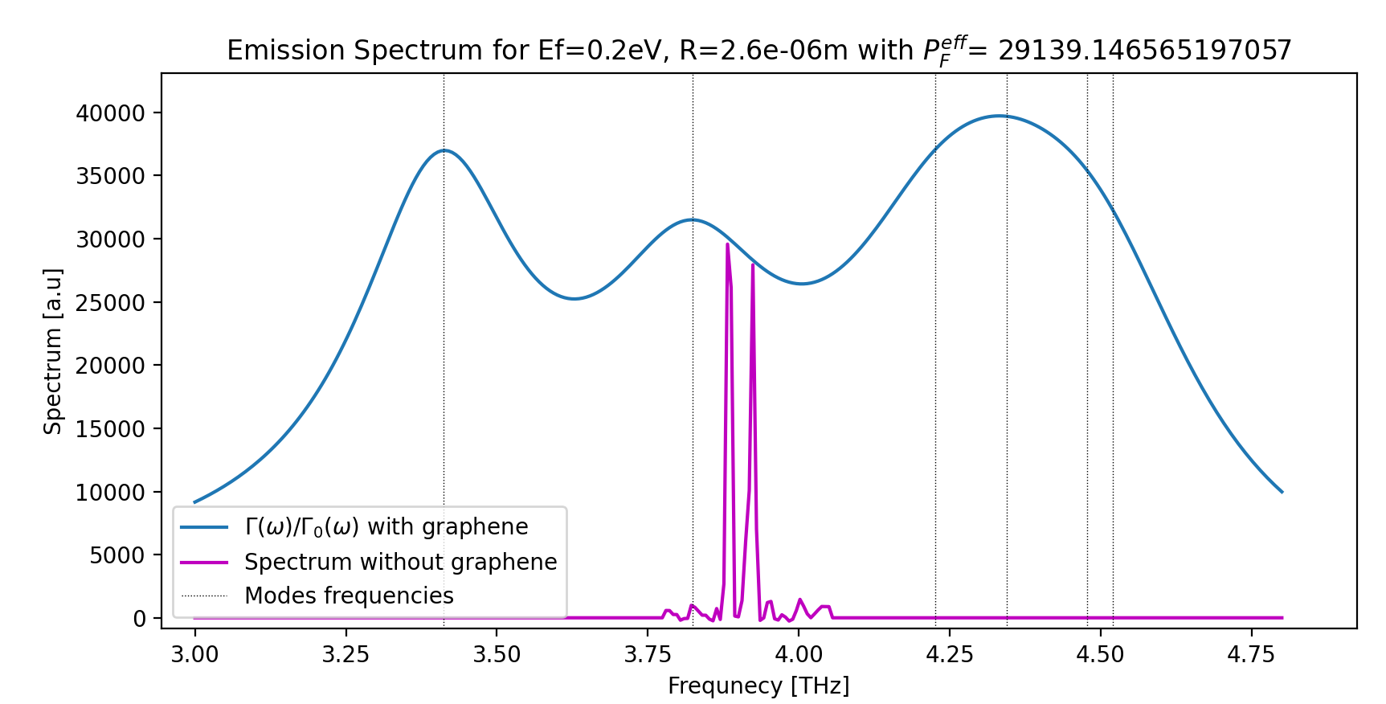
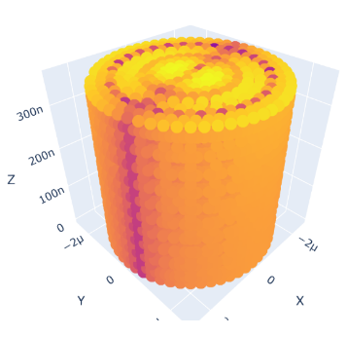
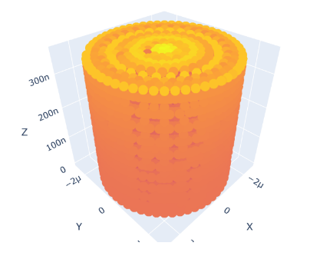
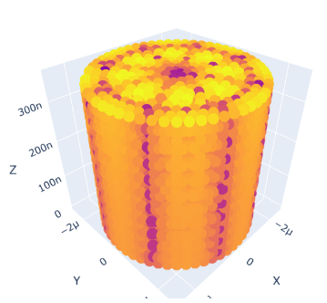
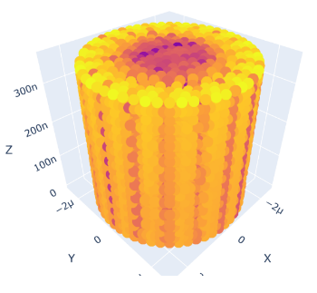
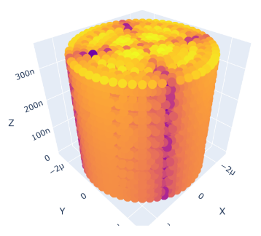
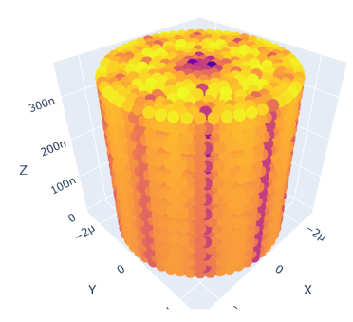
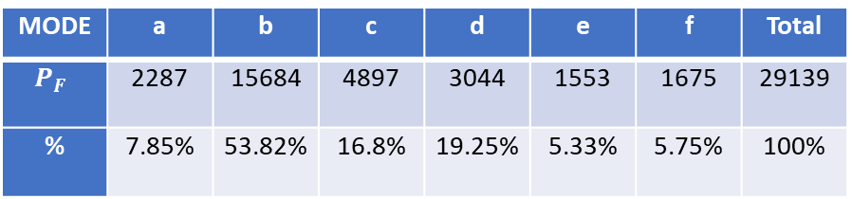
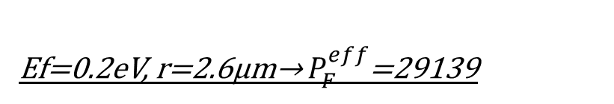
Ef=0.2eV, r=2.6μm→ $P_{F}^{eff}$=29139
Electric Field in the Device [Logarithmic Scale]
(c)
(e)
(b)
(d)
(a)
(f)
(a) f=3.41THz
(d) f=4.34THz
(b) f=3.82THz
(e) f=4.48THz
MODE | a | b | c | d | e | f | Total
$$P_{F}$$ | 2287 | 15684 | 4897 | 3044 | 1553 | 1675 | 29139
% | 7.85% | 53.82% | 16.8% | 19.25% | 5.33% | 5.75% | 100%
(c) f=4.23THz
(f) f=4.52THz

Slide 5
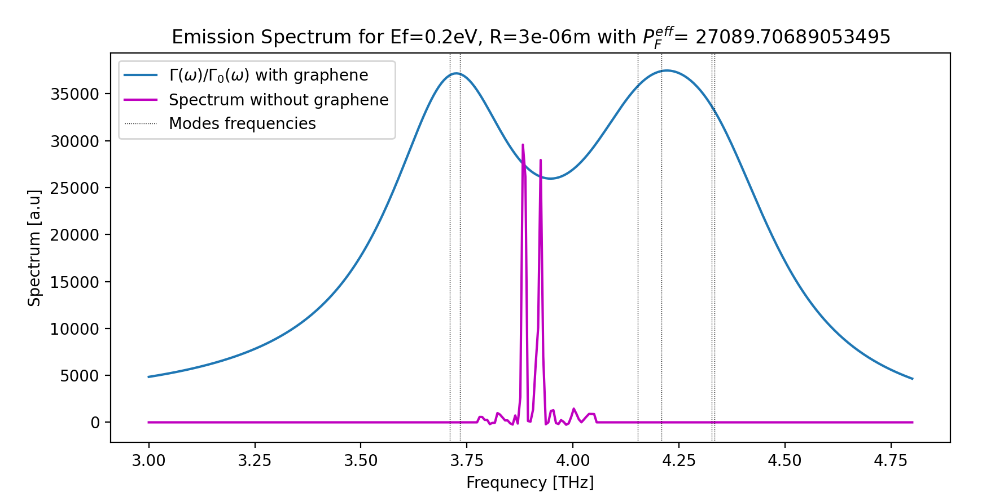
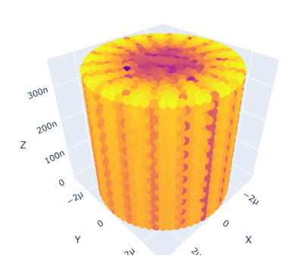
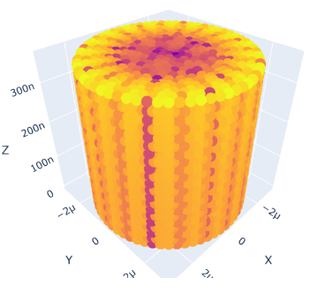
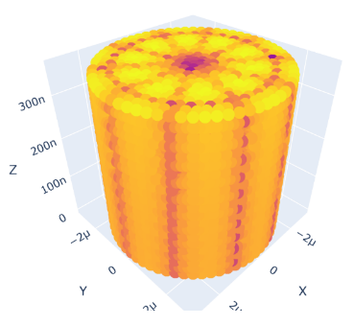
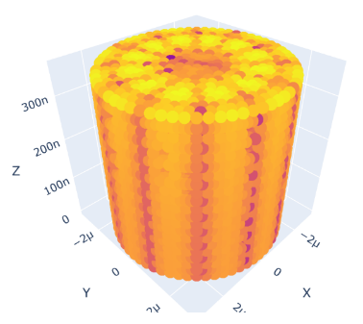
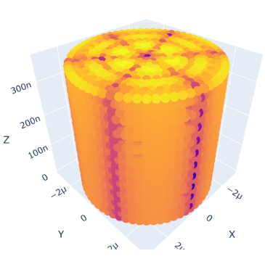
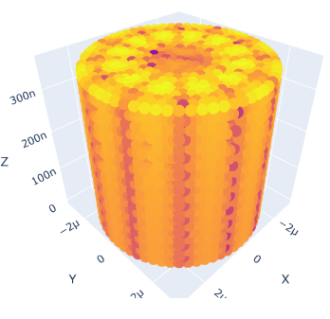
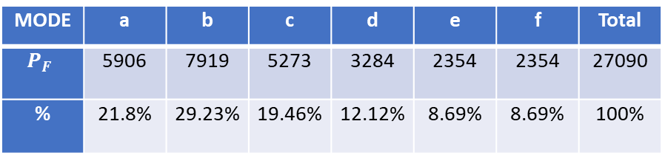
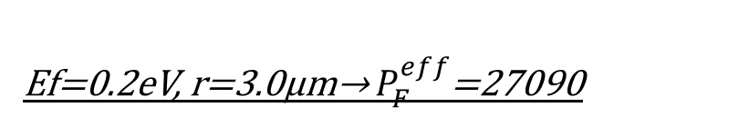
Ef=0.2eV, r=3.0μm→ $P_{F}^{eff}$=27090
Electric Field in the Device [Logarithmic Scale]
(c)
(e)
(b)
(d)
(d) f=4.21THz
(f)
(a) f=3.71THz
(a)
(b) f=3.73THz
(e) f=4.33THz
MODE | a | b | c | d | e | f | Total
$$P_{F}$$ | 5906 | 7919 | 5273 | 3284 | 2354 | 2354 | 27090
% | 21.8% | 29.23% | 19.46% | 12.12% | 8.69% | 8.69% | 100%
(c) f=4.15THz
(f) f=4.333THz

Slide 6
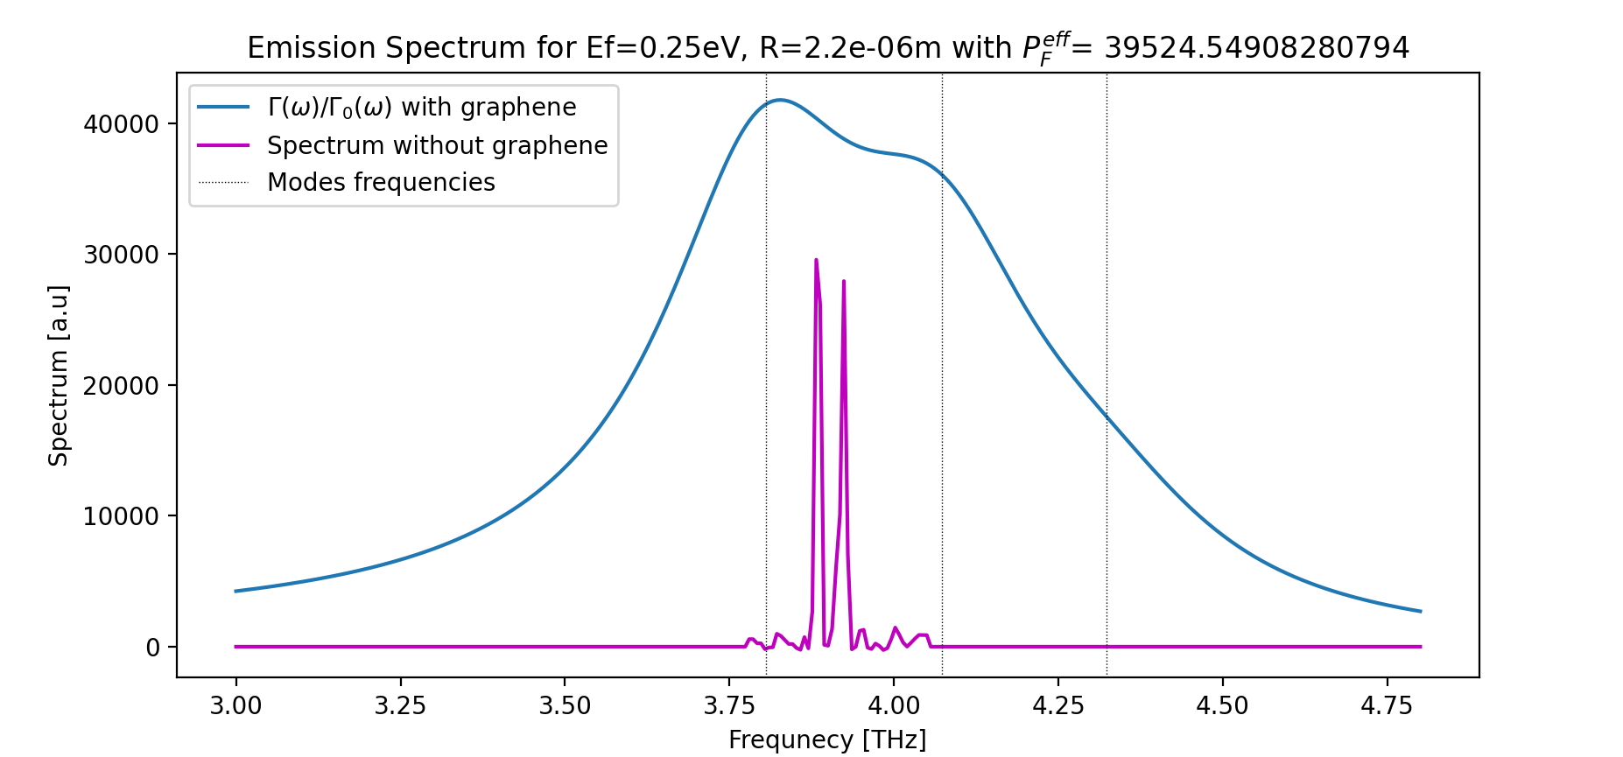
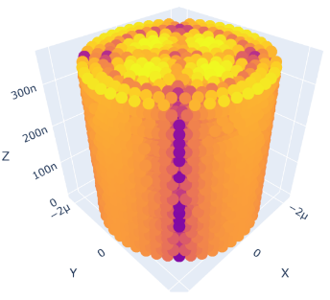
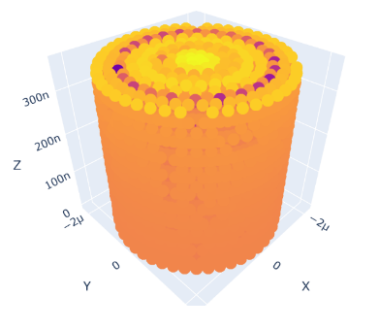
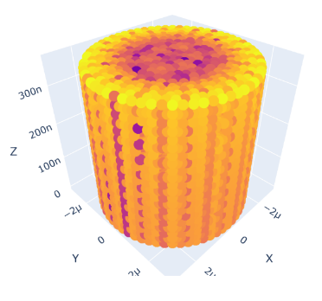


Ef=0.25eV, r=2.2μm→ $P_{F}^{eff}$=39525
Electric Field in the Device [Logarithmic Scale]
(a)
(b)
(a) f=3.81THz
(c)
(b) f=4.07THz
MODE | a | b | c | Total
$$P_{F}$$ | 22280 | 15609 | 1636 | 39525
% | 56.37% | 39.49% | 4.14% | 100%
(c) f=4.32THz

Slide 7






Ef=0.25eV, r=2.26μm→ $P_{F}^{eff}$=30757
Electric Field in the Device [Logarithmic Scale]
(a)
(b)
(c)
(a) f=3.88THz
(b) f=4.14THz
MODE | a | b | c | Total
$$P_{F}$$ | 19277 | 6774 | 4706 | 30757
% | 62.68% | 22.02% | 15.3% | 100%
(c) f=4.26THz

Slide 8








Ef=0.25eV, r=3.0μm→ $P_{F}^{eff}$=31335
Electric Field in the Device [Logarithmic Scale]
(b)
(c)
(a)
(d)
(a) f=3.46THz
(d) f=4.33THz
(e)
(b) f=3.90THz
(e) f=4.46THz
MODE | a | b | c | d | e | Total
$$P_{F}$$ | 2256 | 14656 | 10078 | 2632 | 1713 | 31335
% | 7.2% | 46.77% | 32.16% | 8.4% | 5.47% | 100%
(c) f=4.00THz

