Slide 1
Social Groups in Badgers
Karl Menzel

Slide 2
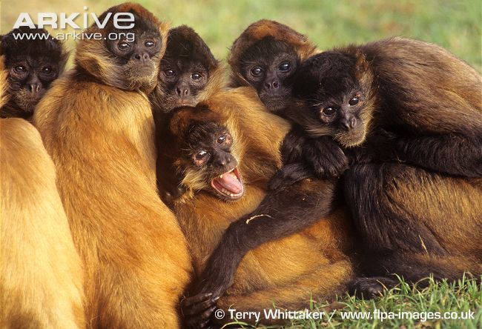
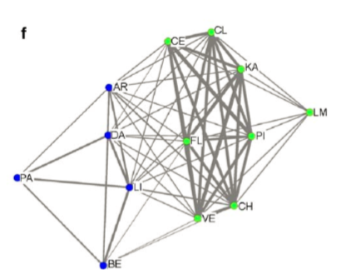
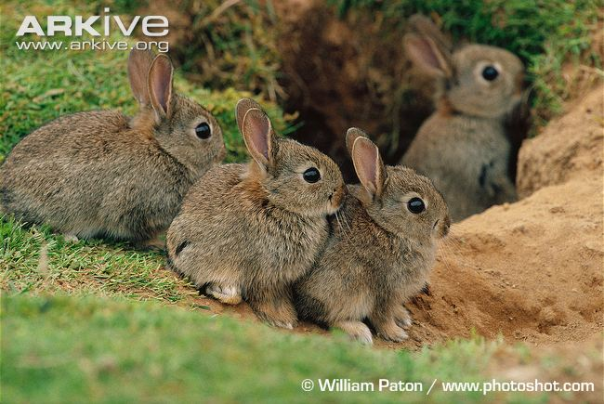
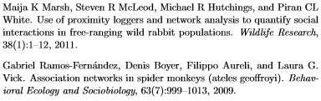
Finding Subgroups
Useful for understanding:
Gene Flow
social interactions
spread of disease

Slide 3
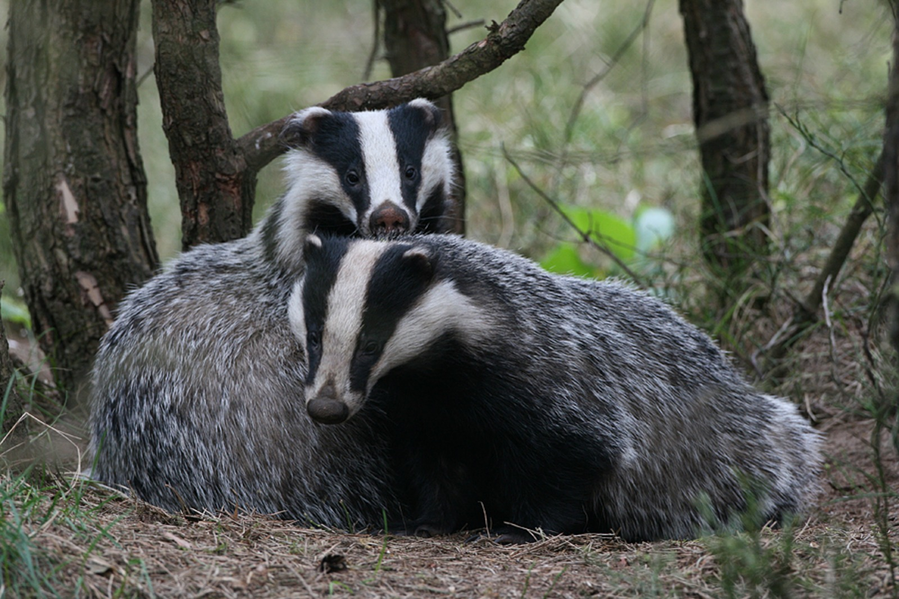
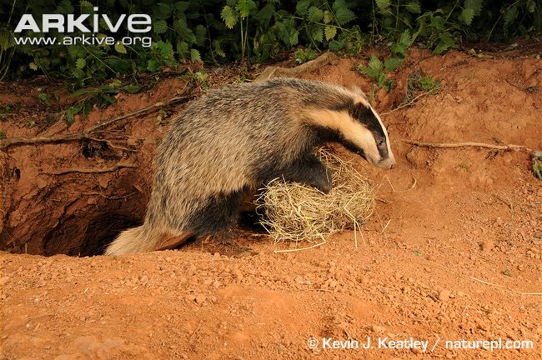
Badger Social Networks
Natural Reservoir of tuberculosis
Badgers live in setts which are systems of underground tunnels

Slide 4
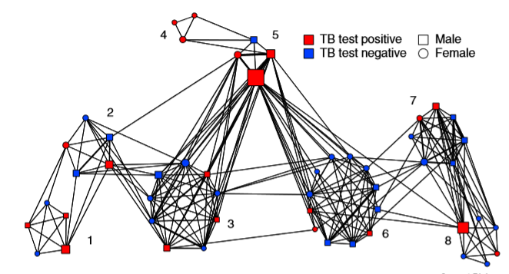

Betweenness and Tuberculosis
Can we cluster the badgers into the correct social groups?
Is flow-betweennes important for the clustering?

Slide 5
Badgers and Radio Collars
Woodchester Park, Gloucestershire, England
51 badgers
Badger | 008p | 009p | 010p | 010y | 011y | 012b | 013p | 014p | 015p | 016p | 018p
008p | 0 | 0 | 0 | 0 | 0 | 354 | 0 | 0 | 0 | 51 | 139
009p | 0 | 0 | 8 | 0 | 102688 | 0 | 0 | 173092 | 198123 | 0 | 0
010p | 0 | 8 | 0 | 0 | 3 | 0 | 74 | 0 | 0 | 0 | 0
010y | 0 | 0 | 0 | 0 | 0 | 0 | 0 | 0 | 0 | 69960 | 0
011y | 0 | 102688 | 3 | 0 | 0 | 766 | 0 | 160749 | 68133 | 0 | 48
012b | 354 | 0 | 0 | 0 | 766 | 0 | 0 | 0 | 0 | 0 | 215319
013p | 0 | 0 | 74 | 0 | 0 | 0 | 0 | 0 | 0 | 0 | 0
014p | 0 | 173092 | 0 | 0 | 160749 | 0 | 0 | 0 | 303544 | 0 | 0
015p | 0 | 198123 | 0 | 0 | 68133 | 0 | 0 | 303544 | 0 | 0 | 0
016p | 51 | 0 | 0 | 69960 | 0 | 0 | 0 | 0 | 0 | 0 | 0
018p | 139 | 0 | 0 | 0 | 48 | 215319 | 0 | 0 | 0 | 0 | 0
020p | 32 | 0 | 0 | 0 | 0 | 5419 | 0 | 0 | 0 | 0 | 2185

Slide 6
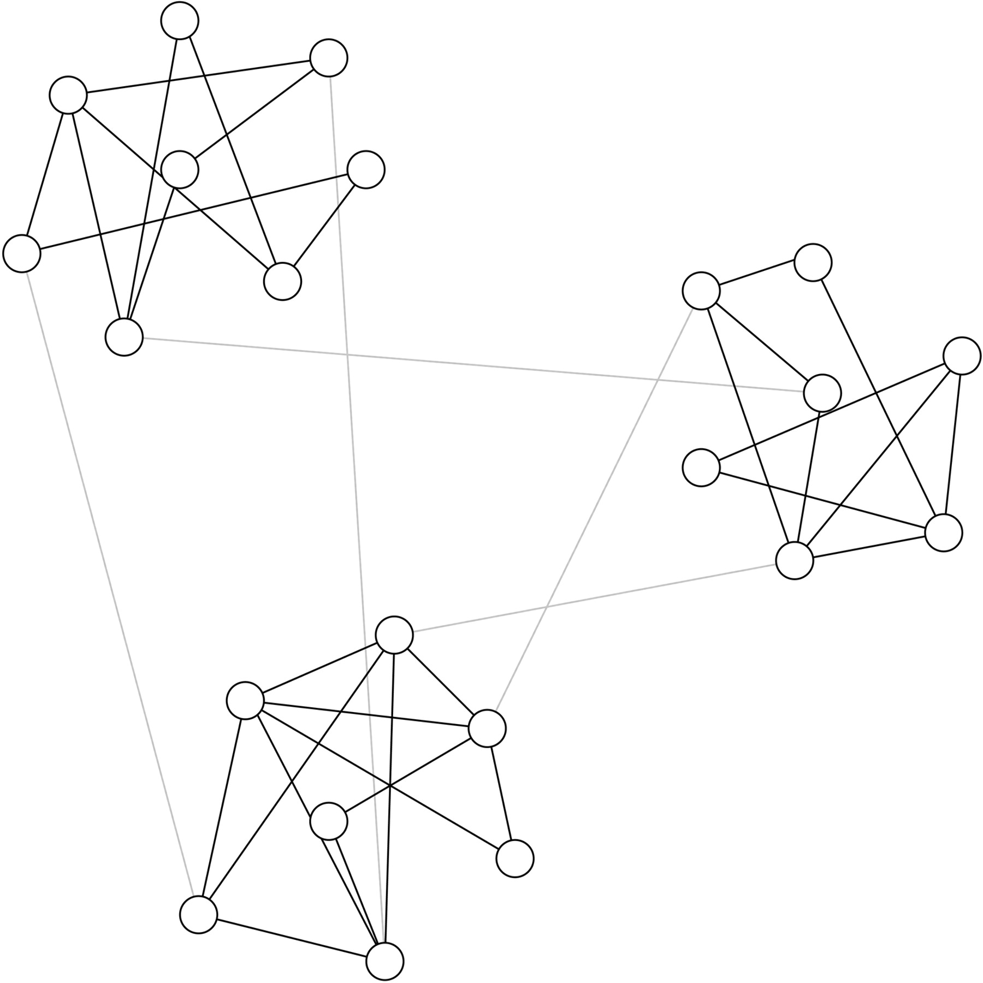
Girvan-Newman Method
1. Calculate the betweenness for all edges in the network.
2. Remove the edge with the highest betweenness.
3. Recalculate betweennesses for all edges affected by the removal.
4. Repeat from step 2 until no edges remain.
M. Girvan, and M. E. J. Newman PNAS 2002;99:7821-7826

Slide 7
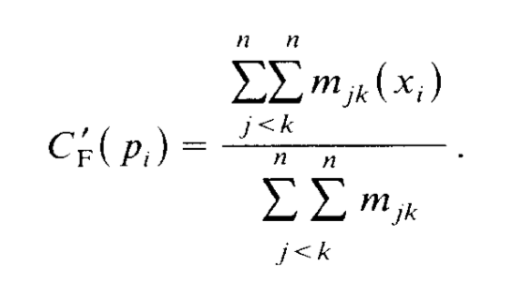
Flow-Betweenness
A
C
S
T
B

Slide 8
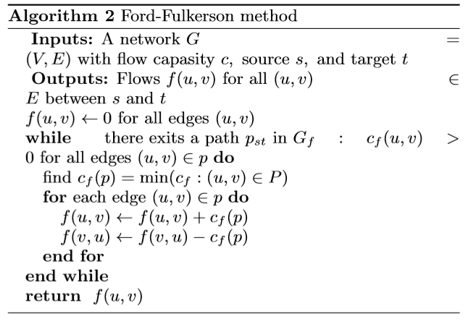
Ford-Fulkerson Method

Slide 9
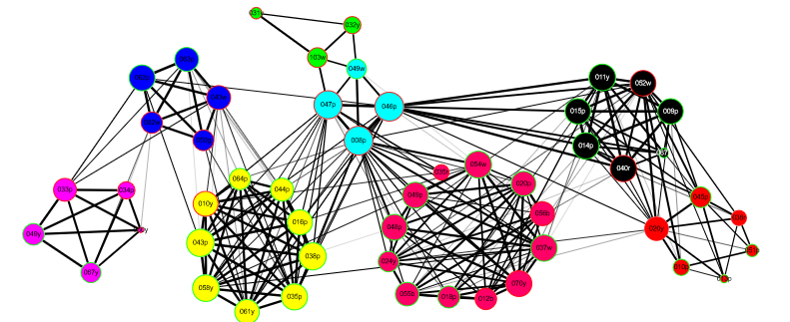
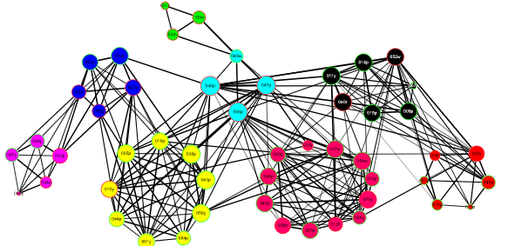
Results 3
Edge Widths are Time
Edge Widths are Flow-Betweenness

Slide 10
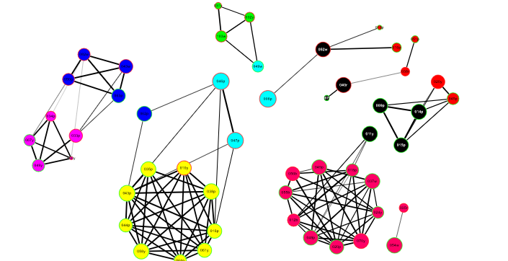
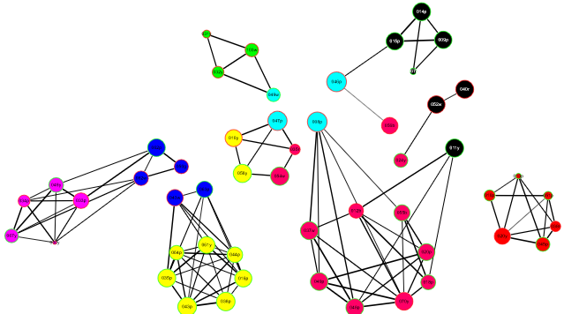
Notes:
Both bad but Flow-Betweenness better because it preserves more groupings. More needs to be considered than time for social groupings: whether or not have tb, differences in seasonality

Slide 11
Edge Widths are Flow-Betweenness

Slide 12
Edge Widths are Time

