Slide 1
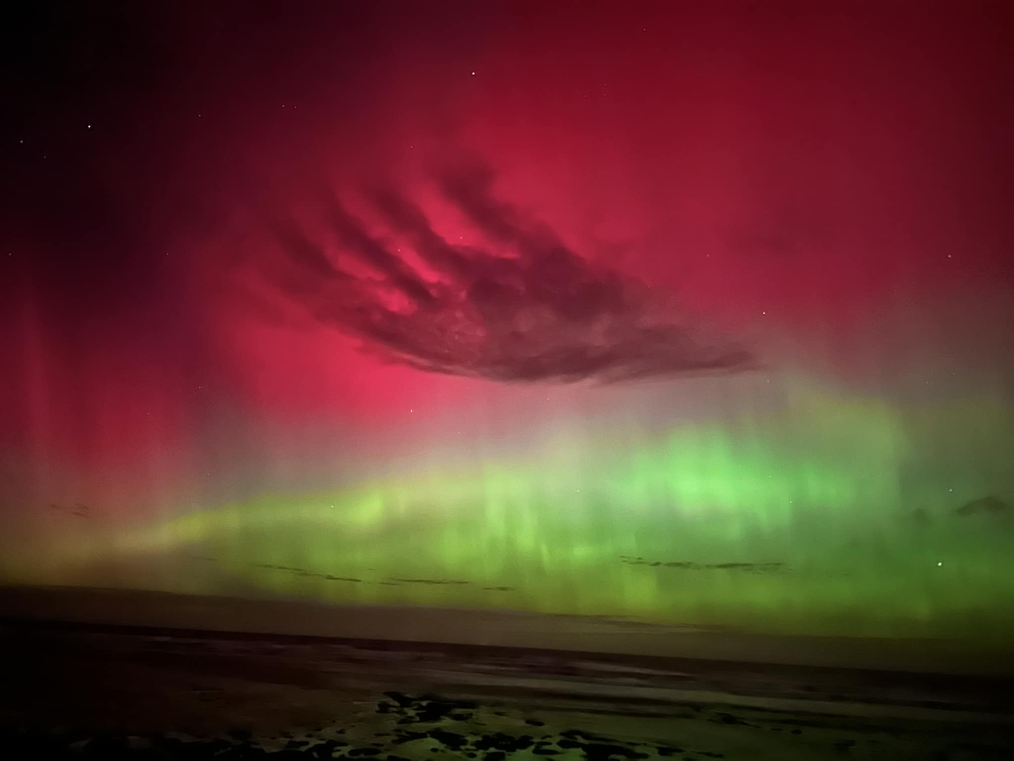
State Operational Summary
Weather and
Seasonal Forecasts
Public Health and Ambulance Victoria
SCC 4 Day Activation Levels and Current Emergencies
Operational Summary
Other Hazards Summary
Fire Restrictions
and Planned Burning
Air Quality Forecast
Upcoming Events
in Victoria
Deployment Information
(only during active deployments)
Victorian Transport
Network
Media Highlights
Sources and Quick Links
State Control Centre Activation
Class 1: {{scc_class1}}
Class 2: {{scc_class2}}

Slide 2




Key points
Last 24 Hours {{kp_last24}} Significant Operational Incidents {{kp_sig_incidents}} Today {{kp_today}} | Outlook {{kp_outlook}}
 | COMMUNITY INFORMATION & WARNINGS at 0830HRS (VicEmergency website)
OPERATIONAL INCIDENTS 24 HOURS TO 0600HRS
Going Fires (as at 0830 hrs) | Total Grass / Bushfires | Total Structure Fires | Active RFAs (as at 0830 hrs) | Total RFAs
{{ops_incidents.0.0}} | {{ops_incidents.0.1}} | {{ops_incidents.0.2}} | {{ops_incidents.0.3}} | {{ops_incidents.0.4}}
Emergency Warning | Watch & Act (Warning) | Advice | Community Info
{{warnings.0.0}}
{{warnings.0.1}}
{{warnings.0.2}}
{{warnings.0.3}}

Slide 3

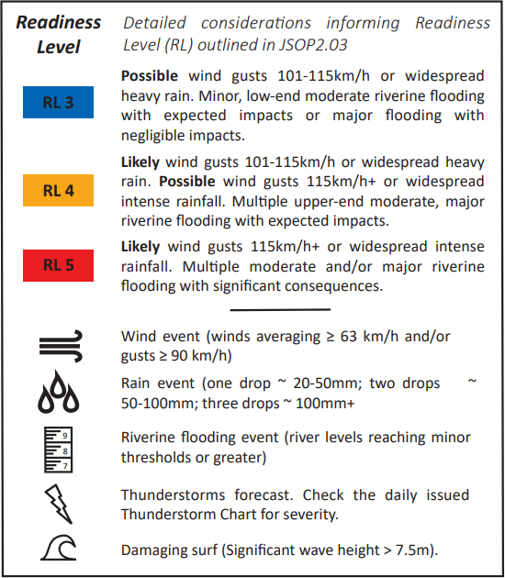
BOM WARNINGS² | Weather for Victoria³
{{bom_warnings}} | Forecast for Victoria {{wx_forecast}} Weather Situation {{wx_situation}}
SCC FIRE WEATHER INTELLIGENCE BRIEFING | {{fire_wx_issued}} | SCC SEVERE WEATHER INTELLIGENCE BRIEFING | {{severe_wx_issued}}
LINK: EM-COP SCC FIRE WEATHER INTELLIGENCE BRIEFING {{fire_wx_text}} | LINK: Em-COP Severe Weather INTELLIGENCE Briefing {{severe_wx_text}}

Slide 4
PUBLIC HEALTH | TRANSPORT UPDATE
Health Alerts and Advisories:⁴ {{health_alerts}} | Metro Service Status:¹⁷ {{metro_status}} V-Line Service Status:²¹ {{vline_status}} Major Airports:^{18,19,20} {{airports}} Road Network:^{22,23,24} {{road_network}}
THUNDERSTORM ASTHMA RISK FORECAST⁷ | THUNDERSTORM FORECAST
{{asthma_text}}
To see the full list of current Health Alerts and Advisories click here.
{{thunderstorm_text}}

Slide 5

Operational statistics | AMBULANCE VICTORIA
 | Emergency Response Plan Escalations – {{av_month}} Code 1 Responses – {{av_month}}
Other hazards
Recent Earthquakes (last 48hrs):⁸ {{earthquakes}} Tsunami:⁹ {{tsunami}} Flood Scenarios:¹⁰ {{flood_scenarios}} National Terrorism Threat Level:¹¹ {{terror_level}} Power Disruptions:¹² {{power_disruptions}}
 | {{av_days.0}} |  | {{av_days.1}} |  | {{av_days.2}} |  | {{av_days.3}} |  | {{av_days.4}} |  | {{av_days.5}} |  | {{av_days.6}}
 | AM | PM | AM | PM | AM | PM | AM | PM | AM | PM | AM | PM | AM | PM
Workload and Demand – Metro Region | {{av_workload.0.0}} | {{av_workload.0.1}} | {{av_workload.0.2}} | {{av_workload.0.3}} | {{av_workload.0.4}} | {{av_workload.0.5}} | {{av_workload.0.6}} | {{av_workload.0.7}} | {{av_workload.0.8}} | {{av_workload.0.9}} | {{av_workload.0.10}} | {{av_workload.0.11}} | {{av_workload.0.12}} | {{av_workload.0.13}}
Workload and Demand – Hume and Loddon Mallee Regions | {{av_workload.1.0}} | {{av_workload.1.1}} | {{av_workload.1.2}} | {{av_workload.1.3}} | {{av_workload.1.4}} | {{av_workload.1.5}} | {{av_workload.1.6}} | {{av_workload.1.7}} | {{av_workload.1.8}} | {{av_workload.1.9}} | {{av_workload.1.10}} | {{av_workload.1.11}} | {{av_workload.1.12}} | {{av_workload.1.13}}
Code 1 |  | {{code1_days.0}} | {{code1_days.1}} | {{code1_days.2}} | {{code1_days.3}} | {{code1_days.4}} | {{code1_days.5}} | {{code1_days.6}}
 | {{year_this}} | {{av_code1.0.0}} | {{av_code1.0.1}} | {{av_code1.0.2}} | {{av_code1.0.3}} | {{av_code1.0.4}} | {{av_code1.0.5}} | {{av_code1.0.6}}
 | {{year_last}} | {{av_code1.1.0}} | {{av_code1.1.1}} | {{av_code1.1.2}} | {{av_code1.1.3}} | {{av_code1.1.4}} | {{av_code1.1.5}} | {{av_code1.1.6}}

Slide 6
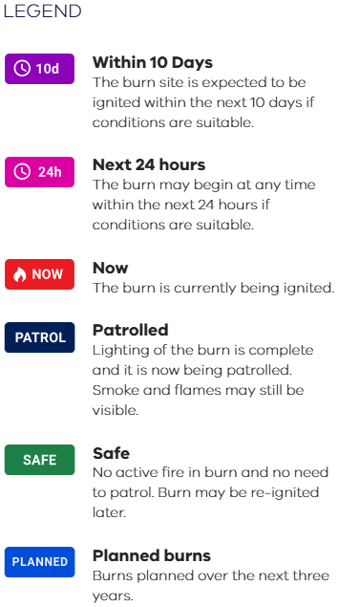
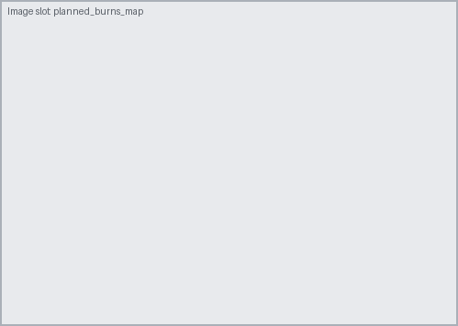
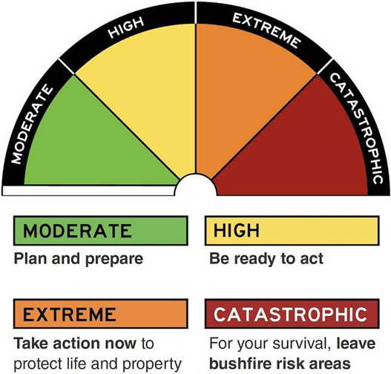
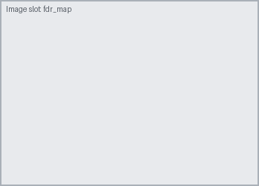
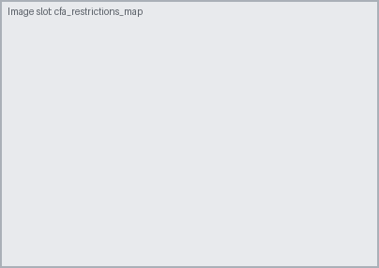

Fire Restrictions | Planned Burning⁶
Australian Fire Danger Ratings and Total Fire Ban: {{tfb_fdr}} For your current local information, visit Total Fire Bans & Fire Danger Ratings CFA Fire Restrictions in Force:¹⁴
 | CURRENT INCIDENT DEPLOYMENTS (All Hazards All Emergencies)
DEECA:¹⁵
 | In Prohibited Period
Hume | {{deeca.0.0}}
Gippsland | {{deeca.1.0}}
Alpine Resorts | {{deeca.2.0}}
Aircraft | ICCs Activated | Personnel deployed Interstate | Personnel deployed Internationally
Dispatched: {{aircraft.0.0}} Planned Dispatch: {{aircraft.0.1}} Standby: {{aircraft.0.2}} | {{iccs_activated}} | {{deploy_interstate}} | {{deploy_international}}

Slide 7

PLANNED BURNING SUMMARY – Yesterday | PLANNED BURNING SUMMARY YTD
*New Ignitions (Continuing Ignitions) **Hectares are for new ignitions only
FFMVic |  |  | CFA
Region | Number (Cont.)* | Ha.** | Region | Number (Cont.)* | Ha.**
BSW | {{pb_yday.0.0}} | {{pb_yday.0.1}} | South West | {{pb_yday.0.2}} | {{pb_yday.0.3}}
GR | {{pb_yday.1.0}} | {{pb_yday.1.1}} | West | {{pb_yday.1.2}} | {{pb_yday.1.3}}
LM | {{pb_yday.2.0}} | {{pb_yday.2.1}} | North West | {{pb_yday.2.2}} | {{pb_yday.2.3}}
HR | {{pb_yday.3.0}} | {{pb_yday.3.1}} | North East | {{pb_yday.3.2}} | {{pb_yday.3.3}}
GIP | {{pb_yday.4.0}} | {{pb_yday.4.1}} | South East | {{pb_yday.4.2}} | {{pb_yday.4.3}}
PPR | {{pb_yday.5.0}} | {{pb_yday.5.1}} |  | {{pb_yday.5.2}} | {{pb_yday.5.3}}
Total | {{pb_yday.6.0}} | {{pb_yday.6.1}} | Total | {{pb_yday.6.2}} | {{pb_yday.6.3}}
 | FFMVic | CFA
Burns Ignited | {{pb_ytd.0.0}} | {{pb_ytd.0.1}}
Operations Ignited | {{pb_ytd.1.0}} | {{pb_ytd.1.1}}
Hectares Treated | {{pb_ytd.2.0}} | {{pb_ytd.2.1}}
Priority Burns Ignited | {{pb_ytd.3.0}} | {{pb_ytd.3.1}}
* Data Explainer: There may be a several day delay in the reporting of Treated Area figures.
PLANNED BURNING SCHEDULED – Today | PLANNED BURNING SUMMARY
 | Situation {{pb_situation}} Risks and Issues {{pb_risks}}
FFMVic |  |  | CFA
Region | Number (Cont.)* | Ha.** | Region | Number (Cont.)* | Ha.**
BSW | {{pb_today.0.0}} | {{pb_today.0.1}} | South West | {{pb_today.0.2}} | {{pb_today.0.3}}
GR | {{pb_today.1.0}} | {{pb_today.1.1}} | West | {{pb_today.1.2}} | {{pb_today.1.3}}
LM | {{pb_today.2.0}} | {{pb_today.2.1}} | North West | {{pb_today.2.2}} | {{pb_today.2.3}}
HR | {{pb_today.3.0}} | {{pb_today.3.1}} | North East | {{pb_today.3.2}} | {{pb_today.3.3}}
GIP | {{pb_today.4.0}} | {{pb_today.4.1}} | South East | {{pb_today.4.2}} | {{pb_today.4.3}}
PPR | {{pb_today.5.0}} | {{pb_today.5.1}} |  | {{pb_today.5.2}} | {{pb_today.5.3}}
Total | {{pb_today.6.0}} | {{pb_today.6.1}} | Total | {{pb_today.6.2}} | {{pb_today.6.3}}

Slide 8




Media Highlights | SOCIAL MEDIA HIGHLIGHTS²⁵
{{media}}
UPCOMING EVENTS IN VICTORIA
{{events}}

Slide 9

State Control Centre | Regional Control Centres
SCC Activation Levels:²⁶ Current State Response Controller: {{src_current}} Incoming State Response Controller ({{src_incoming_date}}): {{src_incoming}} EMV Duty Commissioner: {{emv_duty_commissioner}}
 | Incident Control Centres
RCC – BSW | RCC – GMP | RCC – LMR | RCC – HUM
RCC – GIP | RCC – SMR | RCC – EMR | RCC – NWM
Alexandra | Ararat | Bairnsdale | Ballarat | Benalla
Epsom | Bendoc | Colac | Corryong | Dandenong
Erica | Ferntree Gully | Geelong | Gisborne | Heyfield
Heywood | Horsham | Mansfield | Mildura | Noojee
Orbost | Ovens | Seymour | Shepparton | Sunshine
Swifts Creek | Tallangatta | Warragul | Wangaratta | Warrnambool
Wodonga | Woori Yallock
Not Active
Active
Readiness

Slide 10
















Sources | SCC Product Quick Links
http://www.bom.gov.au/vic/warnings/ http://www.bom.gov.au/vic/warnings/ http://www.bom.gov.au/vic/forecasts/state.shtml https://www2.health.vic.gov.au/public-health/chief-health-officer http://www.health.vic.gov.au/heat-health-alert-system/index.htm https://www2.health.vic.gov.au/public-health/environmental-health/climate-weather-and-public-health/thunderstorm-asthma/forecasting https://earthquakes.ga.gov.au/ http://www.bom.gov.au/tsunami/ https://files-portal.em.vic.gov.au/refdocs/IDV35015.pdf?v=3 https://www.nationalsecurity.gov.au/national-threat-level/current-national-terrorism-threat-level http://app.prod.cop.em.vic.gov.au/sadisplay/poweroutages/ https://www.cfa.vic.gov.au/warnings-restrictions/total-fire-bans-and-ratings/ https://www.cfa.vic.gov.au/warnings-restrictions/fire-danger-period-restrictions https://www.ffm.vic.gov.au/permits-and-regulations/fire-restriction-dates https://plannedburns.ffm.vic.gov.au/ http://ptv.vic.gov.au/live-travel-updates/ https://twitter.com/Melair http://www.avalonairport.com.au/at-avalon/flight-schedules/ https://twitter.com/AvalonAirportAU https://www.vline.com.au/ http://alerts.vicroads.vic.gov.au/ https://twitter.com/VicTraffic https://www.linkt.com.au/melbourne/using-toll-roads/traffic-and-alerts SCC Public Information Team / Facebook / Twitter https://files-portal.em.vic.gov.au/refdocs/SCC-ActivationLevels.htm?v=1620520720076 https://files-em.em.vic.gov.au/Walls/IDV21032.html?v=1709696087146 *Please note that as of 26 November 2022 SES data reported in the State Operational Summary has changed and will exclude ‘Advised Events’. An ‘Advised Event’ can be described as a 132 500 call made to Triple Zero Victoria, that does not meet the requirements for SES unit response as described in the relevant SES Standard Operating Procedures (SOPs). As a result of this change, associated filtering modifications and a revised 24 hr reporting period starting at 0600 hrs instead of 0500 hrs, SES data reported in this document may be different compared to previous event counts. Adjustments have been made to both daily and year-to-date data. Please contact SES if you require more detail about the classification of an Advised Event.
 | BoM Product Quick Links
 | Legend: = Not Currently available as at 0830hrs
Intelligence
Products
Weekly Intel
Summary
SCC
Map Pack
State SitRep
(0600 or 1900)
State Situation
Update
Significant
Incident Update
State Relief &
Recovery Report
SCC
Briefing
Severe
Wind Event
Severe
Rain Event
Severe Weather Intelligence Briefing
Flood Scenarios
Fire Wx &
Heat briefing
Wind Change
Forecast
FDI Estimates
(State)

Slide 11

Avian Influenza Outbreak
{{avian_situation}}
Statewide Situation Overview
Other States
{{avian_other_states}}

Slide 12

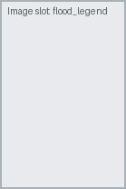
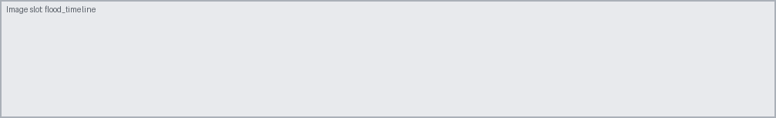
STATEWIDE FLOOD SNAPSHOT¹ | STATE FLOOD OVERVIEW | {{flood_overview_date}}
Flood timeline – {{flood_timeline_title}}
{{flood_table_title}}
 | {{flood_gauges.0.0}} | {{flood_gauges.0.1}} | {{flood_gauges.0.2}} | {{flood_gauges.0.3}} | {{flood_gauges.0.4}}
Height | {{flood_gauges.1.0}} | {{flood_gauges.1.1}} | {{flood_gauges.1.2}} | {{flood_gauges.1.3}} | {{flood_gauges.1.4}}
Status | {{flood_gauges.2.0}} | {{flood_gauges.2.1}} | {{flood_gauges.2.2}} | {{flood_gauges.2.3}} | {{flood_gauges.2.4}}
Trend | {{flood_gauges.3.0}} | {{flood_gauges.3.1}} | {{flood_gauges.3.2}} | {{flood_gauges.3.3}} | {{flood_gauges.3.4}}
Outlook | {{flood_gauges.4.0}} | {{flood_gauges.4.1}} | {{flood_gauges.4.2}} | {{flood_gauges.4.3}} | {{flood_gauges.4.4}}

