Slide 1
Customer Analysis
A descriptive segmentation of key customers for aligning competitive marketing efforts

Slide 2

About us
Vincent v. Zitzewitz
Mehran Chowdhury

Slide 3

Agenda
Task Description
Dataset Exploration
Clustering Process
Identified Customer Segments
Customer Targeting Strategies

Slide 4
Task: Market Analysis
What: Analysis of customer behavior
How: Credit Card Transactions
Who: 8500 customers
When: 6 Month period
Goal: Cluster based Targeted Marketing
Task
Exploration
Clustering
Segments
Targeting

Slide 5
Dataset Exploration
Number of Features: 18
balance_account: Amount of money on customer bank account (Wealth)
full_purchases: maximum purchase amount done in full payment (Big Buy)
credit_limit : limit of credit card for user (Trustworthiness)
balance_frequency_update: frequency of transactions (Frequent buyers)
installments: amount of purchases done in installments
Task
Exploration
Clustering
Segments
Targeting

Slide 6
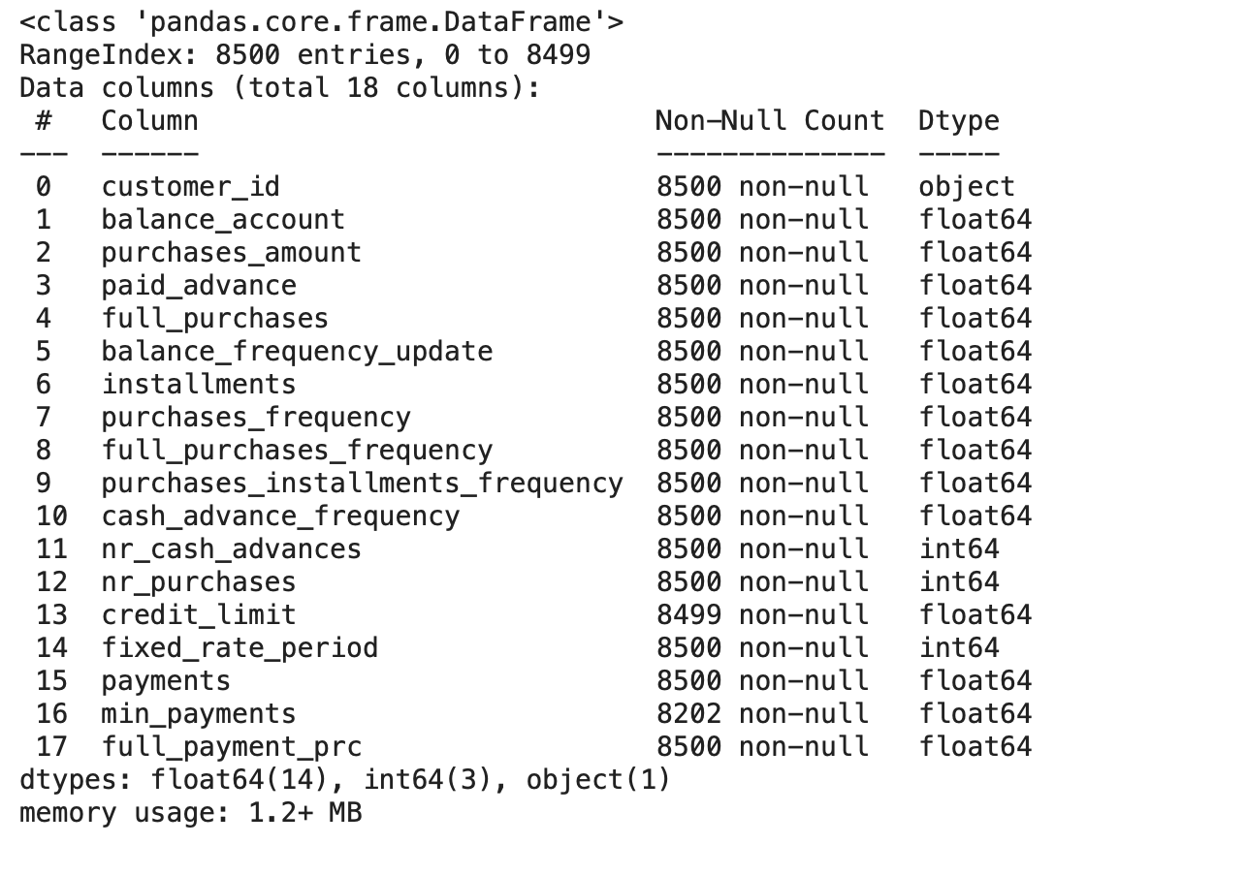
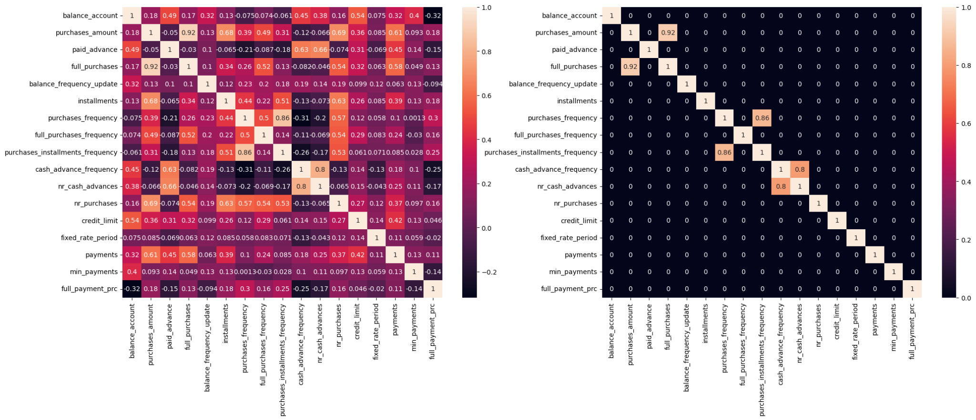
Dataset Exploration
Missing Value Removal
Correlation Analysis
Outlier Removal
Task
Exploration
Clustering
Segments
Targeting

Slide 7
Dataset Exploration: Correlation Analysis
purchases_amount
0.92
full_purchases
Kept
Dropped
purchases_frequency
0.86
purchases_installments_frequency
cash_advance_frequency
0.8
nr_cash_advances
Task
Exploration
Clustering
Segments
Targeting

Slide 8
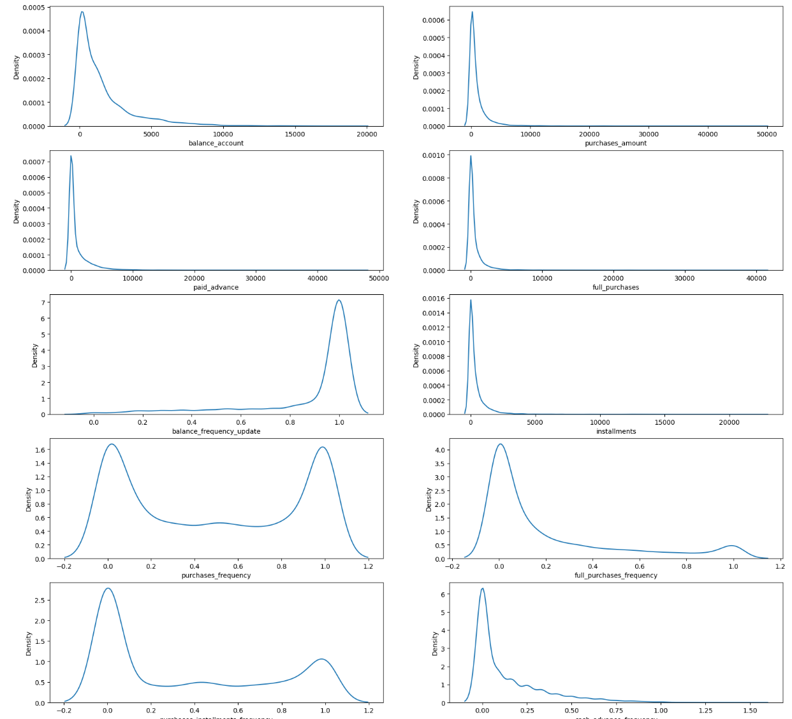
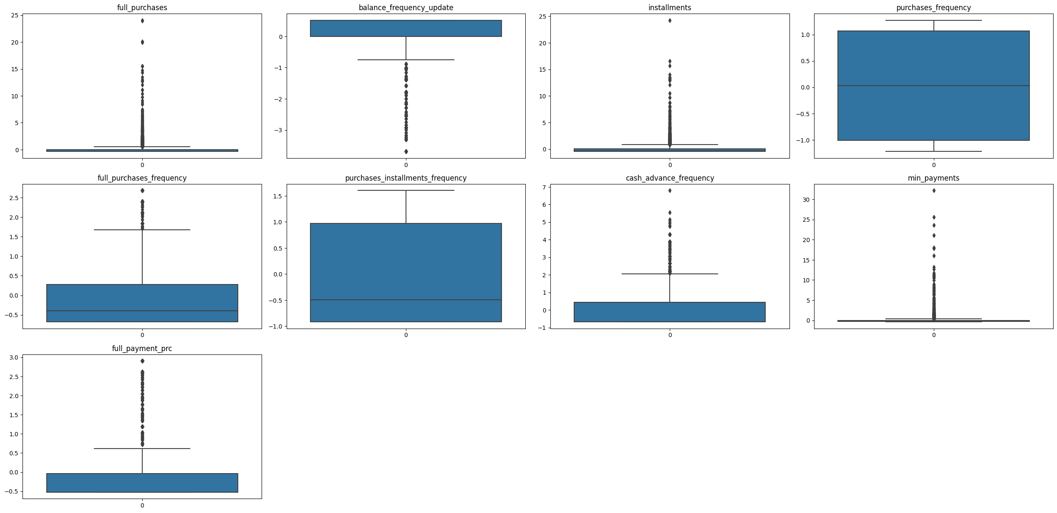
Dataset Exploration: Outlier Removal
Skewness of features
Procedure: Boxplots / IQR
Plot of remaining Data Points
Task
Exploration
Clustering
Segments
Targeting

Slide 9
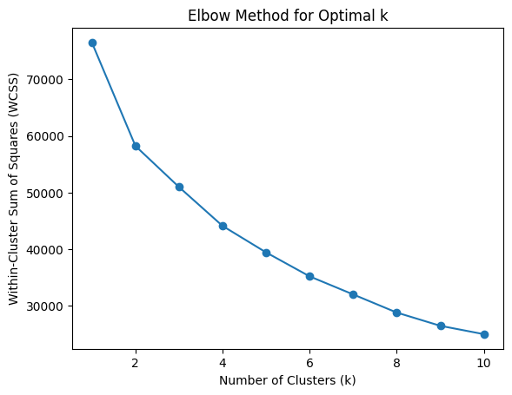
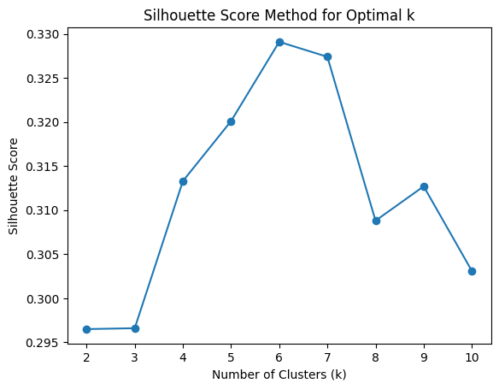
Clustering
Eventually, the dataset was split into four clusters
Task
Exploration
Clustering
Segments
Targeting

Slide 10
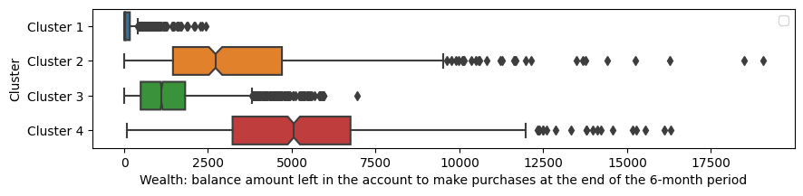

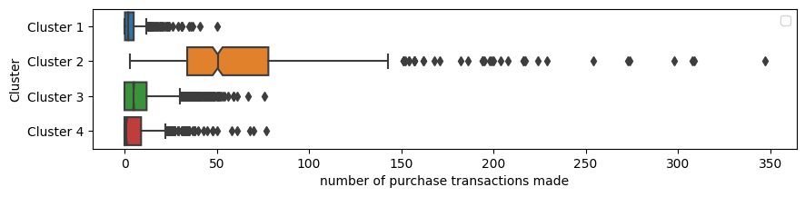
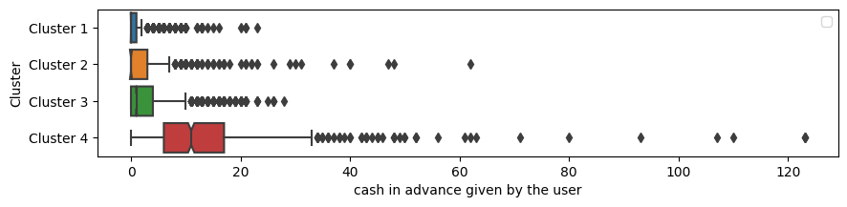
Segments: Cluster 1 Analysis
Characteristics
Low income
Low purchase frequency
Low cash payments
Low cash movements
Task
Exploration
Clustering
Segments
Targeting

Slide 11

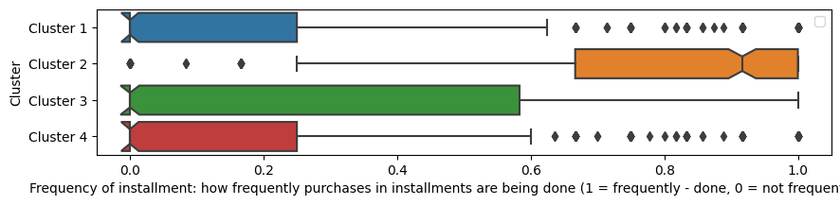
Segments: Cluster 2 Analysis
Characteristics
High income / wealth
High number of purchases
Frequently using installments
Doing big purchases
Task
Exploration
Clustering
Segments
Targeting

Slide 12

Segments: Cluster 3 Analysis
Characteristics
Medium wealth / income
Not doing many transactions
Paying cash in advance
Low credit limit
Task
Exploration
Clustering
Segments
Targeting

Slide 13

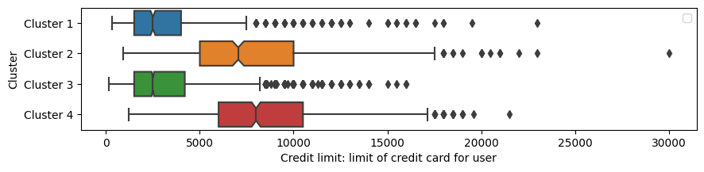
Segments: Cluster 4 Analysis
Characteristics
High income / wealthy
Not buying frequently
Usually paying in cash
High credit card limit
Task
Exploration
Clustering
Segments
Targeting

Slide 14
Targeting
Cluster 1
Low income
Low purchase frequency
Low cash payments
Cluster 4: “3 % off when paying with credit card”
Cluster 2: “5 % off of purchases above 2000 €”
Cluster 2
High income / wealth
High number of purchases
Doing big purchases
Cluster 3: Do not target
income
Cluster 3
Medium wealth / income
Not many transactions
Paying cash in advance
Cluster 1: Do not target
Cluster 4
High income / wealthy
Not buying frequently
Usually paying in cash
Purchase frequency
Task
Exploration
Clustering
Segments
Targeting

Slide 15
Summary & Conclusion
Analysis of customer behavior of 8500 customers over 6 months based on credit card transactions using 18 features
Missing Value Removal
Correlation Analysis
Outlier Removal
Cluster Analysis: Segmentation in four Clusters
Conclusion:
Focus marketing efforts on cluster 2 and cluster 4 due to high income
Increase buying frequency of cluster 4 (high income, low purchase frequency)
Task
Exploration
Clustering
Segments
Conclusion

Slide 16
Questions?

