Slide 1
Gameplay programming Zombie Survival Ai agent
By Kevin Deketelaere

Slide 2
Index
Basic ideas
Decision making structure
Movement
Dealing with enemies
Item registration and usage
Map exploration(Extra ai topic)

Slide 3
Basic ideas
The 5 main things the ai need to do are:
Search map for houses
Search houses for items
Item usage
Deal with enemies
Avoid the purge zones

Slide 4
Movement
Blended steering with 2 components:
Seek
EnemyAvoidance

Slide 5
Dealing with enemies
Shooting the enemy
Dodging the enemy
Running from the enemy

Slide 6
Item registration and usage
Register
Identify
Need?
Pickup
Usage

Slide 7
Map exploration
Search patterns
On the way: explore houses, which have not been explored yet/ have been explored an x time ago.
When in a house, calculate the search path and register item

Slide 8
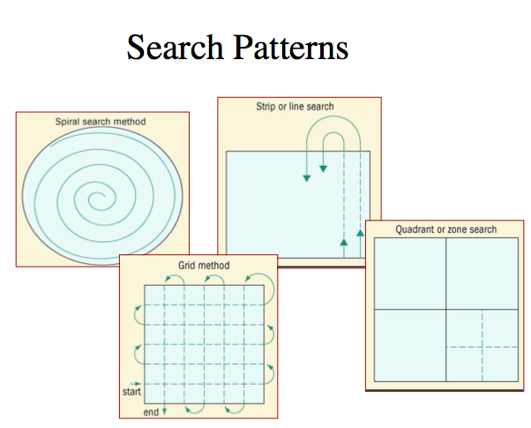
Map exploration(Extra ai topic)
(Forensic) Search patterns
Implemented:
Spiral inwards
Grid/Zigzag search
Spiral outwards
Quadrant + spiral outwards

Slide 9
Questions?

