Slide 1
Business Model
Vison
To built framework that will reduce our cost
Options
Using Dates predict two things
Plan
Use historical data to train ML and Statistical models.
Notes:
Two Things: 1. Potential number of donors at given day at specific branch. (Naïve idea is to use blood groups)
2. Either he is a good donor or bad.

Slide 2
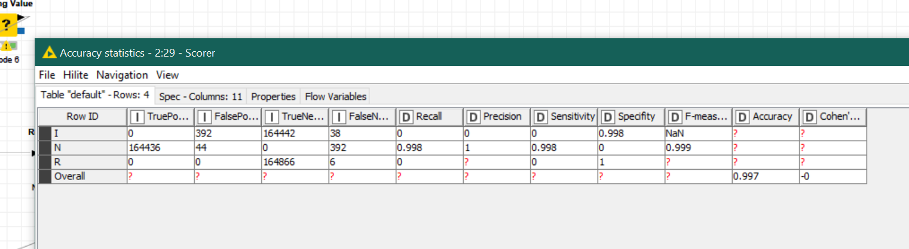
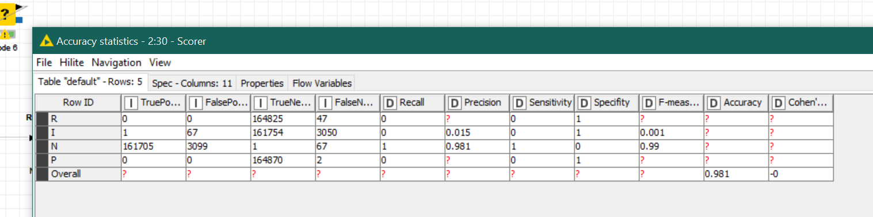
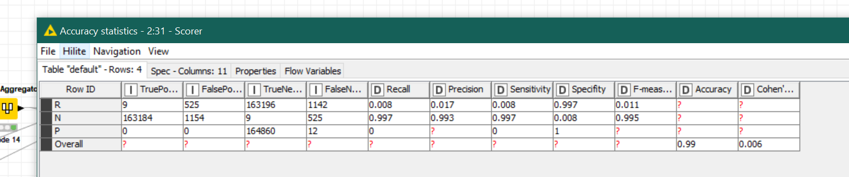
Solution No 1
Predicting test1, test2, test3.

Slide 3
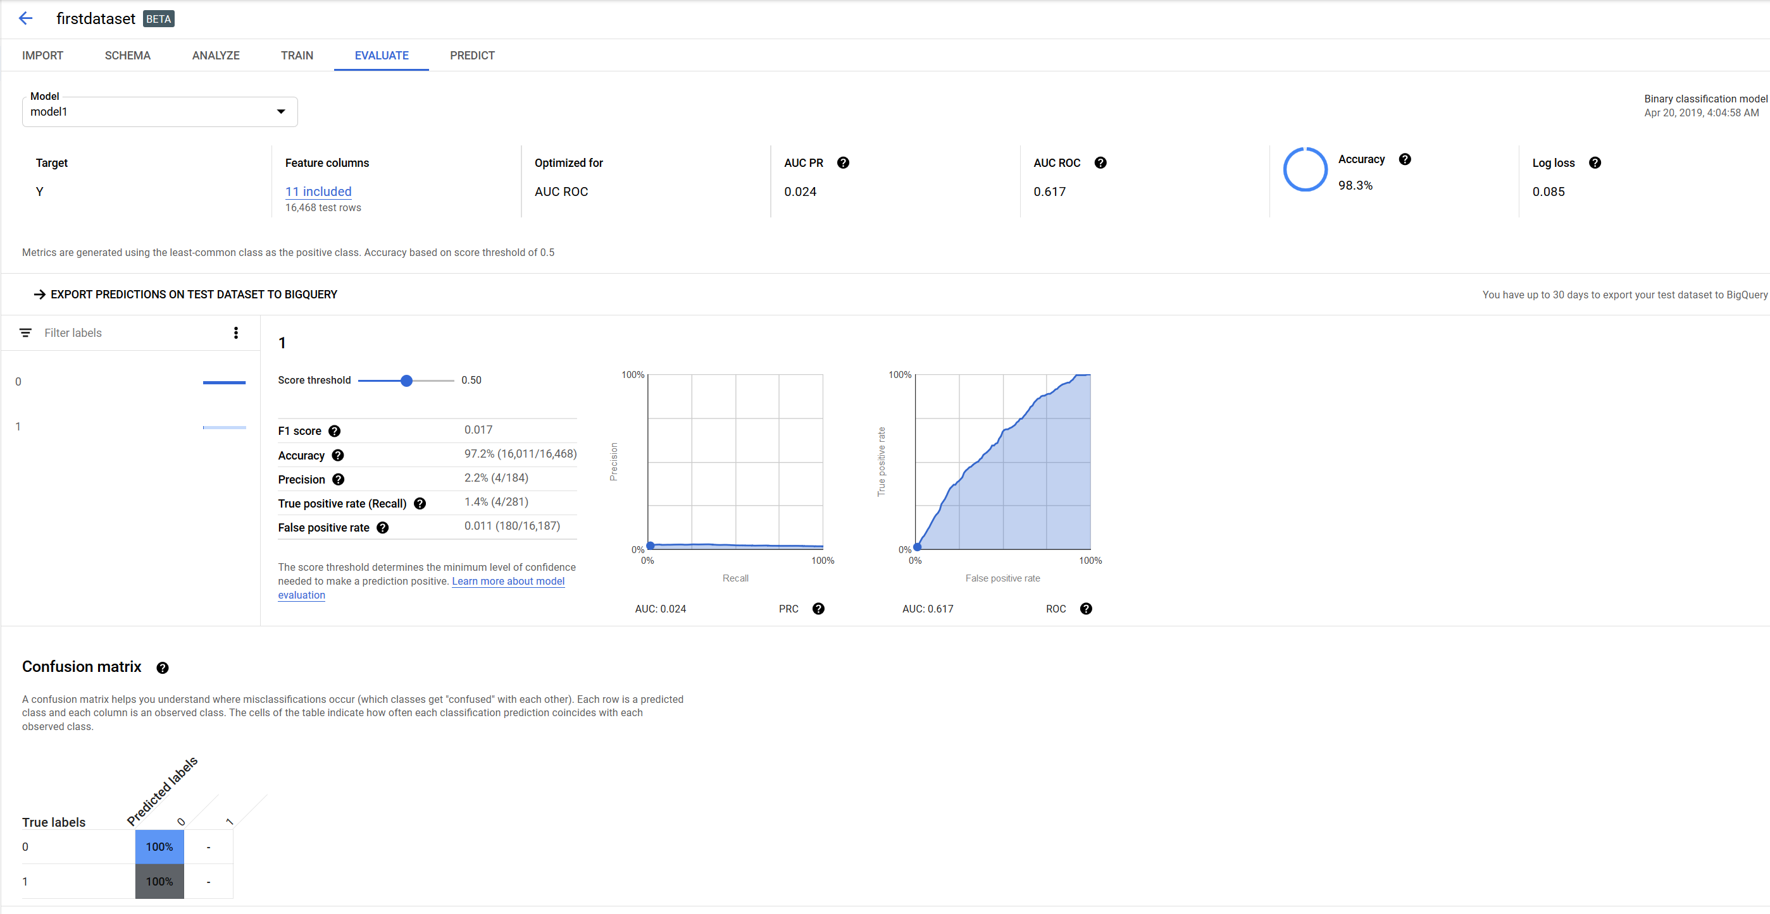
Our Approach

