Slide 1
Data Analytics Project
Football market value Prediction and team recommendation
Ajeya B S Sirajahamed Dharmayath
Viraj C Bukitagar

Slide 2
Problem Statement
Predicting market value of footballers given the data of them from the past years
Given a team, recommend a replacement to the team to make the team better

Slide 3
Why this problem
Most popular sport
Players make a difference to the game
Critical for small budget teams to select best possible players at the given price
Proper combination of players lead to better results

Slide 4
Preprocessing
Positions similar are grouped into one common position
For regression and EDA , players who are not GK - GK attributes set to NULL, and vice versa for GKs.
For regression, accounting for inflation, the value of each player is adjusted such that the ratio of the average of the values of players of each year’s data is 1.

Slide 5
Plots
Stripcharts like:
Market Value of each year
Market value for different positions
Market Value vs age
Market value of each position vs the position’s important attributes
Time series plots of 5 players chosen at random

Slide 6
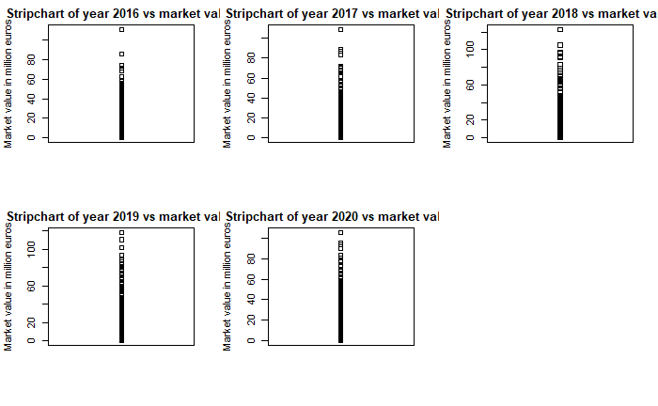
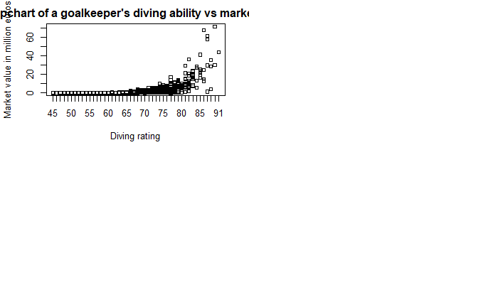
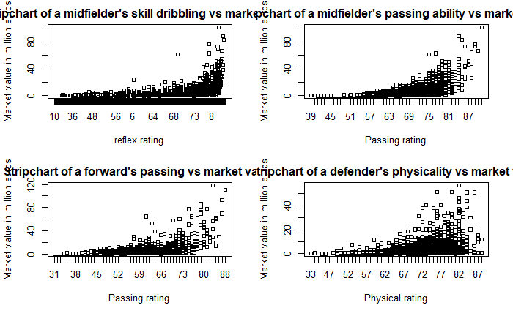
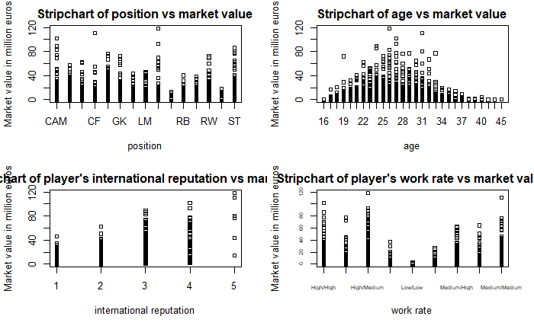
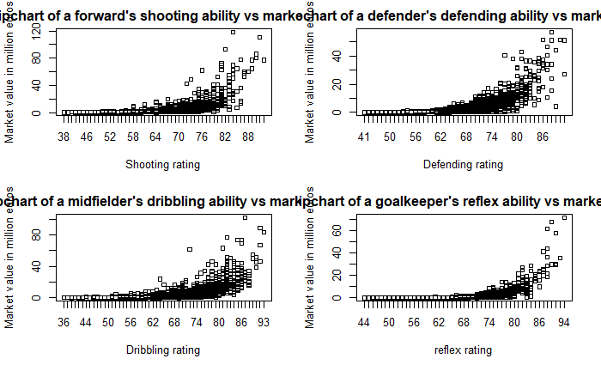
Plots

Slide 7
Plots

Slide 8
Plots

Slide 9
Plots

Slide 10
Plots

Slide 11
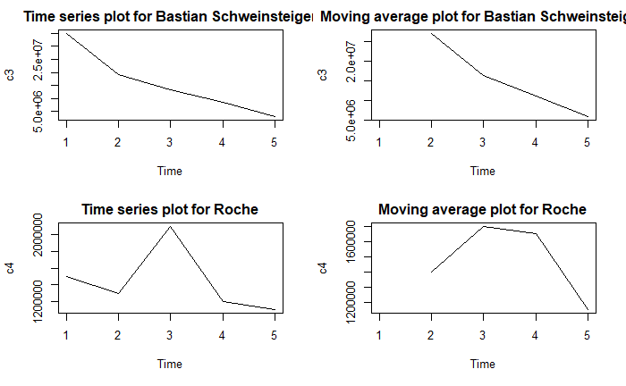
Time Series plots for 5 players chosen at random.

Slide 12
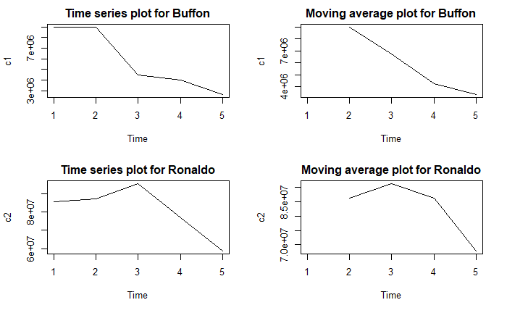
Time Series plots for 5 players chosen at random.

Slide 13
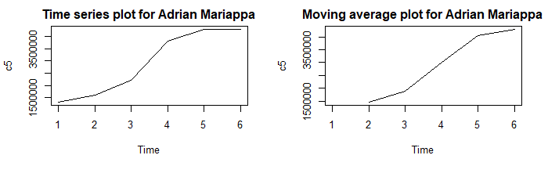
Time Series plots for 5 players chosen at random.

Slide 14
Linear Regression
Attributes which are important and common to all positions are considered.
Training value provides high R² , but while testing, low R² obtained.
The R.M.S.E is also very high.
Hence we can infer overfitting has occurred.
Hence, a model which tries to prevent overfitting, Ridge-Lasso Regression is tried.

Slide 15
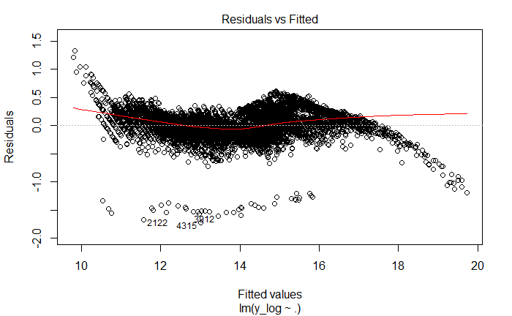
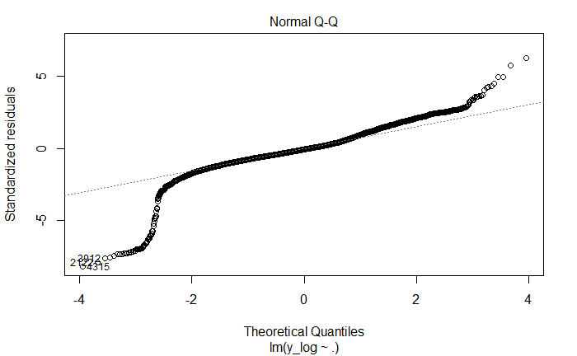
Linear Regression

Slide 16
Ridge-Lasso Regression
Model tried to prevent overfitting.
Same as in linear regression, only attributes which are important and common to all positions are considered.
While testing, R.M.S.E obtained is 8.01.
But very low R² of 0.47.
So we choose a model which learns all the parameters - Neural Networks

Slide 17
Neural Networks
Neural Networks considers all parameters.
We select the features which are applicable to all the players like age,overall rating, physic etc. And also
select the features which are specific to positions as well like for the strikers attacking ability, free kick ability, passing ability and for defenders like defending positioning,defending tackles etc.
The main attribute which is the position of the player is included and one hot encoded.

Slide 18
Neural Networks
This preprocessed data is passed on to the Neural Network Model which has 1 input layer, 3 hidden layers and 1 output layer.
The 3 hidden layers are densely connected layers with activation function as Rectified Linear Unit (ReLu).
The model is run for about 10 epochs with the Adam as the optimizer and mean squared error as the loss function.
The testing data is used for checking the correctness of the model using RMSE(Root Mean Squared Error) as the metric.

Slide 19
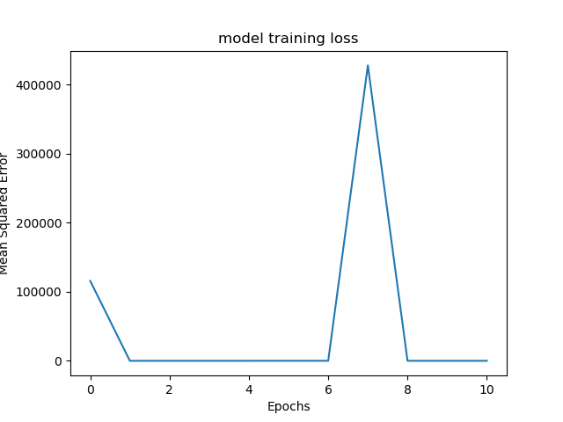
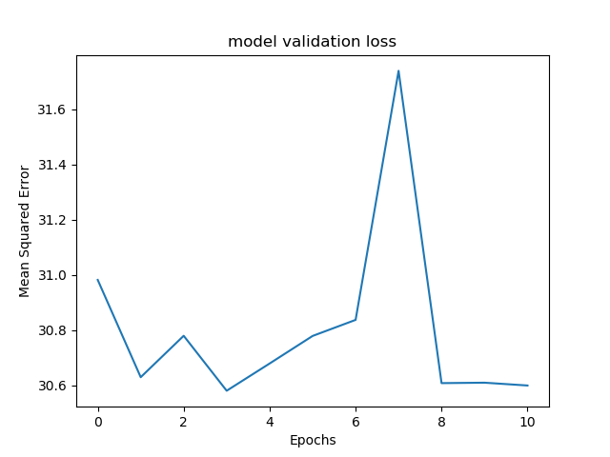
Neural Networks

Slide 20
Team Recommendation - Collaborative Filtering
Based on the transfer values predicted in the Neural Network Model as the good approximation of the transfer value.
Simple weighted average is used to take into account form of the players over the years.
Based on the input of the team and formation, we are constructing the best playing 11 and picking the worst out of them.
We are creating a joint profile using the average statistics of all the attributes which denotes a hypothetical average player to compare with other players.
Then using distance metrics such as Cosine Distances, Minskowski and Pearson coefficients we are determining the similarity between hypothetical player and rest of the players thereby getting the best players who fit into the team

Slide 21
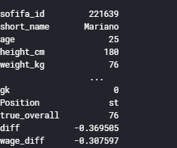
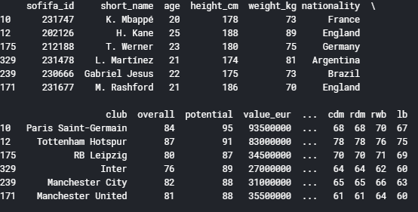
Team Recommendation - Collaborative Filtering

Slide 22

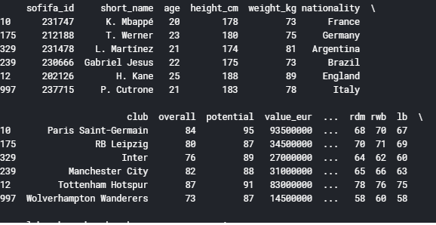
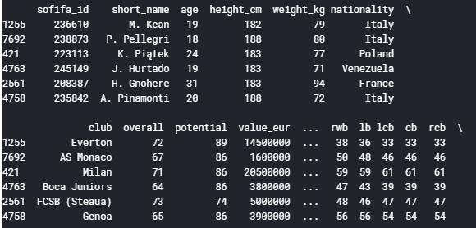
Team Recommendation - Collaborative Filtering

Slide 23
Pipeline
Initial task
Training
Testing
Selection of Model
RMSE > Required threshold
Initial task
NO
Preprocessing , Data Cleaning
EDA - stripcharts
Market value
Yes
Team recommendation
Data Transformation
Collaborative Filtering
Terminate

Slide 24
Conclusion
Neural Networks works best among all models.
We infer from this that all attributes in a model are essential to a model providing good result.
Team Recommendation is tried on different teams , and found to be effective in making the team better.

Slide 25
Thank You

