Slide 1
Big Data Management using Cloudera CDH
Siraj Bagwan

Slide 2
Environment
Cloud Platform: AWS
Services: VPC, EC2, RDS, IAM, CloudWatch
Hadoop Distribution: Cloudera CDH 6.2.0
Operating System: Centos 7, Windows server 2012 (Active Directory)
Database: MySQL 5.7
JAVA: Oracle Java 8
Service Stack:
Service Version Service Version
Hadoop 3.0.0 Impala 3.2.0
Kafka 2.1.0 Hue 4.3.0
Sqoop 1.4.7 Oozie 5.1.0
Spark 2.4.0 Zookeeper 3.4.5
Hive 2.1.1 Sentry 2.1.0

Slide 3
Master Node Planning
Number of master nodes: 3
For Operating System logs and storage: 50 GB
Mounted Two disks for Operating system usage (Raid 1 Conf)
For Name Node Data - Size of Disks: 20 GB
Mounted Two Partitions for Name Node data each of 10 GB (Jbod Conf)
For Journal Node : 10 GB
Zookeeper Storage: 10 GB
For Name node and Resource manager logs: 10 GB

Slide 4
DATA Node Planning
For Operating System logs and storage: 50 GB
Mounted Two disks for Operating system usage (Raid 1 Conf)
Data retention period: 1 year
Total data extracted per year with replication: 250 TB
Yarn Temporary Storage: 15%
Total Cluster Storage Required: 290 TB
Size of disks with 125 MBps Throughput: 6 TB
Each node have 10 disks (JBOD Conf.)
Size of each node: 60 TB
No. of data nodes required: 290/60 ~ 5
10% overhead (node failure): 1
Total data nodes required: 6
dfs.block.scanner.volume.bytes.per.second: 15 MBps
Time taken to scan for bit rot: 8 days

Slide 5
Cluster Planning
Block size of HDFS: 128 MB
1 MB fs image size for per 1000 blocks (Suggested by Cloudera)
250 TB = 256000 GB = 262,144,000 MB
Block Size = 128 MB
Total No. of Blocks = 262144000/128 = 2,048,000
Fs image = 2,048,000/1000 = 2 GB
Heap Size of name node = 2 GB = 4GB (Cloudera Suggest At least 4 GB )
HDD: size 6 TB * 10 disks = 60TB

Slide 6
Data Availability
dfs.namenode.checkpoint.period: 3600
dfs.namenode.checkpoint.txns: 1000000
dfs.namenode.checkpoint.check.period: 600
dfs.namenode.num.checkpoints.retained: 2
dfs.namenode.extra.edits.retained: 1000000
dfs.namenode.edit.log.autoroll.multiplier.threshold: 0.5
dfs.namenode.edit.log.autoroll.check.interval.ms: 300000
fs.trash.checkpoint.interval: 12 hours
fs.trash.interval: 3 days
Create a cronjob to save image offline manually after every hour:
0 * * * * hdfs dfsadmin -fetchImage [directory to store image locally]

Slide 7
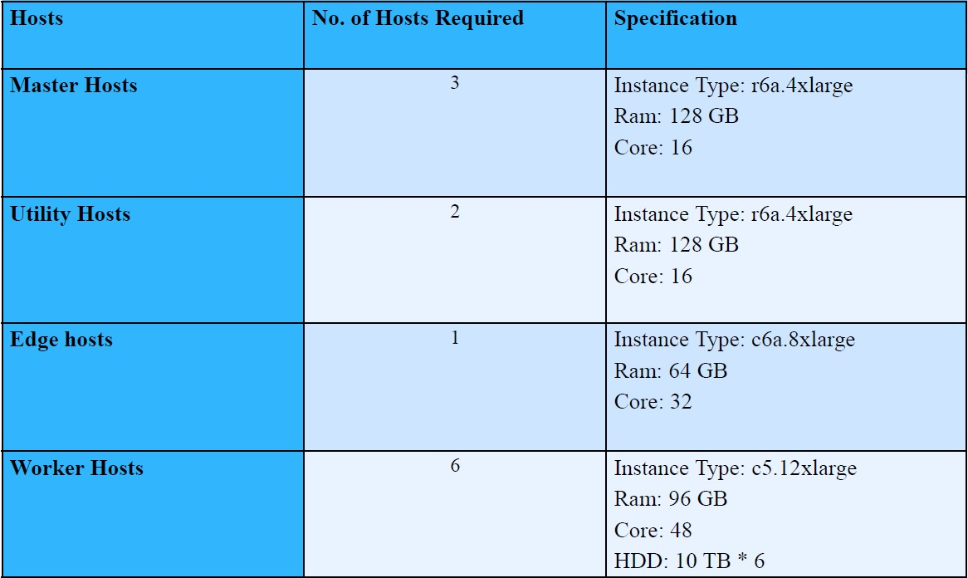
Cluster Planning

Slide 8
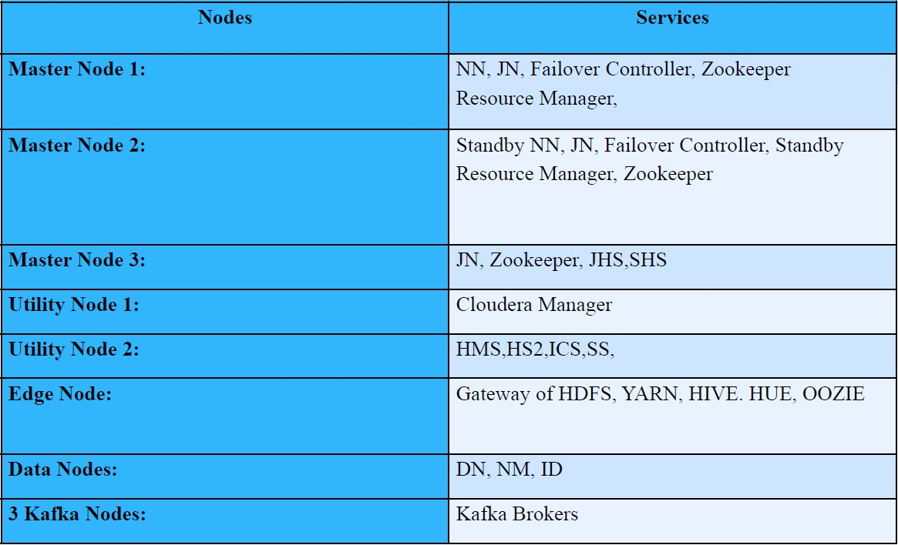
Cluster Planning

Slide 9
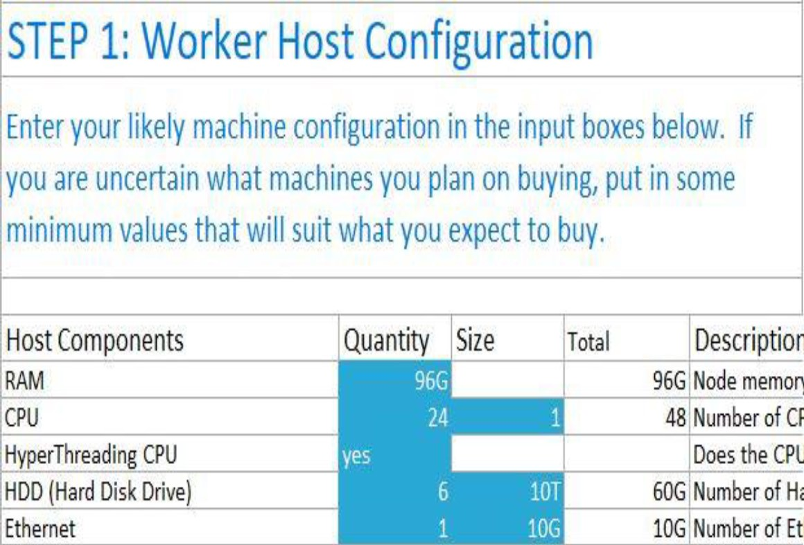
Worker Host configuration

Slide 10
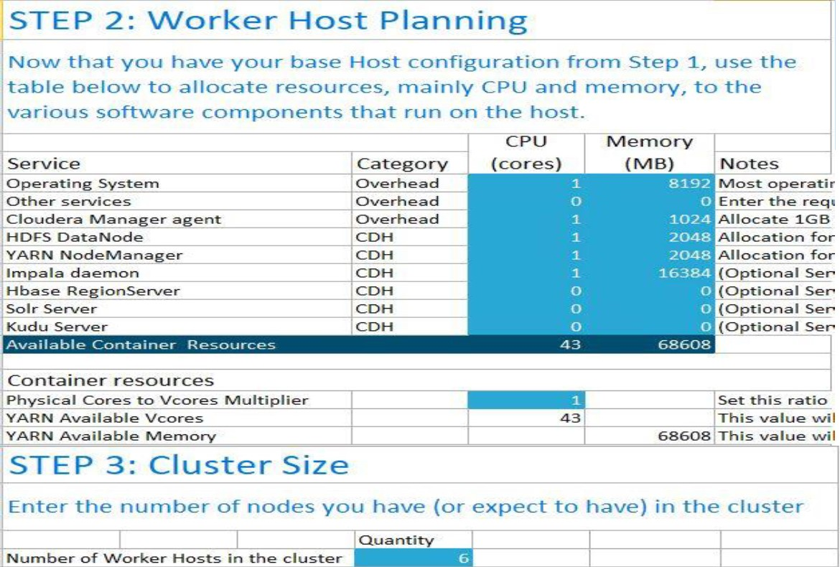
Resource Allocation

Slide 11
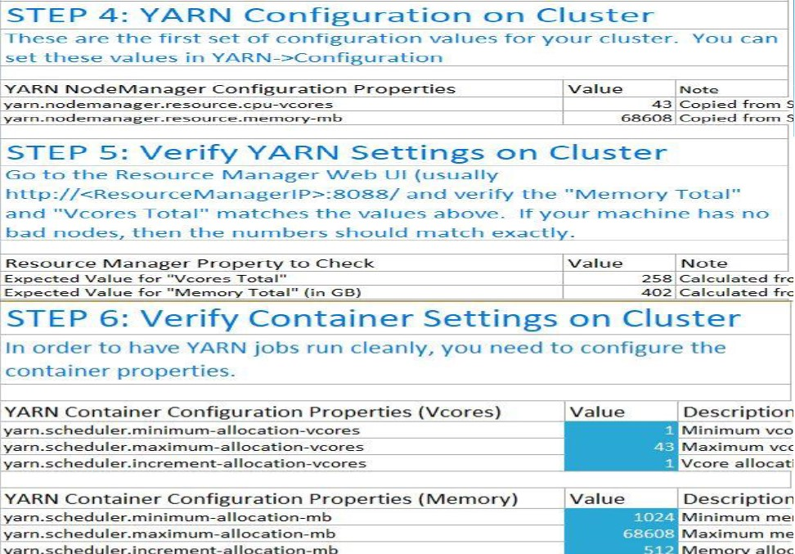
Yarn tuning

Slide 12
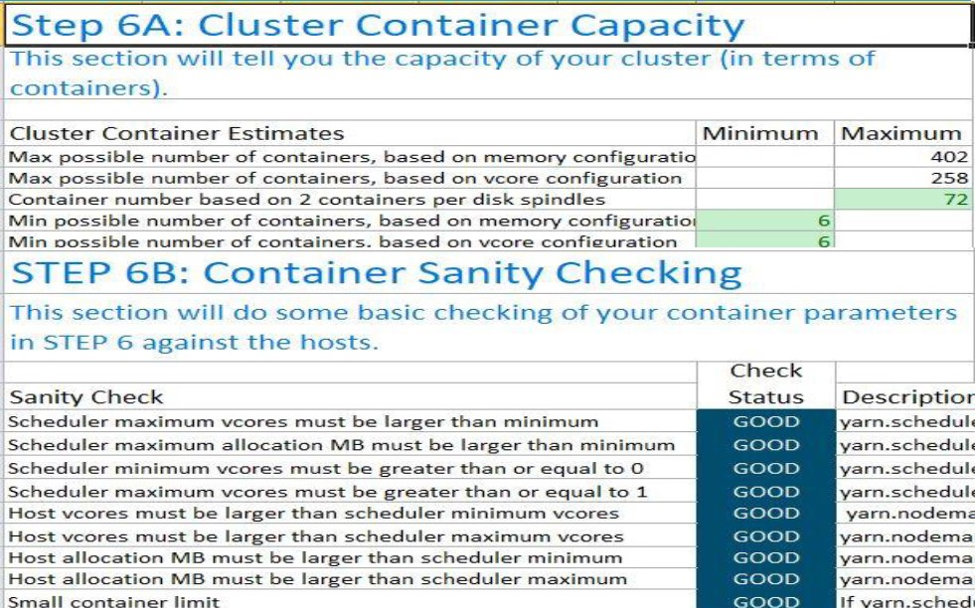
Container Capacity

Slide 13
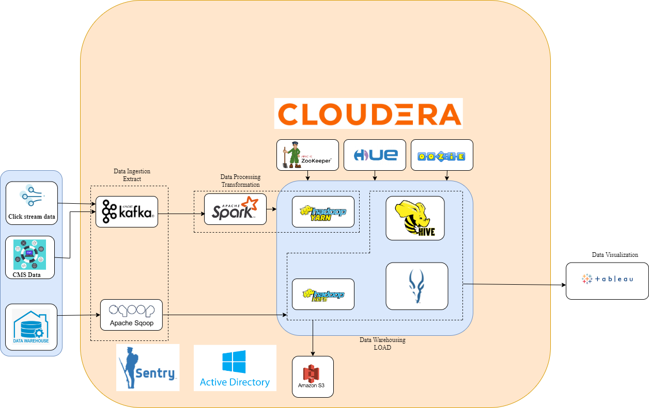
Data Flow diagram

Slide 14
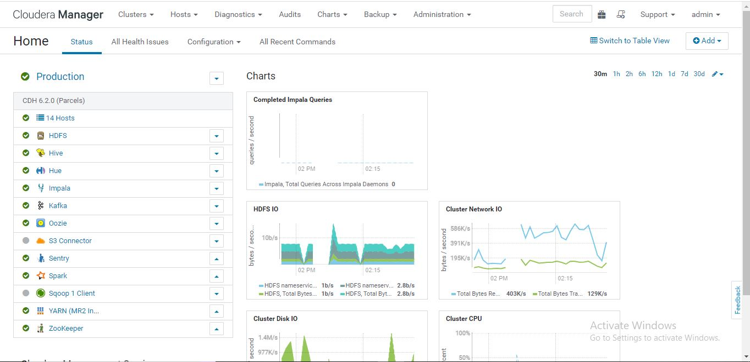
Deployment

Slide 15
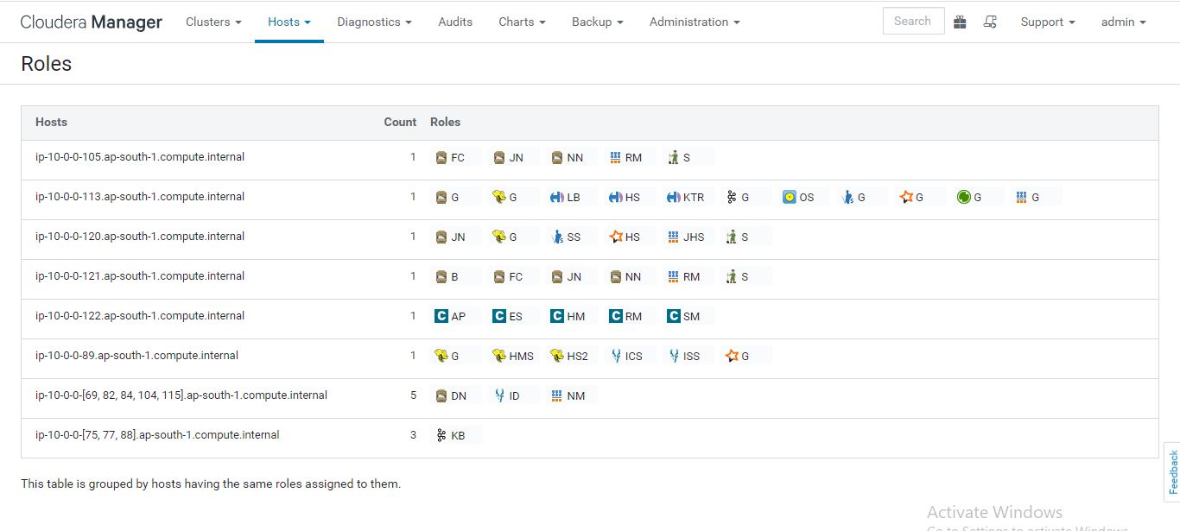
Host and roles placement

Slide 16
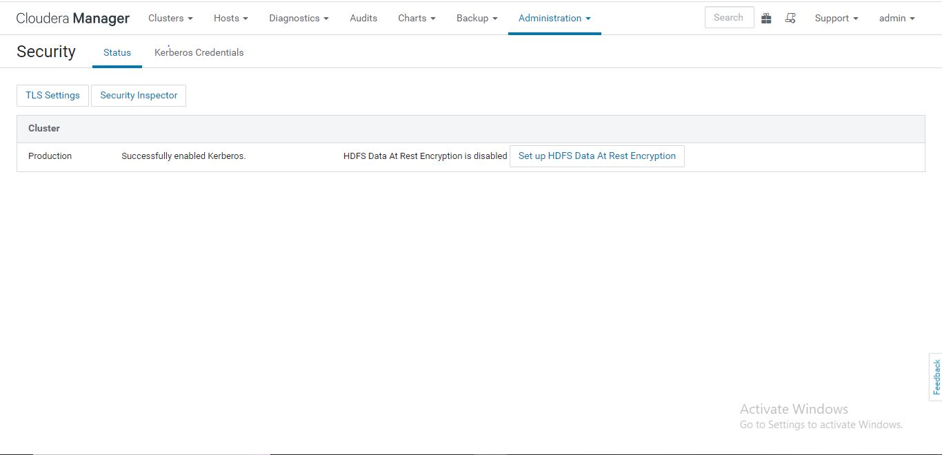
Authentication

Slide 17
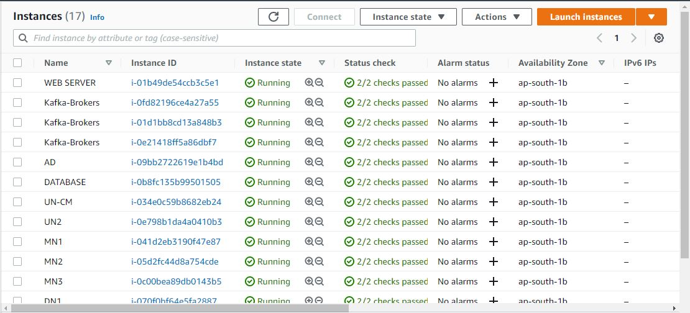
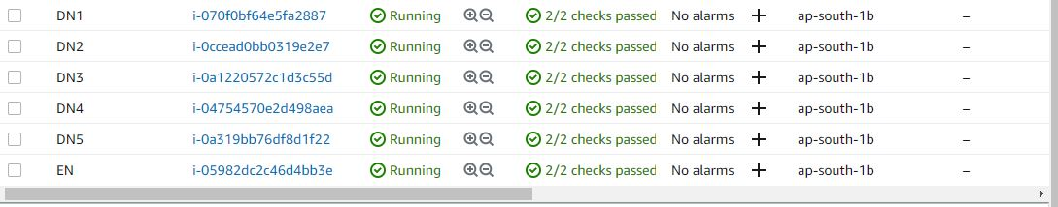
Infrastructure

Slide 18
Thank you

