Slide 1
Big Data Management using Cloudera CDH
Siraj Bagwan

Slide 2
CHALLENGES
Improve click-through rates
Improving click-through rate (the number of clicks that your content receives divided by the number of times your content is shown.) by recommending content to relevant users.
Personalize online ads and content
Showing more relevant ads and content basis on their past interaction to online users to improve user experience.
Lead acquisition
By improving user experience and interaction can be able to raise the ratio of subscription.

Slide 3
Solution
Extract
Collect and gather data of user behavior and interaction and store it to data lake from different sources in order to process.
Transform and Load
Transform the click stream data on data lake and ingest it to data warehouse. Ingest the data from OLTP system to Data Warehouse.
Analysis
Analyze the data present on the cluster using different tools available in order to generate insights.

Slide 4
Environment
Cloud Platform: AWS
Services: VPC, EC2, RDS, IAM, CloudWatch
Hadoop Distribution: Cloudera CDH 6.2.0
Operating System: Centos 7, Windows server 2012 (Active Directory)
Database: MySQL 5.7
JAVA: Oracle Java 8
Service Stack:
Service Version Service Version
Hadoop 3.0.0 Impala 3.2.0
Kafka 2.1.0 Hue 4.3.0
Sqoop 1.4.7 Oozie 5.1.0
Spark 2.4.0 Zookeeper 3.4.5
Hive 2.1.1 Sentry 2.1.0

Slide 5
Master Node Planning
Number of master nodes: 3
For Operating System logs and storage: 500 GB
Mounted Two disks for Operating system usage (Raid 1 Conf)
For Name Node Size of Disks: 500 GB
Mounted Two disks for Name Node data and standby name node (Raid 1 Conf)
For Journal Node disk size: 500 GB
Mounted Two disks for Journal node data on each node (Raid 1 conf)
Zookeeper Storage: 500 GB

Slide 6
DATA Node Planning
For Operating System logs and storage: 500 GB
Mounted Two disks for Operating system usage (Raid 1 Conf)
Data retention period: 1 year
Total data extracted per year with replication: 250 TB
Yarn Temporary Storage: 15%
Total Cluster Storage Required: 290 TB
Size of disks: 6 TB
Each node have 10 disks (JBOD Conf.)
Size of each node: 60 TB
No. of data nodes required: 290/60 ~ 5
10% overhead (node failure): 1
Total data nodes required: 6

Slide 7
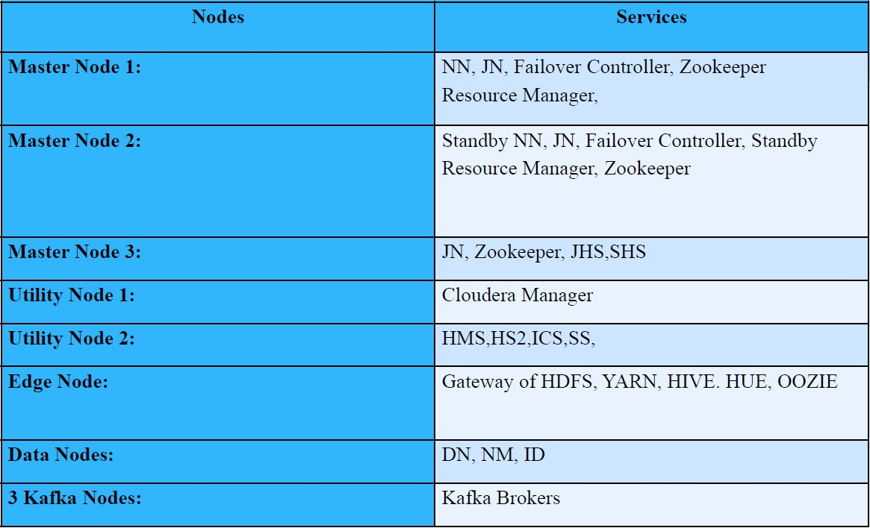
Cluster Planning

Slide 8
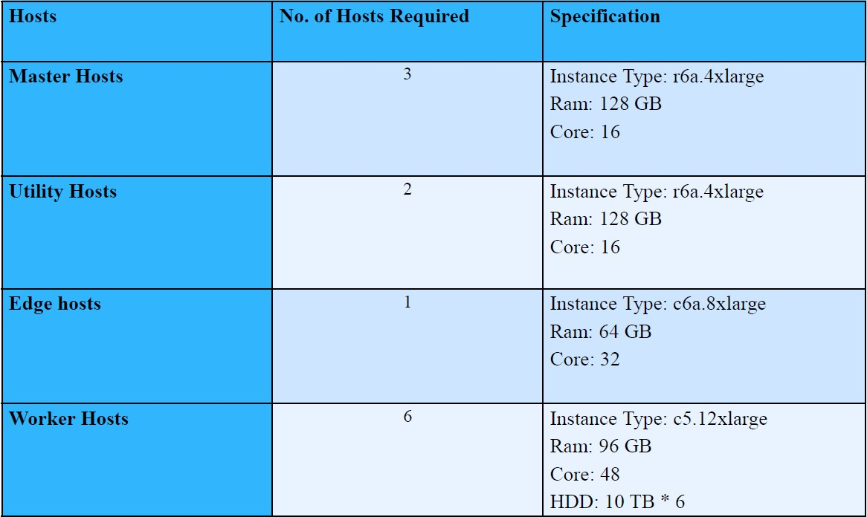
Cluster Planning

Slide 9
Cluster Planning
Block size of HDFS: 128 MB
•1 MB fs image size for per 1000 blocks (Suggested by Cloudera)
•250 TB = 256000 GB = 262,144,000 MB
•Block Size = 128 MB
•Total No. of Blocks = 262144000/128 = 2,048,000
•Fs image = 2,048,000/1000 = 2 GB
•Heap Size of name node = 2 GB = 4GB (Cloudera Suggest At least 4 GB )
•HDD: size 6 TB * 10 disks = 60TB

Slide 10
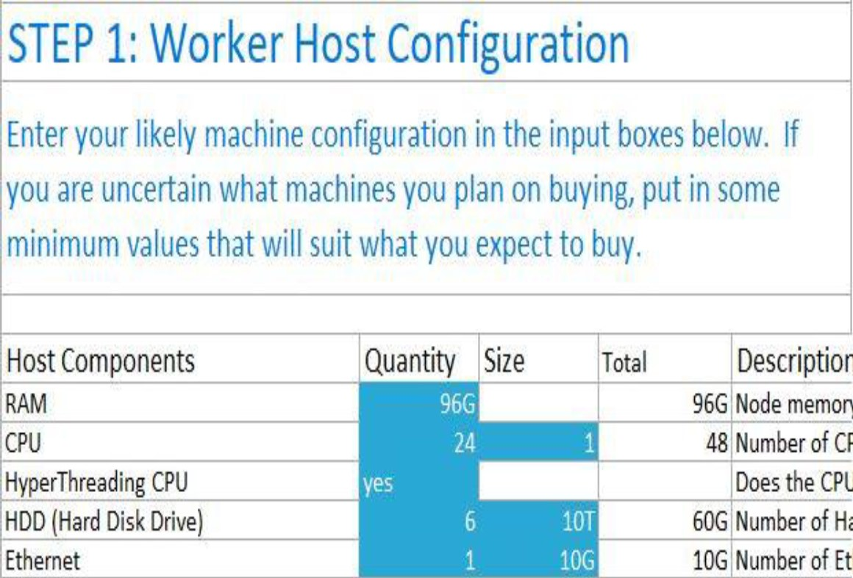
Worker Host configuration

Slide 11
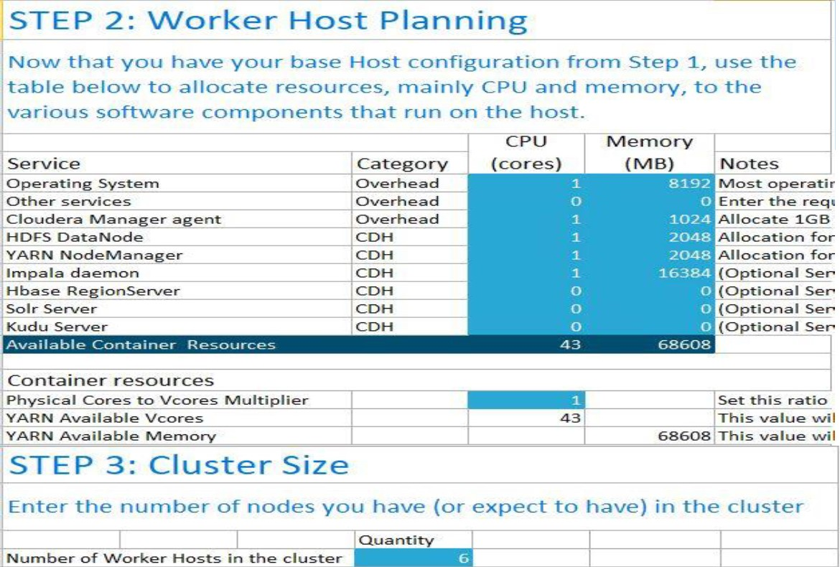
Resource Allocation

Slide 12
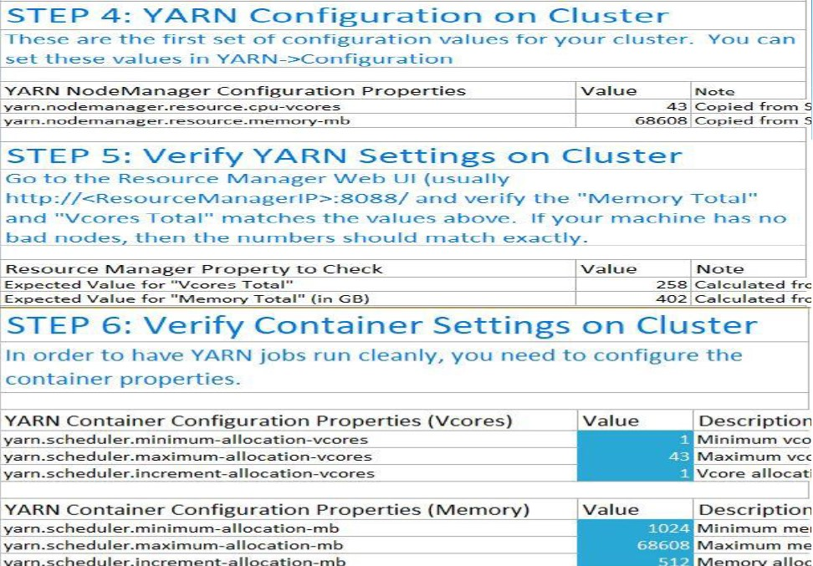
Yarn tuning

Slide 13
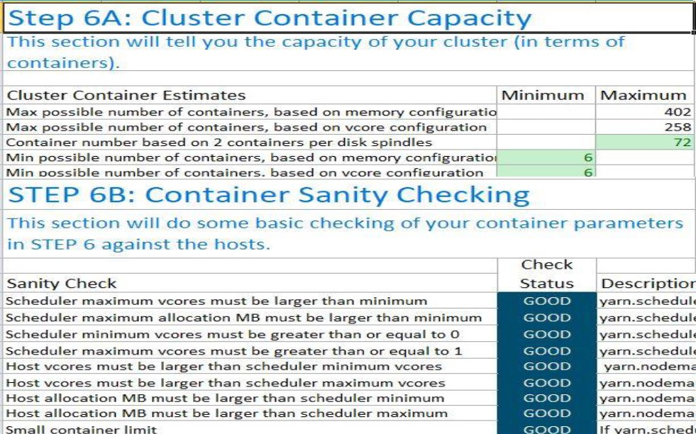
Container Capacity

Slide 14
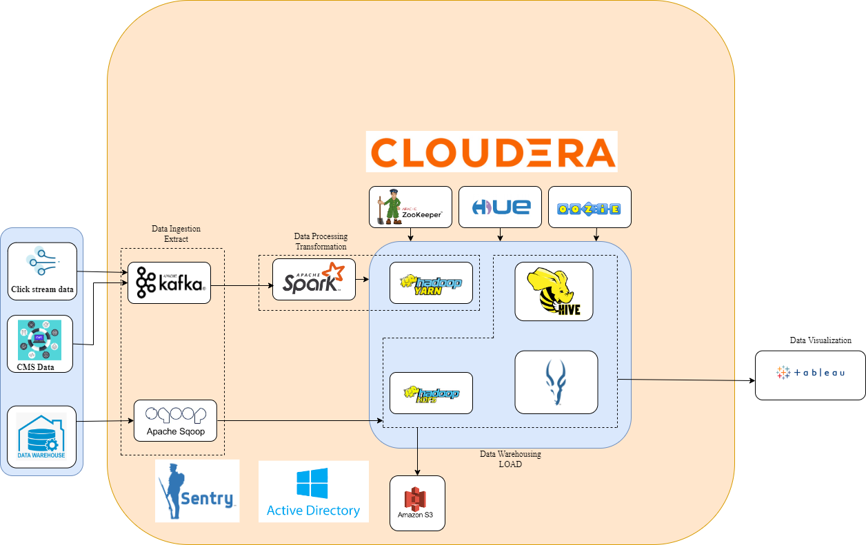
Data Flow diagram

Slide 15
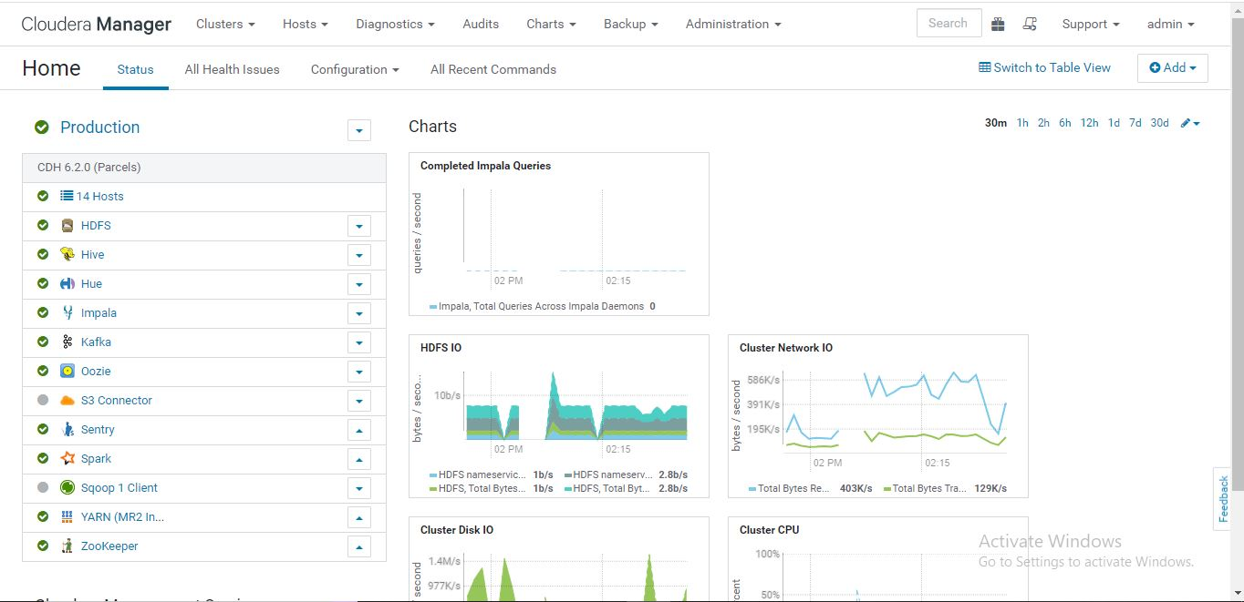
Deployment

Slide 16
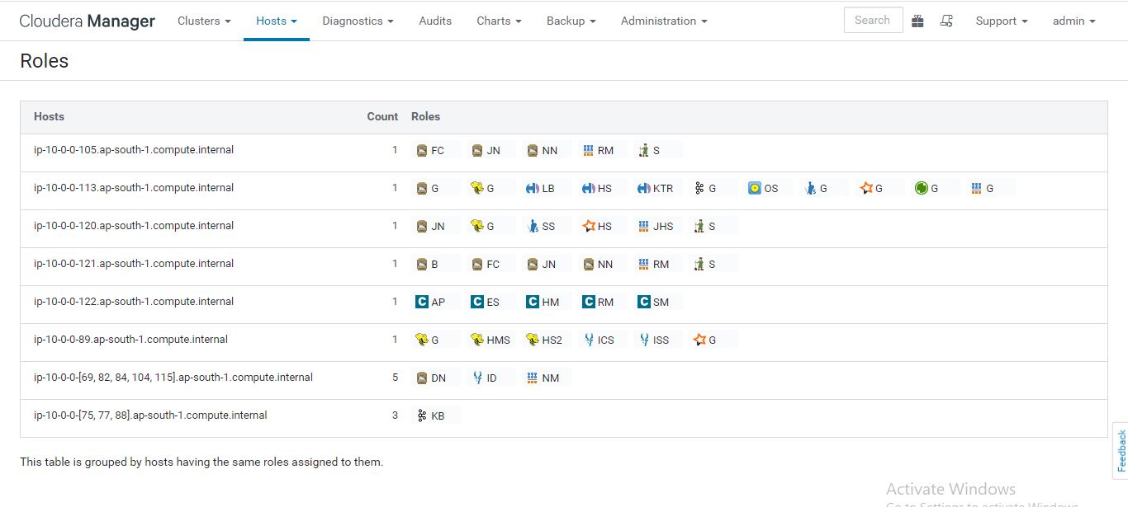
Host and roles placement

Slide 17
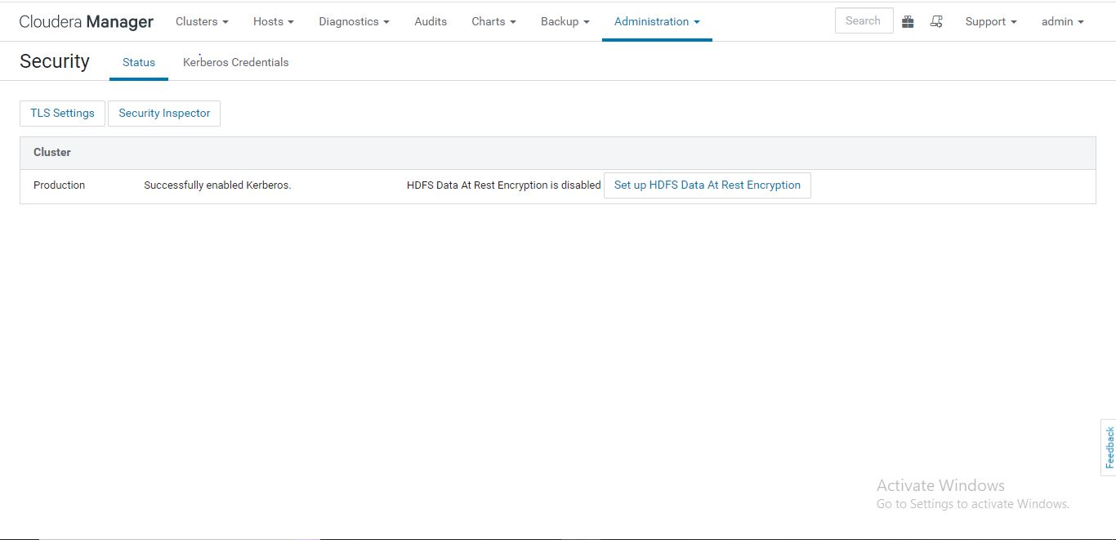
Authentication

Slide 18
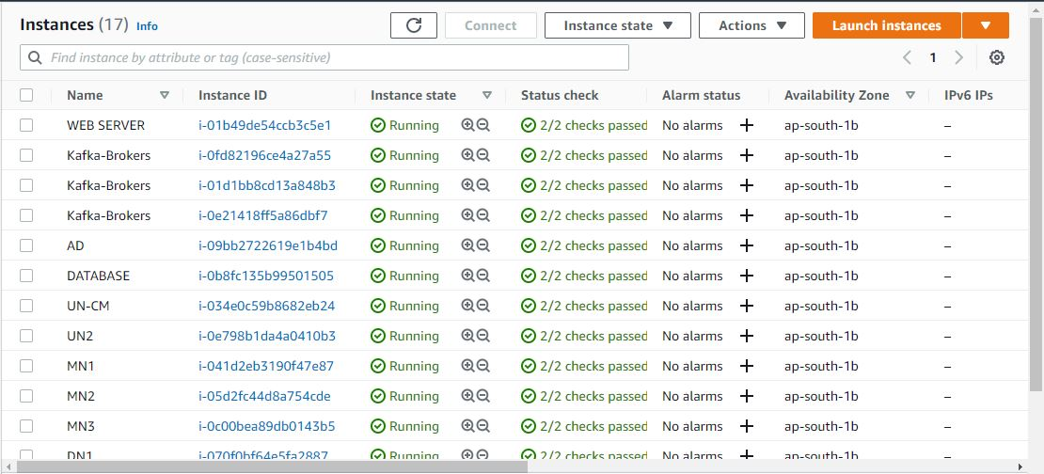
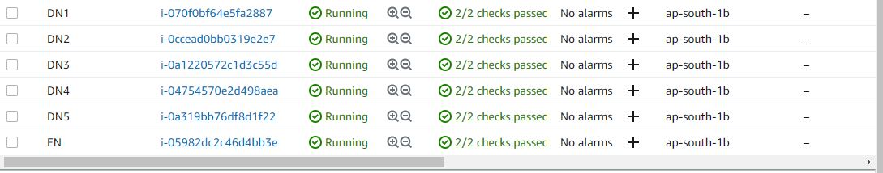
Infrastructure

Slide 19
Thank you

