Slide 1
Siraj Bagwan
Project on Big Data Platform Engineering

Slide 2
Challenges
Improve click-through rates
Improving click-through rate (the number of clicks that your content receives divided by the number of times your content is shown.) by recommending content to relevant users.
Personalize online ads and content
Showing more relevant ads and content basis on their past interaction to online users to improve user experience.
Lead acquisition
By improving user experience and interaction can be able to raise the ratio of subscription.

Slide 3
Solution
Collect
collect and gather data of user behavior and interaction and store it to data lake from different sources in order to process.
Process
Transform the click stream data on data lake and ingest it to data warehouse. Ingest the data from OLTP system to Data Warehouse.
Analyze
Analyze the data present on the cluster using different tools available in order to generate insights.

Slide 4
Capacity Planning

Slide 5
Data retention period: 1 year
Total data collected per year: 250 TB
Data to be stored on each data node: 10 TB
No. of data nodes required: 250/10 = 25
10% overhead (node failure): 3
Total data nodes required: 28
Kafka nodes: 3

Slide 6
Cluster Planning
Hosts | No. of Hosts Required | Specification
Master Hosts | 3 | Instance Type: r6a.4xlarge Ram: 128 GB Core: 16
Utility Hosts | 2 | Instance Type: r6a.4xlarge Ram: 128 GB Core: 16
Edge hosts | 1 | Instance Type: c6a.8xlarge Ram: 64 GB Core: 32
Worker Hosts | 28 | Instance Type: c5a.16xlarge Ram: 128 GB Core: 64

Slide 7
Cluster Planning
Nodes | Services
Master Node 1: | NN, JN, Failover Controller, Zookeeper Resource Manager,
Master Node 2: | Standby NN, JN, Failover Controller, Standby Resource Manager, Zookeeper
Master Node 3: | JN, Zookeeper, JHS,SHS
Utility Node 1: | Cloudera Manager
Utility Node 2: | HMS,HS2,ICS,SS,
Edge Node: | Gateway of HDFS, YARN, HIVE. HUE, OOZIE
Data Nodes: | DN, NM, ID
3 Kafka Nodes: | Kafka Brokers

Slide 8
Cluster Planning
Block size of HDFS: 128 MB
1 MB fsimage size for per 1000 blocks (Cloudera Suggest)
250 TB = 256000 GB = 262,144,000 MB
No. of blocks = 262144000/128 =2048000
Fsimage = 2048000/1000 = 2048 MB = 2GB
Heap Size of name node = 2 GB * 2 = 4GB

Slide 9
Service Stack
Services Versions
Hadoop 3.0.0
Kafka 2.1.0
Sqoop 1.4.7
Spark 2.4.0
Hive 2.1.1
Impala 3.2.0
Hue 4.3.0
Oozie 5.1.0
Zookeeper 3.4.5
Sentry 2.1.0

Slide 10
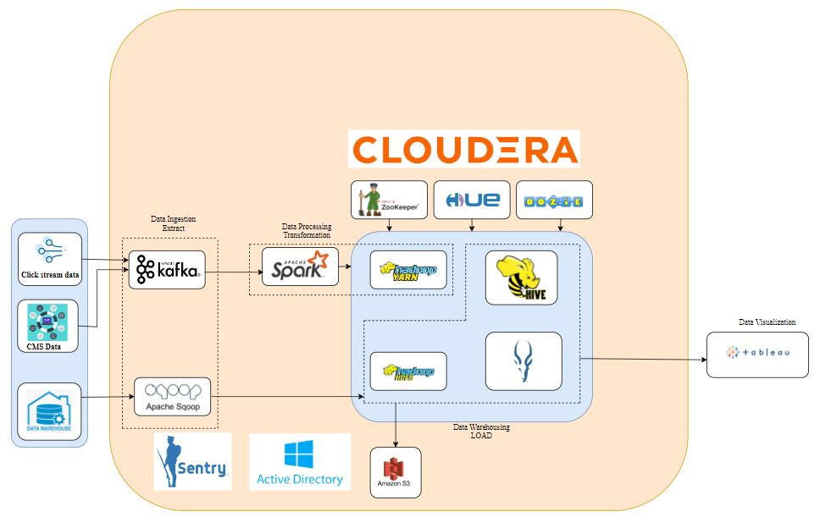
Data Flow Diagram

Slide 11
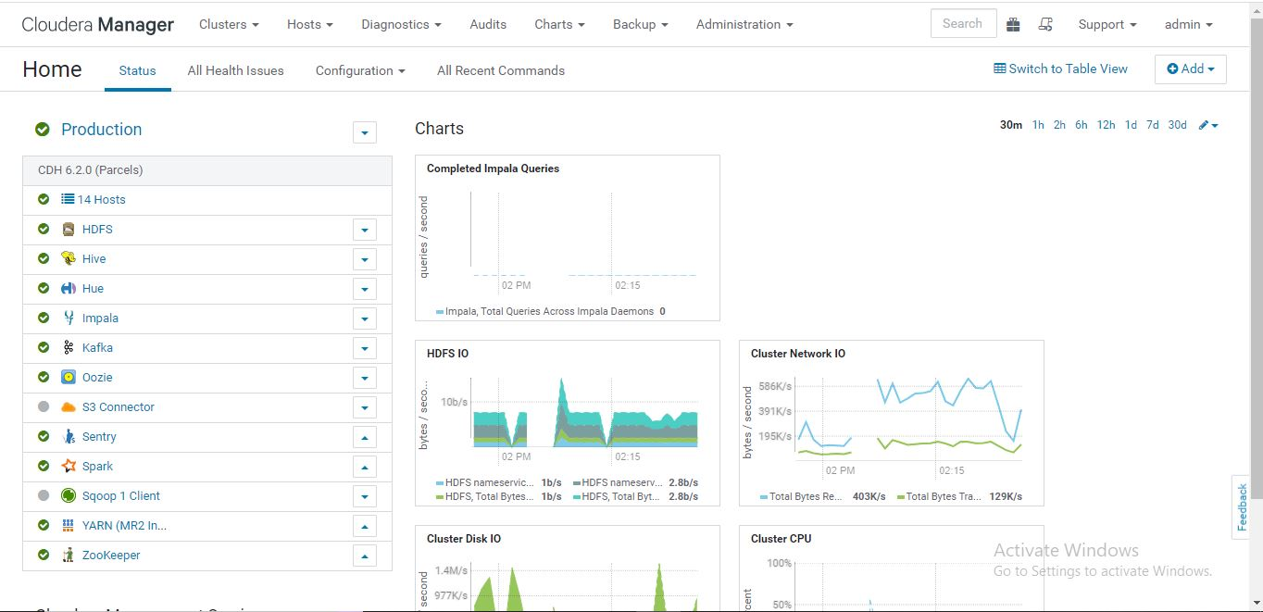

Slide 12
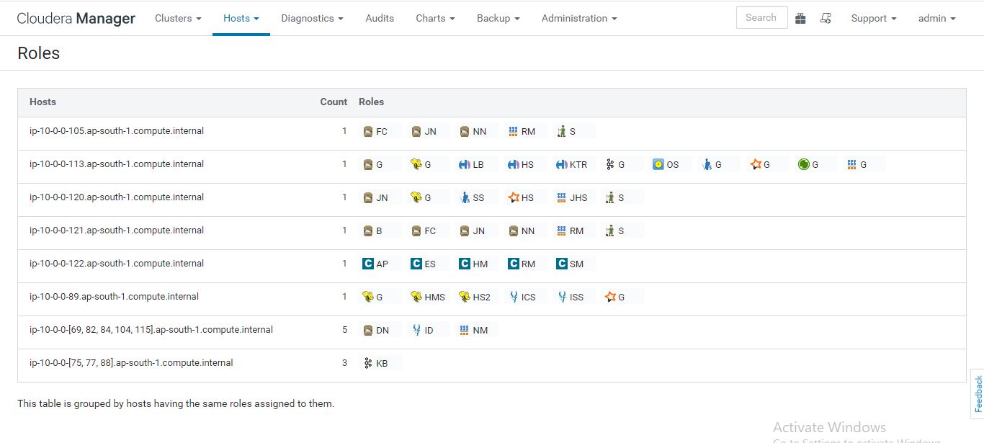

Slide 13
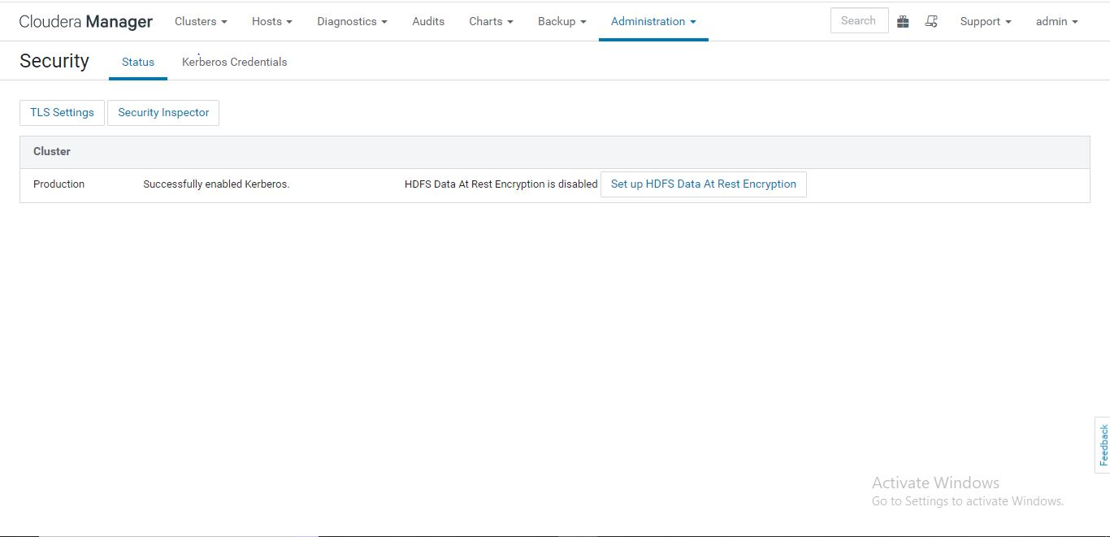

Slide 14
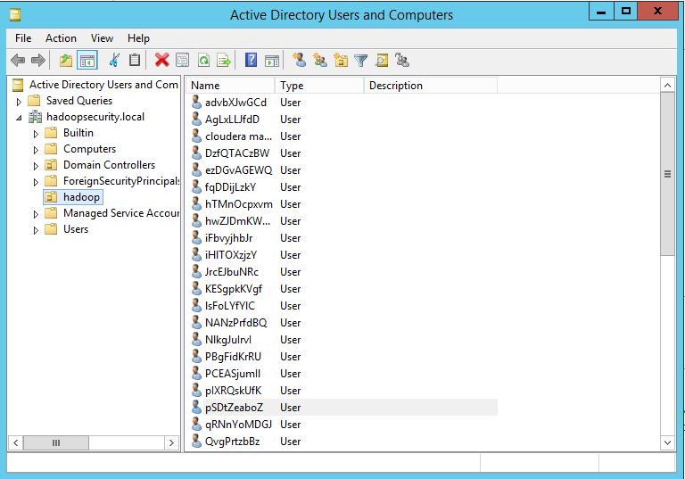

Slide 15
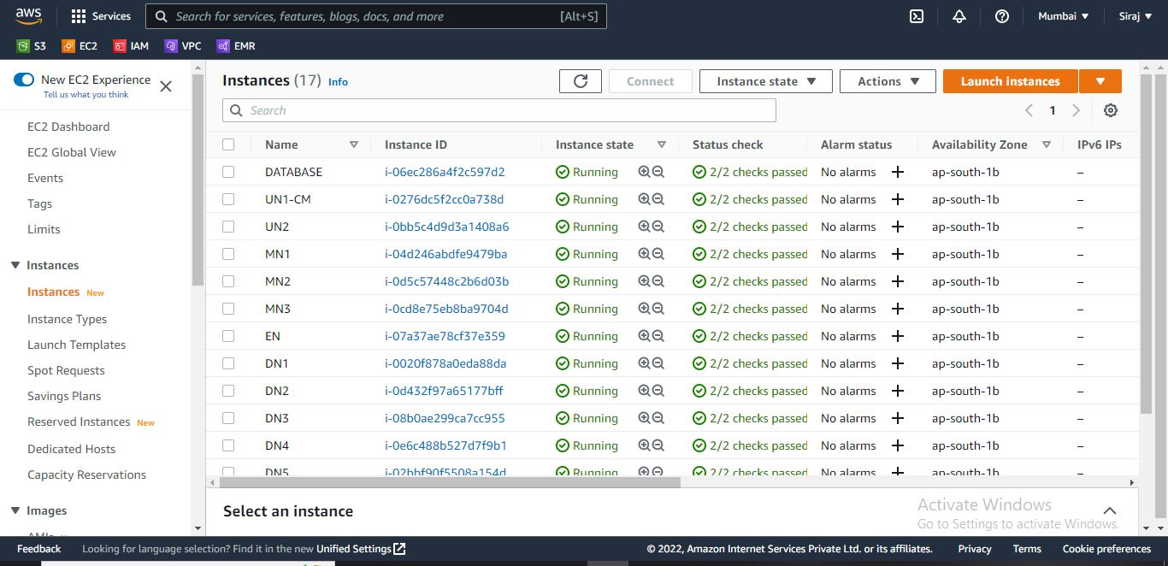

Slide 16
Impact
Click through rate increased thoroughly
Five times increase in conversion rate for successful subscriptions
Grew profitability with delivery of new services and customized content
Increased subscription sales

Slide 17
THANK YOU

