Slide 1
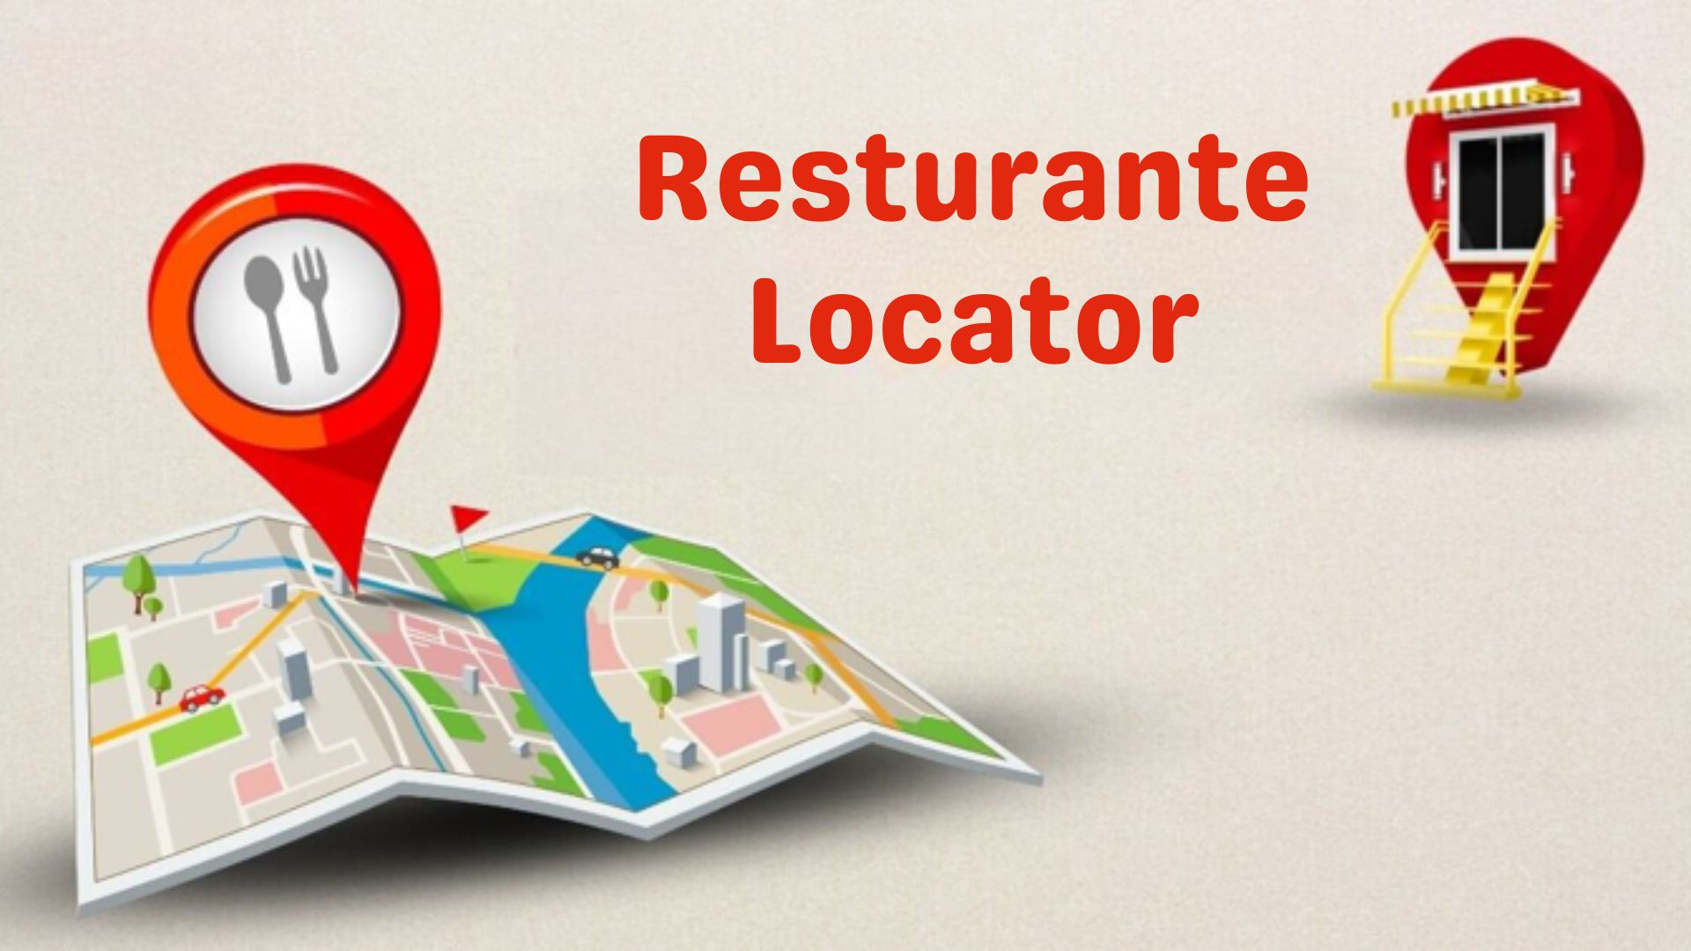

Slide 2

Problem Statement
Students of Geospatial Technologies finding it Difficult to find a restaurant around
Students had to walk far away to find a restaurant

Slide 3
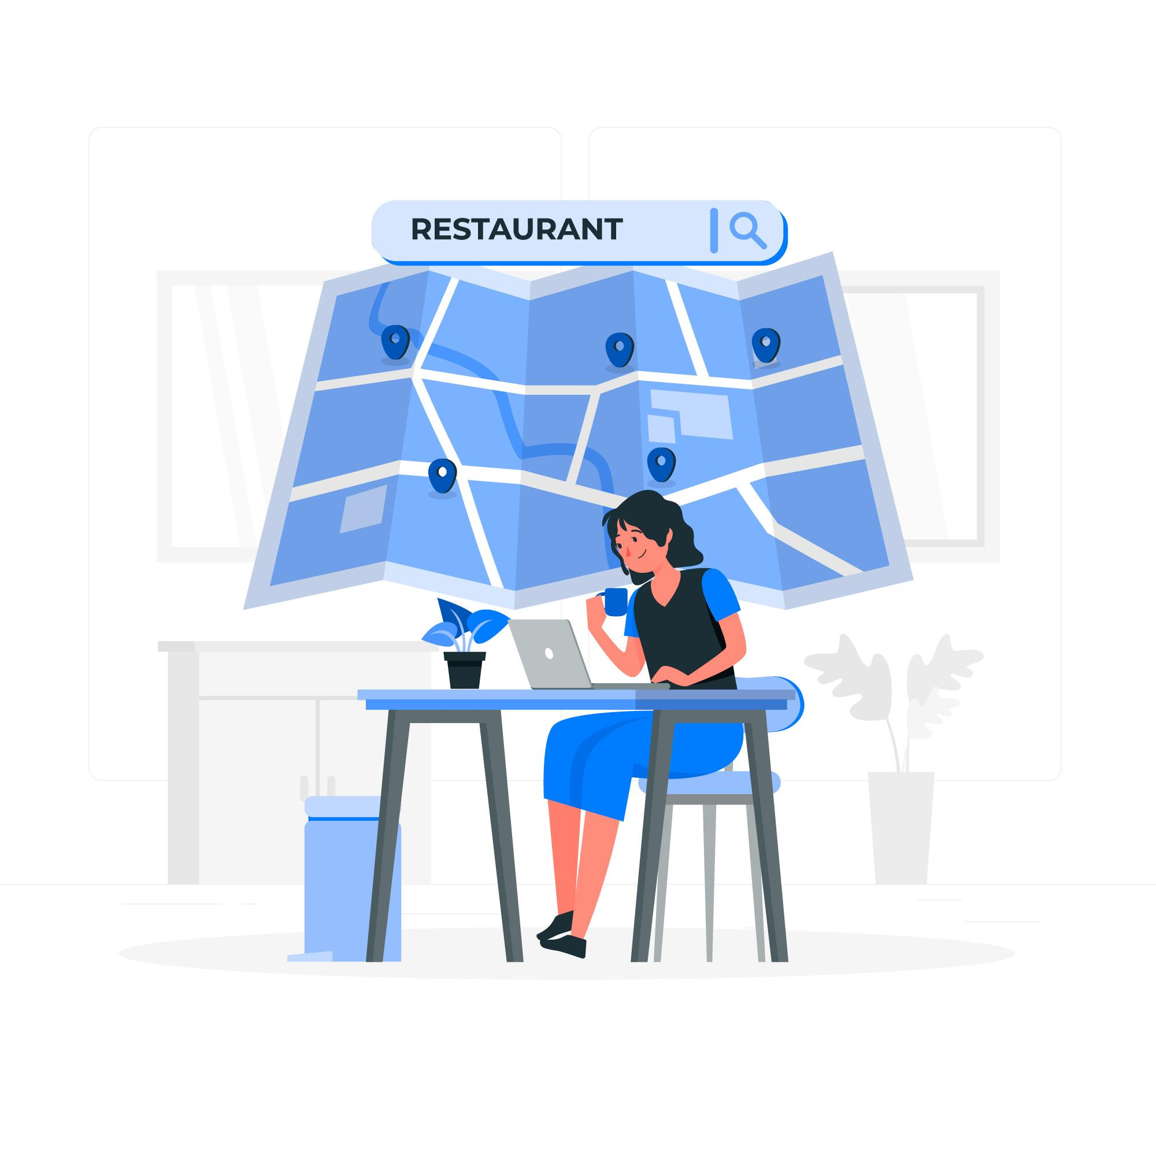
Our Solution
A restaurant locator website that shows nearby restaurants (within a distance of 1000 meters) from the three partner Universities.

Slide 4
How we went about it
Restaurants near partner universities were retrieved from Google maps API
ETL Code was used to Extract, transform and LOAD THE data from the google maps api onto the database
Restaurants from database were displayed on website using Django
Restaurants were also displayed on Leaflet with navigation options
Entire code was placed in Docker and the website was run from a virtual machine

Slide 5
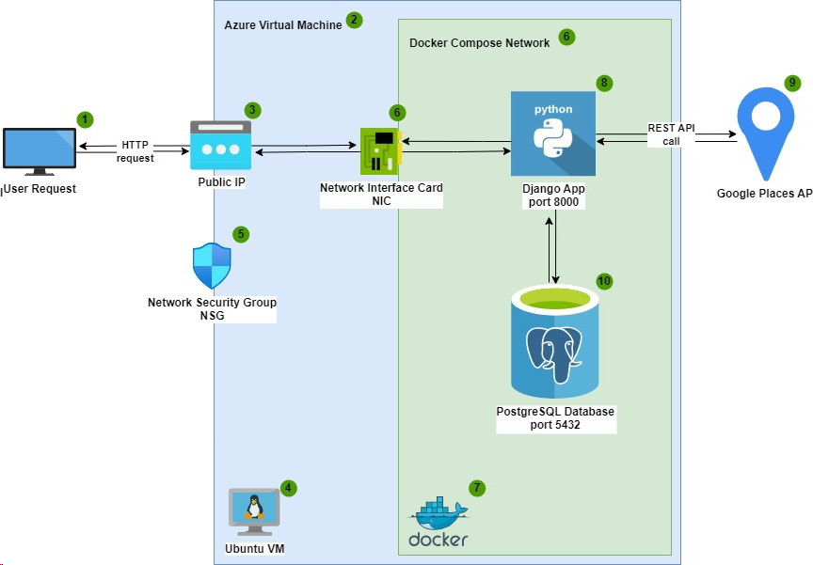

Slide 6
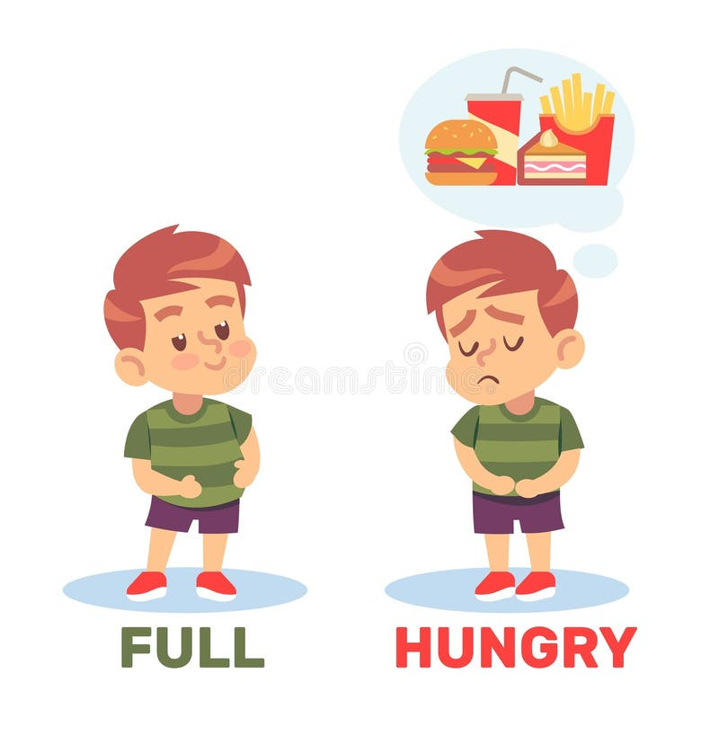
Live Demo
Flavio is hungry and thinking about a nearby restaurant to get food from
Let’s show Flavio how he can find a nearby restaurant with Restaurante Locator!!

Slide 7
Yaayyyy!! Flavio found a good nearby restaurant with Restaurante Locator

Slide 8
Conclusion (Future Developments)
Inclusion of price Range of Restaurants
People would be able to add Pictures
Average Student rating per restaurant
Users would be able to send requests to update information
Any other updates you would like to suggest…

