Slide 1
Customer lifetime value (LTV) prediction in E-commerce
Sirak Jraghatspanyan

Slide 2
The problem
In e-commerce, customers have all the power.
They are looking for the best possible online shopping experience.
In order to do enhance the experience you need Data.
Gathering data from all areas that have an impact on your online store and using this information and machine learning to predict the LTV (Customer lifetime value) will help make data-driven decisions that will drive more online sales.

Slide 3
Why Customer LTV?
We invest in customers (acquisition costs, offline ads, promotions, discounts & etc.) to generate revenue and be profitable.
Naturally, these actions make some customers super valuable in terms of lifetime value but there are always some customers who pull down the profitability.
Therefore, we need to identify these behavior patterns, segment customers and act accordingly.

Slide 4
The Data
Indian E-commerce company sales data:
Amazon Sales (csv file with 24 columns and 129k records): acquired for the period 2022-03-31 and 2022-06-29.
International Sales (csv file with 9 columns and 37k records): acquired for the period 2021-06-05 and 2022-05-11.
Data source : E-Commerce Sales Dataset

Slide 5
Data wrangling (Amazon Sales)
3 columns, having only one unique value and some null values, were dropped.
Null values in the ‘Fulfillment’ and 'Courier Status' columns were imputed using the appropriate values from ‘fulfilled-by’ and ‘Status’ columns respectively.
33 rows, not having the shipping information, were dropped.
Null values in the ‘Amount’ column were imputed using the average value for the rows with the same SKU code.
6 duplicate rows were dropped.

Slide 6
Data wrangling (International Sales)
1000 rows, missing all the values in 6 columns, were dropped.
The data was divided into two datasets and brought to the same format and order, because starting from row 19675 we had different order of columns.After joining those sets and dropping the duplicate rows we were left with 12k rows.
More than 200 rows were just shipping cost information for different orders which were saved in a different dataset and later joined with the main dataset.

Slide 7
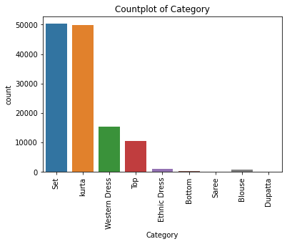
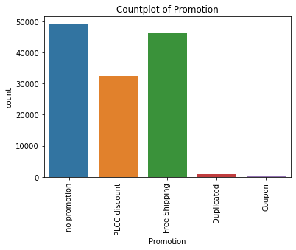
Exploratory Data Analysis(Amazon Sales)
After creating bar plots for all the categorical columns I noticed the following insights:
● Very little percentage of orders are sold via non Amazon sales channels.
● Majority of the orders are delivered by expedited shipping.
● Sets and Kurtas are the most sold item categories: they are being sold 3-5 times more than items in other categories.
● Although products with M and L sizes are the most sold ones, there is also a huge demand for extra large sized items.
● Most of the orders don't have any discount, but at the same time a lot of orders have free shipping and PLCC discount from Amazon.

Slide 8
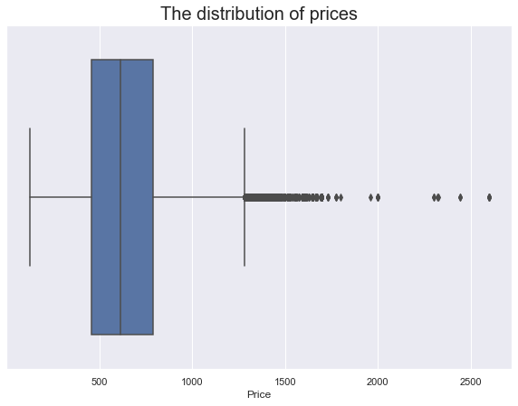
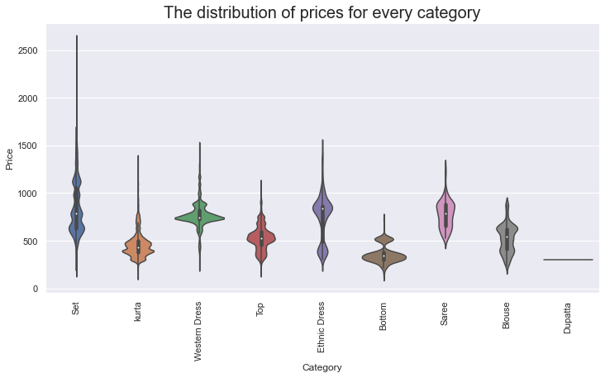
Exploratory Data Analysis (Amazon Sales)
The median price was around 600 rupees and most of the values were between 400-750 rupees.
We also had a lot of outliers which were explained by the different product categories in the next violinplot.
As we can see sets can be more expensive than all the other categories and have a wider range of values

Slide 9
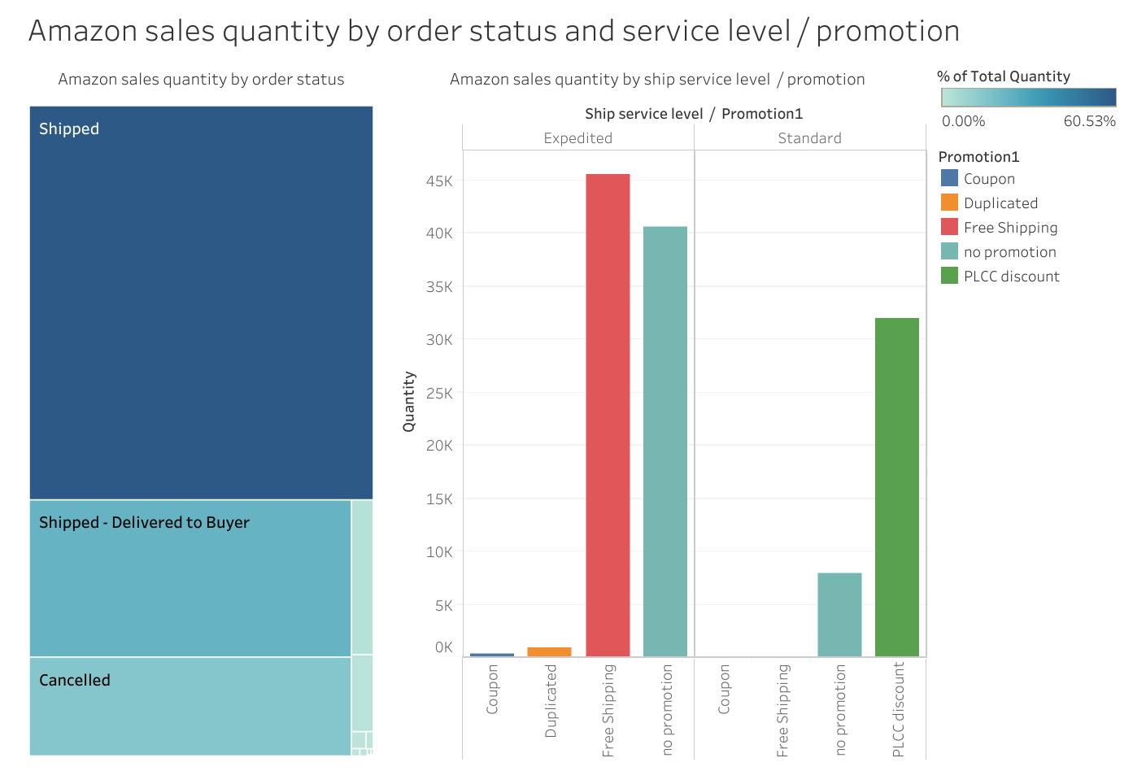
Amazon sales quantity
Most of the customers that choose expedited shipping are using free shipping and in canceled orders, the free shipping is used rarely.
So, maybe making free shipping available for more products and customers will reduce the number of canceled orders and increase sales overall.

Slide 10
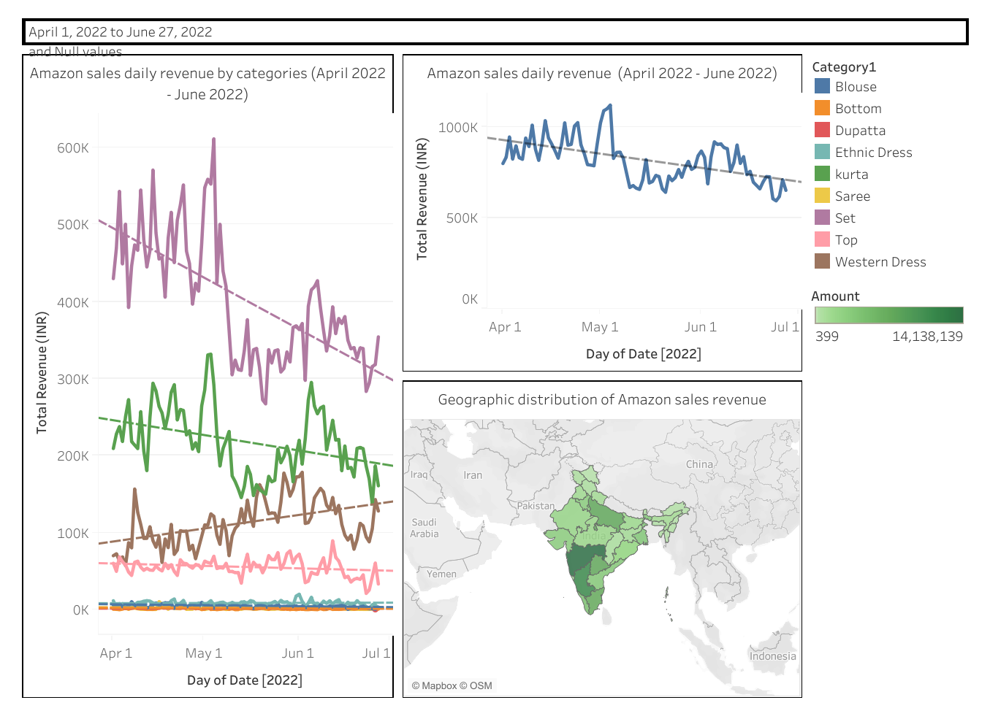
Amazon sales revenue
The company's revenue decreases from April 2022 to June 2022, but it might be because of the seasonality.
Our bestseller categories show a decline in sales (Set & Kurta): the decline is sharper in the Set category. On the other hand, there is a revenue incline for Western dresses which might potentially be a new market segment company can target.
The central and southern states of India show higher demand for the company's products.

Slide 11
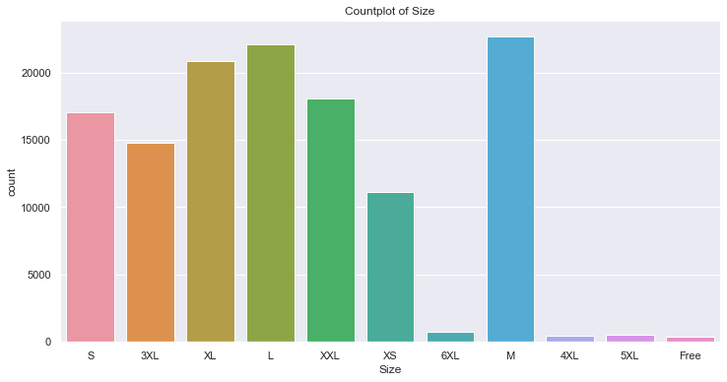
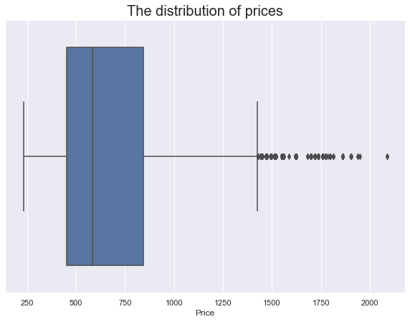
Exploratory Data Analysis
(International Sales)
The distribution of sizes is very similar to the one in Amazon sales: products with M and L sizes are the most sold ones, but there is also a huge demand for extra large sized items.
And for the price, again, the distribution is very similar to the one in previous data: the boxplot shows that the median price is around 600 rupees and most of the values are between 450-850 rupees.

Slide 12
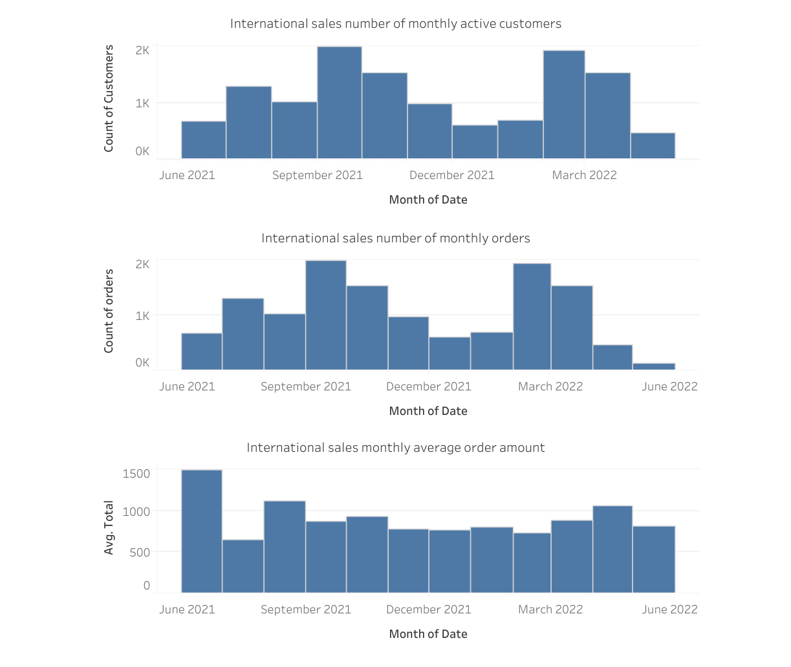
International sales number of monthly active customers, orders and average order amounts.
There are significant increases in number of active customers and orders throughout the periods September 2021-October 2021 and February 2022 - March 2022.
The average order amount is relatively stable throughout the whole time period. The only exceptions are June and July 2021 with the highest and the lowest values respectfully.

Slide 13
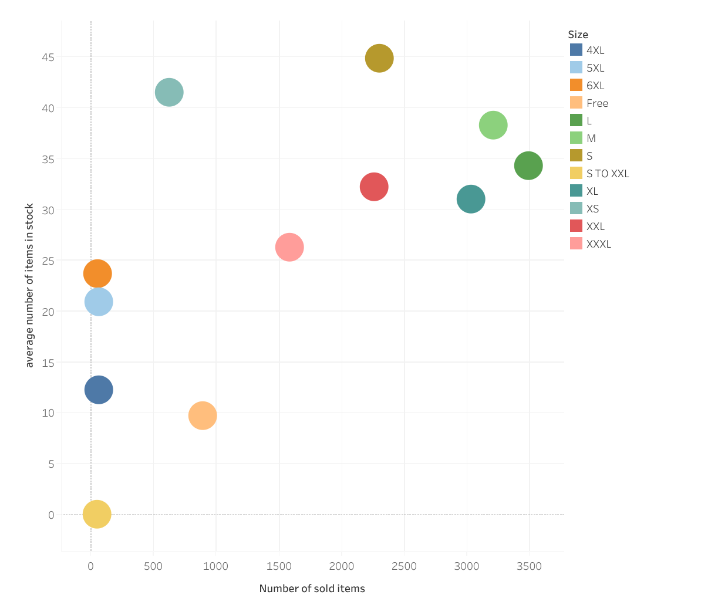
The average number of items in stock vs sold items for each size (International sales)
The sizes in the upper right and lower left corner keep the balance between the in-stock and sold items.
On the contrary, the size 'XS' has more items in stock than most of the sizes but is being sold a few times less than the ones on the upper right corner.
This plot can be useful in warehouse inventory management.

Slide 14
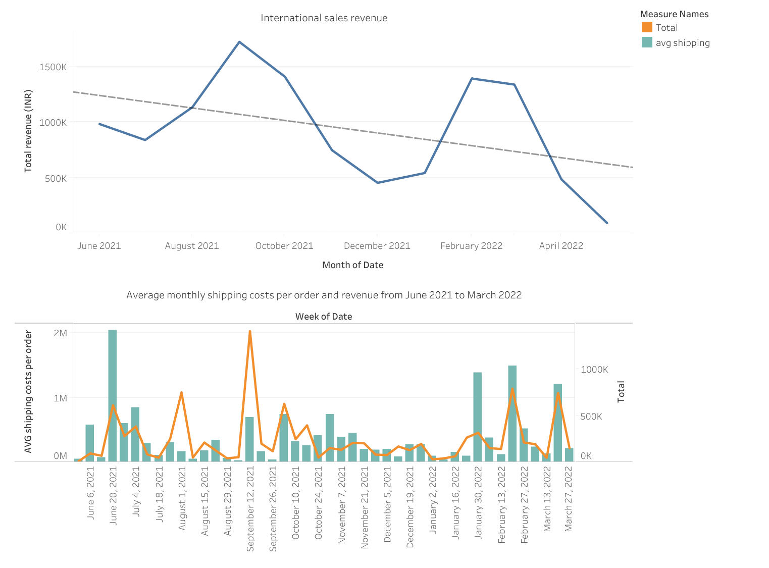
International Sales total revenue and shipping costs
Like the Amazon sales data, there is a total revenue decline in International sales but at the same time, we can notice the presence of seasonality.
In the comparison of shipping costs and revenue, we can notice the positive correlation between them, which was observed in exploratory data analysis, most of the time.
But there are some cases when shipping costs are higher whereas the revenue is on the same level and vice versa. One reason for that difference can be the destinations and distances of orders.

Slide 15
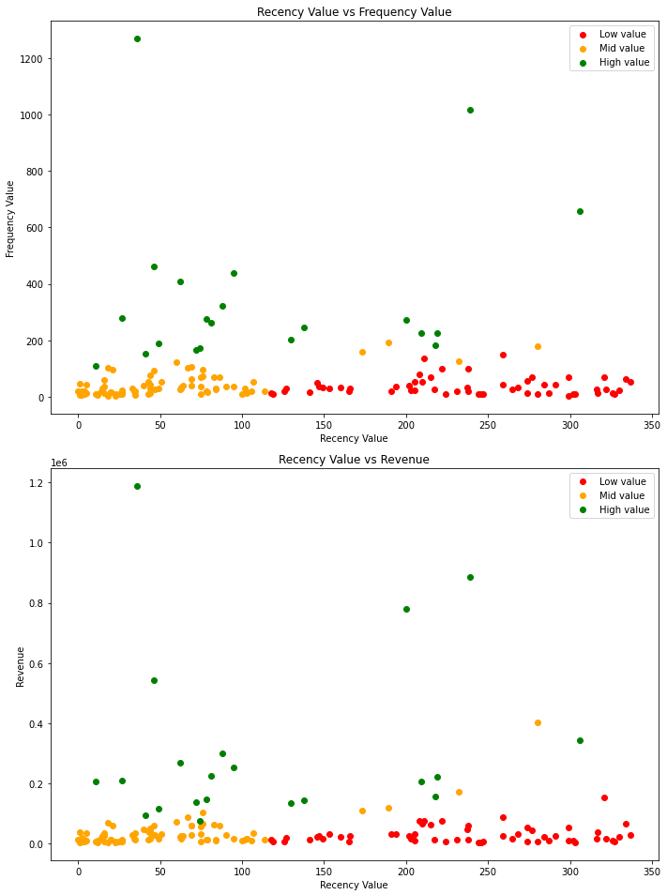
Preprocessing
The customers were segmented using the RFM method which stands for Recency - Frequency - Monetary Value.
After plotting the values in 3 different groups I noticed how the segments are clearly differentiated from each other in terms of RFM.
The data was split to predict the LTV for the last 5 months using the first 6 months of data.

Slide 16
Modeling
For the model I used the XGBoost Regressor and Linear Regression.
Model | XGBoost def hyperpar | XGBoost tuned hyperpar | Linear Regression
RMSE train | 0.003 | 5842.4 | 6696.05
RMSE test | 11771.1 | 8806.6 | 8516.3

Slide 17
Results
As a final model I chose Linear Regression even though it had worse results on the training set. But the results were not practical considering the fact that the rmse on the test set was close to the mean value of the target column.
This could be due to several reasons:
Limited Data: With more data, the model might be able to generalize better.
Outliers: If there are outliers in the target variable (i.e., some customers have extremely high future monetary values), this could be influencing the model's performance.
Overall, while the model's performance is not perfect, it could still provide valuable insights for making business decisions.

