Slide 1


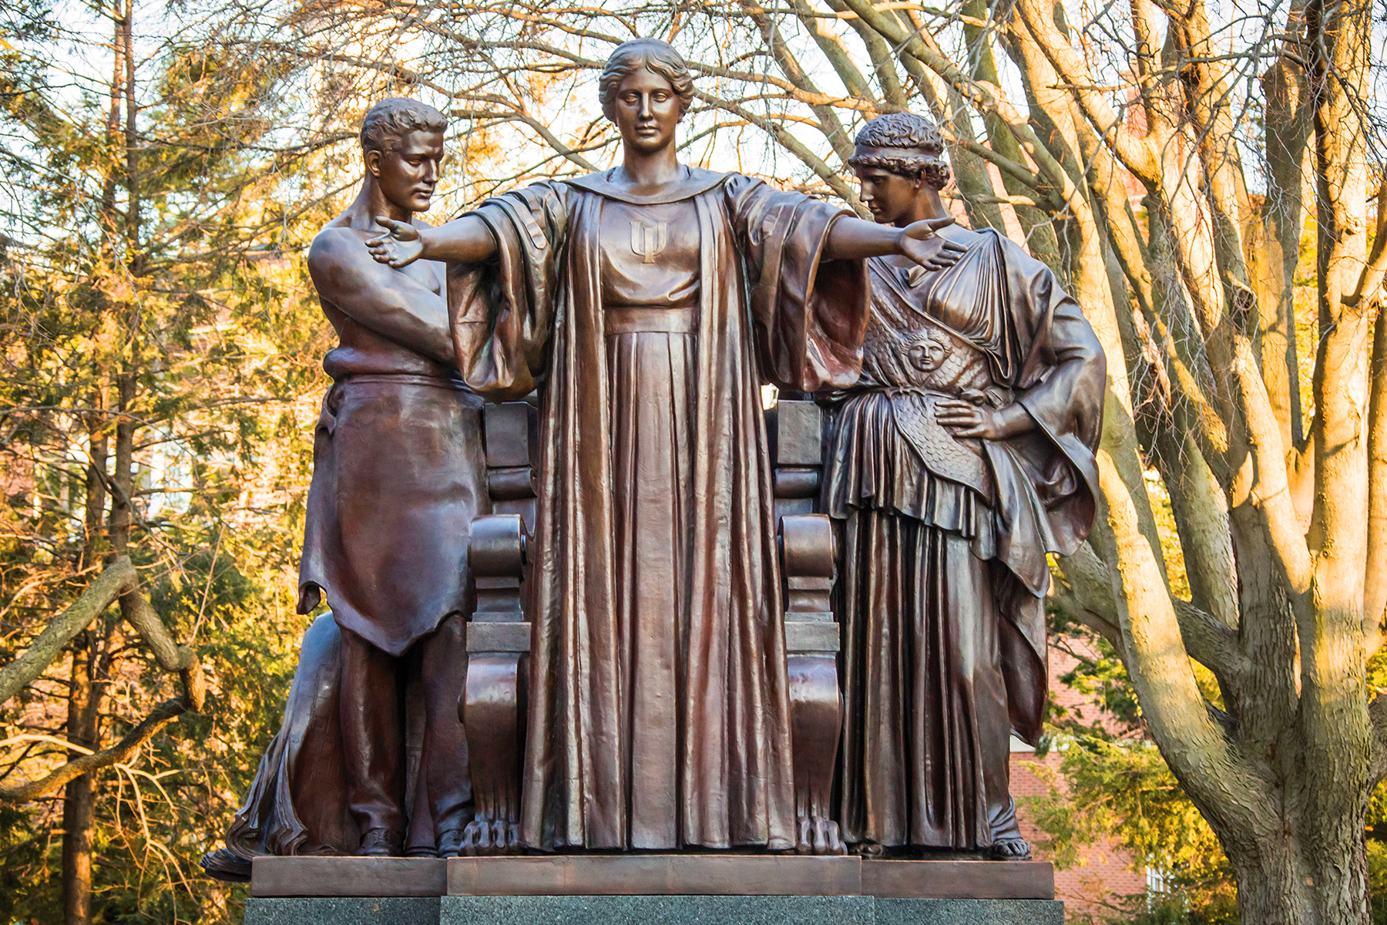
CS225 Final Project
Team Converges
Jialong Li - jialong7@illinois.edu
Siran Xianyu - sxianyu2@illinois.edu
Kaiyi Zhang - kaiyi2@illinois.edu

Slide 2

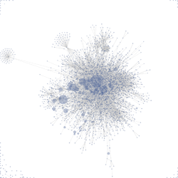
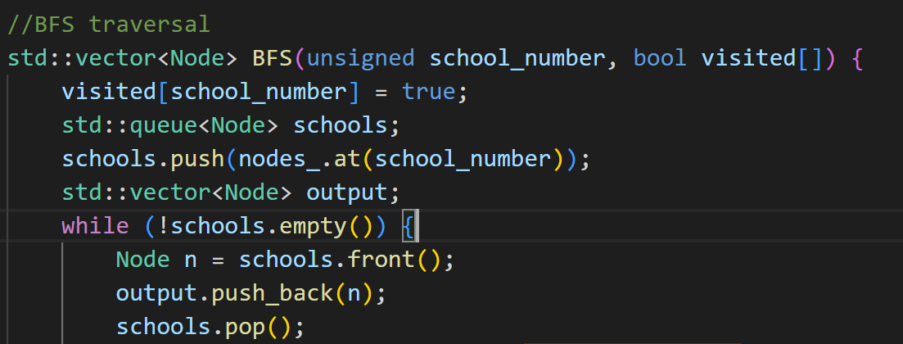
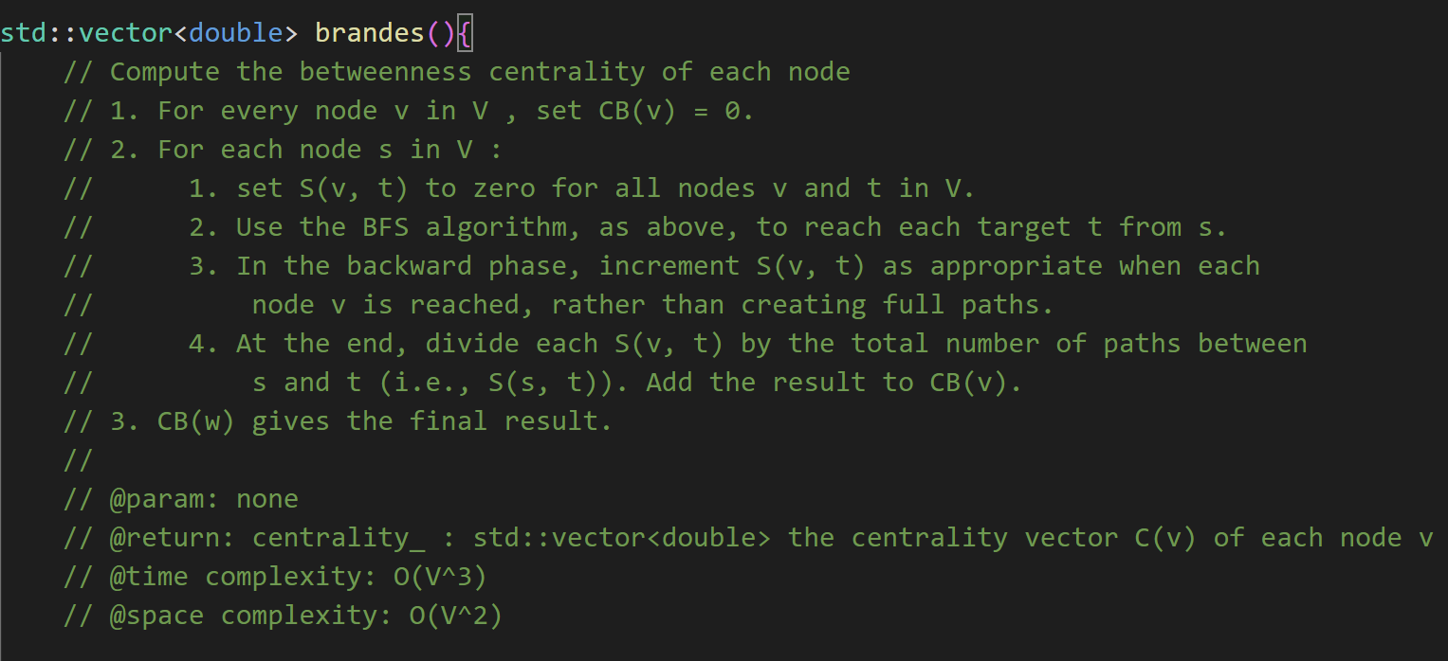
Our Goals
Draw a force-directed graph base on betweenness centrality
BFS
Brandes Algorithm
Fruchterman-Reingold algorithm
Traverse the Graph
Find Connected Components
(with 3 test cases)
Generate centrality for each node
(with 3 test cases)
Find pivot schools (most influential)
Generate Force-directed graph

Slide 3
The Development (difficulties)
The data --- string split, and deduplication
Graph Construction
BFS algorithm
Brandes algorithm
Fruchterman-Reingold algorithm
Output

Slide 4
Responsibilities
The data --- Jialong Li
Graph Construction --- Siran Xianyu
BFS algorithm --- Siran Xianyu, Kaiyi Zhang
Brandes algorithm --- Kaiyi Zhang
Fruchterman-Reingold algorithm --- Siran Xianyu, Jialong Li
Test Cases --- Jialong Li, Kaiyi Zhang
Output & Report --- Jialong Li

Slide 5
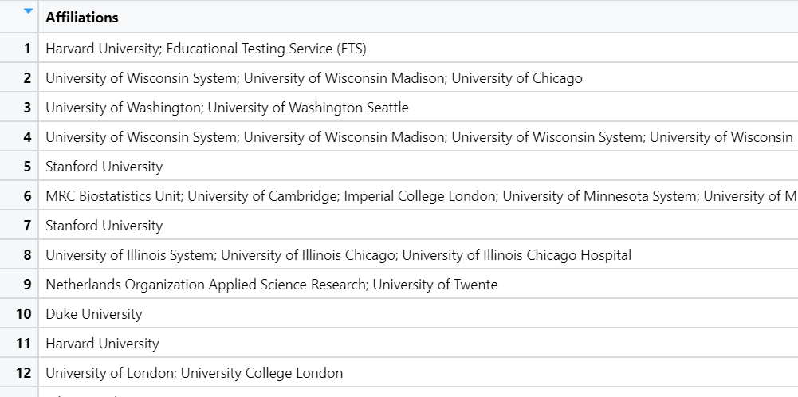



Data_1 - Raw Data
Raw Data
We downloaded 1,000 highly cited articles data from WOS database.
Using the advanced search with query “WC=(Statistics & Probability)) AND (TMSO==("9.92 Statistical Methods")”
Keep only the “Affliations” column.
Raw data (screen shoot)
Mathematically, suppose N is an arbitrary school number in a row. The number of school pairs it can generate is .

Slide 6
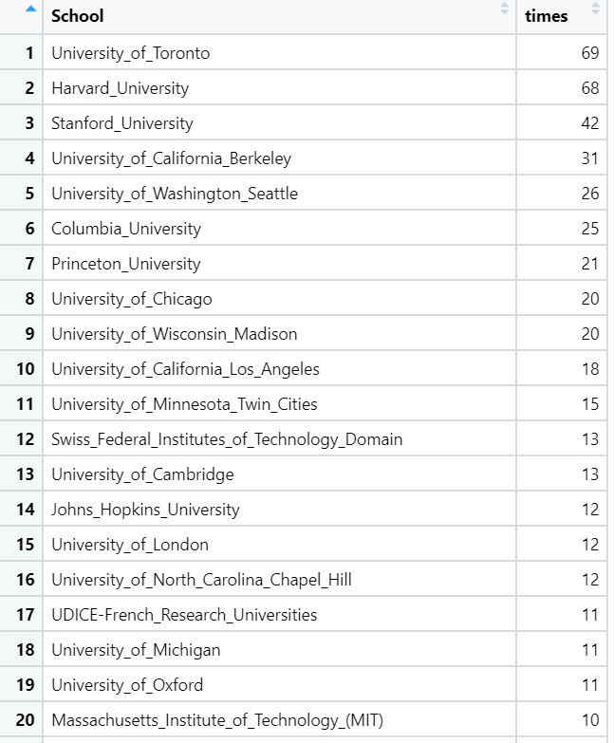
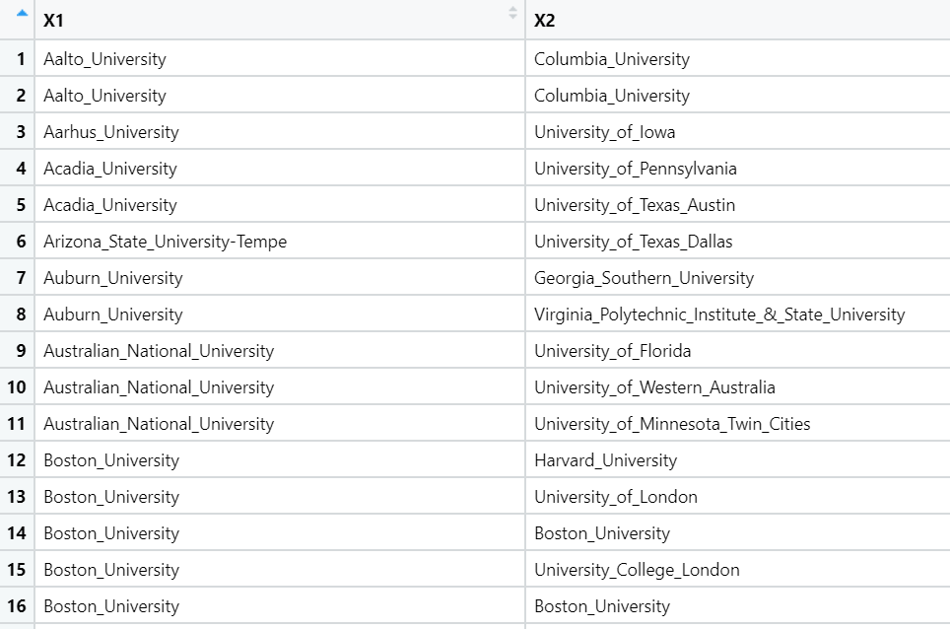
Why Deduplication?
Data_2 - Difficulties
Data_Edges
Connected if they collaborative once
Data_Vertex
Technique used: str_split, deduplication

Slide 7
1. Graph_construction – Intro & Difficulties
Introduction: The graph is constructed based on the input data edges file and input data vertex file.
Difficulty: We created an adjacency list based on the school index, so that neighbors of a a school can be accessed easily by the index of that school

Slide 8
2. BFS – Intro & Difficulties
BFS:
We use BFS algorithm to find the all the vertices that is connected to a starting vertex
We store them to a one dimensional vector in a two dimensional vector called connected_components

Slide 9
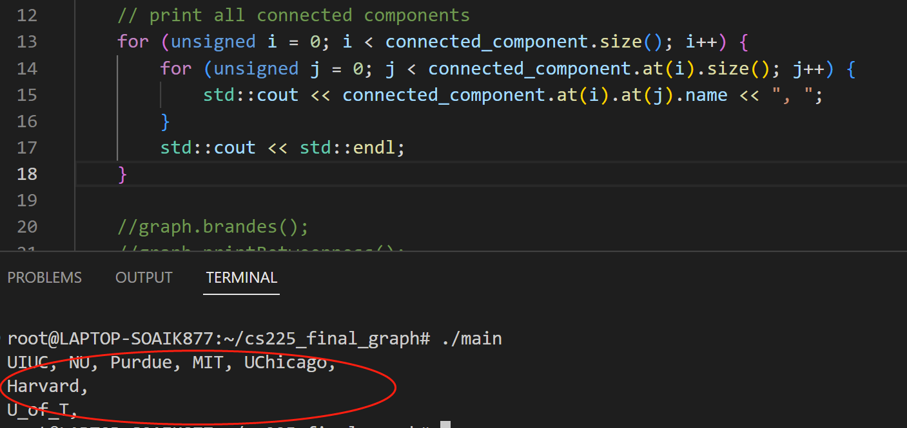
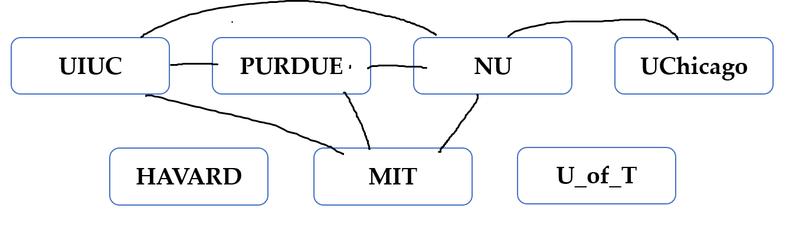
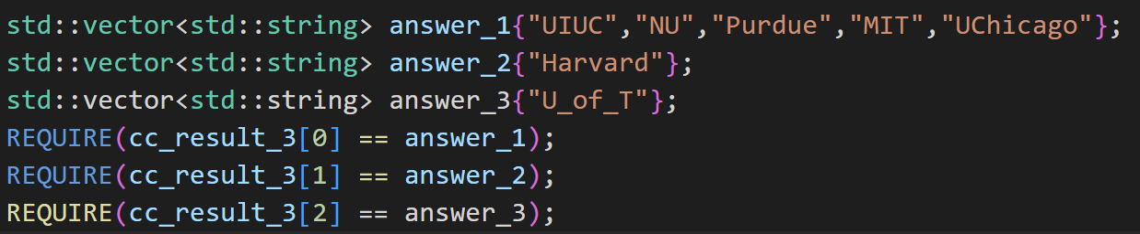
2. BFS – Test Case
data_edge_test2’s structure (by hand)
print the connected components, Correct!
[BFS & Connected component Test 3]
Simple Test:
the number of subgraph
Exact Test:
if they are exactly the same

Slide 10
BFS4ST
Algorithm:
vector<vector<Node>> BFS4ST(unsigned source, unsigned target, bool visited[])
Traverse all connected components
For each connected components, find out if source node and target node are in the same component, if not, return empty vector
If the source and target are in the same connected component, do the BFS
Get the first path in the queue
Add all the neighbors of the current node to the queue
If the current node is the target, add the current path(shortest) to the output
If the current path is longer than the shortest path, stop the BFS
Return the output vector

Slide 11
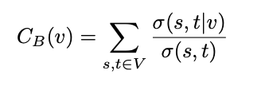
3. Brandes – Intro & Difficulties
Math Definition:
Graph G = <V,E> (unweighted, undirected, connected)
σ(s, t): number of shortest paths between source nodes s and target nodes t.
σ(s, t | v): number of shortest paths between source nodes s and target nodes t that pass through the nodes v
Centrality of node v:

Slide 12
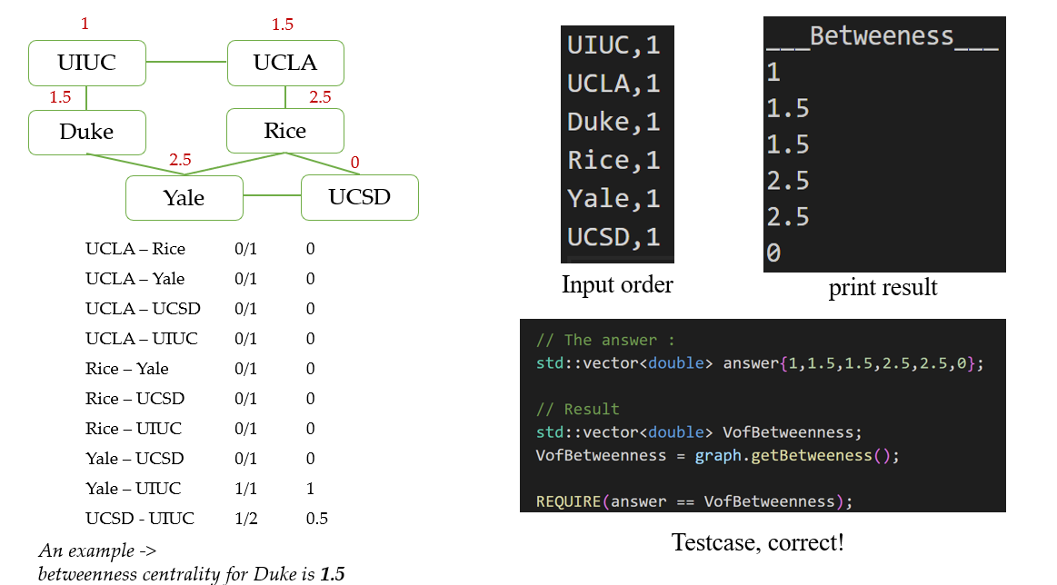
3. Brandes – Test case

Slide 13
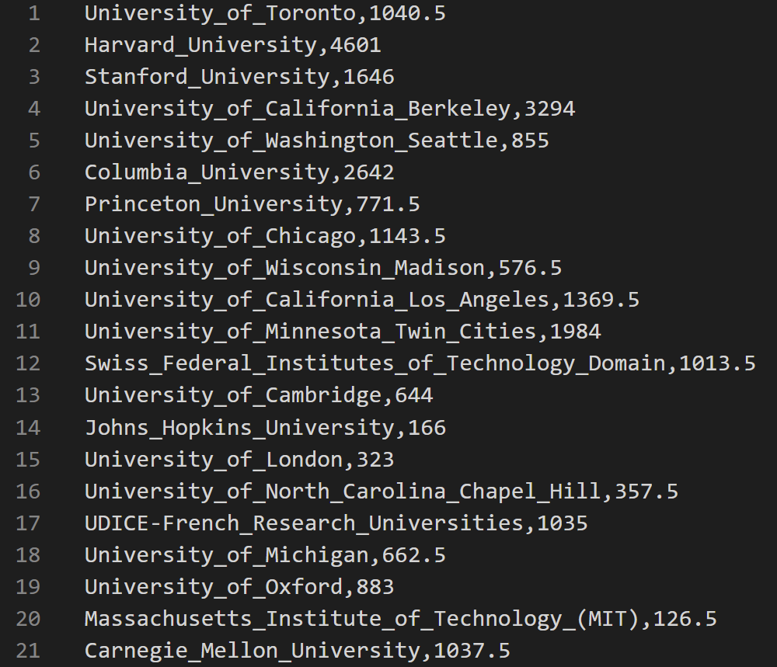
3. Brandes – Output

Slide 14
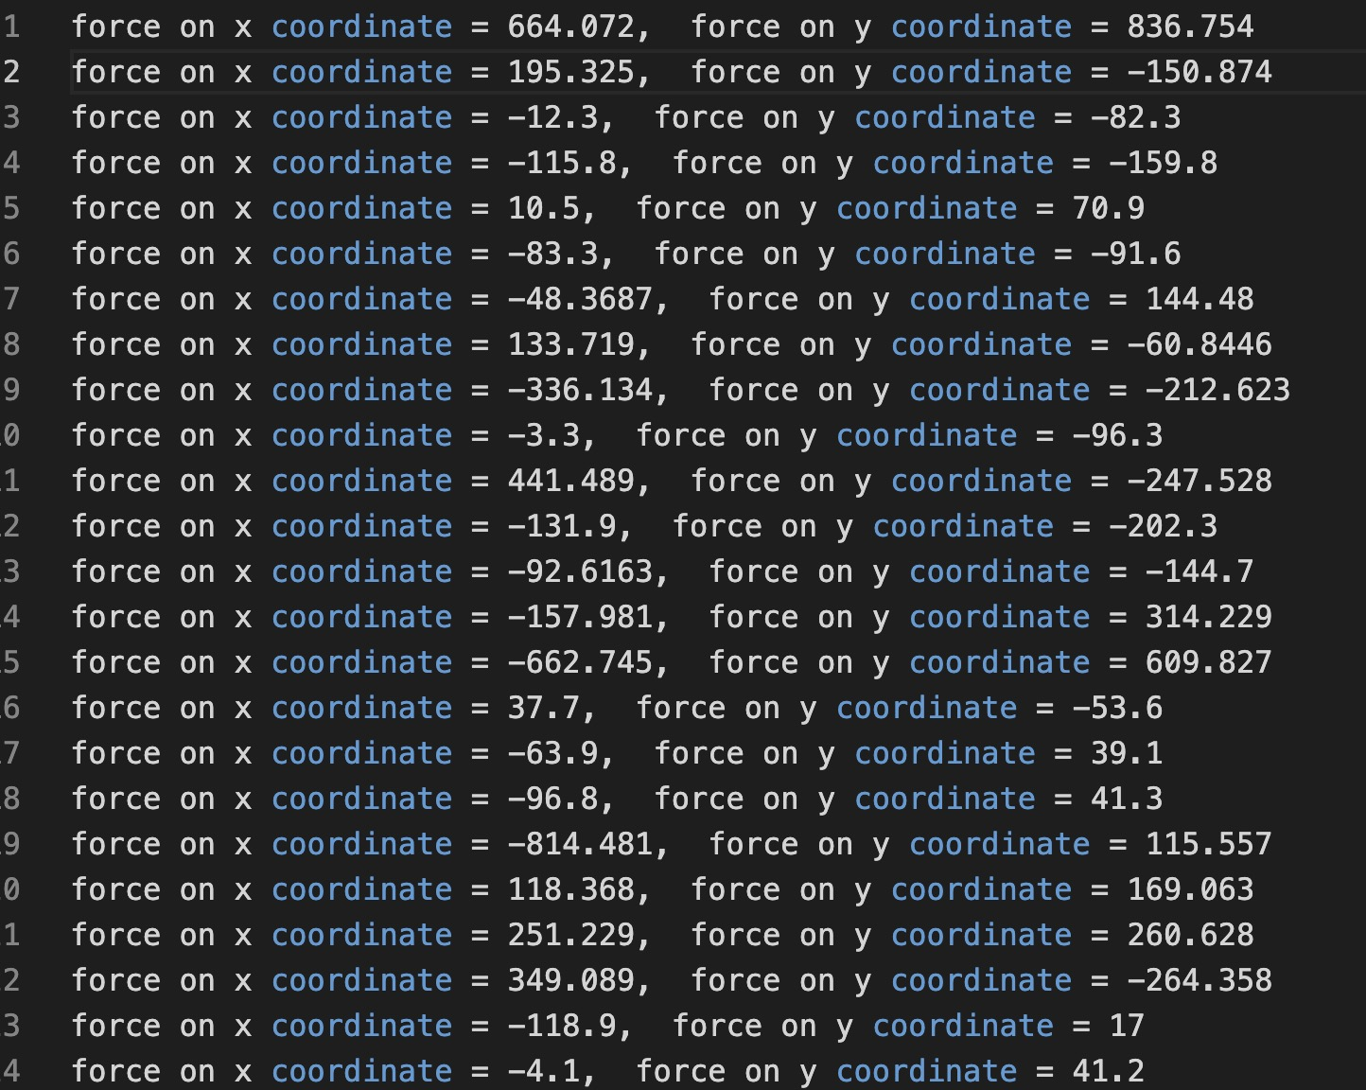
4. Fruchterman-Reingold – Intro & Difficulties

Slide 15
4. Fruchterman-Reingold – Output
Draw:
Introduction: This algorithm calculate the force relation between two vertices and move the vertices based on the net force of a vertex. Difficulty: As the centrality of a vertex varies a lot in a connected component, distance based on the force also varies from 10000 to -2000, making it impossible to build a image containing stable connected components that could run on our computer

Slide 16
The Conclusions (difficulties)
Graph Construction --- details
BFS --- one test case example
Brandes --- one test case example
Fruchterman-Reingold algorithm --- The Map

Slide 17
Individual thoughts
Data quality matters
Part that I like, many mathematic or even physics knowledge that we need to learn.
Part that I didn’t like, Fruchterman-Reingold algorithm is way too hard to learn

