Slide 1
Welcome to MSA Web Apps & APIs Bootcamp
We will be commencing shortly
This is a Microsoft Teams Live event, so you are placed on mute for the entire duration.
If you have any questions, please select “Ask a question” or upvote by liking existing ones.
Captions can be turned on anytime by clicking the “CC” icon.
At any point where you get lost, you can rewind the live stream to any point in time.
This workshop is being recorded and all recordings can be accessed via the same link you used to access this live event.
Having this workshop being recorded, should you not consent, please feel free to leave if you wish.
For updates on the program, please join our Facebook group at https://aka.ms/MSAFacebook
We hope you enjoy the session!

Slide 2


presents
Web App & APIs
Bootcamp

Slide 3
Agenda
01
Welcome Announcements
04
Submission & Marking Guidelines
Web Dev Concepts
05
Microsoft Intern Showcase
02
03
Live Demo
06
Q&A

Slide 4

Web Dev
Concepts

Slide 5
Website vs Web Apps
Websites | Web Apps
Informational | Interactive
Prime purpose is to present information | Dynamic service which collects responses from user and changes state accordingly
Example: Restaurant website with menu | Example: Outlook, Facebook etc.

Slide 6
Web Development Lifecycle
Plan & Analyse
Design
Code
Test
Deploy

Slide 7
Front-End + Back-End = Full-Stack
Front-End
Front-End development primarily focuses on client-side code.
Involves designing user-interface and experience
Back-End
Mainly refers to server-side development.
Under-the-hood
Manage database and APIs

Slide 8
Behind The Scenes – Backend
What goes under the hood?
Process, store and serve data using databases
Ensure security & privacy of the web app and its users
Handle request-response of APIs
Provide interaction with users as well as third-party web services

Slide 9
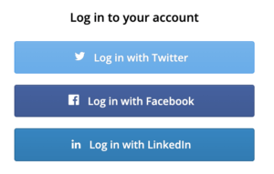
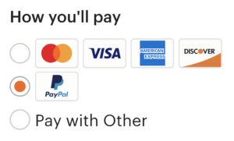
What are APIs?
A method/way for software and web services to use communicate
User interface – not for humans, but for apps and other software
Examples:

Slide 10
REST APIs
REST is a convention / set of rules for web services to communicate with each other.
REST architecture is uses HTTP protocol to communicate
Central to RESTful websites are resources

Slide 11
Characteristics of a REST System
HTTP Method | Action | Example
GET | Obtain information or resource | http://example.com/api/orders (retrieve order list)
POST | Create/Update a new resource | http://example.com/api/orders (create a new order, from data provided with the request)
PUT | Create/Update a new resource | http://example.com/api/orders/123 (update order #123, from data provided with the request)
DELETE | Delete a resource | http://example.com/api/orders/123 (delete order #123)

Slide 12
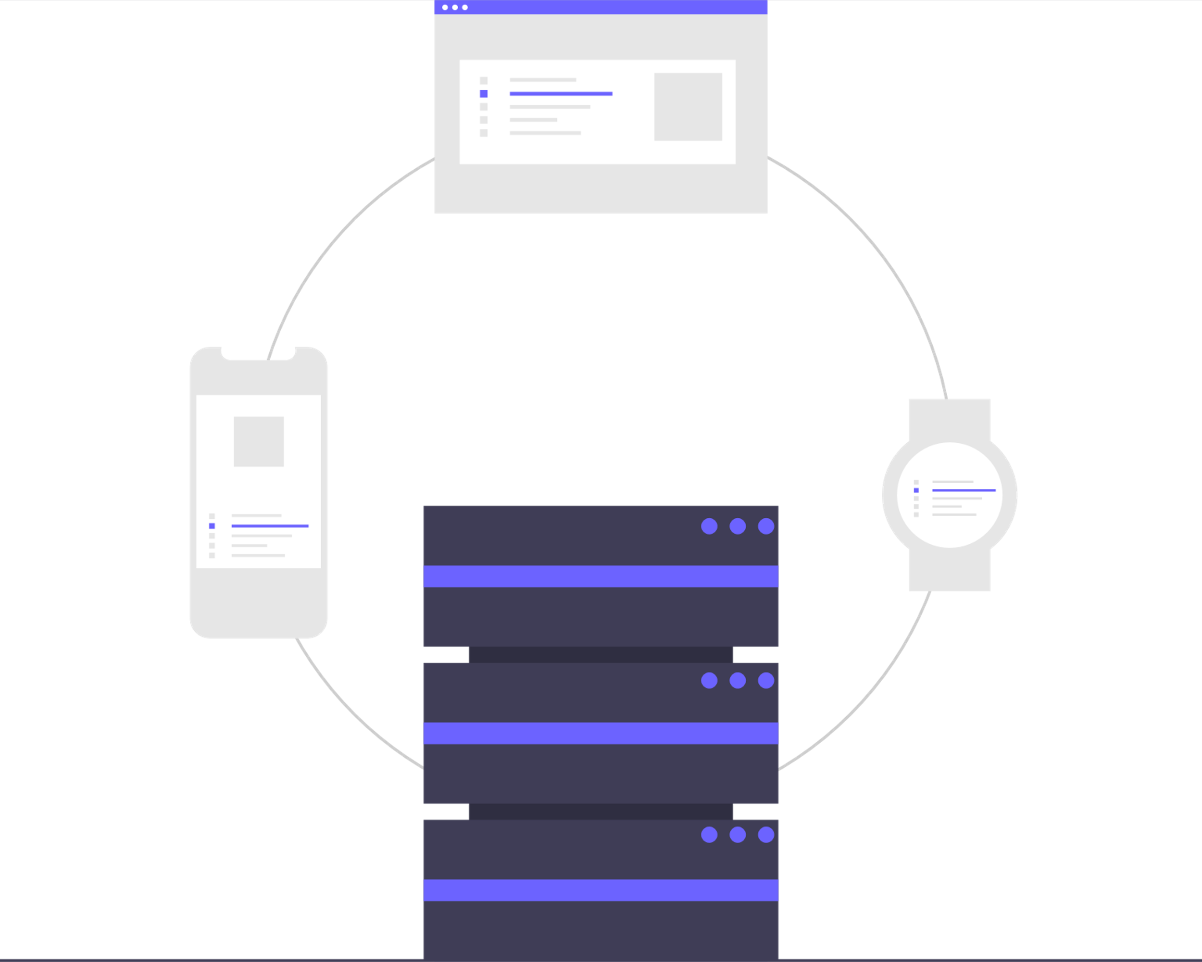
Hosting a Web Service
Choose a hosting provider
Deploy your app using hosting provider of choice
Buy Domain name
Get SSL Certificate

Slide 13
Live Demo

Slide 14
To-Do App
We will create an interactive To-Do with HTML, Bootstrap & Flask
You are not expected to follow along with the pace. We have put up a step-by-step guide to follow at your own pace later.
Step-by-step guide: https://github.com/JerryyZhu/todo_markdown

Slide 15
Submission Guidelines

Slide 16
Submission Guidelines
Fill the project submission form
Detailed instruction can be found on the Bootcamp GitHub
Please make sure your GitHub repo is public

Slide 17
Intern Showcase

Slide 18
Kritika
Khanna

Slide 19
Joseph
Stephen

Slide 20
Prerita
Mehta

Slide 21
Regina
Lin

