Slide 1
Welcome to MSA Azure & Cloud Fundamentals Bootcamp
We will be commencing shortly
This is a Microsoft Teams Live event, so you are placed on mute for the entire duration.
If you have any questions, please select “Ask a question” or upvote by liking existing ones.
Captions can be turned on anytime by clicking the “CC” icon.
At any point where you get lost, you can rewind the live stream to any point in time.
This workshop is being recorded and all recordings can be accessed via the same link you used to access this live event.
Having this workshop being recorded, should you not consent, please feel free to leave if you wish.
For updates on the program, please join our Facebook group at https://aka.ms/MSAFacebook
We hope you enjoy the session!

Slide 2


presents
Azure & Cloud Fundamentals

Slide 3
Agenda
01
Introduction to Git & GitHub
04
Hands-on Demo
Benefits
05
Questions & Answers
02
03
Going Beyond Just Coding

Slide 4

Cloud Concepts

Slide 5

What is Cloud Computing?
A distributed version control system
Designed to coordinate work among teams
Created by Linus Torvalds for development of the Linux kernel

Slide 6
Benefits of Cloud

Slide 7
Economies of Scale

Slide 8
Cloud Deployment Models

Slide 9
Typical Cloud Services

Slide 10
Introduction to Azure

Slide 11
What is Azure?

Slide 12
Tour of Azure Services

Slide 13
Virtual Machines

Slide 14
Computes

Slide 15
Serverless Computing

Slide 16
Project walk-through

Slide 17
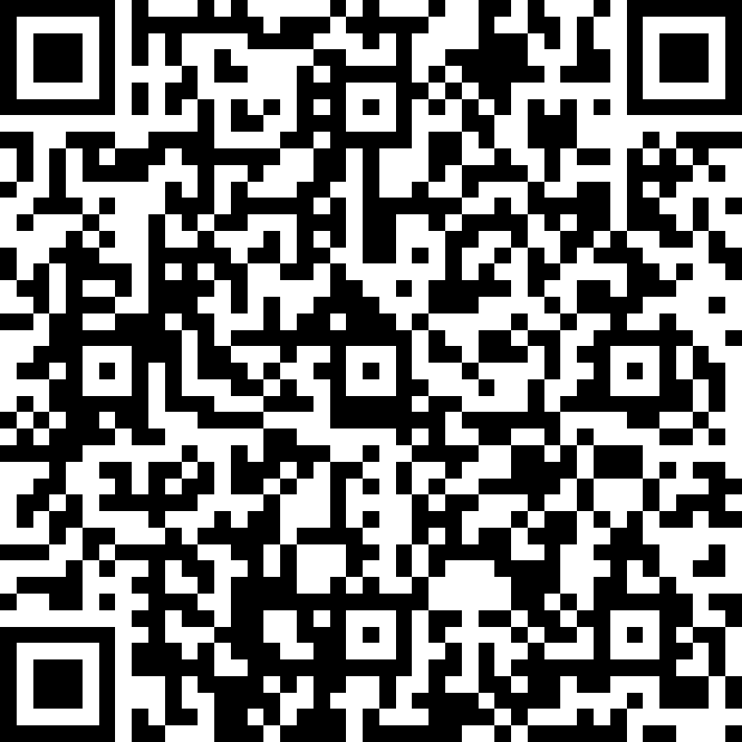
Attendance Form
https://aka.ms/AttendanceForm

Slide 18
Questions and Answers

Slide 19
Thank you for attending!
The recording for this Bootcamp can be accessed via the same link used to access this live event.
All resources can be found on our GitHub repo which can be accessed via the link we sent to your email.

