Slide 1
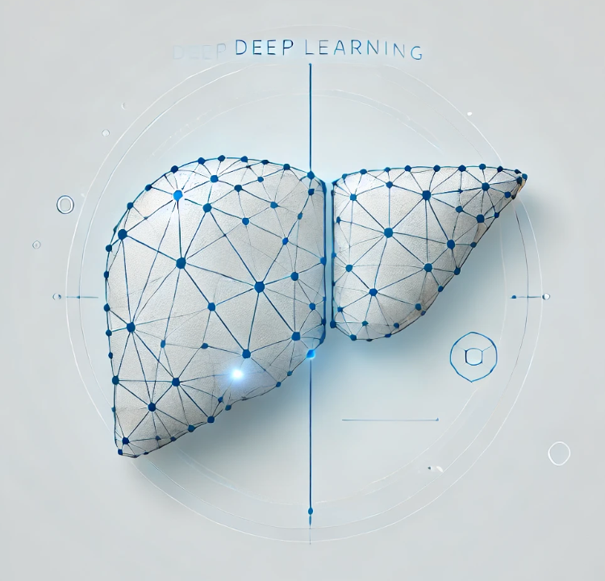


01
Deep Learning for Liver Segmentation using U-Net
Guide:
Prof.Siddique Ibrahim Peer Mohamed
Name
Reg. no
Sirasanagandla Madhuri
21BCE8217
Chigurupati Amarnath
21BCE8893
Ankit Kommalapati
21BCE8228

Slide 2

02
Motivation
Liver diseases affect over 2 billion people globally, with significant mortality rates.
Accurate liver segmentation is vital for diagnosis, treatment planning, and monitoring.
Manual segmentation is time-consuming, error-prone, and inconsistent across practitioners.
AI-powered solutions can automate and improve precision, scalability, and speed in medical imaging.

Slide 3
03
03
Objectives
To develop an automated liver segmentation system using PyTorch and MONAI frameworks.
To explore and implement data preparation techniques for medical imaging datasets.
To optimize the UNet architecture for semantic segmentation tasks in liver imaging.
To evaluate model performance with robust metrics, including the Dice coefficient.
To address challenges in medical imaging, such as class imbalance and preprocessing errors.

Slide 4
04
Problem Survey
Medical Imaging Complexity:
Variations in liver anatomy across patients.
Low contrast in some imaging modalities.
Data Constraints:
Limited annotated datasets.
High cost and effort of manual labeling by radiologists.
Processing Errors:
Potential for file path mismatches and incorrect annotations.
Model Challenges:
Overfitting due to small datasets.
Inefficient handling of class imbalances.

Slide 5
05
LITERATURE SURVEY
A Review of Deep Learning Approaches for Multimodal Image Segmentation of Liver Cancer
Segmentation of Liver Tumors by Monai and PyTorch in CT Images
Comparative Study of Liver Segmentation using U-Net and ResNet50
MDPI (Multidisciplinary Digital Publishing Institute)
ResearchGate
IEEE Xplore
Wiley

Slide 6
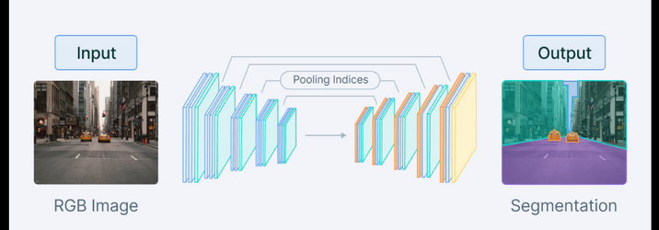
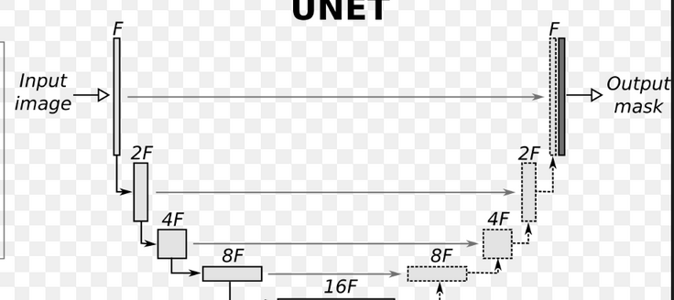
06
04
Subject Knowledge
Segmentation: Assigning each pixel to a class for precise
organ detection.
UNet Architecture:
Widely used in biomedical image segmentation.
Combines encoder and decoder networks for feature extraction and localization.
MONAI Framework:
Specialized tools for medical imaging tasks.
Preprocessing, augmentation, and visualization capabilities.

Slide 7



07
Tools and Technologies
Programming Framework: PyTorch for deep learning model development.
Medical Imaging Tools: MONAI for preprocessing, augmentation, and analysis.
Version Control: GitHub for collaboration and code management.
Evaluation Metrics:
Dice coefficient for segmentation accuracy.
Weighted loss functions for class imbalance.

Slide 8
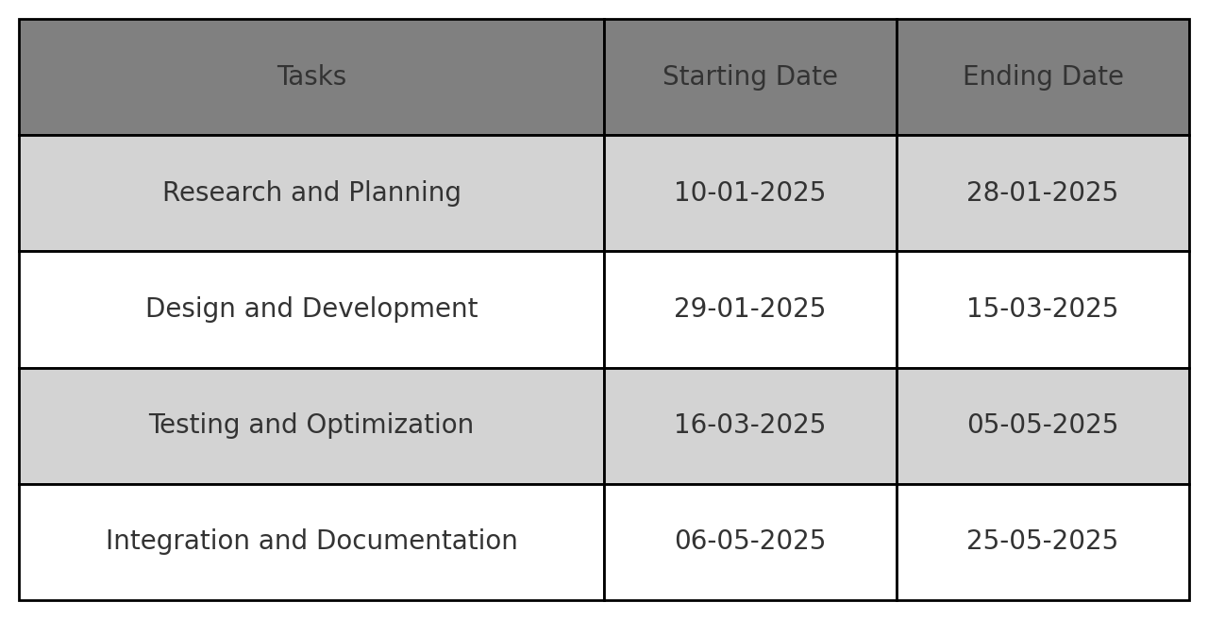
08
TIMELINE

Slide 9
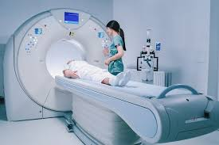
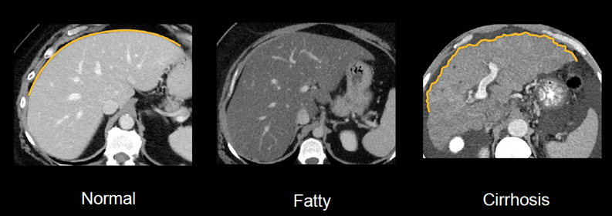
09
09
Proposed Methodology
Input Data: CT and MRI scans from publicly available datasets, such as Decathlon datasets, with additional datasets explored from platforms like Kaggle.
Preprocessing Techniques:
Image normalization and resizing for consistent input dimensions.
Random cropping and data augmentation to enhance training diversity.
Slicing 3D volumes into 2D slices or fixed groups to ensure uniformity in training inputs.
Tools Used: MONAI's utilities for data preprocessing and augmentation.

Slide 10
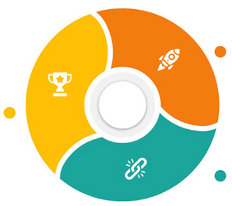


10
EVALUATION AND VALIDATION
Key Metrics
Experimentation
Error Handling
Dice coefficient for overlap accuracy.
Per-class accuracy and confusion matrix analysis.
Testing various augmentation techniques (e.g., rotations, flipping).
Hyperparameter tuning to refine model performance.
Addressing path mismatches and incorrect labeling.

Slide 11
11
CONCLUSION AND FUTURE SCOPE
Successfully developed an AI-powered liver segmentation model with high accuracy.
Impact: Automates and improves liver segmentation, aiding radiologists and clinicians.
Future Work:
Expanding to multi-organ segmentation tasks.
Real-time implementation for clinical use.
Integration with hospital PACS systems for seamless workflows.

Slide 12
12
Thank you!

