Slide 2




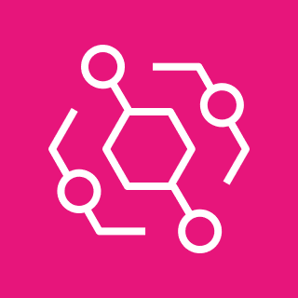





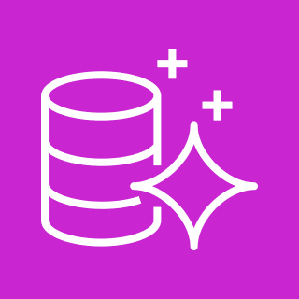








On-premise
AWS Cloud
AWS Storage Gateway
S3
EventBridge
Lambda
Dicom Server
File Gateway
VPC
Aurora
User
Client
RunTask
Results
ECS
Rule Engine
Cognito
Application Load Balancer
CDS App1
App Manage
CDS App2
Viewer
(ex: orthanc)
CDS App3

