Slide 1

Conversational Memory Bot - AI- powered Photo Gallery Assistant
Md. Sirazul Islam Sobuj
Trainee Software Engineer - AI
Domain Name: AI
ID : 30178
Image Placeholder
Notes:
Note: First “Right Click” on the Gradient background, go to “Order” option and “Send it to Back”, then insert your picture into “Image Placeholder”, “Right Click” on the picture and again go to “Order” option and “Send it to Back” to get the “Gradient” effect.

Slide 2
Project Summary
Key Features:
Web interface for uploading, searching, and chatting about images
Upload images and auto-generate metadata (descriptions and tags) using Google Gemini AI
Store images and metadata in ChromaDB, a vector database
Search images using text, images, or both (multimodal search)
Chat interface supporting image-related queries, general knowledge, and conversations

Slide 3
Technologies and Tools
Backend:
FastAPI: Web framework for building RESTful APIs
ChromaDB: Vector database for storing image embeddings and metadata
Google Gemini AI: Generates image descriptions and tags
OpenCLIP: Creates image and text embeddings for search
LangChain: Manages conversational AI chains and memory
Frontend:
Jinja2: HTML templating for rendering web pages
Other Libraries:
dotenv: Environment variable management
sklearn: Cosine similarity calculations

Slide 4
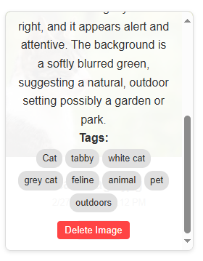
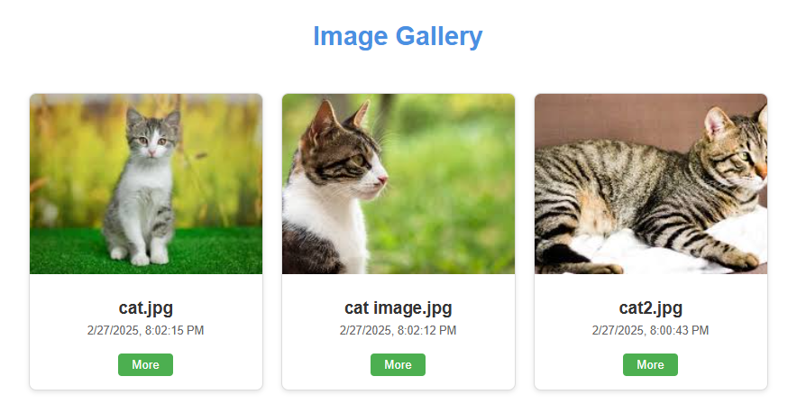
Results
Gallery Page:

Slide 5
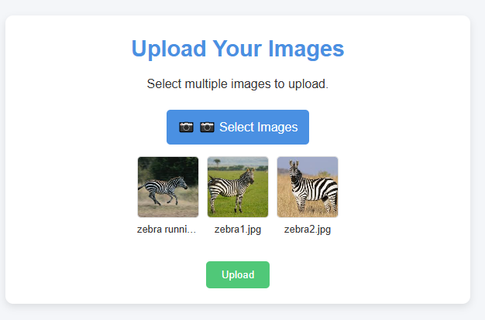
Results
Image Upload Page: Support multiple images upload

Slide 6
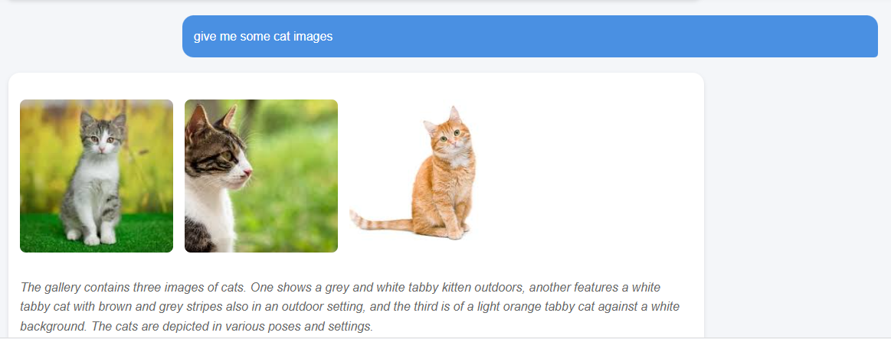
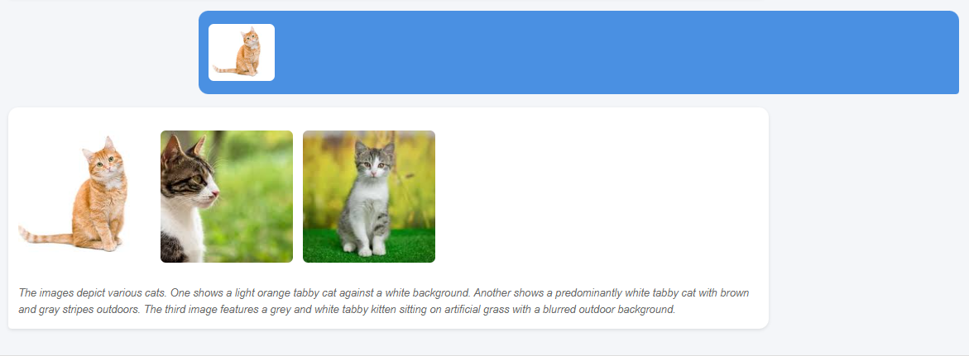
Results
Chat Page: Text-to-Image and Image-to-Image search

Slide 7
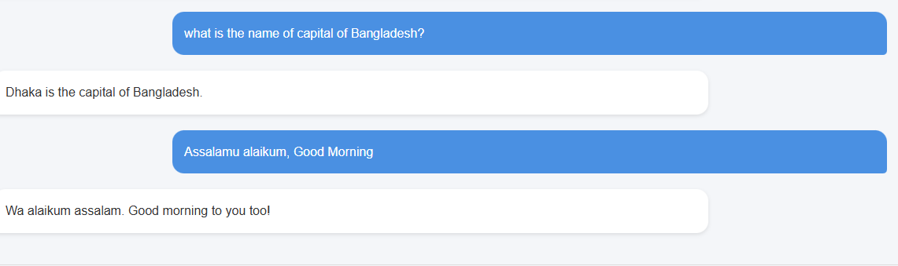
Results
Chat Page: General Knowledge related search

Slide 8
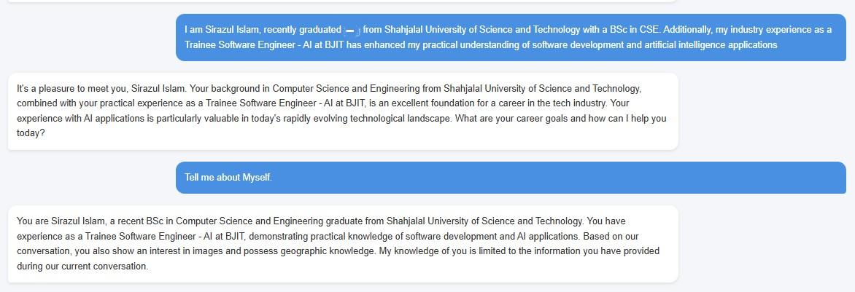
Results
Chat Page: Memorization

Slide 9
Challenges Faced
Optimizing ChromaDB for efficient storage and retrieval of embeddings
Handling multimodal inputs (text and images) for search and chat
Ensuring real-time performance for search and chat responses
Coordinating frontend-backend integration for a seamless experience

Slide 10
Future Scopes
Add user authentication for personalized galleries and chat histories
Introduce advanced search filters (e.g., by voice)
Enable image editing and annotation within the app
Integrate more advanced AI models for enhanced accuracy
Develop a mobile application for broader access
Improve UI/UX design for better usability

Slide 11
Learning
Mastery of vector databases (ChromaDB) for high-dimensional data
Experience integrating pre-trained AI models (Gemini, OpenCLIP)
Proficiency in web development using FastAPI and Jinja2
Knowledge of multimodal AI applications (text + image)
Expertise in error handling and debugging complex systems

Slide 12
Thank You

