Slide 1
Tomato Blight Detector
Team Name : Visionary Providers
Group : 12
Team Members:
Raisa Fairooz - 2018331050
Md Ashraful Islam -2018331056
Md Adith Mollah - 2018331082
Md Sirazul Islam - 2018331116
Siddique Badhon - 2018331110

Slide 2
Introduction
Detection of early and late blight in tomato plants
Image recognition and analysis using CNN-based approach
Model trained, validated and tested on over 4490 images
Obtained an accuracy of ~95% on test data
User application for mobile using Flutter and for web, React as frontend and Fast API as backend

Slide 3
Background
Deep learning is a subfield of machine learning which involves the use of artificial neural network with composing multiple layers to learn complex patterns in data.
A Convolutional Neural Network (CNN) is a type of artificial neural network specifically designed for image analysis task.
Flutter and React are basically open source framework specifically used for providing user experience.
Fast API , a fast , open source , high performance back-end framework for building APIs.

Slide 4
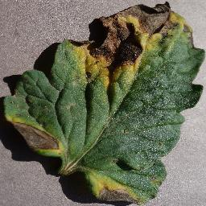
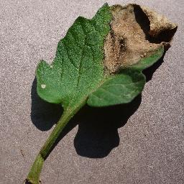
Tomato Early Blight
Tomato Late Blight
Caused by fungus infestation
Black or brown spots on leaves, stems, and fruit
Leathery spots with ring patterns
Small, water-soaked areas in the leaves
Purple-brown, oily-appearing blotches
Grayish white rings and spore-forming structures may appear

Slide 5
Data Preparation
We have collected over 4490 images from kaggle for the purpose of training , validating and testing.
80% of the whole dataset has been used for training and the rest 20% has been utilized for validating and testing purpose.
All the images being resized to 256 by 256 dimension.
Specific image augmentation techniques such as randomized flip to horizontal and vertical sides along with adjusting color contrast and random rotations have been applied.

Slide 6
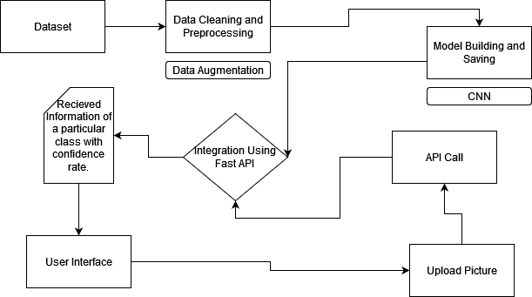
Methodology
Fig 1: Workflow of the system

Slide 7
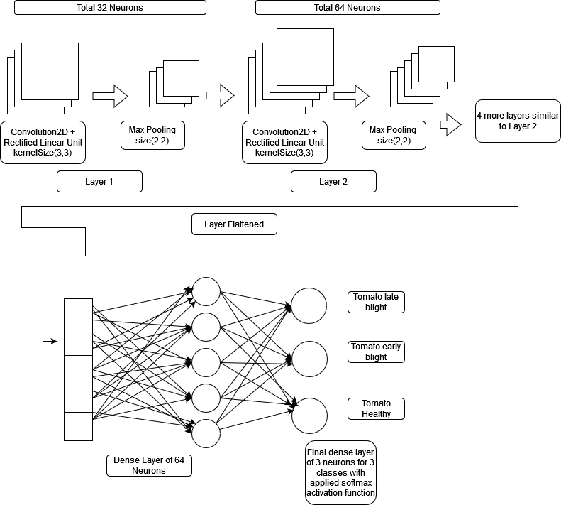
Methodology
relu
Fig 2: Model Architecture

Slide 8
Methodology
Rectified linear unit and softmax activation function has been used in order to build the model.
Before moving to dense layer , a series of convolution with rectified linear unit and max pooling operation has been applied for feature extraction.
Final layer of 3 neurons for 3 classes providing probabilistic result which is normalized due to the activation function softmax.

Slide 9
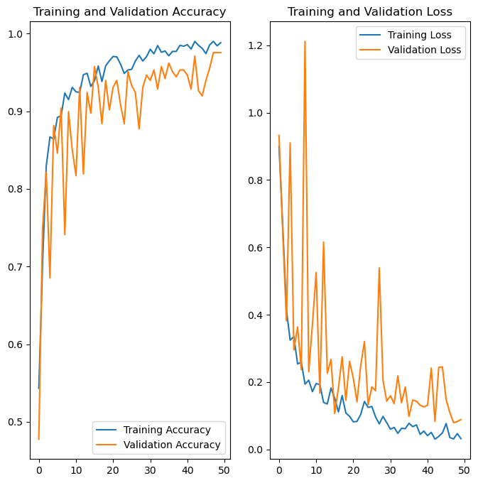
Results and Analysis
Fig 3:Training vs validation accuracy and loss graph

Slide 10
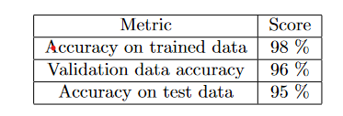
Results and Analysis
Fig 4: Model performance evaluation metrics
After 50 feed forward and back propagation ,accuracy from trained and test data is respectively 98% and 95% .In case of validation accuracy , a score of 96% is being received.

Slide 11
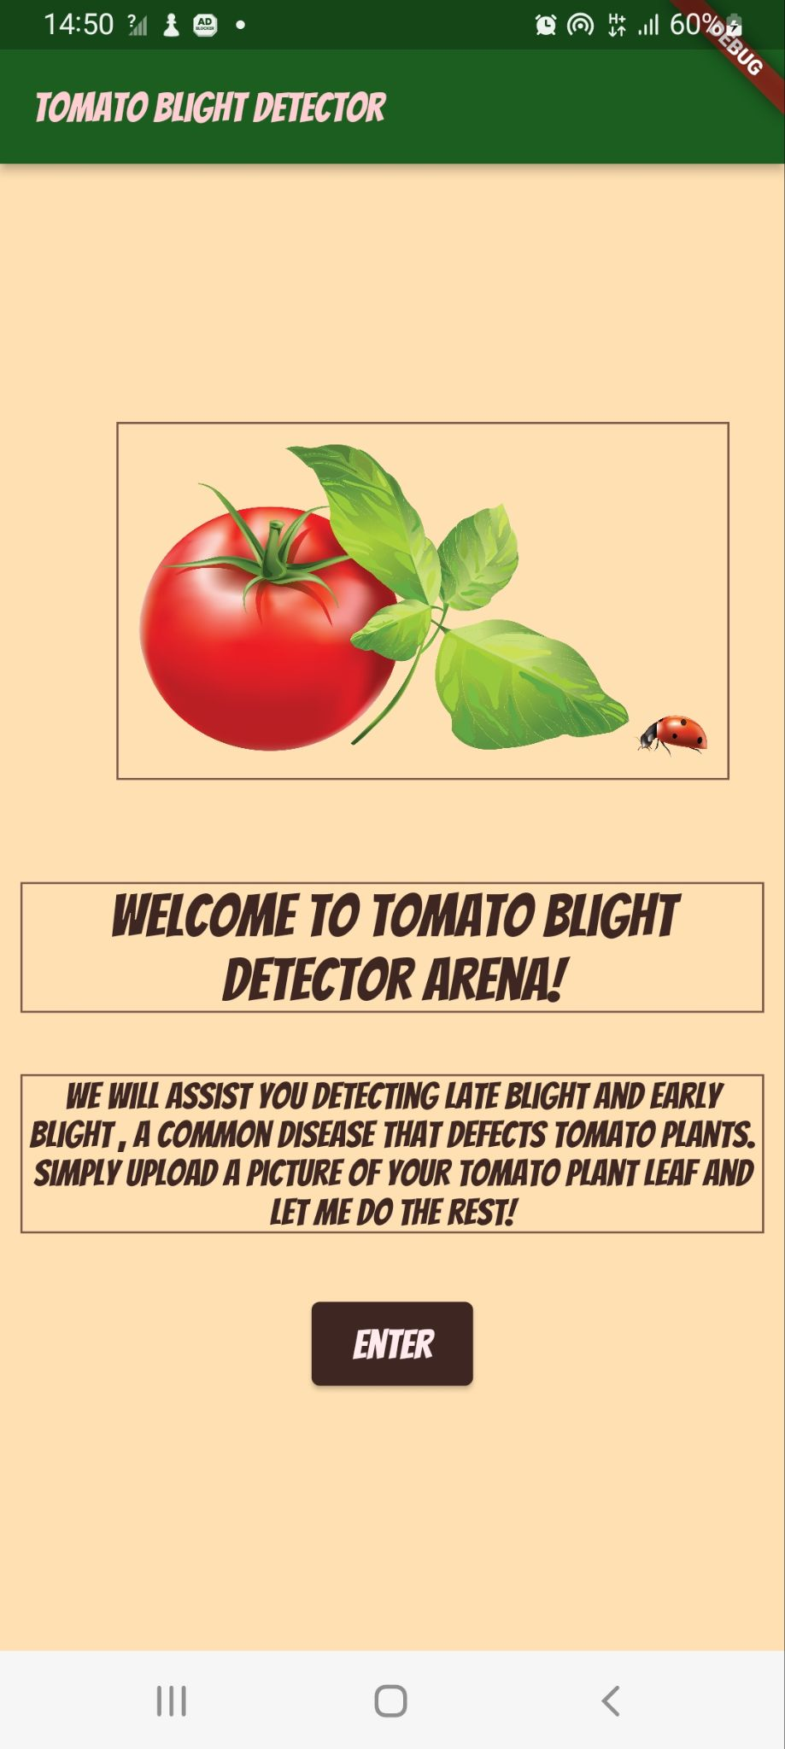
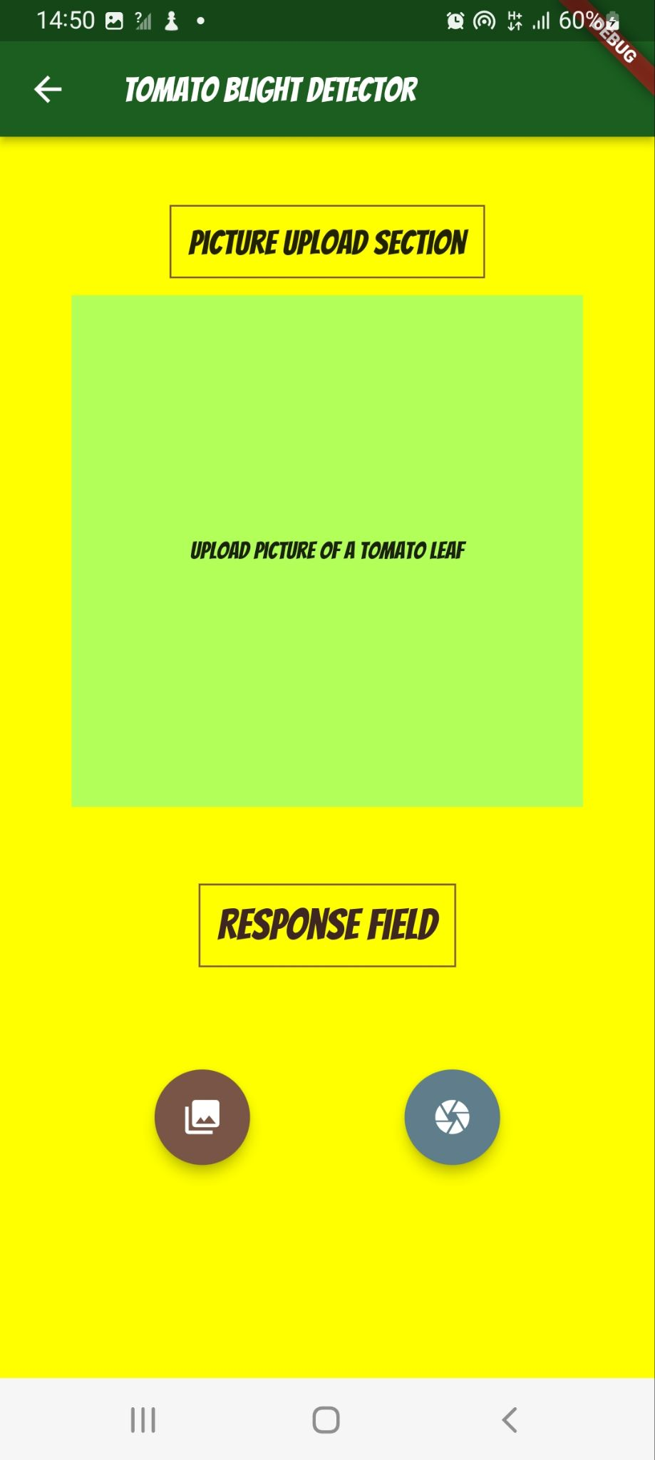
Results and Analysis
Fig 5: Home page
Fig 6: Executing Page

Slide 12
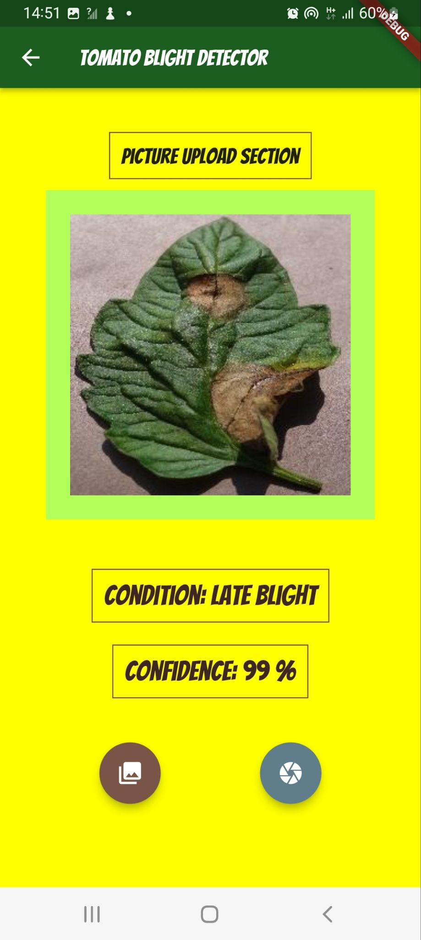
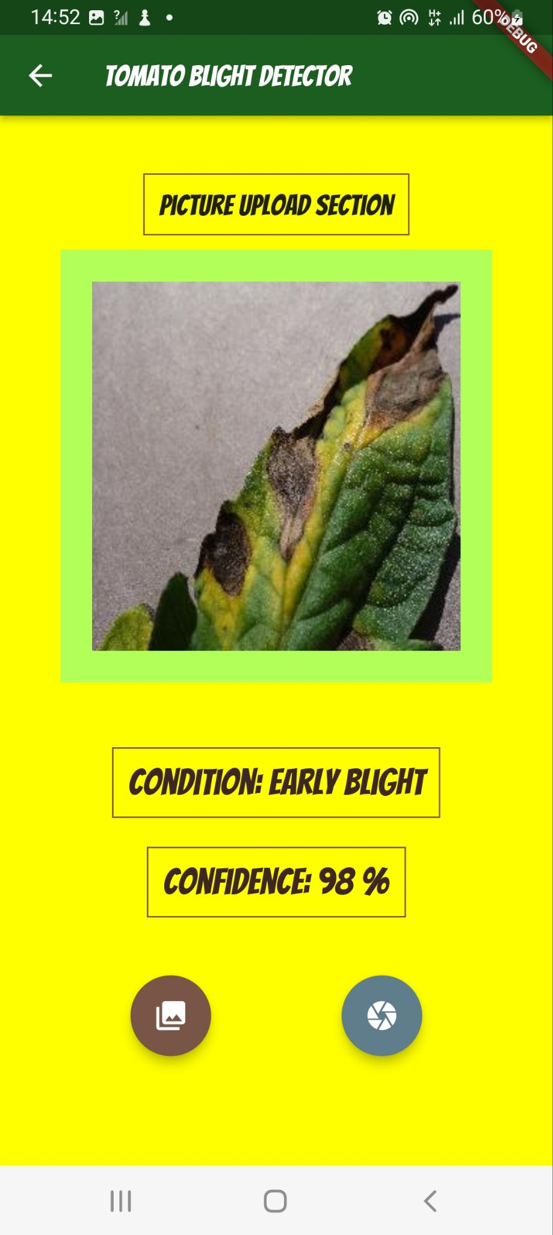
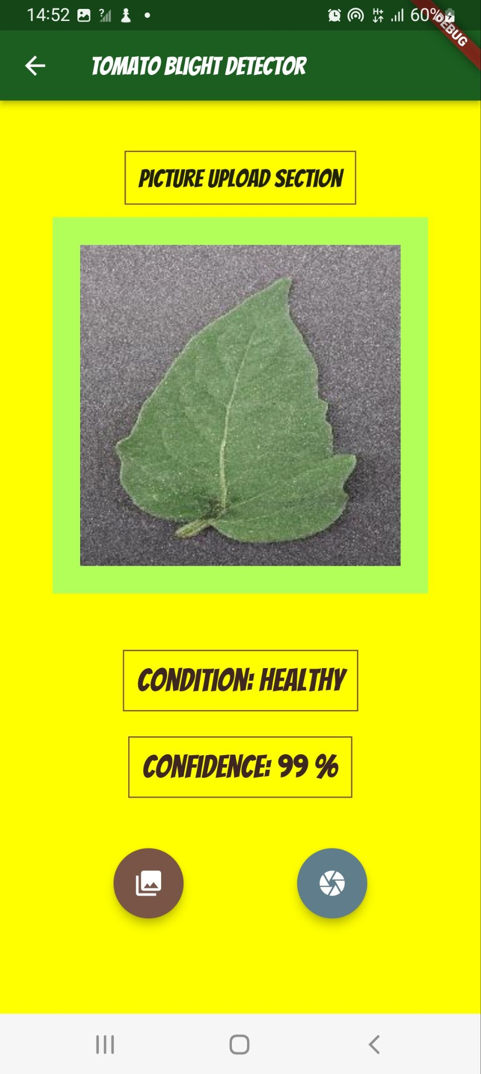
Results and Analysis
Fig 7: Image classification Part

Slide 13
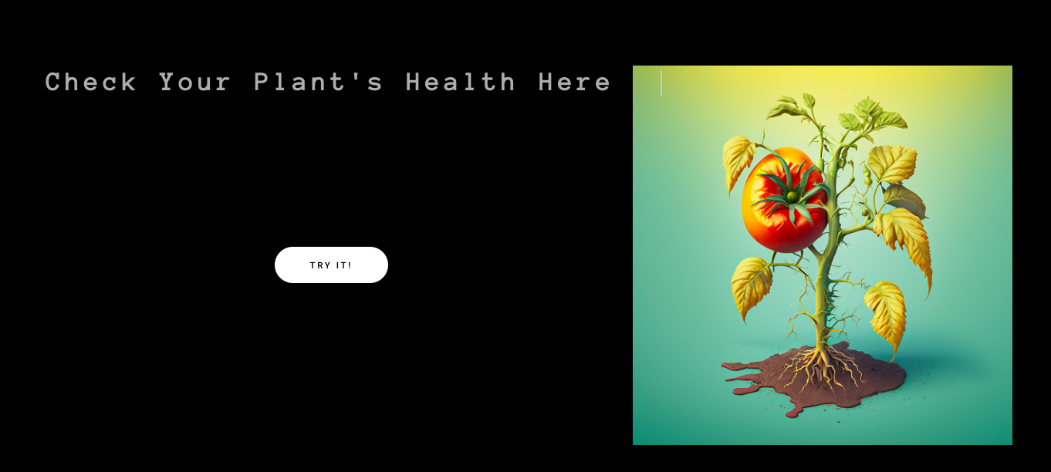
Results and Analysis
Fig 8: Home page

Slide 14
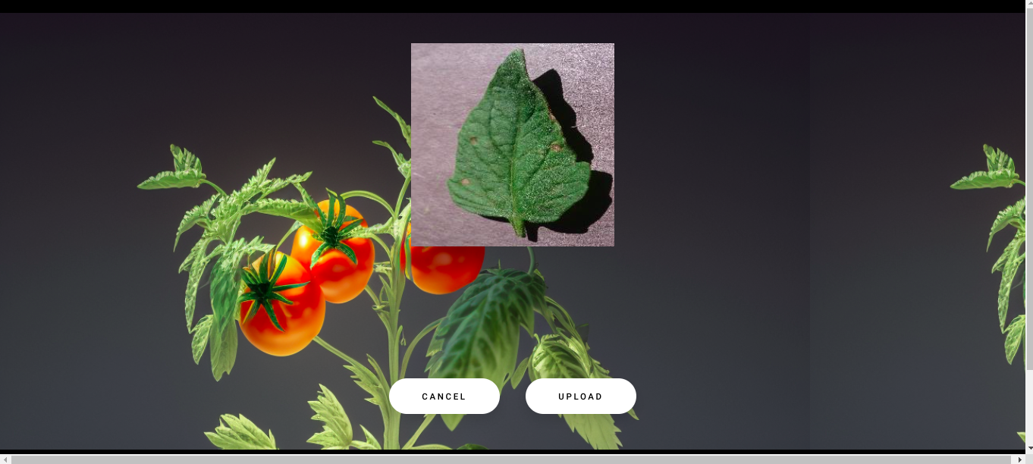
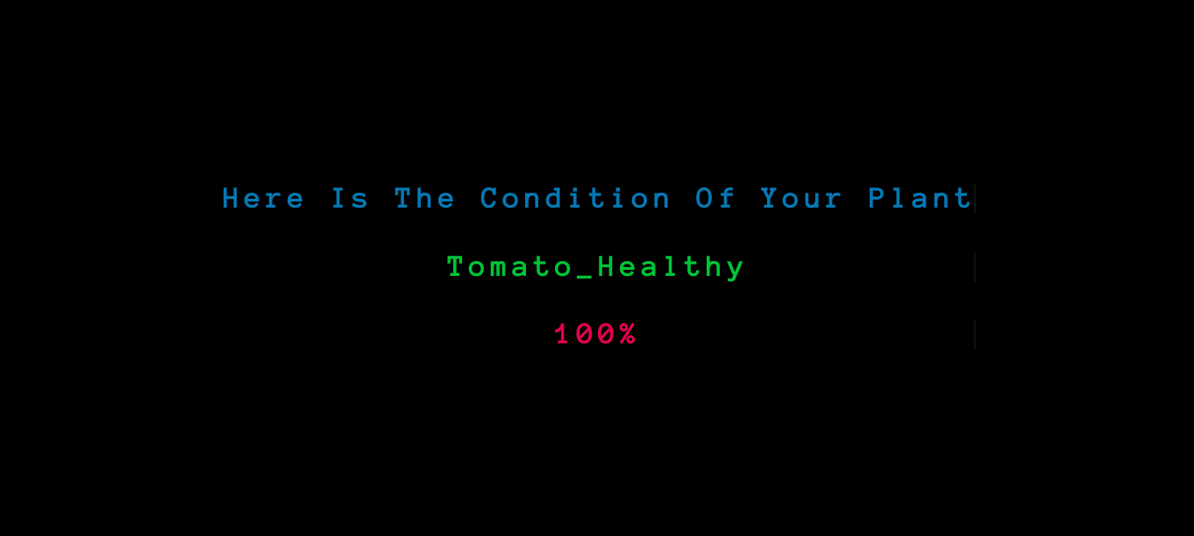
Results and Analysis
Fig 9: Executing section

Slide 15
Conclusion
A CNN architecture has been used for image recognition task of tomato plant leaf to figure out healthy , early blight and late blight conditions.
Combined dataset of 3 classes of images has been used along with several preprocessing and augmentation techniques for training the model which eventually gave promising results.
Overall , this application can drive economic efficiency and environmental sustainability of tomato production.

Slide 16
Thank you
Credits : This presentation template was created by Slidesgo ,including icons by Flaticon and infographics & images by Freepik

