Slide 1

VOICE BASED EMAIL SYSTEM FOR VISUALLY IMPAIRED
Department of computer science and engineering
under the guidance of
Dr.y.adilakshmi_{, M.Tech, PhD}
Associate Professor
By
SIRAZUNNISA – 18481A05K2
V . SAI CHAND – 18481A05M9
Y.HIMAJA – 18481A05N9

Slide 2
ABSTRACT
Internet is the most essential part of today’s world of communication. E-mails are a further important way of communication that is widely used in the business world.
This technology has been useless for incapacitated and blind people. There are around 260 million visually challenged people around the globe and to make this E-mail system closer to visually challenged people, A Voice-Based E-mail System has been proposed.
This system provides them the facility of communication by using Natural Language Processing to convert text to speech (TTS) and speech to text (STT) so that visually challenged people can operate the system easily.
This system reduces the complexity to remember the characters or information regarding keyboard shortcuts. Every function will be based on simple voice commands so that those people could easily make use of the technology.

Slide 3
INTRODUCTION
Generally, the mail system doesn’t take voice-based commands due to which blind people find it difficult to use it.
Our project tries to make the mail system familiar to visually impaired people using text-to-speech and speech-to-text conversions.
Text-to-speech converts text into human-like speech, along with the ability to create a unique, custom voice to use in your applications. And Speech-to-text converts the user’s voice to textual format.
These conversions are done using speech recognition and pyttsx3 packages.
Speech Recognition is an interdisciplinary subfield of NLP. Speech Recognition is the medium to make computers understand our spoken speech

Slide 4
objectives
Aims to develop an email system that will help even a naïve, visually impaired person to use the services for communication without previous training
Doesn’t require the use of a keyboard.
User-Friendly for any kind of person.
Can operate only by using voice commands

Slide 5
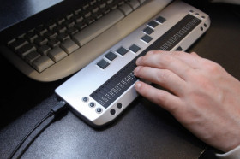
Existing System
General Mail System :
The existing systems do not support any voice commands or audio facilities and therefore it is not suitable for visually challenged people.
Braille keyboard:
Impaired people had to remember & recognize the characters of the keyboard which was very difficult on their path. The problem was later solved using a Braille keyboard, but these keyboards were very costly.
Screen Readers:
Existing screen readers just read the contents on the screen, it doesn’t read and send mails particularly and we also need the use of a keyboard to use screen readers.
.

Slide 6
Proposed system
The Proposed system is a voice-based email for people with poor eyesight.
In this System, the user can send and read emails using voice commands.
In this system, the pc will prompt the user to perform specific operations to avail of various services and if the user has to access the various services then he/she has to perform that operation.
The main advantage of this system is that the use of a keyboard is completely eliminated; the user will have to respond through voice only.
The application is totally voice-based allowing blind people to send and receive emails easily. It converts the user’s spoken voice into text and the text to voice and performs the action accordingly.

Slide 7
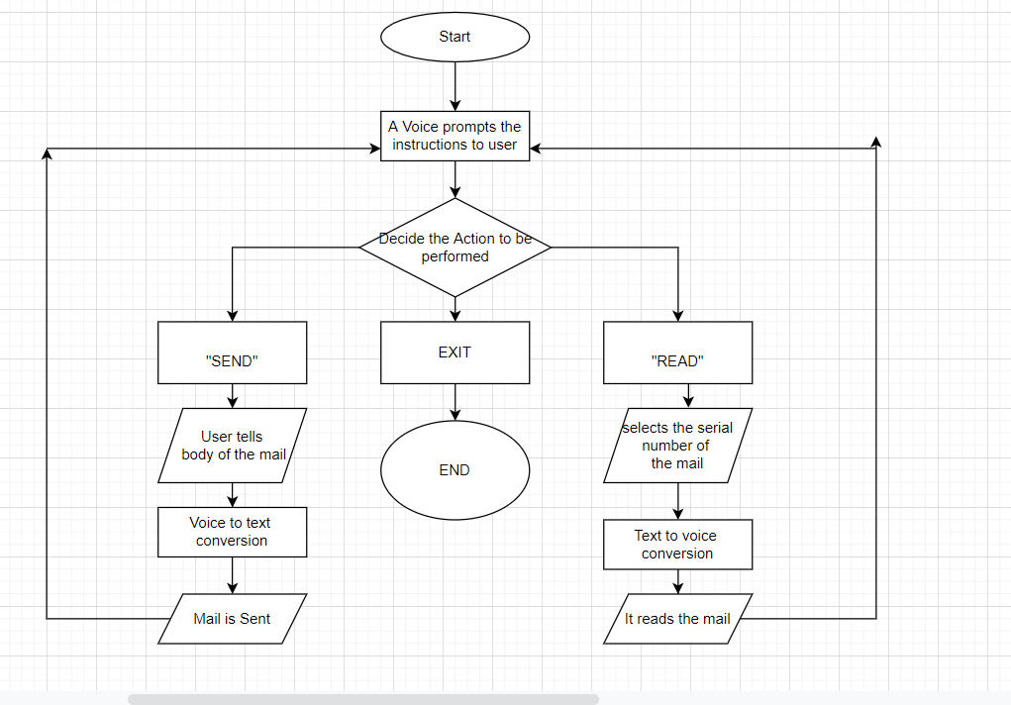
BLOCK DIAGRAM

Slide 8
METHODOLOGY
Steps to run the application
Run the application by double-clicking on it.
Then a voice command prompts saying to select one action Select the required action
If action is “READ”
It asks the serial number of mail which you want to read.
Then it reads the contents in the mail

Slide 9
METHODOLOGY
If action is “SEND”
It asks for the mail id of the receiver
It asks to say the body of the mail
And then mail will be sent to that receiver
If action is “EXIT”
It Stops the Execution
If the voice recognizer cannot able to recognize your voice then prompts you to say again.
This process continues until we give the EXIT command.

Slide 10
IMPLEMENTATION
Steps to build the application:
Install Python IDLE.
Install NLP Libraries.
SpeechRecognotion and Pyaudio – to convert Speech to text
Pyttsx3 – to convert text to Speech
Easyimap –to connect to Gmail server and to read/send emails.
3. When we run the application, A voice prompts and guides the user.
The Voice prompts operates based on the commands provided by the user.
For each command, there is a function associated with it.

Slide 11
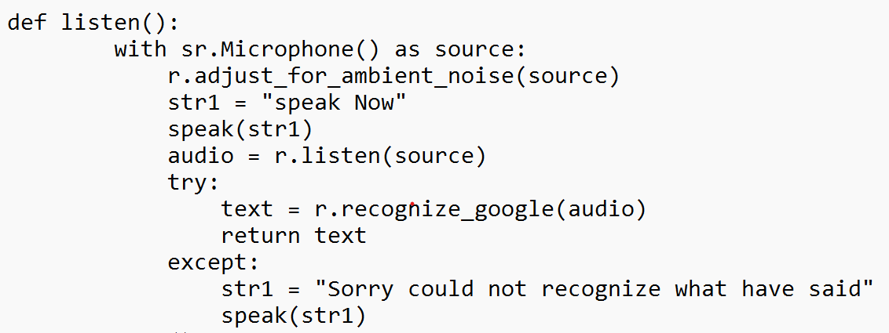
IMPLEMENTATION
1 . Listen()
Initially we should create a recognizer class using Recognizer()
When listen() is called, it takes the source using a microphone.
Using adjust_for_ambient_noise() the recognizer class listens to the audio for the specified duration seconds from the beginning of the audio and then adjusts the energy threshold value so that the whole audio is more recognizable.
recognize_google() method on it to access the Google web speech API and turn spoken language into text. recognize_google() requires an argument audio_data otherwise it will return an error

Slide 12
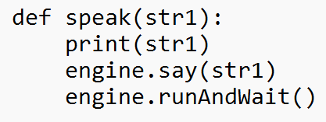
IMPLEMENTATION
2 . Speak()
Initialize pyttsx3 module using init() function.
Say() is used to speak the text.
To run the speech we use runAndWait() All the say() texts won’t be said unless the interpreter encounters runAndWait().

Slide 13
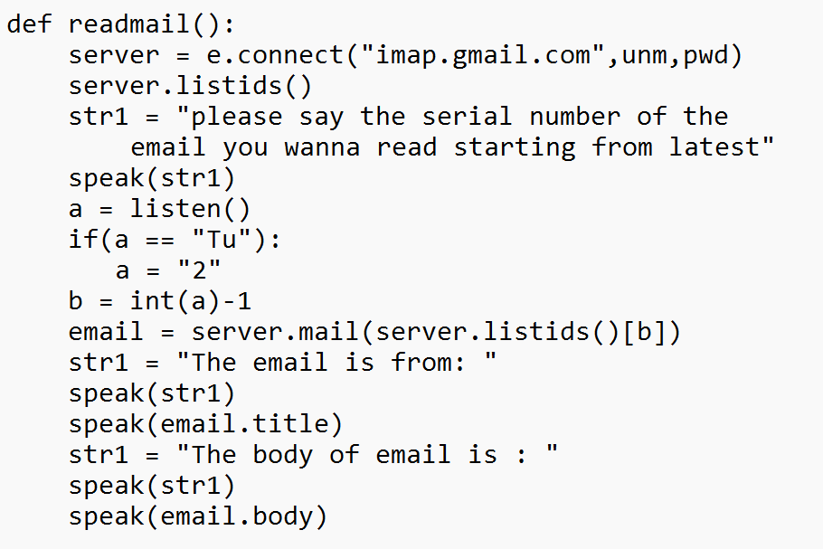
IMPLEMENTATION
3 . readmail()
This module reads the content in the mail
First create an object for connecting to the IMAP server where we have to mention which server to connect here we are connecting to the Gmail server
server = e.connect("imap.gmail.com",unm,pwd)
Server.listids(), returns the IDs of the email in our inbox which is unread.
Email.date() Returns string of 'Date' header.
Email.body() Returns a string of Body.
Email.title() returns string of 'Subject' header.

Slide 14
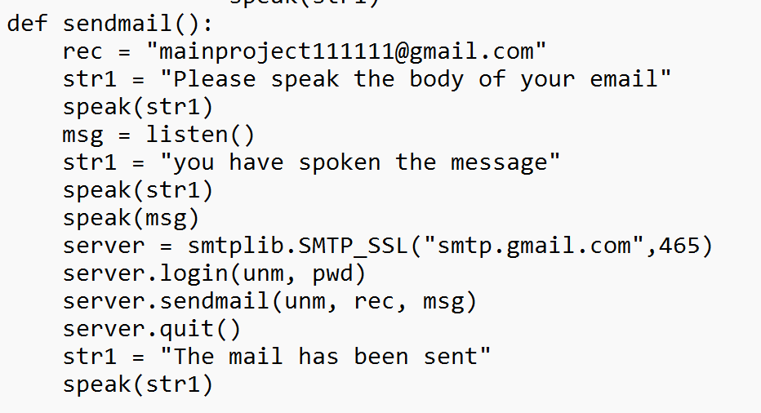
IMPLEMENTATION
4. Sendmail()
It calls listen() function to listen the details of the mail.
server = smtplib.SMTP_SSL("smtp.gmail.com",465) is used to create SSL connection.
To login we use server.login(“example@gmail.com”, “password”)
server.sendmail(unm, rec, msg) used to send the mail.
server.quit() is used to quit the process of sending of mail

Slide 15
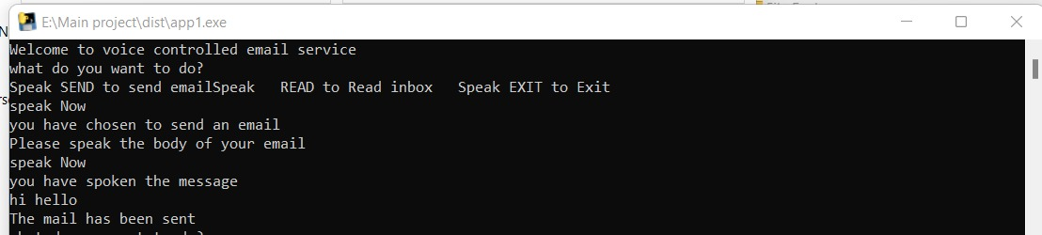
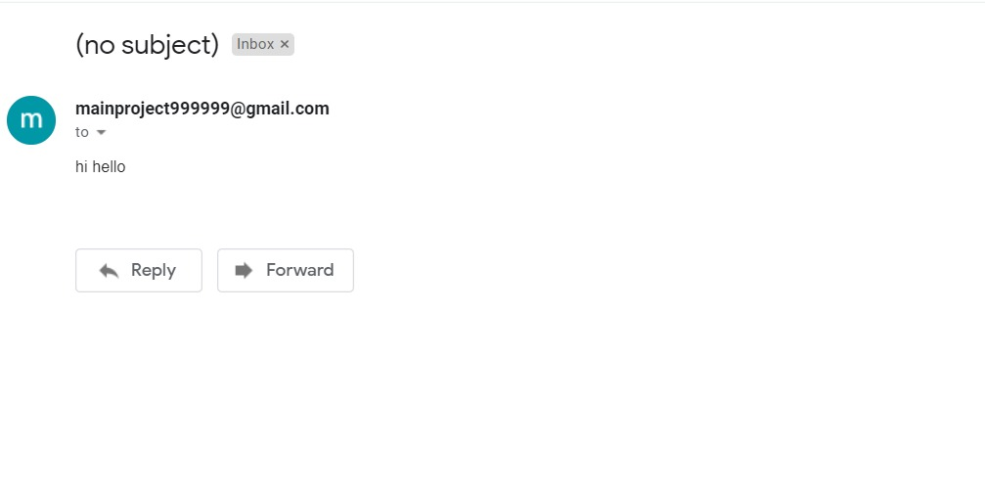
SCREENSHOTS

Slide 16
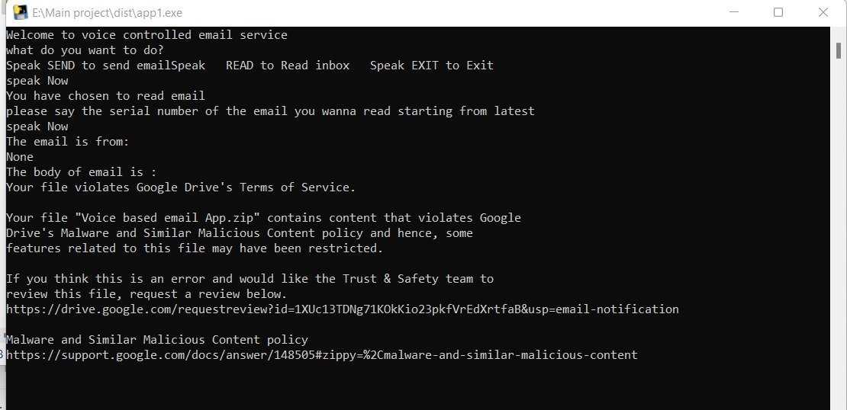
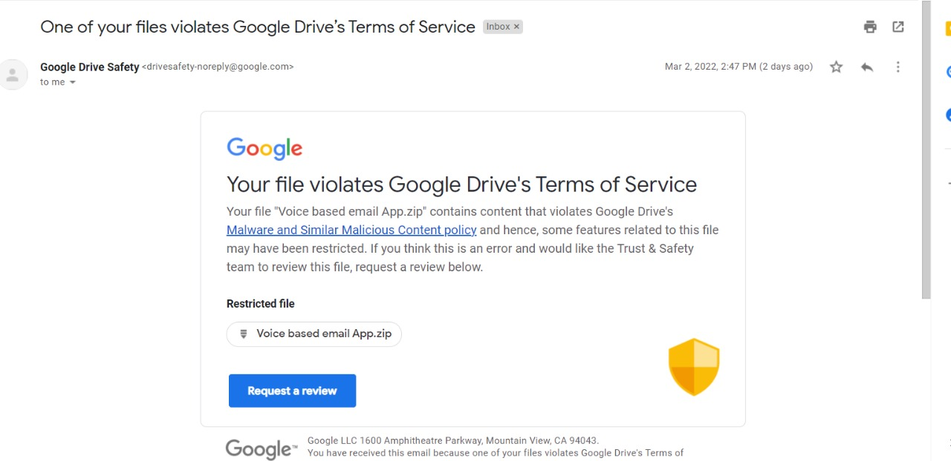
SCREENSHOTS

Slide 17
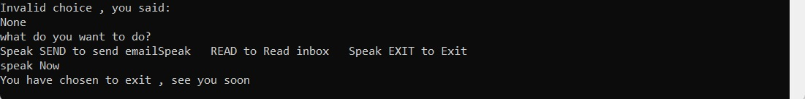
When user wants to leave, user should say EXIT command, then the process stops.

Slide 18
PAPER INFORMATION
:JOURNAL NAME : Stochastic modelling & Applications (UGC CARE JOURNAL)
JOURNAL COST : 8000
JOURNAL HYPERLINK :
..\Videos\VOICE BASED EMAIL SYSTEM FOR VISUALLY IMPAIRED journal (1).pdf

Slide 19
CONCLUSION
By using these speech recognition package and other packages we can build the mail system such that blind people can use it.
It can avoid the usage of keyboards and can work only by using voice commands

Slide 20


