Slide 1
The Technology Value Stream
Jeffrey Reid
Module 1.2
January 10, 2024

Slide 2
What is a Value Stream?
All actions, from start to finish, that are involved in bringing a concept to life for a consumer.
This includes both nonvalue and value-creating actions.
Consumers can be internal and external
The end product is a value.
Good Value Streams involve Value Stream Mapping and Management.

Slide 3
Goals
Value-Stream Designers focus on efficiency goals.
Improvements for speed, cost, quality, and service.
Value Stream Team focus is on pleasing the customer and every activity from start to finish.
For Technology, this is typically the process of converting a business rule into a service the consumer values.

Slide 4
Value Stream Mapping
Allows us to see each process that brings actual value.
Helps identify what the customer needs and is asking for. This in term helps identify what they value and allows us to bring the best product for them forward, in the most efficient manner.
This process provides visibility of the value stream for all roles, from stakeholders to designers.
Results in better planning and product delivery management.

Slide 5
Lead Time vs Processing Time
Lead:
The process time of the entire value stream
Total accumulation of all process time and all waiting time
Waiting time is time spent in an unproductive manner.
This can include time within a workstation, usually in multi-batch production, or before/after the workstation process
Longest lead time is used when multiple different parallel process times are used.
Processing:
This is related to Cycle time, the time spent between two quality products productions.
Process time is the time a product is spent on a workstation.
This sometimes equates to Cycle time, usually when one product is constructed on one workstation
Different factors affect Cycle time that don’t affect processing time, such as multiple, simultaneous product production or multiple operators
In essence, the time spent from start to finish that a product spends in a workstation.

Slide 6
Long Lead Times
Typically a result of many inefficiencies in the workflow.
Technical Factors, Cultural Factors, and Process-related Factors.
Lead times can be decreased following a few practices:
Adopt Continuous Improvement and Continuous Delivery.
Release in smaller pieces rather than one large chunk. This allows for quicker feedback and simplifies deployment.
Streamline Approval processes and utilize Infrastructure as Code techniques.
Automate testing to improve work quality and Monitor all data with robust tools. This results in faster response times for issues and more visibility on production changes.

Slide 7
Short Lead Times
For technology and coding, this is the Ideal.
Can be shortened by implementing 4 policies:
Change your Deployment Frequency. As mentioned previously, shorter release windows are ideal. In addition, deploy on-demand.
Shorten lead time by implementing an efficient Development process.
Invoke a low Failure Rate, if any. This decreases time spent on rollbacks and fixes to bad code.
Aim for Short Recovery times. Robust systems help with this. Aim to fix discovered errors and quickly and efficiently as possible.
The next slide shows the difference between Good and Bad business lead times.

Slide 8
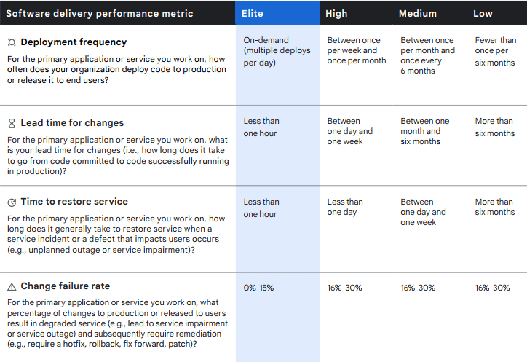
Lead Time Goals

Slide 9
Citations
(2024). Devopsinstitute.com. https://www.devopsinstitute.com/value-stream-management-explained-in-plain-english/
Beal, H. (n.d.). What is a Value Stream? Www.vsmconsortium.org. https://www.vsmconsortium.org/blog/what-is-a-value-stream
Breadcrumbs. (2024). LaunchDarkly. https://launchdarkly.com/blog/deployment-frequency/
DORA Metrics: 4 Key Metrics for Improving DevOps Performance | Codefresh. (2023, April 30). Codefresh. https://codefresh.io/learn/software-deployment/dora-metrics-4-key-metrics-for-improving-devops-performance/
Takt-, Cycle-, Process-, and Lead time | MudaMasters. (n.d.). Www.mudamasters.com. https://www.mudamasters.com/en/lean-toolbox-lean-production-lean-transformations/takt-cycle-process-and-lead-time

