Slide 1
Barriers to a Just, Learning Culture
Jeffrey Reid
Module 9.2
January 20, 2025

Slide 2
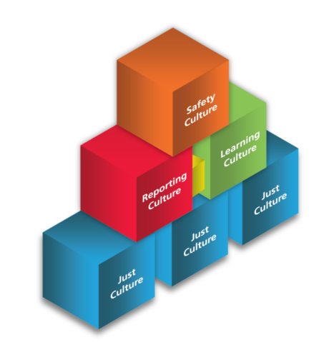
Why a Just Culture is Important
Building Blocks for a Safe Culture
Promotes the comfort needed to report errors and hazards (Reporting Culture)
Learning Culture created from a desire to learn about and from weaknesses in the system

Slide 3
Barriers to a Just Culture
Blame:
Natural thing for people to do when things go wrong.
Common to mistakenly blame people for things that are out of their control.
Sometimes stems from personal flaws.
Outcome Bias:
Usually a reactionary response based on the final result of what happened.
Harsher punishment usually inflicted based on higher levels of harm/danger

Slide 4
Barriers Cont’d
No Transparency:
No information given in advance should an incident occur.
As a result, no information on how a response would look like should something go wrong.
Assessment Inconsistencies:
Very high variability of outcomes for different responses for the same scenarios.
Evaluation processes of actions are wildly inconsistent

Slide 5
How to Fix Blame?
No quick judgements. Take time to formulate decision.
Reduce or eliminate all forms of bias:
Outcome Bias, Attribution bias, Hindsight Bias, etc.
Avoid looking for problems with the people and instead look to view systemic weaknesses.
Apply context to the actions of people during situations of an event. Keep in mind human behavior.
Search for why people did what they did during a situation. Gather effective information surrounding the incident.

Slide 6
How to Fix Outcome Bias?
Do NOT base decisions on outcome.
Instead make decisions based on the response those involved made, keeping context in mind.
Isolate and focus on individuals actions while ignoring outcome.
Consider viewing the scenario as if someone else was involved with similar experience. Would they have done the same?

Slide 7
How to Fix Lack of Transparency?
Reveal organizational processes used in a safety incident
Include what is used to assess the actions of those involved in making the situational decisions.
Also include how a resulting decision is made when an incident occurs.

Slide 8
How to Fix Assessment Inconsistencies?
When creating an appropriate response to an incident, view things the same way each time.
Be aware of natural human behaviors based on events that occurred. Context changes much be kept in mind.
Implement a consistent process to view various situations.
Use this to understand why people in these situations did what they did in the moment.

Slide 9
Citations
Overcoming Barriers to a Just Culture. (n.d.). HQCA - Just Culture. https://justculture.hqca.ca/overcoming-barriers-to-a-just-culture/
Why Is Just Culture Important? (n.d.). HQCA - Just Culture. https://justculture.hqca.ca/why-is-just-culture-important/

