Slide 1

LocalJobFinder
Sirbu-Boeti Eduard-Cristian, 1211EC, FILS
Coord. teacher
sl. dr. ing. Mitrea Dan Alexandru

Slide 2

Contents
◆ Languages, Frameworks & Misc. Used
◆ Similar Applications – OLX
◆ Similar Applications – ProList.ro
◆ Differences – OLX
◆ Differences – ProList.ro
◆ Goals
◆ Presentation
◆ Conclusion

Slide 3
Languages, Frameworks & Misc. Used
Languages
◆ HTML + Handlebars (templating language)
◆ CSS
◆ JavaScript
Frameworks
◆ Node.js (JS server-side development)
◆ Express (handles middleware)
Misc.
◆ MySQL
◆ JSON files
◆ Leaflet API (interactive map)
◆ Socket.IO library (chat feature)

Slide 4
Similar Applications - OLX
◆ Local Job Listings
◆ Engage with services near you.
◆ Broad Range of Jobs
◆ No restrictions in regards to job postings.
◆ Contact and Communication
◆ Contact the service provider directly.
◆ Open Platform
◆ Anyone can post a job listing.

Slide 5
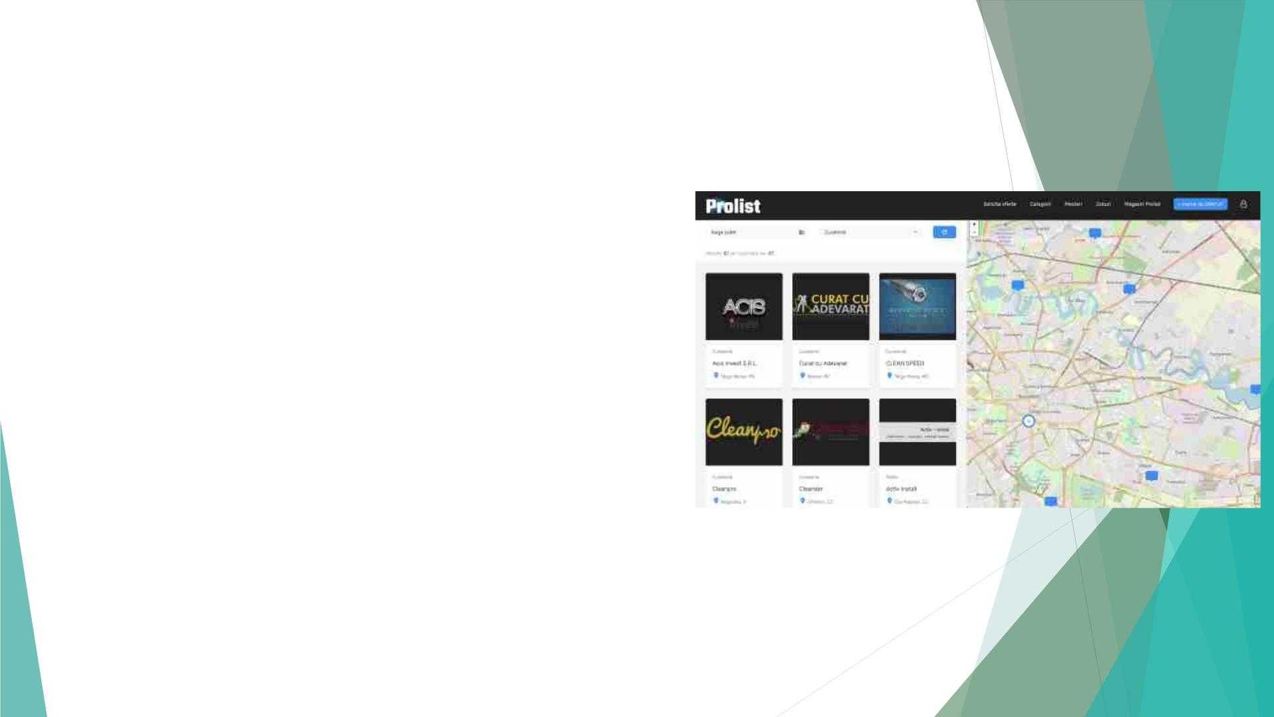
Similar Applications – ProList.ro
◆ Local Job Listings
◆ Filter services to a specific region.
◆ Interactive Map
◆ Similar to us, they have an interactive map of job
listings.

Slide 6
Differences - OLX
◆ Main Use: Buying and Selling Goods
◆ We strictly focus on job postings.
◆ Location Viewing
◆ OLX only displays a rough location that can only be viewed one job posting at a time.
◆ We display all relevant jobs on a map for the customer to have a greater image of how far away the job
postings are.
◆ Cluttered Job Postings
◆ On OLX there are a lot of job postings with irrelevant images.
◆ We have minimalistic postings that have a short title, description and the name of the person who
posted it all in one place

Slide 7

Differences – ProList.ro
◆ Restricted Job Listings
◆ ProList is made with regards to tradesmen.
◆ We offer a broader range of jobs.
◆ Cluttered UI
◆ Half of the screen is cluttered with images.
◆ We are very minimalistic and intuitive.
◆ No Chat
◆ ProList doesn’t have a built-in chat feature.
◆ We have a chat feature for the customer to easily interact
without using any 3rd party software.

Slide 8
Goals
◆ Improve the Interactive Map
◆ Allow Job Posters to Reach out to Customers
◆ We would like to create a bidirectional platform. Right now, customers can reach
out to job posters, but we would also like for the latter to initiate contact with the
customers.
◆ Hire a Moderating Team
◆ Verify job postings and assign them the correct job title.
◆ Improve the UX and UI
◆ Prepare for Scalability

Slide 9
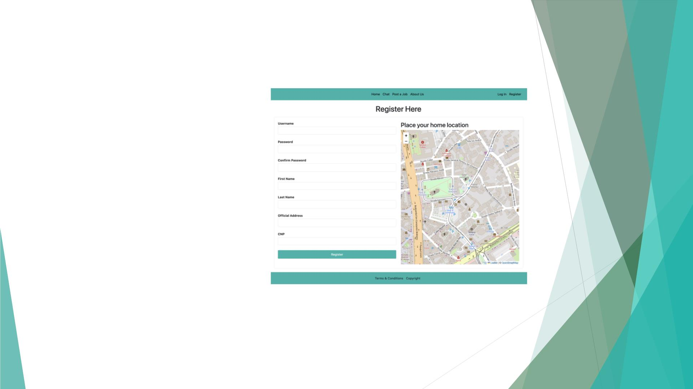
Presentation
1. Create a User Account
• You are required to enter personal data,
the most important one being your home
location.
• Using the home location we will have your
job postings assigned that location.
•
•
Advantages
• Display your accurate location to
customers.
Disadvantages
• Currently you cannot change your
home location or have multiple job
postings with different locations.

Slide 10
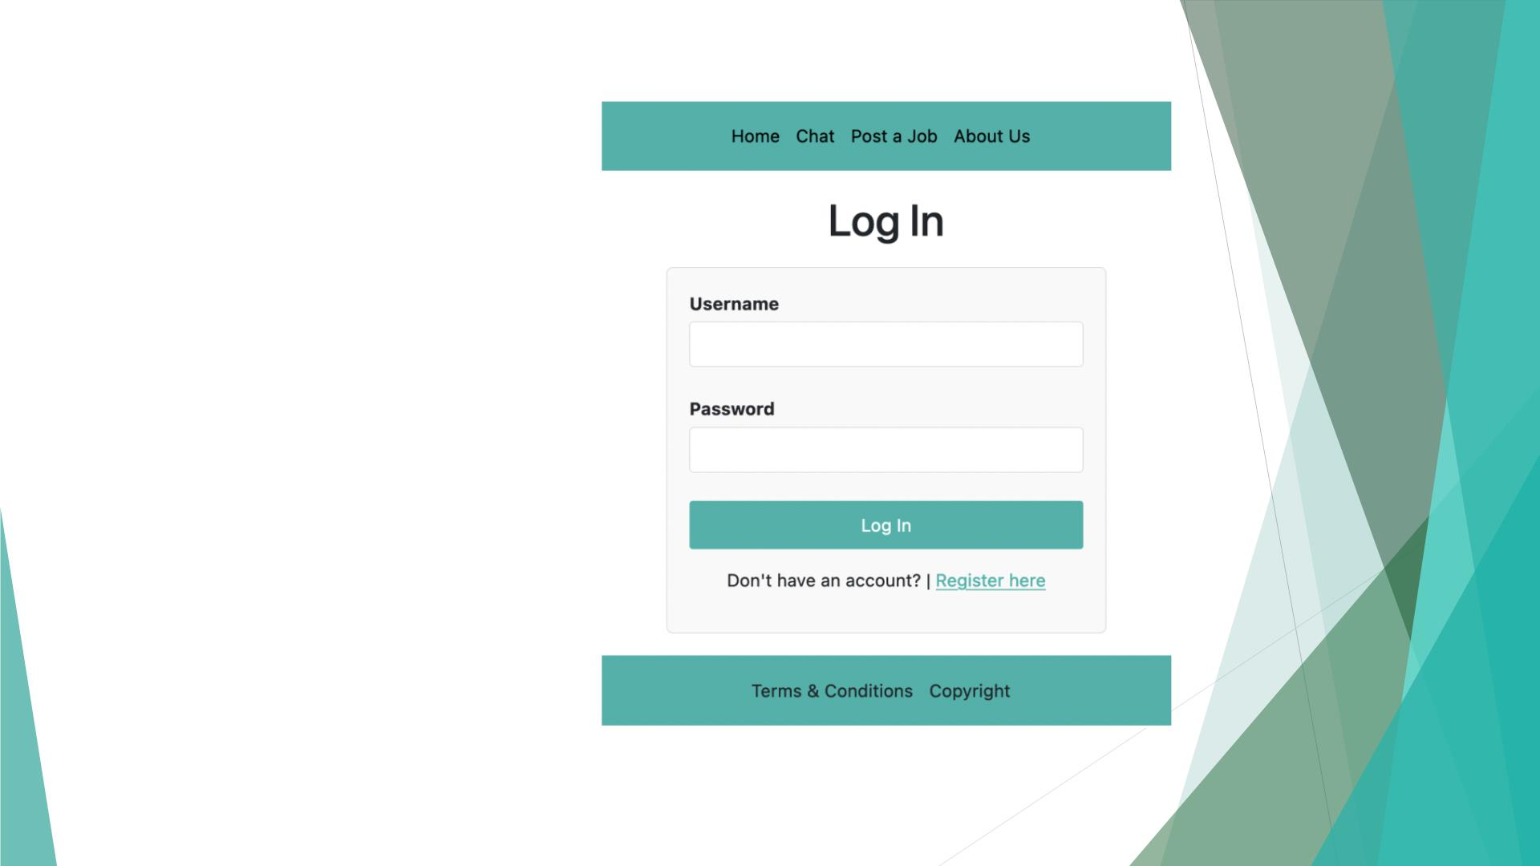
Presentation
2. Logging In
• To be able to chat and post jobs you are
required to login.
• Login page with username and password
• Advantages
• Simple and intuitive login page
• Disadvantages
• No ”Recover Password” feature

Slide 11
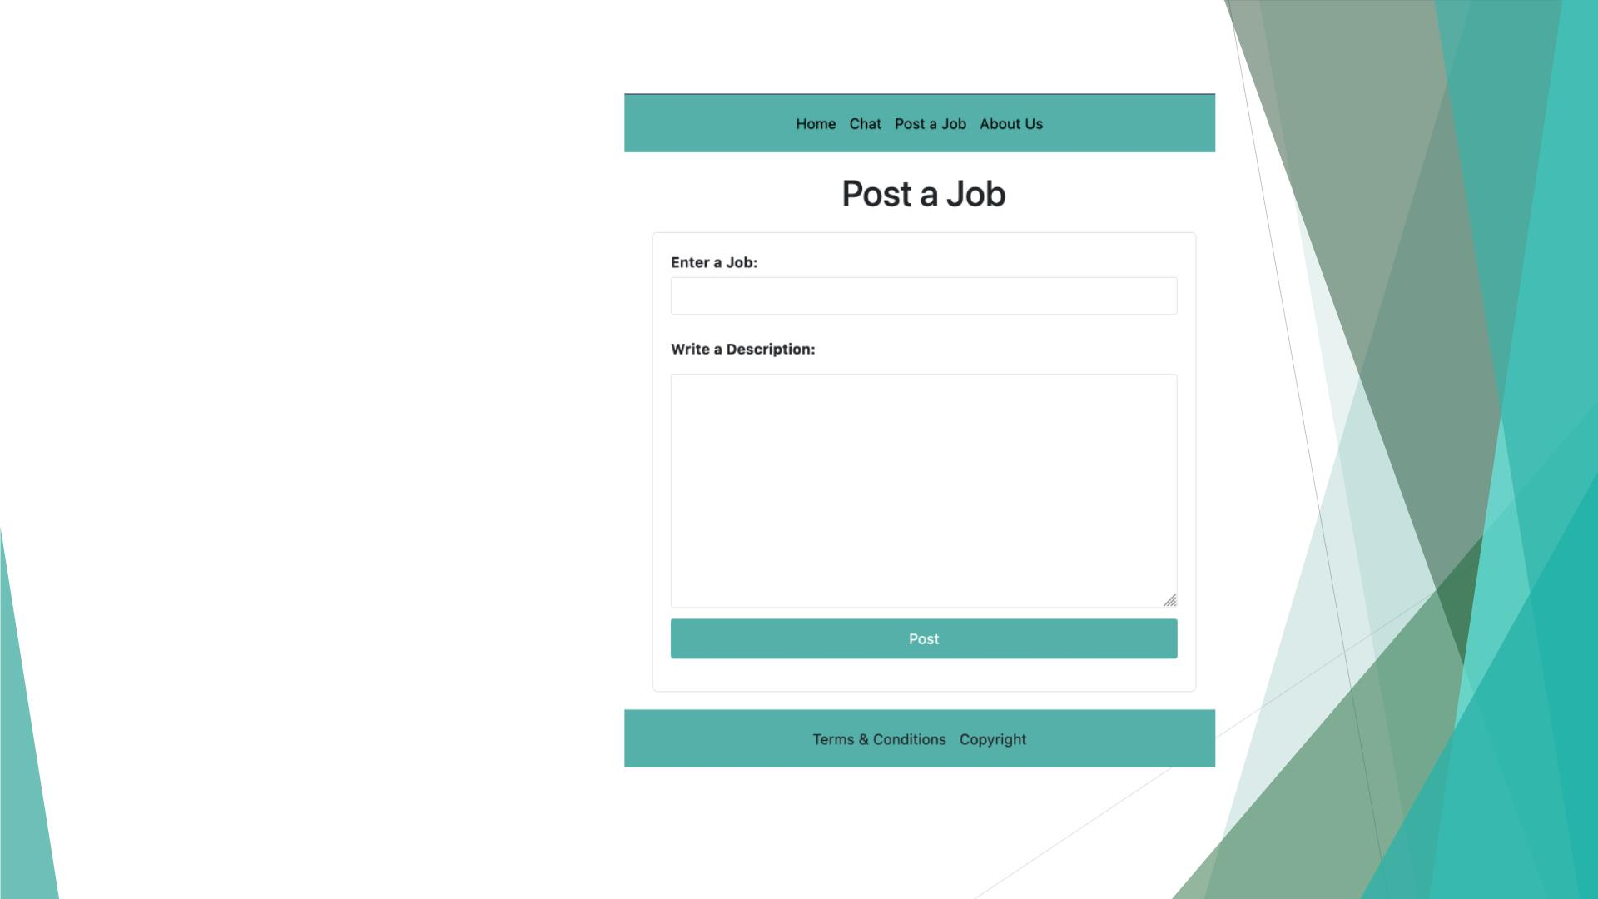
Presentation
3. Post a Job
• To post a job, simply enter the job name
and write a description for your sevices.
• Advantages
• Easy for anyone to post a job.
• Disadvantages
• Currently no select feature for job
name, thus the user must enter it
manually.

Slide 12
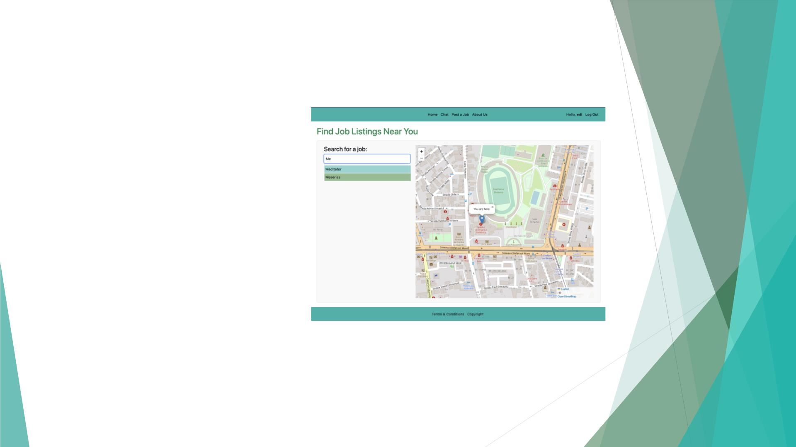
Presentation
4. Searching for Jobs
• Once you want to search for a job posting,
simply search using the search box.
• You will be suggested job names to
autocomplete your search.
• Advantages
• Easy to find a job using our real-time
search suggestions.
• The map gets centered around your
initially defined home location.
• Disadvantages
• There is no feature to suggest a job
name if you misspell the name.

Slide 13
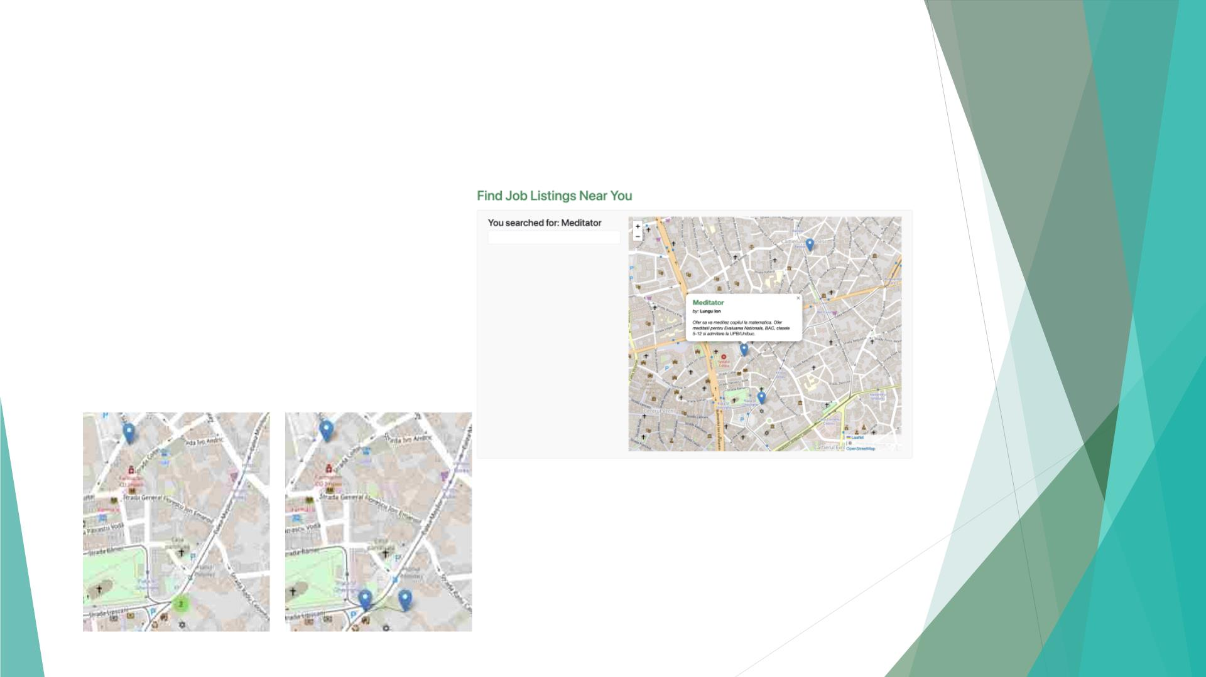
Presentation
4. Finding a Job
• After searching for a service you will be
only shown the relevant postings.
• To view the posting, simply click on the
marker and the job listings will be
displayed.
• Advantages
• No risk of cluttering from too many
markers.

Slide 14
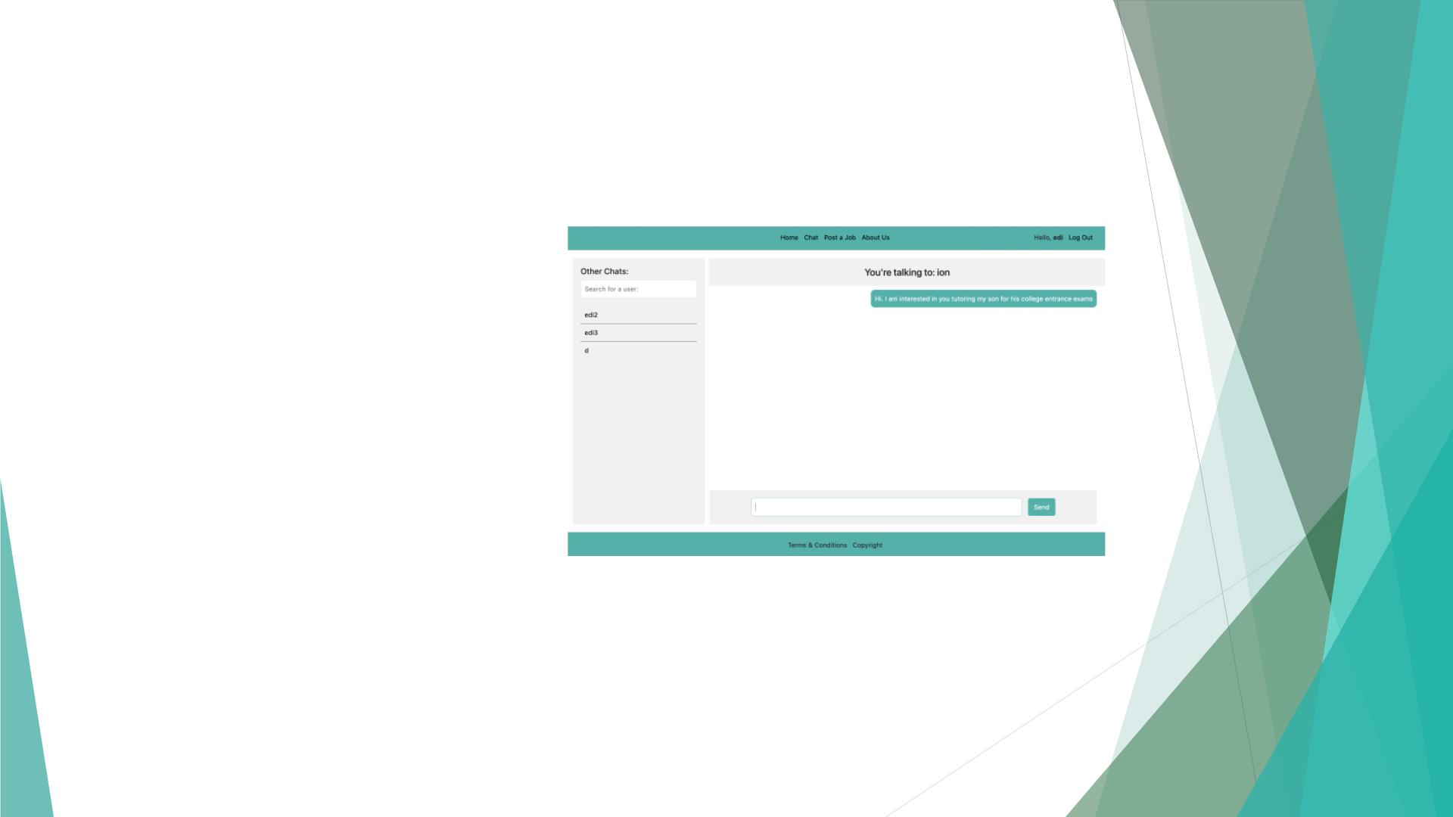
Presentation
5. Chatting with the Job Poster
• When you are ready you can start chatting
with the job poster using our integrated
real-time chat.
• If you want to, you can also view your past
chats on the left side of the screen.
• You can also start a new chat if you know
that person’s username.
• Advantages
• Real-time chat with option to view
your past conversations.
• Disadvantages
• No option to send multimedia
content

Slide 15
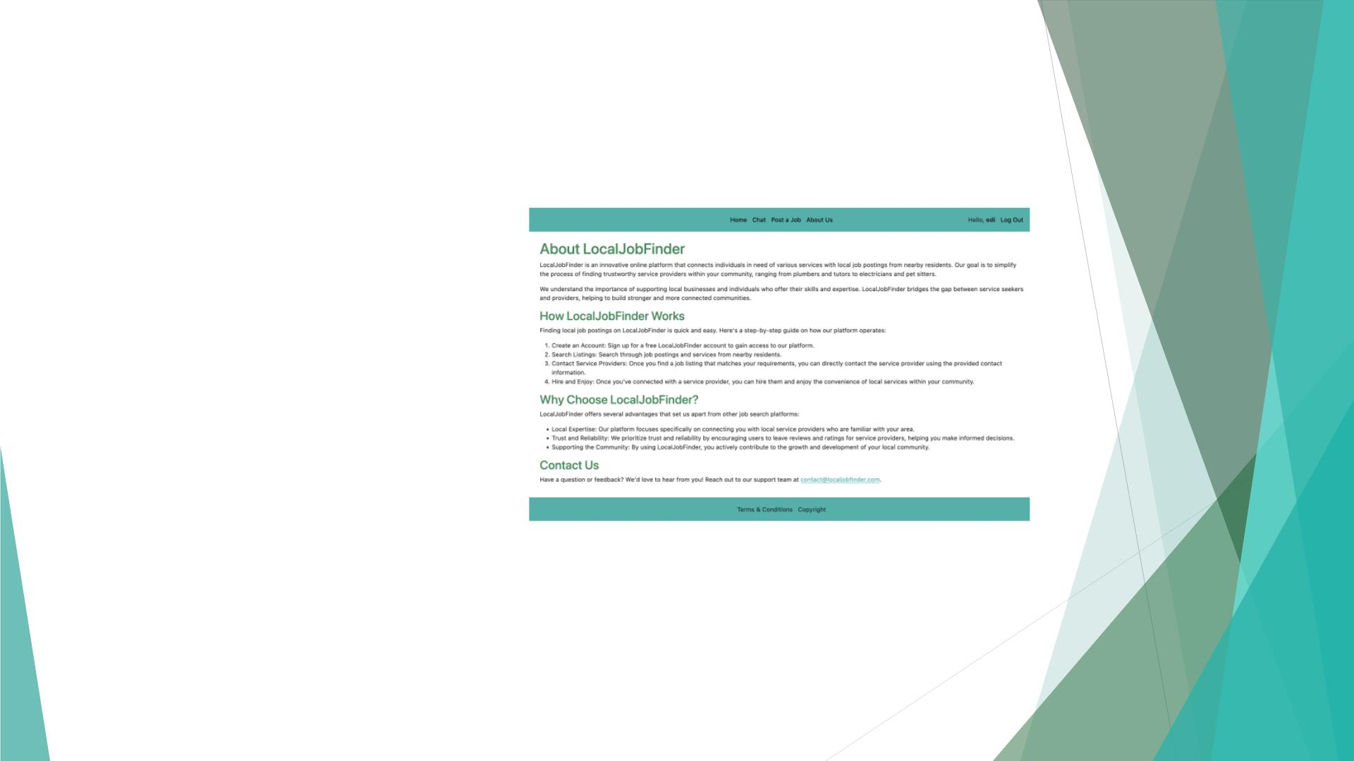
Presentation
6. Finding About Us
• If you want to find out more about us or
see how we LocalJobFinder works,
navigate to out “About Us” page.
• You can also contact us for further
questions.

Slide 16

Presentation
7. Logging Out
• After you are done with your business,
simply logout by pressing the “Log out”
button in the top-right corner

Slide 17
Conclusion
◆ LocalJobFinder offers a convenient, quick and easy way for anybody to
request or offer their services.
◆ We still have a lot more room left to improve and plenty of new and unique
ideas to implement.
◆ We have the capabilities to remain on the market and compete as a unique
service.
◆ Currently we would like to complete our proposed goals and fix all of our
presented disadvantages.

