Slide 1
Data Analysis of COVID19 Dataset
By: Ononuju Gift

Slide 2
Case Overview and Strategy
Objective
1. Identify the variables which are highly related to the cases.
2. Check for the top 3 common symptoms.
Strategy
1. After understanding the datasets, I was able to identify the key intuitive variables.
2. I carried out some data visualization like boxplots, density plots & bar plots using the key variables to understand their relativity to the COVID19 cases.

Slide 3
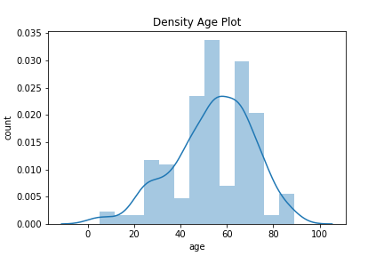
Density Plot
This plot shows that ages between 45 to 50 have the highest covid19 cases while ages between 5 to 25 and ages between 75 to 85 have the lowest covid19 cases

Slide 4
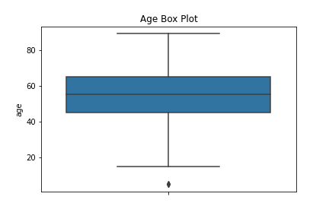
Box Plot
The box plot above shows that the median age value is between 40 to 60 as the data distribution is symmetric. Note that there are also some few minimum outliers.

Slide 5
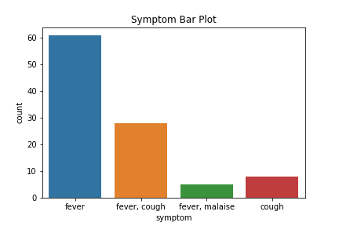
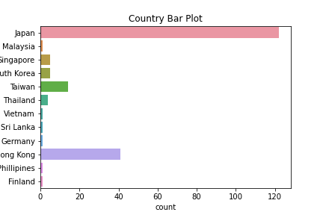
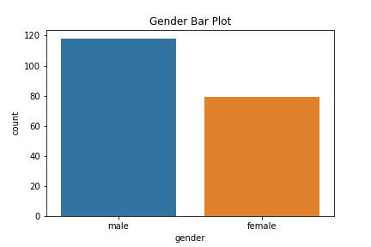
Bar Plots
1. The symptom bar plot shows that fever is the most common symptom prior to the covid19 cases.
2. Japan has the highest number of covid19 cases as shown in the country bar plot.
3. In the gender plot, male gender has more covid19 cases than the female gender.

