Slide 1

COVID-19 Data Analysis Report
By: Ononuju Gift

Slide 2
d
Case Overview and Strategy
Objective
1. Identify the variables which are highly related to the cases.
2. Check for the top 3 common symptoms.
Strategy
1. After understanding the datasets, I was able to identify the key intuitive variables.
2. I carried out some data visualization like boxplots, density plots & bar plots using these key variables as KPIs to understand their relativity to the COVID-19 cases.

Slide 3
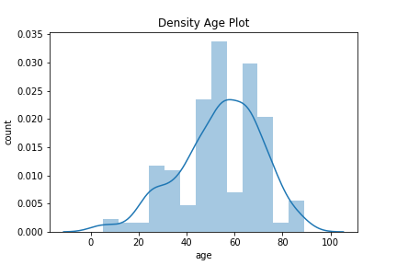
Density Plot - Age vs Count
Data Analysis - Density Age Plot
Insight
This plot shows that ages between 45 to 50 and 65 to 75 have the highest COVID-19 cases. The risk for severe illness with COVID-19 increases with age, with older adults at highest risk. Hence, people within these age brackets should get vaccinated as soon as possible.
Getting vaccinated prevents severe illness, hospitalization and death. People at the age of 65 and older who received both doses of either Pfizer or Moderna vaccines showed 94% reduced risk of COVID-19 related hospitalization according to CDC.
Ages between 5 to 20 and 80 have the lowest COVID19 cases as shown on this Density Age Plot. The COVID-19 pandemic has shown a markedly low proportion of cases among children and teenagers. Age disparities in observed cases could be explained by children and teenagers having lower susceptibility to infection, lower propensity to show clinical symptoms or both.

Slide 4
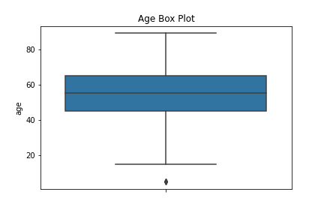
Age Box Plot
Data Analysis - Age Box Plot
Insight
This box plot visually shows that the distribution of the age values prior to the COVID-19 cases is symmetric with the median age value between 50 to 60. However, this simply means that the dispersion of these COVID-19 cases are widely spread across all age range values normally in the COVID-19 Dataset as the Age Box Plot median remains at the middle.
Note that there are also some few minimum outliers. These minimum outliers are age range values between 5 to 10.

Slide 5
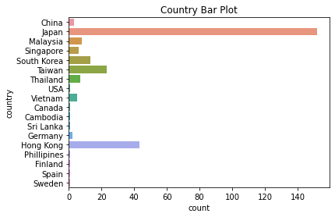
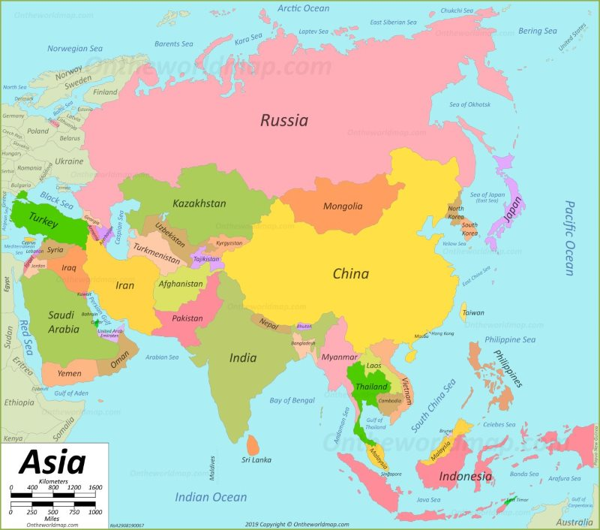
Data Analysis - Country Bar Plot
Bar Plot - Country vs Count
Map
- Count of COVID-19 cases
Insight
The above bar plot shows that Japan has the highest the COVID-19 cases. The people affected should be isolated and placed under medications while strict preventive measures should taken to prevent others from contracting the virus.
It’s also shown from the bar plot that most of the countries with significant number of COVID-19 cases are very close to China and people from these countries might have visited Wuhan. These countries should place strict rules on their immigration policy during these period to prevent more people from getting affected.

Slide 6
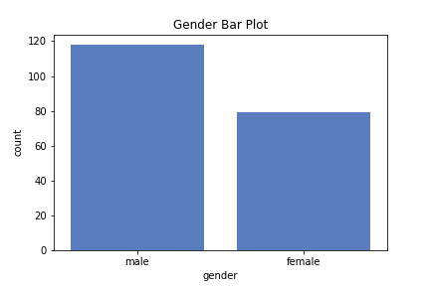


Data Analysis - Gender Bar Plot
Bar Plot - Gender vs Count
Insight
Experiences from previous pandemics and large-scale shocks show that these crises often affect male and female differently.
Using this COVID-19 dataset, this bar plot shows that male gender have more COVID-19 cases than the female gender. Each gender especially the males, should get vaccinated and follow the necessary COVID-19 preventive measures.
COVID-19 Gender Percentage
59.9%
40.1%

Slide 7
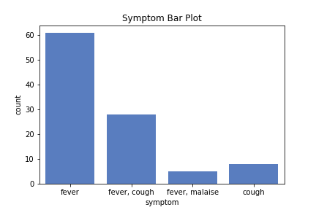
Data Analysis - Symptom Bar Plot
Bar Plot - Symptom vs Count
Insight
People with COVID-19 symptoms have had a wide range of symptoms reported ranging from mild symptoms to severe illness as shown in the COVID-19 dataset used. However, the top 3 most common symptoms as shown on the bar plot include:
Fever
Fever & Cough
Cough
Anyone who notices these kind of symptoms should seek immediate medical attention or visit your doctor or any nearest health facility.

